Slide 1
Replication in Social Psychology
Overview and Case Study Jordan Mark Barbone

Slide 2
Part I
General Background
The replication “crisis”
Center for Open Science (COS)
The reproducibility project
Estimating the reproducibility of psychological research

Slide 3
Why?
Only experiments whose results can be repeated are considered genuine and reliable; in this way experimental repeatability serves as a kind of demarcation criterion between science and non-science
[1]
Sanjay Srivastava at the University of Oregon: The “Hardest Science”
Notes:
Now this quote seems to be favorite of the COS but Braude - in the next paragraph - suggests that replicability is more of a “crude” demarcation criterion and throws at it criticism that really just seems to suggest that replication is a bit impractical in psychological research because of so many factors. But of course, we are already aware of this problem and can’t get around it.

Slide 4
What is the replication “crisis”?
Suggestion of poor use of statistics
Fabrication and falsifying [2]
2% of scientist report falsifying data
14% report colleagues
72% of colleagues questionable practices
Epistemic optimism and pessimistic meta-inductionism
Current star: Brian Wansink
100 study replication [3]
97 originally significant results
36 replicated with significant results
From Estimating the reproducibility of psychological research [3]
Notes:
Statistics is fun but it’s not for everyone. If you have a question, ask someone. Great theorists, clinicians, or experimenters don’t need to be equally great statisticians. But it does help.
philosophical arguments eo - that science present theories that are true or approximately true. Through continued research and replication we may trim away at unnecessary parts of the theories and present something more well-founded. Science essentially should be growing pmi - argues that past scientific theories have been found to be false therefore current ones are likely to be as well
No scientific theory is infallible
BW: Cornell, Consumer Behavior and Market Research - approximately 17 papers retracted - resigning position Issues with data manipulation, false and misleading reporting, and misuse of statistical analyses

Slide 5
Center for Open Science
Non-profit organization in Charlottesville, Virginia
Openness, integrity, and reproducibility of scientific research
Provide tools for managing and dissemination research
Co-Founder: Brian Nosek
The Reproducibility Project
Estimating the reproducibility of psychological science (2015) [3]
Center for Open Science
2008 issues of journals
J Experimental Psychology
Learning, Memory, and Cognition
J Personality and Social Psychology
Direct replication
Notes:
BN received his PhD under Mahzarin R. Banaji - works on Implicit Association

Slide 6
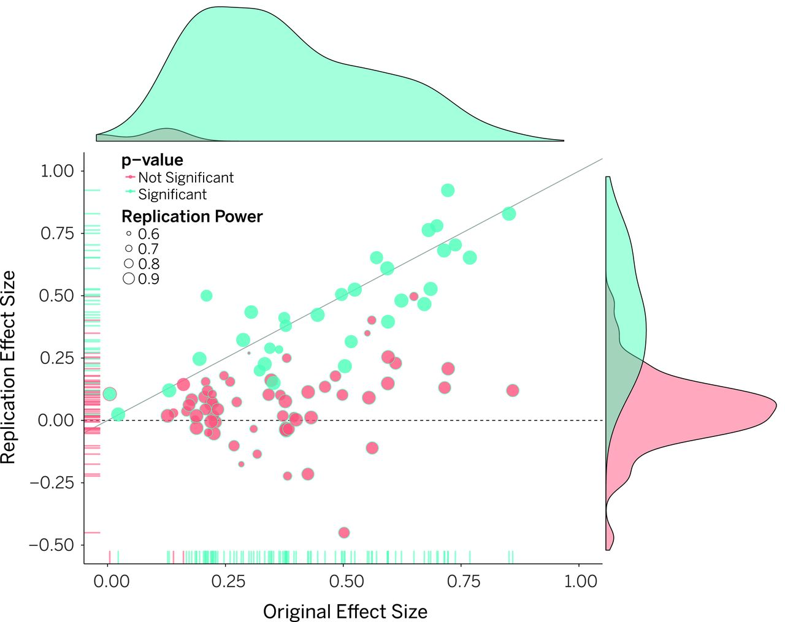
Estimating
Findings
100 articles replicated across various teams
97 articles reported significant results
36 of replicated articles found significant results
With data combined -
Replication success predicted by strength of original evidence
Notes:
Studies that report strong effects are probably safe - but those with weaker effects should be taken with a bit more salt.

Slide 7
Why doesn’t replication occur?
Universities: Publish or perish
Publishers: Prioritization of novelty over replication [3]
Researchers: “We already know this”
But it actually does… - Direct replications are rare - Conceptual or Indirect replications more frequent
Notes:
But science isn’t properly conducted with one instance of a phenomena
A theory can be replicated conceptually by using other variables or procedures
Indirect replications can be more closely linked to the original but confirm the existence of the phenomenon in another population or under another condition

Slide 8
Failures
Original effect is false
Replication produces false negative
Effect is lower than reported
Flawed design, implementation, or analysis
Different methodologies
[3,4]
Notes:
Design of either original or replication

Slide 9
Part II
Case studies
The Marshmallow Test
Famous and well-known
Foundational principles
Issues with sample selection and size
Issues with other explanatory variables
Video games and violence
Publication bias
Data concerns
Recent retractions

Slide 10
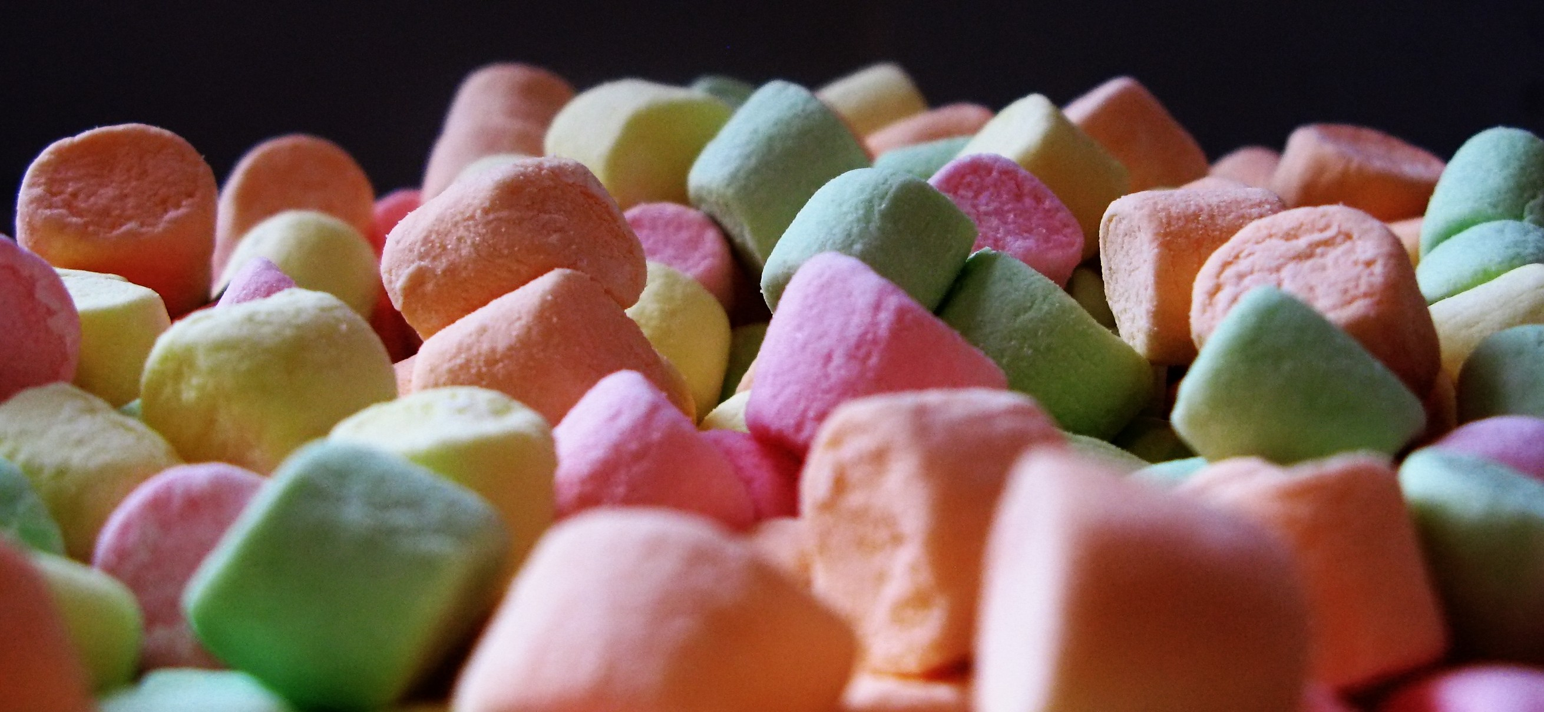
Case Study 1: The Marshmallow Test
Walter Mischel
Self control a key predictor for future success
Original study included 653 pre-preschoolers
Longitudinal study fewer
38-89
Stanford University community
Notes:
I’ve chosen this study because of its historical fame and the replication which was published this month. This isn’t to say that The Marshmallow Test is an instance in which we were wrong but serves as a solid, relevant example of the adaptation of science.

Slide 11
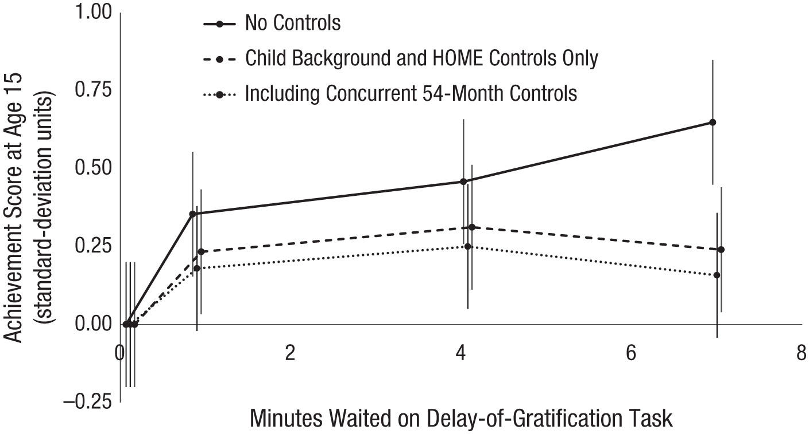
Conceptual Replication
Revisiting the marshmallow test [5]
Conceptual replication
Marshmallow-like test
Historical database for achievement/life-success
Findings
Significance for achievement tests at 15
Insignificant for behavioral measures
Effects were smaller than previous
Effects further reduced when controlled for
Family background
Early cognitive ability
Home environment
Notes:
Used child’s own stated preference for food
Keep in mind that this is just one replication – an indirect replication as well – conceptual. Children were not tested and followed but instead other measures of self-control were examined along with an historic database. This is a conceptual replication: if self-control were a determinant of future success, we would see similar effects with verisimilar measures of self control and success.
This also serves as a good example of research in which findings would likely be without bias. There is no “self-control” industry large enough to lobby for specific research so it’s fairly safe to presume research in this field which is not additionally biased – can’t rule out typical pressures.

Slide 12
Case Study 2: Video game Violence
Violent video games induce
Violent behavior
Violent attitudes/thoughts
Suppression pro-social behaviors
Notes:
You may remember my ranting from earlier in the semester about Bushman and Anderson’s article on video-game violence. Well this rant will be shorter because I’m limited for time. There

Slide 13
Contemporary oppositions
Meta-analysis of publication bias [6]
Aggressive thoughts: 6 null studies required to produce trivial results
Aggressive behavior: publication bias present
Pro-social behavior: No bias
Non-standardized measures (increasing)
Jodi Whitaker
Former student of Brad Bushman
PhD revoked
Papers retracted
RETRACTED “Boom, headshot!”: Effect of video game play and controller type on firing aim and accuracy [7]
RETRACTED The weapons effect [8]
RETRACTED Effects of violent media on verbal task performance in gifted and general cohort children [9]
REVISED Effects of weapons on aggressive thoughts, angry feelings, hostile appraisals, and aggressive behavior: A meta-analytic review of the weapons effect literature [10]
Notes:
There may be some inherent bias where Ferguson is a strong opponent to sensational research which finds correlation or causality of violence from video games. However his approach tends to include literature review and meta-analyses. Yet, just as researchers who seek to explore the connections, Ferguson is seeking to explore
JW: Bushman was cleared of wrongdoing - Several papers retracted - oh, and two of those she did not have involvement in… The junior, female author was punished while the senior, male author was not…

Slide 14
Now what?
It’s fine. Psychology is fine.
Pessimistic meta-inductionism vs Epistemic optimism
Greater increase for transparency, openness, and replicability
Emergence of groups dedicated to these principles
Increased interest and use of open-source programs and data sharing
Growing interest in null study publication
Open access journals for public dissemination
Notes:
The Marshmallow Study may just be an example when a study becomes too famous
I’m not saying that the entire field of video game aggression and violence is up flawed, but it’s not good when a well-known name in the field is associated with such a terrible event
I’ve been told before that some journals simply aren’t as good as others. Let’s not forget that the Lancet published Wakefield’s work and Science and Nature

Slide 15
References
[1] Braude SE. ESP and psychokinesis: A philosophical examination. Universal-Publishers; 2002.
[2] Fanelli D. How many scientists fabricate and falsify research? A systematic review and meta-analysis of survey data. PloS One 2009;4:e5738.
[3] Open Science Collaboration. Estimating the reproducibility of psychological science. Science 2015;349. doi:10.1126/science.aac4716.
[4] Open Science Collaboration. An open, large-scale, collaborative effort to estimate the reproducibility of psychological science. Perspectives on Psychological Science 2012;7:657–60. doi:10.1177/1745691612462588.
[5] Watts TW, Duncan GJ, Quan H. Revisiting the marshmallow test: A conceptual replication investigating links between early delay of gratification and later outcomes. Psychological Science 2018;29:1159–77. doi:10.1177/0956797618761661.
[6] Ferguson CJ. Evidence for publication bias in video game violence effects literature: A meta-analytic review. Aggression and Violent Behavior 2007;12:470–82.
[7] Whitaker JL, Bushman BJ. RETRACTED: “Boom, headshot!”: Effect of video game play and controller type on firing aim and accuracy. Communication Research 2014;41:879–91. doi:10.1177/0093650212446622.
[8] Benjamin AJ, Bushman BJ. RETRACTED: The weapons effect. Current Opinion in Psychology 2018;19:93–7. doi:https://doi.org/10.1016/j.copsyc.2017.04.011.
[9] Çetin Y, Wai J, Altay C, Bushman BJ. RETRACTED: Effects of violent media on verbal task performance in gifted and general cohort children. Gifted Child Quarterly 2016;60:279–86. doi:10.1177/0016986216660382.
[10] Benjamin Jr A, Kepes S, Bushman BJ. Effects of weapons on aggressive thoughts, angry feelings, hostile appraisals, and aggressive behavior: A meta-analytic review of the weapons effect literature. Personality and Social Psychology Review 2018;22:347–77. doi:10.1177/1088868317725419.

