Slide 1




Enhancing SPIFFE/SPIRE environment with a nested security token model

Slide 2
Agenda
What is SPIFFE/SPIRE?
The nested token model
Signature schemes
Applications to SPIRE and cloud environments

Slide 3







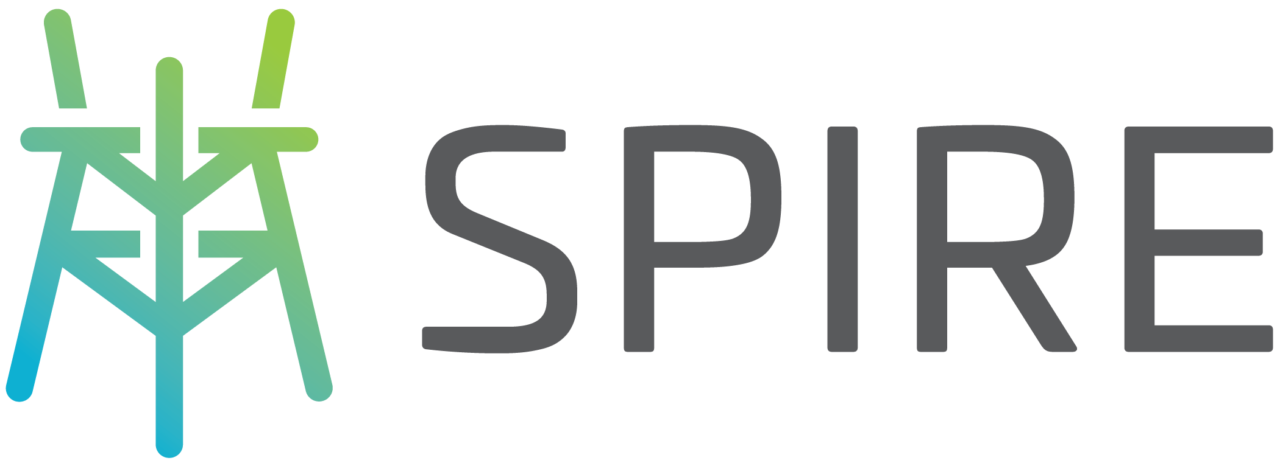



SPIFFE / SPIRE
Two different projects mainteined by
Focus on cloud security and workload identity management
is the specification
is the implementation

Slide 4

Workload identities
A piece of software identified by a signed ID: SPIFFE Verifiable Identity Document (SVID)
spiffe://foo/bar
Formats: X509 or JWT
URI scheme
Trust domain
Workload ID
Attestation: Uses selectors to bind an SVID to a workload
SPIRE Server
SPIRE Agent
spiffe://td/w1
W1
Workload
API
spiffe://td/w2
W2
spiffe://td/w3
W3

Slide 5

Limitations
SPIRE have some limitations:
No support for user identities
No support for delegation or attenuation
May be susceptible to replay attacks

Slide 6
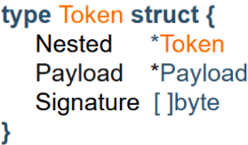
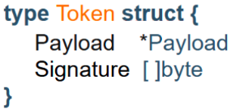
Nested Token
Tokens: set of signed data containing any information
Three components: Payload, Signature and Nested
Can be extended adding new information, creating a nested structure

Slide 7
Mandatory Claims
Required for nested token validation
Mandatory Claim | Format | Description
Issuer (iss) | IDClaim | The issuer identification, being composed either: A common name (CN), backed by an Identity Provider (IdP) A public key (PK), when an IdP is not available An identity document (ID), allowing to verify the signer identity and signature
Issued At Time (iat) | Epoch Time | A timestamp that specifies when the token was issued
Version (ver) | byte | Defines how the token should be understood and processed across various platforms (i.e., signature scheme and algorithm)

Slide 8


Signature Schemes: Two modes of operation
ID-mode: Backed by an Identity Provider, allows signer identification. Binds the issuer to an unique audience
Anonymous mode: Uses ephemeral keys and a signature aggregation scheme to create smaller tokens and a cryptographic chain

Slide 9
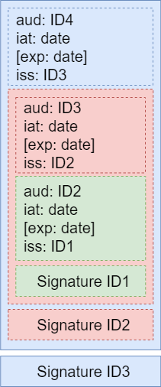

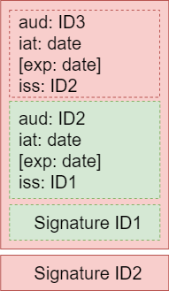
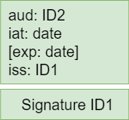
ID Mode
Link between issuer and audience
Bearer must match audience (mandatory)
No replay attacks
WL1
WL2
WL3

Slide 10
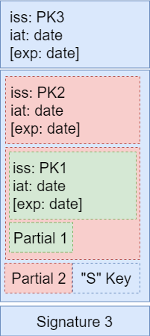
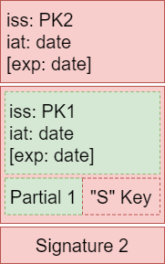
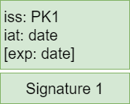

Anonymous mode
Schnorr signature Concatenation (SchoCo)
Reduces up to 50% signature size
32 bytes
64 bytes
Partial Signature
Signature
Aggregation Key

Slide 11




Use case: DSVID
Delegated SVID (DSVID): Uses the nested token to create a delegation chain
1
5
6
7
Extend DSVID
Extend DSVID
Validate DSVID
Front-end workload
Middle-tier
Target
workload
Middle-tier
Middle-tier
2
4
TTP
SPIRE
Create DSVID
3
Notation
DSVID
OAuth token
mTLS

Slide 12
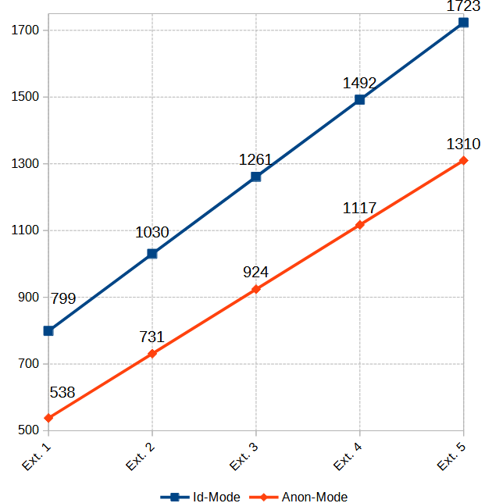
Benchmarking
Token size (bytes)
Operation
Scheme | Minting/Extension (μs) | Validation (μs)
ID-Mode | 189.69 ± 36.34 | 351.23 ± 84.56
Anonymous-mode | 1015.01 ± 246.86 | 659.56 ± 144.62

Slide 13
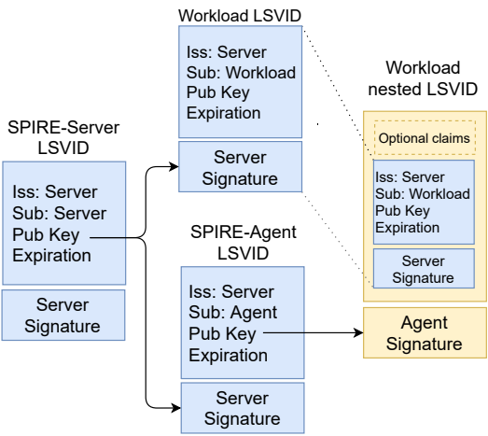
Use case: LSVID
Lightweight SVID (LSVID) is a small and flexible identity document that can be extended and used as a token
Created by SPIRE-Server
Support attenuation, delegation, or other application lvl functionality
Can embed another LSVID in the Identity claims

Slide 14
Considerations & Future work
ID-Mode relies on an existing IdP, promoting a well-defined chain of trust between workloads
Anon-Mode implements a signature concatenation scheme, resulting in smaller tokens without requiring an IdP
Future work:
Hybrid Mode: aggregates ID and Anonymous keys, resulting in a unique key for each token
SchoCo-Biscuits: improve existing Biscuits implementation, adding the signature aggregation scheme

Slide 15

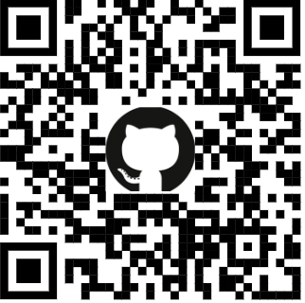
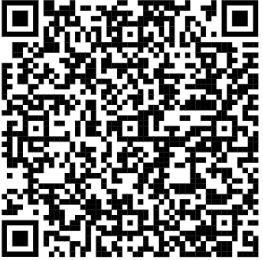
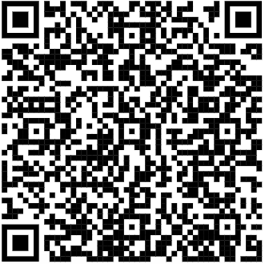
References
SPIFFE Slack channel: #wg-assertions-and-tokens
Nested token proof of concept: Golang package
Nested token Specification
LSVID Specification

Slide 16





Thanks!

