Slide 1





Assertions and Tokens WG
LSVID spec. and updates
SPIFFE/SPIRE
SEP-OCT/2023

Slide 2
Identity claims construction
Identity claims contain an identity document or its unique identifier (e.g., issuer, audience, subject).
Its original construction adopted a JSON-like key:value, where the key is the claim name and the value contains a type.value sub-structure. E.g.:
iss:CN.spiffe://example.org/workload
This construction adds undesired complexity. Some alternatives are being discussed

Slide 3
A specific claim to each identity type
Each identity type (e.g., common name, public key, LSVID) has a specific claim to store it using a JSON-like key:value:
iss-CN:spiffe://example.org/workload
iss-PK:SXNzdWVyUHVibGljS2V5
iss-LS:e0xTVklELVBheWxvYWR9.e1NlcnZlciBTaWduYXR1cmV9

Slide 4
A unique claim to all related identities
Each identity claim (e.g., issuer, audience, subject) uses a key:value format where the value is an array, following JSON spec (RFC-8259), containing the values in a predefined order:
iss:[
spiffe://example.org/workload,
SXNzdWVyUHVibGljS2V5,
e0xTVklELVBheWxvYWR9.e1NlcnZlciBTaWduYXR1cmV9
]
The array elements can also be in key:value format:
iss:[
CN:spiffe://example.org/workload,
PK:SXNzdWVyUHVibGljS2V5
]

Slide 5
Ongoing...
Documentation
LSVID spec. and use case scenario description under review
Proof-of-concept documentation updates
Experiments
Running phase 2 (ID and anonymous mode) benchmarks Presentation with first results next meeting
Proof-of-concept Phase 3 use case scenario (LSVID and nested model)

Slide 6



PoC 3: LSVID use case scenario
Extend LSVID
Extend LSVID
Validate LSVID
Subject
workload
Middle-tier
Target
workload
Middle-tier
Middle-tier
Asserting
workload
SPIRE
MTLS
Keys
LSVID
Extend LSVID
Notation
mTLS
*LSVID extension can use ID or Double mode

Slide 7

Thanks!

Slide 8
New claim format type
Identity claims (e.g., issuer, subject, audience, etc.) can embed an LSVID
Type (type) | Description | Example
ID (id) | An ID as unique LSVID identifier (e.g. SPIFFE-ID) | id:spiffe://example.org/workload
public key (pk) | The public key, used as the identifier | pk:SXNzdWVyUHVibGljS2V5
LSVID (ls) | The complete LSVID embedded in the claim | ls:e0xTVklELVBheWxvYWR9.e1NlcnZlciBTaWduYXR1cmV9

Slide 9
Ongoing tasks
Documentation
LSVID spec. and use case scenario description under review
Proof-of-concept documentation updates
Papers
ID and Anonymous mode benchmark
“SchoCo: Schnorr Concatenation”
Cryptography
ECDSA proof of signature possession (proof a valid OAuth without revealing it)
Study of signature aggregation schemes and its applications
Development
Integration with Prometheus
Phase 3 proof-of-concept

Slide 10
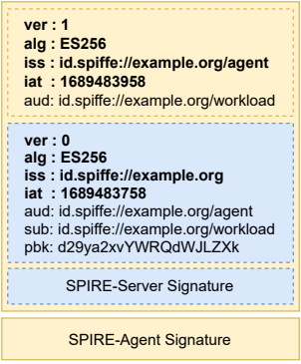
New mandatory claim
Claim | Format | Description
Version (ver) | byte | An unique identifier of the LSVID version, containing scheme related informations (e.g., creation, extension)
Algorithm (alg) | string | An unique algorithm identifier, as defined in JSON Web Algorithms (JWA)[RFC7518]
Issuer (iss) | string (type.value) | An ID, public key or LSVID, according to adopted scheme
Issued at time (iat) | NumericDate value | A timestamp that specifies when the token was issued since epoch

Slide 11
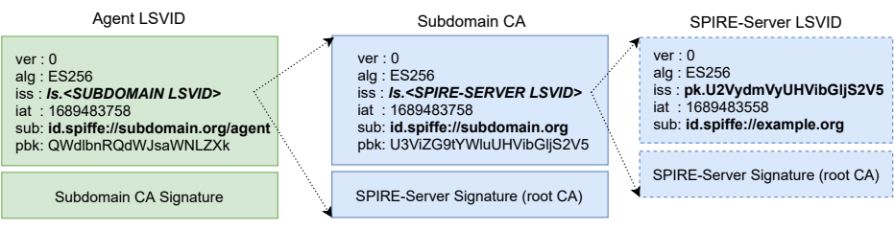
Trust bundle as a nested token
Each hop in the trust bundle set its LSVID as the issuer and the downstream CA ID/public key as the subject / pbk claims
SPIRE-Server public key can be retrieved similarly to OIDC /keys endpoint

