Slide 1
LOGISTIC REGRESSION ON TANZANIA WATER POINTSPrediction

Slide 2
Project Objectives
1. Fix Waterpoints in Problem Areas:
: Fix at least 30% of non-working waterpoints in the regions of Mtwara, Lindi, Mara, and Rukwa within the next year.
. Send repair teams to these areas, make sure resources are used effectively, and set up systems to check the status of repairs regularly.
2. Repair and Maintain Waterpoints with Water:
: Repair over 8,000 waterpoints that have water but are not working, and fix all the waterpoints needing repairs in Kigoma within 18 months.
Create and follow a plan to repair these waterpoints, start with those that already have water, and schedule regular checks to keep them working.
3. Improve Installer Performance and Payment:
: Reduce pump failures caused by the government, district councils, and Fini Water by 25% in the next year.
Review why these installers have high failure rates, consider using different installers if needed, and look at how payment affects maintenance. Improve training and incentives for installers based on these findings.

Slide 3
Business Problem
The Tanzanian government has a severe water crisis on their hands
They want to predict which pumps are functional, functional but need repairs, and non functional
Taarifa and Tanzanian Ministry of Water have shared the dataset to aid understanding of pump failure
I will build model to help the government improve maintenance operations and ensure clean drinking water is accessible to communities across Tanzania
Precision is our main metric of model selection
A non functional well being predicted as a functional well is worse than the opposite case

Slide 4
Data
Dataset contains information on 60,000 waterpoints in Tanzania
39 independent variables
Pump Status
Functional
Functional needs repairs
Non functional
Available for download on DrivenData
https://www.drivendata.org/competitions/7/pump-it-up-data-mining-the-water-table/page/23/

Slide 5
IMPORTS
Data Manipulation and Visualization
pandas as pd: Data manipulation and analysis library, particularly useful for handling structured data.
numpy as np: Provides support for large, multi-dimensional arrays and matrices, along with a collection of mathematical functions.
matplotlib.pyplot as plt: A plotting library for creating static, animated, and interactive visualizations.
seaborn as sns: Built on top of matplotlib, it provides a high-level interface for drawing attractive and informative statistical graphics.
%matplotlib inline: A magic function in Jupyter notebooks that allows matplotlib plots to be displayed inline within the notebook.
Model Evaluation and Selection
sklearn.model_selection:
train_test_split: Splits arrays or matrices into random train and test subsets.
GridSearchCV: Exhaustive search over a specified parameter grid for model tuning.
cross_val_score: Evaluates a score by cross-validation.
RepeatedStratifiedKFold: Cross-validator that provides train/test indices to split data into train/test sets while ensuring each fold is a good representative of the whole.

Slide 6
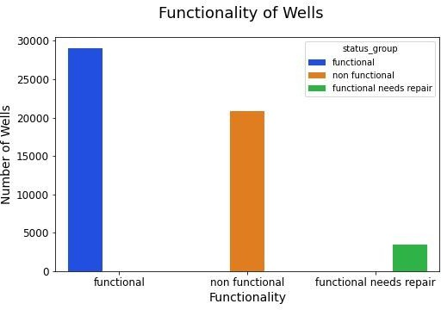
Distribution of Waterpoints
29,000 functional
21,000 non functional
3,500 functional needs repairs

Slide 7
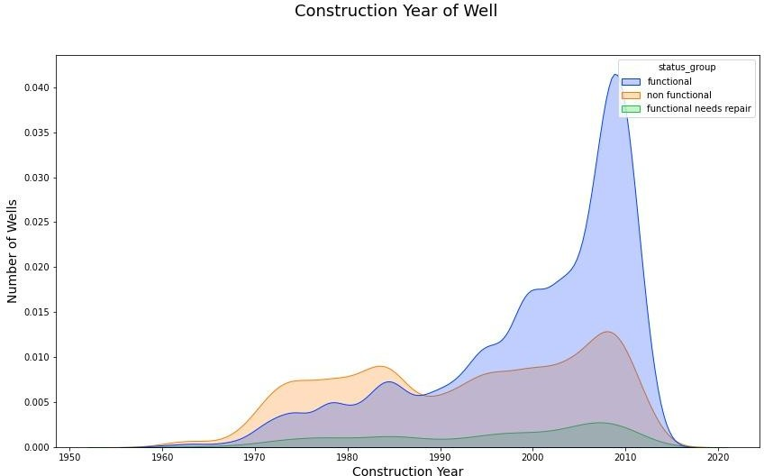
Construction Year of Waterpoint
As expected, the older the pump installation year, the more non functional pumps there are.
High rate of functioning pumps after 1988 peaking in 2000s

Slide 8
Recommendations
>Prioritize Critical Areas: Southeast (Mtwara, Lindi), North (Mara), and Southwest (Rukwa): Focus on these regions where the rate of non-functional waterpoints is high. Immediate intervention is crucial due to the severity of the situation.
>Assess and Repair Functional But Needing Maintenance Points: Kigoma: Address the cluster of functional waterpoints needing repair to prevent costly future failures.
> Investigate and Improve Installer Performance:
Government, District Council, and Fini Water: Conduct a thorough review of why these entities have higher failure rates. Potential issues could include quality of installation, maintenance practices, or training deficits.

