Slide 1

CRSP useful variables
WHARTON RESEARCH DATA SERVICES
April 15, 2020
Notes:
Welcome to this WRDS Presentation about Coverage of CRSP Stock data…

Slide 2

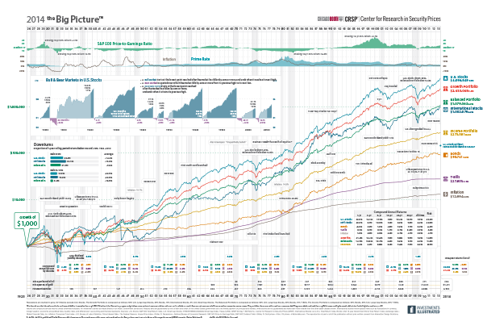
CRSP useful variables
“Negative” Prices
Adjusting Prices and Shares for Splits
Returns with Dividends
Delisting Returns
Market Capitalization.
Notes:
We’ll cover 4 topics.
Which securities are included and what are not. Coverage by specific types of securities.
Coverage by Stock Exchanges
Compare CRSP coverage vs Compustat coverage

Slide 3
1. “Negative” Prices

Slide 4
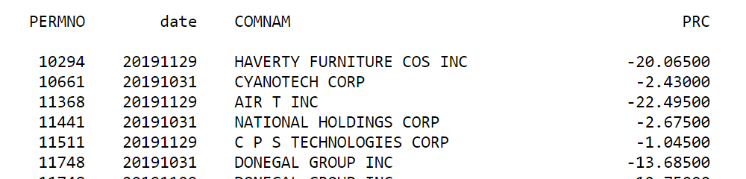
“Negative” Prices
Notes:
If the closing price is not available for any given period, the number in the price field is replaced with a bid/ask average.
Bid/ask averages have dashes placed in front of them.
These do not incorrectly reflect negative prices;
they serve to distinguish bid/ask averages from actual closing prices.

Slide 5
2. Adjusting Prices and Shares for Splits

Slide 6
Adjusting Prices and Shares for Splits
Adjusted prices = abs(PRC) / CFACPR Adjusted shares = SHROUT * CFACSHR
date | TICKER | PRC | CFACPR
20140603 | AAPL | 637.54 | 7
20140604 | AAPL | 644.82 | 7
20140605 | AAPL | 647.35 | 7
20140606 | AAPL | 645.57 | 7
20140609 | AAPL | 93.70 | 1
20140610 | AAPL | 94.25 | 1
20140611 | AAPL | 93.86 | 1
20140612 | AAPL | 92.29 | 1
CFACSHR is not always equal to CFACPR. This can be caused by less common distribution events, spin-offs, and rights.

Slide 7
3. Returns with Dividends

Slide 8
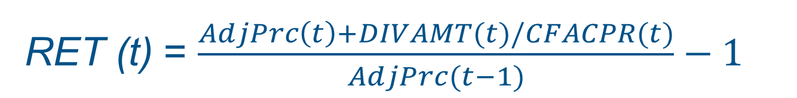
Return with Dividends
RET (t) = $\frac{AdjPrc\left(t\right)+DIVAMT(t)/CFACPR(t)}{AdjPrc(t−1)}−1$
Notes:
DIVAMT are Dividend Amount in that day or in that month.
In monthly data, monthly return is not calculated from the accumulation of daily returns.
It is calculated by that formula. It is like Dividends were distributed the last trading day of the month.

Slide 9
4. CRSP Delisting Returns

Slide 10
CRSP Delisting Returns
Delisting Date
dlamt
dlret
Listed Period
Delisted Period
Notes:
A delisting return is the return on a security after it has been removed from a stock exchange
To be part of CRSP, a security has to be listed in a major Stock Exchange.
If it is removed from those exchanges, it does not have prices and returns in the standard CRSP files (DSF,MSF).
However, many of these delisted securities may still have value after delisting. Why? Not all delisting is related with poor performance. And value after delisting may change.
Significant proportion of delisting securities are due to Acquisition.
A delisting return is the return on a security after it has been removed from exchange, and is calculated by comparing the security’s value after delisting (generally the next day or few days after delisting) with the price on the last trading day (at least for daily data. Monthly data is different as we’ll see…)
The omission of delisting returns may affect estimates of portfolio returns.

Slide 11
Delisting Returns: daily vs monthly
Daily Data
PERMNO | Date | PRC | RET
27474 | 20150529 | 24.80 | 0.3%
27474 | 20150601 | 24.67 | -0.5%
27474 | 20150602 | 24.95 | 1.1%
27474 | 20150603 | 24.91 | -0.2%
27474 | 20150604 | 23.13 | -7.1% |  | PERMNO | Date | Delisting Code | Delisting Amount | Delisting Payment Date | Delisting Return
27474 | 20150605 | 23.09 | -0.2% |  | 27474 | 20150605 | 241 | 24.98 | 20150608 | 8.2%
Monthly Data
PERMNO | Date | PRC | RET
27474 | 20150529 | 24.80 | 3.0% |  | PERMNO | Date | Delisting Code | Amount After Delisting | Date of Delisting Payment | Delisting Return
27474 | 20150630 |  |  |  | 27474 | 20150630 | 241 | 24.98 | 20150608 | 0.7%
Notes:
A delisting return is the return on a security after it has been removed from a stock exchange
Daily data: CRSP provides daily delisting returns, which are the returns attributable to the delisting.
Monthly data: CRSP generally includes the return from the beginning of the month to the date of the delisting. That is, the partial month return, and the daily delisting return.
monthly delisting returns are rarely missing because they contain partial month returns even when the delisting return is missing.

Slide 12
Missing Delisting Returns
Type Of Delisting* | Missing | Non-Missing | Percentage is missing
M&A (dlstcd=200s) | 96 | 13,194 | 1%
Dropped (Price below acceptable level, Bankruptcy, Insolvent) (dlstcd=500s) | 3,094 | 7,118 | 30%
Issue Liquidated (dlstcd=400s) | 190 | 1,418 | 12%
Issue Exchanged (dlstcd=300s) | 8 | 1,010 | 1%
* From daily crsp files
What to do?
Delisting Returns and Their Effect on Accounting-Based Market Anomalies (Beaver, McNichols, Price) JAE, 2007.
Nothing (assume dlret=0). Bias.
-100%
-30%
Use average DLRET from non-missing three-digit delisting cases.

Slide 13
5. Market Capitalization

Slide 14
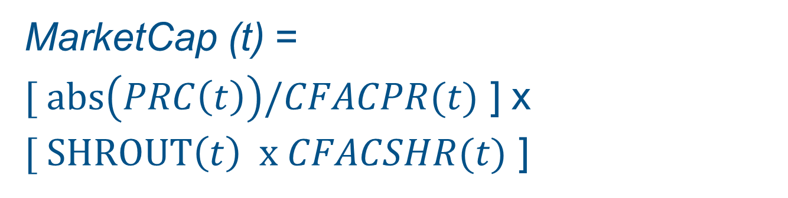

Market Cap …
MarketCap (t) = [ $abs\left(PRC\left(t\right)\right)/CFACPR(t)$ ] x [ $SHROUT\left(t\right) x CFACSHR(t)$ ]
In Most of the cases …
MarketCap (t) = $abs\left(PRC\left(t\right)\right)$ x $SHROUT\left(t\right)$
Notes:
DIVAMT are Dividend Amount in that day or in that month.
In monthly data, monthly return is not calculated from the accumulation of daily returns.
It is calculated by that formula. It is like Dividends were distributed the last trading day of the month.

Slide 15
Summary
“Negative Prices”
Adjusting Prices and Shares for Splits
Returns with Dividends
Delisting Returns
Market Capitalization.
Notes:
We’ll cover 4 topics.
Which securities are included and what are not. Coverage by specific types of securities.
Coverage by Stock Exchanges
Compare CRSP coverage vs Compustat coverage

Slide 16


