Slide 1
PHYS 7703: Planetary Science
Topic 2: The Earth System
Lecture 2: Atmosphere 1
Disclaimer: Much of the material contained within these lectures is subject to
copyright and is not for distribution or use outside of this course.

Slide 2
Outline of Earth Study
Lecture 1: Interior and Surface.
Lecture 2: Atmosphere Part 1.
Lecture 3: Atmosphere Part 2.
Lecture 4: Atmosphere Part 3.
Lecture 5: Atmosphere Part 4.
Lecture 6: The Moon.
Lecture 7: Atmospheric Evolution Part 1.
Lecture 8: Atmospheric Evolution Part 2.
Lecture 9: Atmospheric Evolution Part 3.

Slide 3
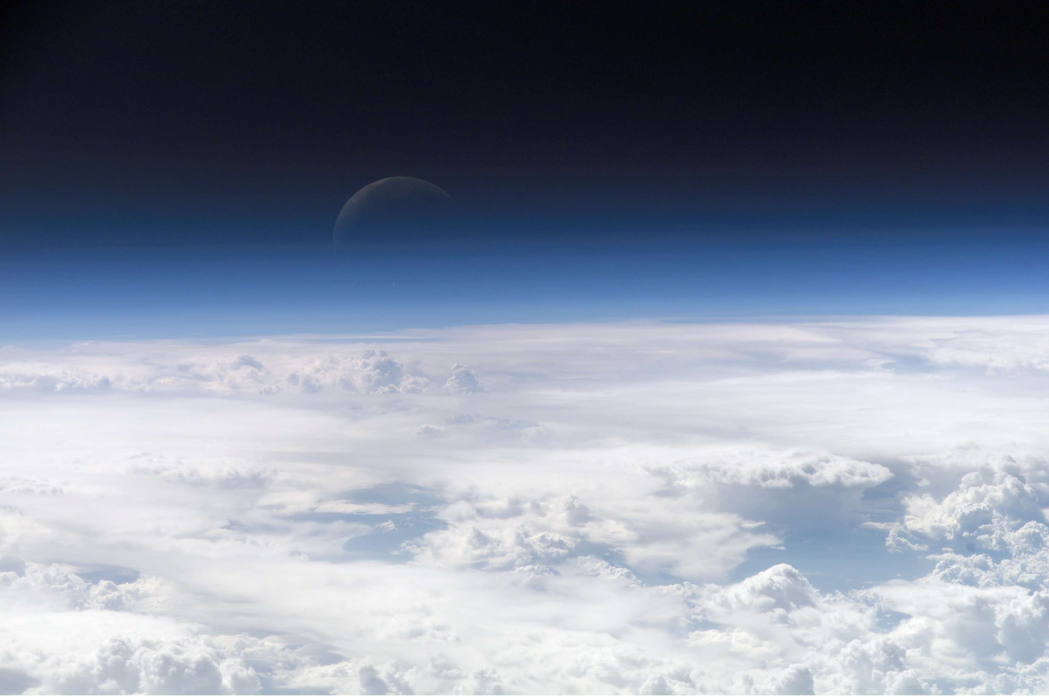
What is an Atmosphere
Gaseous envelope bound to a gravitating body.
Image courtesy of Earth Sciences and Image Analysis Laboratory, NASA Johnson Space Center

Slide 4

Balance
Upward Pressure Forces vs. Downward Gravitational Forces
This is the Hydrostatic Equation
P = Pressure
ρ = mass density (kg/m³)
g = gravitational acceleration (m/s²)
(1)

Slide 5
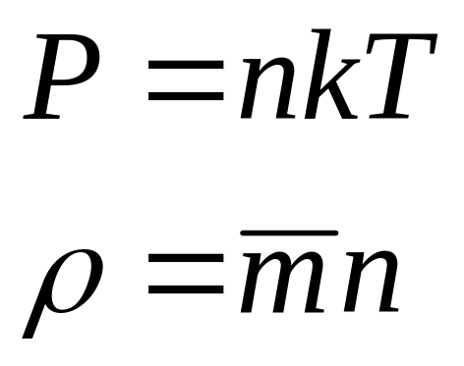
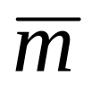
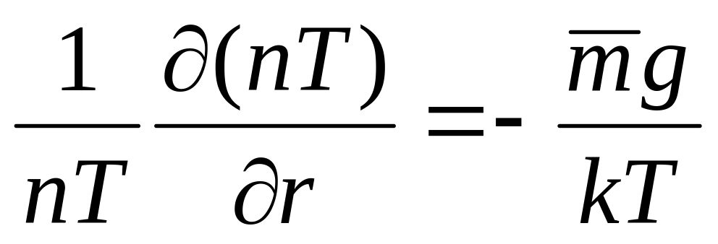
Ideal Gas
is the mean atmospheric mass (kg).
n is the atmospheric number density (m⁻³).
k = 1.380 6504(24)×10⁻²³ (J/K).
Insert (2) and (3) into (1).
(2)
(3)
(4)

Slide 6
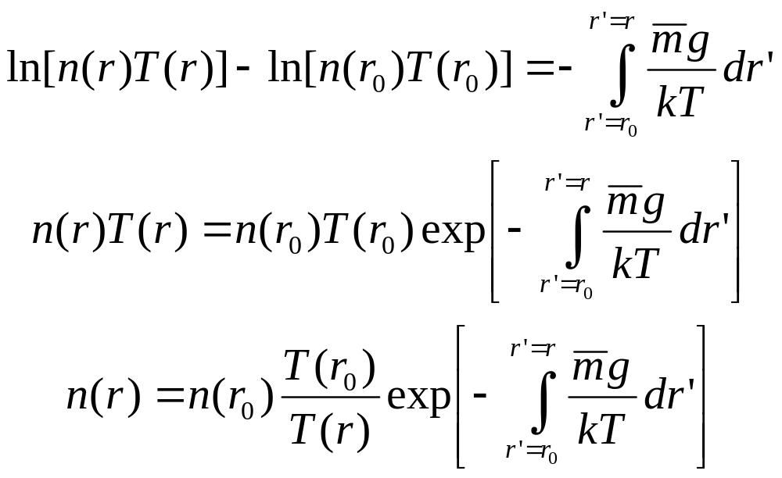
Barometric Equation
(5)
(6)
(7)

Slide 7
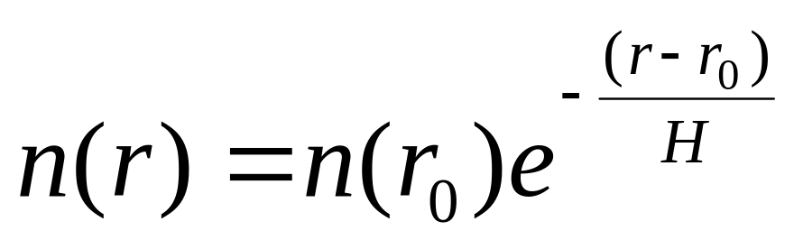
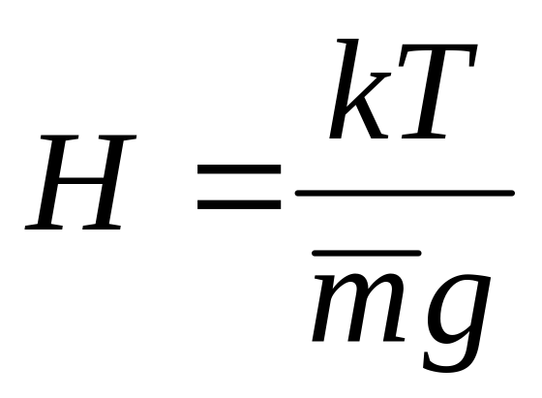
Simplification
Assume T, g and m remain roughly constant.
Mean atmospheric scale height
(8)
(9)
Notes:
Examine this equation in detail. The most important thing to take away from this is that atmospheres vary exponentially with altitude. Also note that the vertical variations dominate over horizontal variations.

Slide 8
The Barometric Law
Pressure declines exponentially with altitude
Thus, it forms a (nearly) straight line when plotted on a log scale ⇒

Slide 9
100
80
Altitude
(km)
60
40
20
10⁻³ 1 10³
Pressure (mbar)

Slide 10
100
80
Pressure decreases away from the Earth’s surface.
Altitude
(km)
60
40
20
10⁻³ 1 10³
Pressure (mbar)

Slide 11
100
80
Altitude
(km)
60
40
20
200 250 300
(-73 -23 +27 ºC)
Temperature (K)

Slide 12
100
80
Altitude
(km)
60
40
20
Temperature decreases
200 250 300
Temperature (K)

Slide 13
100
80
Altitude
(km)
60
40
20
Troposphere
0-10 km
Temperature decreases
200 250 300
Temperature (K)

Slide 14
100
80
Altitude
(km)
60
Temperature increases
40
20
Troposphere
0-10 km
200 250 300
Temperature (K)

Slide 15
100
80
Altitude
(km)
60
Temperature increases
Stratosphere
10-50 km
40
20
Troposphere
0-10 km
200 250 300
Temperature (K)

Slide 16
100
80
Mesosphere
50-90 km
Temperature decreases
60
Stratosphere
10-50 km
40
20
Troposphere
0-10 km
200 250 300
Temperature (K)

Slide 17
+ 1000 ºC
Thermosphere
90 + km
100
Temperature increases
80
Mesosphere
50-90 km
60
Stratosphere
10-50 km
40
20
Troposphere
0-10 km
200 250 300
Temperature (K)

Slide 18
Troposphere
heated by convection
turbulent, mixed
contains all weather (wind, rain, clouds, etc.)
water is important in this region
Stratosphere
not well mixed, or “stratified”
cold at base, warmer in upper region
ozone present
ozone heats upper region by absorbing uv
radiation

Slide 19
+ 1000 ºC
100
80
60
ozone
Stratosphere
10-50 km
40
20
water
Troposphere
0-10 km
200 250 300
Temperature (K)

Slide 20
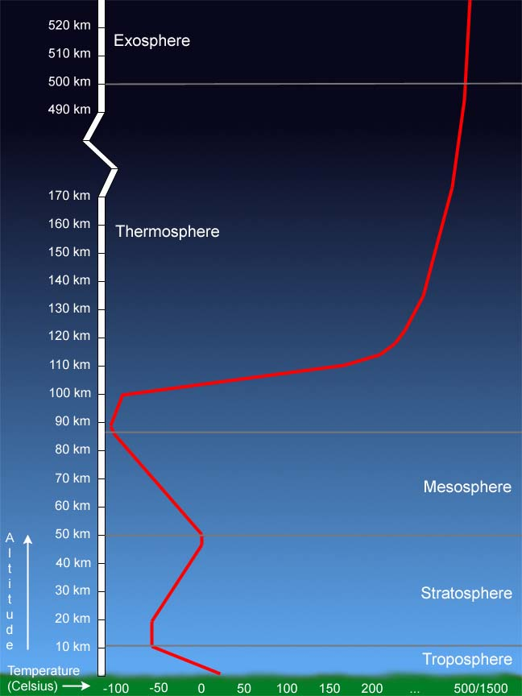
Organization Past 100 km

Slide 21
Transport
Atmospheres function to redistribute energy from different sources in order to establish equilibrium.
Energy is transported via:
  Conduction
  Radiation
  Advective Convection
  Diffusive Convection
  Chemistry

Slide 22
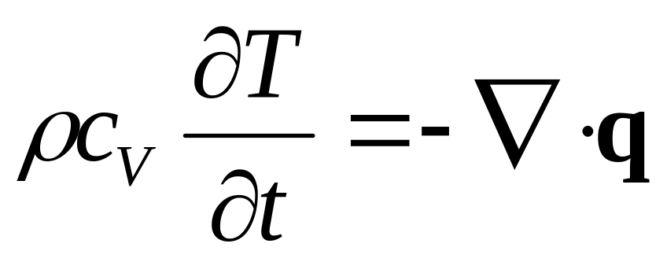
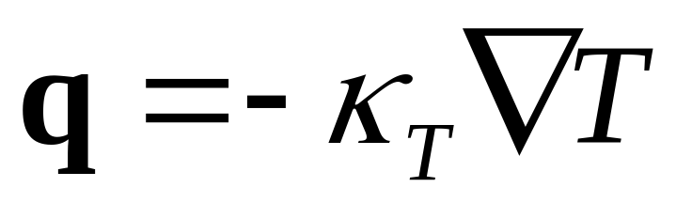
Conduction
Transport through collisions
Thermal diffusion equation:
c_{V} is the specific heat capacity at a constant volume (J/K/kg).
q is the heat conduction vector (W/m²)
(10)
(11)

Slide 23
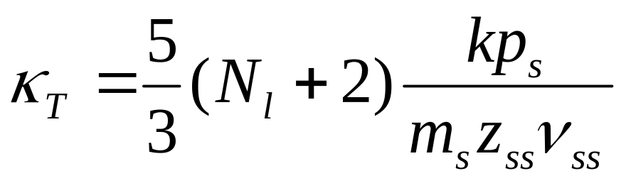
Thermal Diffusion
κ_{T} is the molecular thermal diffusion coefficient (W/m/K).
N_{l} is the conducting particles’ internal degrees of freedom.
p_{s} is the species pressure.
m_{s} is the species mass.
z_{ss} is a geometrical factor
ν_{ss} is the self-collision frequency (Hz).
(12)

Slide 24
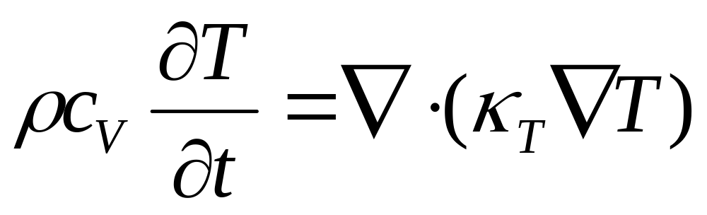
Convection
Insert (11) into (10).
This is the equation for simple diffusion
  Tends to spread out perturbations
(13)
Conduction transports energy from areas of high concentration to areas of lower concentration.

Slide 25
Transport
Atmospheres function to redistribute energy from different sources in order to establish equilibrium.
Energy is transported via:
  Conduction
  Radiation
  Advective Convection
  Diffusive Convection
  Chemistry

Slide 26
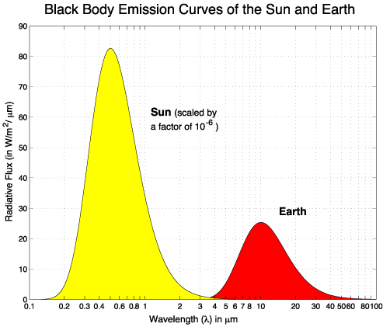
Radiation
Processes that absorb and re-emit electromagnetic energy.
Dominates where the optical depth of the radiation is greatest.
Atmospheres absorb the sun’s shortwave radiation and re-radiate at longer wavelengths.

Slide 27
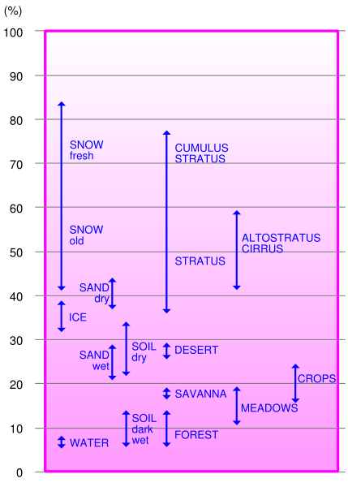
Albedo
Percentage or fraction of incident radiation reflected.
Geometrical albedo: reflected from a flat surface that is an ideal reflector.
Bond albedo: total radiation reflected versus total incident
Planet | Mercury | Venus | Earth | Moon | Mars | Jupiter | Saturn | Uranus | Neptune | Pluto
Geometric Albedo | 0.138 | 0.84 | 0.367 | 0.113 | 0.15 |  |  |  |  | 0.44-0.61
Bond Albedo | 0.119 | 0.75 | 0.29 | 0.123 | 0.16 | 0.343 | 0.342 | 0.290 | 0.31 | 0.4

Slide 28
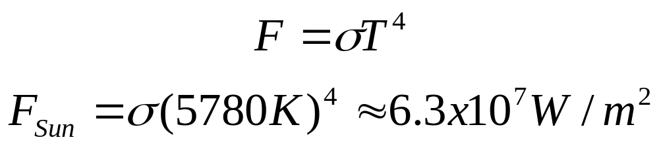
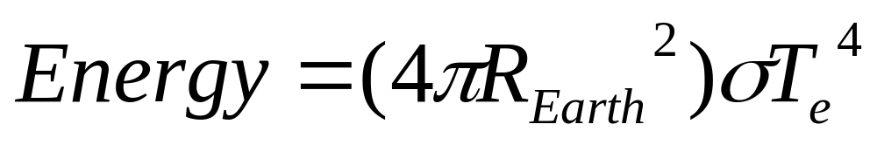
Quick Blackbody Calculation
Stefan-Boltzmann Law
σ = 5.67 x 10⁻⁸ W/m²/K⁴
Energy emitted by the Earth
T_{e} is the effective radiating temperature.
(14)
(15)
(16)

Slide 29
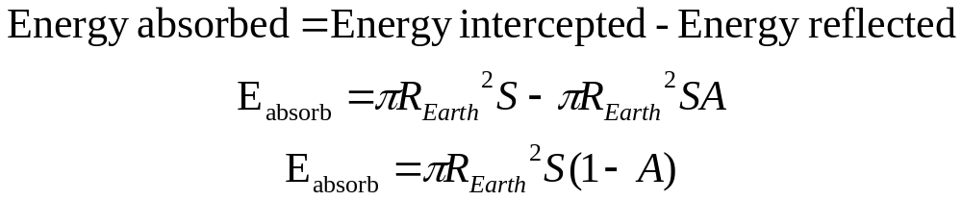
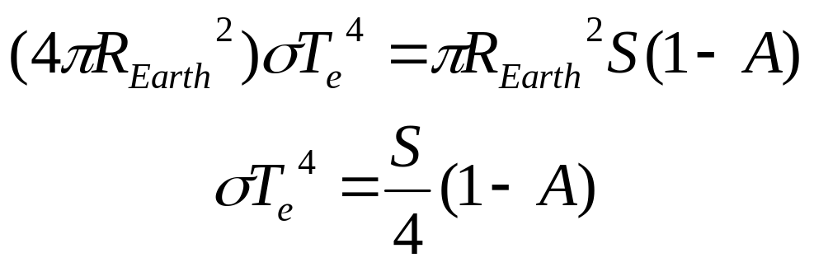
Quick Blackbody Calculation
Energy absorbed by the Earth
S is the solar flux
Equate (19) with (16)
(17)
(18)
(19)
(20)
(21)
Notes:
S is the solar flux

Slide 30
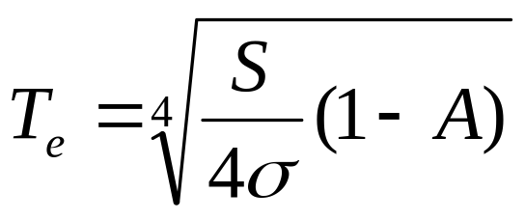
Quick Blackbody Calculation
Rearranging (21)
Insert values of S (1370 W/m²) and A (~0.3) to get T_{e} = 255 K.
Seems cold! (~-18ºC or 0ºF)
Actual mean surface temperature is 288K.
Greenhouse effect contribution is then 33K or about 11% of the total temperature.
(22)

Slide 31
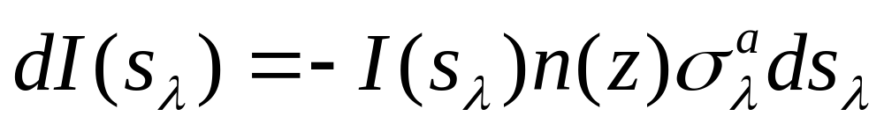
Radiative Transfer
Radiative Transfer Equation
I is the radiation intensity (photons/m²).
n(z) is the neutral density (m⁻³).
σ_{λ}ª is the photon absorption cross-section (m⁻²).
ds_{λ} is the pathlength of the radiation (m).
(23)

Slide 32
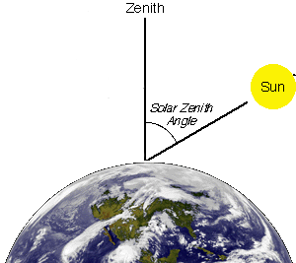
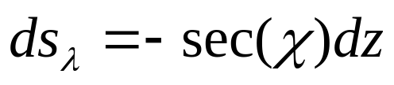
“Plane-Parallel” Approximation
Assume that the atmospheres remain roughly vertically stratified into parallel planes that are horizontally uniform.
Simple relation between dz and ds_{λ}
χ is the solar zenith angle
χ
(24)

Slide 33
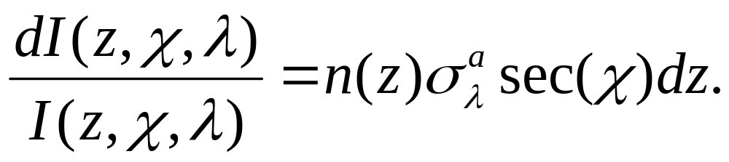
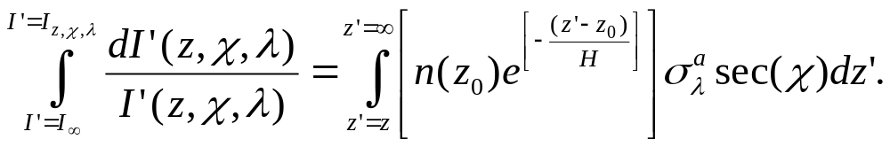
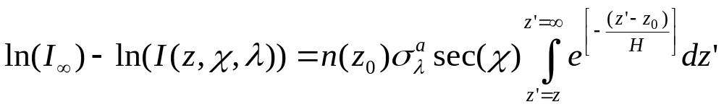
Radiative Transfer
Use barometric equation (7) to replace n.
The neutral density at infinity goes to zero
-
(25)
-
(26)
-
(27)

Slide 34
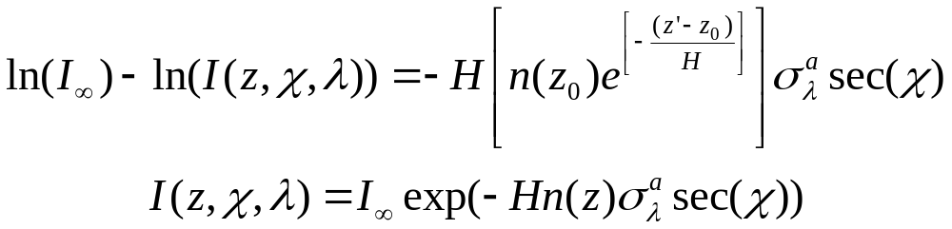
Radiative Transfer
Simplifying
This gives how incoming radiation intensity attenuates in a strictly absorbing atmosphere.
(28)
(29)

Slide 35
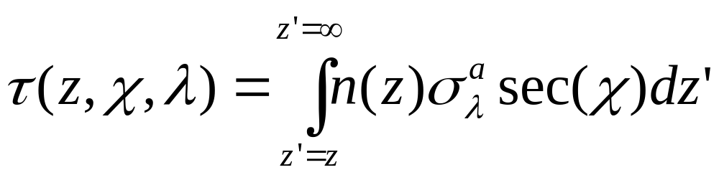
Optical Depth
Measure of transparency.
Negative logarithm of the fraction of radiation that is scattered or absorbed in a path.
(30)

Slide 36
Transport
Atmospheres function to redistribute energy from different sources in order to establish equilibrium.
Energy is transported via:
  Conduction
  Radiation
  Advective Convection
  Diffusive Convection
  Chemistry

Slide 37
Convection
Differs from thermal conduction and radiation because it redistributes both ENERGY and MATTER.
Advection: transport through fluid flow.
Diffusion: transport through micro-physical brownian motion and subsequent interparticle collisions.

Slide 38
Adiabatic Buoyancy
Imagine…Parcel of air at a specific altitude.
  Same density as surroundings.
Instantaneously given extra T.
Re-establish pressure equilibrium without exchanging heat.
Expansion also cools.
Altitude
Temperature

Slide 39
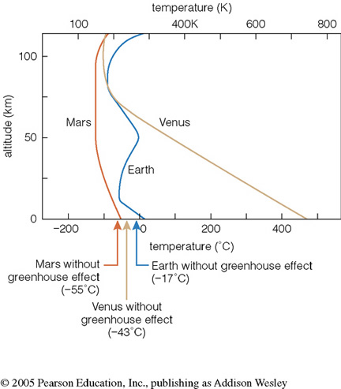
Temperature Profiles
The buoyancy effect proceeds in both directions:
  Hot parcels move upwards
  Cool parcels move downwards
For buoyant convection to play a major role the temperature must decrease with altitude.

Slide 40
Adiabatic Lapse Rate
First law of thermodynamics
Assuming no energy exchange
The amount of heat required to elevate the temperature of one mole of material by 1K without changing the pressure or volume are
These are the Thermal Heat Capacities at constant volume or pressure.
(1)
(2)
(3)
(4)

Slide 41
Adiabatic Lapse Rate
Substituting (1) for dQ in (4) we get
Rewrite the ideal gas law slightly (PV=NkT)
Inserting (7) and (3) back into (5)
(5)
(6)
(7)
(8)

Slide 42
Adiabatic Lapse Rate
Introduce the specific heat capacity c_{p}
Utilizing this and the density in (8) we get
Now using (1) (∇P=-ρg)
Which simplifies to
(9)
(10)
(11)
(12)

Slide 43
Adiabatic Lapse Rate
This is the dry adiabatic lapse rate of an atmosphere.
(12)
Convection dominates whenever the actual temperature decreases faster than the dry adiabatic lapse rate.
Superadiabatic Temperature Gradient

Slide 44
Transport
Atmospheres function to redistribute energy from different sources in order to establish equilibrium.
Energy is transported via:
  Conduction
  Radiation
  Advective Convection
  Diffusive Convection
  Chemistry

Slide 45
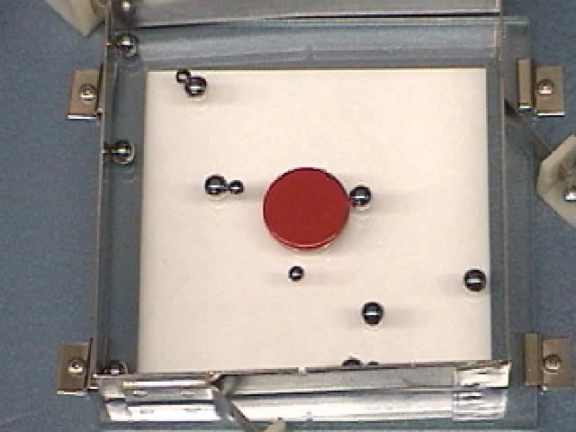
Diffusion
Net transport of material and energy through the micro-physical brownian motion of particles and the subsequent interparticle collisions
Two Formulations:
  Eddy (turbulent) diffusion
  Molecular diffusion

Slide 46
Eddy (Turbulent) Diffusion
Net result of turbulent processes:
  Maintain constant mixing ratios in an atmosphere.
Introduce a macro-scale turbulent diffusion coefficient.
K_{E}(0) and n(0) are the eddy diffusion coefficient (m²/s) and neutral density (m⁻³) at a reference altitude.
(13)

Slide 47
Eddy (Turbulent) Diffusion
Eddy processes also distribute energy
The eddy heat flux, q_{eddy}, transports energy downward to the lower atmosphere.
Net cooling on the upper atmosphere.
Usage is controversial but necessary.
(14)

Slide 48
Molecular Diffusion
Works to separate constituents.
Describes how individual fluid species diffuse through one another
This is called binary diffusion
  Varies inversely with collision frequency
ν_{st} is the bi-molecular collision frequency (Hz) between species “s” and species “t”
Generally the formulation is as follows (with A_{S} and T^{b} as experimentally determined parameters):
(15)
(16)

Slide 49
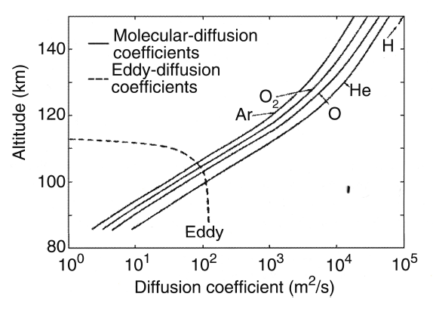
Diffusion Comparison
Eddy: increases as n^{-1/2}
Molecular: n⁻¹
Therefore Eddy diffusion is dominant at low altitudes while molecular diffusion dominates at high altitudes.
Taken from Gombosi 1999.
Region where turbulence dominates = Homosphere
Transition region: Homopause or Turbopause

