Slide 1
PHYS 7703: Planetary Science
Topic 2: The Earth System
Lecture 6: The Moon
Disclaimer: Much of the material contained within these lectures is subject to
copyright and is not for distribution or use outside of this course.

Slide 2
Outline of Earth Study
Lecture 1: Interior and Surface.
Lecture 2: Atmosphere Part 1.
Lecture 3: Atmosphere Part 2.
Lecture 4: Atmosphere Part 3.
Lecture 5: Atmosphere Part 4.
Lecture 6: The Moon.
Lecture 7: Atmospheric Evolution Part 1.
Lecture 8: Atmospheric Evolution Part 2.
Lecture 9: Atmospheric Evolution Part 3.
Notes:
2

Slide 3
General Characteristics
Mean Earthcentric Distance | 384,000 km
Orbital Period | 27.321 Days
Mean Radius | 1737.1 km
Mean Density | 3.346 g/cm³
Albedo | 0.12
Eccentricity | 0.054
Formation Date | 4.527 ± 0.010 Billion Years ago

Slide 4
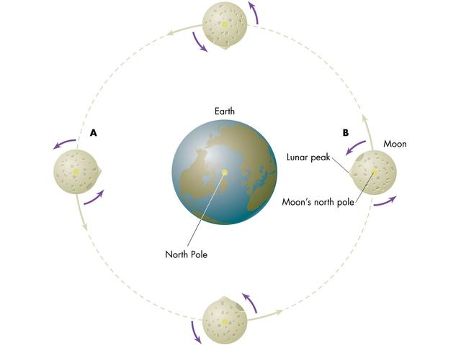
http://www.mhhe.com/physsci/astronomy/arny/instructor/graphics/ch06/0611.html
Notes:
The moon is tidally locked with Earth. This means that we only see one side of the moon, but does not mean that there is a “dark side of the moon.” Note that in general both sides of the moon get the same amount of sunlight per day.

Slide 5
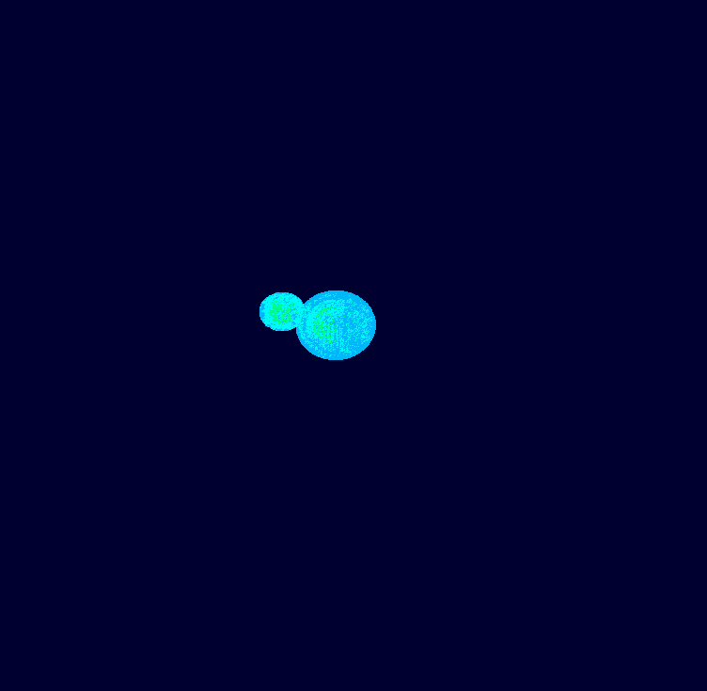
Moon-forming impact
All the evidence is consistent with the Moon having been formed by a glancing impact from a Mars-sized planetesimal (0.1 Earth masses or larger)

Slide 6
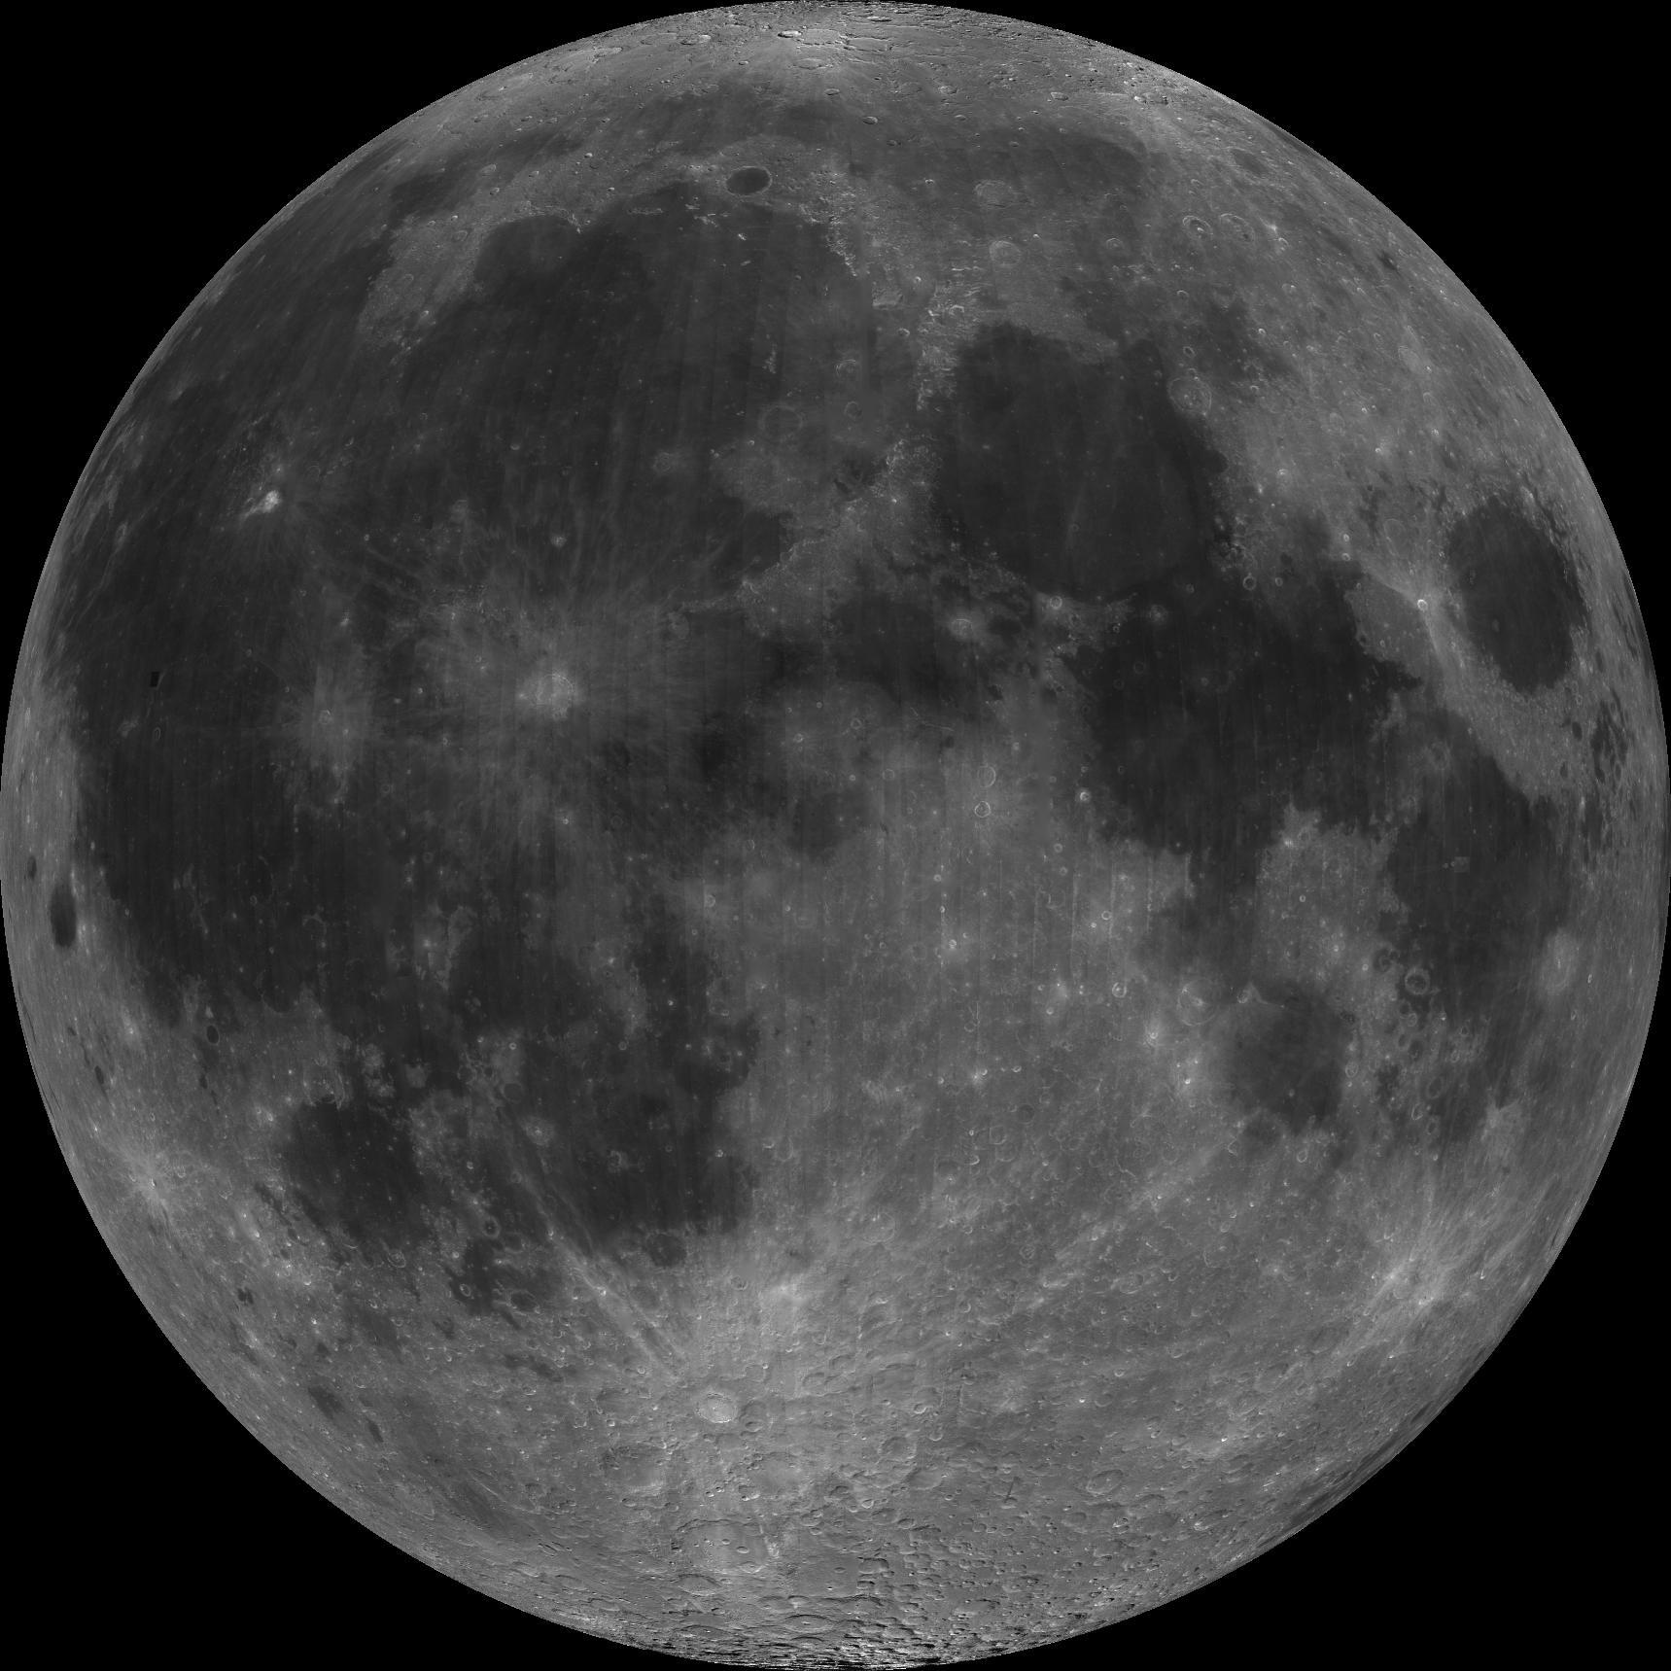
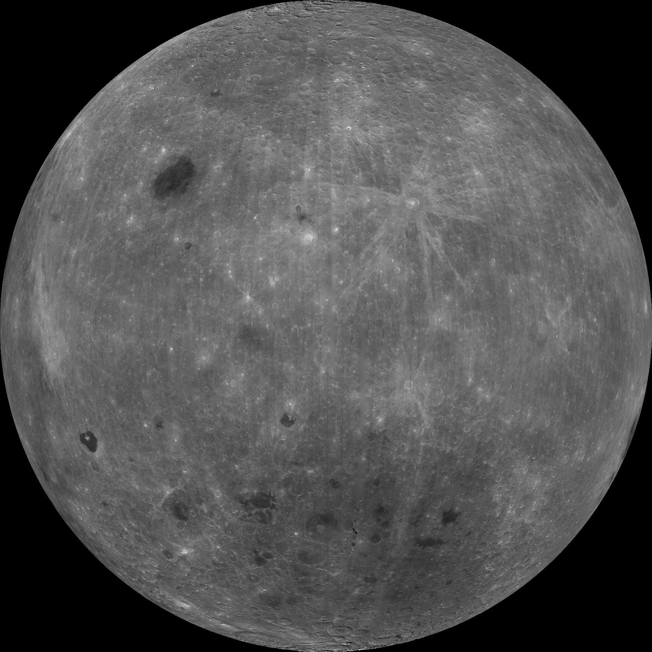
Near Side/Far Side
Notes:
We are all familiar with the near side of the moon. It is also useful to become familiar with the dark side of the moon. A few things to point out about the differences. First notice that the near side is dominated by the dark maria terrain. This terrain is basaltic and covers roughly 16% of the lunar surface. The far side is dominated by terrae or highlands. These regions are bright and consist of pulverized lunar material. The entirety of the surface is covered by regolith or “lunar soil.”

Slide 7
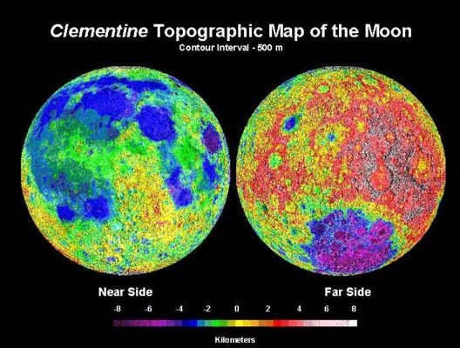
Lunar Topography

Slide 8
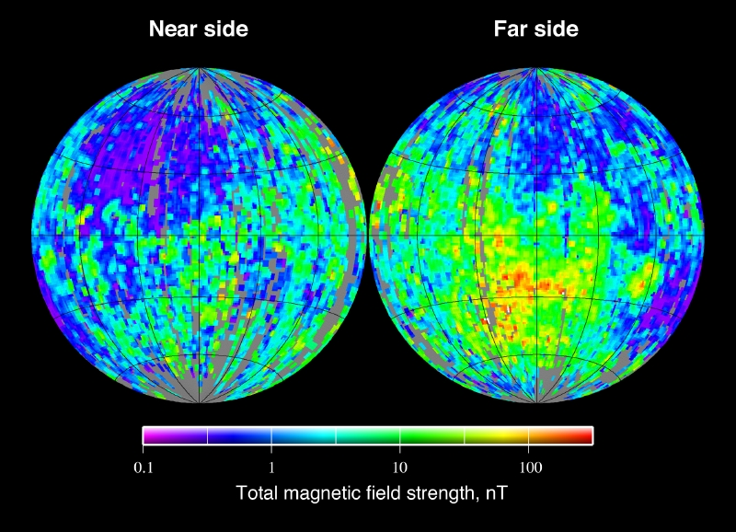
Lunar Magnetic Field
Notes:
8

Slide 9
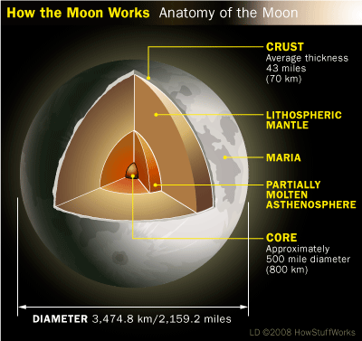
Lunar Interior
Notes:
9

Slide 10
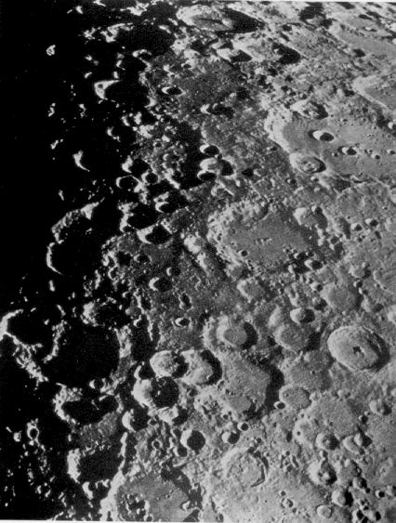
Highlands
Heavily cratered

Slide 11
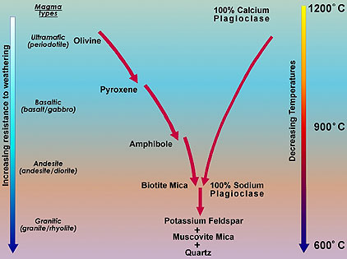
Highlands
Highland crust is primarily anorthsosite in composition
Higher Si content, lower in Fe, Mg (Felsic)
KREEP elements
Notes:
11

Slide 12
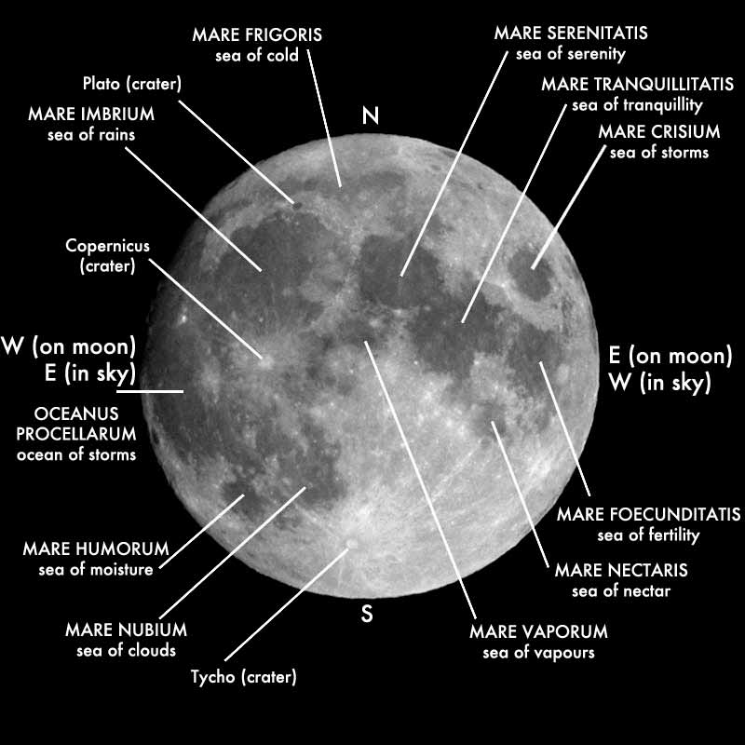
Maria
Make up about 30% of the near side of the moon
Lower crater counts indicate the maria formed after the highlands

Slide 13
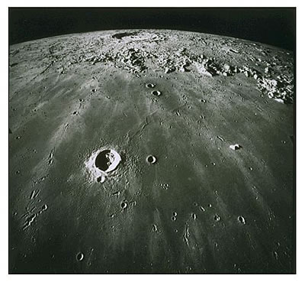
Maria
Heavy bombardment by large impactors created large basins
Large fractures from impact lowered overburden pressure and created pathways for magma to the surface
Notes:
13

Slide 14
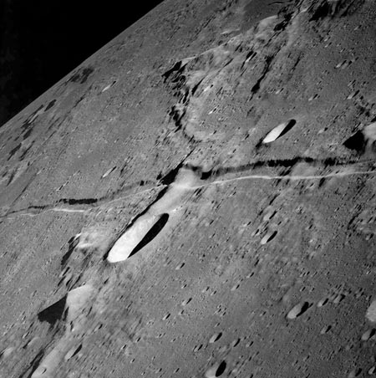
Maria
Maria flows are thin (~100 m)
Maria show evidence of surface tectonics and volcanism
Faults
Notes:
14

Slide 15
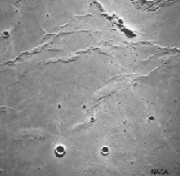
Maria
Maria flows are thin (~100 m)
Maria show evidence of surface tectonics and volcanism
Wrinkle ridges
Notes:
15

Slide 16
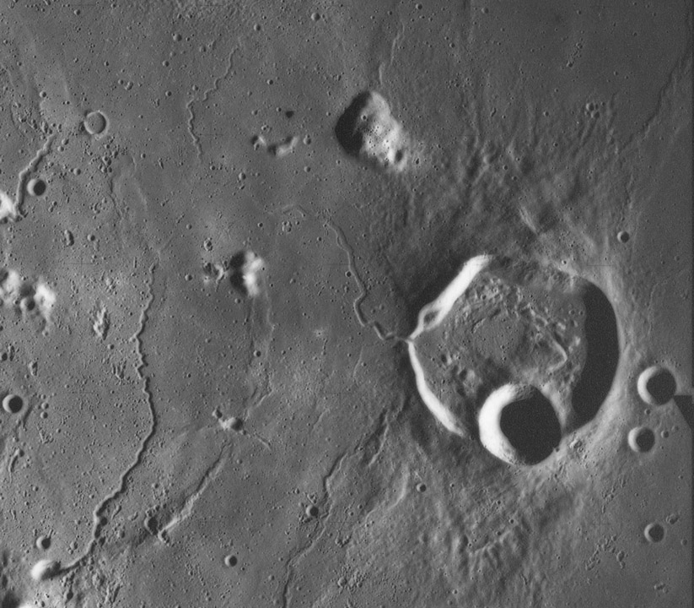
Maria
Maria flows are thin (~100 m)
Maria show evidence of surface tectonics and volcanism
Lava tubes
Notes:
16

Slide 17
Maria
Composed primarily of basalt
Higher in Fe, Mg (mafic)
Completely devoid of water
No amphibole or mica
KREEP elements
Notes:
17

Slide 18
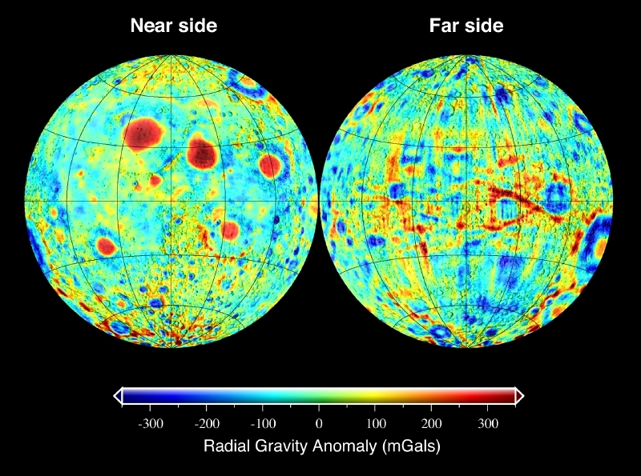
Maria – Gravitational Anomalies
The large impact basins removed material from the crust
The mantle material upwelled to isostatically compensate
The higher density mantle material creates higher mass concentrations or mascons

Slide 19
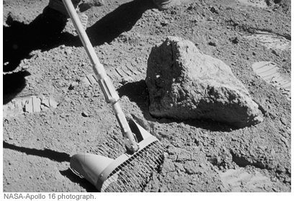
Regolith
Fine-grained, angular grains
“Lunar-soil”
At depth, rock fragments and fine-grained dust are lithified by overburden pressure.

Slide 20
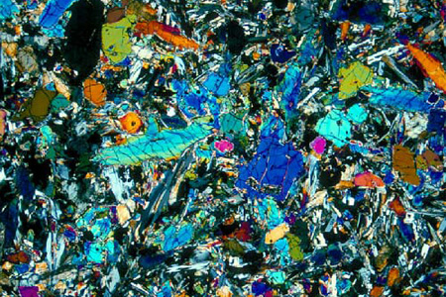
Regolith
Basically pulverized surface rocks
Pulverized by meteoritic impacts
Some partial melting from impact heating
Notes:
20

Slide 21
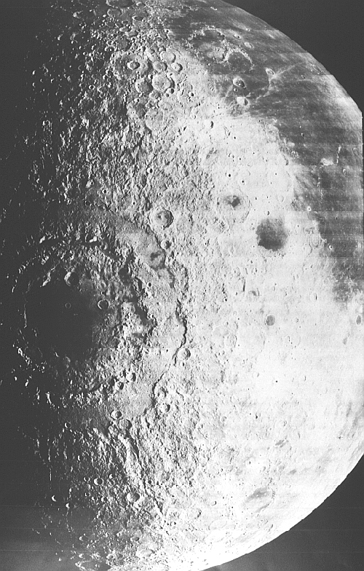
General Timeline
After collision/formation, the Moon’s molten outer crust solidified ~4.3 Ga
The Late Bombardment produces the large basins such as Imbrium and Orientale ~3.8 Ga
Mare volcanism follows until ~3.0 Ga
Not much since then except the occasional meteorite and astronaut

