Slide 1
AWS AMI Creator
Alternative Method Proposal to Standarize and Create AWS AMI

Slide 2



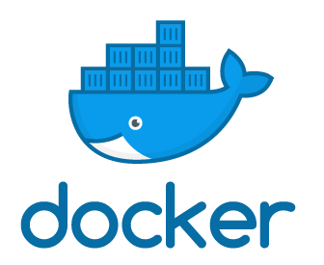



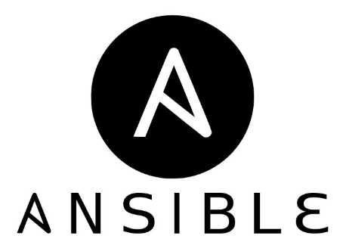

Global Architecture Model
EPHEMERAL
RESOURCES
AWS Cloud
VPC
4
1
EC2
Instance
APPs
Jenkins Pipeline
2
Params
For
AMI Creation
Applying Ansible Role
3
Roles Playbooks Inventory
AMI
Deleting Temporal EC2 Instance

Slide 3
Why use these Technologies ?
Jenkins:
Could be used as a simple “Orchestrator” to execute your “Container Application” [AWS AMI Creator at this case]
Centralize in the created Pipeline the AMI Creation
Support Params and Several Execution models with them:
API
Pipeline Invokes from JOBs/Other Pipelines
Support the creation of Workers from Containers (Detailed in another Proposal)

Slide 4
Why use these Technologies ?
Ansible:
Declarative Language to implement “IaC”
“Idempotent”
Portable / Crossplatform
Ansible Roles can be used without modification in several environments: On-Premise, Clouds, etc…
Integrated “Debug Levels and Reports”
Wide used solution in OpenSource World:
Community References and Support
Red Hat Support (If Required)
Integration with AWS (More than 169 AWS Modules supported)
Integration with “Compliance Frameworks” [More in future Proposal]

Slide 5
Why use these Technologies ?
Docker:
Isolation of the Application Dependencies
“IaC” – Include as additional “SourceCode” in your “Code Repo”
Crossplatform – Execute your “Containerized APPs” without changes
Your local Container could be deployed in DEV/PRE/PRO without changes
“Ephemeral” and “Light”:
Destroy Containers after executions and “Save Resources”
Less resources that VMs [“Shared Storage Layers”, “Non Hypervisor”, etc..]
“Wide-Known” Solution with “Wide Opensource Community Support”
Although not used here, there are “Orchestrator” that facilitate the “Expose as Service/s”, Lifecycle, etc…

Slide 6
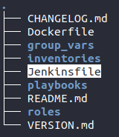
Main Solution Components [Jenkins]
In the source code is included the Jenkinsfile to create the pipeline directly from it (“Pipeline as Code”) – Present on root directory:

Slide 7
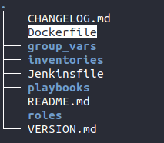
Main Solution Components [Docker]
In our case is included in the repository a Dockerfile to create the reguired “Docker Image”: - The below screenshot show the main directory for “AWS AMI Creator”

Slide 8
Main Solution Components [Docker]
Using the indicated Dockerfile you can build the next Docker image:
From that Image you can run the AWS AMI Creator solution given the indicated parameters
Check the Repository Documentation to obtain examples about “build, run and executed” the container

Slide 9
Main Solution Components [Ansible]
This component contains the main functionality that allows:
AWS AMI CREATOR
Create Temp EC2 Instance
Execute “Remotely” the Ansible Role on EC2 Instance
Create the AWS AMI From Previous Configured EC2
Delete Temp EC2 and Release Docker Container

Slide 10
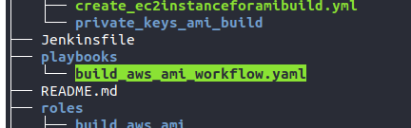
Main Solution Components [Ansible]
How Ansible get the “work be done” ?:
Implementation of “Main WorkFlow” in the nextPlaybook:

Slide 11
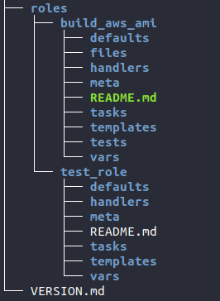
Main Solution Components [Ansible]
How Ansible get the “work be done” ?:
Implementation of EC2 Instance configuration in separated Roles
Currently are included under next directory:
Two roles included : A main workflow role and a test role (The “PLAN is include the Roles for each Desired component HERE”)

Slide 12

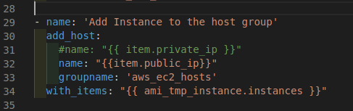
Main Solution Components [Ansible]
How Ansible get the “work be done” ?:
Configuration for remote connecction options and “Dynamic Inventory” in the next file:
An from the Ansible Role corresponding to the Workflow:

Slide 13
Main Solution Components [Ansible]
How Ansible get the “work be done” ?:
The Solution Only requires the parameters related to the temporal EC2 Instance creation and the AMI Tags/Descriptions/etc… - i.e:
'{"extra_sec_group" : "ami_creator_test", “extra_base_image”: "ami-03caa3f860895f82e", "extra_subnet_id" : "subnet-a45136fc", "extra_inst_type" : "t2.micro", "extra_region": "us-west-1", "extra_inst_profile_name" : "aws_ami_creator", "extra_tags": "{}", "extra_key_name": "aw_ami_creator", "extra_ami_des" : "An ami first test with new method", "extra_ami_name": "ami_new_mehtod_test", "extra_apply_role" : "test_role", "extra_aws_access_key" : “<optional – AutoDetect if Included in IAM Role or another one>" , "extra_aws_secret_key" : “<optional – AutoDetect if Included in IAM Role or another one>“ }'

Slide 14
VIDEO DEMO TIME
AMI Creation using test_role

Slide 15
Thanks for your Attention!!
Contact Me for Any Question/Suggestion on my GitHub Site Repository:
https://github.com/jmbelvar81

