Slide 1
Tweet Argument Summarization
Marcus Hughes
5/11/17 NLP CS 375
Williams College

Slide 2
Can we improve tweet summarization using argument mining ideas for classification?

Slide 3
Good Morning Patriots!! Happy #TGIF! If you haven't heard, we are WINNING the fight for #Prolife. Keep Praying for the unborn &amp; to #DefundPP
Looks like our sense of conscience is somewhat twistet... #abortion #PlannedParenthood #ProFamilia #defundPP https://t.co/KOZO7gLv9v
"WTF? These monsters should welcome an investigation (of nothing is being done wrong)
#DefundPP NOW!
https://t.co/qU4XRyLEnX
"@DrottM: #DefundPP #Life begins at conception. https://t.co/UoXlMerlM7\\u2026
https://t.co/a329TM5jok\
“ #NoHillary2016 #ChooseLife #UrMotherDid!
My favorite #prolife follows: @Liberty_Pike @LifeNewsHQ @LilaGraceRose @SBAList #DefundPP #AllLivesMatter #HandsUpDontCrush"
This girl didn't #ShoutYourAbortion and a lullaby to her baby gave her the career she always wanted https://t.co/ZveevxWw81
#DefundPP
"#PepsiPerfect Is this the one made from aborted human cells used in the development of artificial flavor enhancers? #defundPP
It's meant to stop forcing taxpayers to fund an organization that kills babies. #DefundPP https://t.co/8RNPByoq0N
stevenlaststraw: RT catwahler: RT LeahR77 Abortion Has NEVER Been About CHOICE #DefundPP #PJNET #TCOT
https://t.co/4BS4ni0bfi
Planned Parenthood Supporters Funnel Cash to Local School Elections
https://t.co/kw1Mwsks5e
Baby killers pay for protxn w/our $. #DefundPP
Tell your Senators to Defund Planned Parenthood SIGN &amp; RT #DefundPP https://t.co/aKvL3tuSEP
#DefundPP better yet close it down. Plenty of other clinics for women. https://t.co/RopOXtfgHX

Slide 4
Good Morning Patriots!! Happy #TGIF! If you haven't heard, we are WINNING the fight for #Prolife. Keep Praying for the unborn &amp; to #DefundPP
Looks like our sense of conscience is somewhat twistet... #abortion #PlannedParenthood #ProFamilia #defundPP https://t.co/KOZO7gLv9v
"WTF? These monsters should welcome an investigation (of nothing is being done wrong)
#DefundPP NOW!
https://t.co/qU4XRyLEnX
"@DrottM: #DefundPP #Life begins at conception. https://t.co/UoXlMerlM7\\u2026
https://t.co/a329TM5jok\
“ #NoHillary2016 #ChooseLife #UrMotherDid!
My favorite #prolife follows: @Liberty_Pike @LifeNewsHQ @LilaGraceRose @SBAList #DefundPP #AllLivesMatter #HandsUpDontCrush"
This girl didn't #ShoutYourAbortion and a lullaby to her baby gave her the career she always wanted https://t.co/ZveevxWw81
#DefundPP
"#PepsiPerfect Is this the one made from aborted human cells used in the development of artificial flavor enhancers? #defundPP
It's meant to stop forcing taxpayers to fund an organization that kills babies. #DefundPP https://t.co/8RNPByoq0N
stevenlaststraw: RT catwahler: RT LeahR77 Abortion Has NEVER Been About CHOICE #DefundPP #PJNET #TCOT
https://t.co/4BS4ni0bfi
Planned Parenthood Supporters Funnel Cash to Local School Elections
https://t.co/kw1Mwsks5e
Baby killers pay for protxn w/our $. #DefundPP
Tell your Senators to Defund Planned Parenthood SIGN &amp; RT #DefundPP https://t.co/aKvL3tuSEP
#DefundPP better yet close it down. Plenty of other clinics for women. https://t.co/RopOXtfgHX

Slide 5
Good Morning Patriots!! Happy #TGIF! If you haven't heard, we are WINNING the fight for #Prolife. Keep Praying for the unborn &amp; to #DefundPP
Looks like our sense of conscience is somewhat twistet... #abortion #PlannedParenthood #ProFamilia #defundPP https://t.co/KOZO7gLv9v
"WTF? These monsters should welcome an investigation (of nothing is being done wrong)
#DefundPP NOW!
https://t.co/qU4XRyLEnX
"@DrottM: #DefundPP #Life begins at conception. https://t.co/UoXlMerlM7\\u2026
https://t.co/a329TM5jok\
“ #NoHillary2016 #ChooseLife #UrMotherDid!
My favorite #prolife follows: @Liberty_Pike @LifeNewsHQ @LilaGraceRose @SBAList #DefundPP #AllLivesMatter #HandsUpDontCrush"
This girl didn't #ShoutYourAbortion and a lullaby to her baby gave her the career she always wanted https://t.co/ZveevxWw81
#DefundPP
"#PepsiPerfect Is this the one made from aborted human cells used in the development of artificial flavor enhancers? #defundPP
It's meant to stop forcing taxpayers to fund an organization that kills babies. #DefundPP https://t.co/8RNPByoq0N
stevenlaststraw: RT catwahler: RT LeahR77 Abortion Has NEVER Been About CHOICE #DefundPP #PJNET #TCOT
https://t.co/4BS4ni0bfi
Planned Parenthood Supporters Funnel Cash to Local School Elections
https://t.co/kw1Mwsks5e
Baby killers pay for protxn w/our $. #DefundPP
Tell your Senators to Defund Planned Parenthood SIGN &amp; RT #DefundPP https://t.co/aKvL3tuSEP
#DefundPP better yet close it down. Plenty of other clinics for women. https://t.co/RopOXtfgHX

Slide 6
Good Morning Patriots!! Happy #TGIF! If you haven't heard, we are WINNING the fight for #Prolife. Keep Praying for the unborn &amp; to #DefundPP
Looks like our sense of conscience is somewhat twistet... #abortion #PlannedParenthood #ProFamilia #defundPP https://t.co/KOZO7gLv9v
"WTF? These monsters should welcome an investigation (of nothing is being done wrong)
#DefundPP NOW!
https://t.co/qU4XRyLEnX
"@DrottM: #DefundPP #Life begins at conception. https://t.co/UoXlMerlM7\\u2026
https://t.co/a329TM5jok\
“ #NoHillary2016 #ChooseLife #UrMotherDid!
My favorite #prolife follows: @Liberty_Pike @LifeNewsHQ @LilaGraceRose @SBAList #DefundPP #AllLivesMatter #HandsUpDontCrush"
Very short statements
Spelling errors
Usage of nontraditional POS
Usage of abbreviations
Interlinked meaning with other hashtags
Way too many to look at by hand
This girl didn't #ShoutYourAbortion and a lullaby to her baby gave her the career she always wanted https://t.co/ZveevxWw81
#DefundPP
"#PepsiPerfect Is this the one made from aborted human cells used in the development of artificial flavor enhancers? #defundPP
It's meant to stop forcing taxpayers to fund an organization that kills babies. #DefundPP https://t.co/8RNPByoq0N
stevenlaststraw: RT catwahler: RT LeahR77 Abortion Has NEVER Been About CHOICE #DefundPP #PJNET #TCOT
https://t.co/4BS4ni0bfi
Planned Parenthood Supporters Funnel Cash to Local School Elections
https://t.co/kw1Mwsks5e
Baby killers pay for protxn w/our $. #DefundPP
Tell your Senators to Defund Planned Parenthood SIGN &amp; RT #DefundPP https://t.co/aKvL3tuSEP
#DefundPP better yet close it down. Plenty of other clinics for women. https://t.co/RopOXtfgHX

Slide 7
Summarization Approaches
Extractive
"Abortion is the intentional killing of an unborn baby. And it doesn't take religion to know that killing an unborn baby is wrong. #DefundPP” EV_Black: RT jstines3: Nothing in MY Constitution says FED GOVT can fund infant killing! \n\n#DefundPP #PJNET #TCOT \\u2026 https://t.co/c9ou7qELVi” BC you R a Heartless Baby Killing Bitch! Go get a Job at #DefundPP https://t.co/PFlEw79ssN"
Abstractive
Nothing in my constitution says fed govt can fund infant killing. Funding death of unborn is not role of fed govt. Birth control is free and readily available. Cruz attacked for stating truth & attempting to t_url #cruzcrew #pjnet #trusted .

Slide 8
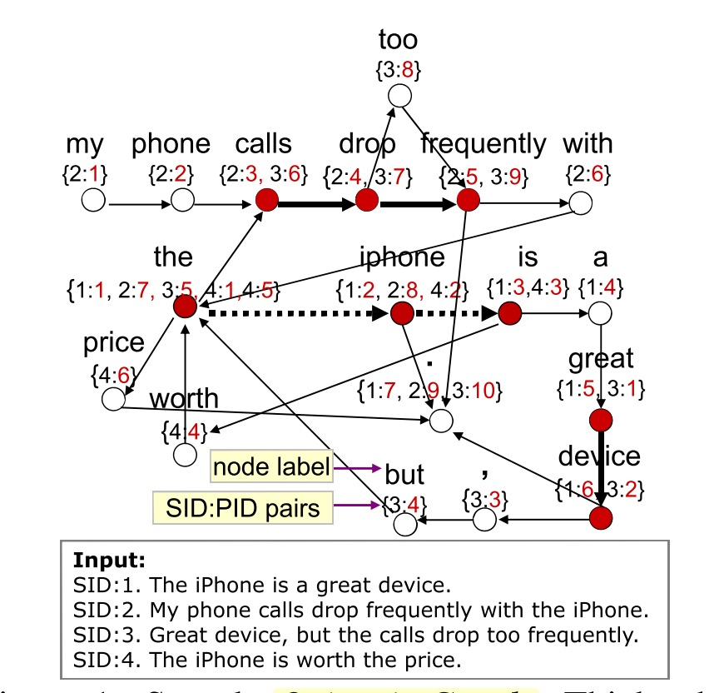
Summarization algorithms
Baseline: random, most recent
Frequency based: SumBasic, Hybrid TF-IDF
Graph based: Opinosis, LexRank, TextRank, Phrase reinforcement
Cluster based: k-means clustering
Other: decay models, neural networks
Ganesan, K., Zhai, C., & Han, J. (2010).

Slide 9
Evaluation
Summary One
So Instagram can sell your pictures to advertisers without u knowing starting January 16th I’m bout to delete my instagram! Instagram debuts new privacy policy , set to share user data with Facebook
Human evaluation
Readability, Informativeness, Redundancy, Grammaticality
Automatic evaluation
ROUGE-N, ROUGE-L, ROUGE-SU4
BLEU
Pyramid method
Precision, recall, and F-measure
Summary Two
Instagram changed their policies to state that they will have the right to sell your photos to advertisers beginning January 16th. You can only opt out by deleting your account.
Summary Three
Instagram will have the rights to sell your photos to Advertisers as of jan 16. Over for Instagram on January 16th - Instagram says it now has the right to sell your photos unless you delete your account by January 16th http://t.co/tsjic6yA
Summary 1 and 3 from Xu, Grishman, Meyers, and Ritter (2013)

Slide 10
Apply to Tweets?
Inouye, D., & Kalita+, J. K. (2011). Comparing Twitter Summarization Algorithms for Multiple Post Summaries. 2011 IEEE Third Int’l Conference on Privacy, Security, Risk and Trust and 2011 IEEE Third Int’l Conference on Social Computing, 298–306. https://doi.org/10.1109/PASSAT/SocialCom.2011.31

Slide 11
Can we improve tweet summarization using argument mining ideas for classification?

Slide 13
Ganesan, K., Zhai, C., & Han, J. (2010). Opinosis : A Graph-Based Approach to Abstractive Summarization of Highly Redundant Opinions. Proceedings of the 23rd International Conference on Computational Linguistics, (August), 340–348. https://doi.org/http://portal.acm.org/citation.cfm?id=1873781.1873820

Slide 14
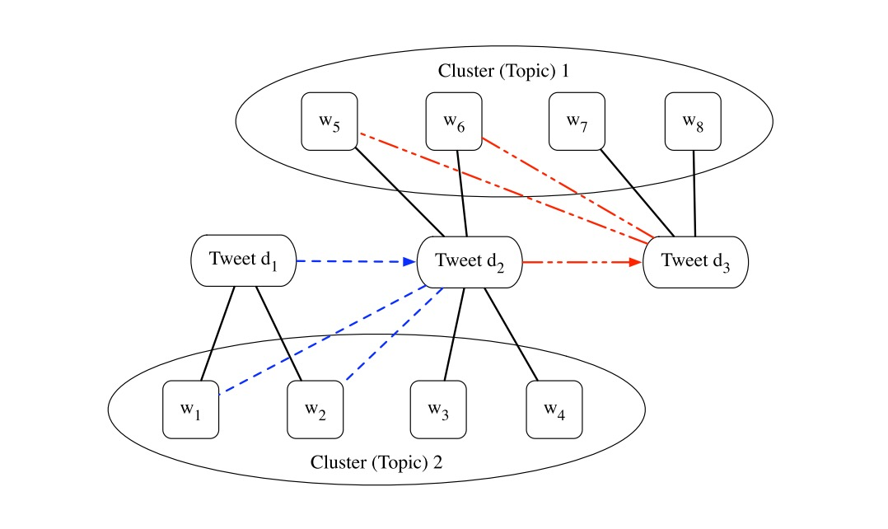
Freddy Chong, Tat Chua, S. A. (2013). Automatic Summarization of Events From Social Media. International AAAI Conference on Weblogs and Social Media, 81–90. Retrieved from http://citeseerx.ist.psu.edu/viewdoc/summary?doi=10.1.1.309.517

Slide 15
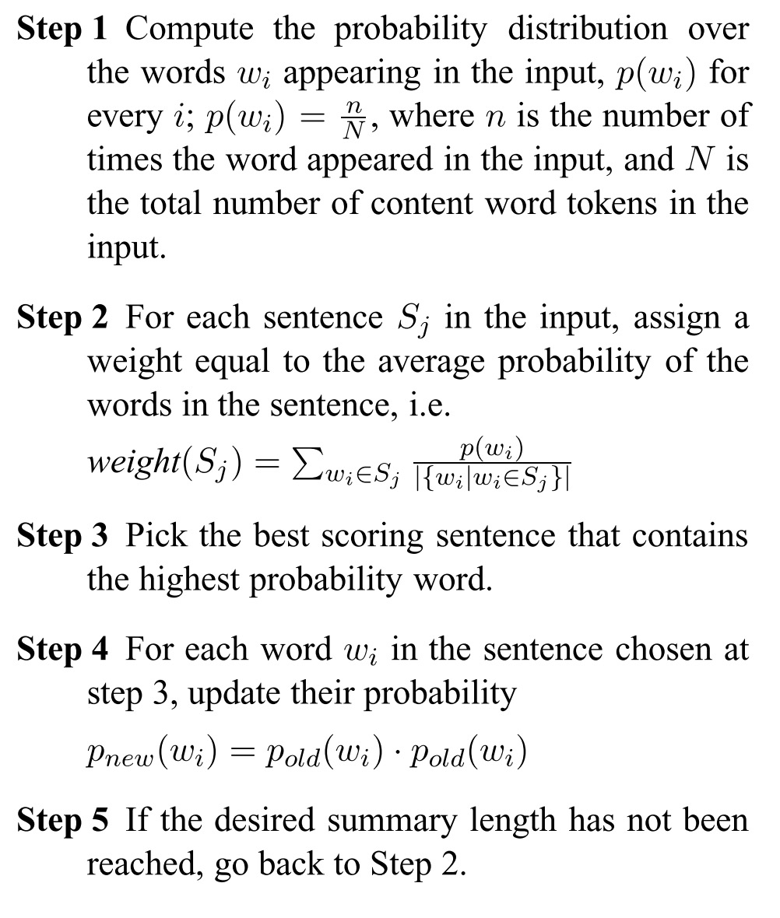
Nenkova, A., & Vanderwende, L. (2005). The impact of frequency on summarization. Microsoft Research Redmond Washington Tech Rep MSRTR2005101. Retrieved from http://www.cs.bgu.ac.il/~elhadad/nlp09/sumbasic.pdf

