Slide 1
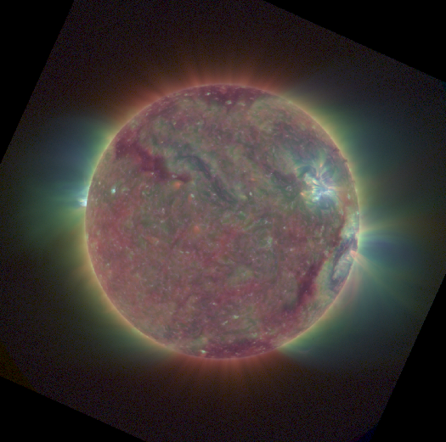
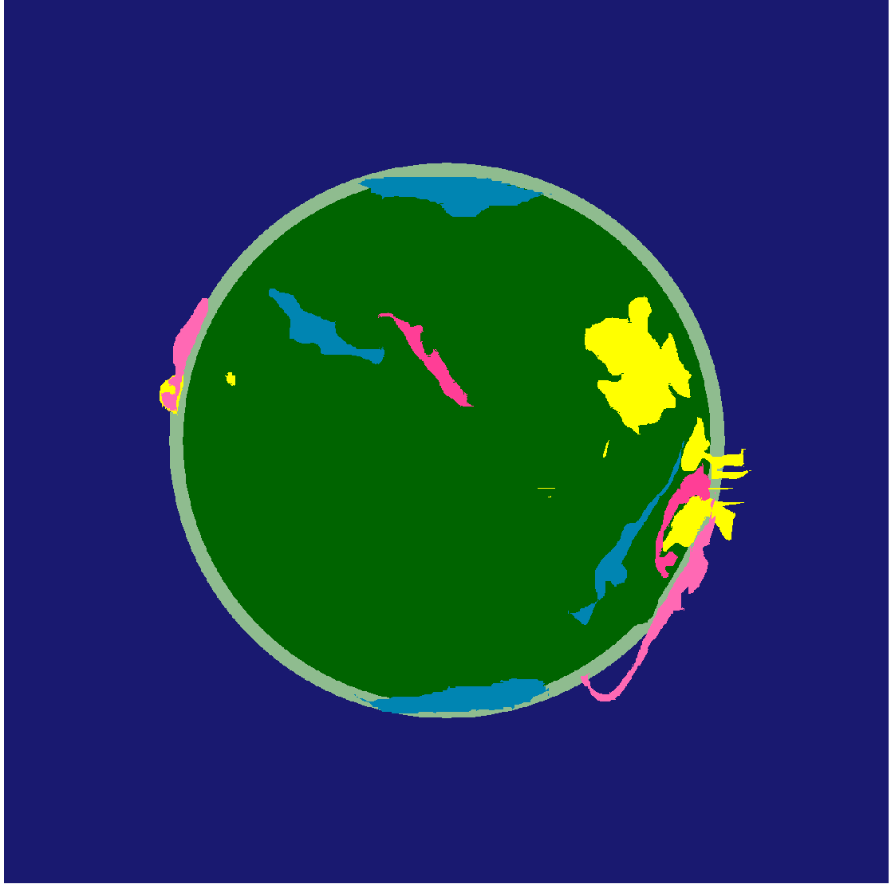

Solar Thematic Map Generation
Marcus Hughes
15 May 2018
advised by Jon Park (Williams)
collaboration with Daniel Seaton (NOAA/CIRES)
and Jon Darnel (NOAA/CIRES)
Notes:
Grew up with ideas of a happy sun. I feel like we all drew pictures like this at some point.

Slide 2
Contributions
- Develop human
labeled database
- Create suite of machine learning
approaches to compare performance
-Applications of database and fractal dimension
- Plan for future work
How can we classify what’s happening
on the Sun
in real time?
Please interrupt with questions.

Slide 3
Solar Physics Background

Slide 4
Notes:
This video shows one way that the Sun is an angry place. See this flare from September and how it propagates outward across the surface of the Sun over the course of hours. Sometimes these events come toward us: enter my project.

Slide 5
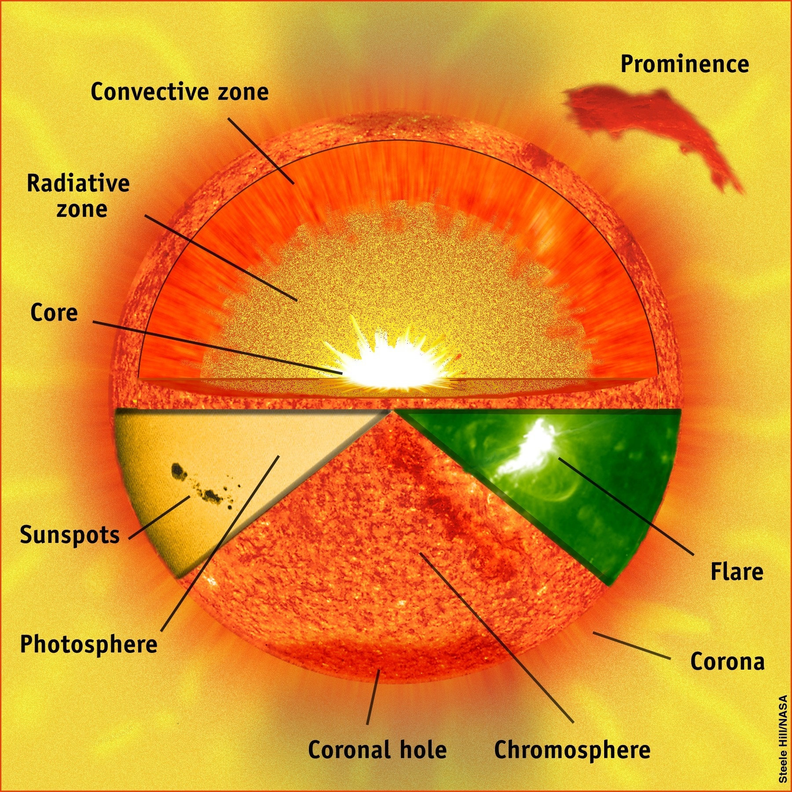
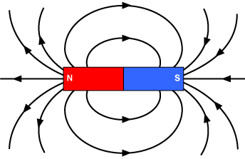
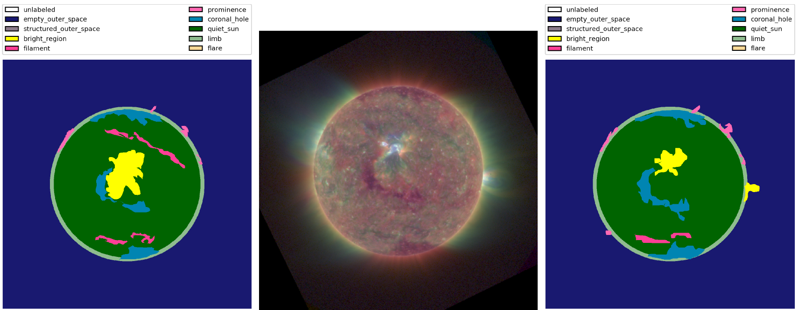
Active Regions

Slide 6
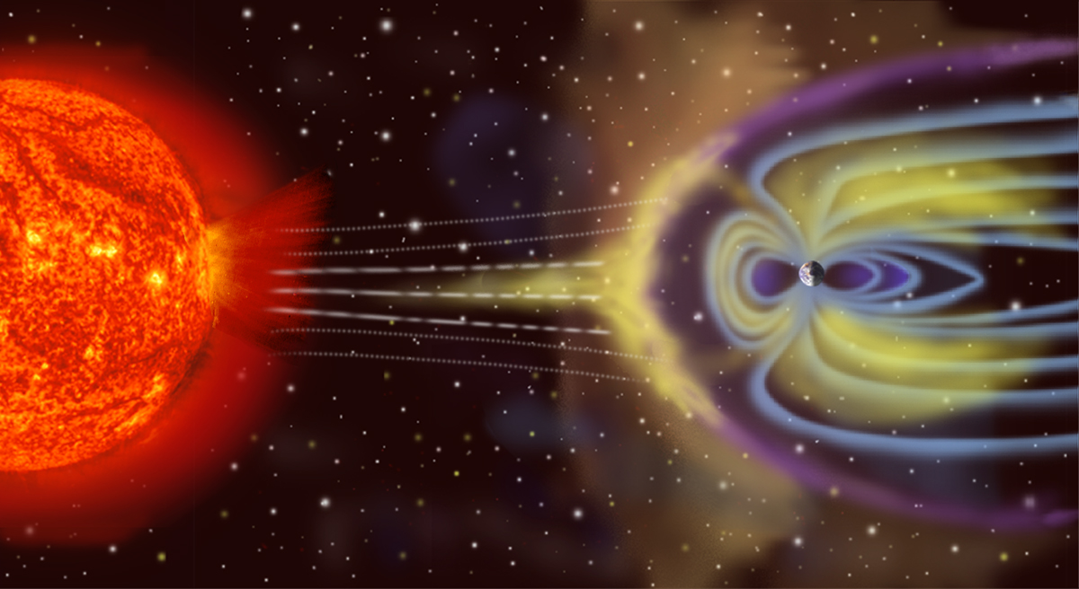
Space Weather Hazards
https://upload.wikimedia.org/wikipedia/commons/f/f3/Magnetosphere_rendition.jpg
Notes:
Carrington Event: 1859 –
+ aurora was visible Monterrey, Mexico; Cuba; Hawaii; Colombia
+ Fires at telegraph stations
+ a modern Carrington Event would cost humanity $1 trillion to $2 trillion in the first year and take another four to 10 years to achieve full recovery.
March 1989 geomagnetic storm
+ nine hour outage in Quebec
+ even later that year shut down stock market briefly
Solar Storm of 2012 – similar magnitude but did not hit Earth

Slide 7
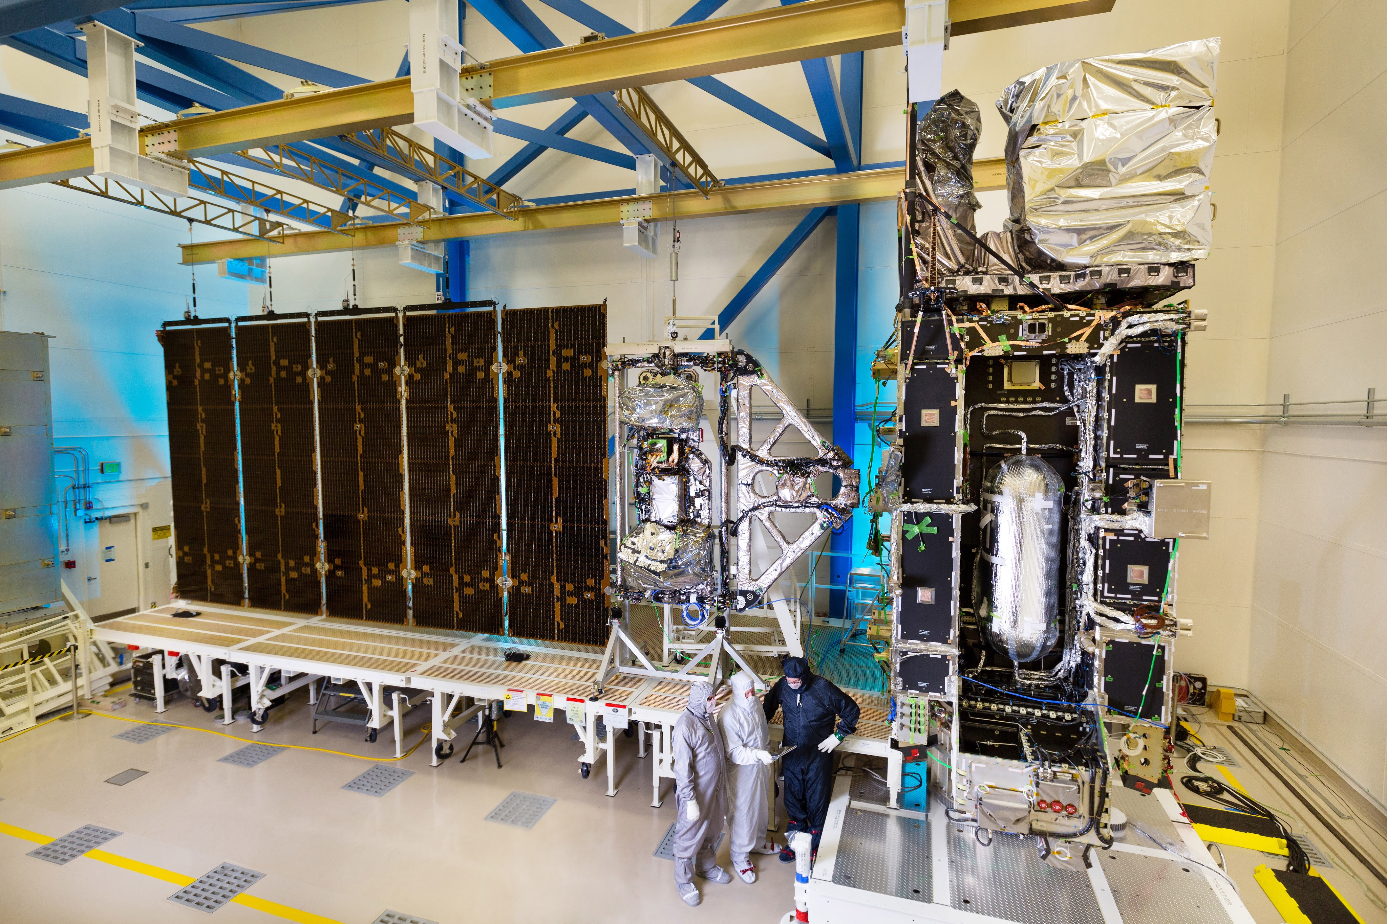
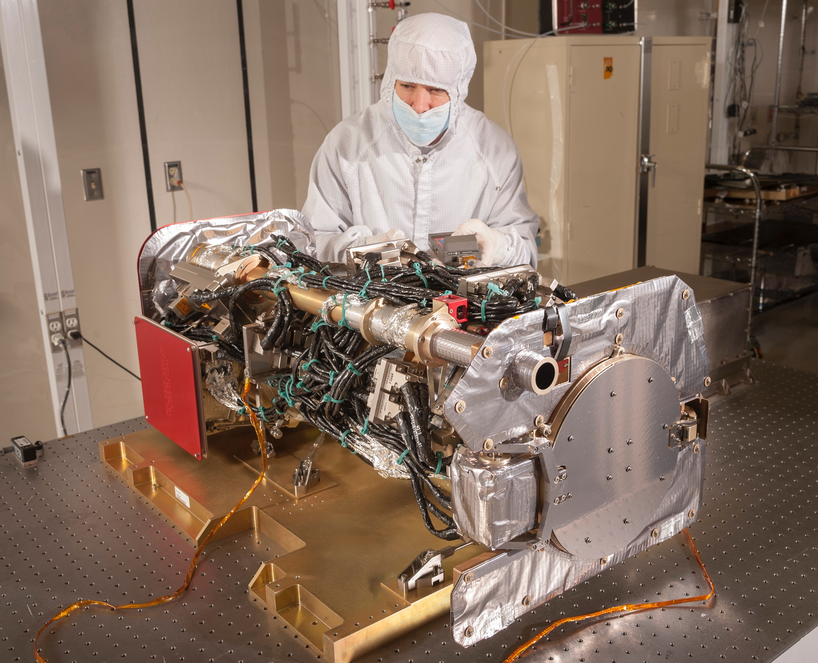
Additional Motivation
Notes:
Beyond just being a tool for day-to-day forecasting this project has astronomical significance. The majority of the data comes from this GOES-R satellite of NOAA. Mainly a weather satellite someone had the bright idea of putting an instrument on the solar panel here.

Slide 8
Additional Motivation
Notes:
Here’s the imager the data come from.
Turns out there are twenty years funded. Takes 8700 images per day or 65 million over its lifetime.
Around 138 gigabytes of data per day or over 1 petabyte over its lifetime.
Able to probe outer regions of corona where fundamental physics occurs… treasure trove to help answer the question of how the Sun evolves and why the corona is so much hotter

Slide 9
Prior Work

Slide 10
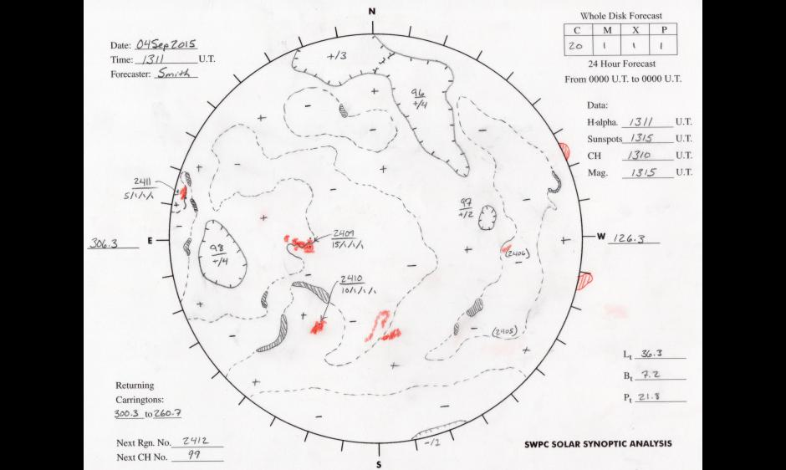
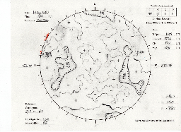

Slide 11
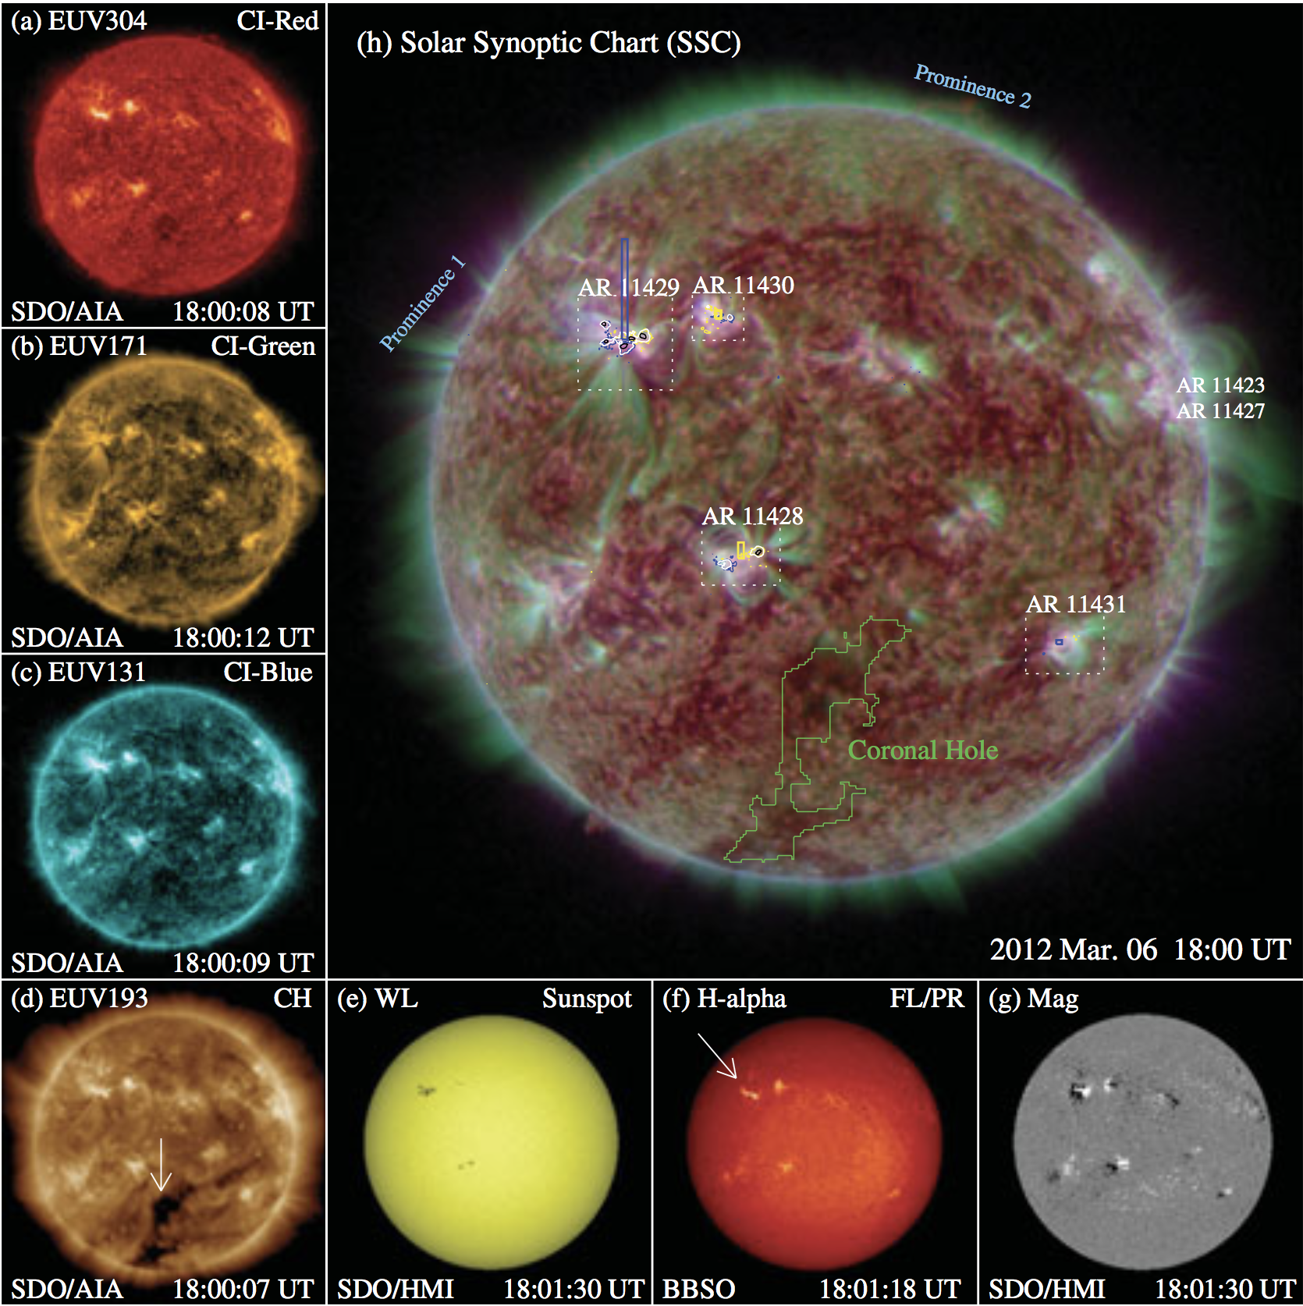
Song et al. (2015)
Notes:
Song et al. 2015
- stable segmentation on short time scales in absence of major activity
- consistent smooth trends and classifications over long periods of time
- consistency with human drawn maps
Other work is largely unsupervised

Slide 12
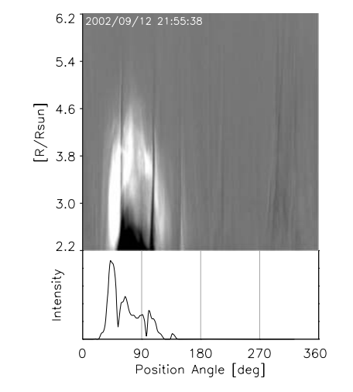
Unsupervised approaches
1. Edge based: dilation, erosion, top hat
2. Region based: histogram segmentation, clustering, region growing
3. Hybrid: Spatial Possibilistic Classification Algorithm (SPoCA)
Olmedo et al.(2008)

Slide 13
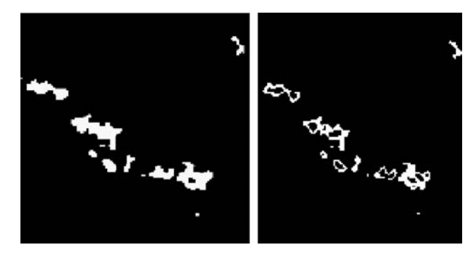
Revathy, Lekshmi, & Nayar (2005)

Slide 14
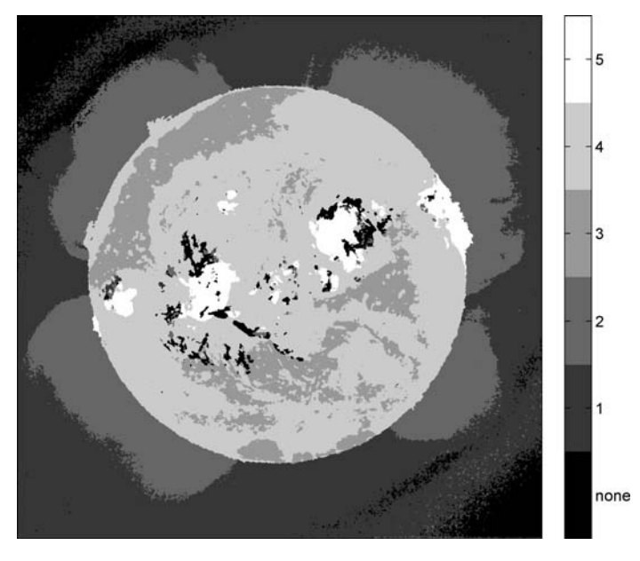
Supervised approaches
Variations on
Bayesian classifier:
De Wit (2006)
Rigler et al. (2012)
De Visscher et al. (2015)
ANN Flare identification:
Borda et al. (2002)
De Wit (2006)

Slide 15
Data Sources:
Solar Imagery and Annotations

Slide 16
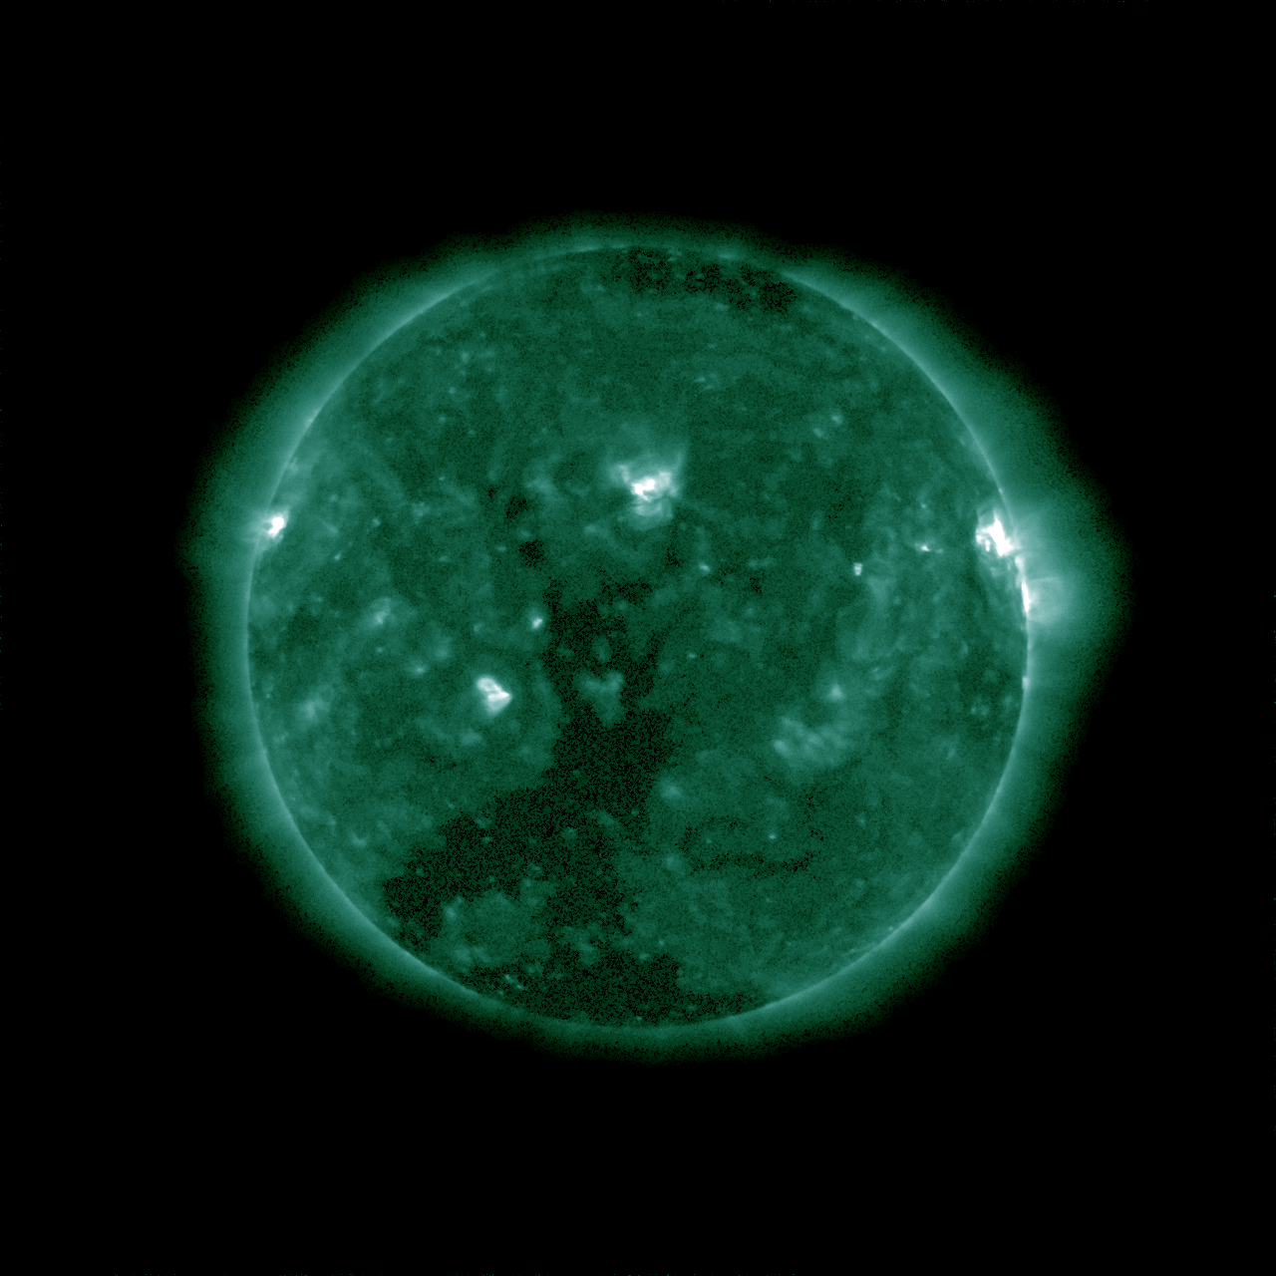
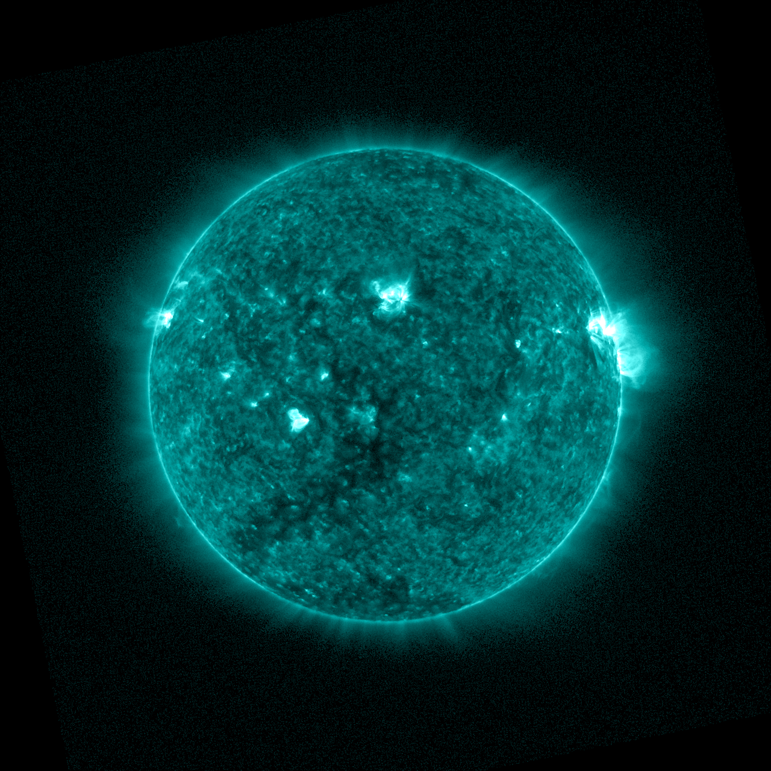
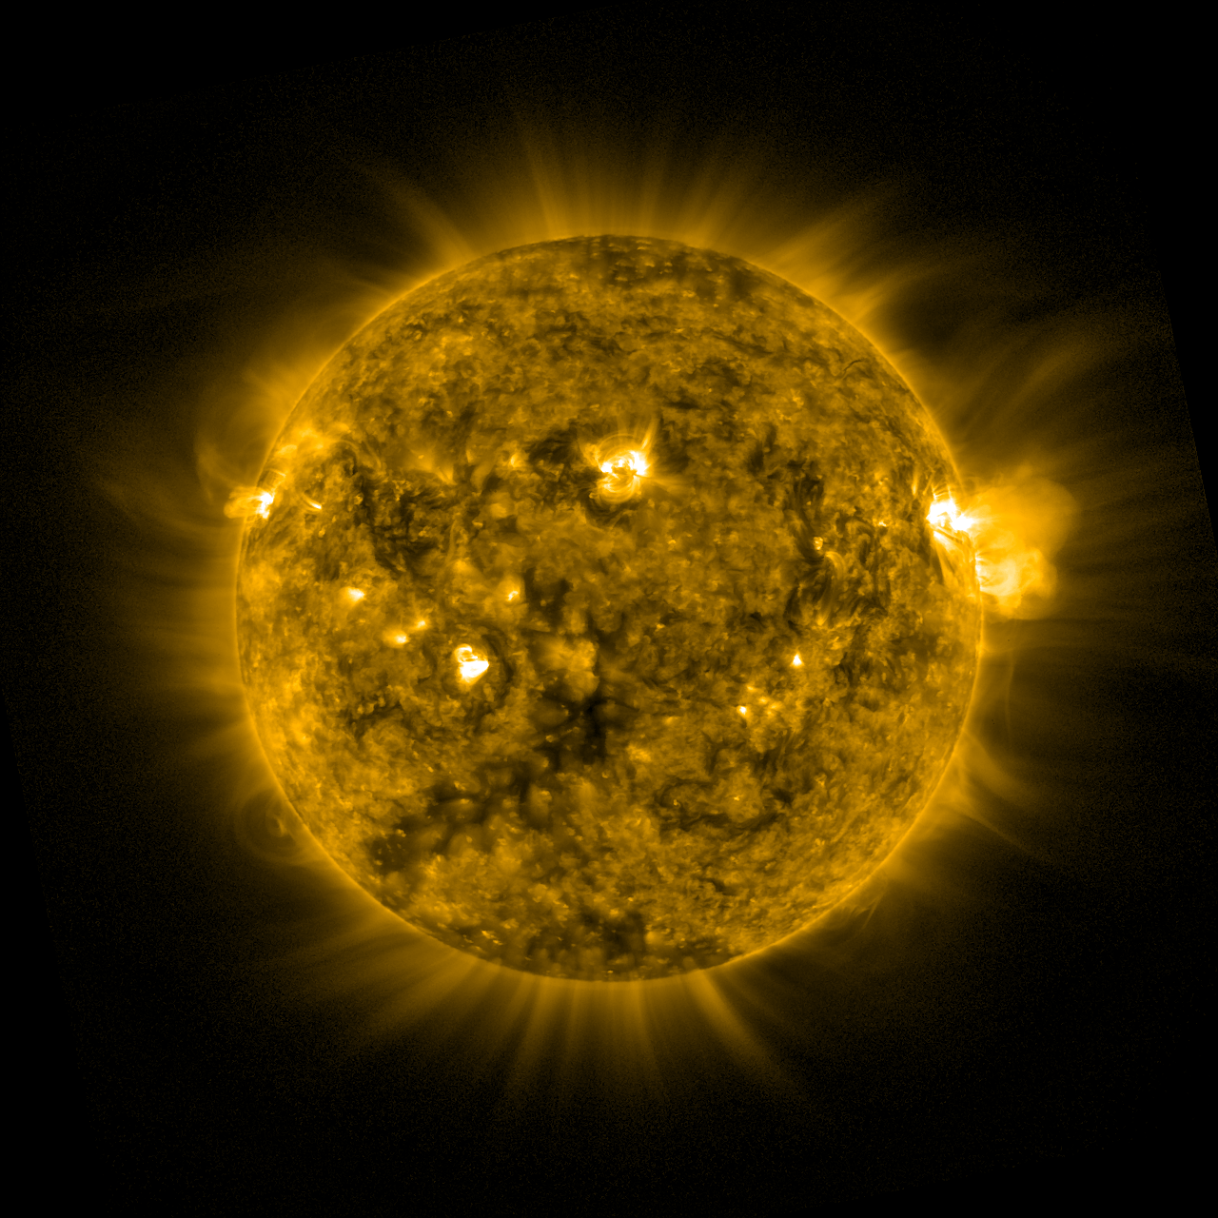
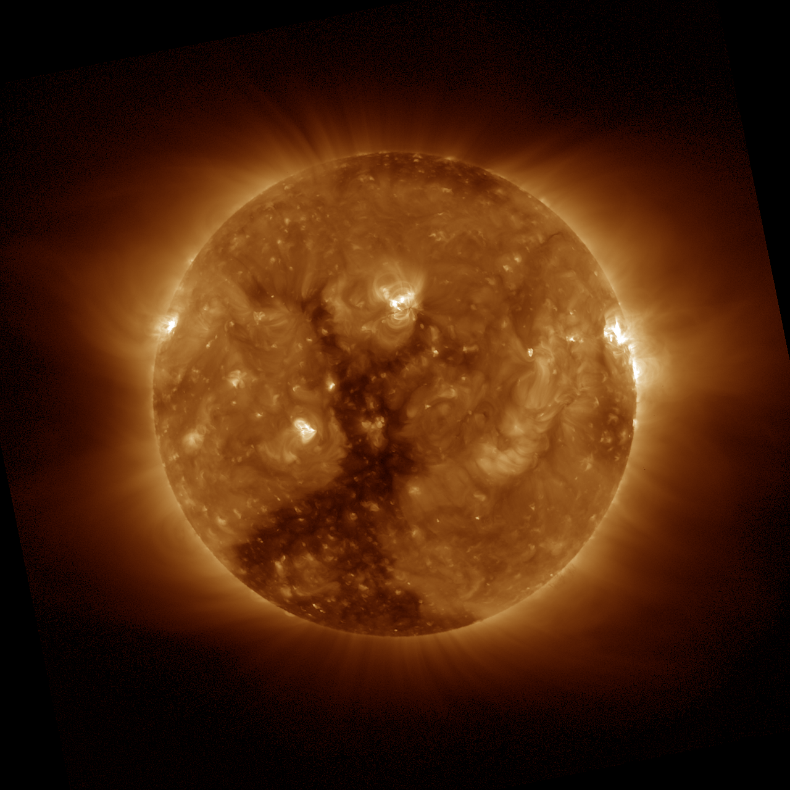
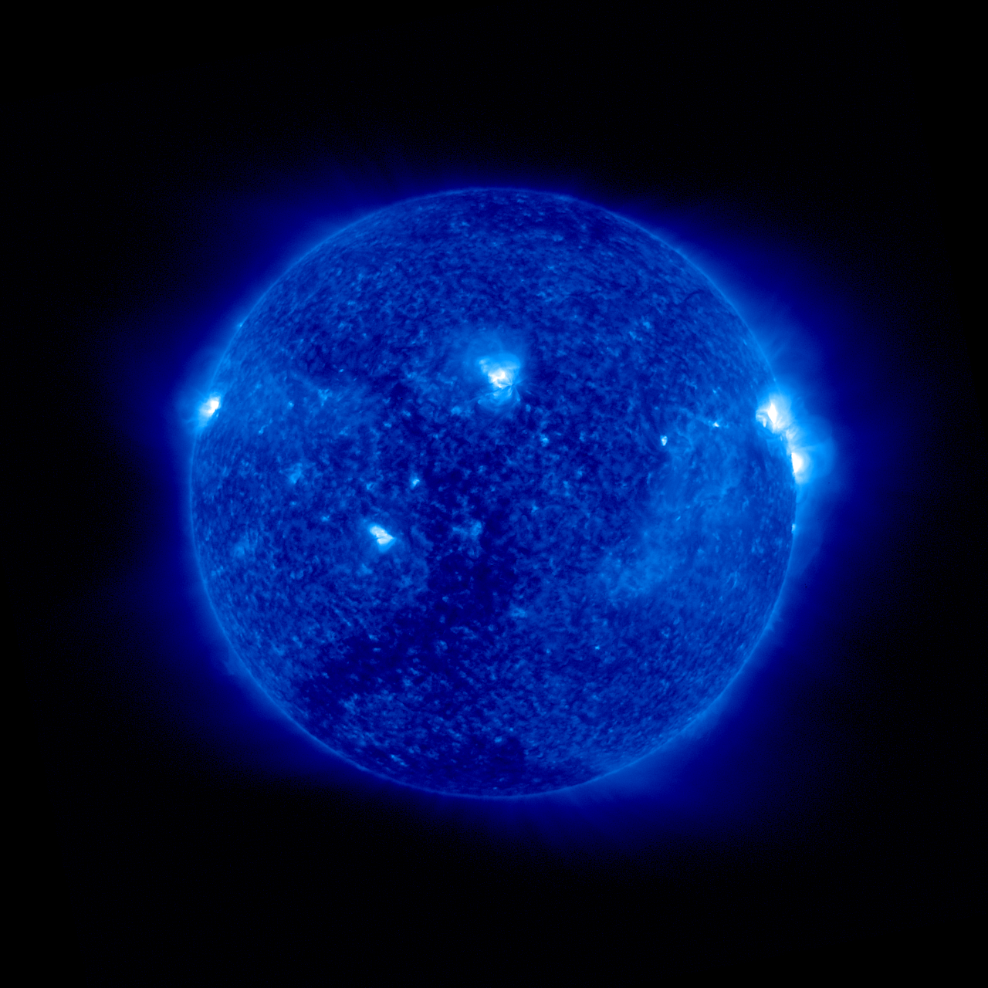
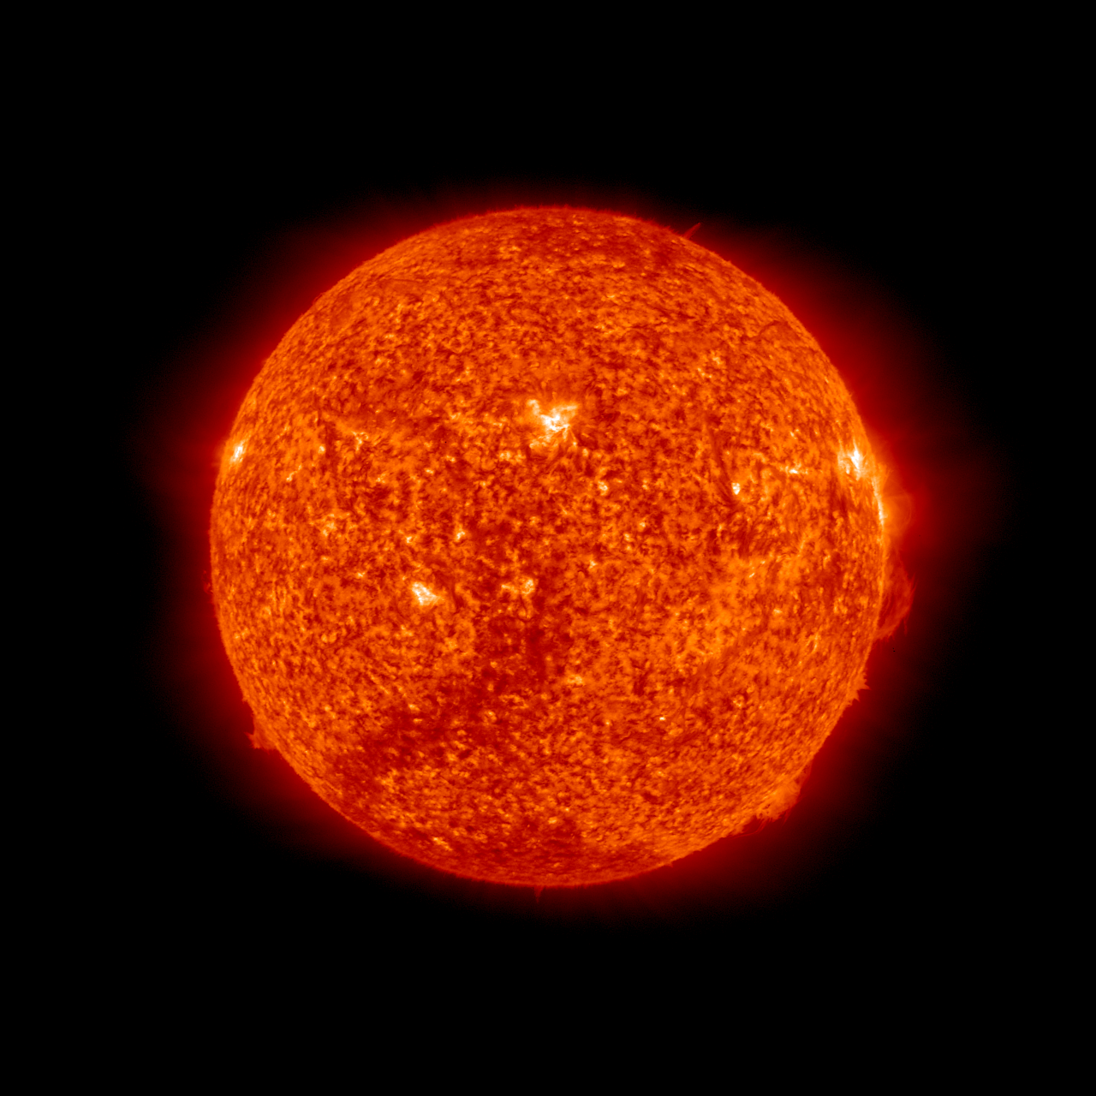
GOES-R/SUVI EUV Passbands
6.8
6.8
5.6,7.0
5.8
6.1
6.3
4.7

Slide 17
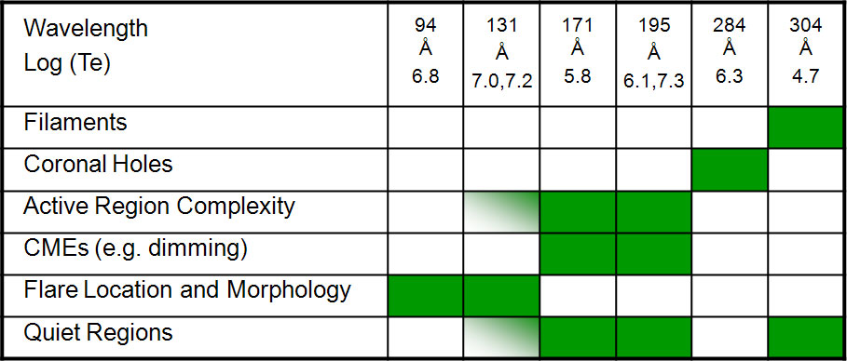

Slide 18
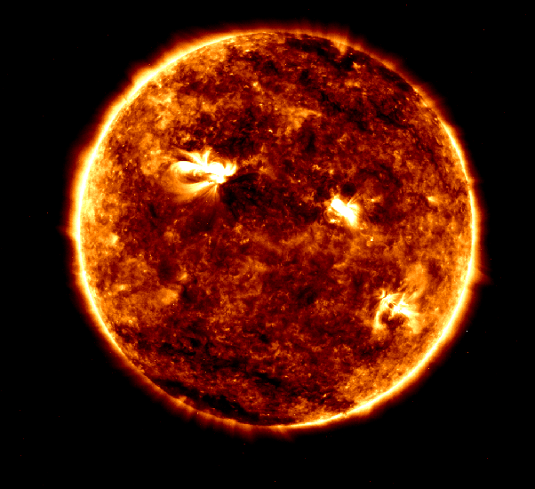
Data available now!
(as of May 5th)
bit.ly/suvidata
The Sun this morning!

Slide 19
Data Preparation

Slide 20
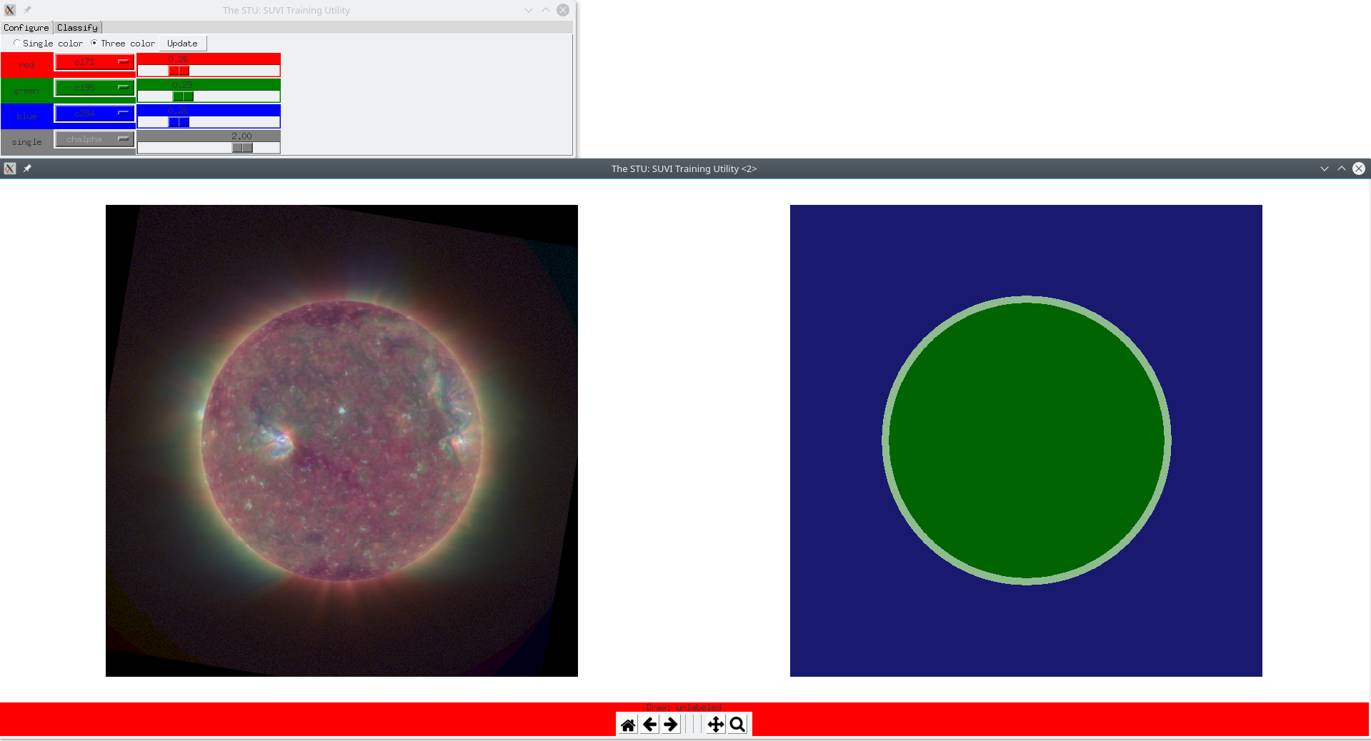
Human Annotation

Slide 21
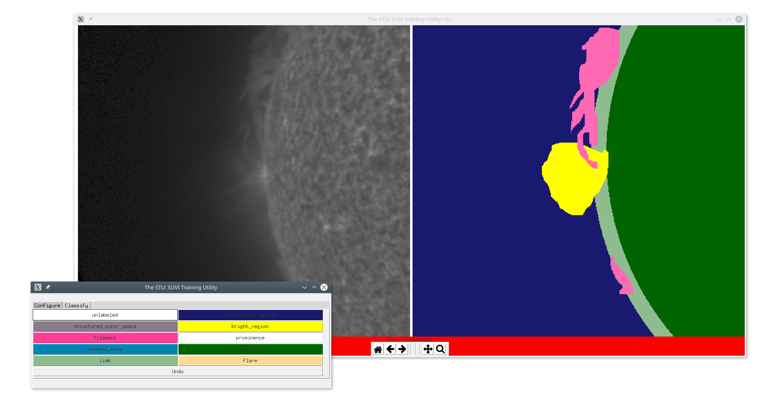
Human Annotation

Slide 22
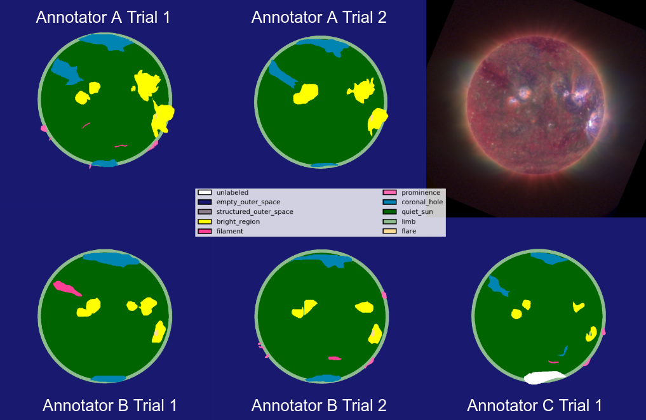
Annotator Comparison

Slide 23
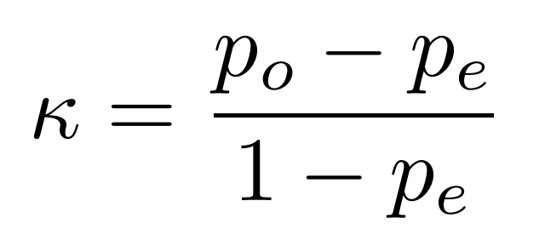
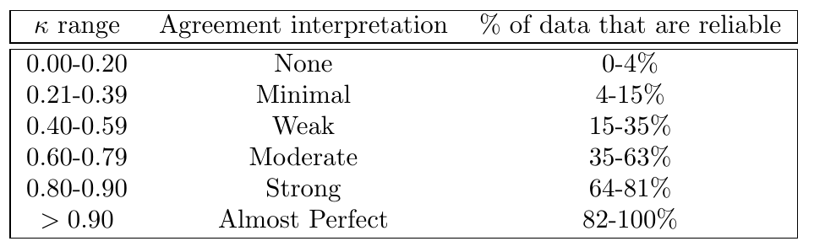
Cohen’s Kappa
Quantifies agreement

Slide 24
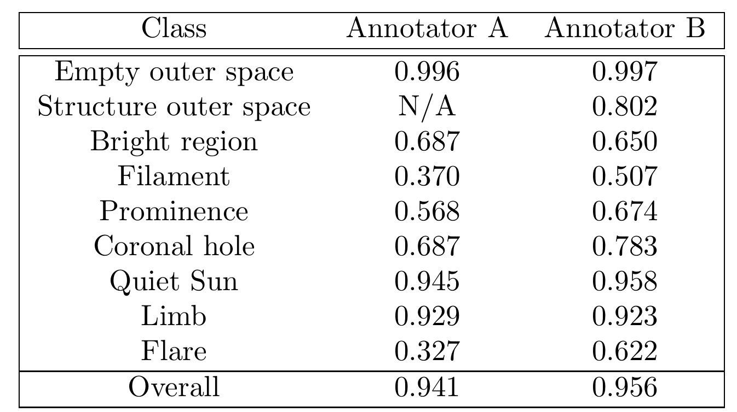
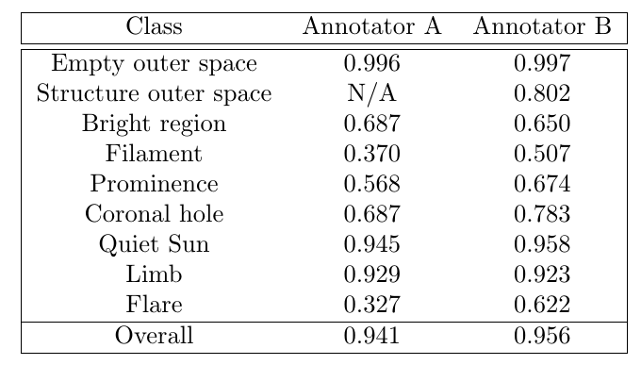
How consistent are annotators?

Slide 25
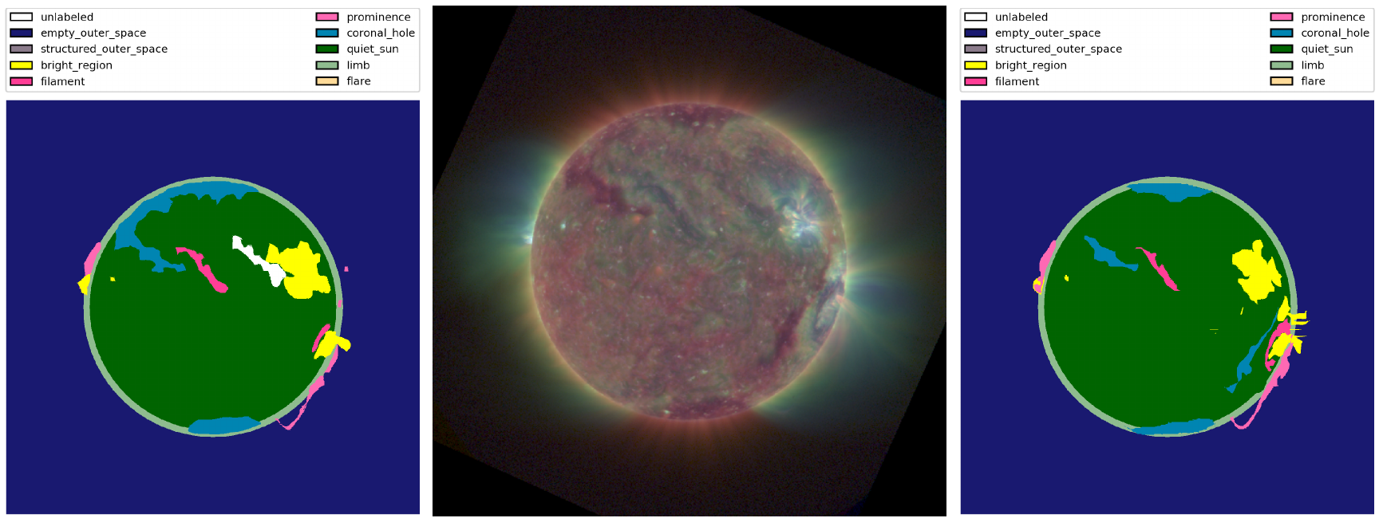
Annotator Inconsistency

Slide 26
Do annotators agree with each other?

Slide 27
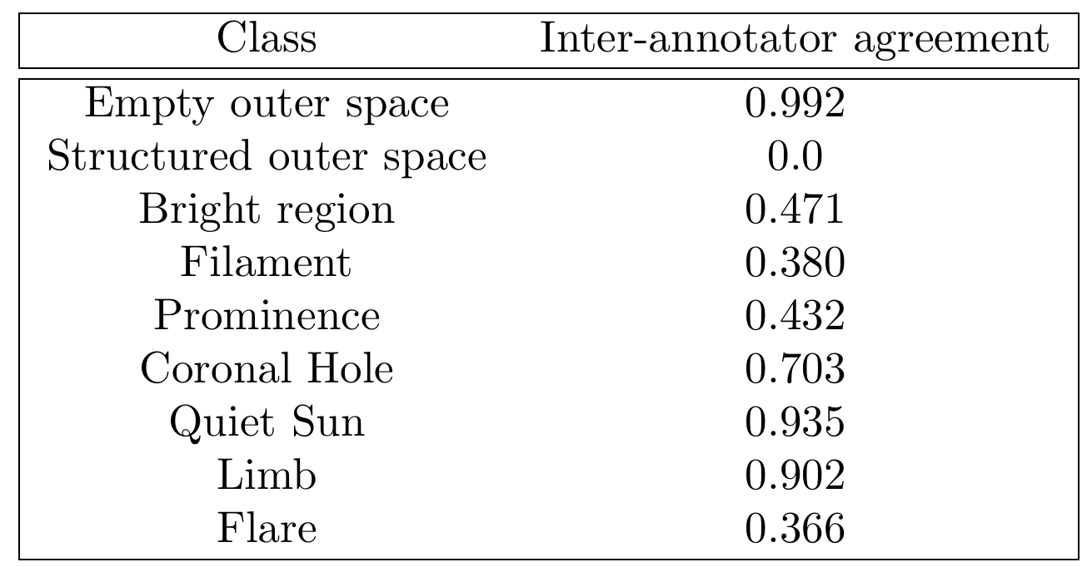
How consistent are annotators?

Slide 28
Machine Learning Time!

Slide 29
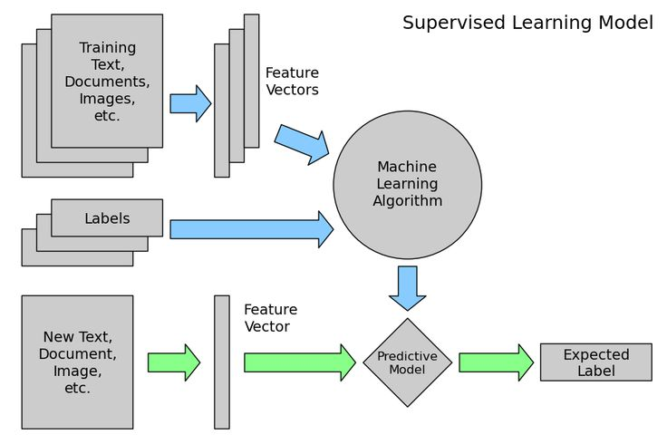
http://jeremy.kiwi.nz/pythoncourse/2016/04/01/lesson07rd.html

Slide 30
Pixel Approach

Slide 31
Classifiers

Slide 32
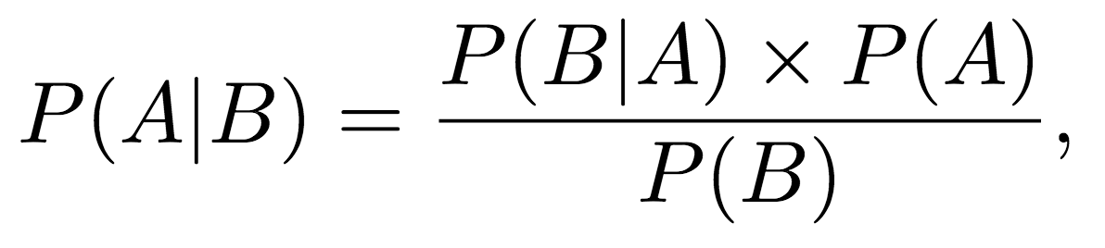
Bayesian Model
Probability of a pixel given a
class
Probability of a class
Probability of a class given a pixel
Probability of a pixel
Notes:
Probability of a pixel is independent of class, ignore it
Probability of a class could be though of as uniform

Slide 33
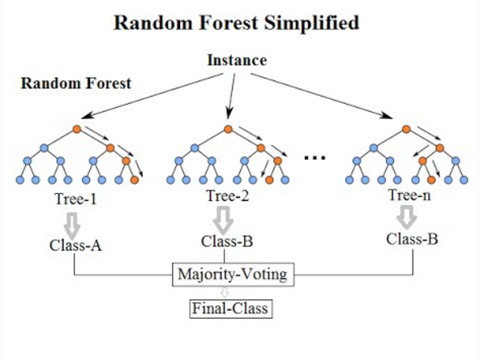
Random Forest
https://medium.com/@williamkoehrsen/random-forest-simple-explanation-377895a60d2d

Slide 34
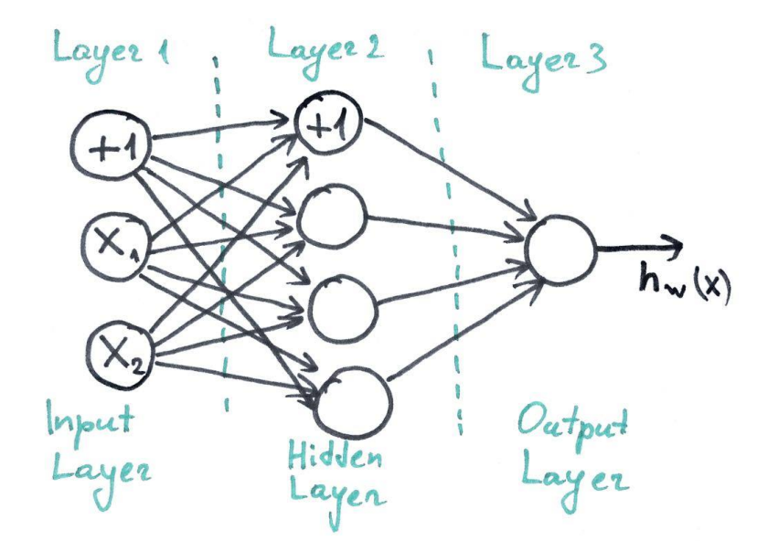
Neural Network

Slide 35
Experiments

Slide 36
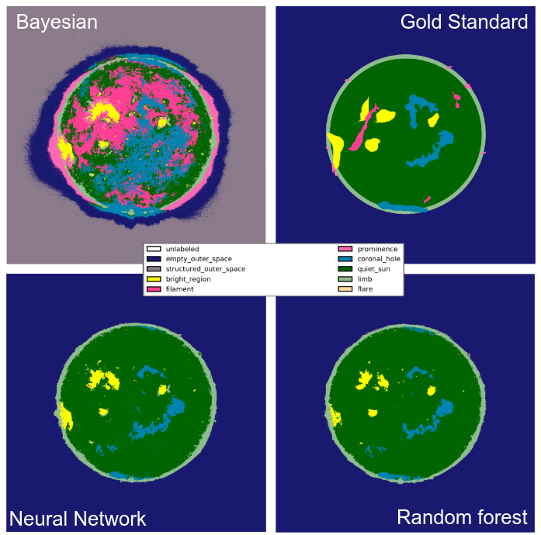
Baseline

Slide 37
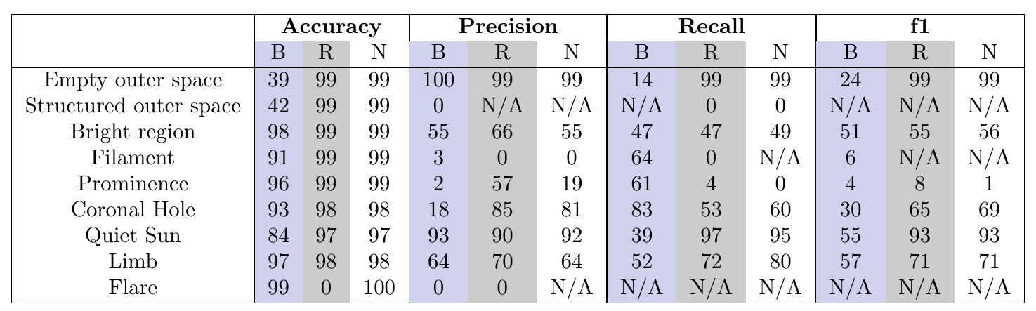
Baseline
Notes:
Precision is defined as: TP}{TP + FP}
It measures the ability of the classifier to not label a pixel the given class when it is not. Recall is another metric that characterizes the classifier's ability to identify all pixels of a given class:
\[\text{recall} = \frac{TP}{TP + FN}\]
Both precision and recall are important but are often anti-correlated. The f1 score combines them:
\[\text{f1} = \frac{2 \times \text{precision} \times \text{recall}}{\text{precision} + \text{recall}}\]

Slide 38
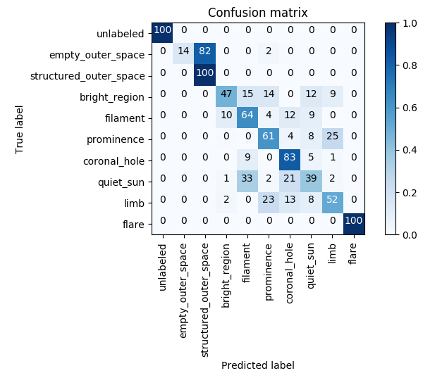
Bayesian

Slide 39
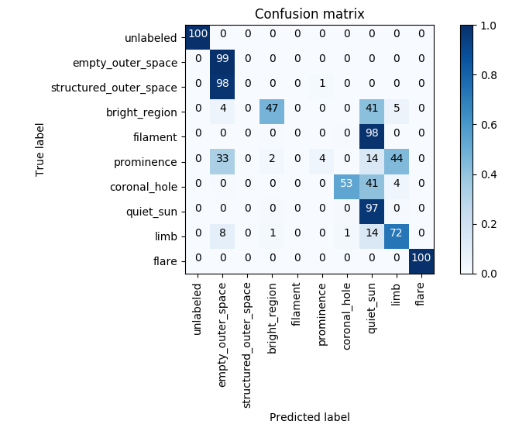
Random Forest

Slide 40
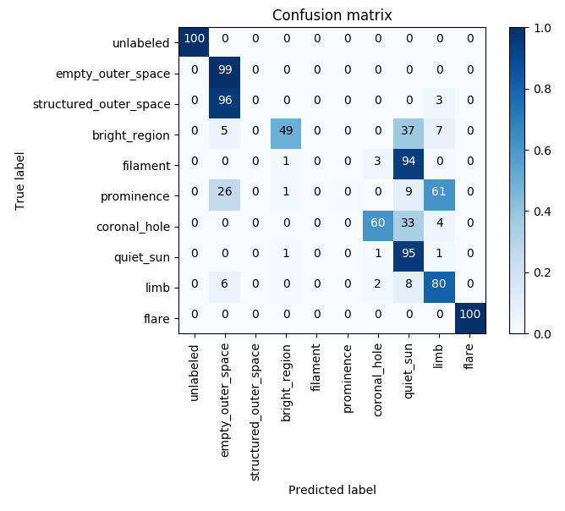
Neural Network

Slide 41
Issues

Slide 42
Issues

Slide 43
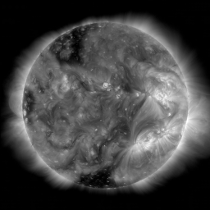
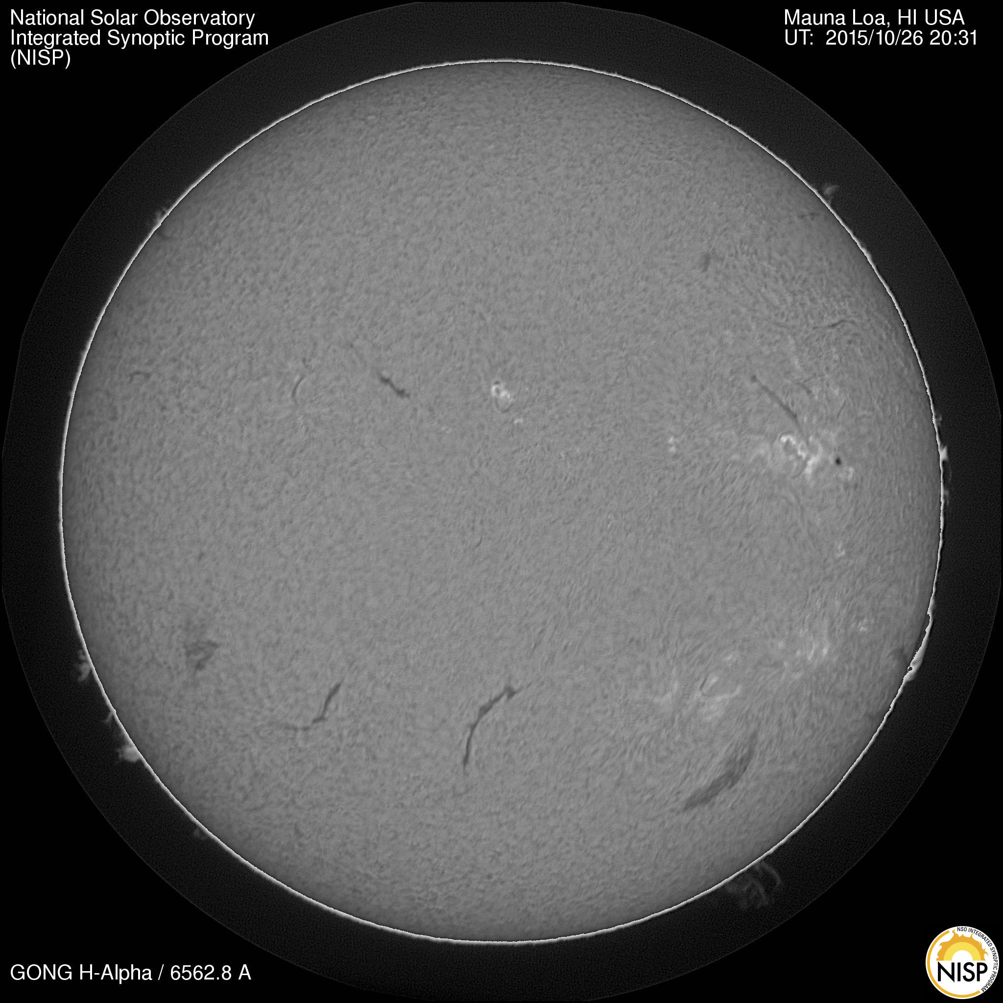
H-alpha

Slide 44
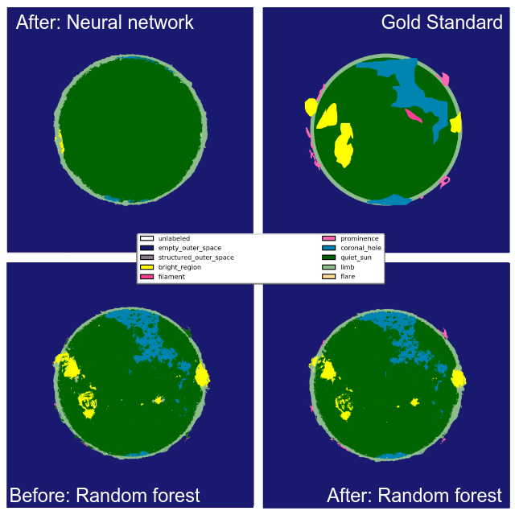

Slide 45
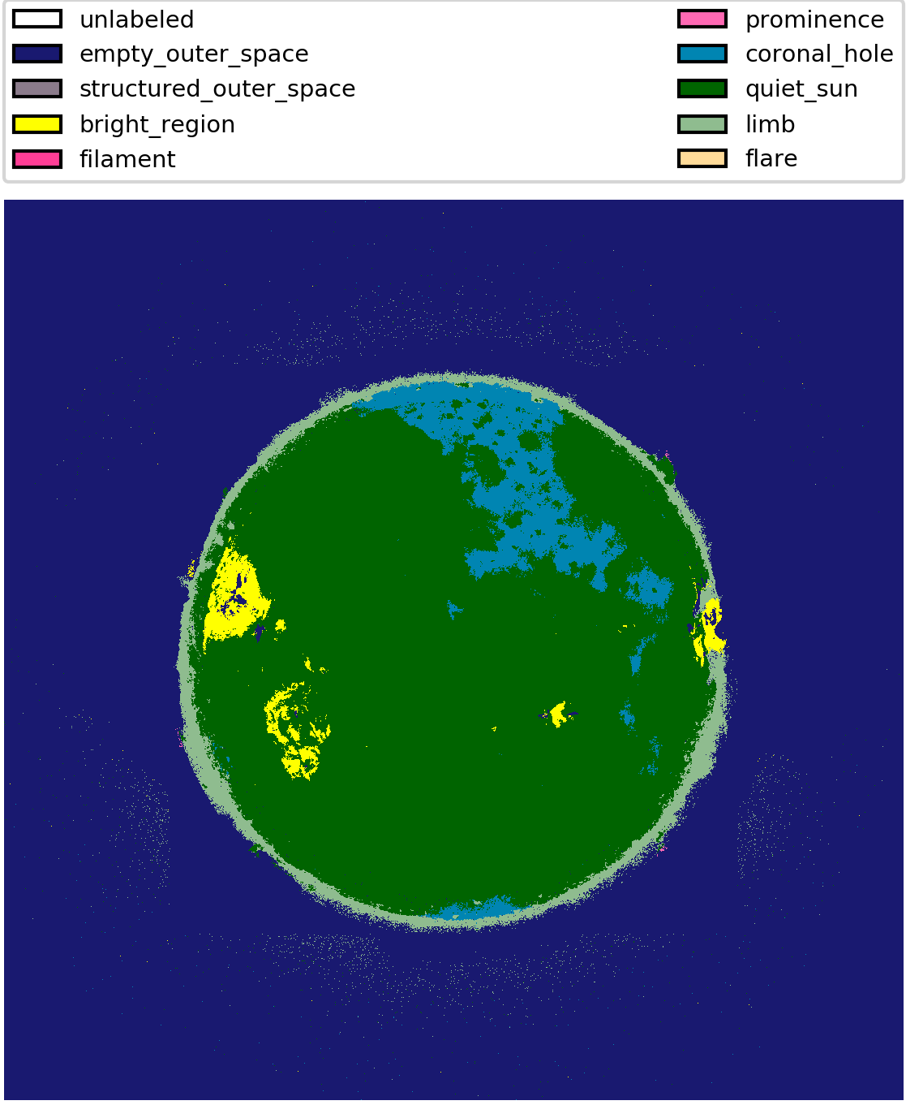
Line ratios?

Slide 46
Spatial Structure?

Slide 49
Applications

Slide 50
Database
Condense thematic maps into database:
  Width and height
  Minimum, average, and maximum brightness
  Percentiles of brightness
  Times
  Area

Slide 51
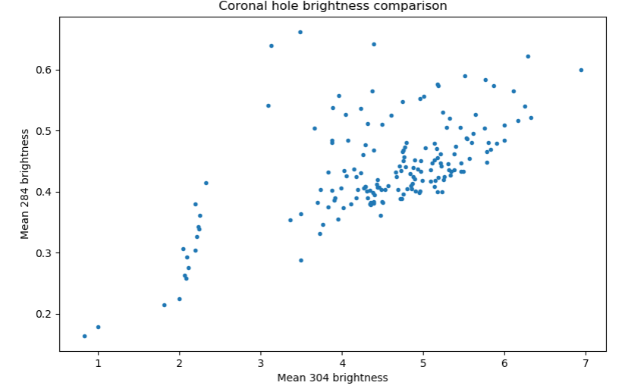
Database

Slide 52
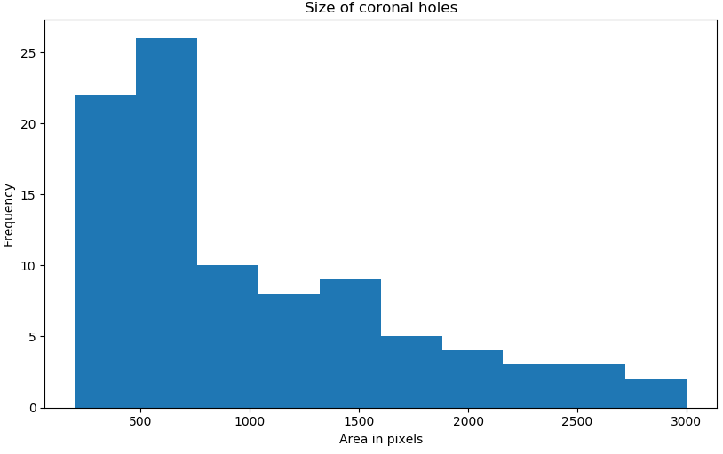
Database

Slide 53
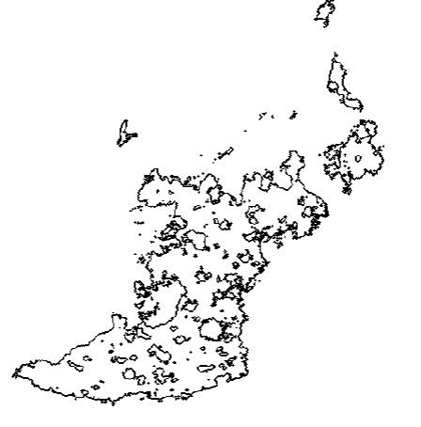
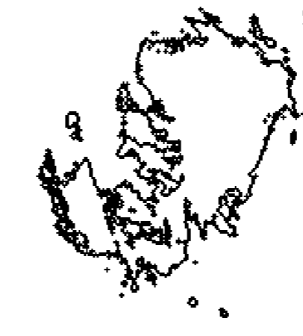
Fractal Dimension
Coronal hole:
1.26 +/- 0.06
Active regions:
1.15 +/- 0.12

Slide 54
Future Possibilities
Enlarge database by forecaster deployment and synoptic map processing
Focusing on filaments
Investigating prediction ability
Exploring issue of machine learning with inconsistent training

Slide 56
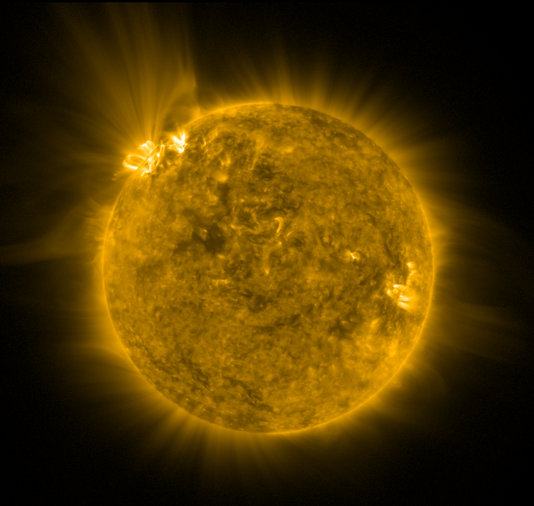
Questions?
GOES-16 and SUVI data are still in a preliminary state and may contain errors. SUVI data should not be used operationally and the user assumes all responsibility for use of the data
Notes:
. McAteer et al. (2015) utilized magnetograms from the SOHO mission to compare the fractal dimension of active regions to their classification and flare rate and found that the dimension was invariant under classification at least 1.2 to produce M-class flares or stronger \cite{mcateer+2005}.
Aschwanden and Aschwanden (2008) found that flares in their sample, including a strong M-class flare, had fractal dimensions ranging from 1.0 to 1.89
On the other hand Georguilis (2012) argued that fractal dimension is insufficiently differentiating to determine if an active region will flare or not \cite{Georgoulis2012}.

