Slide 1
eastwest
TECHSTART
Your dream · Our focus
QR Payment Platform
Infrastructure Design Review
TechStart · a group under EastWest ITG
HA · Scalability · Observability · BSP readiness
Notes:
Hands-on infrastructure design review. We present the current build, then the four platform topics we need input on: high availability, scalability on Kubernetes, observability, and BSP readiness. Final slide is left blank to capture the infra team's feedback live.

Slide 2
OVERVIEW
What we built
1
The product
2
The build
3
Where it runs
4
What we need
Customer scans a QR at checkout
Pays from their bank account
Merchant order releases on payment
2 Python / Flask services
One database each
Integrated over REST
AWS EC2 — dev / test
Azure ACI — production
Jenkins build and deploy
Review of HA and scaling
Observability direction
BSP readiness check
Verified end to end
31.00
1,469.00
300 s
2 s
2
order total
settled
payer balance
after debit
QR validity
window
merchant status
poll interval
services, 2
databases
Figures observed from both services executed end to end, not estimated.
eastwest
TechStart · EastWest ITG
2
Notes:
Keep this to 60 seconds. The five numbers prove the thing actually runs.

Slide 3
SCOPE
Business requirements and assumptions
Requirements — as built
Assumptions
# | Requirement | Status
1 | Customer pays a merchant by scanning a QR code | Working
2 | QR expires automatically after 5 minutes | Working
3 | A QR cannot be paid twice | Working
4 | Merchant sees payment without refreshing | Working
5 | Order releases only after funds actually move | Gap
6 | Platform survives losing one instance | Gap
Azure and AWS accounts are lab, not production
Prototype volume — no throughput target agreed
Services stay separately deployable
Existing Kubernetes manifests are the intended runtime
If an assumption is wrong
The one functional gap
The merchant order is marked paid before the money moves. Two databases commit one after the other, so a failure between them leaves an order paid with no matching debit.
Lab → production changes urgency, not the plan
A volume target changes all sizing here
A shared ITG cluster changes the Kubernetes plan
eastwest
TechStart · EastWest ITG
3
Notes:
Requirements 1-4 work. 5 and 6 are the two we want the infra team's view on.

Slide 4
JOURNEY
User flow
User
E-Commerce Checkout
items + total
Generate QR
valid 5 minutes
Scan QR
QR valid?
NO
Back to store
get a new QR
YES
YES
NOT LOGGED IN
Payment Details
items + total
Logged in?
Login
Confirm
Cancel
Guards in the flow
Expiry — 300 s
Single use per order
Live status re-check before debit
Balance check
Process Payment
No amount deducted
Payment complete
QR scan screen
Flow reviewed against the code: QR validity is 300 seconds (5 minutes).
eastwest
TechStart · EastWest ITG
4
Notes:
This mirrors the flow diagram from the team, corrected to the 300 s the code actually uses.

Slide 5
ARCHITECTURE
Target architecture — hub and spoke
One region, one hub, four spokes. No workload endpoint reachable from the internet.
One banking payment, phone to database
1
Front Door Premium TLS ends here; WAF; the only way in
2
Application Gateway WAF v2 internal — the Private Link origin
3
API Management Premium checks the sign-in token first
4
AKS private cluster the banking app; no public API server
5
Azure Firewall Premium inspects everything outbound
6
Banking endpoint reaches bankdb only
7
PostgreSQL — bankdb accounts, ledger, transactions
Why this shape
Spokes peer with the hub only — apps cannot reach each other
Service Bus is the only link between the apps
Core banking over ExpressRoute, never the internet
Open with the infra team
Singapore region — cross-border basis and BSP notice required
eastwest
TechStart · EastWest ITG
5
Notes:
Walk the seven numbers, then stop. Two things to raise: the Service Bus decision, because it is what fixes the two-database gap on the next slide, and the Singapore region, because Azure has no PH region and that needs a legal basis, not engineering.

Slide 6
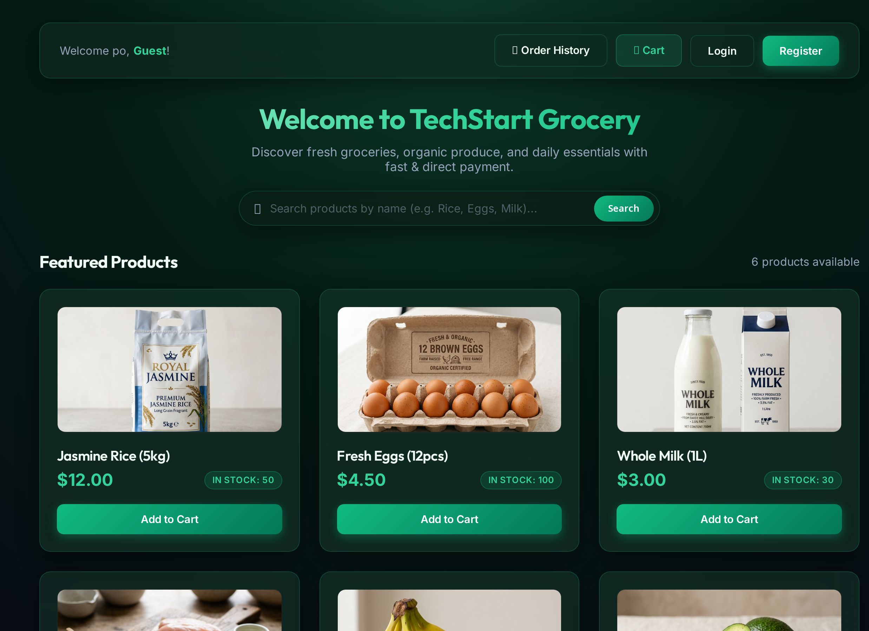
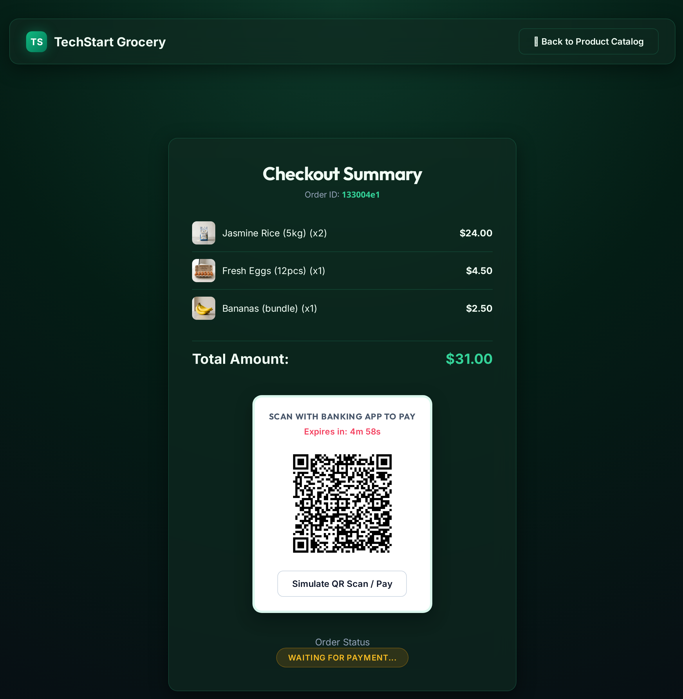
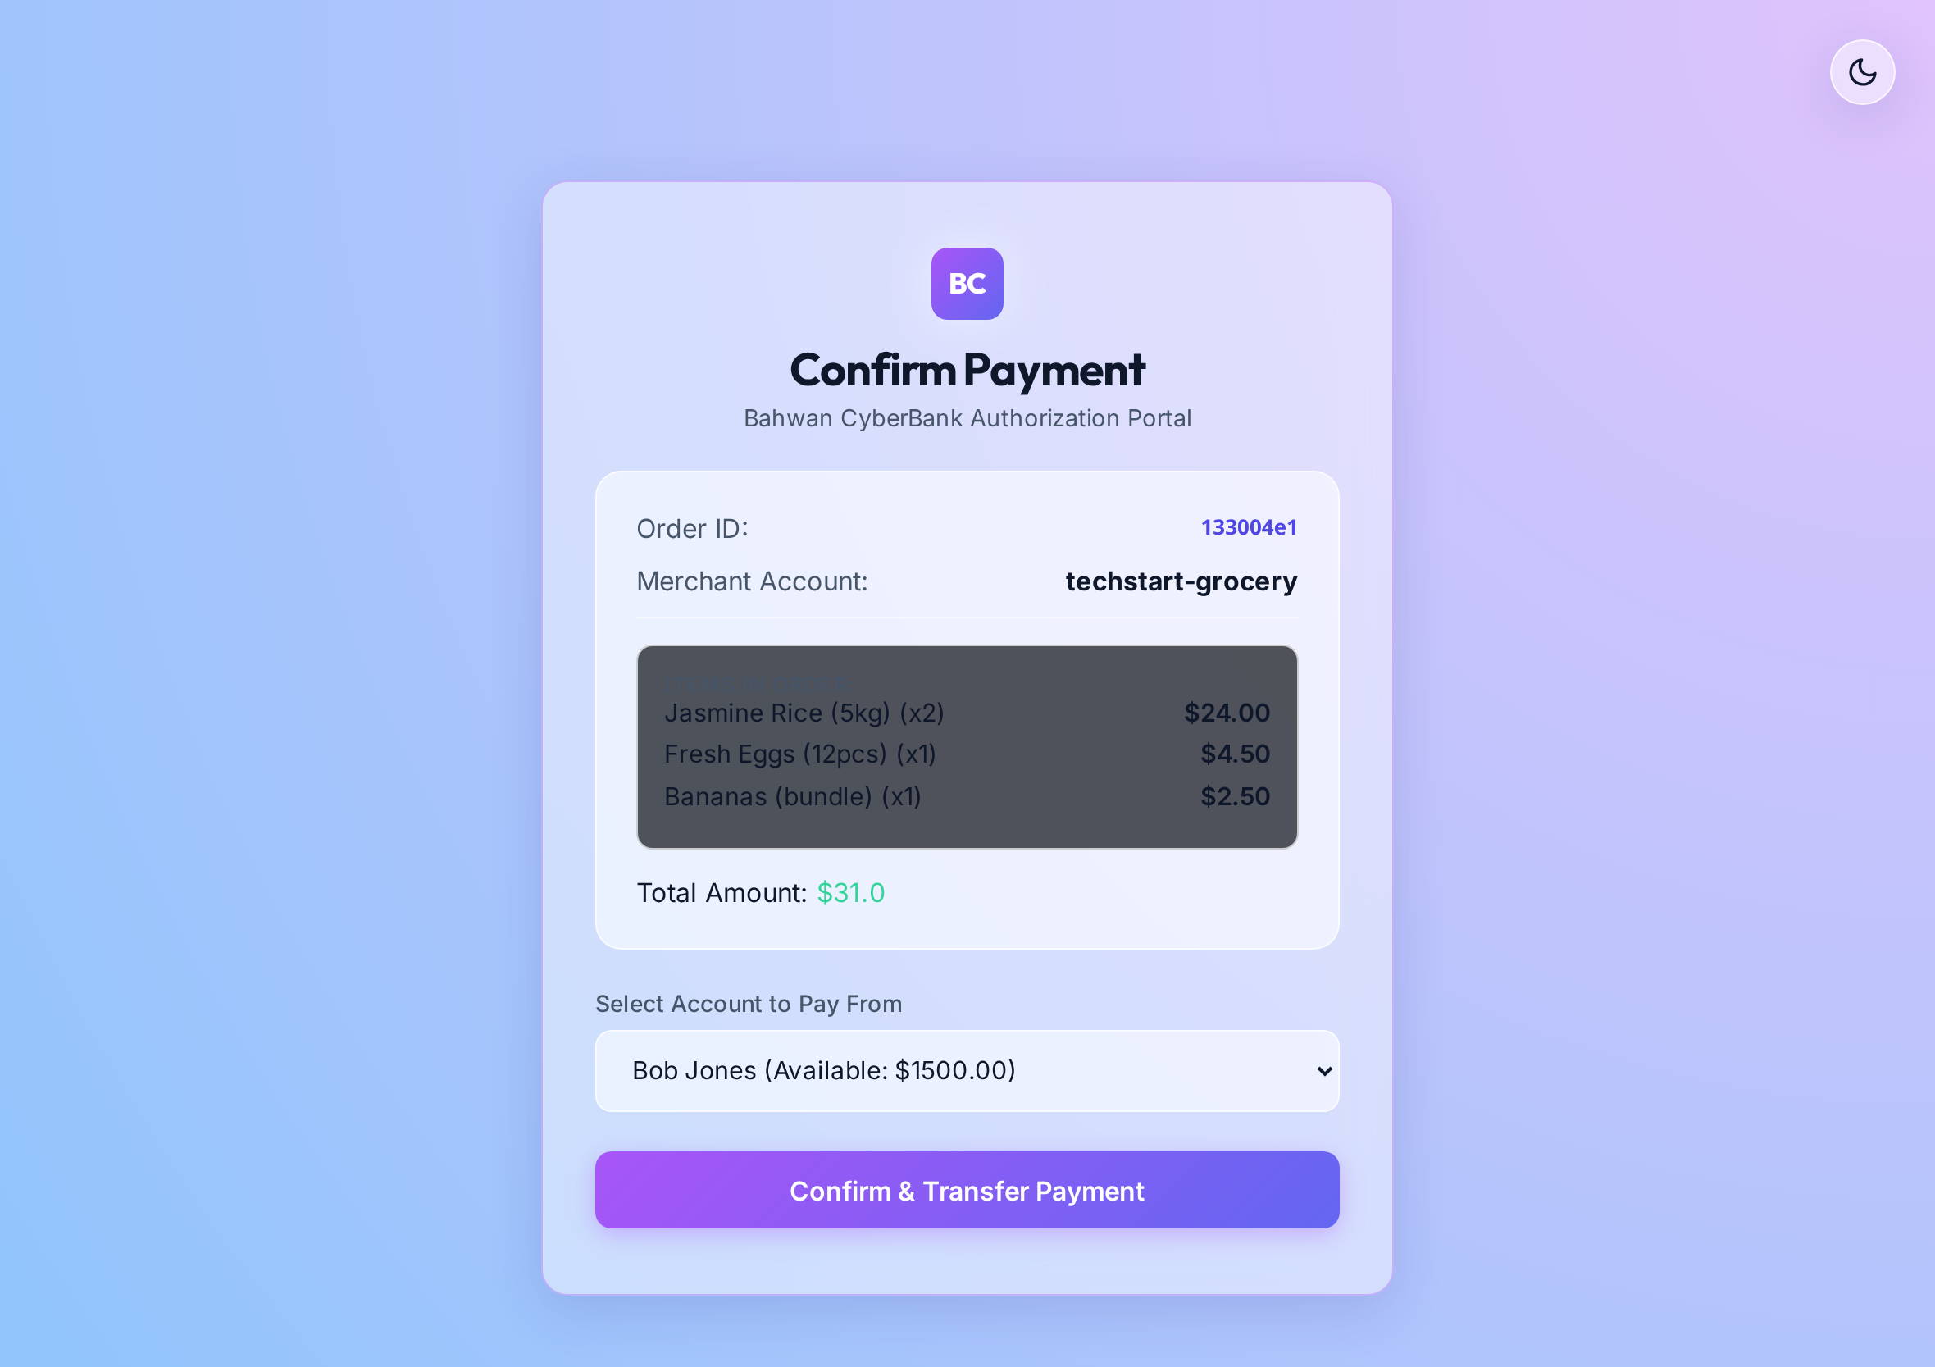
DEMO
The application, running
Merchant catalogue
QR presented at checkout
Authorising in the bank app
Live captures from both services running end to end. Images are placed at their true aspect ratio.
eastwest
TechStart · EastWest ITG
6
Notes:
Thirty seconds. The point is that it works, so the conversation can be about the platform.

Slide 7
RUNTIME
How a payment moves
Customer
Merchant app
Merchant DB
Bank app
Bank DB
1 checkout — create order
2 save order · PENDING · 300 s
3 show QR
4 scan QR, log in, confirm
5 check the order is still payable
6 tell merchant it is paid
7 commit 1 — order PAID
8 commit 2 — money moves
9 receipt
Steps 7 and 8
Two commits, two databases, nothing joining them. This is the gap.
eastwest
TechStart · EastWest ITG
7
Notes:
Nine steps. Land on 7 and 8 — that is the design question for the infra team.

Slide 8
TOPIC 1 OF 4
High availability
Layer | Today | What we think it should be
Edge | One Nginx container, no failover | Managed gateway, health-probed backend pool
Application | 2 containers, but no load balancer in front | 2+ replicas actually load balanced
Database | Single node, no replica | Zone-redundant managed instance
Backup | None configured, no restore ever tested | Automated backup, PITR, rehearsed restore
Deploys | Delete then recreate — outage every release | Rolling update, gated on readiness
0
100%
?
Ask the infra team
What availability target applies here?
What RPO and RTO do we design to?
Standard gateway pattern in ITG?
tiers with a redundant
instance taking traffic
of releases cause
a planned outage
RPO and RTO
never agreed
eastwest
TechStart · EastWest ITG
8
Notes:
The three numbers are the whole slide. We cannot pick RPO/RTO ourselves.

Slide 9
TOPIC 2 OF 4
Scalability on Kubernetes
Today — Azure Container Instances
Proposed — AKS
Public FQDN
per container
app-1
app-2
Ingress
+ WAF
Service
ClusterIP
Pods
HPA 2→N
Managed DB
private
No load balancer · no autoscaling · fixed count · recreate to deploy
Horizontal Pod Autoscaler · cluster autoscaler · rolling updates · probes enforced
Already done
Blockers to fix first
Ask the infra team
Deployment, Service and Secret manifests written
Liveness and readiness probes defined
Config is all environment variables
Stateless request handling
Session key is per-instance — externalise it
Service type is LoadBalancer — should be ClusterIP
Secrets are plaintext in the manifest
No connection pooling for the database
AKS or Container Apps for this workload?
Is there a shared ITG cluster we join?
What scales it — CPU, or requests per second?
Who owns the manifests after handover?
eastwest
TechStart · EastWest ITG
9
Notes:
Our strongest slide: the manifests exist. The lift is smaller than it looks.

Slide 10
TOPIC 3 OF 4
Observability
Logs
Metrics
Traces
NOW
print() to stdout, lost on redeploy
NOW
None collected
NOW
No correlation ID between services
TARGET
Container Insights → Log Analytics, structured JSON
TARGET
Azure Monitor, workload dashboards
TARGET
OpenTelemetry → App Insights
What this costs us today
Ask the infra team
A failed payment is discovered by the customer, not by us
An incident cannot be reconstructed after the fact
/health exists — but nothing is configured to call it
No dashboard, no alert, no on-call signal
Standard ITG logging stack for us to use?
Azure Monitor or Dynatrace?
Who receives the alerts?
eastwest
TechStart · EastWest ITG
10
Notes:
The /health line usually lands hardest: we built the probe and never wired it up.

Slide 11
TOPIC 4 OF 4
BSP readiness
Instrument | Requirement | Where we stand
Circular 1055 | QR Ph — EMVCo standard, signed payload | Not met — our QR is a plain URL
Circular 1198 | Merchant onboarding, settlement, disputes | Not met — no KYC or settlement
MORB App. 75 | Encryption in transit and at rest, key management | Not met — HTTP throughout
Circular 1140 | Technology outsourcing, exit plan, BCP | Partial — no exit or BCP yet
RA 10173 (DPA) | Lawful basis for cross-border data transfer | Open — data sits in centralindia
RA 9160 (AMLA) | Covered and suspicious transaction reporting | Not met — no reporting
The two that need a decision, not code
Ask the infra team
Cross-border data — Azure has no PH region, so a transfer basis is required
Licensing under Circular 1198 may apply before any launch
Who owns the QR Ph conformance work?
Is there an existing ITG cross-border transfer basis we inherit?
Which controls does ITG already provide centrally?
Engineering-side mapping only, not a legal opinion. Every citation to be confirmed with Compliance and Legal.
eastwest
TechStart · EastWest ITG
11
Notes:
Be careful here: we are engineers reading circulars. Present as a mapping to be confirmed, never as a compliance conclusion.

Slide 12
LIVE CAPTURE
Feedback and recommendations
To be filled in with the Infrastructure team during this session
Feedback
Recommendations
Action items · owner
eastwest
TechStart · EastWest ITG
12
Notes:
Deliberately blank. This is the hands-on part — capture the infrastructure team's feedback, their recommendations, and who owns each follow-up, live on this slide.

