Slide 1


QR Payment Platform
Solution Design
Presented by TechStart
Merchant QR generation · Bank-side scanning and authorisation · Posting in the core banking system
TechStart
1
Notes:
Solution design for a QR payment capability. The merchant channel generates the QR, the banking channel scans and authorises it, and the core banking system performs the posting. Four platform topics follow: availability, scalability, observability and regulatory alignment.

Slide 2
OVERVIEW
Solution overview
1
Merchant channel
2
Banking channel
3
Core banking
4
Confirmation
Customer checks out
Order is created
QR code is generated
Customer scans the QR
Reviews the order
Authorises the payment
Funds transfer is posted
Balances are updated
Reference is returned
Order is marked paid
Merchant is notified
Receipt is shown
Design principle
The merchant channel never holds funds and never moves money. It generates a QR that references an order. Every debit, credit and balance stays inside the core banking system.
QR is single-use
Time-bound — 300 s
Customer authenticates first
Posting happens in T24
TechStart
2
Notes:
One minute. The design principle line is the important one.

Slide 3
SCOPE
Business requirements
1
E-Commerce generates the QR at checkout, from the order
The core requirement
2
Banking app scans the QR to initiate the payment
E-Commerce
generates the QR
3
Core banking performs the posting debit payer, credit merchant
Banking App
scans the QR
4
QR is single-use and time-bound expires after 300 seconds
5
Customer authenticates before authorising
T24 — Core Banking
performs the business logic and posting
6
Merchant is notified on confirmation
7
Order and payment are traceable end to end
The bank remains the system of record.
TechStart
3
Notes:
Read requirement 1 to 3 as one sentence: the merchant generates, the bank scans, and the core banking system posts.

Slide 4
SCOPE
Assumptions
# | Assumption
1 | There are no budget constraints on the solution.
2 | A third-party payment gateway can provide this capability. This design assumes an in-house build using the bank's own channels and core system.
3 | E-Commerce is the QR generator only. It never holds funds and never moves money.
4 | The banking app is the scanning and authorisation channel only.
5 | All business logic, posting and balances remain in the core banking system.
6 | The core banking system is T24.
7 | The existing microservice and API management layer can be reused for the integration.
8 | Volumes are pilot scale. A production throughput target will be set separately.
Build vs buy
A gateway would shorten delivery
An in-house build keeps the ledger and the customer journey inside the bank
Boundary
Channels present and capture
T24 decides and records
Nothing settles outside the core
TechStart
4
Notes:
Assumption 1 and 6 are the two to confirm in the room.

Slide 5
JOURNEY
User flow
User
E-Commerce Checkout
items + total
Generate QR
valid 5 minutes
Scan QR
QR valid?
NO
Back to store
get a new QR
YES
YES
NOT YET
Payment Details
items + total
Logged in?
Login
Confirm
Cancel
Controls in the flow
Expiry — 300 s
Single use per order
Status checked before posting
Balance verified in core
Post to T24
No amount deducted
Payment complete
QR scan screen
TechStart
5
Notes:
Two outcomes: confirm posts to T24, cancel deducts nothing.

Slide 6
ARCHITECTURE
Solution architecture
Channels present and capture. The core banking system decides and records.
E-Commerce
Banking App
Microservice / APIM
T24 — Core Banking
Create order
items + total
Create Order API
Azure DB
Display QR
Return QR payload
Scan QR
Get Order API
Confirm payment
Payment API
Funds Transfer posting
debit payer · credit merchant
Order marked PAID
Update order status
Posting reference
TechStart
6
Notes:
Five rows. Note the only lane that touches money is T24, on row four. Solid arrows are requests, dashed are responses.

Slide 7
INTERFACES
System interfaces
Channels reach the core banking system through API management and a site-to-site link.
Azure Cloud
Channels
web + mobile
WAF
filters traffic
API Gateway
APIM, token check
Ingress
controller
Microservice
AKS
Database
Azure SQL
TLS in transit · no workload endpoint published directly to the internet
Site-to-Site VPN
On-Premises Data Centre
NGFW
perimeter firewall
Load balancer
distributes calls
JBoss
application server
T24
core banking
T24 remains the system of record for accounts, balances and postings
TechStart
7
Notes:
Two zones, one link. The channels never talk to T24 directly.

Slide 8
NETWORK
Network and remote access
Private connectivity between the Azure workload and the on-premises core.
Azure — spoke virtual network
On-premises data centre
Front door + WAF
public entry point
VPN gateway
terminates the tunnel
Customer
phone or browser
API Management
internal only
NGFW
inspects the traffic
AKS private cluster
no public API server
T24 application servers
JBoss
Private endpoints
database and secrets
S2S VPN
T24 core banking
system of record
VPN gateway
to the data centre
Redundant tunnels are used so the link to the core is not a single point of failure.
TechStart
8
Notes:
Point at the VPN: redundant tunnels, and the AKS API server is private.

Slide 9
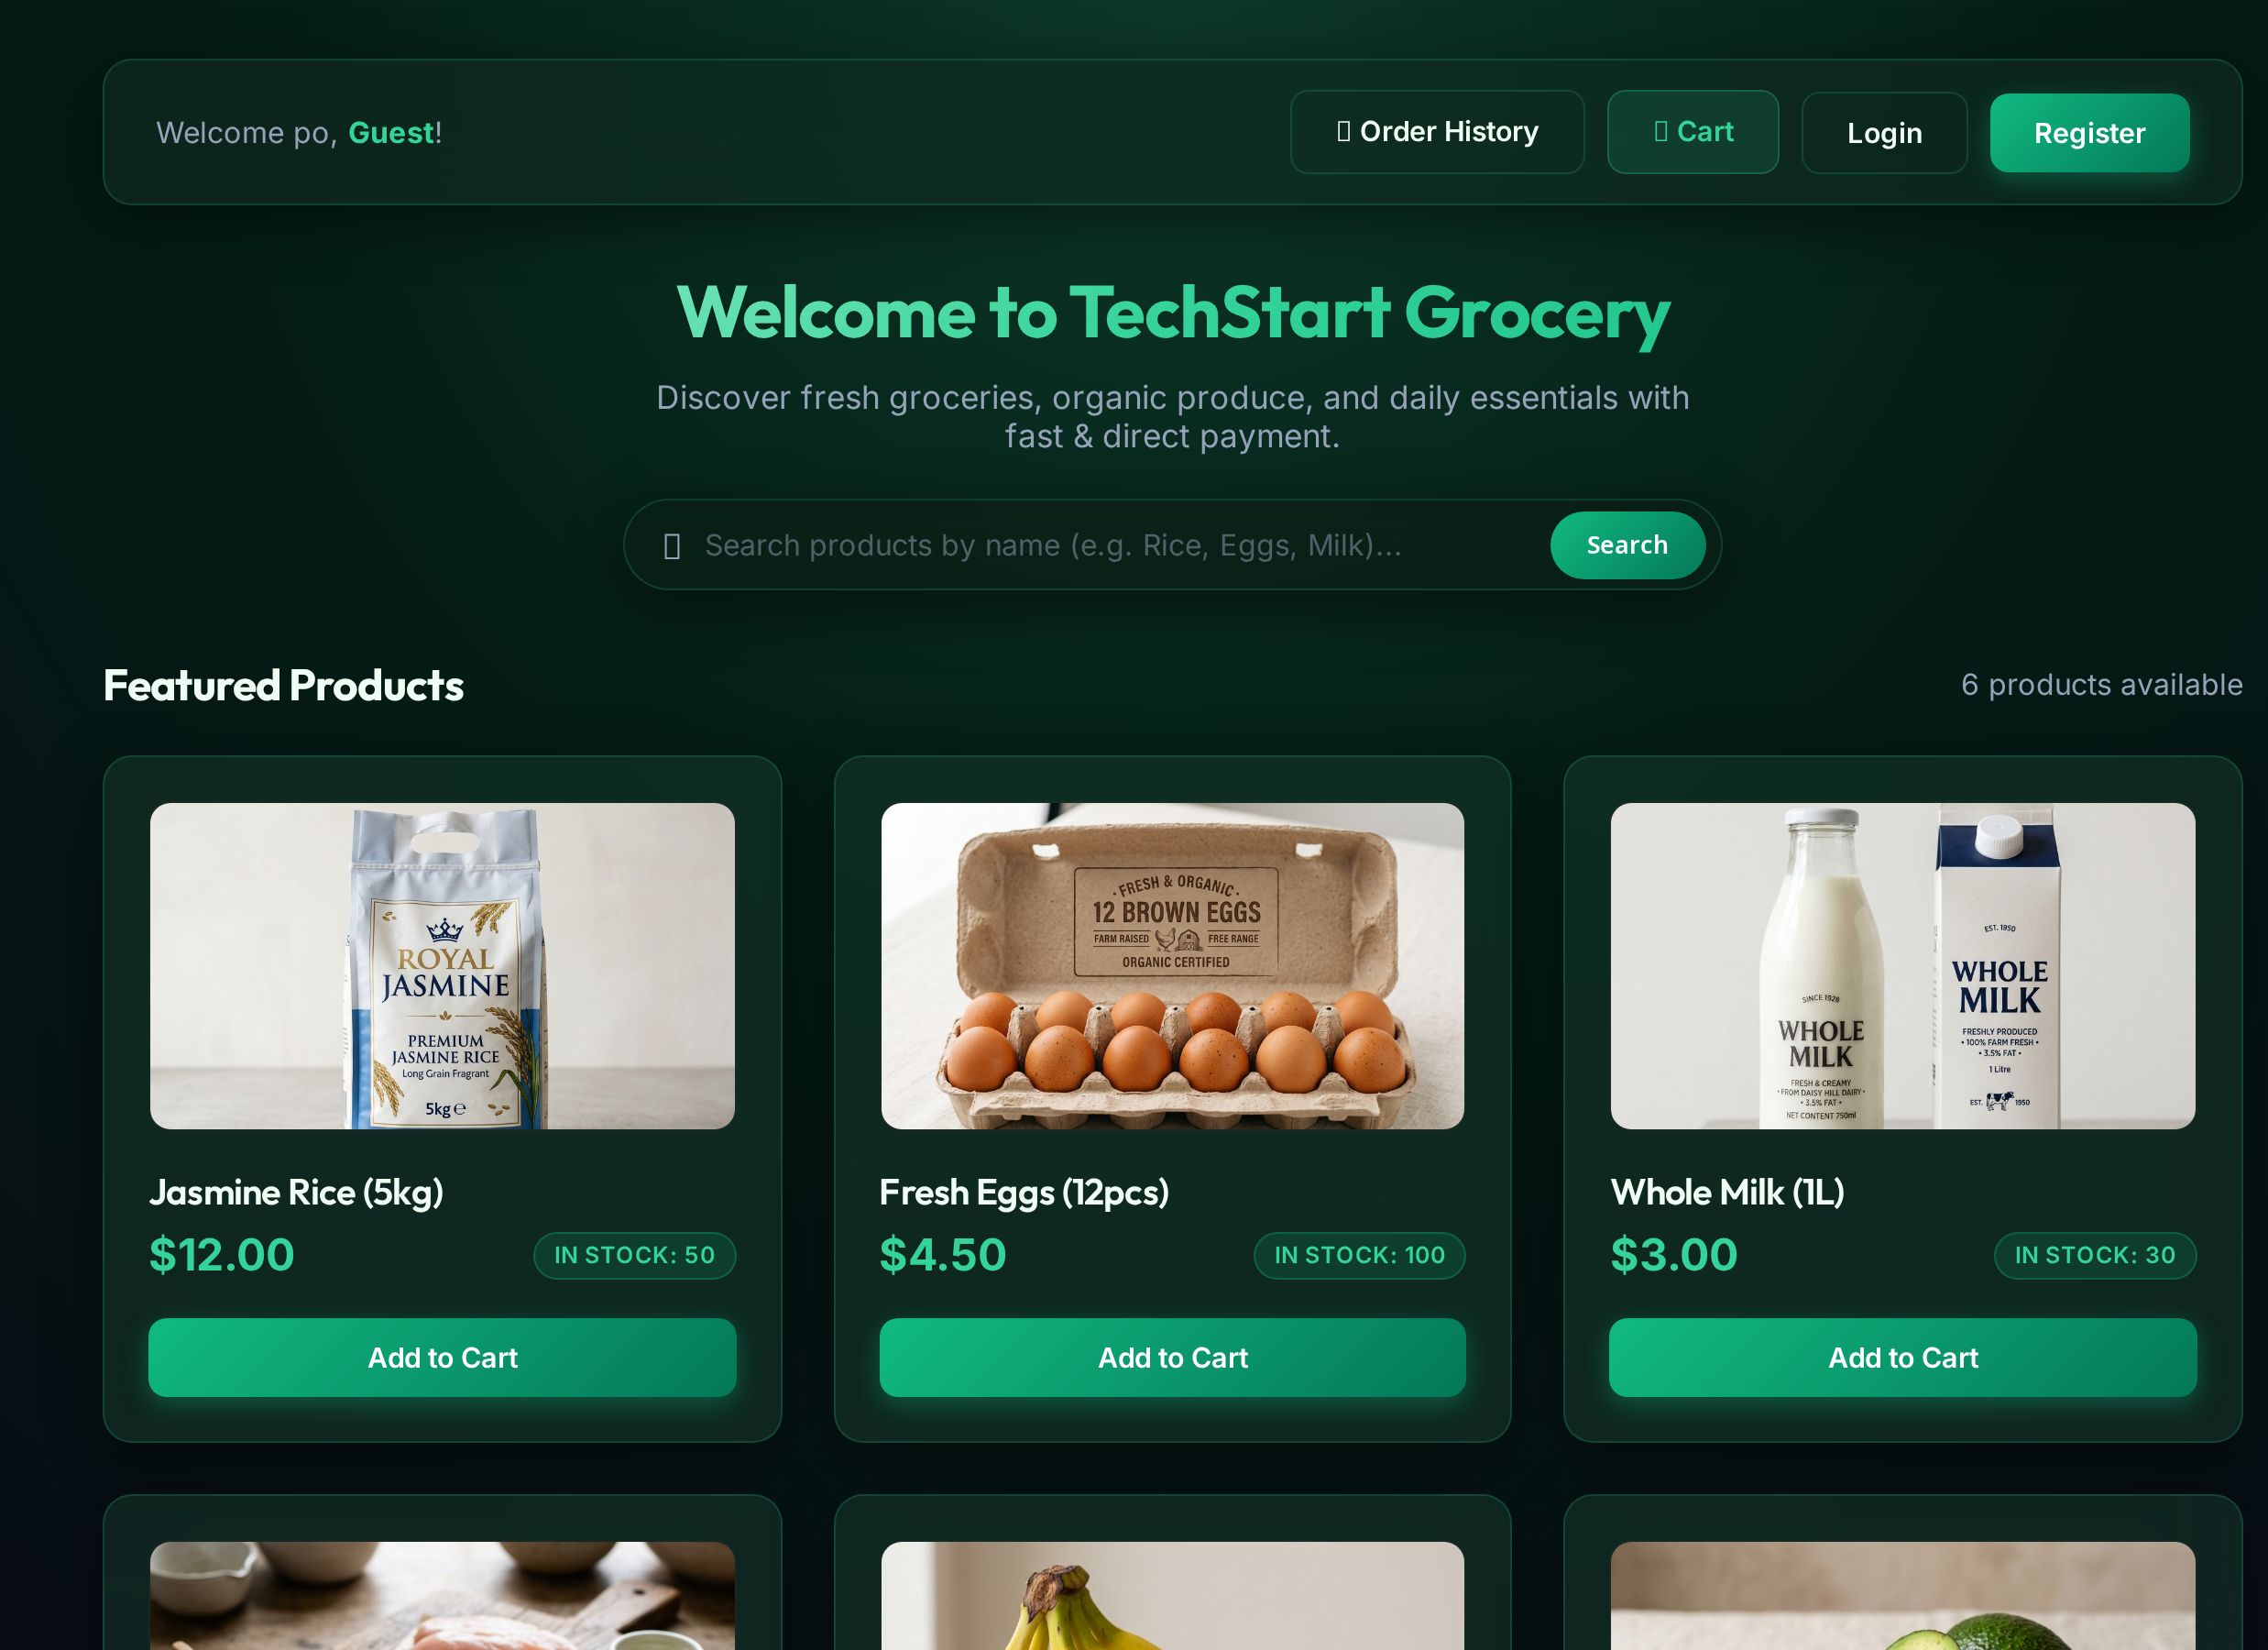
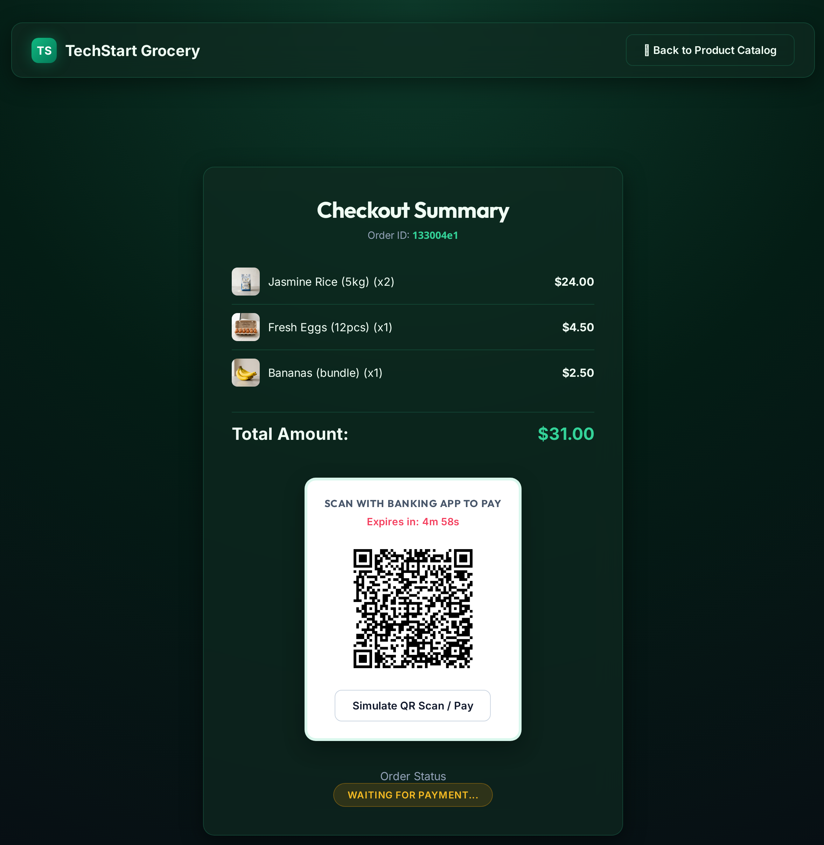
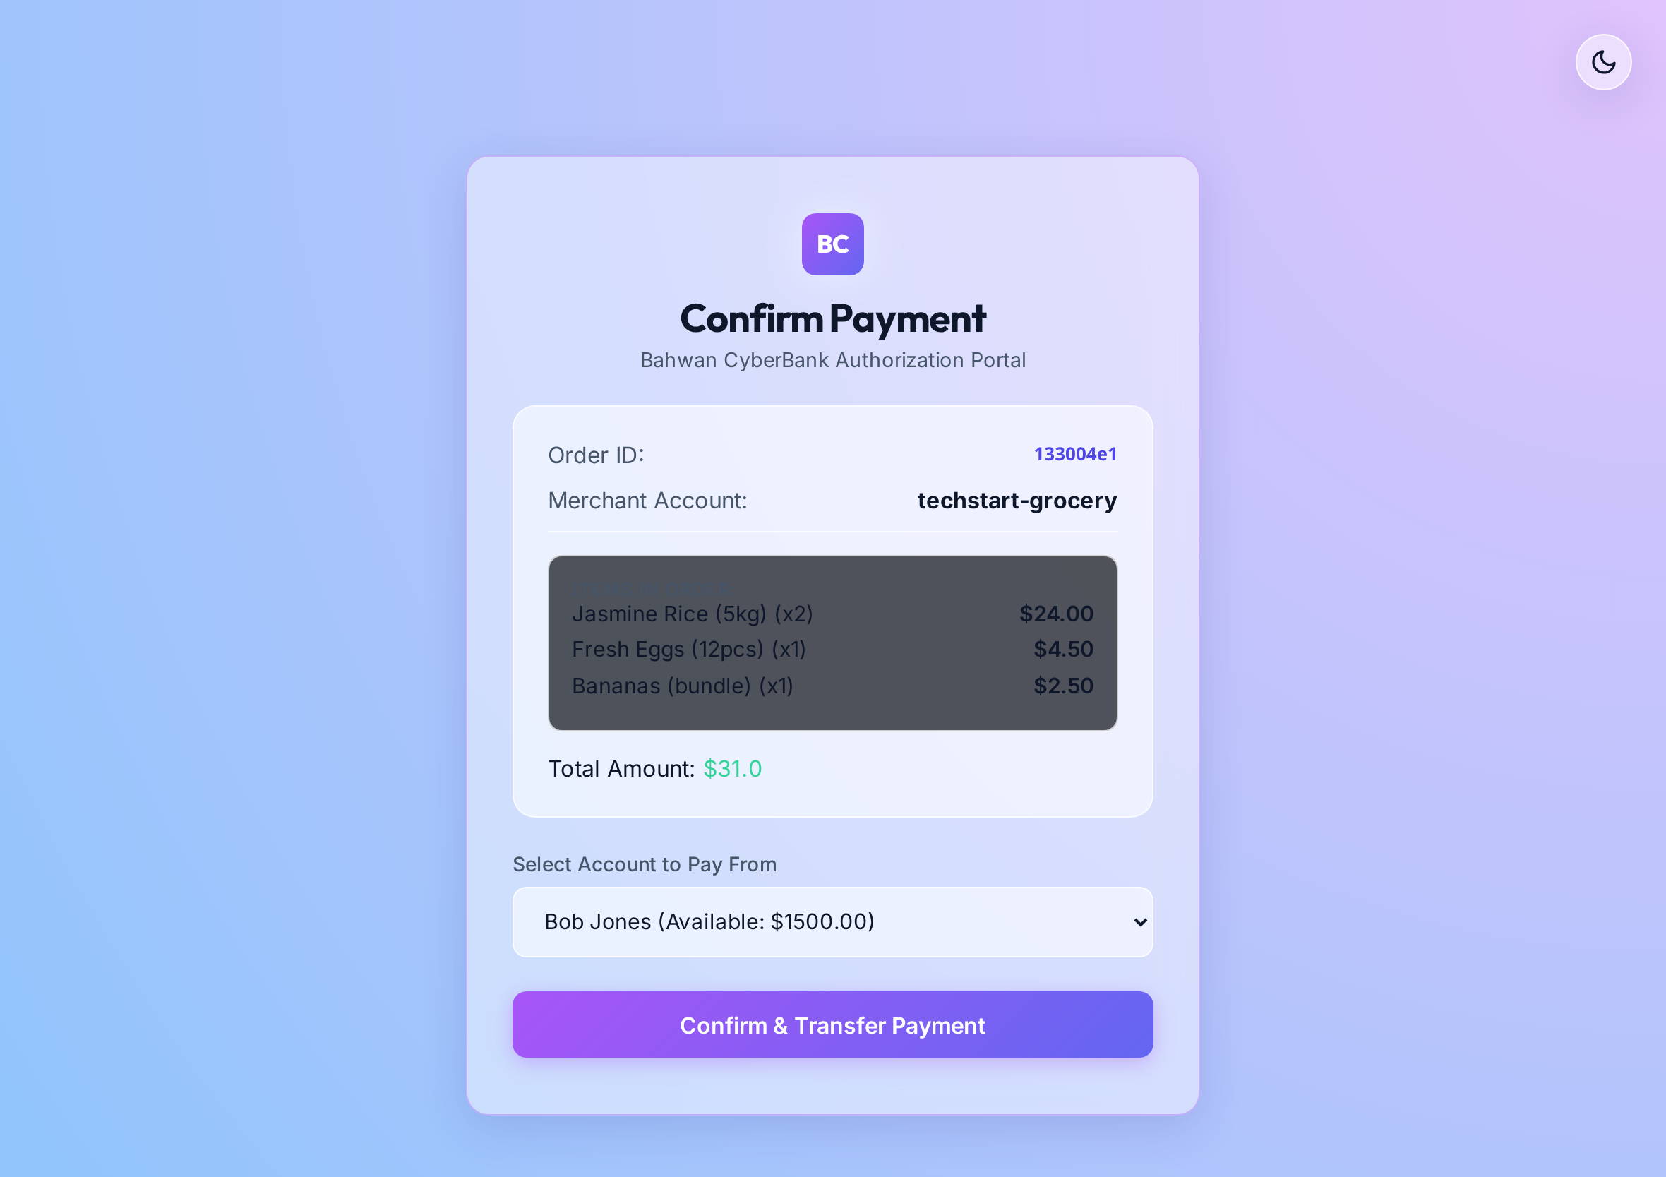
DEMO
The application
Merchant catalogue
QR presented at checkout
Authorising in the bank app
TechStart
9
Notes:
Thirty seconds — show that the journey works, then move to the platform topics.

Slide 10
RUNTIME
Payment sequence
Customer
E-Commerce
Banking App
Microservice
T24
1 checkout
2 QR displayed
3 scan and log in
4 get order details
5 items and total
6 confirm payment
7 post funds transfer
8 posting reference
9 order marked paid
10 receipt
Step 7 is the only step that moves money, and it happens inside T24.
TechStart
10
Notes:
Ten steps. Land on step 7.

Slide 11
TOPIC 1 OF 4
High availability
Application tier
Availability targets
Two or more replicas spread across availability zones, behind a health-probed ingress
99.9%
Data tier
service availability
Zone-redundant managed database with automated backup and point-in-time restore
5 min
Deployment
recovery point objective
Rolling updates gated on readiness probes, so a release does not interrupt service
1 hour
Core banking link
recovery time objective
Redundant site-to-site tunnels between Azure and the data centre
Recovery objectives to be confirmed and signed off before build.
TechStart
11
Notes:
The three numbers are the ask for sign-off.

Slide 12
TOPIC 2 OF 4
Scalability on Kubernetes
Ingress
single entry, WAF
Service
ClusterIP
Pods
HPA scales 2 → N
Managed DB
private endpoint
T24
over the S2S link
How it scales
What makes that possible
Already in place
Horizontal Pod Autoscaler on CPU and requests per second
Cluster autoscaler adds nodes when pods cannot be placed
Pods are stateless, so any replica can serve any request
Session state held outside the pod
Configuration supplied by environment and secret store
Connection pooling in front of the database
Deployment, Service and Secret manifests written
Liveness and readiness probes defined
Health endpoints exposed by both services
TechStart
12
Notes:
The manifests already exist, which shortens the path to a managed cluster.

Slide 13
TOPIC 3 OF 4
Observability
Logs
Metrics
Traces
Structured JSON from every container, shipped to a Log Analytics workspace with a defined retention period.
Azure Monitor collects saturation, latency and error rate, surfaced on a workload dashboard.
OpenTelemetry with a correlation identifier carried across the channels, the microservice and the core.
Health and self-healing
What we can answer
Liveness and readiness probes enforced by the platform
Unhealthy pods removed from rotation automatically
Alerts routed to an on-call rota
Where a specific payment reached, and how long each hop took
Whether an error came from the channel, the microservice or the core
Whether the service met its availability target this month
TechStart
13
Notes:
Frame as: a single payment can be followed across all four tiers.

Slide 14
TOPIC 4 OF 4
BSP and regulatory alignment
Instrument | Requirement | How the design responds
Circular 1055 | National QR code standard — QR Ph | EMVCo-format payload with a signed order reference
Circular 1198 | Merchant payment acceptance | Merchant onboarding, settlement and dispute handling in the core
MORB Appendix 75 | Information security risk management | TLS in transit, keys in Key Vault and HSM, immutable audit trail
Circular 1140 | Technology outsourcing risk | Documented exit strategy, portable stack, continuity plan
RA 10173 | Data privacy and residency | In-country archive copy; cross-border basis to be documented
RA 9160 | Anti-money laundering reporting | Covered and suspicious transaction reporting from the core
Confirmed with Compliance and Legal
Standing position
The cross-border transfer basis and the licensing position are decided outside engineering
The core banking system remains the record for every posting and balance
Engineering mapping for discussion. Citations to be confirmed with Compliance and Legal.
TechStart
14
Notes:
Present as a mapping for discussion, never as a compliance conclusion.

Slide 15
LIVE CAPTURE
Feedback and recommendations
Feedback
Recommendations
Action · owner
TechStart
15
Notes:
Capture the infrastructure team's input here during the session.

