Slide 1
Strictly Private and Confidential
QR Payment Platform
Current-State System Design
Cloud & Infrastructure Architecture Review
Prepared for: Head of Infrastructure · For architecture review
>
www.eastwestbanker.com
1
Notes:
Scope: this deck documents the CURRENT deployed architecture of a two-service QR payment prototype, assessed from an infrastructure and cloud-platform standpoint. It is a design-only review — no application code was changed. Screenshots and the runtime sequences were captured from the prototype actually running end to end.

Slide 2
Project Details
Project Name
:
QR Payment Platform — Banking App and Merchant (E-commerce) App
Document Type
:
Current-State (As-Is) System Design · Infrastructure & Cloud Architecture
Prepared By
:
Cloud Architecture Study Team
Reviewed With
:
Head of Infrastructure
Repository
:
github.com/jmbilbao25/Banking-App
Environments in Scope
:
AWS EC2 (Dev/Test) · Azure Container Instances (Prod) · Jenkins CI/CD
Strictly Private and Confidential
Scope and Objectives
:
Establish a verified, evidence-based baseline of the platform as it runs today, so that platform investment and a cloud target state can be argued from fact rather than from the README.
Document the deployed runtime topology across both cloud environments
Trace the end-to-end payment flow hop by hop, including ports, protocols and timeouts
Record the delivery pipeline, network posture, data tier and observability position
Assess resilience, scalability and recoverability against a production operating bar
Identify the architecture-level gaps that must close before any production traffic
All statements in this deck were reconstructed from the repository contents and from the prototype executed end to end in a sandbox, not from documentation.
>
www.eastwestbanker.com
2
Notes:
Framing for the infra head: we are not proposing features. We are presenting a measured baseline of what exists, and the platform gaps between that baseline and something operable. Everything is traceable to a file or an observed run.

Slide 3
Design Considerations
Design Approach
:
Two independently deployable Python/Flask services — a banking service and a merchant service — integrated over synchronous REST. Each owns its own relational database. Containers are built once and promoted from AWS Dev to Azure Prod by a Jenkins pipeline.
Design Alternatives
:
Kubernetes manifests for both services already exist in the repository but are not the deployed path; production currently runs on Azure Container Instances. AKS is therefore an available, partially prepared alternative rather than a greenfield decision.
Constraints and Limitations
:
Prototype was built to demonstrate a payment journey, not to meet an operating standard
Azure Container Instances offers no ingress, autoscaling or rolling-update primitive
No infrastructure-as-code — cloud resources are created by imperative CLI calls in CI
Single-node databases in both environments; no managed HA tier is provisioned
Strictly Private and Confidential
Dependencies
:
Docker Hub (image distribution) · Jenkins (build and deploy orchestration) · Azure subscription (ACI, Azure Database for MySQL) · AWS account (EC2 Dev/Test host).
Assessment Basis
:
Repository inspection, container and pipeline definitions, plus a live end-to-end execution of both services to confirm the runtime behaviour documented here.
>
www.eastwestbanker.com
3
Notes:
The alternatives line matters: the k8s manifests being present but unused is the single cheapest lever we have. The team has already done part of the work for a managed orchestrator; it simply is not the deployed path.

Slide 4
Design Considerations
Assumptions
Assumption | Identified by | Impact if assumption is proven invalid
The Azure and AWS environments in the pipeline are non-production / lab subscriptions. | Study Team | If any is a production subscription, the public endpoints and inline pipeline credentials become an immediate operational exposure and must be remediated before this review proceeds.
Existing container images can be rebuilt unchanged onto a managed orchestrator (AKS or Container Apps). | Study Team | Additional refactoring effort is required — chiefly externalising session state and the service-to-service addressing that is currently passed as environment variables.
The published Kubernetes manifests represent the team's intended target runtime. | Study Team | The migration path must be re-planned; effort estimates based on reusing those manifests would not hold.
Reported transaction volume is prototype-scale, with no committed throughput or latency target. | Study Team | Capacity, autoscaling and database sizing must be re-derived from a real volume forecast before any sizing in this deck is used.
The two services are intended to remain separately deployable, not merged into one application. | Study Team | The integration analysis and the network segmentation design would both be restated around a single deployable unit.
Strictly Private and Confidential
>
www.eastwestbanker.com
4
Notes:
Assumption 1 is the one we want confirmed in the room. Everything downstream about urgency depends on whether those endpoints are lab or real.

Slide 5
Design Considerations
Architecture and Platform Risks
# | Risk Description | Exposure | Mitigation
R-1 | Every tier is a single instance behind a single DNS name. There is no load balancer distributing traffic across the two production containers. | Availability | Introduce a managed ingress (Application Gateway / Front Door) and place both replicas behind a health-probed backend pool.
R-2 | Deployment recreates each container (delete then create), so every release is a full outage of that service. | Availability | Move to a platform with rolling updates and readiness gating — AKS (manifests already exist) or Azure Container Apps.
R-3 | Single-node databases with no replica, no automated backup and no point-in-time recovery. RPO and RTO are undefined. | Data loss | Managed database with zone-redundant HA, automated backups and a tested restore. Define and sign off RPO/RTO.
R-4 | All traffic, including service-to-service calls, is cleartext HTTP on port 80. No TLS anywhere in the path. | Confidentiality | TLS termination at a managed edge, HTTPS end to end, and private networking for east-west traffic.
R-5 | Two databases are committed in sequence with no distributed transaction, queue, retry or reconciliation. A timeout leaves them permanently disagreeing. | Integrity | Asynchronous integration over a managed broker with an outbox, idempotent consumers and a scheduled reconciliation job.
R-6 | Images are published to a public registry under a mutable :latest tag, unsigned and unscanned. What is running cannot be proven. | Supply chain | Private registry (ACR) with immutable digests, vulnerability scanning and signed images gated in the pipeline.
R-7 | No infrastructure-as-code; environments are produced by imperative CLI calls, so they cannot be reproduced or audited. | Operability | Declarative IaC (Bicep or Terraform) under version control, applied by pipeline with drift detection.
R-8 | No metrics, tracing, structured logging or alerting. An incident cannot be detected proactively or reconstructed afterwards. | Operability | OpenTelemetry to Azure Monitor / App Insights, correlation IDs across services, dashboards and SLO-based alerts.
Strictly Private and Confidential
>
www.eastwestbanker.com
5
Notes:
R-1 through R-5 are the ones that would stop a go-live. R-6 through R-8 are what make the platform operable once it is live. We sequence them in that order on the roadmap slide.

Slide 6
Solution Overview
System context and component responsibilities
Description/s
:
A customer shops on the merchant service, which issues a QR code encoding a payment URL addressed to the banking service. The customer authorises the payment in the banking service, which then calls the merchant service back to release the order.
Merchant domain
Banking domain
Integration shape
Bidirectional, synchronous, cleartext HTTP.
Addressing is by environment variable, not service discovery.
No broker, no retry, no circuit breaker.
In production this path leaves the trust boundary.
HTTP :80
Nginx
:80 reverse proxy
Nginx
:80 reverse proxy
Customer
Browser / device
Strictly Private and Confidential
ecommerce-app
Flask · Gunicorn :5000
ecomdb
MySQL 5.7
banking-app
Flask · Gunicorn :5001
bankdb
MySQL 5.7
customer scans the QR → HTTP :80 to the banking edge
synchronous REST — order lookup and payment callback
Both services also expose /health, and container probes are defined for it in the unused Kubernetes manifests.
>
www.eastwestbanker.com
6
Notes:
The red arrow is the crux of the whole review: the two domains are coupled synchronously and bidirectionally, over the public internet in production.

Slide 7
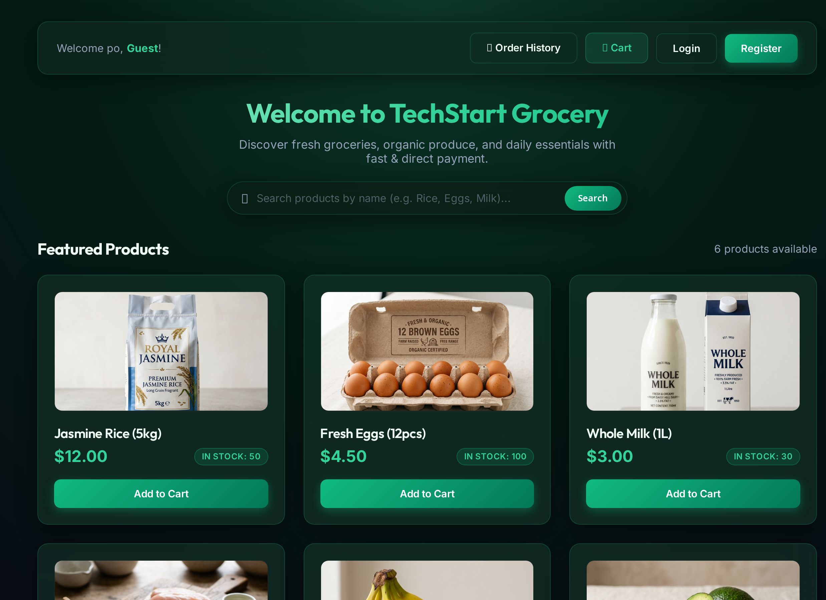
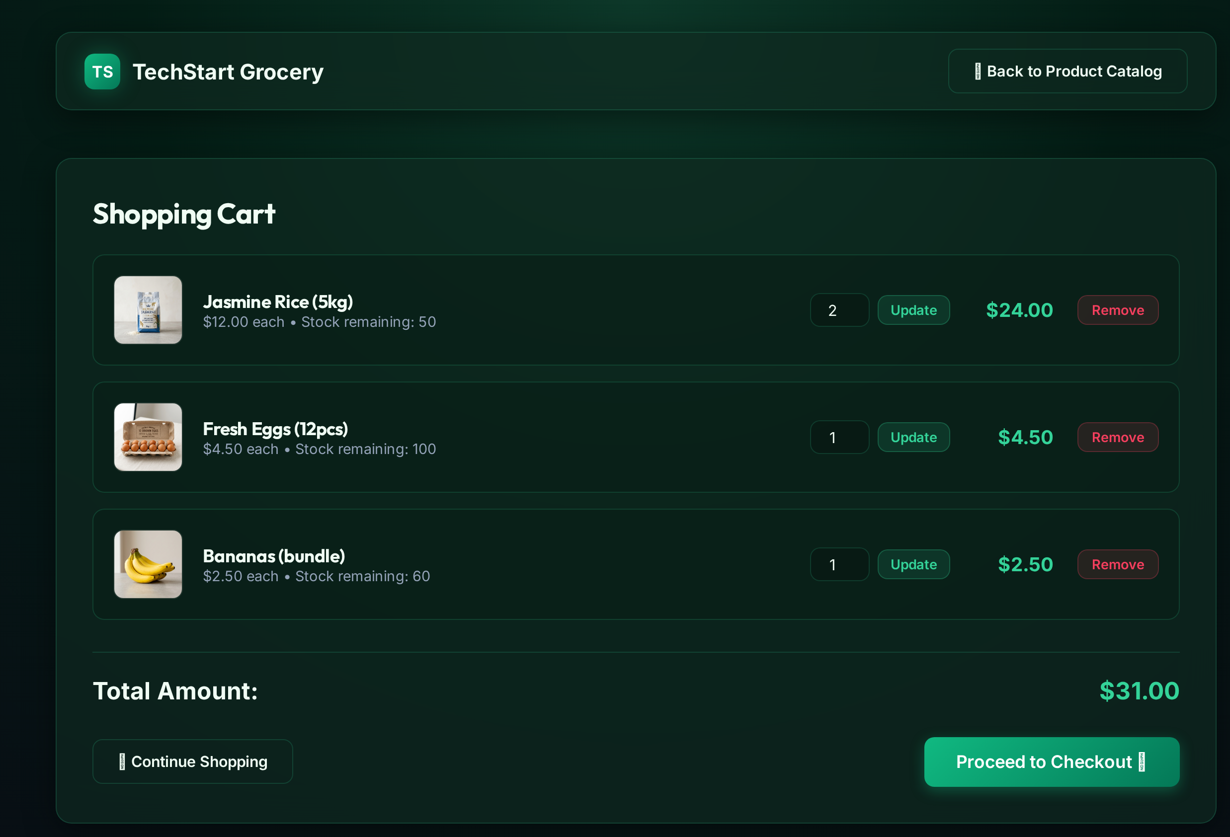
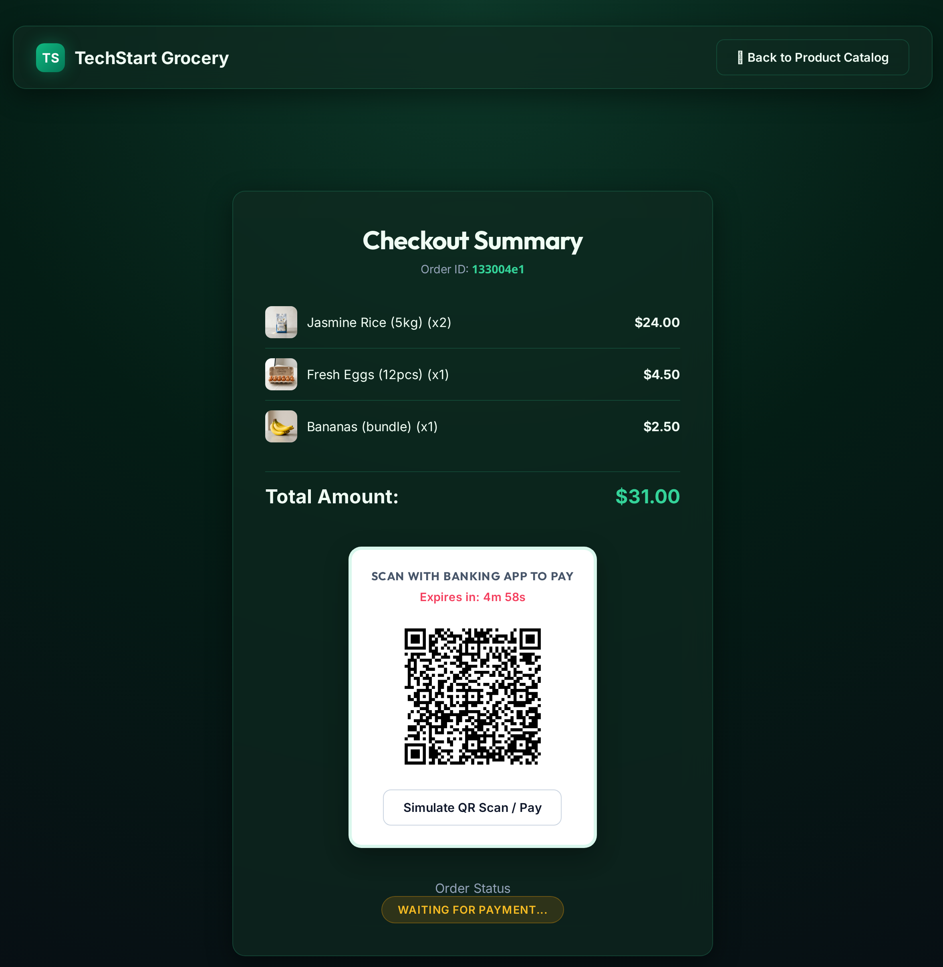
User Interfaces
Merchant service — catalogue to QR presentment
Product catalogue
Basket review
Checkout and QR presentment
Strictly Private and Confidential
Basket state is held in the signed session cookie — no server-side session store.
Stock is re-validated against the database on every basket mutation.
Order is created PENDING with a 300-second expiry; the page polls status every 2 s.
Screens captured from the prototype running end to end; order 133004e1, total 31.00.
>
www.eastwestbanker.com
7
Notes:
These are real captures from a live run, not mock-ups. The QR encodes a plain HTTP URL pointing at the banking service, built from the BANK_PUBLIC_BASE environment variable.

Slide 8
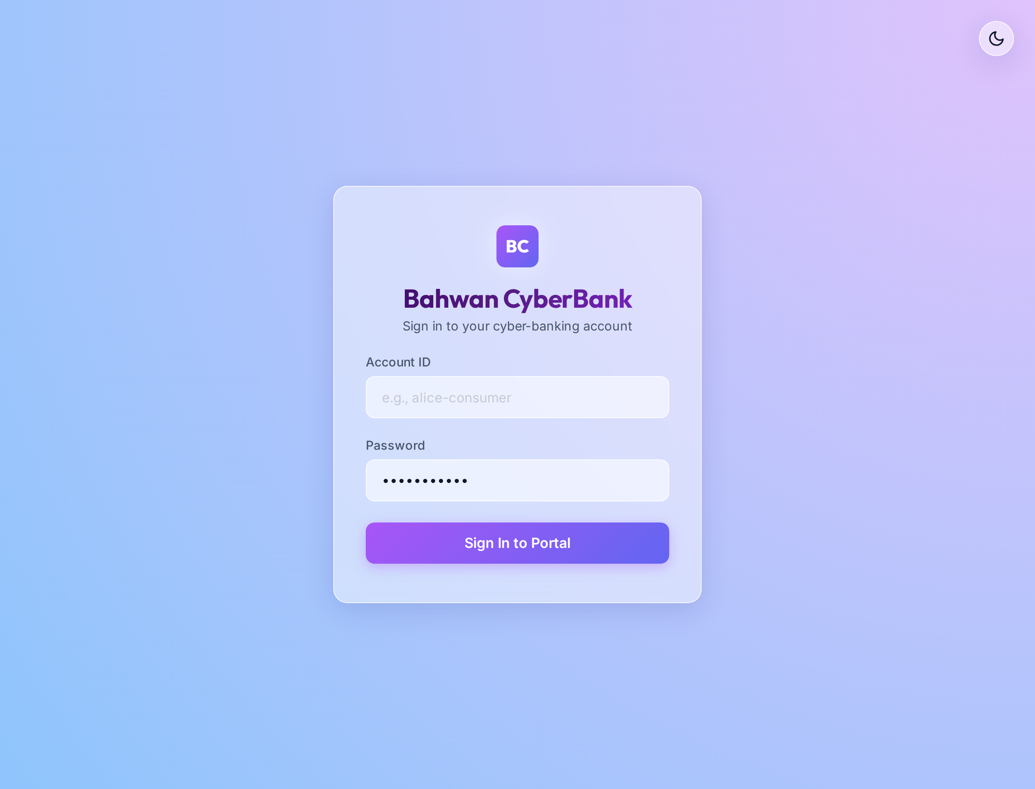
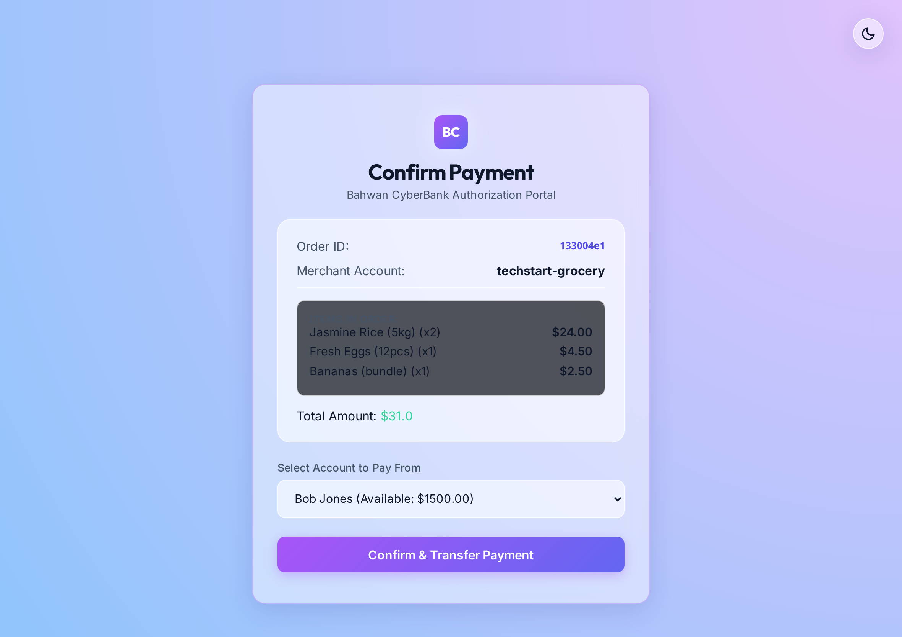
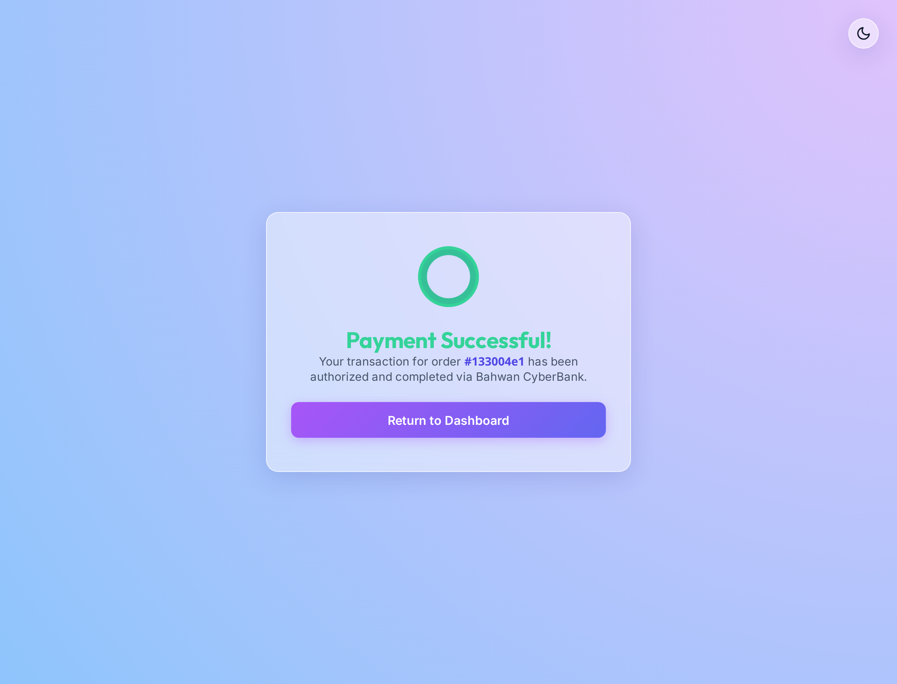
User Interfaces
Banking service — authorisation to settlement
Authentication
Payment authorisation
Settlement confirmation
Strictly Private and Confidential
Scanning the QR without a session stores next_url and redirects to login.
Order lines are fetched live from the merchant service with a 2-second timeout.
Rendered only after the merchant callback and the ledger commit have both returned.
Session cookies are signed with an application-local key, so they are not portable between replicas.
>
www.eastwestbanker.com
8
Notes:
Note for the infra head: because the signing key is application-local, two replicas cannot validate each other's sessions. That is a platform constraint, not a code preference.

Slide 9
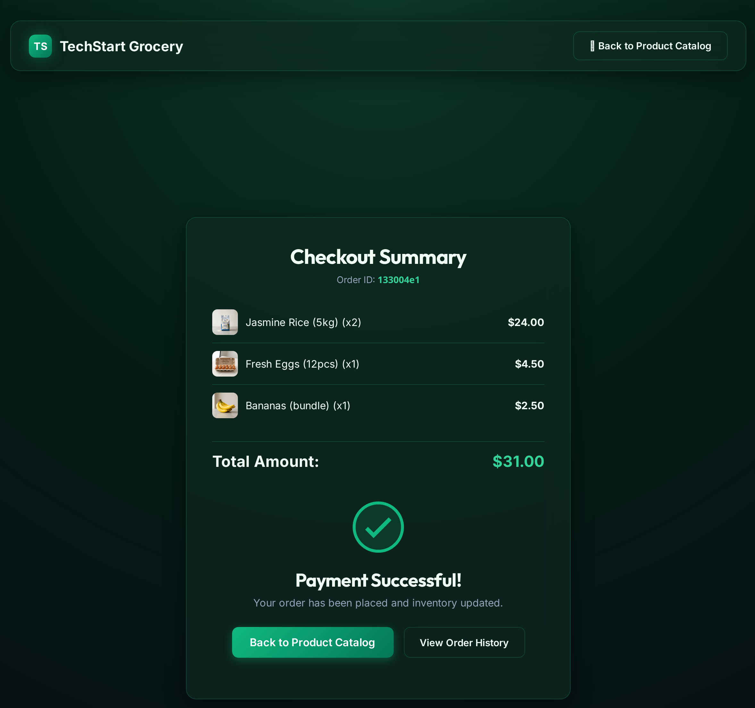
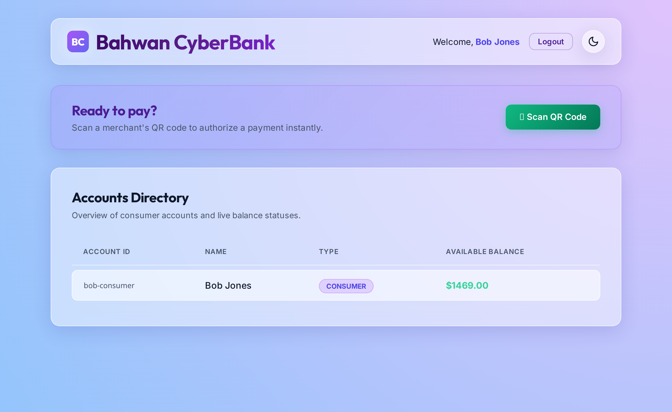
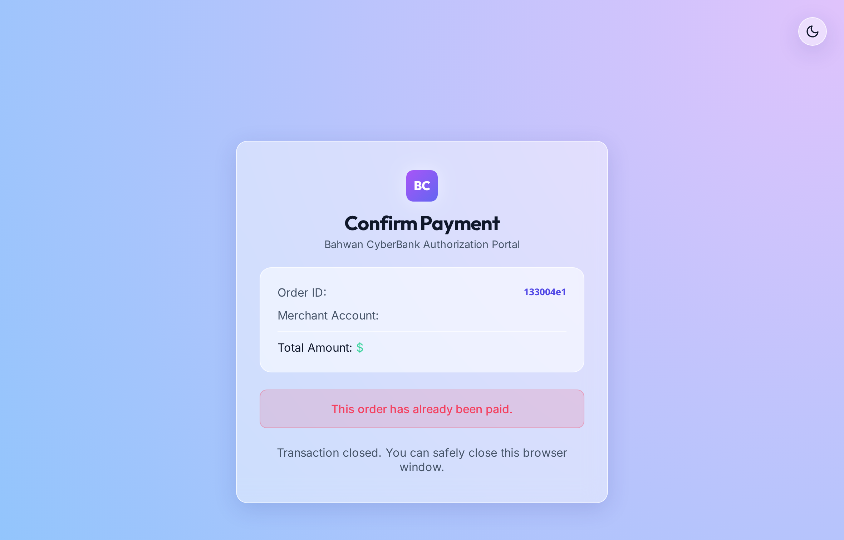
User Interfaces
Post-settlement state across both services
Merchant order converges to PAID
Ledger balance after debit
Replay of the same QR
Strictly Private and Confidential
Reached only by the 2-second client poll — the merchant is never pushed a notification.
Payer balance moved 1,500.00 to 1,469.00 for the 31.00 order.
A second presentment of the same order is refused by the duplicate check.
State convergence between the two services depends entirely on client-side polling; there is no server-to-server notification or event.
>
www.eastwestbanker.com
9
Notes:
The middle screenshot is our proof the flow really settled: 1500 minus 31 equals 1469, observed in the running system.

Slide 10
Runtime Sequence
End-to-end QR payment — every network hop as deployed today
Customer
device
Nginx :80
merchant edge
ecommerce-app
Gunicorn :5000
ecomdb
MySQL 5.7
Nginx :80
bank edge
banking-app
Gunicorn :5001
bankdb
MySQL 5.7
LEGEND
request
1 · CATALOGUE AND BASKET
response
1 GET / — cleartext HTTP, no TLS
2 proxy_pass http://ecommerce:5000
database write
3 store.html + session cookie (basket state)
cross-service
2 · ORDER CREATION AND QR PRESENTMENT
4 GET /checkout/create
5 INSERT orders (PENDING, expires_at = +300 s)
Note
Steps 12–15 are the exposure window.
The merchant database commits before the bank database, and the two calls cross the public internet.
No distributed transaction, queue or reconciliation exists.
Strictly Private and Confidential
6 GET /qr/{order_id}
7 QR PNG — encodes BANK_PUBLIC_BASE env var
3 · CLIENT-SIDE STATUS POLLING
8 GET /api/orders/{id}/status — polled every 2 000 ms
4 · PAYER AUTHENTICATION
9 GET /pay?order_id&amount&merchant_account&expires
10 proxy_pass http://banking:5001
11 302 /login → POST /login → session cookie
5 · SETTLEMENT — TWO DATABASES, TWO COMMITS
12 GET /api/orders/{id} · timeout 2 s then 3 s
13 POST /api/orders/{id}/paid · timeout 5 s
14 COMMIT 1 — status = PAID, stock decremented
15 COMMIT 2 — balances + transaction inserted
Reconstructed from banking-app/app.py, ecommerce-app/app.py and nginx/nginx.conf; confirmed against a live run.
>
www.eastwestbanker.com
10
Notes:
Walk the audience down the five bands. The punchline is band 5: steps 12 to 15. Merchant state becomes durable at step 14 and bank state at step 15, with a network call between them and nothing to reconcile the gap.

Slide 11
Runtime Sequence
Settlement call chain — commit ordering and the exposure window
banking-app
Gunicorn :5001
ecommerce-app
Gunicorn :5000
ecomdb
MySQL 5.7 — merchant
bankdb
MySQL 5.7 — bank
What the ordering guarantees
The merchant's order is marked PAID and stock is decremented BEFORE any money moves.
Once step 6 commits, that outcome is durable and irreversible.
READ-ONLY PRE-CHECKS
1 GET /api/orders/{id} · timeout 2 s (render the form)
2 GET /api/orders/{id} · timeout 3 s (re-check status)
MERCHANT SIDE COMMITS FIRST
3 POST /api/orders/{id}/paid · timeout 5 s
What fails in the window
Any fault between steps 6 and 10 — database failover, container eviction, a lost response, a 5 s timeout that in fact succeeded — leaves the order PAID with no corresponding ledger entry.
Strictly Private and Confidential
4 UPDATE orders SET status = 'PAID'
5 UPDATE products SET stock = stock − quantity
6 COMMIT — merchant state is now durable
BANK SIDE COMMITS SECOND — EXPOSURE WINDOW
7 200 OK
Platform capability required
Transactional outbox, a managed broker with at-least-once delivery, idempotent consumers, and a scheduled reconciliation sweep.
8 UPDATE accounts — debit payer, credit merchant
9 INSERT transactions
10 COMMIT — bank state is now durable
Timeout values are the literal values configured in the banking service's HTTP client calls.
>
www.eastwestbanker.com
11
Notes:
This is the slide to linger on. It is not a coding style question — it is a missing platform capability. Two datastores cannot be made consistent by ordering alone.

Slide 12
Infrastructure and Technology Stack
Current deployment topology across both cloud environments
AWS · EC2 single VM · Dev / Test
Delivery pipeline
Nginx :80
merchant
Nginx :80
bank
Posture
Docker Compose on one VM.
Public IP, HTTP :80 only.
Both apps and both databases share a single failure domain.
Jenkins · agent any
no pinned agent, no IaC
ecommerce-app
Gunicorn
banking-app
Gunicorn
docker build
image built from repository
MySQL 5.7
docker volume
MySQL 5.7
docker volume
Docker Hub · public registry
:latest mutable tag, unsigned, unscanned
Strictly Private and Confidential
Deploy to Dev · AWS EC2
ssh StrictHostKeyChecking=no to a hardcoded IP, then compose pull / up
Azure · Container Instances · Production · centralindia
bank-app-1
ACI · 1 vCPU
bank-app-2
ACI · 1 vCPU
Gaps at this tier
No load balancer, gateway or WAF in front of the four containers.
Each container has its own public DNS label.
No VNet, no private endpoint, no autoscaling, no rolling update.
Validation gate
curl the Dev endpoint, retry up to 2 minutes
ecom-app-1
ACI · 1 vCPU
ecom-app-2
ACI · 1 vCPU
Deploy to Prod · Azure ACI
az container delete then create, per instance
Azure Database for MySQL — public endpoint
Consequence
Delete-then-create means every production release is a planned outage, and a mutable :latest tag means the running artefact cannot be identified or deterministically rolled back.
>
www.eastwestbanker.com
12
Notes:
Two environments with materially different topologies, and neither has an ingress tier. The pipeline promotes correctly but deploys destructively.

Slide 13
System Interfaces
Interface inventory and integration characteristics
Description/s
:
All integration is synchronous REST over cleartext HTTP. There is no message broker, no API gateway and no service mesh in the current design.
Source | Destination | Interface | Type | Frequency | Transport / posture
Customer device | Nginx → ecommerce-app | GET / · /cart · /checkout/* | Synchronous HTML | Interactive | HTTP :80, cleartext
Customer device | ecommerce-app | GET /api/orders/{id}/status | Synchronous JSON | Every 2 000 ms per open checkout | HTTP :80, cleartext
Customer device | ecommerce-app | GET /qr/{order_id} | Image (PNG) | Once per order | HTTP :80, cleartext
Customer device | Nginx → banking-app | GET/POST /pay · /login | Synchronous HTML | Interactive | HTTP :80, cleartext
banking-app | ecommerce-app | GET /api/orders/{id} | Synchronous JSON | Twice per payment | HTTP, public internet, 2 s / 3 s timeout
banking-app | ecommerce-app | POST /api/orders/{id}/paid | Synchronous JSON | Once per payment | HTTP, public internet, 5 s timeout
Container platform | Both services | GET /health | Liveness / readiness | Defined, never executed | Only in the unused k8s manifests
Each service | Its own database | SQLAlchemy / PyMySQL | Database session | Per request | In-cluster or public MySQL endpoint
Strictly Private and Confidential
Interface observation
The two highlighted rows are the only east-west calls in the system, and they carry the settlement decision. In production they traverse the public internet with no private link, no mutual authentication and no retry.
>
www.eastwestbanker.com
13
Notes:
Six of nine interfaces are customer-facing and cleartext. The two that matter most for money movement are the two that leave the trust boundary entirely.

Slide 14
Infrastructure and Technology Stack
Component versions and support position
Description/s
:
Python/Flask services packaged as single-stage Docker images, fronted by Nginx and persisted to MySQL. Versions below are the versions pinned in the repository.
Layer | Technology | Version | Role | Support position
Runtime | Python | 3.11 (slim base image) | Application runtime | Supported
Framework | Flask | 3.0.3 | Web framework for both services | Supported
Framework | Flask-SQLAlchemy | 3.1.1 | ORM and data access | Supported
App server | Gunicorn | 21.2.0 | WSGI server, bound to container port 80 | Supported
Edge | Nginx | Container image, :80 | Reverse proxy; no TLS configured | No TLS termination
Database | MySQL | 5.7 | Relational store, one per service | Reached end of life October 2023
Database | Azure Database for MySQL | Managed, public endpoint | Production data tier | Supported; not privately networked
Fallback store | SQLite | Bundled with Python | Silent fallback when DB_HOST does not resolve | Not fit for production use
Container | Docker | Single-stage build, runs as root | Image packaging | USER directive present but commented out
Orchestration (Dev) | Docker Compose | v3.8 file format | Single-VM orchestration on EC2 | No HA, no scheduler
Orchestration (Prod) | Azure Container Instances | Managed | Runs four containers, two per service | No ingress, autoscale or rolling update
Orchestration (defined) | Kubernetes manifests | apps/v1 | Deployment, Service, Secret — present in repo | Not deployed; Service is type LoadBalancer
CI/CD | Jenkins | Declarative pipeline, agent any | Build, promote and deploy | Supported
Registry | Docker Hub | Public repository | Image distribution | Mutable :latest, unsigned, unscanned
Strictly Private and Confidential
MySQL 5.7 end-of-life is the single most schedule-sensitive item in this table.
>
www.eastwestbanker.com
14
Notes:
Lead with MySQL 5.7: it is out of support, which converts a technical-debt conversation into a dated one. Moving to a managed, supported version also delivers HA and backups.

Slide 15
Network and Remote Access
Current network posture
Description/s
:
There is no private networking anywhere in the current design. Every component is reachable over the public internet on cleartext HTTP, and east-west service traffic leaves the trust boundary and returns over the same public path.
AWS EC2 — public IP
Azure ACI — public DNS labels
Absent controls
• TLS / HTTPS anywhere in the path
• WAF and DDoS protection
• API gateway or managed ingress
• VNet, subnets, NSGs, private endpoints
• Rate limiting at the edge
• Bastion or just-in-time admin access
• Egress control and IP allow-listing
Administrative access to Dev is by SSH to a hardcoded public IP with host-key checking disabled.
Security group :80 open
HTTP :80
4 containers, each its own public FQDN
Internet
any client
HTTP :80
Nginx → Flask (compose bridge network)
No VNet · no subnet · no NSG
Strictly Private and Confidential
MySQL on the same docker network
Azure MySQL public endpoint
East-west service-to-service calls traverse the public internet — no private link, no mTLS
Target direction
Front Door or Application Gateway with WAF terminates TLS at the edge; workloads move into a VNet with private endpoints to the data tier; east-west traffic stays inside the VNet and is mutually authenticated. This is the prerequisite for every other hardening item.
>
www.eastwestbanker.com
15
Notes:
For an infra audience this is the most actionable slide: nothing here requires application rework. It is all platform and network configuration.

Slide 16
Data and Databases
Data ownership, schema and durability position
Description/s
:
Each service owns a private schema, and there is no shared database and no cross-service foreign key. The order lifecycle and the ledger are therefore two independent consistency domains joined only by an HTTP call.
ecomdb — owned by ecommerce-app
bankdb — owned by banking-app
Durability position
• Single-node MySQL in both environments
• No read replica or standby
• No automated backup or PITR configured
• Dev data sits on a local docker volume
• RPO and RTO are undefined
• Monetary values are stored as floating point rather than exact decimal
users
id · username · password
accounts
id · name · type · is_admin · password · balance
products
id · name · price · image_url · stock
transactions
id · order_id · from_acct · to_acct · amount · timestamp
Strictly Private and Confidential
orders
id · user_id · total_amount · status · created_at · expires_at
transactions.order_id is the only link to the merchant domain
It is a plain column — not a foreign key, and not uniquely indexed
order_items
id · order_id · product_id · product_name · price · quantity · subtotal
Concern | Current position | Required for production
High availability | None — single instance per environment | Zone-redundant managed instance with automatic failover
Backup and recovery | Not configured; no restore has been tested | Automated backups, point-in-time restore, periodic restore drills
Network exposure | Public endpoint / shared docker network | Private endpoint, no public network access
Cross-domain consistency | Two commits, no coordination | Outbox plus broker, idempotent consumers, reconciliation sweep
>
www.eastwestbanker.com
16
Notes:
The durability column is the part to press: there is no backup and no tested restore. That is an operational, not architectural, gap and it can be closed quickly.

Slide 17
Reporting and Processes
Observability and operational reporting position
Description/s
:
Diagnostics today consist of unstructured print statements to container stdout. There is no metrics pipeline, no distributed tracing, no log aggregation and no alerting.
Capability | Current state | Operational consequence | Recommended platform service
Application logging | print() to stdout, unstructured, lost on replace | No post-incident reconstruction is possible | Container Insights → Log Analytics
Log retention | None — no aggregation or retention policy | Nothing survives a redeploy, i.e. every release | Log Analytics workspace with retention
Metrics | None collected | Saturation, latency and error rate are invisible | Azure Monitor with workload dashboards
Distributed tracing | No correlation ID crosses the two services | A payment cannot be followed across services | OpenTelemetry → Application Insights
Health probing | /health exists; probes only in unused manifests | Unhealthy containers are never replaced | Probes enforced by the orchestrator
Alerting and on-call | None | Failures are found by users, not the platform | Alert rules bound to SLOs, routed to on-call
Availability reporting | No SLI, SLO or error budget defined | Reliability cannot be stated or improved | SLO dashboards with error-budget alerts
Audit trail | transactions table only; mutable | Cannot answer a point-in-time audit question | Append-only store, immutable retention
Strictly Private and Confidential
Position
The platform currently has no means of detecting that a payment failed, and no means of reconstructing one after the fact. Observability is the prerequisite for operating this service at all, ahead of any feature work.
>
www.eastwestbanker.com
17
Notes:
Tie this back to slide 11: the dual-commit exposure window is not merely possible — today it would also be undetectable and unrecoverable.

Slide 18
Fault Management
Failure modes and blast radius
Failure event | Platform response today | Blast radius | Detection
Nginx container stops | None — no supervisor beyond docker restart policy, no second instance | Full outage of that service | User report
Application container stops | ACI restarts the instance; clients pinned to that DNS label fail meanwhile | Full outage for that label | User report
Application becomes unhealthy but stays up | Nothing — no readiness probe is executed in the deployed path | Silent black-holing of requests | None
Database instance fails | No standby, no failover; connections simply fail | Full outage plus potential data loss | User report
Database volume is lost | No backup and no tested restore exists | Permanent ledger loss | None until reconciliation
DB_HOST fails to resolve at start-up | Silently falls back to a pod-local SQLite file and reports healthy | Divergent, ephemeral ledger per replica | None — /health returns ok
Merchant callback times out after committing | Bank aborts and tells the customer the payment failed | Permanent cross-database disagreement | None
Production release | Container is deleted then recreated | Planned outage on every deploy | Expected
Availability-zone loss | Not addressed; no zonal or regional redundancy | Total outage | Cloud provider status
Strictly Private and Confidential
Common root cause
Every row above traces to the same two absences: no redundant, load-balanced instance at any tier, and no platform-level health enforcement.
Highest-leverage remediation
A managed orchestrator with health-gated rolling updates plus a zone-redundant managed database closes seven of the nine rows without any application change.
>
www.eastwestbanker.com
18
Notes:
The 'silent SQLite fallback' row is the one that tends to land hardest with infrastructure teams: a DNS blip becomes silent data divergence while health checks still report success.

Slide 19
Performance and Reliability
Current characteristics and known load behaviour
Description/s
:
No load test, latency budget or throughput target exists. The figures below are structural characteristics derived from the deployed configuration, not measurements.
Dimension | Current position | Assessment
Service level objective | None defined; no SLI, SLO or error budget | Reliability cannot be stated or measured
Capacity per instance | 1 vCPU / 1 GiB per ACI container, Gunicorn default worker count | Unsized — worker count is not tuned to the CPU allocation
Horizontal scale | Fixed at two containers per service; no autoscaling and no load balancer to use them | Effective concurrency is one instance
Latency profile of a payment | Up to three sequential cross-service HTTP calls with 2 s + 3 s + 5 s timeouts | Worst-case tail latency of roughly 10 s before any database work
Polling overhead | Each open checkout page issues 0.5 requests per second, each hitting the database | Load scales with idle browser tabs rather than with transactions
Database connections | Default SQLAlchemy pool per container; no proxy or external pooler | Connection storms likely as instance count grows
Caching | None at any layer | Every read reaches the database
Static asset delivery | Served by the application container; no CDN | Avoidable load on the application tier
Backpressure | No rate limiting, queueing or shedding anywhere | A traffic spike degrades into failure rather than delay
Strictly Private and Confidential
Note
The 10-second worst-case payment latency is a design consequence of chaining synchronous calls, not a tuning problem; it resolves only by making the settlement path asynchronous.
>
www.eastwestbanker.com
19
Notes:
The polling-overhead row usually gets attention: load is driven by open tabs rather than by transactions, which is exactly the wrong scaling property for a payment system.

Slide 20
Scalability, Resilience and Disaster Recovery
Description/s
:
The platform is single-region and single-instance in effect. No disaster recovery plan, runbook or recovery objective currently exists.
Scalability
Resilience
Disaster recovery
Fixed instance count, set imperatively in the pipeline
No autoscaling on any signal
No load balancer, so the second instance receives no traffic
Session state in an app-local signed cookie prevents free horizontal scaling
Data tier cannot scale reads — no replica
Single failure domain per environment
No zone redundancy at app or data tier
Health probes defined but never executed
No retry, circuit breaker or bulkhead on cross-service calls
Deployment model removes capacity before restoring it
No secondary region
No database backup configured
No restore has ever been tested
RPO and RTO undefined and unagreed
No documented recovery runbook
Strictly Private and Confidential
Objective | Current | Interim target | Production target
Availability | Not measured | 99.0 % single region, health-gated rolling deploys | 99.9 % zone-redundant, no planned downtime
RPO | Undefined — data loss is unbounded | 24 hours via automated daily backup | 5 minutes via point-in-time restore
RTO | Undefined — no restore procedure exists | 4 hours with a documented, rehearsed runbook | 1 hour with automated failover
Deployment impact | Full outage per release | Zero-downtime rolling update | Blue-green or canary with automated rollback
Interim targets are deliberately modest — they are what the existing Kubernetes manifests could deliver once actually deployed.
>
www.eastwestbanker.com
20
Notes:
Ask for one decision here: agreement on RPO and RTO. Every other number on this slide follows from those two, and neither can be chosen by the delivery team alone.

Slide 21
Architecture Maturity Assessment
Current state against a production operating bar
Domain | Level | Current position | Production bar
Compute and orchestration | 1 / 5 | ACI with fixed instances; no ingress, autoscale or rolling update | Managed orchestrator, health-gated rolling deploys
Networking | 1 / 5 | Public cleartext HTTP end to end; no VNet or private endpoints | Private VNet, TLS at a WAF-protected edge
Data platform | 1 / 5 | Single-node MySQL 5.7 (end of life); no HA, backup or PITR | Zone-redundant managed database with tested restore
Service integration | 1 / 5 | Synchronous, bidirectional HTTP; no broker, retry or reconciliation | Asynchronous events with outbox and idempotency
Delivery and supply chain | 2 / 5 | Gated Dev→Prod promotion, but destructive deploys from a mutable tag | Immutable signed digests, scanned images, progressive delivery
Configuration and secrets | 1 / 5 | Credentials inline in pipeline definitions; no secret store | Managed identity plus a secret store, no static credentials
Infrastructure as code | 1 / 5 | None — imperative CLI calls create cloud resources | Declarative IaC in version control with drift detection
Observability | 1 / 5 | Unstructured stdout only; no metrics, tracing or alerting | Full telemetry pipeline with SLO-based alerting
Resilience and DR | 1 / 5 | Single region, single instance; no backup, RPO/RTO undefined | Multi-zone with agreed and rehearsed recovery objectives
Health and self-healing | 2 / 5 | /health endpoints exist and probes are written, but are not deployed | Probes enforced by the orchestrator with automatic replacement
Strictly Private and Confidential
What is already right
Clean service separation with private schemas, health endpoints, environment-driven configuration, an idempotent seed, and a Dev→Prod pipeline with a validation gate. The foundations are sound.
What blocks production
No redundancy, no private networking, no backup, no observability, and an unsupported database version. These are platform gaps, not application defects.
>
www.eastwestbanker.com
21
Notes:
Be even-handed: the application decomposition is genuinely good for a prototype. What is missing is a platform underneath it, which is precisely this audience's remit.

Slide 22
Recommended Direction
Sequenced by risk reduction per unit of effort
PHASE 1
PHASE 2
PHASE 3
Stop the bleeding
Weeks 1–2 · configuration only
Make it operable
Weeks 3–8 · platform work
Make it correct at scale
Quarter 2 · architecture change
Enable automated database backups and perform a test restore
Terminate TLS at a managed edge; disable plain HTTP
Move credentials out of pipeline definitions into a secret store
Remove the silent SQLite fallback so failures are loud
Ship container logs to a Log Analytics workspace
Deploy the existing manifests to a managed orchestrator
Health-gated rolling updates to end deployment downtime
Managed database with zone redundancy and private endpoint
Workloads into a VNet; private east-west traffic only
Private registry with immutable digests and image scanning
Metrics, tracing and correlation IDs across both services
Replace the synchronous callback with broker-based events
Transactional outbox plus idempotent consumers
Scheduled reconciliation between the two domains
Autoscaling driven by real throughput signals
Declarative IaC for every environment
Agreed RPO/RTO with a rehearsed recovery runbook
Strictly Private and Confidential
Sequencing rationale
Phase 1 is configuration only and removes the risk of unrecoverable data loss and cleartext credentials within a fortnight — no application change is required.
Phase 2 is platform work that reuses the Kubernetes manifests already written, and it closes seven of the nine fault-management rows.
Phase 3 is the only phase requiring application change, and it is the only way to make the two-database settlement path correct under failure.
>
www.eastwestbanker.com
22
Notes:
Close on the ask: endorsement of the Phase 1 list, agreement on RPO/RTO, and a decision on the Phase 2 orchestrator target. Phase 3 needs no decision today.

Slide 23
Other Design Details
Testing Approach
:
No automated test suite, and no test stage in the pipeline
The only gate is a curl reachability check against the Dev endpoint after deployment
For this review both services were executed end to end and the payment journey observed and captured
Required before production: integration tests across the service boundary, a failure-injection exercise on the settlement path, and a load test to establish a latency budget
Deployment Approach
:
Jenkins builds one image per service and promotes the same artefact from Dev to Prod
Dev deployment is SSH plus Docker Compose onto a single EC2 host
Production deployment deletes and recreates each Azure Container Instance, which incurs downtime on every release
No rollback path — the :latest tag is mutable, so the previous artefact is not addressable
Strictly Private and Confidential
Cost Position
:
Current footprint is small: one EC2 instance, four 1 vCPU container instances and one managed MySQL instance. The Phase 1 and Phase 2 recommendations are largely configuration and managed-service adoption rather than net new capacity, so the material cost increase is the managed database HA tier and the log analytics workspace.
Decisions Requested
:
Confirm whether the Azure and AWS subscriptions in the pipeline are lab or production
Agree RPO and RTO so the data-tier design can be fixed
Endorse the Phase 1 remediation list and nominate the Phase 2 orchestrator target
>
www.eastwestbanker.com
23
Notes:
Finish on the three decisions. Keep it short — the deck has already made the case, and this slide only needs to capture what we are asking them to sign off.

