Slide 1
Bacchus Winery
Case Study
Blue Team
Riley Dorrington, Robin Tageant, Brianne Hulgan, Andy Nguyen, Joseph Black
CSD310 Database Development and Use
7/14/2022

Slide 2
Group Introduction
The Blue team has been tasked with assisting Bacchus Winery to incorporate new business methods to help them improve their products and customer service.
We created valuable reports for the Bacchus Winery management team to seamlessly address the following areas of concern:
Suppliers actual delivery time is consistent with their estimates.
Products are being sold as anticipated.
Hours each employee worked during the last four quarters.

Slide 3
Case Study Description
In anticipation of the yearly “snapshot” of the Bacchus Winery business, Stan and Davis Bacchus need the information to determine the state of the inventory, distribution, and employees. Needed information includes:
A month by month report that answers - are our suppliers delivering on time? Are there any significant gaps between expected delivery and actual delivery?
Wine distribution - are all wines selling as anticipated? Are there any wines not selling? Which distributor carries which wine?
Employee time - how many hours have each employee worked during the last four quarters?

Slide 4
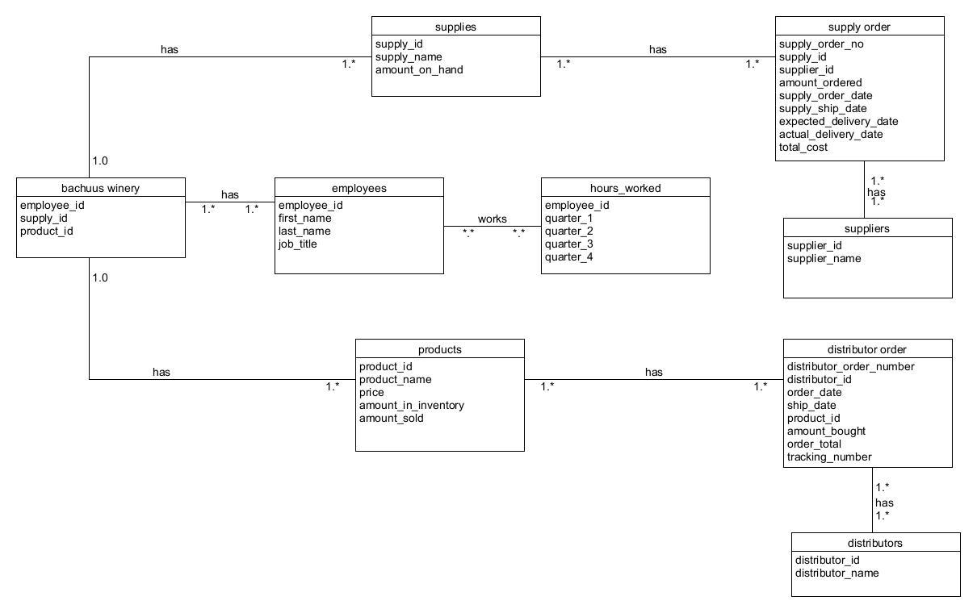
Group Object-Relational Diagram

Slide 5
Report Descriptions
Record # 1:
This record will run a query showing the expected delivery dates and the actual delivery dates of each supply order.
Record # 2:
This record creates a join from the “Products” table, “Distributor” table and the “distributor order” table and runs a query displaying the distributor, the wine name and the amount the wine has sold.
Record # 3:
This record creates a join combining the “employee” and “hours worked” tables to display each employee and how many hours they have worked over the last four quarters.

Slide 6



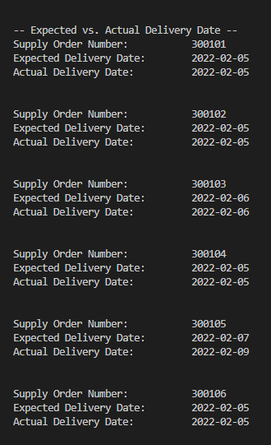
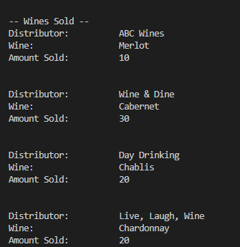
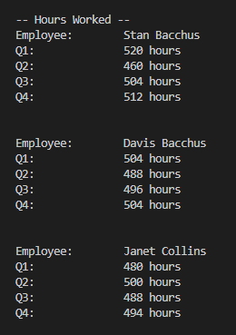
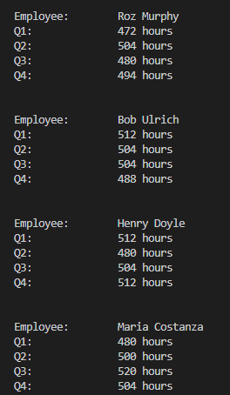
Report Results
Record #1

Slide 7
Case Study Assumptions
We made an assumption that most of the employees worked an average 40 hour work week.
We made an assumption that not all expected delivery dates matched the actual delivery dates
We assumed that not every wine was sold in equal quantities.
We assumed which distributors sold their respective wine.
We made assumptions about how many supplies we had on hand.
We assumed that the 20 employees managed by Henry Doyle were handled and calculated separately
We made assumptions about how many supplies we purchased, and how much wine was sold.

