Slide 1
AI Agent for Network Operations
“AI-Agent-for-Network-Operations v1”

Slide 2
“AI-Agent-for-Network-Operations” overview
Overview
“AI-Agent-for-Network-Operations v1” is an AI agent tool that accesses network devices (Cisco devices) based on alerts detected by the Zabbix monitoring system. It investigates the devices by executing Cisco CLI commands and uses an LLM to provide diagnostic results based on both the monitoring data and the command output.
System Architecture
  LLM: Gemini API (gemini-2.5-flash)
  AI Agent Framework: LangGraph
  Tool 1 “get_zabbix_problems” : Retrieves problem information and the IP addresses of the devices associated with those problems using the Zabbix API.
  Tool 2 “get_cisco_cli” : Uses the IP addresses obtained by Tool 1 to connect to Cisco devices via SSH using Netmiko, execute CLI commands, and retrieve the command output.

Slide 3
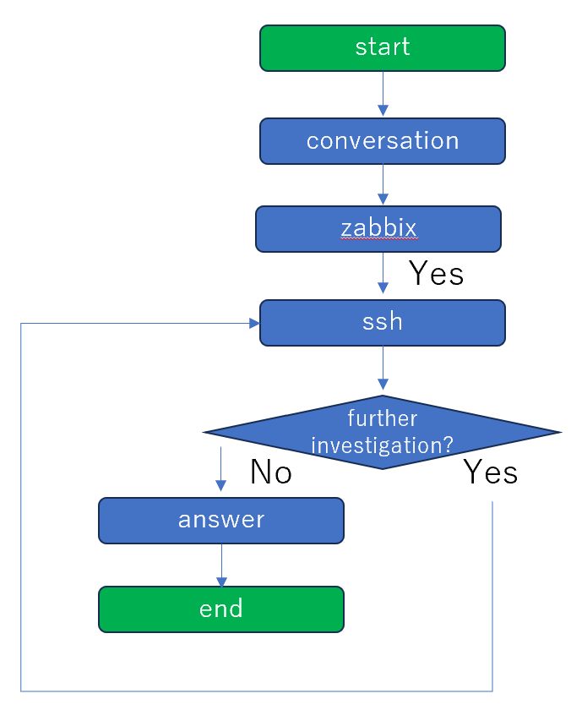
“AI-Agent-for-Network-Operations” flow
Receive the user’s inquiry
Execute the “get_zabbix_problems” tool
Execute the “get_cisco_cli” tool
Based on the inquiry and the results from both tools, the AI determines whether additional investigation is needed (limited to one additional investigation)
Based on the inquiry and the results from both tools, the AI provides the diagnostic results

Slide 4
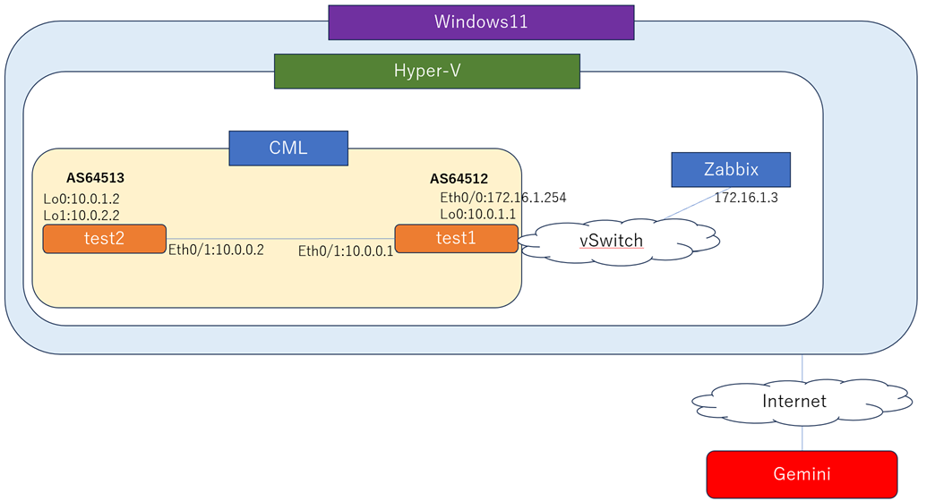
“AI-Agent-for-Network-Operations” operation example
Environment
  Gemini API
  Windows11
  Python 3.11
  Zabbix 7.4
  Cisco routers（Cisco Modeling Labs）
Scenario
Configure Ethernet0/1 on Cisco router test1 as an OSPF passive interface. As a result, the OSPF adjacency between test1 and test2 goes down. The BGP peering session also goes down because it uses a Loopback0 IP address learned through OSPF.

Slide 5
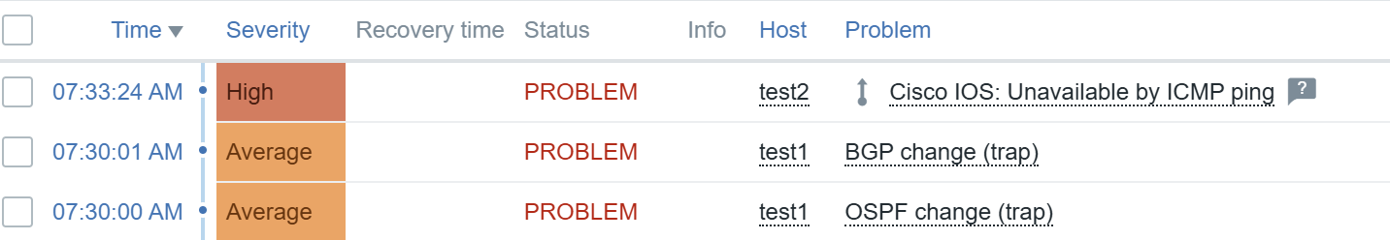
“AI-Agent-for-Network-Operations”
operation example
Zabbix detected BGP and OSPF change events on Cisco router test1, as well as a loss of connectivity to Cisco router test2.

Slide 6
“AI-Agent-for-Network-Operations”
operation example
The user submits the inquiry "The network is not working" through the prompt.。
[conversation]
User inquiry: I cannot use network
Inquiry through
prompt
AI agent

Slide 7
“AI-Agent-for-Network-Operations” operation example
Execute the “get_zabbix_problems” tool. Use the Zabbix API to retrieve problem information from Zabbix and the IP addresses of the devices associated with those problems. Retrieve information about BGP and OSPF change events on test1, the loss of connectivity to test2, and the corresponding IP addresses.
[zabbix] Retrieving problems from Zabbix
[zabbix] Target: test2 10.0.0.2
[zabbix] Problem: Cisco IOS: Unavailable by ICMP ping
[zabbix] Target: test1 172.16.1.254
[zabbix] Problem: BGP change (trap)
[zabbix] Target: test1 172.16.1.254
[zabbix] Problem: OSPF change (trap)
problems
IP address
AI agent
API
Zabbix

Slide 8
“AI-Agent-for-Network-Operations” operation example
Execute the “get_cisco_cli” tool based on the IP addresses retrieved from Zabbix. Use Netmiko to access the Cisco devices via SSH, execute the CLI commands (show ip int brief, show ip ospf nei, and show ip bgp summary), and retrieve the command output.
[ssh] Target: 172.16.1.254
[ssh] Commands: ['show ip int brief', 'show ip ospf nei', 'show ip bgp summary']
IP address
AI agent
SSH
router
test1
show ip int brief
show ip ospf nei
show ip bgp summary

Slide 9
“AI-Agent-for-Network-Operations” operation example
SSH access to test2 fails.
[ssh] Target: 10.0.0.2
[ssh] Commands: ['show ip int brief', 'show ip ospf nei', 'show ip bgp summary']
[ssh] SSH connection failed: TCP connection to device failed.
Common causes of this problem are:
1. Incorrect hostname or IP address.
2. Wrong TCP port.
3. Intermediate firewall blocking access.
Device settings: cisco_ios 10.0.0.2:22
IP address
AI agent
SSH
router
test2

Slide 10
“AI-Agent-for-Network-Operations” operation example
Based on the user's inquiry and the results from the “get_zabbix_problems” and “get_cisco_cli” tools, the LLM determines that additional investigation is not required.
[check] Asking the AI whether additional investigation is needed
[check] AI decision: No
AI agent
Gemini API
LLM
User’s inquiry
problem
IP address
If necessary,
additional
investigation

Slide 11
“AI-Agent-for-Network-Operations” operation example
Based on the user's inquiry and the results from the “get_zabbix_problems” and “get_cisco_cli tools”, the LLM generates a response and provides the diagnostic results to the user.
[answer] Generating the final response
AI agent
Gemini API
LLM
User’s inquiry
problem
IP address
answer

Slide 12
“AI-Agent-for-Network-Operations” operation example
An example of answer
==============================
Final Response
==============================
Based on the information provided, here's an analysis of the network issues:
**Overall Network Status**
The "I cannot use network" report is consistent with multiple critical issues detected across your Cisco network devices, specifically `test2` (10.0.0.2) being completely unreachable and `test1` (172.16.1.254) experiencing significant routing protocol failures.
---
**Problems Detected by Zabbix**
* **`test2` (Hostname: `test2`, IP: `10.0.0.2`)**:
* **"Cisco IOS: Unavailable by ICMP ping"** (Severity: Warning)
* This indicates that `test2` is not responding to ICMP pings, meaning it is currently unreachable at the network layer.
* **`test1` (Hostname: `test1`, IP: `172.16.1.254`)**:
* **"BGP change (trap)"** (Severity: Average)
* **"OSPF change (trap)"** (Severity: Average)
* These alerts indicate recent state changes or issues with the Border Gateway Protocol (BGP) and Open Shortest Path First (OSPF)
routing protocols on `test1`.
---

Slide 13
“AI-Agent-for-Network-Operations” operation example
An example of answer
**Current Status of Cisco Devices**
**1. Device: `test2` (10.0.0.2)**
* **Status:** This device is currently completely unresponsive from a network perspective.
* Zabbix reports it is **unavailable by ICMP ping**.
* Attempts to connect via SSH (TCP port 22) **failed due to a TCP connection error**.
* **Conclusion:** The combination of ICMP unreachability and TCP connection failures strongly suggests that `test2` is either powered off, disconnected from the network, has a critical hardware/software failure, or is being blocked by an intermediate device
(like a firewall) that is preventing all network access.

Slide 14
“AI-Agent-for-Network-Operations” operation example
An example of answer
**2. Device: `test1` (172.16.1.254)**
* **Interface Status:** The device itself appears to be operational and its key interfaces are up:
* `Ethernet0/0` (172.16.1.254) is `up/up`.
* `Ethernet0/1` (10.0.0.1) is `up/up`.
* `Loopback0` (10.0.1.1) is `up/up`.
* Other interfaces are administratively down, which is not necessarily an issue.
* **OSPF Status:**
* The command `show ip ospf nei` produced **no output**, indicating that `test1` has no active OSPF neighbors. This directly
confirms the "OSPF change" alert from Zabbix, meaning OSPF routing is not functioning on `test1`.
* **BGP Status:**
* The BGP session with neighbor `10.0.1.2` (in AS 64513) is in an **`Idle` state**.
* It has been in this state for approximately **28 minutes and 15 seconds**, and has exchanged `0` messages (MsgRcvd, MsgSent). This confirms the "BGP change" alert and indicates the BGP session is not established, and `test1` is not learning routes via BGP.
---

Slide 15
“AI-Agent-for-Network-Operations” operation example
An example of answer
**Possible Causes of the Network Issue**
The user's inability to use the network is very likely due to the combined problems on `test1` and `test2`.
**Regarding `test2` (10.0.0.2) Unreachability:**
**Local Network Issue:** `test1` has an interface `Ethernet0/1` configured with IP `10.0.0.1`. Since `test2` has IP `10.0.0.2`, both
devices are in the same `10.0.0.0/24` subnet. This suggests they are either directly connected or connected via a common
Layer 2 segment (e.g., a switch).
* **Primary Causes:**
* **Power Failure:** `test2` might be powered off or lost power.
* **Physical Disconnection:** The network cable connecting `test2` to the network might be unplugged, faulty, or the port on
`test2` or the connecting switch might be down.
* **Hardware/Software Failure:** `test2` could be experiencing a critical hardware malfunction or an operating system crash.
* **Firewall Blocking (Less likely for complete unreachability unless new rules applied):** An intermediate firewall could be
blocking all traffic to `10.0.0.2`, including ICMP and SSH.

Slide 16
“AI-Agent-for-Network-Operations” operation example
An example of answer
**Regarding `test1` (172.16.1.254) Routing Protocol Failures:**
* **OSPF Failure:** The absence of OSPF neighbors means `test1` is not exchanging routes via OSPF. This could be due to:
* **Neighbor Down/Unreachable:** OSPF neighbors are offline or not reachable.
* **Interface Issues:** The interface(s) participating in OSPF could be experiencing problems (e.g., errors, duplex mismatches)
preventing adjacency formation.
* **Configuration Mismatch:** Mismatched OSPF areas, authentication, network types, or timer settings with potential neighbors.
* **ACL Blocking:** An Access Control List (ACL) might be blocking OSPF protocol traffic (multicasts on 224.0.0.5/6).
**BGP Failure:** The BGP session with `10.0.1.2` being in `Idle` state indicates that the TCP connection for BGP has not been
established. This could be due to:
* **Unreachability to Neighbor:** `test1` cannot reach the BGP neighbor `10.0.1.2`. `test1`'s BGP router identifier is `10.0.1.1` (its
Loopback0 IP).
* **Neighbor Down/Misconfigured:** The BGP peer `10.0.1.2` might be offline, misconfigured, or not listening for BGP connections.
* **ACL Blocking:** A firewall or ACL is blocking TCP port 179 for BGP.
* **Configuration Mismatch:** Incorrect AS number, neighbor IP address, or authentication settings configured on either `test1`
or the peer.

Slide 17
“AI-Agent-for-Network-Operations” operation example
An example of answer
**Additional Checks That May Be Useful**
**For `test2` (10.0.0.2):**
1. **Physical Inspection:** Physically check `test2` for power status, console access, and network cable connections.
2. **From `test1`:**
* `ping 10.0.0.2 source Ethernet0/1`: Test reachability from `test1`'s directly connected interface.
* `show arp 10.0.0.2`: See if `test1` has an ARP entry for `test2`. If not, it suggests `test2` is not responding at Layer 2 or Layer 3.
* `show interface Ethernet0/1`: Check for any errors (input/output errors, discards) on the interface connected to the `10.0.0.0/24` subnet.
**For `test1` (172.16.1.254):**
1. **OSPF Checks:**
* `show ip ospf interface brief`: To verify which interfaces are participating in OSPF and their state.
* `show ip ospf`: To check the OSPF process ID, router ID, and LSA counts.
* `show running-config | section router ospf`: To review the OSPF configuration for any misconfigurations.
* `show ip route ospf`: To see if any OSPF learned routes are present (likely none currently).
* Verify reachability to expected OSPF neighbors.

Slide 18
“AI-Agent-for-Network-Operations” operation example
An example of answer
2. **BGP Checks:**
* `show ip bgp summary`: (Already provided, but good for quick re-check).
* `show ip bgp neighbors 10.0.1.2`: To get detailed information about the BGP session state, error messages, and timers.
* `show running-config | section router bgp`: To review the BGP configuration, checking for correct AS numbers, neighbor IP,
and authentication settings.
* `ping 10.0.1.2 source Loopback0`: To verify reachability to the BGP neighbor from the source interface configured for BGP.
* `show ip route bgp`: To see if any BGP learned routes are present (likely none if in Idle state).
3. **General Checks:**
* `show logging`: To check for recent error messages or warnings that might provide more context for the routing protocol
changes.
* `show interface status` or `show interface <interface-name>`: To check the status and error counters of interfaces connected to potential BGP/OSPF peers.
* Check for any recently applied ACLs (`show access-lists`) that might be inadvertently blocking routing protocol traffic (e.g.,
OSPF multicasts or BGP TCP port 179).

