Slide 1
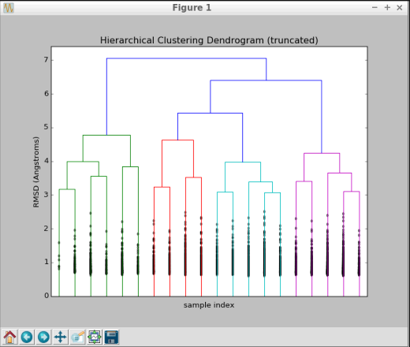
Clustering Scr-Kinase Benchmark
t r a j e c t o r y 4630 conformations
( p a r a ll e l e x e c u t i o n, execution time ~ 1s )
463
463
463
463
463
463
k-means
clustering
(RMSD)
10
10
10
10
10
10
10² clusters, each with a
representative conformation (centroid)
fast_protein_cluster
hierarchical clustering
(execution time < 1s)

Slide 2
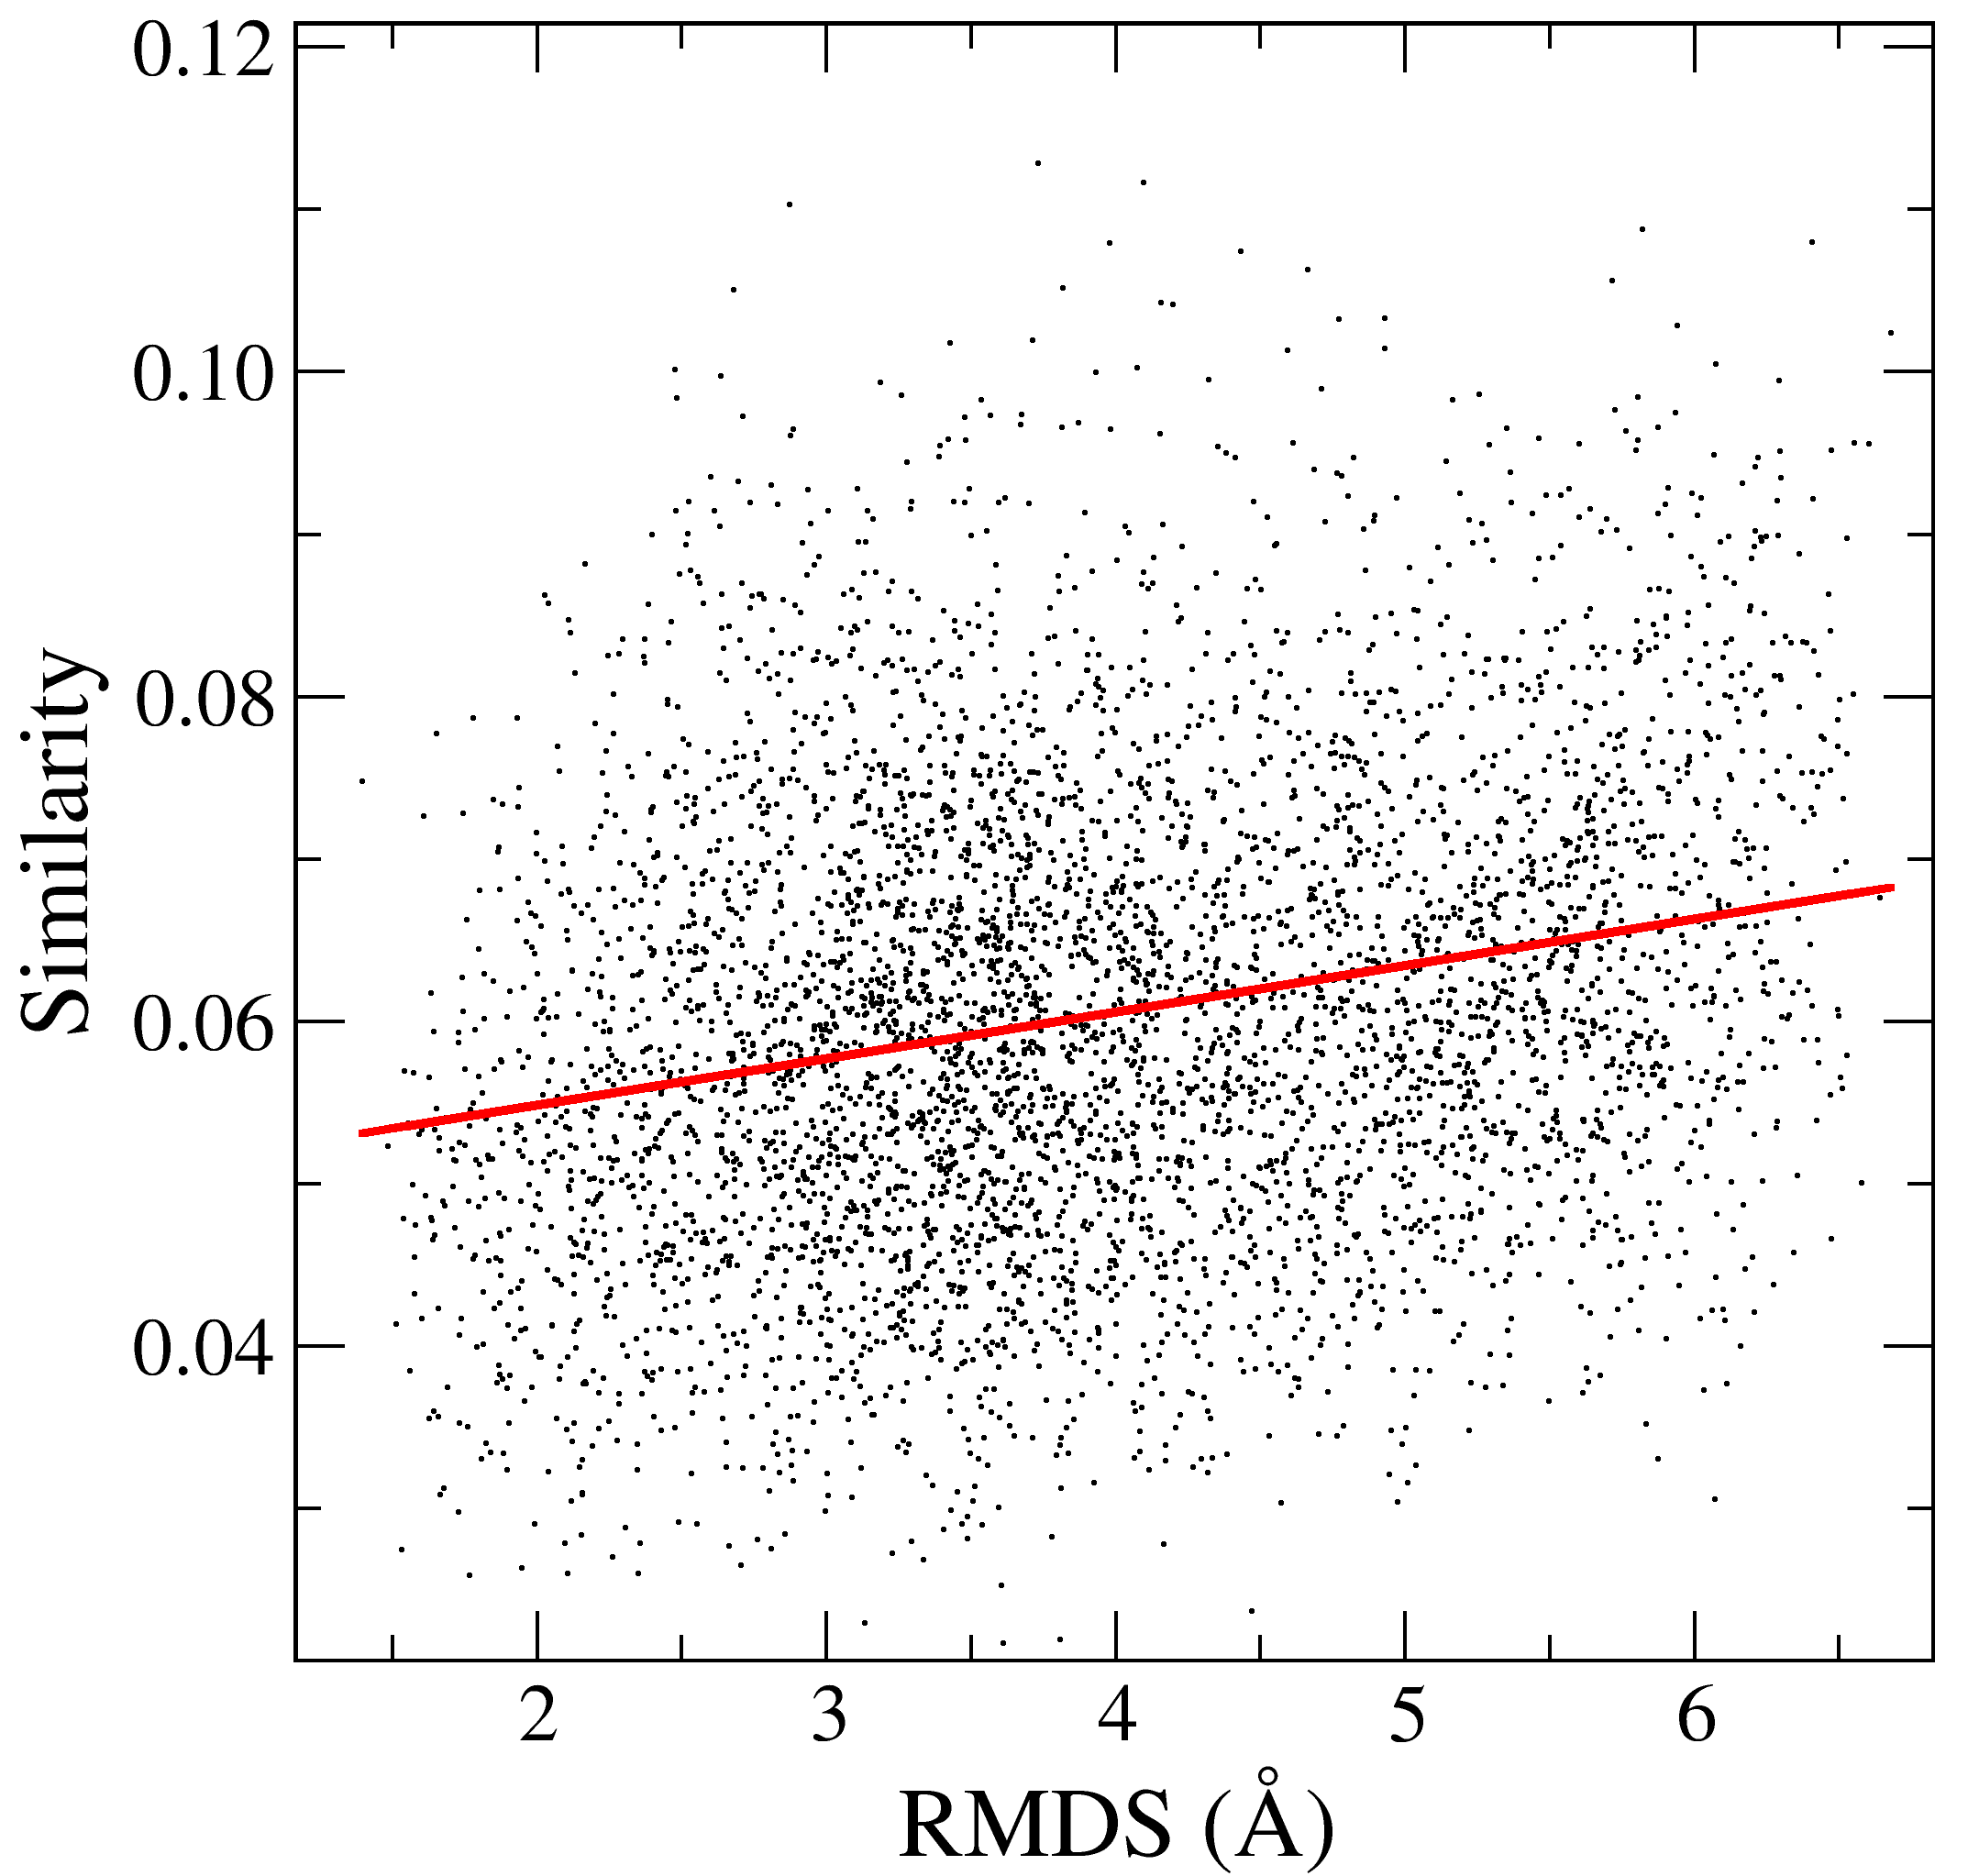
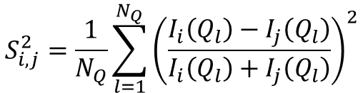
RMSD versus Similarity-profile for pair of centroids
$$S_{i,j}^{2}=\frac{1}{N_{Q}}\sum_{l=1}^{N_{Q}}{{\left(\frac{I_{i}\left(Q_{l}\right)−I_{j}\left(Q_{l}\right)}{I_{i}\left(Q_{l}\right)+I_{j}\left(Q_{l}\right)}\right)}^{2}}$$
Equation for the similarity between two I(Q) profiles:
4628 frames clustered into 100 clusters
All RMSD pairs among the 100 cluster centroids versus all Similarity pairs among the 100 clusters centroids
SANS profile difference
Results: very mild correlation between RMSD and Similarity for centroids comparison.

Slide 3
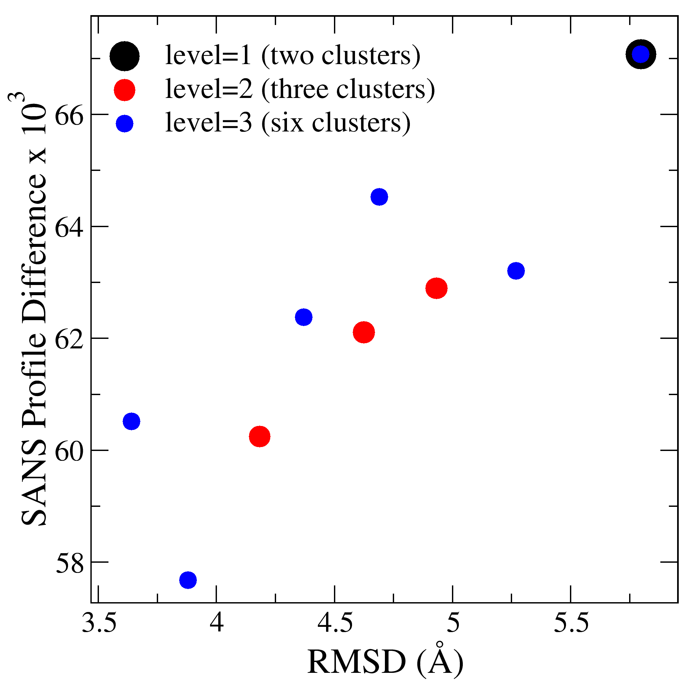
RMSD versus Similarity between Clusters
We compare RMSD and I(Q) between pair of clusters at a given clustering level
Clustering Level
0
1
(two clusters, one possible comparison)
2
(three clusters, three possible comparisons)
3
(four clusters, six possible comparisons)
A
Given clusters A and B, calculate RMSD and difference in SANS profiles between its members, then take the average of these
two properties.
B

