Slide 1
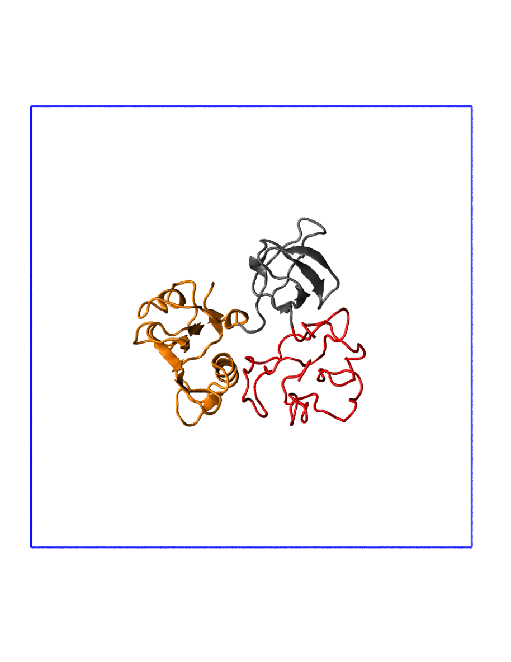
Segmental D-Labeling In Silico
Two deuteration models
(SH4-SH3-SH2)_{H}
All protein hydrogenated
100% D₂O solvent
(SH4-SH3)_{D}-(SH2)_{H}
SH4 & SH3 deuterated
SH2 hydrogenated
43% D₂O solvent
Simulation details
500 ns
Tip4P-D water for disordered SH4
Mass of D=1 a.u.
% Protein exchangeable D = solvent % of D₂O
c-Src Kinase
SH3
SH2
SH4 (IDP)
Simulation box (water not shown)

Slide 2
Theoretical SANS Intensities of c-Src
1. (SH4-SH3-SH2)_{H} in 100% D₂O
2. (SH4-SH3)_{D}-(SH2)_{H} in 43% D₂O
Details
Background subtracted
Conformational averaging (5,000 frames)
Decomposed into coherent & incoherent contributions

