Slide 1
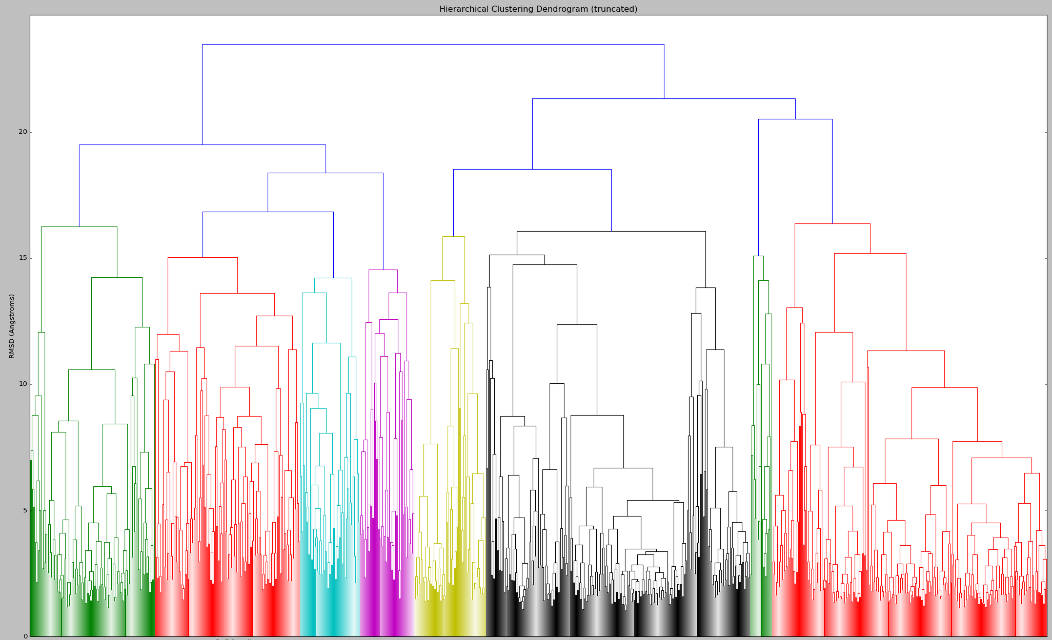
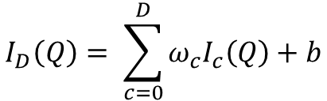
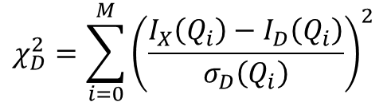
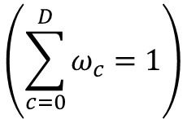
depth=0
depth=1
depth=2
depth=3
$$I_{D}\left(Q\right)= \sum_{c=0}^{D}{{ω_{c}I}_{c}\left(Q\right)+b}$$
$$\left(\sum_{c=0}^{D}{ω_{c}}=1\right)$$
Intensity at a given depth
$$χ_{D}^{2}=\sum_{i=0}^{M}{{\left(\frac{I_{X}\left(Q_{i}\right)−I_{D}\left(Q_{i}\right)}{σ_{D}\left(Q_{i}\right)}\right)}^{2}}$$
Goodness of fit at a given depth

