Slide 1
(new) STORY OF PAPER
Intro: add a short summary of lithium diffusion in solids and possible techniques to determine it (muon spin, nmr, neutrons) as well as the associated challenges, more detailed background on QENS
Extend results/discussion for Li diffusion:
QENS data fitted → Diff. coefficient → act. energy Ea → + hopping length → relate to POWGEN structure data. → determining critical step
Goal: prediction which modification might be able to reduce act. energy → e.g. other doping
WE HAVE (so far)…
ICP-OES, XRD → have desired LLZO phase and composition
POWGEN structure→ lattice and occupancy for tetr. (99% tetr.), 60Ta (78% cubic and 22% tetr.), Problem: for 36 Al refinement not perfect for atomic position or/and occupancy?? Possibly 2 cubic and one tetr. Phase?) → additional value to XRD: detailed atomic parameters, especially for Li
VISION→ proof water free (all 3 samples) → QENS possible
QENS:
tetr. LLZO →no significant QENS signal → no contribution to Li self diffusion
60 Ta and 36 Al → activation Energy and Diffusion coefficient from fitting low Q values (fit for high Q values possible?? (get tau/L values? → do we have the raw data for high Q values?)
HT-AC Impedance → for all samples E_{a} and σ_{ION} for T=300-600K, for tetr. 4 orders of magnitude lower
Information on the hopping distances in the cubic and tetr. phase
Can we at least estimate if assuming 1 cubic and 1 tetr phase – would be important… (see slide 5)

Slide 2
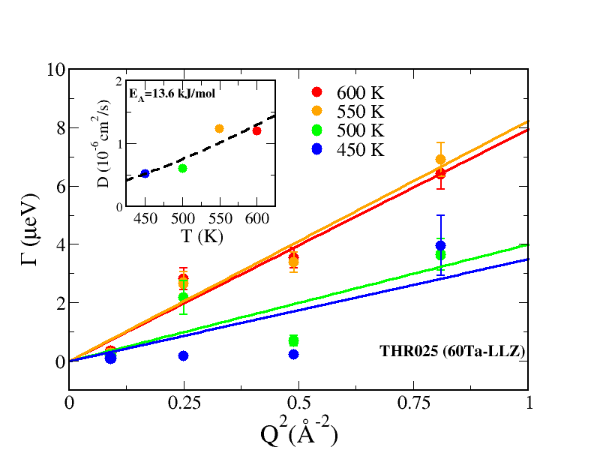
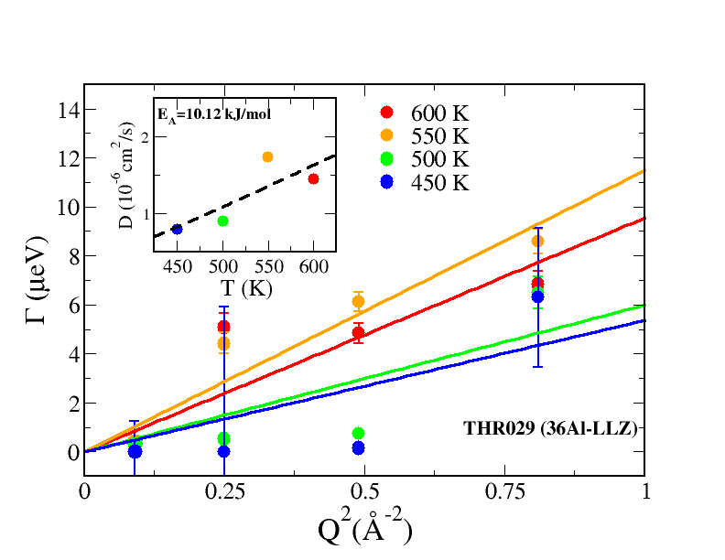
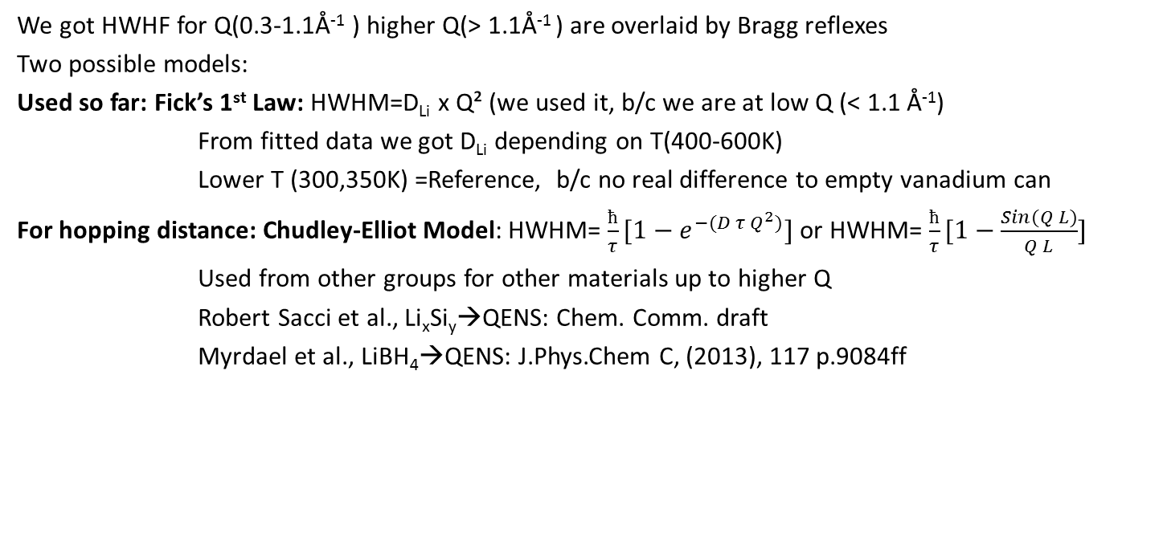
QENS of 60Ta-LLZO + 36Al-LLZO, + tetr. LLZO, @300K – 600K
Figure :
HWHM Γ plotted against Q² for temperatures 450 K to 600 K to derivate Li self-diffusion constant D of (Left) 60Ta-LLZO and (Right) 36Al-LLZO. In each graph a plot of D_{Li} against T is inlayed to determine self-diffusion’s activation Energy E_{A}.
We got HWHF for Q(0.3-1.1Å⁻¹ ) higher Q(> 1.1Å⁻¹ ) are overlaid by Bragg reflexes
Two possible models:
Used so far: Fick’s 1st Law: HWHM=D_{Li} x Q² (we used it, b/c we are at low Q (< 1.1 Å⁻¹)
From fitted data we got D_{Li} depending on T(400-600K)
Lower T (300,350K) =Reference, b/c no real difference to empty vanadium can
For hopping distance: Chudley-Elliot Model: HWHM= $\frac{ħ}{τ}[1−e^{−(D τ Q^{2})}]$ or HWHM= $\frac{ħ}{τ}[1−\frac{Sin(Q L)}{Q L}]$
Used from other groups for other materials up to higher Q
Robert Sacci et al., Li_{x}Si_{y}→QENS: Chem. Comm. draft
Myrdael et al., LiBH₄→QENS: J.Phys.Chem C, (2013), 117 p.9084ff
→ do we have the raw data for high Q values? (see next slide)

Slide 3
Questions/Answers so far :
Do we have the raw data for high Q, too?
Souleymane: We could not reliably fit the higher Q data (above 1.1) b/c of strong structural peaks. That is probably why we stopped the fits at 1.1.
How do we get this residence time value, or the pre-exponential factor τ₀?
The residence time should in principle come directly from the fit of HWHM over the whole range of Q, including high Q as we discussed during the experiments. I know we limited ourselves to 1.1 A-1 in the fits due to coherent peaks at high Q.
Note however, that for long range translational diffusion as seems to be the case in your systems (and not in the amorphous LiSi Sacci measured), tau becomes infinitely small and can not be calculated as Li does not reside long enough in any site. Perhaps we should plot data over whole Q range to see …
Now perhaps, you could use your estimated jump length from POWGEN to estimate the tau values, (tau=D/6l) if you assume hopping mechanism.
Is it possible that we use the Li-Atom distances from 300K POWGEN measurement to calculate tau?
Souleymane: You may use the information from the POWGEN data to estimate tau (just for the sake of holistically looking at the whole data set you have) but this approach should be used with caution since our QENS data does not support a jump type diffusivity (nor does it exclude it b/c we can’t make sense of the high Q behavior). So, as an academic exercise or to walk the reader through, this approach may be acceptable. Molecular dynamics might be necessary.
Do we even have the high Q raw data?
How do we know?
Do we need this or can we skip tau and just compare L?
Which diffusion do we actually measure in QENS?

Slide 4
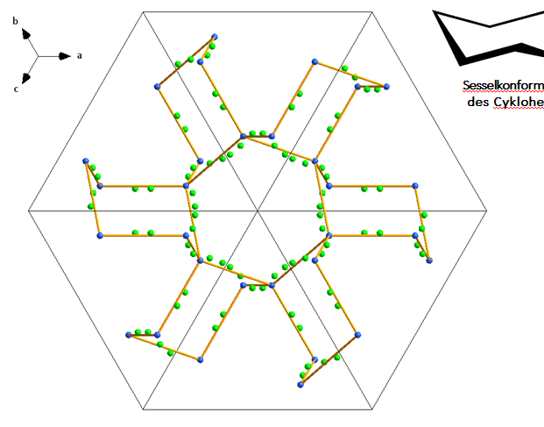
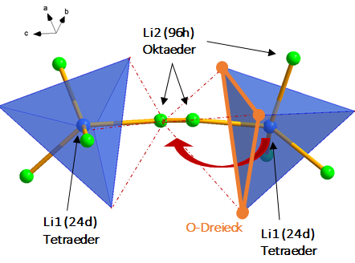
Li diffusion pathways
Li sites - long range order
111 plane
Jump distance from Li1 to Li2 interesting (through O triangle)
Also from Li2 to Li2 (and possibly directly from Li1 to next Li1)

Slide 5
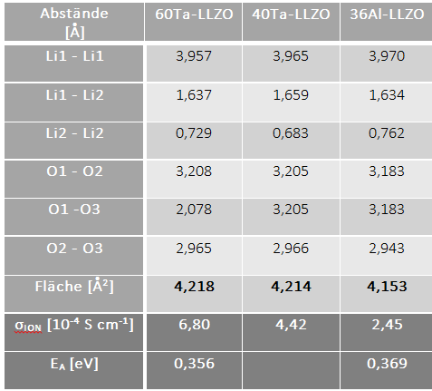
Jump distances and conductivity for our materials:
Cubic
For tetr.:
Conduction path more difficult – from Li1(tetr.) to Li2(oct.) to Li3(oct.) to Li1(tetr.)
Shortest distance between tetr. and oct. ~ 2.54 A and all others are even longer → O triangle area also ~4.20 but due to different angle, path is closer to an O atom → higher E_{a}?
Distance (Å)
3,208
Area (Å²)
From EIS
Comparison to other groups – next slide
From QENS
0,14
0,10
Opposite trend??both almost fully substituted, Al on Li site – effect? On which Site is the Al (normally on Li1)? which jump distance do we measure?

Slide 6
Comparison to other groups
MATERIAL | TECHNIQUE | GROUP | Model | D_{LI} | E_{A} | Journal
36Al-LLZO/ 40Ta-LLZO | QENS | WE | Ficks 1st law | 1x10-6 cm²/s | 0.1- 0.14 eV
xNb-LLZO | QENS | Nozaki et al., | Ficks 1st law |  | 15-20 kJ/mol | SSI, 262, (2014), p. 585
xNb-LLZO | µSR | " " |  | 1x10⁻¹² to 4x10⁻¹¹ cm²/s | s.o.
40Ta-LLZO | NMR | Hayamizu et al. |  | 1x10⁻¹² | 39,4 kJ/mol | Solid State Nuc Res, 70, (2015), p.21
25Al-LLZO | µSR | Amores et al. |  | 4,6x10⁻¹¹ cm²/s | 0,19-0,55 eV | J. Mater Chem A, 4, (2016) p.1729
LixSiy | simulation | Moon et al. |  |  |  | J. pow source, 328, (2016) p.558
Li12C60 | QENS | Christofolini et al. | Debye-Waller law |  |  | J. Phys Rev B, 61, Nr.5 (2000) p.3404
LiTFSI ionogel | QENS | Cerclier | rapid jump |  |  | ECS Trans. 64, Nr.4 (2014), p.27
LiPS4 | NMR | Haymamizu |  |  |  | SSI, 285, (2016), p.51
liquid Li | QENS | Blagoveshchenskii et al. | Ficks 1st law | 7,9x10⁻⁵ cm²/s | 0,104 eV | Physica B, 407, (2012), p.4567
liquid Li | QENS | Blagoveshchenskii et al. |  |  |  | Physics of Solid State, 56, Nr.1 (2014), p.120
LiMoO2 | QENS | Kamazawa et al. | Ficks 1st law | 10⁻⁸ cm²/s @400K |  | Phys Rev B, 83, 094401, (2011), p.1ff
LiBH4 | QENS | Myrdael et al. | /Chudley-Elliot Model + Tau + L | 10⁻⁷ cm²/s @300K |  | J. Phys Chem C, 117, (2013), p.9084
LiClO4 in EC/PC | QENS | Andersson et al. | /Gaussian jump length distribution model | 1,6x10⁻¹⁰ m²/s |  | Physica B, 301, (2001), p.44
LixSiy | QENS | Sacci et al. | /Chudley-Elliot Model + Tau + L | 3,3 to 17,9x10-6 cm²/s | o,20 eV | Chem Comm DRAFT!
1 kJ/mol = ~ 0,01 eV

Slide 7
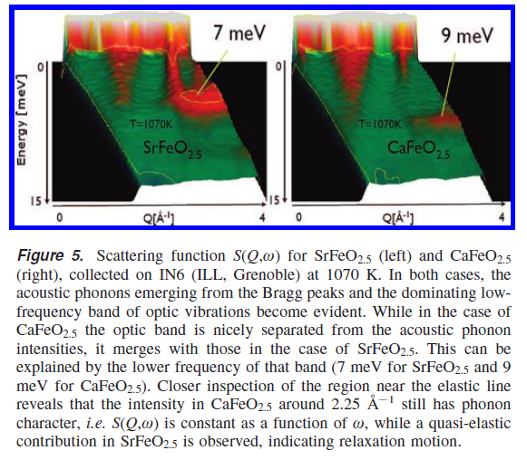
Other approaches to find out if we have transport or vibration (VISON?)

