Slide 1
Quasielastic Neutron Scattering Studies of Hybrid Perovskites
M.K. Crawford and N. Herron (DuPont)
M. Tyagi (NIST)
N. Jalarvo (ORNL)
November 25, 2014

Slide 2
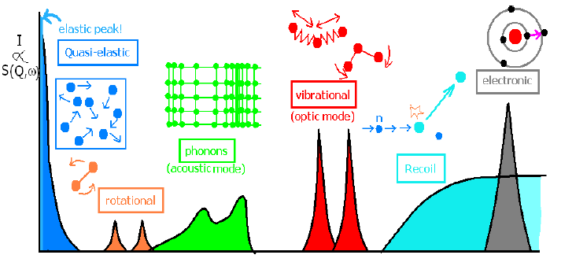
Quasielastic and Inelastic Neutron Scattering
Energy Transfer

Slide 3
Elastic fixed window scans
Measure intensity of elastic scattering vs T
Intensity of elastic scattering decreases as intensity transforms to quasielastic scattering
QENS reflects the presence of dynamical processes that exceed the energy resolution of the NIST back-scattering spectrometer
Resolution = 0.8 μeV ~ 0.006 cm⁻¹
In time domain, this corresponds to processes that occur on the 10⁻⁹-10⁻¹² sec timescale

Slide 4
Mean Square Displacement: MAPbI₃
Main Features
Cubic-tetragonal transition near 330 K does not affect MA cation dynamics
Pm3m → I4/mcm
First-order structural phase transition (orthorhombic → tetragonal) at T_{c} = 160 K
Dynamics first appear near 60 K
Methyl or MA rotations?
Quasielastic scans were then collected at various temperatures based upon this result

Slide 5
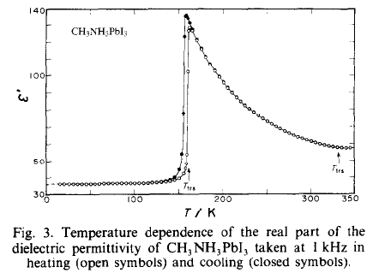
QENS vs Dielectric Constant
Cubic-tetragonal transition at 330 K does not affect MA cation dynamics or dielectric properties
Free rotation of MA cation
Strong drop in MSD and dielectric constant at tetragonal-orthorhombic phase transition
MA reorientations become restricted below T_{c}
Low T dynamics associated with rotations of methyls or MA ions around C-N axis (no orientation of dipole moments shown by dielectric constant)
Similar hysteresis

Slide 6
Mean Square Displacement: MAPbBr₃
Main features
Cubic-tetragonal transition at 236 K does not appear (as for iodide)
Pm3m → I4/mcm
Two structural transitions near 150 K
Tetragonal 1 → tetragonal 2
Tetragonal 2 → orthorhombic
Low temperature dynamics first appear near 30 K
60 K in iodide!

Slide 7
Mean Square Displacement: MAPbBr_{0.75}I_{2.25}
Main features
Smoothly increasing MSD
No sign of structural phase transition(s)!
At least no first-order (discontinuous) transitions
Sample is at APS for x-ray diffraction vs T

Slide 8
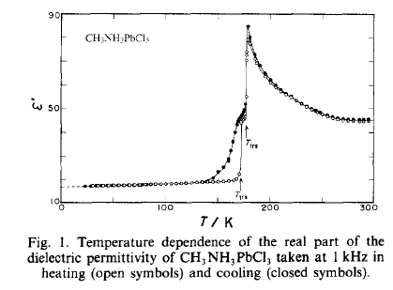
Mean Square Displacement: MAPbCl₃
Main features
Cubic-tetragonal 2 transition
Dielectric constant changes here
Pm3m → P4/mmm
Two first-order structural phase transitions
Two step dynamical transition starting at 30 K

Slide 9
Quantum Mechanical Tunneling
Tunnel transitions appear at T = 4 K
Only observed in MAPbCl₃
Just barely observable with HFBS spectrometer resolution of 0.8 μeV
MA cation rotations?
Methyl rotations?
Impurity phase?
Check synchrotron XRD
If due to MAPbCl₃, provides a measure of rotational barrier height
Q = 1.32 Å⁻¹

Slide 10
Next steps
Complete data analysis for activation energies of dynamics below T = 100 K
See is bromoiodide has any structural transitions
Suppressed by halogen disorder?
Next two weeks
Continue QENS and INS measurements at ORNL
Neutron diffraction determination of structures of fully deuterated samples
Especially MAPbI₃
PDF analysis of disordered structures using POWGEN data?

