Slide 1
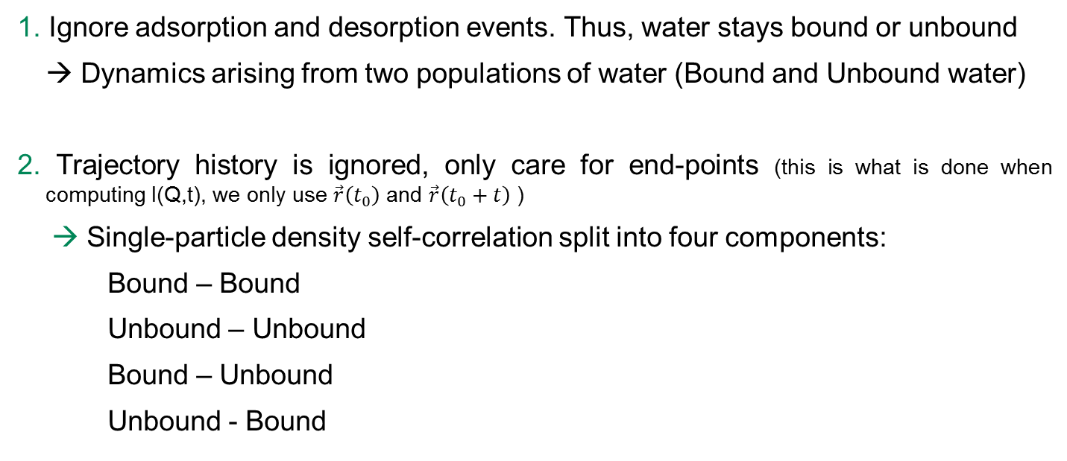
Decomposing I(Q,t)
Two methods of decomposition:
1. Ignore adsorption and desorption events. Thus, water stays bound or unbound
→ Dynamics arising from two populations of water (Bound and Unbound water)
2. Trajectory history is ignored, only care for end-points (this is what is done when computing I(Q,t), we only use $\vec{r}\left(t_{0}\right)$ and $\vec{r}\left(t_{0}+t\right)$ )
Single-particle density self-correlation split into four components:
Bound – Bound
Unbound – Unbound
Bound – Unbound
Unbound - Bound
Notes:
I am not sure if QCMD highlighted this one.

Slide 2
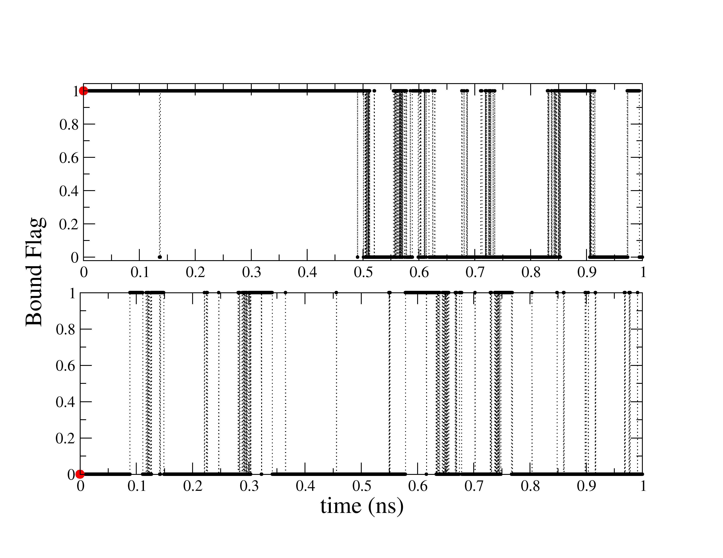
Two Representative Examples
Time series for two water hydrogens. One hydrogen started bound to the surface, and the other started unbound. (a value of 1 means bound, and 0 means unbound)
Notes:
I am not sure if QCMD highlighted this one.

Slide 3
Two populations of water (decomposition 1)
Calculate I(Q,t) for all segments → I_{B}(Q,t)
Calculate I(Q,t) for all segments → I_{U}(Q,t)
Desorption event (yellow squares)
not taken into account
Notes:
I am not sure if QCMD highlighted this one.

Slide 4
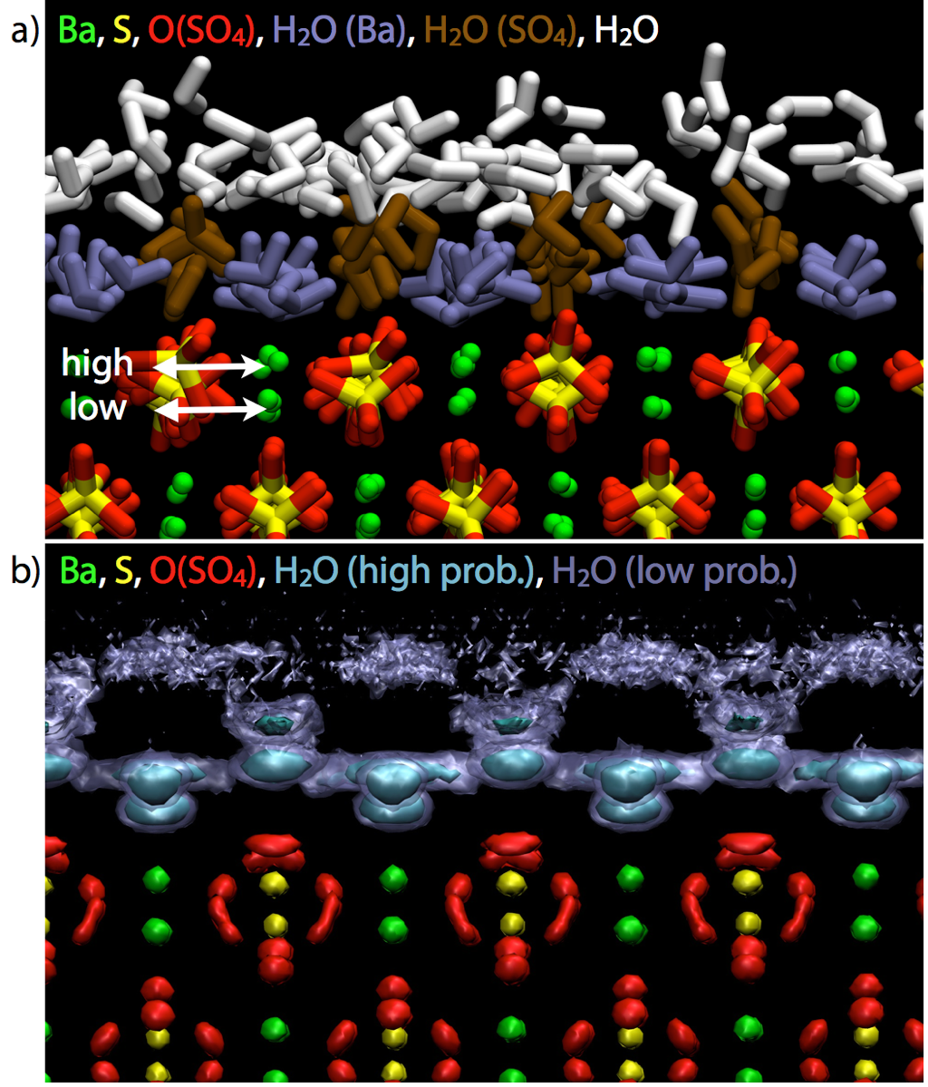





Single-particle density self-correlations (decomposition 2)
Conditions are only imposed on the end-points
B
B
All → All | $$G\left(\vec{r},t\right)=1/{N_{H}\sum_{i}{{\left\langle ρ_{i}\left(\vec{r},t_{0}\right)ρ_{i}\left(\vec{r},t_{0}+t\right)\right\rangle }_{t_{0}}}}$$
B → B | $$1/{N_{H}\sum_{i}{{\left\langle ρ_{Bi}\left(\vec{r},t_{0}\right)ρ_{Bi}\left(\vec{r},t_{0}+t\right)\right\rangle }_{t_{0}}}}$$
B → U, U → B | $$1/{N_{H}\sum_{i}{{\left\langle ρ_{Bi}\left(\vec{r},t_{0}\right)ρ_{Ui}\left(\vec{r},t_{0}+t\right)\right\rangle }_{t_{0}}}}$$
U → U | $$1/{N_{H}\sum_{i}{{\left\langle ρ_{Ui}\left(\vec{r},t_{0}\right)ρ_{Ui}\left(\vec{r},t_{0}+t\right)\right\rangle }_{t_{0}}}}$$
$${ρ=ρ}_{B}+ρ_{U}$$
$$ρ_{U}$$
$$ρ_{B}$$
$I=I_{BB}+I_{UU}$ + $I_{BU}$ + $I_{UB}$
Notes:
I am not sure if QCMD highlighted this one.

Slide 5
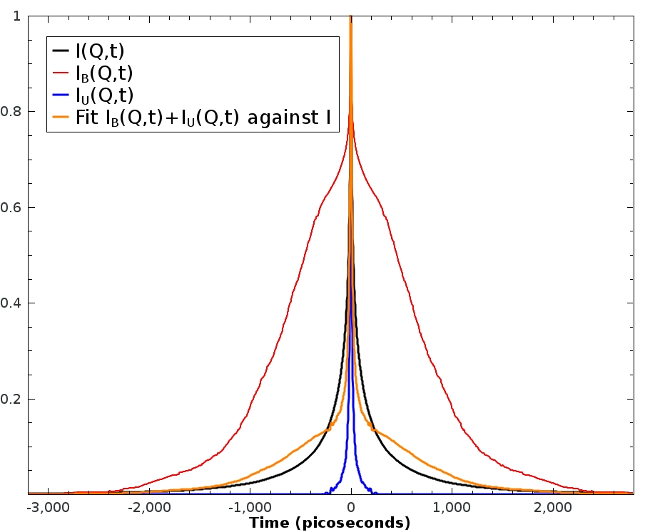
Two populations of water: Results
I_{B} decreases much slower than I_{U} (expected)
I_{B} has two clearly defined decays
I_{B}+I_{U} cannot reproduce whole I(Q,t). We have to include desorption/adsorption
Notes:
I am not sure if QCMD highlighted this one.

Slide 6
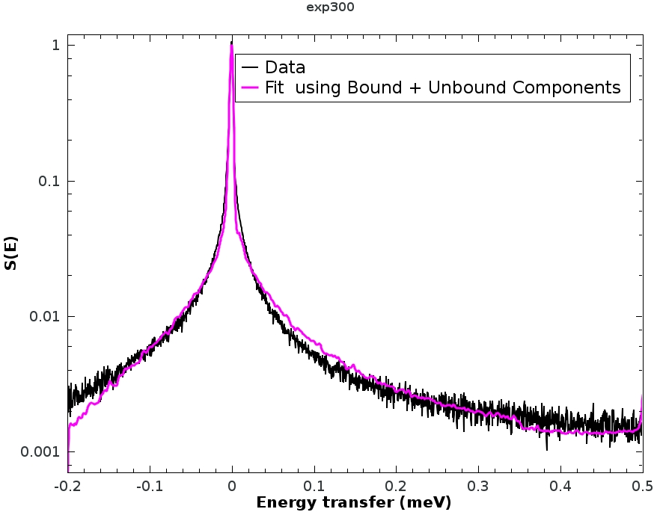
Two populations of water: Fit
Fit of the Q-integrated 300K data using the bound and unbound components previously calculated
$$S\left(E\right)=R\left(E−E_{0}\right)⊗\left[aδ\left(E\right)+{bS}_{B}\left(E\right)+{cS}_{U}\left(E\right)\right]+LB$$
(The fit is terrible)
Conclusion: we cannot ignore the adsorption and desorption events
Notes:
I am not sure if QCMD highlighted this one.

Slide 7
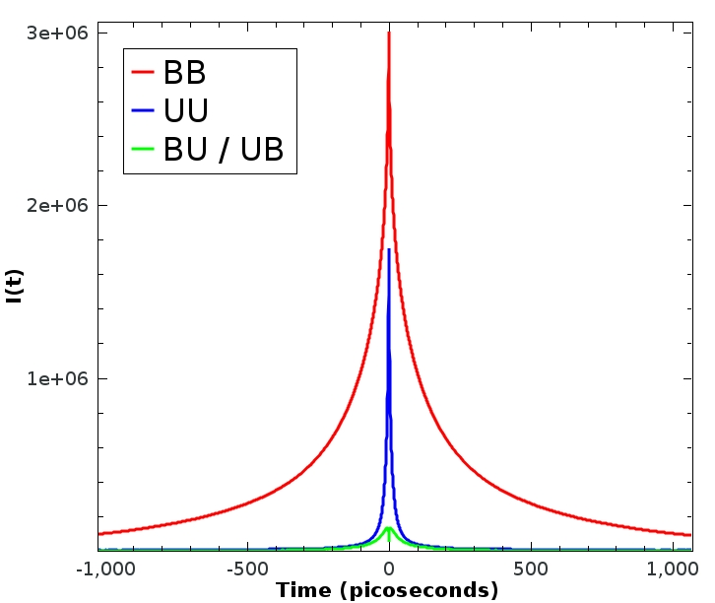
Single-particle density self-correlations: Results
I_{BB} decreases much slower than I_{U} (expected)
I_{BB}, I_{UU} , I_{BU} and contain absorption and desorption events
Notes:
I am not sure if QCMD highlighted this one.

Slide 8
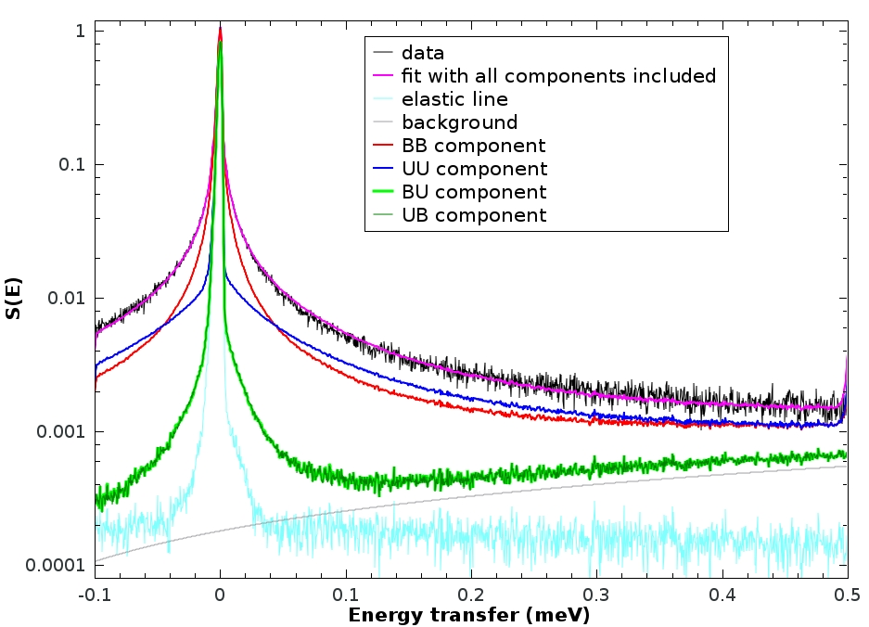
Single-particle density self-correlations: Fit
$Because I=I_{BB}+I_{UU}$ + $I_{BU}$ + $I_{UB}$ we can write the model fit as:
$$S\left(E\right)=R\left(E−E_{0}\right)⊗\left[aδ\left(E\right)+{bS}_{simulation}\left(E\right)\right]+LB= R\left(E−E_{0}\right)⊗\left[aδ\left(E\right)+b\left(S_{BB}+S_{UU}{+S}_{BU}{+S}_{UB}\right)\right]+LB$$
S_{BB} dominates the signal for E<0.045meV, or t > 90ps.
Notes:
I am not sure if QCMD highlighted this one.

Slide 9
Title
Notes:
I am not sure if QCMD highlighted this one.

