Slide 1
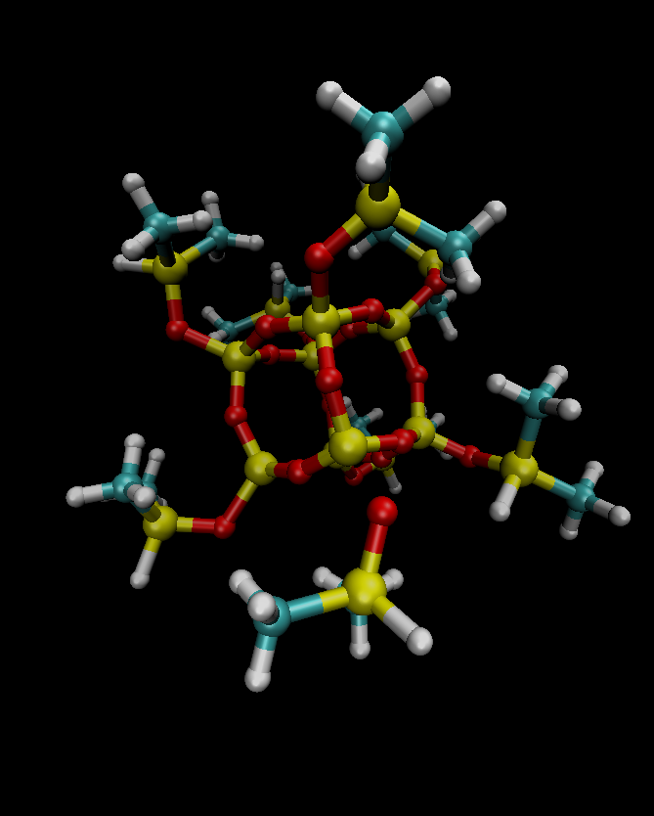
A: side-chain
B: isopropyl
C: methyl
B
C
A

