Slide 1
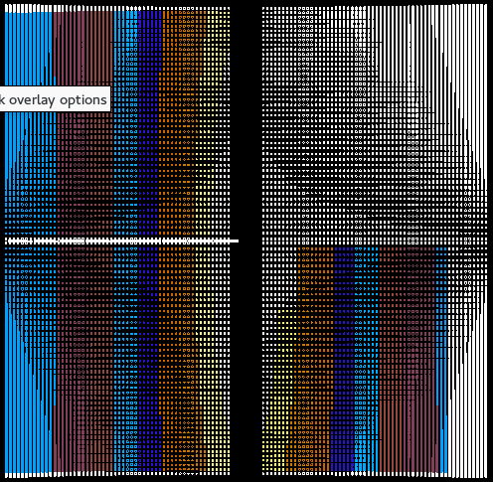
Current View
Proposed View
Top
Left/South
Top
Right/North
Difraction detectors
Bottom
Left/South
Bottom
Right/North

