Slide 1
Improve your application scalability with CQRS and events
Jorge Branquinho

Slide 2
Simple CRUD
- simple and intuitive design
- low development cost
<Feature> Controller
<Feature> Service
<Feature> Repository
OrdersController > BuyProduct(…)
OrderService > BuyProduct(…)
OrderRepository > AddOrder(…)

Slide 3
Simple CRUD
- But can quickly become complex and difficult to manage all the services
- Examples: circular dependencies, too much logic on a single service, too many people changing the same file at the same time, etc.
<Feature> Controller
<Feature> Service A
<Feature> Repository
OrdersController > BuyProduct(…)
OrderService > BuyProduct(…)
OrderRepository > AddOrder(…)
<Domain> Service
<Feature> Service B
<Feature> Service C
IdentityService > GetUserDetails(…)
PaymentService > ProcessPayment(…)
FraudDetectionService > CheckoutOrder(…)
Notes:
Customer controller (BuyProduct) =>CustomerService (RegisterPurchase) => PaymentService (ProcessPayment) => ProductOrderService (ProcessOrder) => …

Slide 4
Command Query Responsibility Segregation – What is it?
It is a design pattern where you separate operations that change data from operations that read data
The goal is separation of responsibilities
Traditional system
CQRS
CustomerService
GetCustomerByIdQuery
GetCustomerById
GetAllCustomers
AddNewCustomer
DeleteCustomerById
Queries
(read data)
GetAllCustomersQuery
AddNewCustomerCommand
Commands
(handle changes)
DeleteCustomerByIdCommand
Notes:
Analogy: the kitchen is where the food is prepared according to the rules and the process. The menu is what the customers use to see what is available.

Slide 5
Command Query Responsibility Segregation – What is it?
A command is a request to change something in the system
It should:
Change state
Contain business intent
Should not return a big data object*
Should enforce business rules
Should be validated
Be consistent and transaction-friendly
A query is a request to get data
It should:
NOT change state
Return simple or complex information
Optimized for fast reading and presentation
Be fast
Filter and aggregate data (denormalized data)
Data shaped for the UI
CQRS
GetCustomerByIdQuery
Queries
(read data)
GetAllCustomersQuery
AddNewCustomerCommand
Commands
(handle changes)
DeleteCustomerByIdCommand

Slide 6
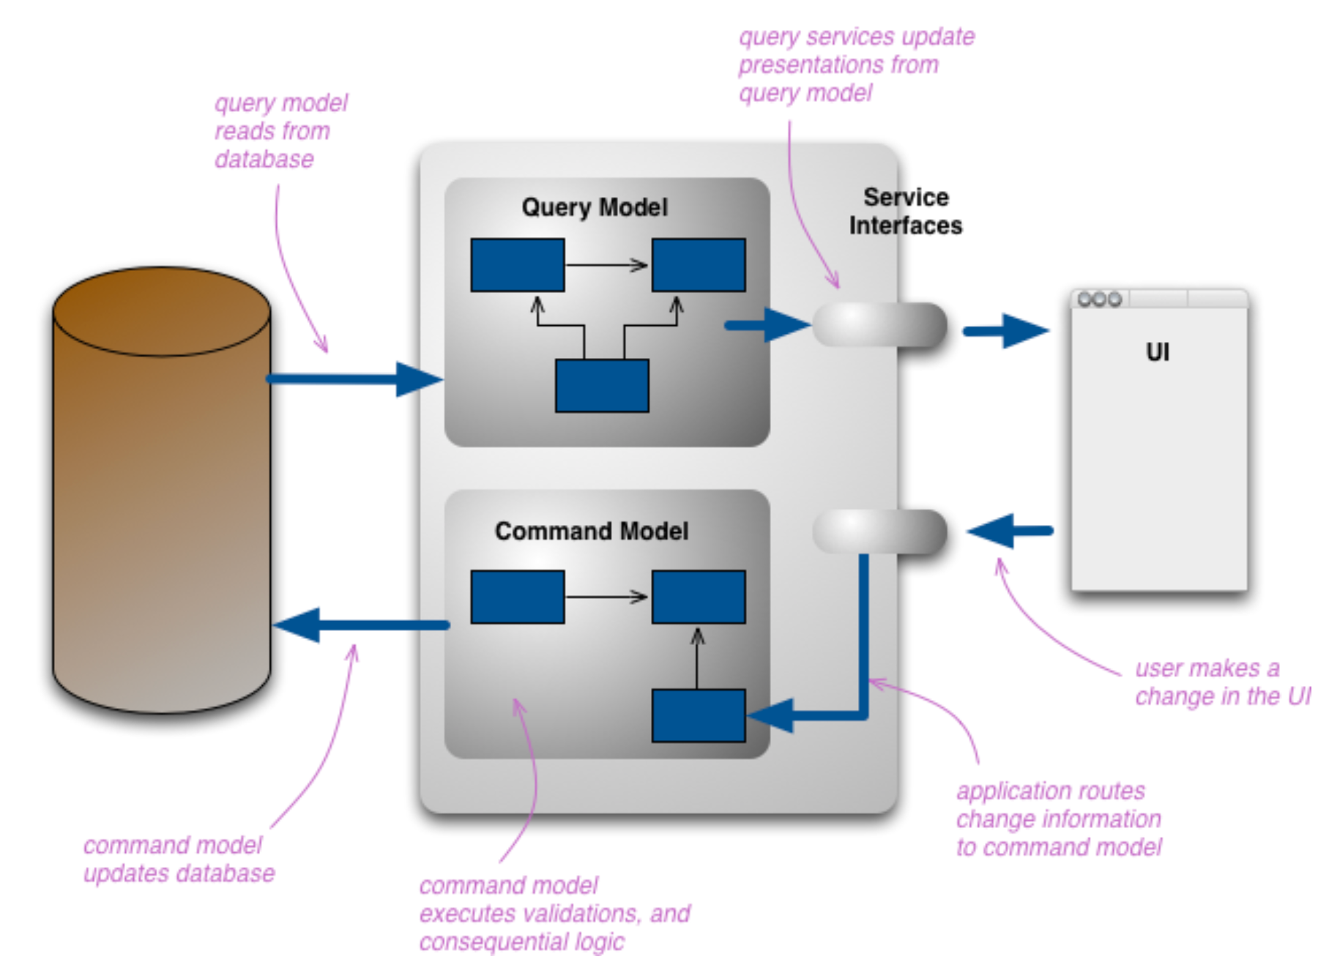
Command Query Responsibility Segregation – Light versus Full
Light CQRS does not require:
Two Databases or separate stores (repositories) for reading and writing
Microservices or distributed systems
Event sourcing or Domain driven design (DDD) but highly recommends it
CQRS
GetCustomerByIdQuery
Queries
(read data)
GetAllCustomersQuery
AddNewCustomerCommand
Commands
(handle changes)
DeleteCustomerByIdCommand
Credit: https://martinfowler.com/bliki/CQRS.html

Slide 7
Architecture with CQRS + event sourcing
<Domain> Service(s)
IdentityService > GetUserDetails(…)
<Feature> Controller
Command / Query Handler
<Feature> Repository
Command / query
BuyProductCommand
OrdersController > BuyProduct(…)
BuyProductCommandHandler(…)
OrderRepository > AddOrder(…)
Each handler is specific to an operation – not a feature
Raise Event(s)
raise OrderPlaced event
Notes:
Customer controller (BuyProduct) =>RegisterPurchaseCommand (raise events to processpayment) => …

Slide 8
Architecture with CQRS + event sourcing
<Domain> Service(s)
?
Event Handler
<Feature> Repository
event
OrderPlaced event
OrderPlacedEventHandler - processes payment
Raise Event(s)
raise OrderPaid event
Notes:
Customer controller (BuyProduct) =>RegisterPurchaseCommand (raise events to processpayment) => …

Slide 9
Architecture with CQRS + event sourcing
<Domain> Service(s)
?
Event Handler
<Feature> Repository
event
OrderPaid event
OrderPaidEventHandler - checks for fraud
Raise Event(s)
Notes:
Customer controller (BuyProduct) =>RegisterPurchaseCommand (raise events to processpayment) => …

Slide 10
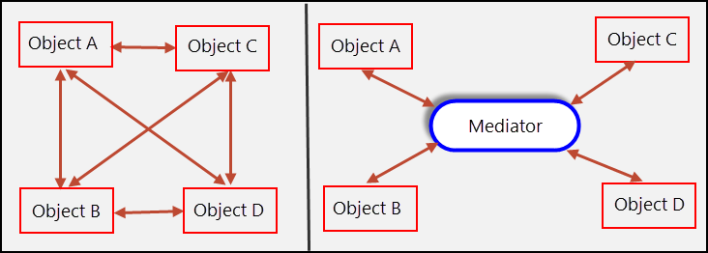
Command Query Responsibility Segregation – Mediator
Mediator Pattern
Another design pattern – an object in between 2 components that handles the communication between them.
Used for:
Decoupling
Cleaner architecture
Centralized pipeline behavior
Credit: https://springframework.guru/gang-of-four-design-patterns/mediator-pattern/

Slide 11

Pros
Clear separation of concerns and cleaner business logic
Makes it easier to implement DDD and event sourcing
Faster and more flexible for reading operations
Scalability and maintainability
Easy to work with large teams and/or complex domains
Easier to deal with circular dependencies
Cons
More boilerplate code
Not intuitive to every developer
Higher development cost (more code, more unit tests, etc)
Overkill in simple projects
Requires a disciplined team
Can still loop if the event sourcing logic has bugs
Notes:
Should be used when the pros outwheight the cons

Slide 12
Command Query Responsibility Segregation – when to use it?
When not to used it:
By default
Simple CRUD application
Not a silver bullet or a one size fits all solution
Use it when:
System is rather complex
You require high-performance especially on read operations
Multiple views for the same data
System requires consistency everywhere
Advantages outweigh the disadvantages
Notes:
Should be used when the pros outwheight the cons

Slide 13
Thank you
Credit:
https://learn.microsoft.com/en-us/azure/architecture/patterns/cqrs
https://springframework.guru/gang-of-four-design-patterns/mediator-pattern/
https://martinfowler.com/bliki/CQRS.html
https://github.com/keyvanakbary/cqrs-documents
https://docs.aws.amazon.com/prescriptive-guidance/latest/modernization-data-persistence/cqrs-pattern.html

Slide 14
QUIZ & Q&A
What is/are the design pattern(s) that are commonly in use behind CQRS and event sourcing? A) Ports and adapters B) Mediator C) Command query responsibility segregation
D) Singletons
What is an event?
A) A request to change system state
B) A database transaction
C) A fact that something already happened
D) A function call between services
Given a brand-new project with 4 developers to create a hotel room-booking application - which approach should you apply?
Do you agree/disagree with the following statement “Using CQRS we no longer have a need for services”?
Why combine CQRS and event sourcing?

Slide 15
QUIZ & Q&A - answers
What is/are the design pattern(s) that are commonly in use behind CQRS and event sourcing? B) Mediator C) Command query responsibility segregation
What is an event? C) A fact that something already happened
Given a brand-new project with 4 developers to create a hotel room-booking application - which approach should you apply? Simple layered CRUD (small team + faster to implement and maintain in the beginning)
Do you agree/disagree with the following statement “Using CQRS we no longer have a need for services”? No. You may still need domain and application services to handle common logic
Why combine CQRS and event sourcing? CQRS separates intent (commands) from observability (queries). Events give you a audit history, traceability and replicability. Both help decoupling components.

