Slide 1

Quizz Driven Teaching (a.k.a QUIDDITCH)
Jean-Michel.Bruel@univ-tlse2.fr
12/04/2018

Slide 2
« Désolé » (Apologies)
For the slides in English
Reuse purpose
English Class at Blagnac DUT Info
For the difference with the title from the program
“Construire un cours de A à Quizz” (I love it, but it’s not mine!)
For the length of the slides
Built as a tutorial
Intended for a broader audience (colleagues, …)

Slide 3
What is it all about ?
Applying Quality principles to teaching
Test-driven

Slide 4
What is it all about ?
As a teacher I want …
To pass useful knowledge
To make sure students get the message
To make sure students get the right message
As a student I want …
To have fun!
To play !
To have credits/ETCS
To learn useful knowledge

Slide 5
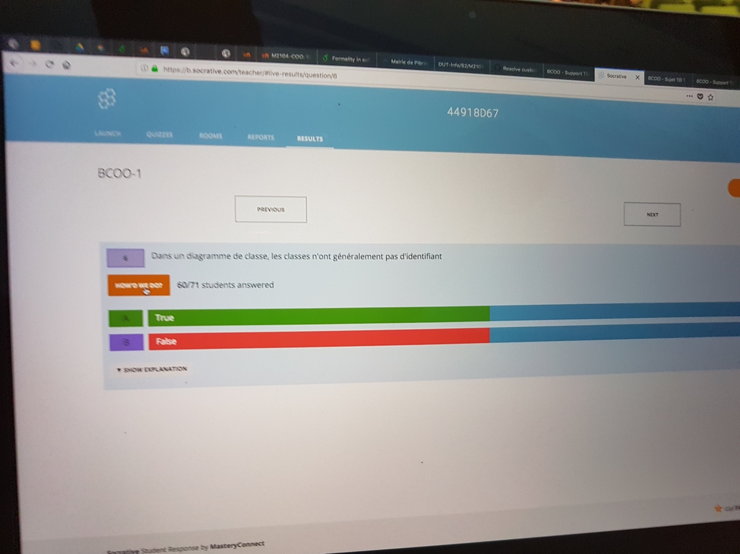
Feedback immediat

Slide 6
More can be done…
Races
Exam/Paper version of the questions
Statistics
…

Slide 7
Take over

Slide 8
Thanks!
Contact: jean-michel.bruel@univ-tlse2.fr
Socrative web site: https://www.socrative.com/ (free)
Room # (live test): 44918D67

