Slide 1

Chemical Competition in Peatlands
Jon Swanson, M.S.
Edwin O. Smith High School
Jessica Budke, M.S.
Bernard Goffinet Ph.D.
Department of Ecology and Evolutionary Biology
University of Connecticut
Storrs, Connecticut
This work was funded by a grant from the National Science Foundation

Slide 2
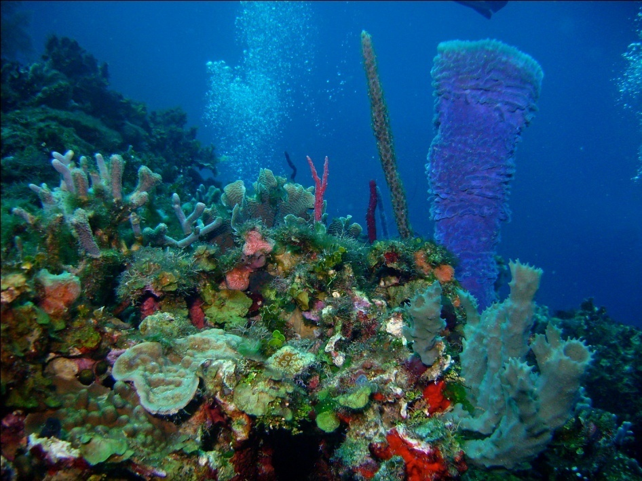
Ecological Competition
Competition- interaction between two or more species utilizing a common resource
Ex. Coral species compete for space in a reef ecosystem

Slide 3
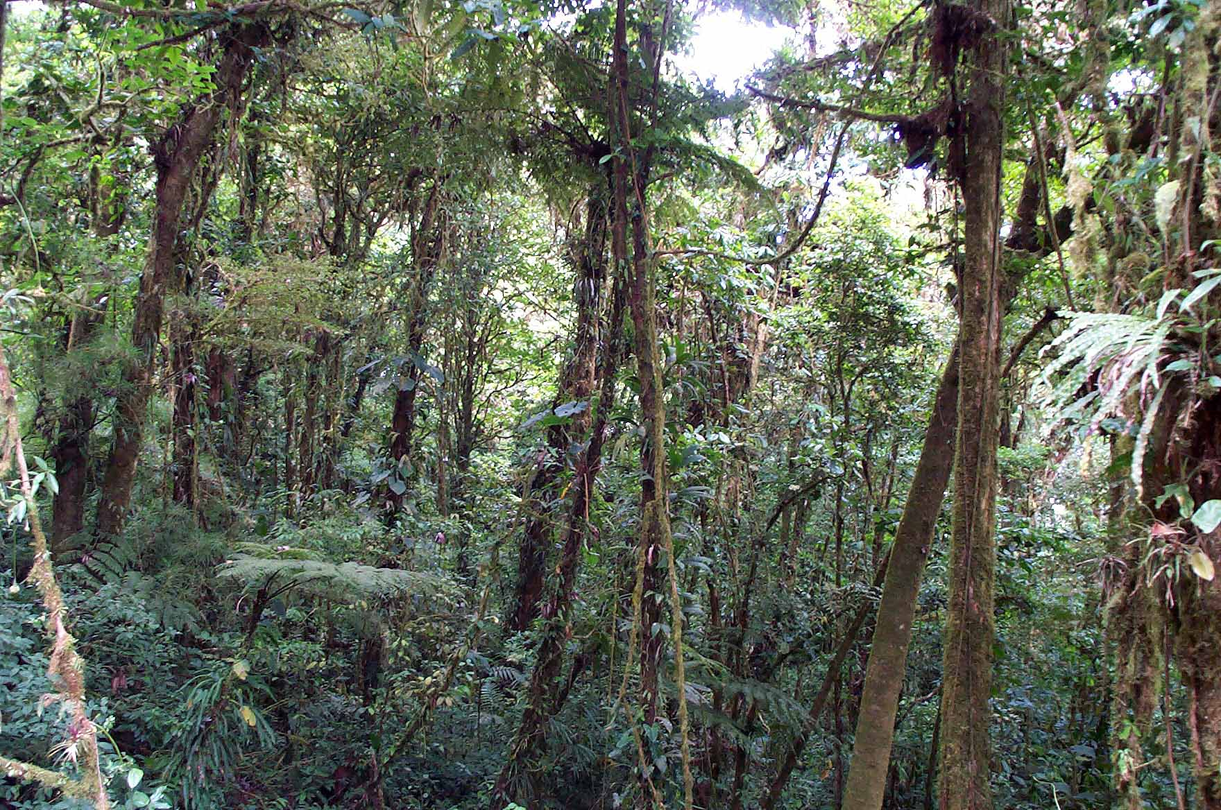
Competition in plants?
Plants compete for resources just like animals
Ex. Competition for light in a rainforest

Slide 4
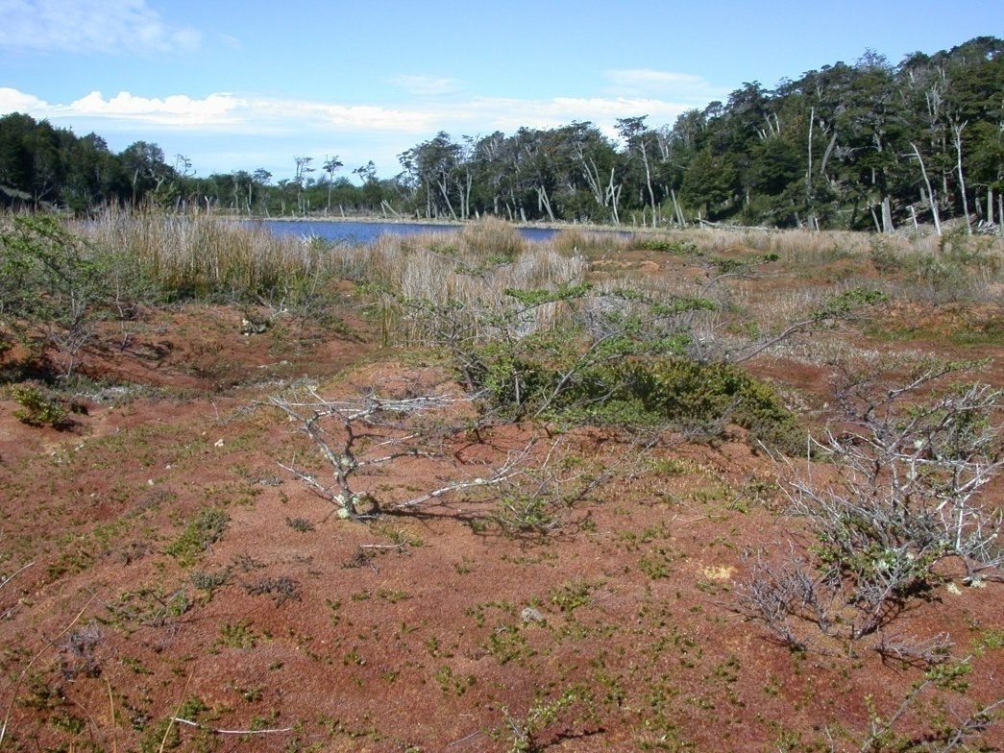
Competition in plants?
Some plants compete by changing their environment to better suit themselves and exclude the other plants in the area
  Ex. Sphagnum

Slide 5
Peat Bog Chemistry
pH in a peat land ranges from a neutral 7 (fen) to a very acidic 3.5 (bog)
Mosses of the genus Sphagnum may trigger a drop in the pH and subsequently dominate the environment
The question is how?

Slide 6
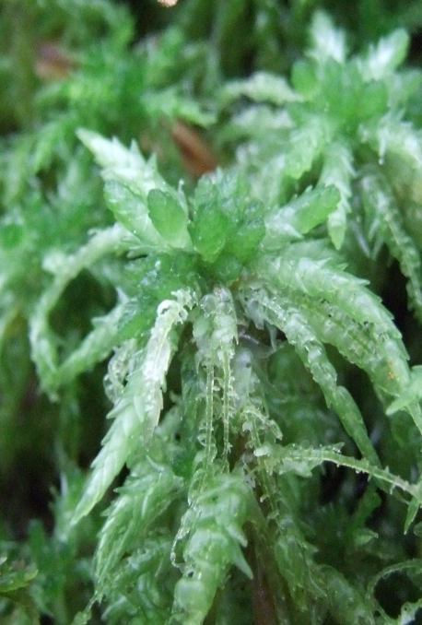
Ion Exchange in Sphagnum
Na⁺
H⁺
K⁺
Na⁺
Mg⁺
H⁺
H⁺
H⁺
Mg⁺
Na⁺
Ca²⁺
K⁺
H⁺
Typical surface water contains a number of cations.

Slide 7
Ion Exchange in Sphagnum
Individual Sphagnum cell
Na⁺
H⁺
H⁺
K⁺
H⁺
Na⁺
Mg⁺
H⁺
H⁺
H⁺
H⁺
Mg⁺
H⁺
Na⁺
Ca²⁺
H⁺
K⁺
H⁺
As Sphagnum mosses settle in the wetland, their cell walls begin
to exchange cations in the water for hydrogen ions in the wall.

Slide 8
Ion Exchange in Sphagnum
Individual Sphagnum cell
H⁺
H⁺
H⁺
Na⁺
K⁺
Na⁺
Mg⁺
Na⁺
H⁺
H⁺
H⁺
H⁺
H⁺
Ca²⁺
Mg⁺
K⁺
H⁺
H⁺
The end result is an increase in the hydrogen ion concentration
in the surrounding water leading to a decrease in pH.

Slide 9
An Acidic Environment
By decreasing the pH of the wetland water, the Sphagnum makes the environment less hospitable to other plant species
Over time the other plant species die and the area becomes dominated by the Sphagnum mosses
The result is a bog

Slide 10
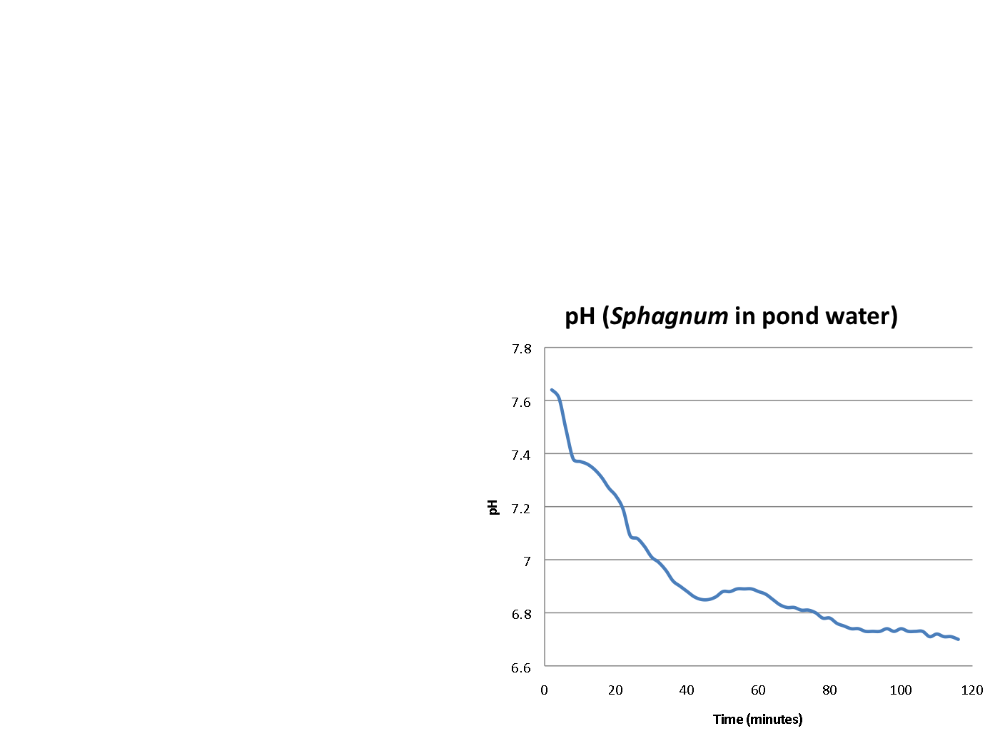
In the Lab
The same ion exchange can be demonstrated in a lab setting
30 g of Sphagnum
400 ml of H₂O

Slide 11
Succession in Peatlands
As species of Sphagnum start to invade the wetland, the pH drops rapidly
  Remember- pH is a base 10 scale and at higher pH’s fewer H⁺ are needed to change the pH
This pH drop allows other, even more acid tolerant species of Sphagnum to settle in the area
This ion exchange, along with the decay of the dead Sphagnum plants, can bring the pH in a bog down to a very acidic 3.5

Slide 12
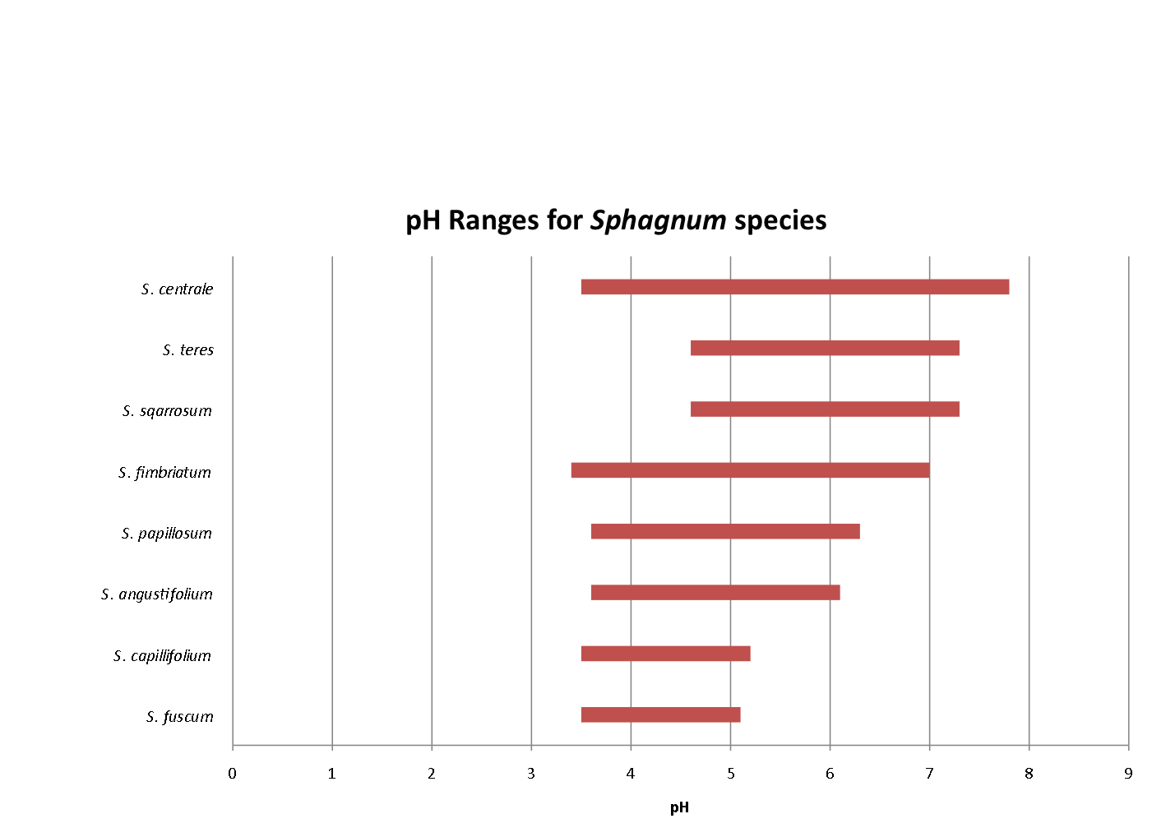
Succession in Peatlands
S. squarrosum
Data from McQueen, Cyrus B. Field Guide to the Peat Mosses of Boreal North America. Hanover, NH: University of New England, 1990. Print.

Slide 13
Succession in Peatlands
Initial wetland vegetation consists of a mix of grasses, sedges, shrubs and some mosses.
When Sphagnum settles, it lowers the pH, making the environment poor for the survival of the other species

Slide 14
Succession in Peatlands
The decreased pH creates a very acidic environment
  The result is a Sphagnum dominated wetland
  The continued growth of layers of living Sphagnum on top of dead plants creates a low oxygen environment beneath the mat
Low O₂ and low pH = severely decreased bacterial activity

Slide 15
Preservation in Peatlands
Bogs have been a good place to find animals and artifacts from thousands of years ago due to decreased bacterial activity
  For example, a mammoth was pulled from a frozen bog in Siberia having been almost perfectly preserved by the bog environment for 40,000 years

