Slide 1
Deliverable 1
The Textbook Triad
Jacob Cole, Michael Pittard, Parker Cantu

Slide 2
Project Description
UNTextbook Finder
Voertman’s, UNT Bookstore, Amazon, and Chegg
Uses Python for web scraping
Scrapy framework
JSON files will be used to store the scraped data

Slide 3
Project Timeline
1.1 Project Planning
1.2 Manual
2.1 Develop interface
2.2 Create web scraping scripts
3.1 Controller (between the front-end and backend)
4.1 Testing and revising
5.1 Deployment

Slide 4
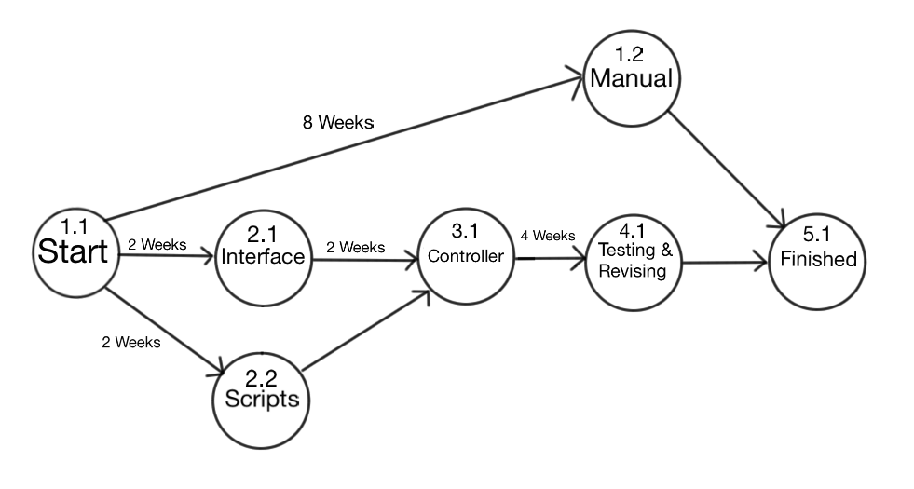
PERT Diagram

Slide 5
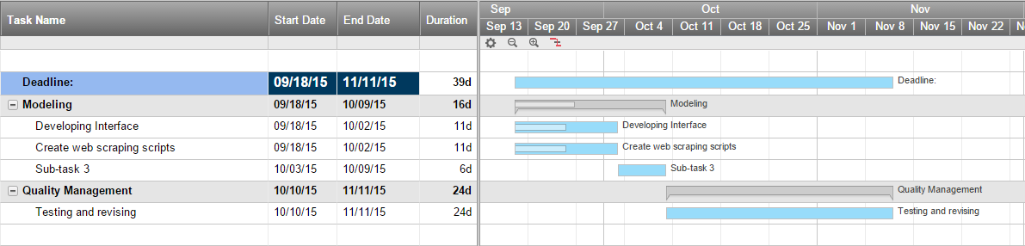
Gantt Chart

Slide 6
Risk Analysis
Connection timeouts/3rd party websites down
3rd party webpage format change
Flawed logic
Inaccurate dependencies
Time spent on design decisions

Slide 7
Report
Jacob (leader)
backend scripts
Parker
interface
Michael
controller

Slide 8
Report (cont.)
Repository Policies
GitHub as remote repository (public)
A branch with each of our names as the branch name
Merge our branches into master when we will a feature is ready
Merge conflicts will be handled by communication

