Slide 1
Visualizing High Dimensions
HUGEN 2073
Genomic Data Visualization and Integration
Slides borrow/adapted from H. J. Park with permission
Notes:
Avoiding common pitfalls when clustering biological data

Slide 2

High dimension can be visualized in dimension-reduced forms
In biomedical studies, n<<p (=dimension)
n = sample size (e.g., people)
p = number of variables (e.g., SNPs)
Dimensionality reduction means reducing the number of variables
Examples
Clustering
Principal component analysis (PCA)
t-distributed stochastic neighbor embedding (t-SNE)
https://tincture.io/precision-medicine-targets-wallets-better-than-disease-6596e5a7a8cc
Notes:
High Variance: features with a lot of variance contain a lot of potential signal — signal (a.k.a. useful information) is a basic requirement for building a good model.
Uncorrelated: features that are highly correlated with each other are less useful and in certain cases downright harmful (when the correlation is so high as to cause multicollinearity). To see why this is so, pretend that you employ a roomful of talented stock traders. Would you prefer them to all invest in a similar manner or differently? If it were me, I would prefer them to be as different from each other as possible — this creates a diversifying effect where the traders protect each other from their errors and you almost never have a situation where everyone is simultaneously wrong.
Not That Many: We want to have a low number of features relative to our number of target variable observations. Too many features relative to observations would result in an overfit model that performs poorly out of sample.

Slide 3
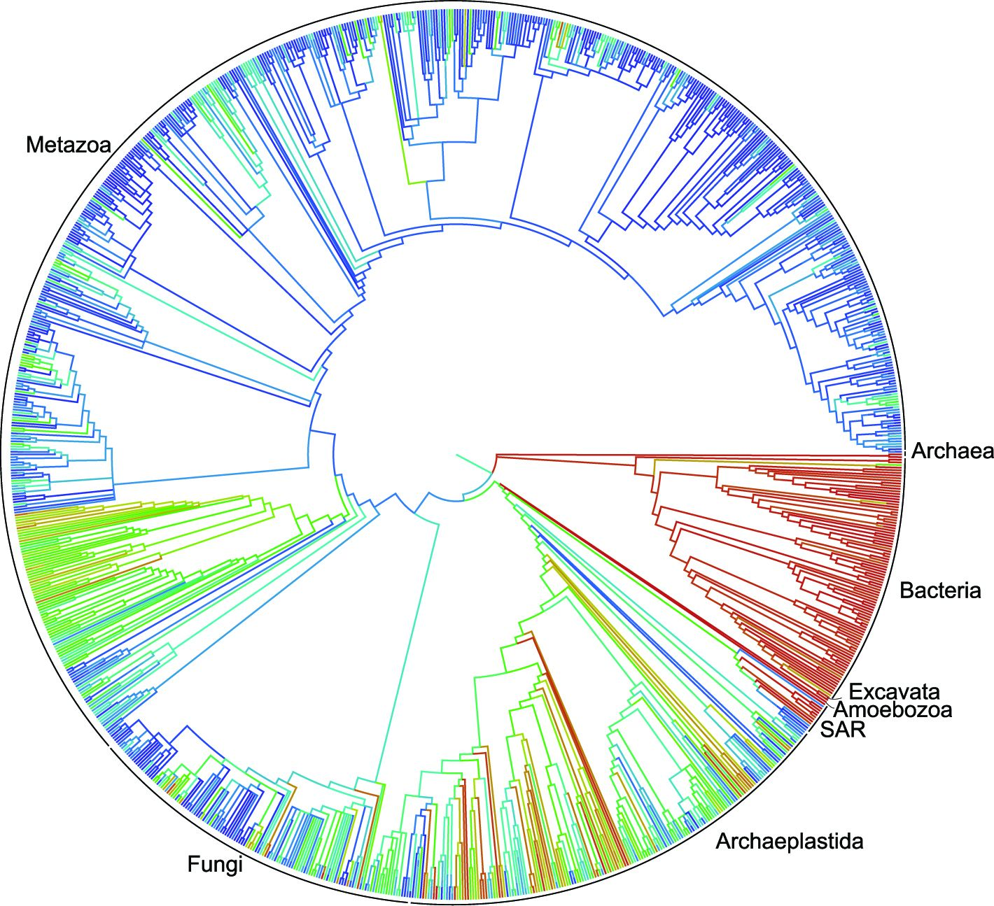
Hierarchical clustering groups data points in a nested fashion by similarity
Clustering of biological species
To understand clusters, we need to understand
What data was used?
How was the similarity estimated?
https://www.sciencemag.org/news/2015/09/first-comprehensive-tree-life-shows-how-related-you-are-millions-species

Slide 4
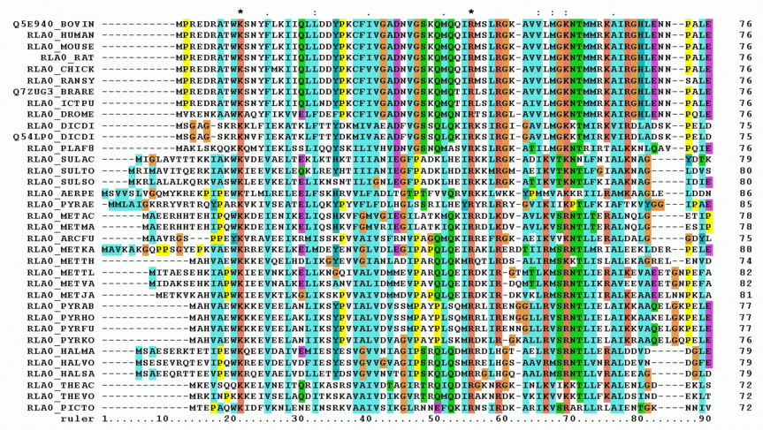
Hierarchical clustering groups data points in a nested fashion by similarity
What data was used?
DNA sequences of biological species
Clustering of biological species
2. How was the distance estimated? A distance measure
https://en.wikipedia.org/wiki/Multiple_sequence_alignment

Slide 5
Hierarchical clustering groups data points in a nested fashion by similarity
What data was used?
DNA sequences of biological species
A phylogenetic tree
2. How was the distance estimated? An evolutional model
https://en.wikipedia.org/wiki/Multiple_sequence_alignment

Slide 6
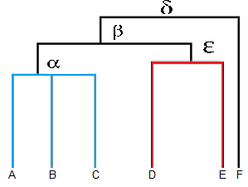
Hierarchical clustering makes a tree (dendrogram)
Clustering of biological species

Slide 7

Dendrogram visualizes hierarchical relationship of terminal nodes
Dendrogram = nodes + edges
Nodes
root node: no parent allowed
intermediate nodes: multiple descendants
terminal nodes: data points
Edges represent the relationship
$$γ$$
https://www.statisticshowto.datasciencecentral.com/hierarchical-clustering/
Notes:
dendogram can be a column graph (as in the image below) or a row graph. Some dendograms are circular or have a fluid-shape, but software will usually produce a row or column graph. No matter what the shape, the basic graph comprises of the same parts:
The clade is the branch. Usually labeled with Greek letters from left to right (e.g. α β, δ…).
Each clade has one or more leaves. The leaves in the above image are:
Single (simplicifolius): F
Double (bifolius): D E
Triple (trifolious): A B C
A clade can theoretically have an infinite amount of leaves. However, the more leaves you have, the harder the graph will be to read with the naked eye.

Slide 8

Dendrogram visualize group memberships
Leaves A, B, and C are more similar to each other than to D, E, or F.
Leaves D and E are more similar to each other than to A, B, C, or F.
Leaf F is different from all of the other leaves.
$$γ$$
https://www.statisticshowto.datasciencecentral.com/hierarchical-clustering/
Notes:
The clades are arranged according to how similar (or dissimilar) they are. Clades that are close to the same height are similar to each other; clades with different heights are dissimilar — the greater the difference in height, the more dissimilarity (you can measure similarity in many different ways; One of the most popular measures is Pearson’s Correlation Coefficient).
Note that on the above graph, the same clave, β joins leaves A, B, C, D,and E. That means that the two groups (A,B,C & D,E) are more similar to each other than they are to F.

Slide 9

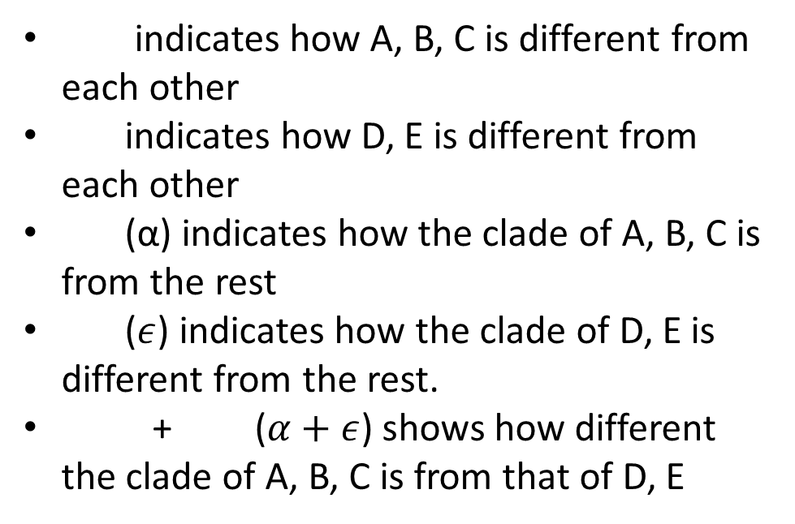
Dendrogram visualizes distances among objects
indicates how A, B, C is different from each other
indicates how D, E is different from each other
(α) indicates how the clade of A, B, C is from the rest
($ε$) indicates how the clade of D, E is different from the rest.
+ ($α+ε$) shows how different the clade of A, B, C is from that of D, E
$$γ$$
https://www.statisticshowto.datasciencecentral.com/hierarchical-clustering/
Notes:
The clades are arranged according to how similar (or dissimilar) they are. Clades that are close to the same height are similar to each other; clades with different heights are dissimilar — the greater the difference in height, the more dissimilarity (you can measure similarity in many different ways; One of the most popular measures is Pearson’s Correlation Coefficient).
Note that on the above graph, the same clave, β joins leaves A, B, C, D,and E. That means that the two groups (A,B,C & D,E) are more similar to each other than they are to F.

Slide 10
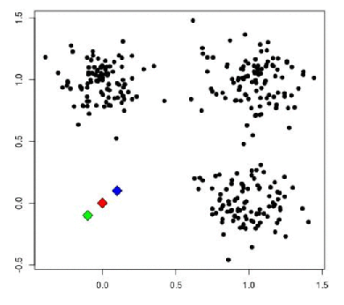
Clustering based on distance
Algorithm of K-means clustering on 2-D data
Given data of two dimensions (features)
Dimension 2
Dimension 1
https://towardsdatascience.com/cluster-analysis-create-visualize-and-interpret-customer-segments-474e55d00ebb

Slide 11
Clustering based on distance
Algorithm of K-mean clustering on 2-D data
Given data of two dimensions
Assuming three clusters (K=3)
Dimension 2
Dimension 1
https://towardsdatascience.com/cluster-analysis-create-visualize-and-interpret-customer-segments-474e55d00ebb
Notes:
Note that there are a wealth of methods to determine

Slide 12
Clustering based on distance
Algorithm of K-mean clustering on 2-D data
Given data of two dimensions
Assuming three clusters (K=3)
Randomly choose the center point (centroid) for the clusters
Dimension 2
Dimension 1
https://towardsdatascience.com/cluster-analysis-create-visualize-and-interpret-customer-segments-474e55d00ebb
Notes:
Note that there are a wealth of methods to determine

Slide 13
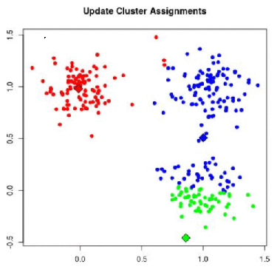
Clustering based on distance
Algorithm of K-mean clustering on 2-D data
Given data of two dimensions
Assuming three clusters (K=3)
Update cluster assignments based on the distance
Dimension 2
Dimension 1
https://towardsdatascience.com/cluster-analysis-create-visualize-and-interpret-customer-segments-474e55d00ebb

Slide 14
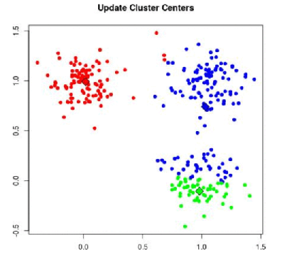
Clustering based on distance
Algorithm of K-mean clustering on 2-D data
Given data of two dimensions
Assuming three clusters (K=3)
Update the cluster centers
Dimension 2
Dimension 1
https://towardsdatascience.com/cluster-analysis-create-visualize-and-interpret-customer-segments-474e55d00ebb

Slide 15
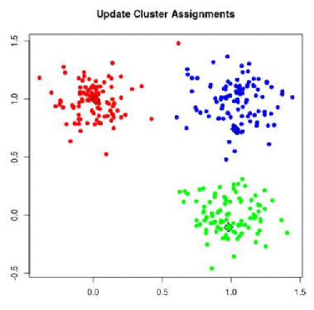
Clustering based on distance
Algorithm of K-means clustering on 2-D data
Given data of two dimensions
Assuming three clusters (K=3)
Update cluster assignments based on the distance
Things to control
How to determine K
Location of the initial points
When to stop
How to calculate distance
Dimension 2
Dimension 1
https://towardsdatascience.com/cluster-analysis-create-visualize-and-interpret-customer-segments-474e55d00ebb

Slide 16
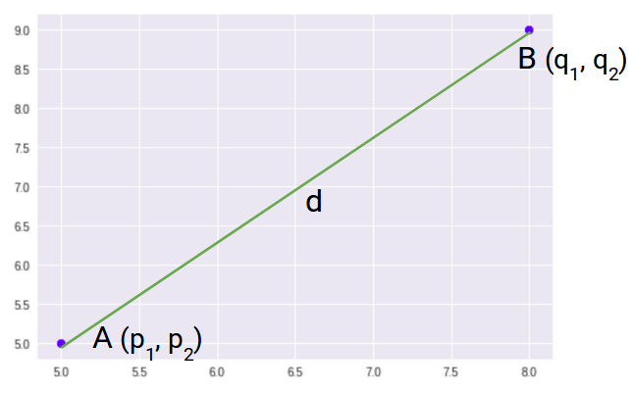
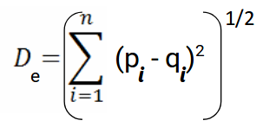
Distance metric
Euclidean Distance represents the shortest distance between two points
,
Where n is the number of dimensions,
p_{i} and q_{i} are data points
https://www.analyticsvidhya.com/blog/2020/02/4-types-of-distance-metrics-in-machine-learning/

Slide 17
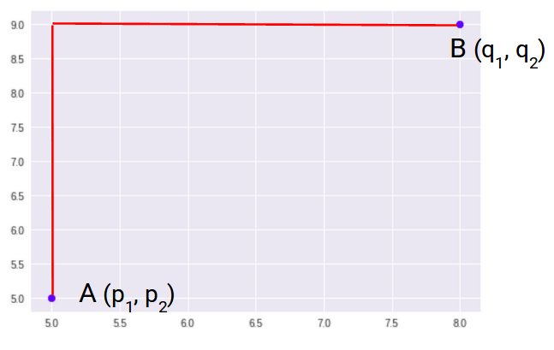
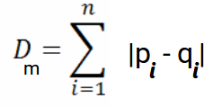
Distance metric
Manhattan Distance is the sum of absolute differences between points across all the dimensions
https://www.analyticsvidhya.com/blog/2020/02/4-types-of-distance-metrics-in-machine-learning/

Slide 18
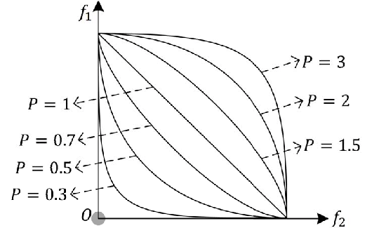
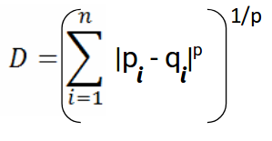
Distance metric
Minkowski Distance is the generalized form of Euclidean and Manhattan Distance
Xu et al. 2018 IEEE Transactions on Cybernetics 49(11)

Slide 19
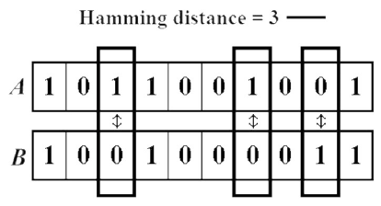
Distance metric
The Hamming Distance between two strings of the same length is the number of positions at which the corresponding characters are different.
Ishengoma, DOI: 10.5815/ijieeb.2014.06.08

Slide 20
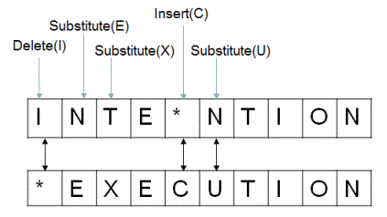
Distance metric
The Edit Distance (Levenshtein distance) between two strings, str1 and str2 is the number of the number of operations required to transform str2 into str1
Requires a set of operators
https://viblo.asia/p/edit-distance-L4x5xdQ15BM

Slide 21
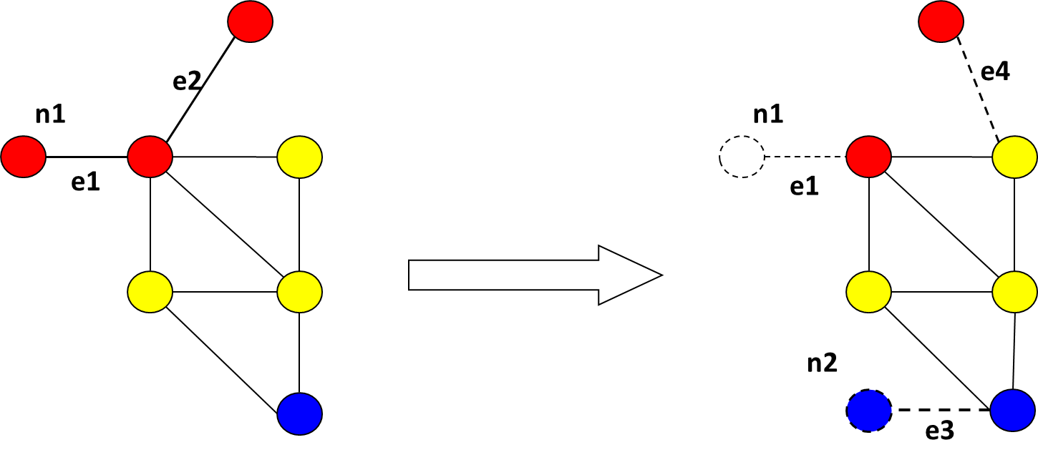
Distance metric
The Edit Distance (Levenshtein distance) between two strings, str1 and str2 is the number of the number of operations required to transform str2 into str1
Requires a set of operators
E. g., graph edit distance with operators for
Edge add/delete
Node add/delete
E. g., distance between two genotype sequences of the same length
?
https://viblo.asia/p/edit-distance-L4x5xdQ15BM

Slide 22
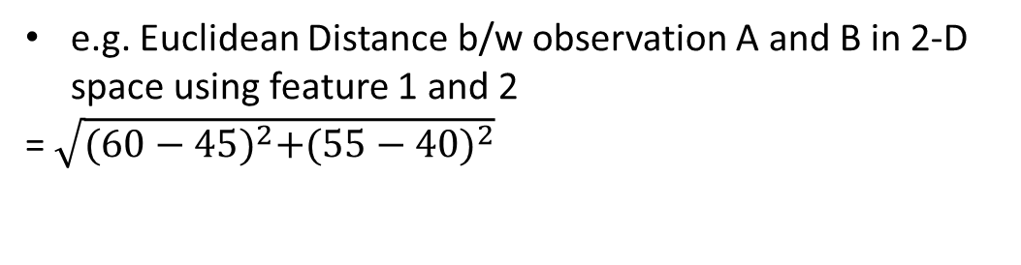
Distance among data points in multi-dimensional space
e.g. Euclidean Distance b/w observation A and B in 2-D space using feature 1 and 2
= $\sqrt{{(60−45)}^{2}+{(55−40)}^{2}}$
Observation\features | Feature 1 | Feature 2 | Feature 3 | Feature 4 | Feature 5
Observation A | 45 | 40 | 35 | 35 | 56
Observation B | 60 | 55 | 50 | 50 | 71
Notes:
When you have more than 2 features or dimensions, you can still calculate distances in a similar way.

Slide 23
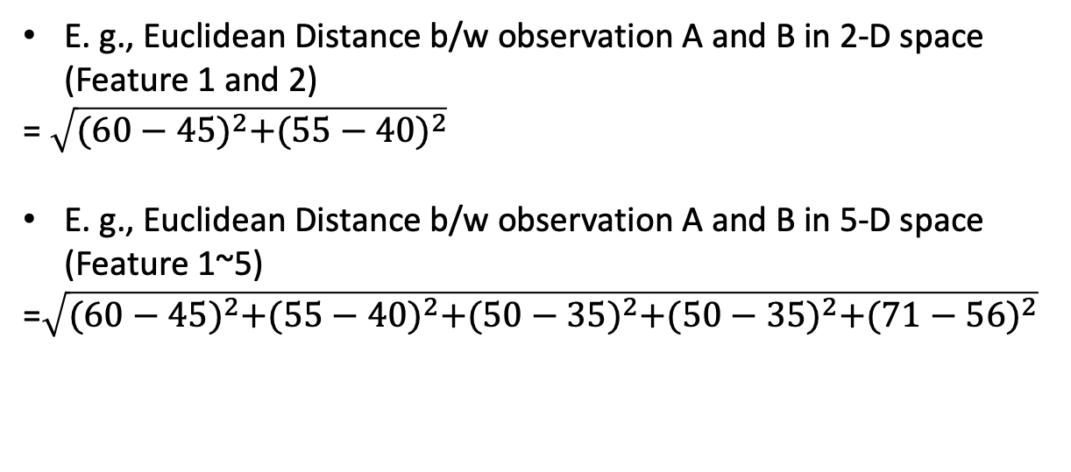
Distance among data points in multi-dimensional space
Observation\features | Feature 1 | Feature 2 | Feature 3 | Feature 4 | Feature 5
Observation A | 45 | 40 | 35 | 35 | 56
Observation B | 60 | 55 | 50 | 50 | 71
E. g., Euclidean Distance b/w observation A and B in 2-D space (Feature 1 and 2)
= $\sqrt{{(60−45)}^{2}+{(55−40)}^{2}}$
E. g., Euclidean Distance b/w observation A and B in 5-D space (Feature 1~5)
=$\sqrt{{(60−45)}^{2}+{(55−40)}^{2}+{(50−35)}^{2}+{(50−35)}^{2}+{(71−56)}^{2}}$
Notes:
When you have more than 2 features or dimensions, you can still calculate distances in a similar way.

Slide 24
Distance in high dimensional data does not correspond to that in a 2-D figure
Any 2-d figure cannot exactly represent the distance on high-dimensional data.
How to find 2D (two variables) space in which information among data points are mostly kept?
PC2
PC1
https://towardsdatascience.com/cluster-analysis-create-visualize-and-interpret-customer-segments-474e55d00ebb
Notes:
The problem comes in when you need to visualize them.

Slide 25
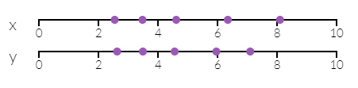
Principal components maximize variance
5 samples on a 2-d space (X and Y)
How to find 2D (two variables) space in which information among data points are mostly kept?
Variance in data can be taken as information
Adapted from http://setosa.io/ev/principal-component-analysis/
Notes:
PCA is useful for eliminating dimensions. Below, we've plotted the data along a pair of lines: one composed of the x-values and another of the y-values.
If we're going to only see the data along one dimension, though, it might be better to make that dimension the principal component with most variation. We don't lose much by dropping PC2 since it contributes the least to the variation in the data set.
By comping up with the variable maximizing variance within a data set, the data set might need a small number of variables.
In this example when two variables x and y represent the data set, the first principal component, the extracted variable that maximize the variance explains all the difference in the data and it effectively reduces dimensionality.

Slide 26
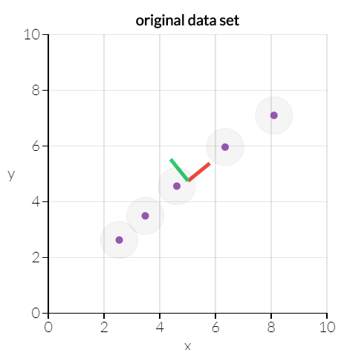
Principal components maximize variance
5 samples on a 2-d space (X and Y)
How to find 2D (two variables) space in which information among data points are mostly kept?
With variance in data as information, PCA can find a 1-d line preserving most information.
http://setosa.io/ev/principal-component-analysis/
Notes:
PCA is useful for eliminating dimensions. Below, we've plotted the data along a pair of lines: one composed of the x-values and another of the y-values.
If we're going to only see the data along one dimension, though, it might be better to make that dimension the principal component with most variation. We don't lose much by dropping PC2 since it contributes the least to the variation in the data set.
By comping up with the variable maximizing variance within a data set, the data set might need a small number of variables.
In this example when two variables x and y represent the data set, the first principal component, the extracted variable that maximize the variance explains all the difference in the data and it effectively reduces dimensionality.

Slide 27
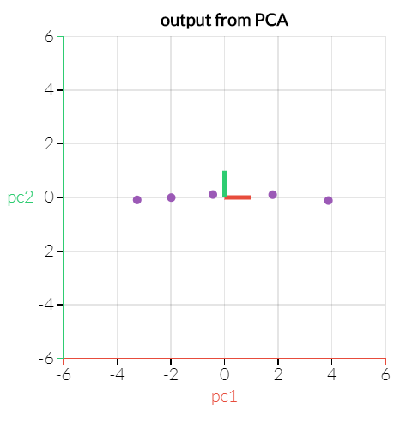
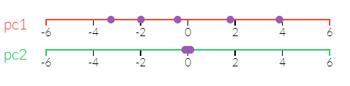
Principal components maximize variance
Can identify two axes that maximize variance in high dimension
http://setosa.io/ev/principal-component-analysis/
Notes:
If we're going to only see the data along one dimension, though, it might be better to make that dimension the principal component with most variation. We don't lose much by dropping PC2 since it contributes the least to the variation in the data set.
By comping up with the variable maximizing variance within a data set, the data set might need a small number of variables.
In this example when two variables x and y represent the data set, the first principal component, the extracted variable that maximize the variance explains all the difference in the data and it effectively reduces dimensionality.

Slide 28
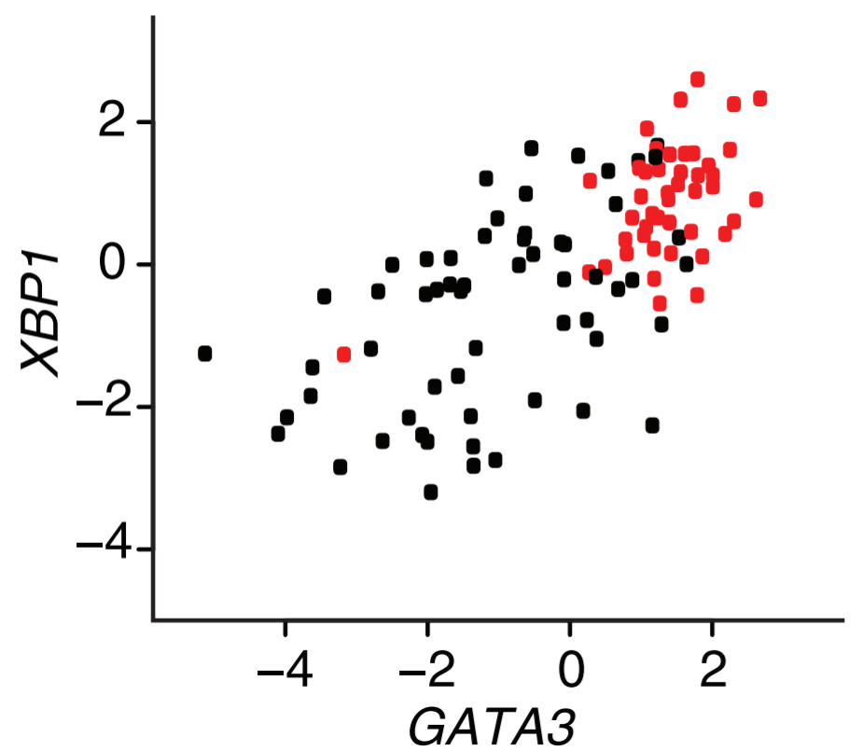
Principal components in biomedical research
Breast cancer samples (ER+ in red and ER- in black)
Markus, Nat. Biotechnology, Vol. 26 Num. 3, 2008
Notes:
Principal component analysis (PCA) is a technique used to emphasize variation and bring out strong patterns in a dataset. It's often used to make data easy to explore and visualize.
First, consider a dataset in only two dimensions, like (height, weight). This dataset can be plotted as points in a plane. But if we want to tease out variation, PCA finds a new coordinate system in which every point has a new (x,y) value. The axes don't actually mean anything physical; they're combinations of height and weight called "principal components" that are chosen to give one axes lots of variation.
PCA is useful for eliminating dimensions. Below, we've plotted the data along a pair of lines: one composed of the x-values and another of the y-values.
If we're going to only see the data along one dimension, though, it might be better to make that dimension the principal component with most variation. We don't lose much by dropping PC2 since it contributes the least to the variation in the data set.
By comping up with the variable maximizing variance within a data set, the data set might need a small number of variables.
In this example when two variables x and y represent the data set, the first principal component, the extracted variable that maximize the variance explains all the difference in the data and it effectively reduces dimensionality.

Slide 29
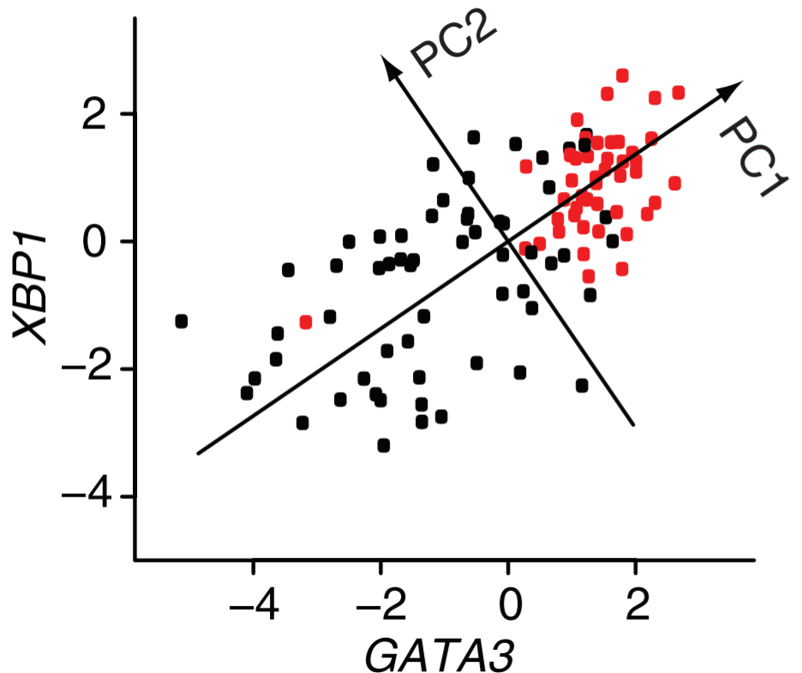
Principal components in biomedical research
Breast cancer samples (ER+ in red and ER- in black)
Markus, Nat. Biotechnology, Vol. 26 Num. 3, 2008
Notes:
Principal component analysis (PCA) is a technique used to emphasize variation and bring out strong patterns in a dataset. It's often used to make data easy to explore and visualize.
First, consider a dataset in only two dimensions, like (height, weight). This dataset can be plotted as points in a plane. But if we want to tease out variation, PCA finds a new coordinate system in which every point has a new (x,y) value. The axes don't actually mean anything physical; they're combinations of height and weight called "principal components" that are chosen to give one axes lots of variation.
PCA is useful for eliminating dimensions. Below, we've plotted the data along a pair of lines: one composed of the x-values and another of the y-values.
If we're going to only see the data along one dimension, though, it might be better to make that dimension the principal component with most variation. We don't lose much by dropping PC2 since it contributes the least to the variation in the data set.
By comping up with the variable maximizing variance within a data set, the data set might need a small number of variables.
In this example when two variables x and y represent the data set, the first principal component, the extracted variable that maximize the variance explains all the difference in the data and it effectively reduces dimensionality.

Slide 30
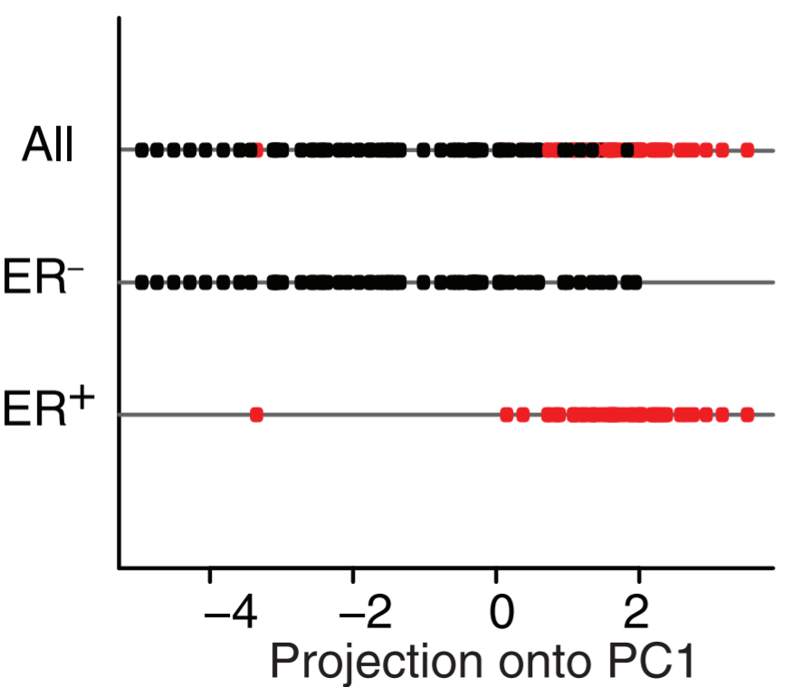
Principal components in biomedical research
Things to analyze in PCA
Their projection to PCAs: PC1 well separates the grouping of your interest
Markus, Nat. Biotechnology, Vol. 26 Num. 3, 2008
Notes:
Principal component analysis (PCA) is a technique used to emphasize variation and bring out strong patterns in a dataset. It's often used to make data easy to explore and visualize.
First, consider a dataset in only two dimensions, like (height, weight). This dataset can be plotted as points in a plane. But if we want to tease out variation, PCA finds a new coordinate system in which every point has a new (x,y) value. The axes don't actually mean anything physical; they're combinations of height and weight called "principal components" that are chosen to give one axes lots of variation.
PCA is useful for eliminating dimensions. Below, we've plotted the data along a pair of lines: one composed of the x-values and another of the y-values.
If we're going to only see the data along one dimension, though, it might be better to make that dimension the principal component with most variation. We don't lose much by dropping PC2 since it contributes the least to the variation in the data set.
By comping up with the variable maximizing variance within a data set, the data set might need a small number of variables.
In this example when two variables x and y represent the data set, the first principal component, the extracted variable that maximize the variance explains all the difference in the data and it effectively reduces dimensionality.

Slide 31
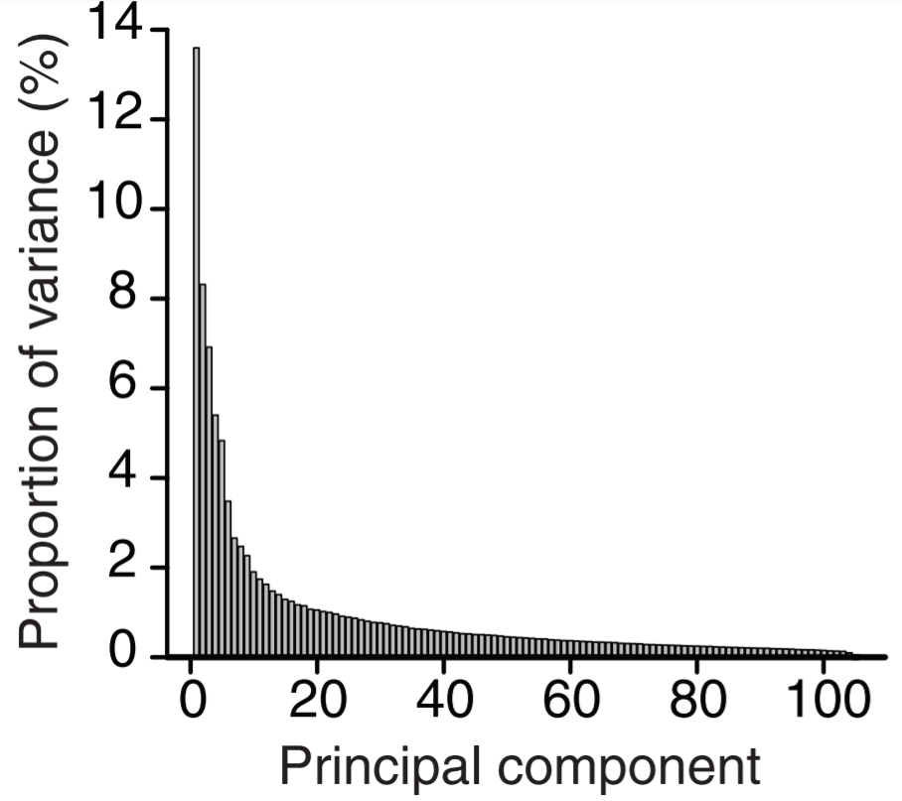
Principal components in biomedical research
Some things to check in PCA
Projection of data onto PCs
Proportion of variance per PC
Markus, Nat. Biotechnology, Vol. 26 Num. 3, 2008
Notes:
Principal component analysis (PCA) is a technique used to emphasize variation and bring out strong patterns in a dataset. It's often used to make data easy to explore and visualize.
First, consider a dataset in only two dimensions, like (height, weight). This dataset can be plotted as points in a plane. But if we want to tease out variation, PCA finds a new coordinate system in which every point has a new (x,y) value. The axes don't actually mean anything physical; they're combinations of height and weight called "principal components" that are chosen to give one axes lots of variation.
PCA is useful for eliminating dimensions. Below, we've plotted the data along a pair of lines: one composed of the x-values and another of the y-values.
If we're going to only see the data along one dimension, though, it might be better to make that dimension the principal component with most variation. We don't lose much by dropping PC2 since it contributes the least to the variation in the data set.
By comping up with the variable maximizing variance within a data set, the data set might need a small number of variables.
In this example when two variables x and y represent the data set, the first principal component, the extracted variable that maximize the variance explains all the difference in the data and it effectively reduces dimensionality.

Slide 32
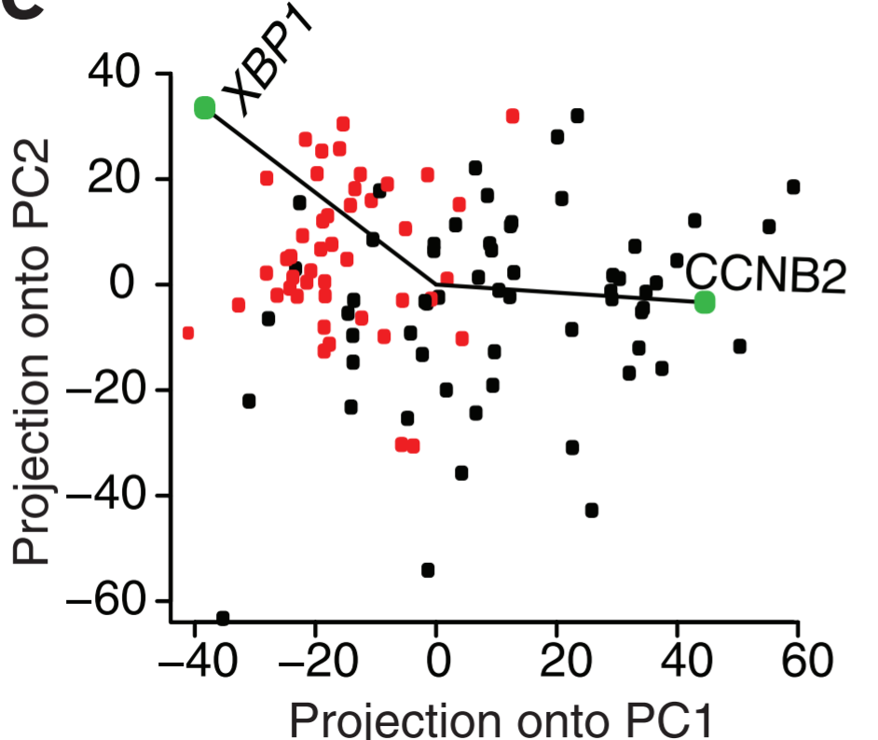
Principal components in biomedical research
Things to check in PCA
Projection of data onto PCs
Proportion of variance per PC
Weights of your genes on the PCs
Markus, Nat. Biotechnology, Vol. 26 Num. 3, 2008
Notes:
Principal component analysis (PCA) is a technique used to emphasize variation and bring out strong patterns in a dataset. It's often used to make data easy to explore and visualize.
First, consider a dataset in only two dimensions, like (height, weight). This dataset can be plotted as points in a plane. But if we want to tease out variation, PCA finds a new coordinate system in which every point has a new (x,y) value. The axes don't actually mean anything physical; they're combinations of height and weight called "principal components" that are chosen to give one axes lots of variation.
PCA is useful for eliminating dimensions. Below, we've plotted the data along a pair of lines: one composed of the x-values and another of the y-values.
If we're going to only see the data along one dimension, though, it might be better to make that dimension the principal component with most variation. We don't lose much by dropping PC2 since it contributes the least to the variation in the data set.
By comping up with the variable maximizing variance within a data set, the data set might need a small number of variables.
In this example when two variables x and y represent the data set, the first principal component, the extracted variable that maximize the variance explains all the difference in the data and it effectively reduces dimensionality.

Slide 33
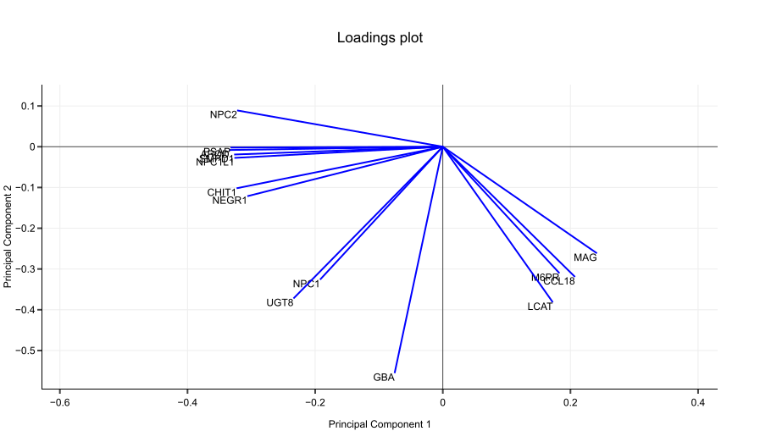
A loading plot shows how strongly each dimension influences a principal component.
A loading plot shows
Their projected values on each PC show how much weight they have on that PC
e. g., NPC2 and MAG influence PC1
e. g., GBA influences PC2
The angles b/w variables show how they correlated with each other
e. g., APOD and PSAP positively correlated
NPC2 and GBA not likely to be correlated
NPC2 and MAG negatively correlated
http://setosa.io/ev/principal-component-analysis/
Notes:
Suppose we had another data set with a different set of variables, such as NPC2, UGT8 and so on.
See how these vectors are pinned at the origin of PCs (PC1 = 0 and PC2 = 0)? Their project values on each PC show how much weight they have on that PC. In this example, NPC2 and CHIT1 strongly influence PC1, while GBA and LCAT have more say in PC2.
Another nice thing about loading plots: the angles between the vectors tell us how characteristics correlate with one another. Let’s look at Figure 2.
When two vectors are close, forming a small angle, the two variables they represent are positively correlated. Example: APOD and PSAP
If they meet each other at 90°, they are not likely to be correlated. Example: NPC2 and GBA.
When they diverge and form a large angle (close to 180°), they are negative correlated. Example: NPC2 and MAG.
Now that you know all that, reading a PCA biplot is a piece of cake.

Slide 34
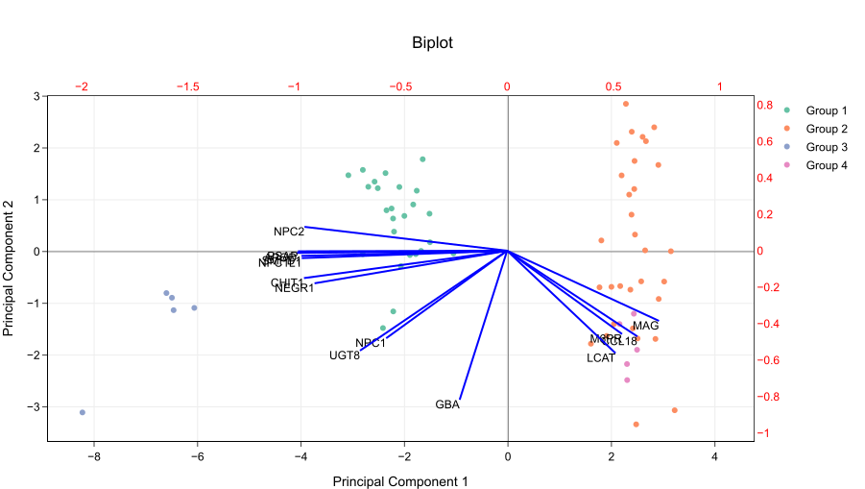
PCA biplot = PCA score plot + loading plot
Bottom axis: PC1 score
Left axis: PC2 score
Top axis: loadings on PC1
Right axis: loadings on PC2
http://setosa.io/ev/principal-component-analysis/
Notes:
You probably notice that a PCA biplot simply merge an usual PCA plot with a plot of loadings. The arrangement is like this:
In other words, the left and bottom axes are of the PCA plot — use them to read PCA scores of the samples (dots). The top and right axes belong to the loading plot — use them to read how strongly each characteristic (vector) influence the principal components.

Slide 35
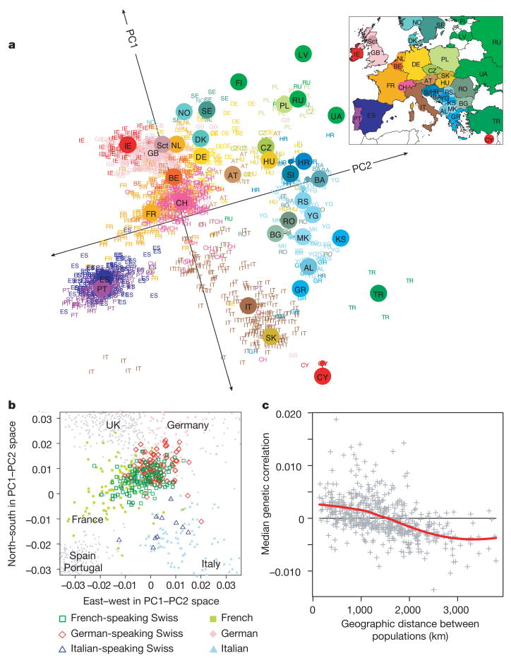
Example of PCA in genetics: principal components of ancestry

Slide 36
Limitations of PCA
PCs are linear combinations of data
Outliers
Missing data
etc

Slide 37
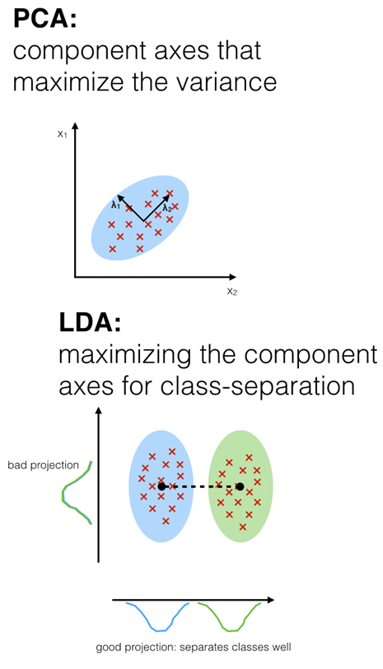
Linear Discriminant Analysis (LDA) vs. PCA
1. Both rank the new axes in the order of importance.
2. Both tell us which feature contributes more in creating the new axes.
3. Difference
PCA looks for attributes with the most variance.
LDA tries to maximize the separation of known categories.

Slide 38
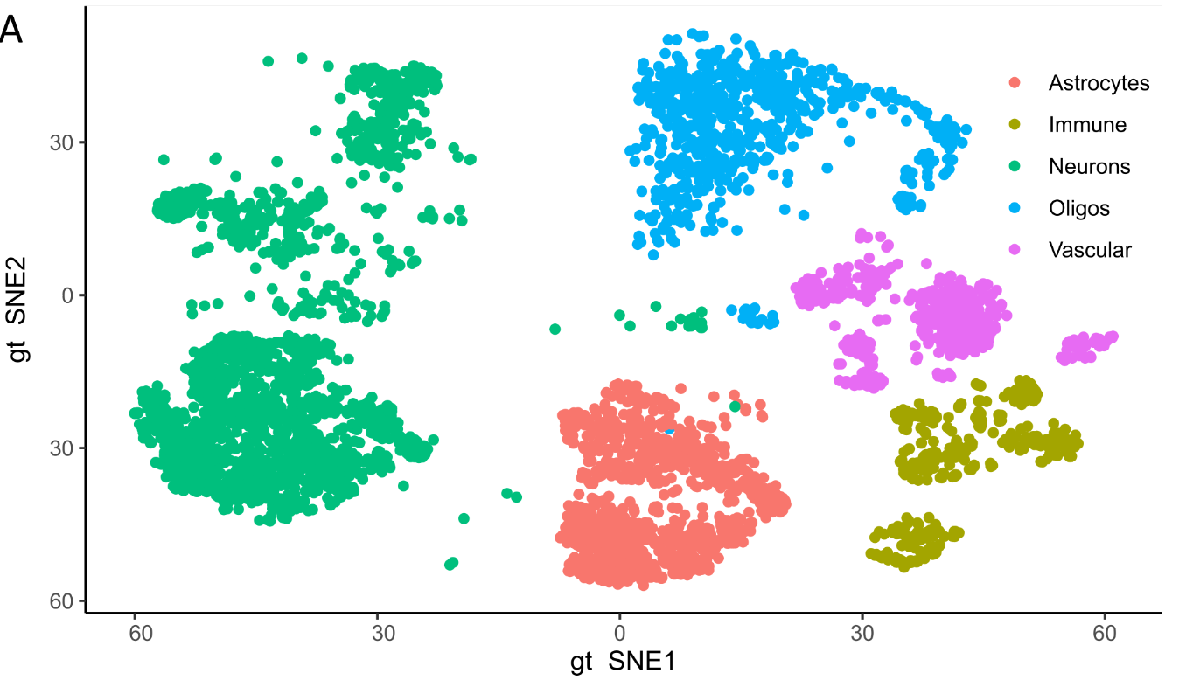
t-SNE for visualizing high dimensional biomedical data
Things to keep in mind for t-SNE
X-/y-axis are non-linear
Distance roughly represents their similarity.
Connection with neighbor is also important
Mainly used for visualization only
Notes:
Principal component analysis (PCA) is a technique used to emphasize variation and bring out strong patterns in a dataset. It's often used to make data easy to explore and visualize.
First, consider a dataset in only two dimensions, like (height, weight). This dataset can be plotted as points in a plane. But if we want to tease out variation, PCA finds a new coordinate system in which every point has a new (x,y) value. The axes don't actually mean anything physical; they're combinations of height and weight called "principal components" that are chosen to give one axes lots of variation.
PCA is useful for eliminating dimensions. Below, we've plotted the data along a pair of lines: one composed of the x-values and another of the y-values.
If we're going to only see the data along one dimension, though, it might be better to make that dimension the principal component with most variation. We don't lose much by dropping PC2 since it contributes the least to the variation in the data set.
By comping up with the variable maximizing variance within a data set, the data set might need a small number of variables.
In this example when two variables x and y represent the data set, the first principal component, the extracted variable that maximize the variance explains all the difference in the data and it effectively reduces dimensionality.

Slide 39
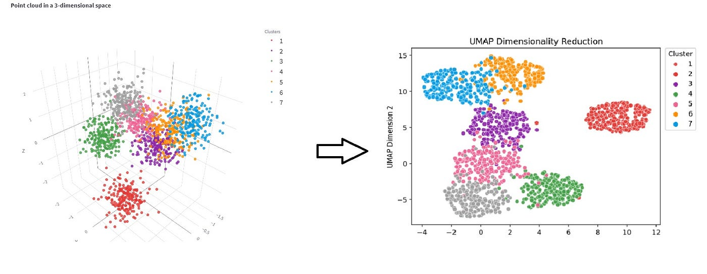
UMAP
Uniform manifold approximation and projection
Another non-linear dimension reduction technique
Has some advantages over t-SNE
Notes:
Figure source: https://medium.com/mcd-unison/umap-an-alternative-dimensionality-reduction-technique-7a5e77e80982

Slide 40
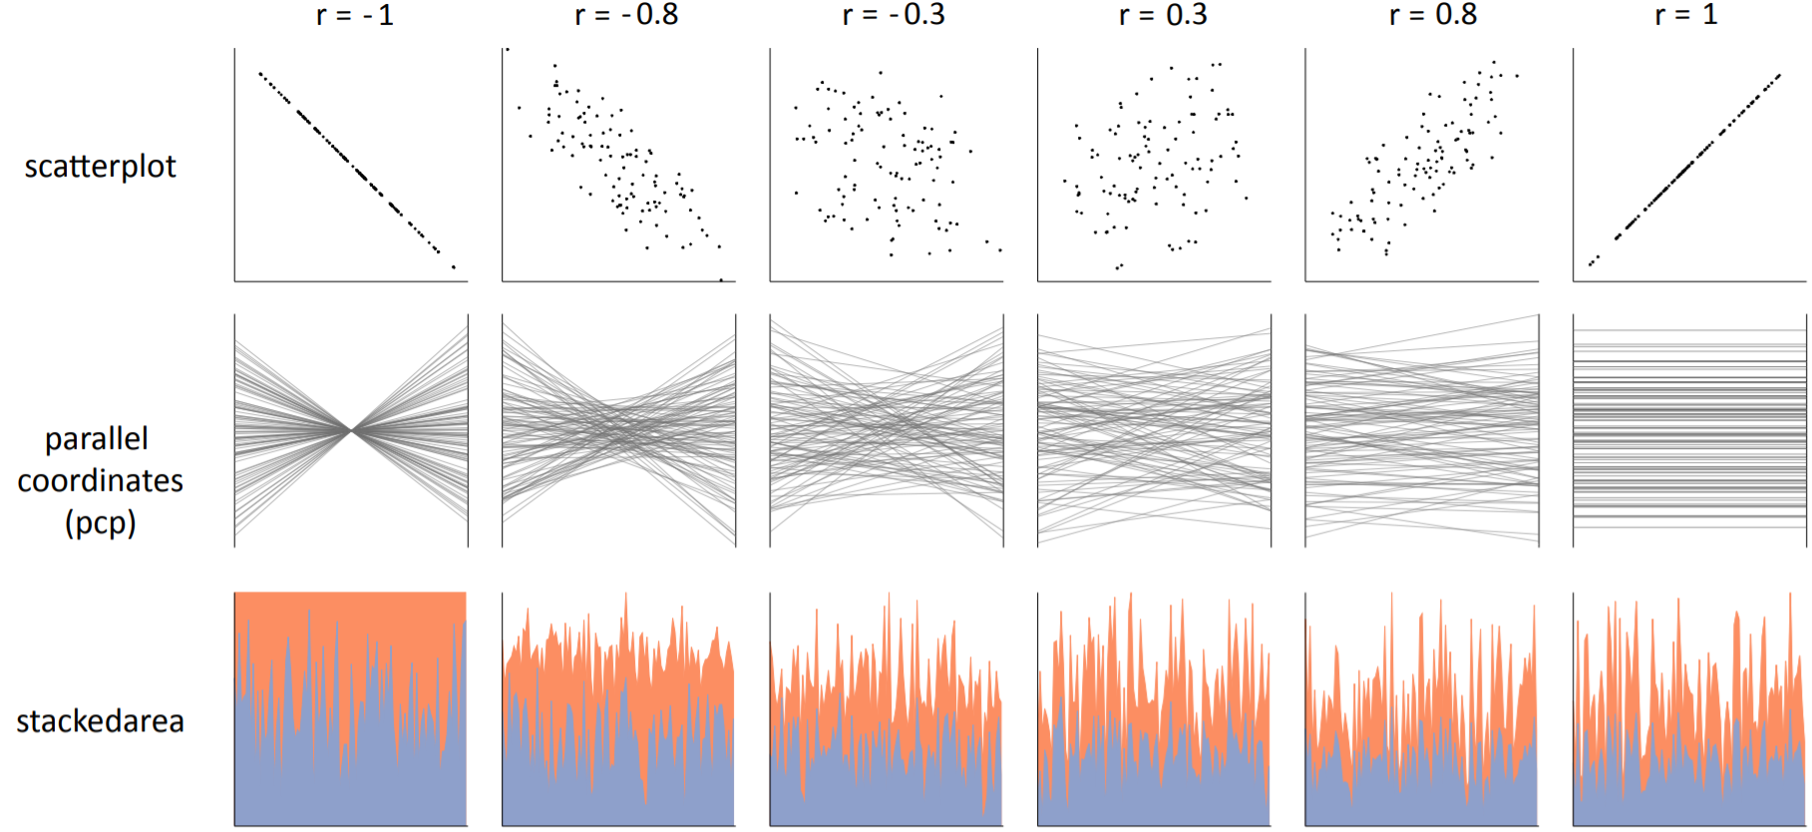
Effective visualization for correlation
Harrison et al. Ranking visualizations of correlation using weber’s law. IEEE transactions on visualization
and computer graphics, 20(12):1943–1952, 2014

Slide 41
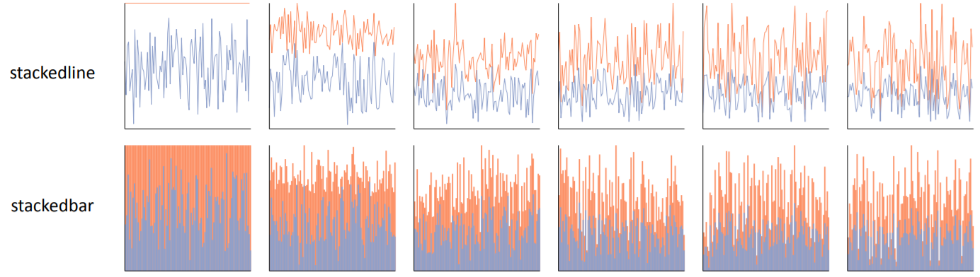
Effective visualization for correlation
Harrison et al. Ranking visualizations of correlation using weber’s law. IEEE transactions on visualization
and computer graphics, 20(12):1943–1952, 2014

Slide 42
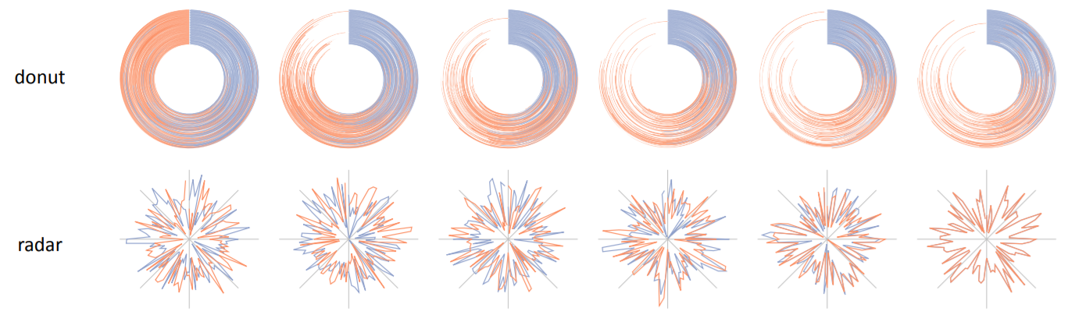
Effective visualization for correlation
Harrison et al. Ranking visualizations of correlation using weber’s law. IEEE transactions on visualization
and computer graphics, 20(12):1943–1952, 2014

Slide 43
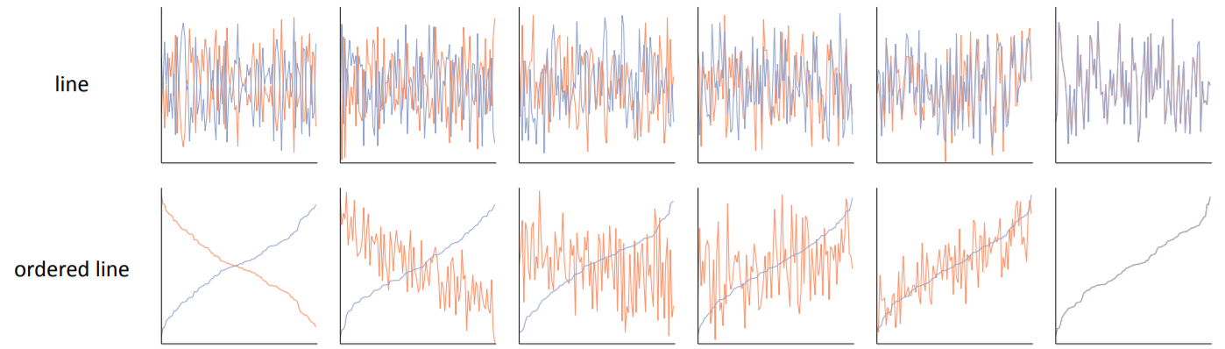
Effective visualization for correlation
Harrison et al. Ranking visualizations of correlation using weber’s law. IEEE transactions on visualization
and computer graphics, 20(12):1943–1952, 2014

Slide 44
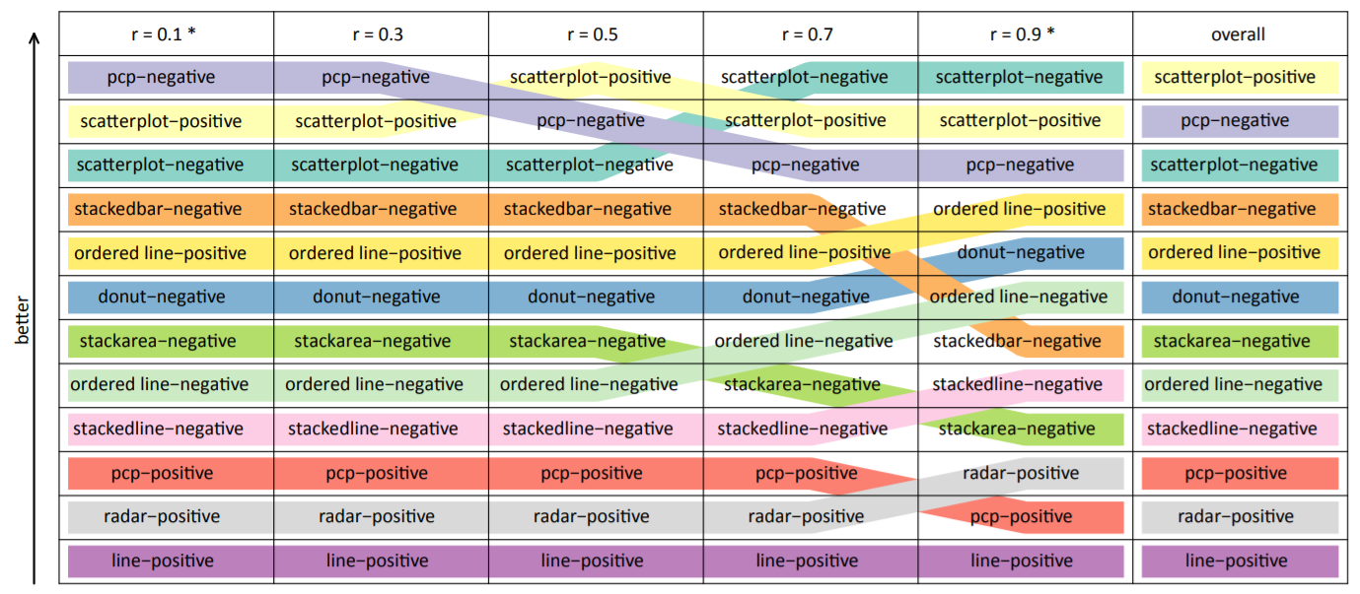
Effective visualization for correlation
Responses from 1,687 participants (gender balanced)
*-negative/-positive refers to negative/positive sign of the correlation coefficient
Harrison et al. Ranking visualizations of correlation using weber’s law. IEEE transactions on visualization
and computer graphics, 20(12):1943–1952, 2014

Slide 45
Effective visualization to claim correlation
As correlation gets stronger,
scatterplot, ordered line, stackedline, and radar become more effective
scatterplot, pcp, stacked bar, stacked area become less effective
Harrison et al. Ranking visualizations of correlation using weber’s law. IEEE transactions on visualization
and computer graphics, 20(12):1943–1952, 2014

Slide 46
Effective visualization to claim correlation
Across all the correlations,
scatterplot and pcp work the best
line and radar work worst
This is a good way to show multiple changes along a variable
Harrison et al. Ranking visualizations of correlation using weber’s law. IEEE transactions on visualization
and computer graphics, 20(12):1943–1952, 2014

