Slide 1
Machine Learning 1

Slide 2
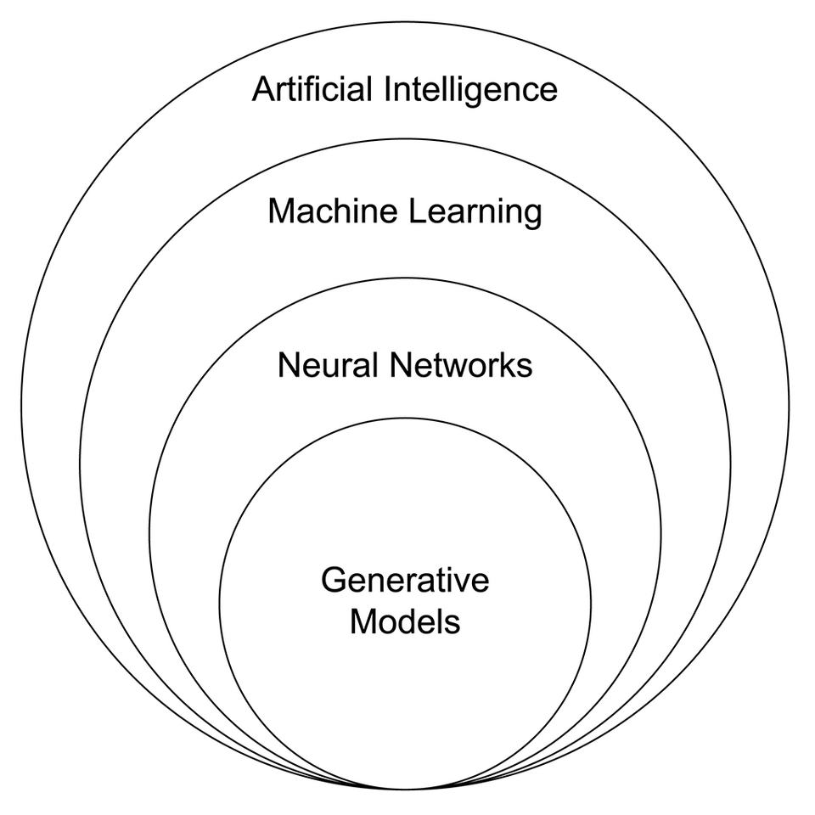
Terminology
AI
ML
Deep learning
Statistical learning
https://commons.wikimedia.org/wiki/File:AI_relation_to_Generative_Models_subset,_venn_diagram.png
Notes:
https://commons.wikimedia.org/wiki/File:AI_relation_to_Generative_Models_subset,_venn_diagram.png

Slide 3
High-dimension datasets (n << p)
SNP arrays
RNA-seq
Single-cell RNA-seq
Methylation/epigenetics
Proteomics
Metabolomics
Images
Text/language
…

Slide 4
2D plots are not enough
Try exercises 1 and 2

Slide 5
The curse of dimensionality
Not just “there are a lot of variables, and we don’t know which are important”
Distance concentration
Points become ~equidistant
→ “Nearest neighbor” means less
Volume
Grows exponentially with p
→ Data extremely sparse
→ Huge sample size needed to cover the space
Most of the volume is near the boundary
Very little interior
“Distance from center” means less
Projections are deceptive
Lower-dimensional subsets will appear to have structure even if they’re pure noise
Statistical problems (more variables than datapoints)
→ need for feature selection/extraction
→ easy to find “perfect fit” based on noise alone (overfitting)
See Example 3

Slide 6
What kind of structure?
ML methods assume structure.
It’s up to you to ask the right question and choose the right tool.
Are there clusters/groups?
Does variation exist globally along smooth gradients?
Is there predictive structure (i.e., can some variables predict others?)
Are there local structures?
Is there hierarchical structure?
Are there networks/relational structures?
How complex is the structure? What is the intrinsic dimensionality?

Slide 7
Supervised vs. unsupervised ML answer different questions
Type of ML | Kind of question | You are given | Goal | Assumptions
Supervised | Is there a mapping from X→Y? | Input variables (X) Target/outcome/labels (Y) | Predict Y Estimate relationships between X and Y | The predictive structure (model type) Signal in X could explain Y
Unsupervised | What structure exists in X? | Only the data (X) No outcome/labels | Describe variation Find groups, dimensions, gradients, etc. | Continuous or discrete structure Local or relational structure

Slide 8
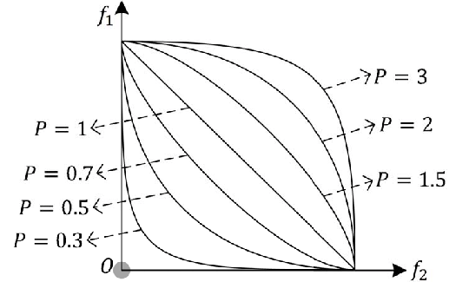
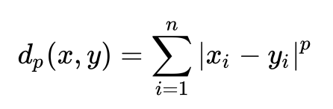
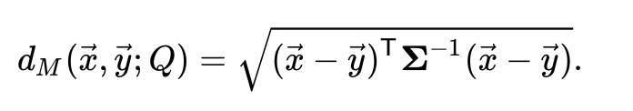
How to measure distance
Minkowski distance =
Euclidean distance (p=2)
Manhattan Distance (p=1)
More generally, p >= 1
Correlation distance
Mahalanobis distance (analogous to a higher-dimensional z-score)
Xu et al. 2018 IEEE Transactions on Cybernetics 49(11)

Slide 9
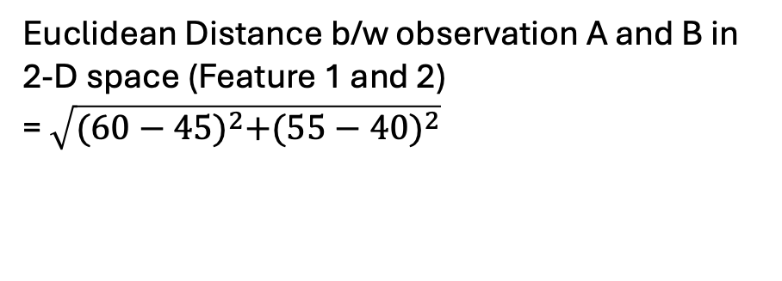
Euclidean distance example
Observation\features | Feature 1 | Feature 2 | Feature 3 | Feature 4 | Feature 5
Observation A | 45 | 40 | 35 | 35 | 56
Observation B | 60 | 55 | 50 | 50 | 71
Euclidean Distance b/w observation A and B in 2-D space (Feature 1 and 2)
= $\sqrt{{(60−45)}^{2}+{(55−40)}^{2}}$
Notes:
When you have more than 2 features or dimensions, you can still calculate distances in a similar way.

Slide 10
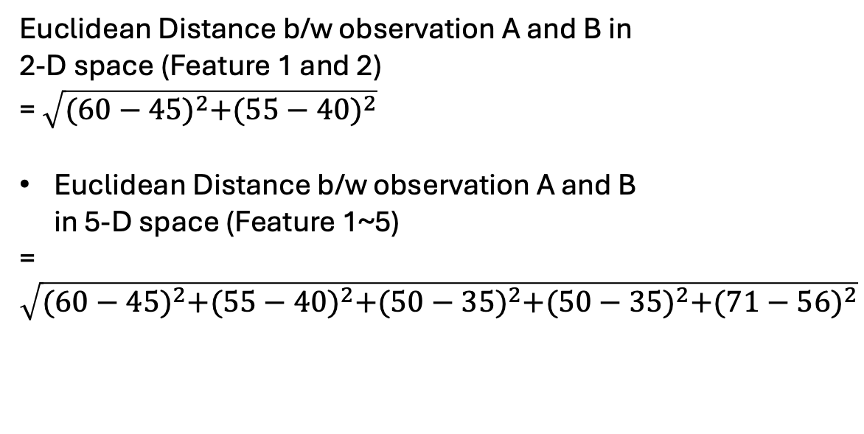
Euclidean distance example
Observation\features | Feature 1 | Feature 2 | Feature 3 | Feature 4 | Feature 5
Observation A | 45 | 40 | 35 | 35 | 56
Observation B | 60 | 55 | 50 | 50 | 71
Euclidean Distance b/w observation A and B in 2-D space (Feature 1 and 2)
= $\sqrt{{(60−45)}^{2}+{(55−40)}^{2}}$
Euclidean Distance b/w observation A and B in 5-D space (Feature 1~5)
=$\sqrt{{(60−45)}^{2}+{(55−40)}^{2}+{(50−35)}^{2}+{(50−35)}^{2}+{(71−56)}^{2}}$
Notes:
When you have more than 2 features or dimensions, you can still calculate distances in a similar way.

Slide 11
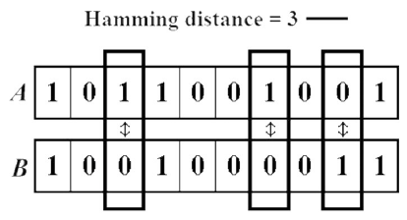
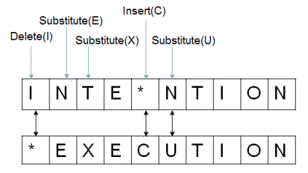
Other metrics
Hamming distance
Levenshtein distance
Ishengoma, DOI: 10.5815/ijieeb.2014.06.08
https://viblo.asia/p/edit-distance-L4x5xdQ15BM

Slide 12
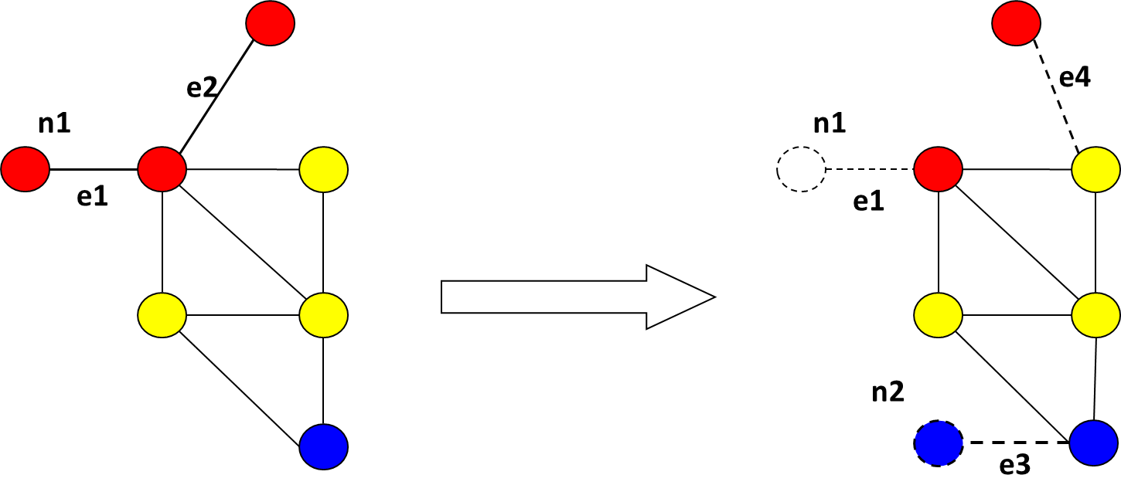
Other distances (con’t.)
The Edit Distance (Levenshtein distance) between two strings, str1 and str2 is the number of the number of operations required to transform str2 into str1
Requires a set of operators
E. g., graph edit distance with operators for
Edge add/delete
Node add/delete
E. g., distance between two genotype sequences of the same length
?
https://viblo.asia/p/edit-distance-L4x5xdQ15BM

Slide 13
Unsupervised ML
Main kinds of techniques, and some specific algorithms
Dimension reduction
PCA, MDS, etc.
UMAP/t-SNE
Clustering
Hierarchical clustering
k-means

Slide 14
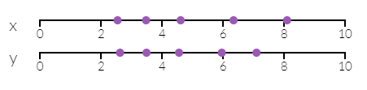
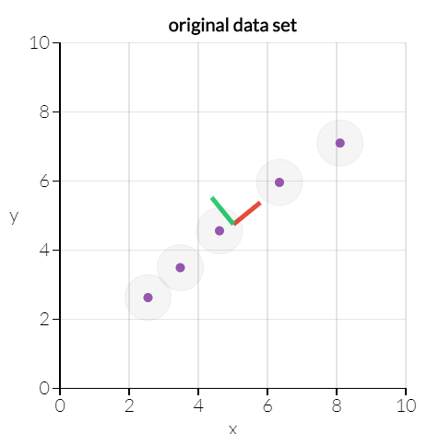
Principal components analysis for dimension reduction
5 samples on a 2-d space (X and Y)
How to find 2D (two variables) space in which information among data points are mostly kept?
With variance in data as information, PCA can find a 1-d line preserving most information.
http://setosa.io/ev/principal-component-analysis/
Notes:
PCA is useful for eliminating dimensions. Below, we've plotted the data along a pair of lines: one composed of the x-values and another of the y-values.
If we're going to only see the data along one dimension, though, it might be better to make that dimension the principal component with most variation. We don't lose much by dropping PC2 since it contributes the least to the variation in the data set.
By comping up with the variable maximizing variance within a data set, the data set might need a small number of variables.
In this example when two variables x and y represent the data set, the first principal component, the extracted variable that maximize the variance explains all the difference in the data and it effectively reduces dimensionality.

Slide 15
Principal components maximize variance
5 samples on a 2-d space (X and Y)
How to find 2D (two variables) space in which information among data points are mostly kept?
Variance in data can be taken as information
Adapted from http://setosa.io/ev/principal-component-analysis/
Notes:
PCA is useful for eliminating dimensions. Below, we've plotted the data along a pair of lines: one composed of the x-values and another of the y-values.
If we're going to only see the data along one dimension, though, it might be better to make that dimension the principal component with most variation. We don't lose much by dropping PC2 since it contributes the least to the variation in the data set.
By comping up with the variable maximizing variance within a data set, the data set might need a small number of variables.
In this example when two variables x and y represent the data set, the first principal component, the extracted variable that maximize the variance explains all the difference in the data and it effectively reduces dimensionality.

Slide 16
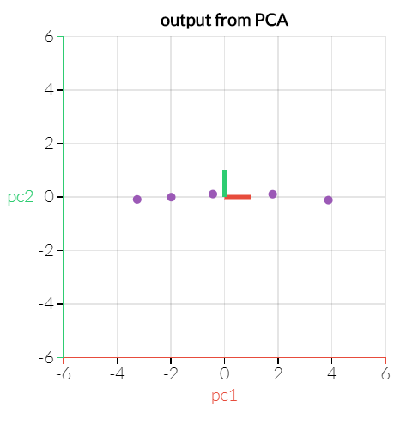
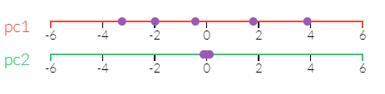
Principal components maximize variance
Can identify two axes that maximize variance in high dimension
http://setosa.io/ev/principal-component-analysis/
Notes:
If we're going to only see the data along one dimension, though, it might be better to make that dimension the principal component with most variation. We don't lose much by dropping PC2 since it contributes the least to the variation in the data set.
By comping up with the variable maximizing variance within a data set, the data set might need a small number of variables.
In this example when two variables x and y represent the data set, the first principal component, the extracted variable that maximize the variance explains all the difference in the data and it effectively reduces dimensionality.

Slide 17
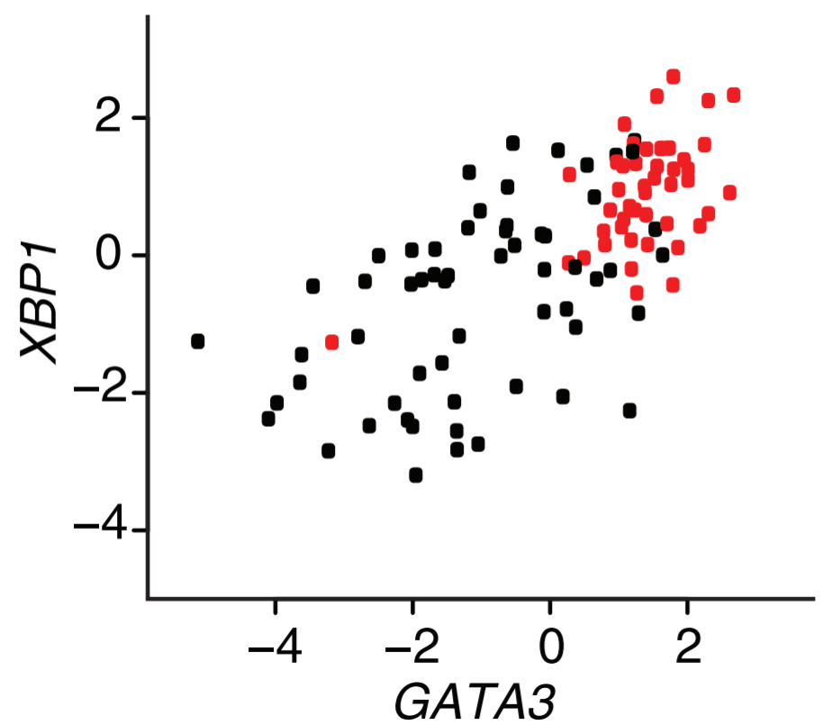
Principal components in biomedical research
Breast cancer samples (ER+ in red and ER- in black)
Markus, Nat. Biotechnology, Vol. 26 Num. 3, 2008
Notes:
Principal component analysis (PCA) is a technique used to emphasize variation and bring out strong patterns in a dataset. It's often used to make data easy to explore and visualize.
First, consider a dataset in only two dimensions, like (height, weight). This dataset can be plotted as points in a plane. But if we want to tease out variation, PCA finds a new coordinate system in which every point has a new (x,y) value. The axes don't actually mean anything physical; they're combinations of height and weight called "principal components" that are chosen to give one axes lots of variation.
PCA is useful for eliminating dimensions. Below, we've plotted the data along a pair of lines: one composed of the x-values and another of the y-values.
If we're going to only see the data along one dimension, though, it might be better to make that dimension the principal component with most variation. We don't lose much by dropping PC2 since it contributes the least to the variation in the data set.
By comping up with the variable maximizing variance within a data set, the data set might need a small number of variables.
In this example when two variables x and y represent the data set, the first principal component, the extracted variable that maximize the variance explains all the difference in the data and it effectively reduces dimensionality.

Slide 18
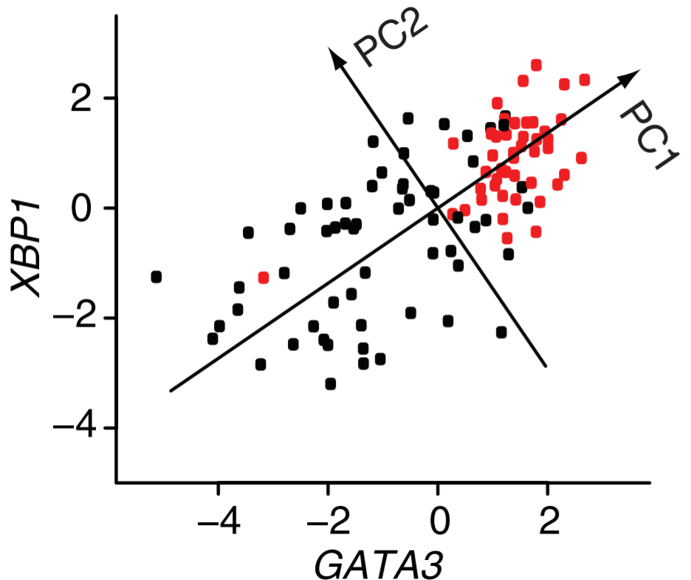
Principal components in biomedical research
Breast cancer samples (ER+ in red and ER- in black)
Markus, Nat. Biotechnology, Vol. 26 Num. 3, 2008
Notes:
Principal component analysis (PCA) is a technique used to emphasize variation and bring out strong patterns in a dataset. It's often used to make data easy to explore and visualize.
First, consider a dataset in only two dimensions, like (height, weight). This dataset can be plotted as points in a plane. But if we want to tease out variation, PCA finds a new coordinate system in which every point has a new (x,y) value. The axes don't actually mean anything physical; they're combinations of height and weight called "principal components" that are chosen to give one axes lots of variation.
PCA is useful for eliminating dimensions. Below, we've plotted the data along a pair of lines: one composed of the x-values and another of the y-values.
If we're going to only see the data along one dimension, though, it might be better to make that dimension the principal component with most variation. We don't lose much by dropping PC2 since it contributes the least to the variation in the data set.
By comping up with the variable maximizing variance within a data set, the data set might need a small number of variables.
In this example when two variables x and y represent the data set, the first principal component, the extracted variable that maximize the variance explains all the difference in the data and it effectively reduces dimensionality.

Slide 19
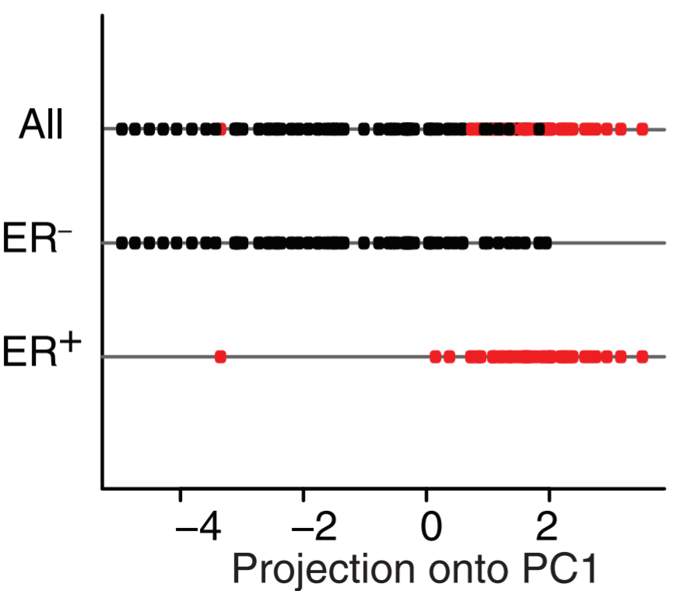
Principal components in biomedical research
Things to analyze in PCA
Their projection to PCAs: PC1 well separates the grouping of your interest
Markus, Nat. Biotechnology, Vol. 26 Num. 3, 2008
Notes:
Principal component analysis (PCA) is a technique used to emphasize variation and bring out strong patterns in a dataset. It's often used to make data easy to explore and visualize.
First, consider a dataset in only two dimensions, like (height, weight). This dataset can be plotted as points in a plane. But if we want to tease out variation, PCA finds a new coordinate system in which every point has a new (x,y) value. The axes don't actually mean anything physical; they're combinations of height and weight called "principal components" that are chosen to give one axes lots of variation.
PCA is useful for eliminating dimensions. Below, we've plotted the data along a pair of lines: one composed of the x-values and another of the y-values.
If we're going to only see the data along one dimension, though, it might be better to make that dimension the principal component with most variation. We don't lose much by dropping PC2 since it contributes the least to the variation in the data set.
By comping up with the variable maximizing variance within a data set, the data set might need a small number of variables.
In this example when two variables x and y represent the data set, the first principal component, the extracted variable that maximize the variance explains all the difference in the data and it effectively reduces dimensionality.

Slide 20
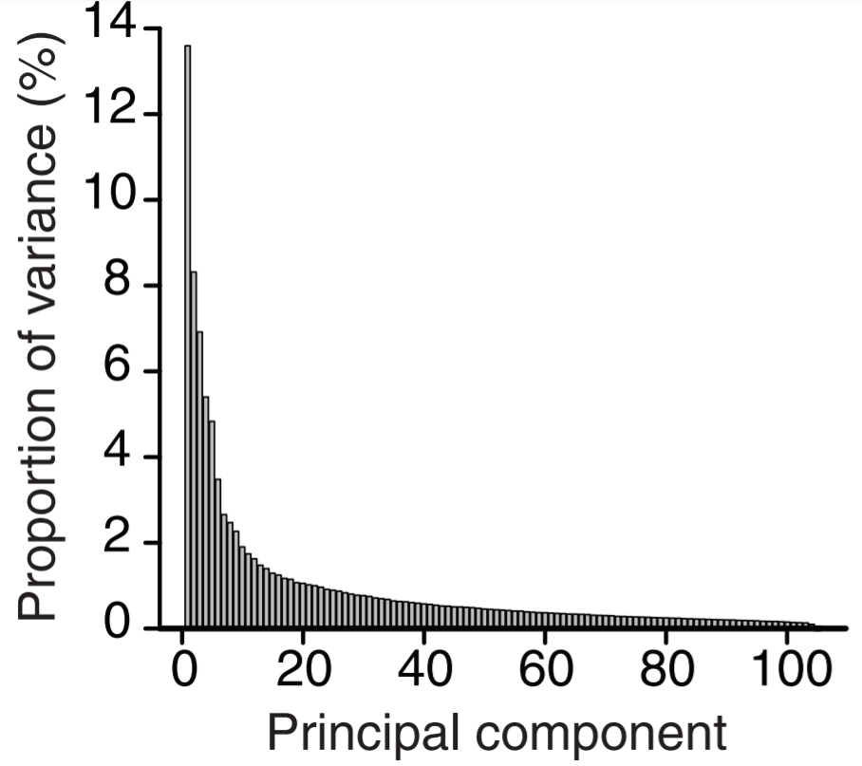
Principal components in biomedical research
Some things to check in PCA
Projection of data onto PCs
Proportion of variance per PC
Markus, Nat. Biotechnology, Vol. 26 Num. 3, 2008
Notes:
Principal component analysis (PCA) is a technique used to emphasize variation and bring out strong patterns in a dataset. It's often used to make data easy to explore and visualize.
First, consider a dataset in only two dimensions, like (height, weight). This dataset can be plotted as points in a plane. But if we want to tease out variation, PCA finds a new coordinate system in which every point has a new (x,y) value. The axes don't actually mean anything physical; they're combinations of height and weight called "principal components" that are chosen to give one axes lots of variation.
PCA is useful for eliminating dimensions. Below, we've plotted the data along a pair of lines: one composed of the x-values and another of the y-values.
If we're going to only see the data along one dimension, though, it might be better to make that dimension the principal component with most variation. We don't lose much by dropping PC2 since it contributes the least to the variation in the data set.
By comping up with the variable maximizing variance within a data set, the data set might need a small number of variables.
In this example when two variables x and y represent the data set, the first principal component, the extracted variable that maximize the variance explains all the difference in the data and it effectively reduces dimensionality.

Slide 21
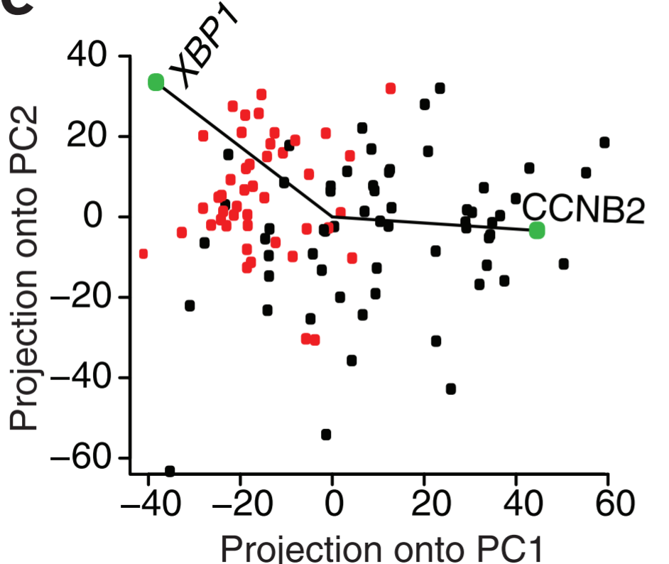
Principal components in biomedical research
Things to check in PCA
Projection of data onto PCs
Proportion of variance per PC
Weights of your genes on the PCs
Markus, Nat. Biotechnology, Vol. 26 Num. 3, 2008
Notes:
Principal component analysis (PCA) is a technique used to emphasize variation and bring out strong patterns in a dataset. It's often used to make data easy to explore and visualize.
First, consider a dataset in only two dimensions, like (height, weight). This dataset can be plotted as points in a plane. But if we want to tease out variation, PCA finds a new coordinate system in which every point has a new (x,y) value. The axes don't actually mean anything physical; they're combinations of height and weight called "principal components" that are chosen to give one axes lots of variation.
PCA is useful for eliminating dimensions. Below, we've plotted the data along a pair of lines: one composed of the x-values and another of the y-values.
If we're going to only see the data along one dimension, though, it might be better to make that dimension the principal component with most variation. We don't lose much by dropping PC2 since it contributes the least to the variation in the data set.
By comping up with the variable maximizing variance within a data set, the data set might need a small number of variables.
In this example when two variables x and y represent the data set, the first principal component, the extracted variable that maximize the variance explains all the difference in the data and it effectively reduces dimensionality.

Slide 22
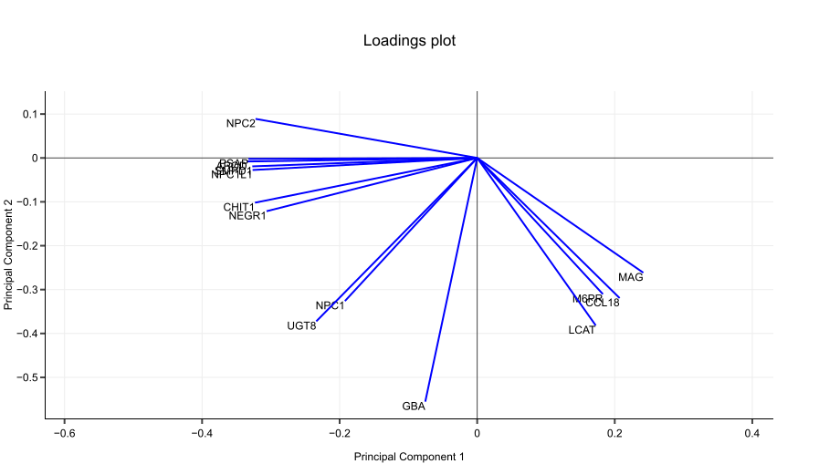
A loading plot shows how strongly each dimension influences a principal component.
A loading plot shows
Their projected values on each PC show how much weight they have on that PC
e. g., NPC2 and MAG influence PC1
e. g., GBA influences PC2
The angles b/w variables show how they correlated with each other
e. g., APOD and PSAP positively correlated
NPC2 and GBA not likely to be correlated
NPC2 and MAG negatively correlated
http://setosa.io/ev/principal-component-analysis/
Notes:
Suppose we had another data set with a different set of variables, such as NPC2, UGT8 and so on.
See how these vectors are pinned at the origin of PCs (PC1 = 0 and PC2 = 0)? Their project values on each PC show how much weight they have on that PC. In this example, NPC2 and CHIT1 strongly influence PC1, while GBA and LCAT have more say in PC2.
Another nice thing about loading plots: the angles between the vectors tell us how characteristics correlate with one another. Let’s look at Figure 2.
When two vectors are close, forming a small angle, the two variables they represent are positively correlated. Example: APOD and PSAP
If they meet each other at 90°, they are not likely to be correlated. Example: NPC2 and GBA.
When they diverge and form a large angle (close to 180°), they are negative correlated. Example: NPC2 and MAG.
Now that you know all that, reading a PCA biplot is a piece of cake.

Slide 23
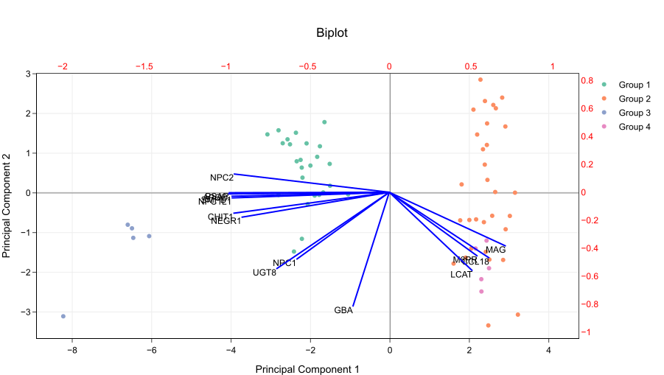
PCA biplot = PCA score plot + loading plot
Bottom axis: PC1 score
Left axis: PC2 score
Top axis: loadings on PC1
Right axis: loadings on PC2
http://setosa.io/ev/principal-component-analysis/
Notes:
You probably notice that a PCA biplot simply merge an usual PCA plot with a plot of loadings. The arrangement is like this:
In other words, the left and bottom axes are of the PCA plot — use them to read PCA scores of the samples (dots). The top and right axes belong to the loading plot — use them to read how strongly each characteristic (vector) influence the principal components.

Slide 24
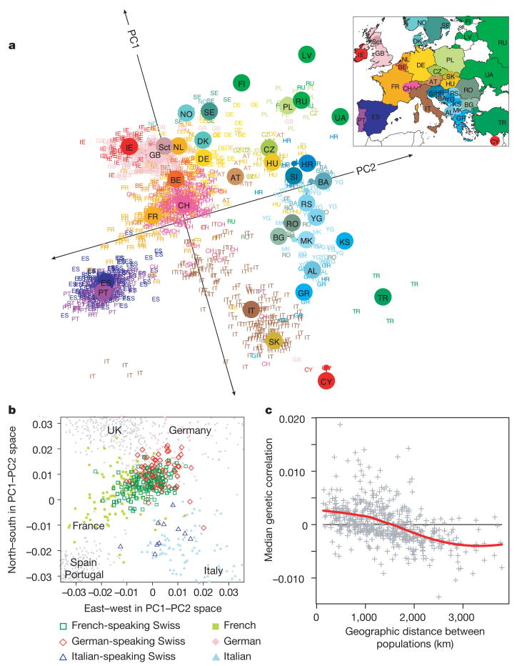
Example of PCA in genetics: principal components of ancestry

Slide 25
Limitations of PCA
PCs are linear combinations of data
Outliers
Missing data

Slide 26
PCA examples
See exercises 4-8

Slide 27
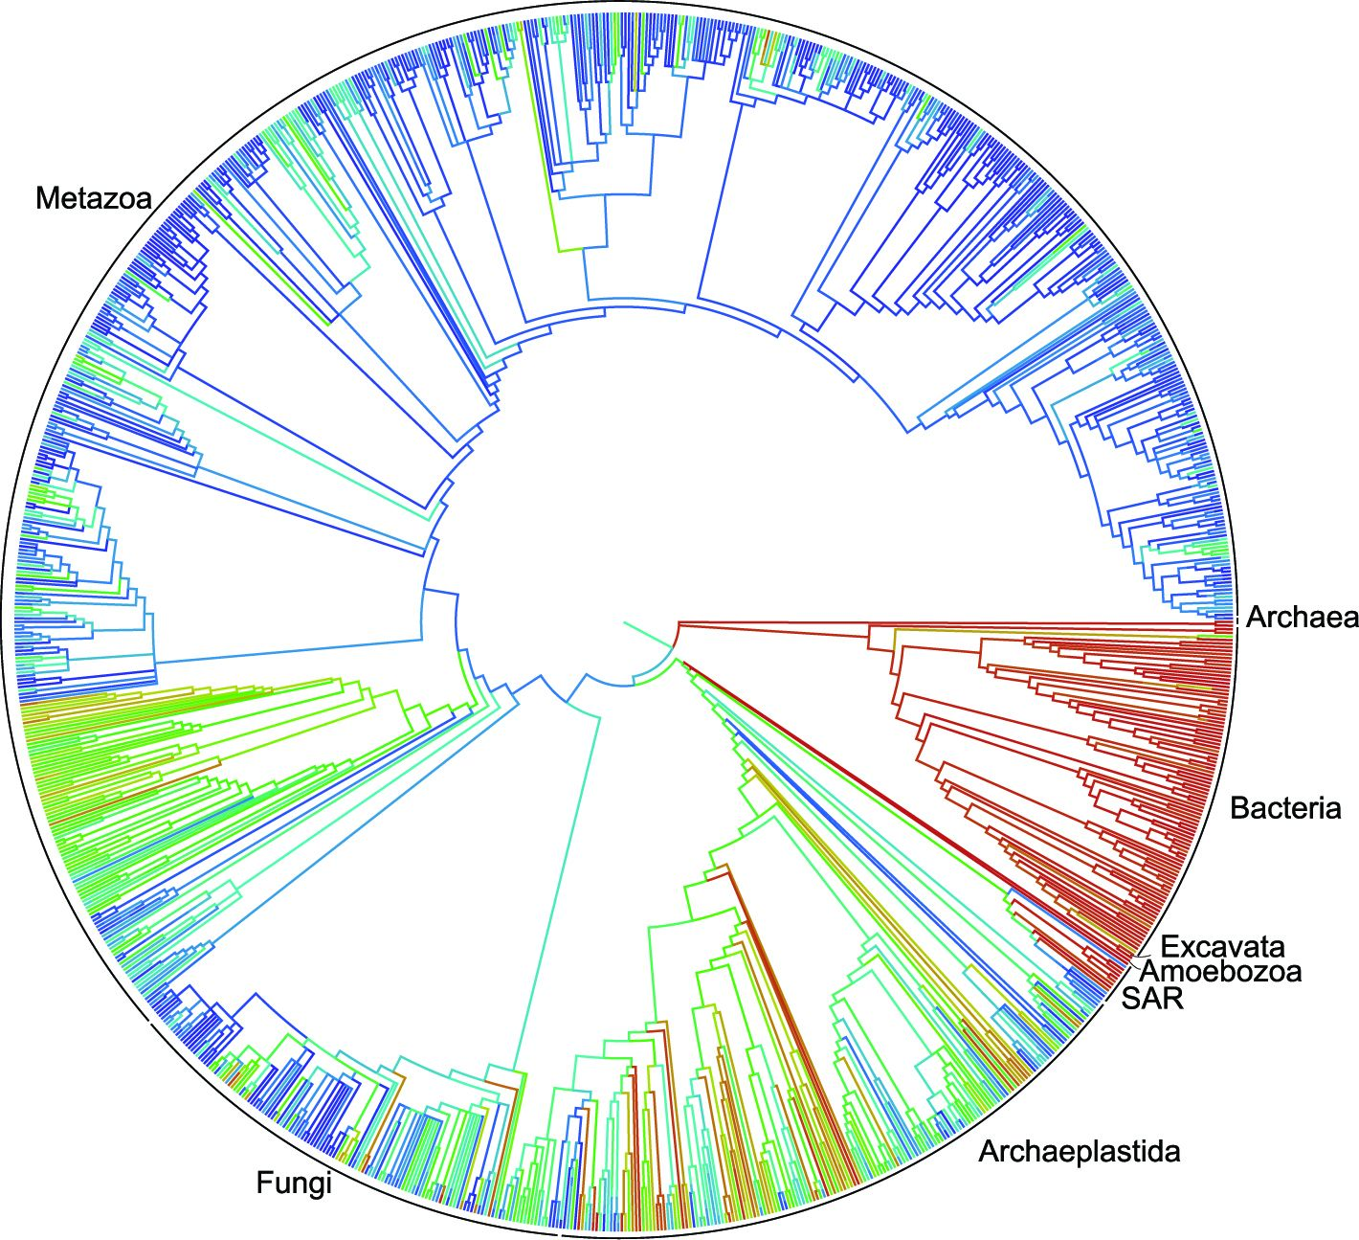
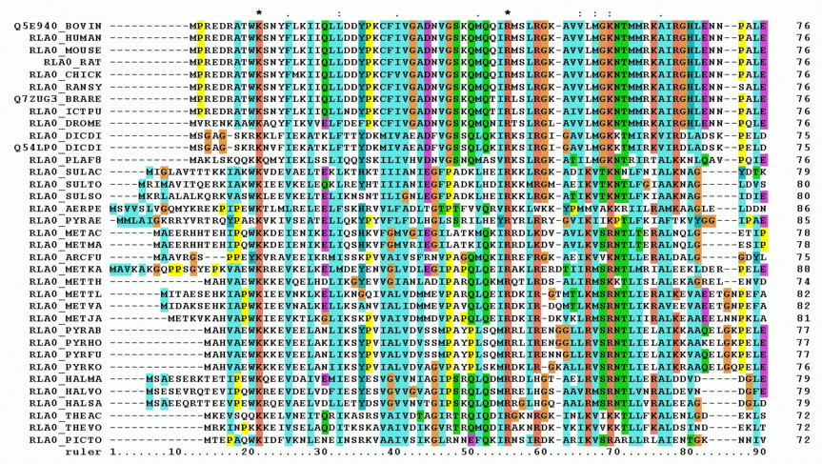
Hierarchical clustering groups data points in a nested fashion by similarity
What data was used?
DNA sequences of biological species
Clustering of biological species
2. How was the distance estimated? A distance measure
https://en.wikipedia.org/wiki/Multiple_sequence_alignment

Slide 28
Hierarchical clustering groups data points in a nested fashion by similarity
What data was used?
DNA sequences of biological species
A phylogenetic tree
2. How was the distance estimated? An evolutional model
https://en.wikipedia.org/wiki/Multiple_sequence_alignment

Slide 29
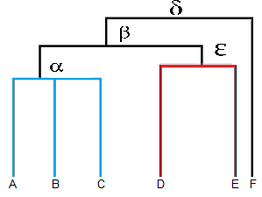
Hierarchical clustering makes a tree (dendrogram)
Clustering of biological species

Slide 30

Dendrogram visualizes hierarchical relationship of terminal nodes
Dendrogram = nodes + edges
Nodes
root node: no parent allowed
intermediate nodes: multiple descendants
terminal nodes: data points
Edges represent the relationship
$$γ$$
https://www.statisticshowto.datasciencecentral.com/hierarchical-clustering/
Notes:
dendogram can be a column graph (as in the image below) or a row graph. Some dendograms are circular or have a fluid-shape, but software will usually produce a row or column graph. No matter what the shape, the basic graph comprises of the same parts:
The clade is the branch. Usually labeled with Greek letters from left to right (e.g. α β, δ…).
Each clade has one or more leaves. The leaves in the above image are:
Single (simplicifolius): F
Double (bifolius): D E
Triple (trifolious): A B C
A clade can theoretically have an infinite amount of leaves. However, the more leaves you have, the harder the graph will be to read with the naked eye.

Slide 31

Dendrogram visualize group memberships
Leaves A, B, and C are more similar to each other than to D, E, or F.
Leaves D and E are more similar to each other than to A, B, C, or F.
Leaf F is different from all of the other leaves.
$$γ$$
https://www.statisticshowto.datasciencecentral.com/hierarchical-clustering/
Notes:
The clades are arranged according to how similar (or dissimilar) they are. Clades that are close to the same height are similar to each other; clades with different heights are dissimilar — the greater the difference in height, the more dissimilarity (you can measure similarity in many different ways; One of the most popular measures is Pearson’s Correlation Coefficient).
Note that on the above graph, the same clave, β joins leaves A, B, C, D,and E. That means that the two groups (A,B,C & D,E) are more similar to each other than they are to F.

Slide 32

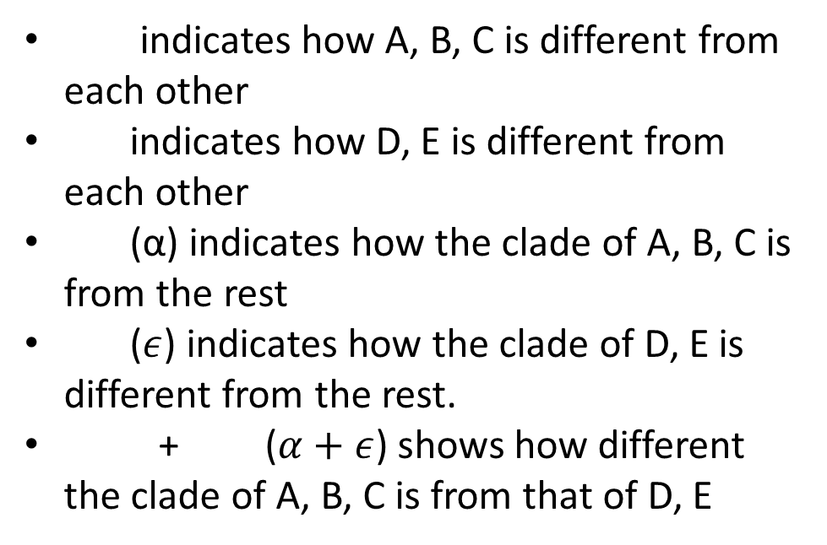
Dendrogram visualizes distances among objects
indicates how A, B, C is different from each other
indicates how D, E is different from each other
(α) indicates how the clade of A, B, C is from the rest
($ε$) indicates how the clade of D, E is different from the rest.
+ ($α+ε$) shows how different the clade of A, B, C is from that of D, E
$$γ$$
https://www.statisticshowto.datasciencecentral.com/hierarchical-clustering/
Notes:
The clades are arranged according to how similar (or dissimilar) they are. Clades that are close to the same height are similar to each other; clades with different heights are dissimilar — the greater the difference in height, the more dissimilarity (you can measure similarity in many different ways; One of the most popular measures is Pearson’s Correlation Coefficient).
Note that on the above graph, the same clave, β joins leaves A, B, C, D,and E. That means that the two groups (A,B,C & D,E) are more similar to each other than they are to F.

Slide 33
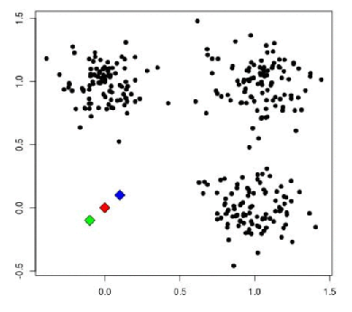
Clustering based on distance
Algorithm of K-means clustering on 2-D data
Given data of two dimensions (features)
Dimension 2
Dimension 1
https://towardsdatascience.com/cluster-analysis-create-visualize-and-interpret-customer-segments-474e55d00ebb

Slide 34
Clustering based on distance
Algorithm of K-mean clustering on 2-D data
Given data of two dimensions
Assuming three clusters (K=3)
Dimension 2
Dimension 1
https://towardsdatascience.com/cluster-analysis-create-visualize-and-interpret-customer-segments-474e55d00ebb
Notes:
Note that there are a wealth of methods to determine

Slide 35
Clustering based on distance
Algorithm of K-mean clustering on 2-D data
Given data of two dimensions
Assuming three clusters (K=3)
Randomly choose the center point (centroid) for the clusters
Dimension 2
Dimension 1
https://towardsdatascience.com/cluster-analysis-create-visualize-and-interpret-customer-segments-474e55d00ebb
Notes:
Note that there are a wealth of methods to determine

Slide 36
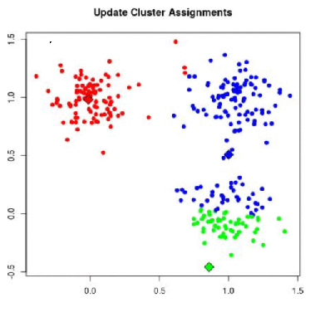
Clustering based on distance
Algorithm of K-mean clustering on 2-D data
Given data of two dimensions
Assuming three clusters (K=3)
Update cluster assignments based on the distance
Dimension 2
Dimension 1
https://towardsdatascience.com/cluster-analysis-create-visualize-and-interpret-customer-segments-474e55d00ebb

Slide 37
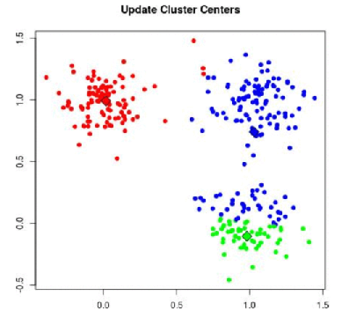
Clustering based on distance
Algorithm of K-mean clustering on 2-D data
Given data of two dimensions
Assuming three clusters (K=3)
Update the cluster centers
Dimension 2
Dimension 1
https://towardsdatascience.com/cluster-analysis-create-visualize-and-interpret-customer-segments-474e55d00ebb

Slide 38
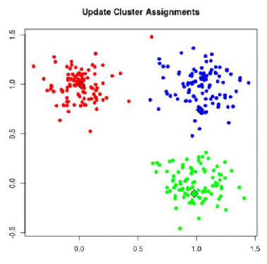
Clustering based on distance
Algorithm of K-means clustering on 2-D data
Given data of two dimensions
Assuming three clusters (K=3)
Update cluster assignments based on the distance
Things to control
How to determine K
Location of the initial points
When to stop
How to calculate distance
Dimension 2
Dimension 1
https://towardsdatascience.com/cluster-analysis-create-visualize-and-interpret-customer-segments-474e55d00ebb

Slide 39
Dimension reduction and clustering example
See exercises 9-10

Slide 40
How “unsupervised”?
The models don’t decide everything for you!
Pre-process the data?
Feature selection?
Linear or non-linear?
What distance metric? (What weights?)
How many clusters?
Etc.

Slide 41
Supervised ML
Type of ML | Kind of question | You are given | Goal | Assumptions
Supervised | Is there a mapping from X→Y? | Input variables (X) Target/outcome/labels (Y) | Predict Y Estimate relationships between X and Y | The predictive structure (model type) Signal in X could explain Y
Unsupervised | What structure exists in X? | Only the data (X) No outcome/labels | Describe variation Find groups, dimensions, gradients, etc. | Continuous or discrete structure Local or relational structure

Slide 42
What can you predict with ML?
There are many ways to conceptually organize ML methods.
Most either
predict a continuous outcome (like regression) or
predict a discrete outcome (classification)
We could also organize by “function”
Regression/linear models
Kernel methods
Instance-based and distance-based methods
Tree-based methods
Neural nets
Probabilistic/generative models
(Note that this is not exhaustive or exclusive.)

Slide 43
Regression/linear models
Generalized linear (mixed) models
Includes regression (linear, logistic)
Always linear with respect to predictors
You are familiar with many of these
Problem: what if n << p?
→ Regularized linear models
Ridge regression
Lasso regression
Elastic net

Slide 44
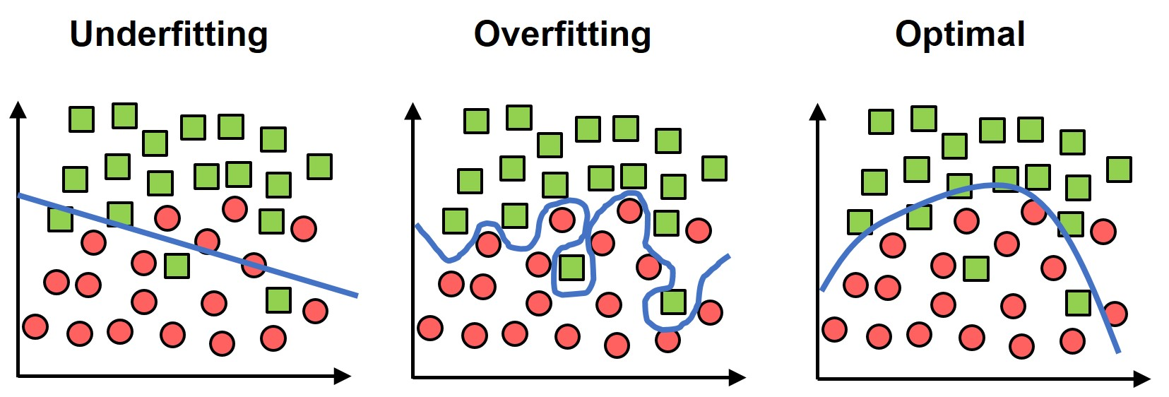
Problems
Problem: overfitting
= fitting the training data too closely (including noise)
= training error << testing error
very easy to overfit when n << p
→ model doesn’t generalize
One solution (for regression): regularization/feature selection
Note that over- and under-fitting is a universal problem in ML (not just for regression)

Slide 45
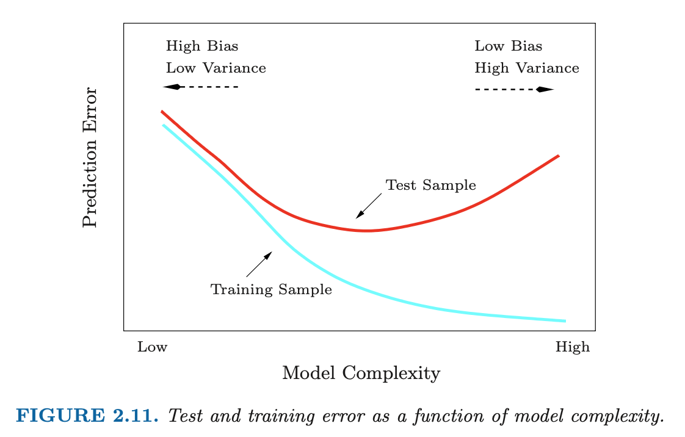


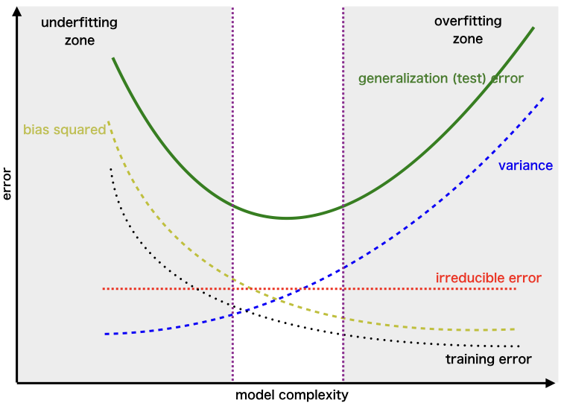
Fitting and “bias-variance tradeoff”
We want a model that generalizes to new data
We can decompose test error into bias² + variance + irreducible noise
Bias
Systematic error
How far is the average prediction from the truth?
High bias → model too simple (underfitting)
Variance
Sensitivity of the model to the training data
How much would prediction change if you trained on a different sample?
High variance → model too complex (overfitting)
Goal: find the “sweet spot”

Slide 46
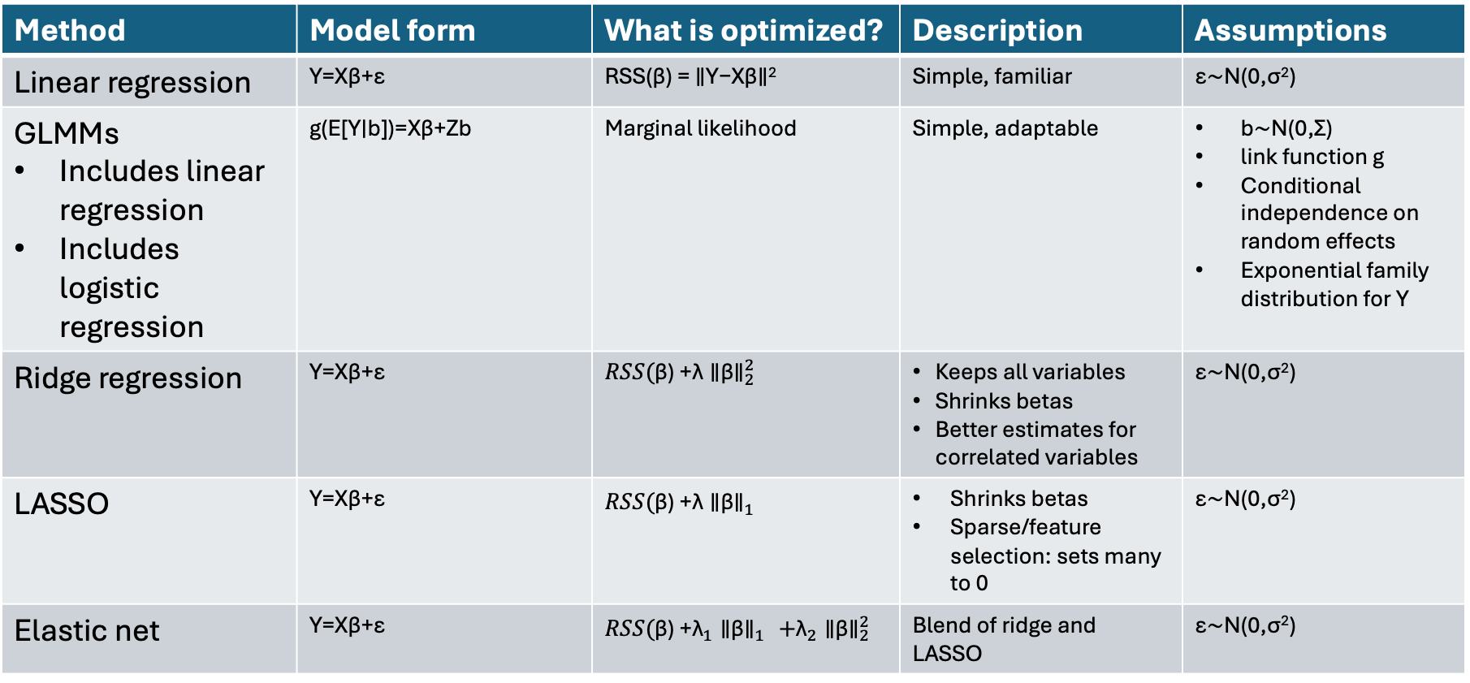
Comparison of regression methods
Method | Model form | What is optimized? | Description | Assumptions
Linear regression | Y=Xβ+ε | RSS(β) = ∥Y−Xβ∥² | Simple, familiar | ε∼N(0,σ²)
GLMMs Includes linear regression Includes logistic regression | g(E[Y∣b])=Xβ+Zb | Marginal likelihood | Simple, adaptable | b∼N(0,Σ) link function g Conditional independence on random effects Exponential family distribution for Y
Ridge regression | Y=Xβ+ε | ​$RSS(\text{β}\text{) +}\text{λ}{\text{∥}\text{β}\text{∥​}}_{2}^{2}$ | Keeps all variables Shrinks betas Better estimates for correlated variables | ε∼N(0,σ²)
LASSO | Y=Xβ+ε | ​$RSS(\text{β}\text{) +}\text{λ}{\text{∥}\text{β}\text{∥​}}_{1}^{}$ | Shrinks betas Sparse/feature selection: sets many to 0 | ε∼N(0,σ²)
Elastic net | Y=Xβ+ε | ​$RSS(\text{β}\text{) +}{\text{λ}}_{1}{\text{∥}\text{β}\text{∥​}}_{1}^{}+{\text{λ}}_{2}{\text{∥}\text{β}\text{∥​}}_{2}^{2}$ | Blend of ridge and LASSO | ε∼N(0,σ²)

Slide 47
Regression example
See Example 1
What’s wrong here??

Slide 48
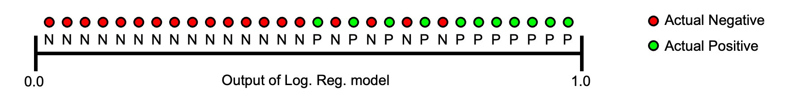
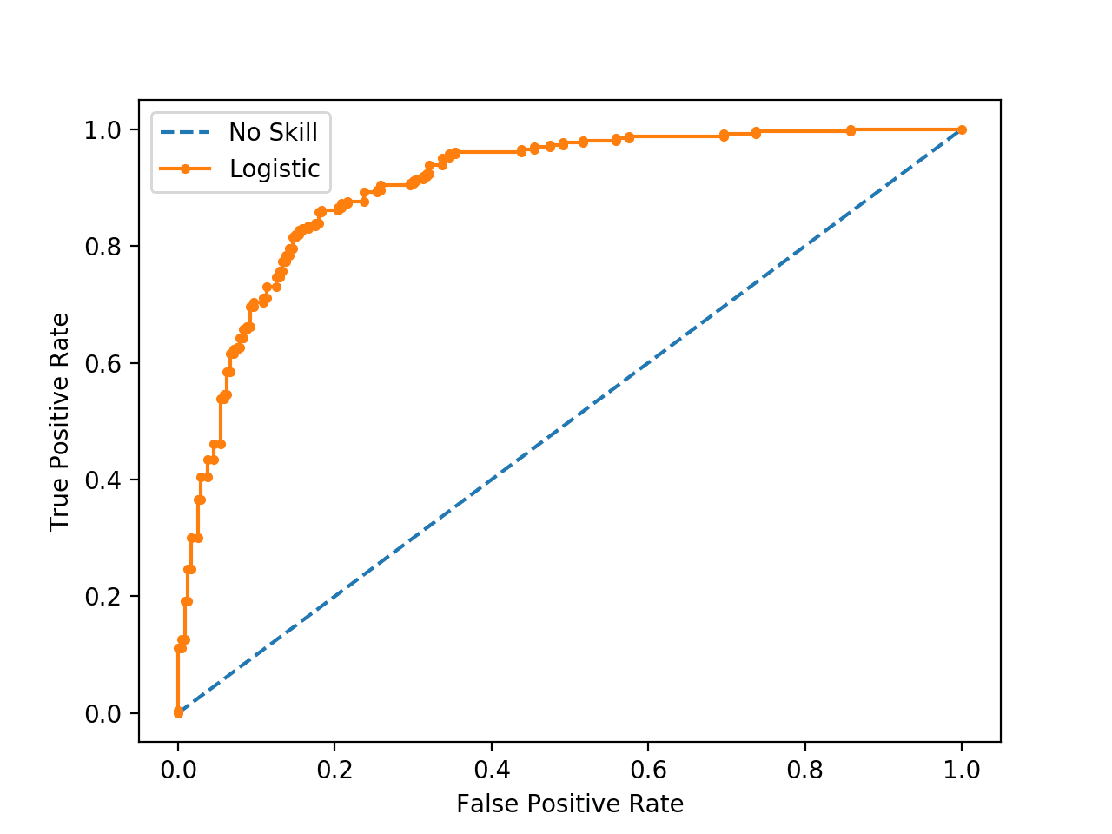
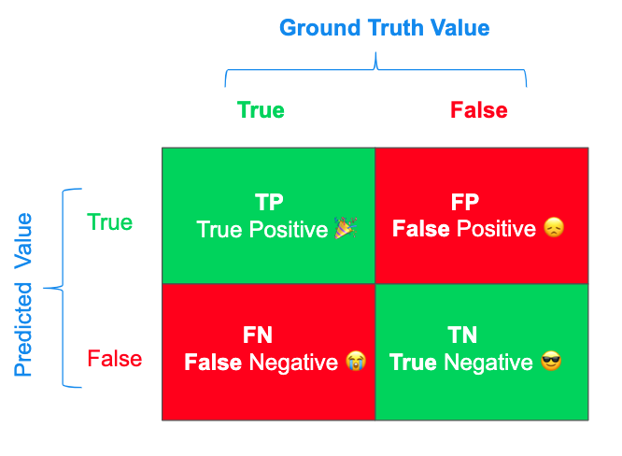
Digression on visualizing classifier results
Receiver operating characteristic (ROC)
The relationship between false positive rate and true positive rate as in a model
One possible threshold
= sensitivity
https://blog.floydhub.com/a-pirates-guide-to-accuracy-precision-recall-and-other-scores/
= 1 - specificity

Slide 49
Problems
Problems
We only saw how well the model can do on the training data
Training performance overestimates testing performance
So how can we estimate the generalization error?
How do we choose hyperparameters (like lambda)?
Solution: cross-validation
“Bias-variance tradeoff”

Slide 50
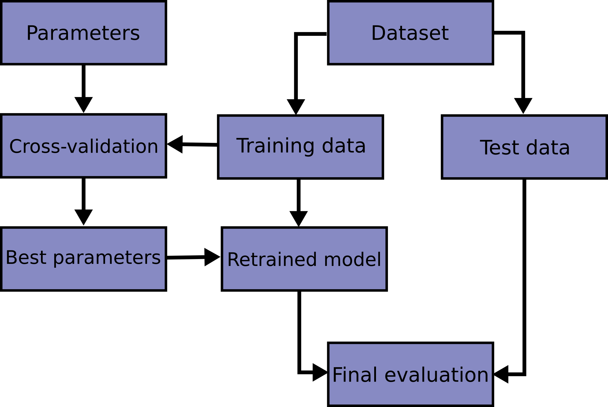
Cross-validation
Split data into training and testing sets (80% vs. 20%, often)
Make a “grid” of possible values for the hyperparameter(s) (e.g., lambda)
For each possible value of the hyperparameter(s)
Split training data into k folds (often 5 or 10)
For each of the k folds
Train model on the other k-1 folds
Compute its error on the left-out fold
Now average the k errors
Select the value of the hyperparameter with the smallest average error
Use that value and train the model on the full training set
Calculate its error on the testing set

Slide 51
Cross-validation
See example 2

Slide 52
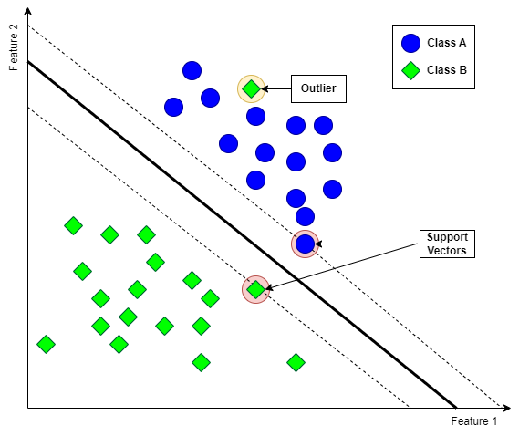
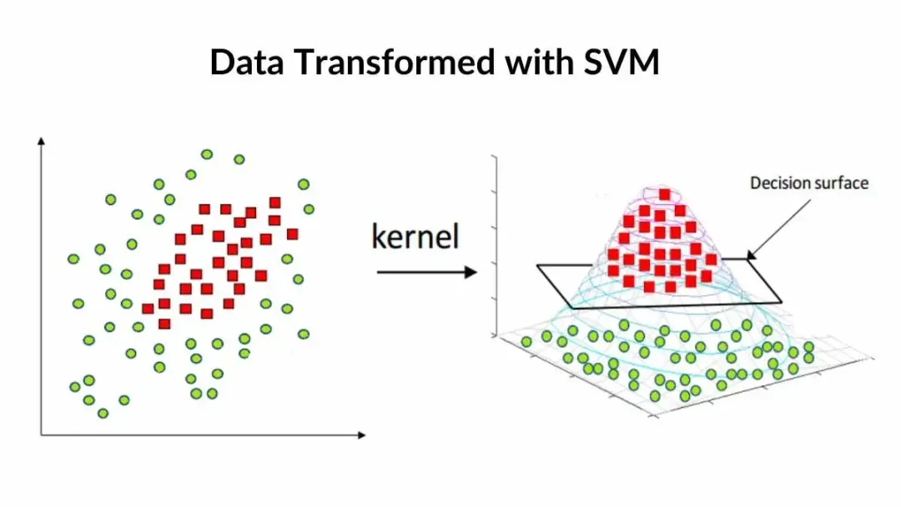
Kernel methods
Example: support vector machine
Goal: binary classification (like logistic regression)
Want a decision boundary dividing the two classes
SVM: choose the separating hyperplane with the largest margin

Slide 53
Instance/distance-based methods
Distance-based methods: prediction relies on distance/similarity
Instance-based methods: are training data stored in the model and use for prediction?
k-nearest neighbors (kNN) is an example of both

Slide 54
kNN
Idea: classify a new point based on labels of its neighbors
Choose k
Compute its distance from all training data points
Find the k nearest neighbors
Assign the point to the majority class among those neigbors
Parameters to tune
k (use cross-validation!)
large k = underfitting (low bias and high variance)
small k = overfitting (higher bias and lower variance)
distance metric
feature scaling
weighting
(dimensionality reduction?)
See example 3

Slide 55
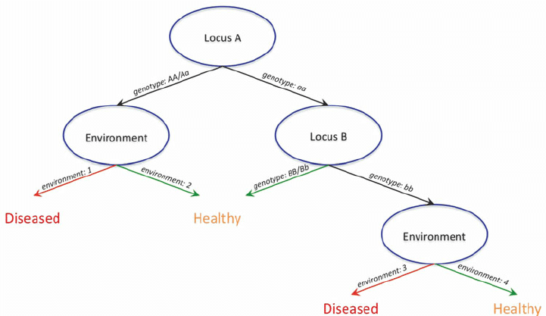
Tree-based methods
Decision trees
Recursively partition feature-space (many if-then splits)
Prediction can be regression-based or majority-vote
Advantages
Nonlinear
Interactions
Mixed data types
Feature selection
Disadvantages: high variance/unstable/over-fitting
Parameters: maximum depth, number of samples in each split, number of terminal nodes, penalty for number of nodes
Random forest
Resample (boostrap) many times from your data
Train a decision tree on each one and keep all of them
Classifier: average the votes of all the trees
Many extensions/variations exist

Slide 56
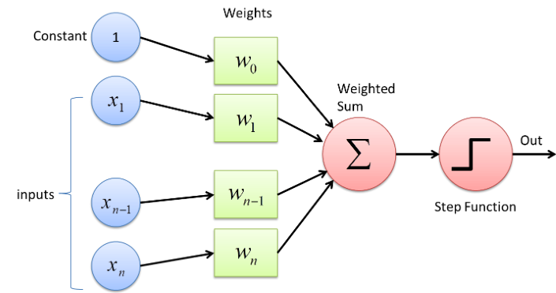
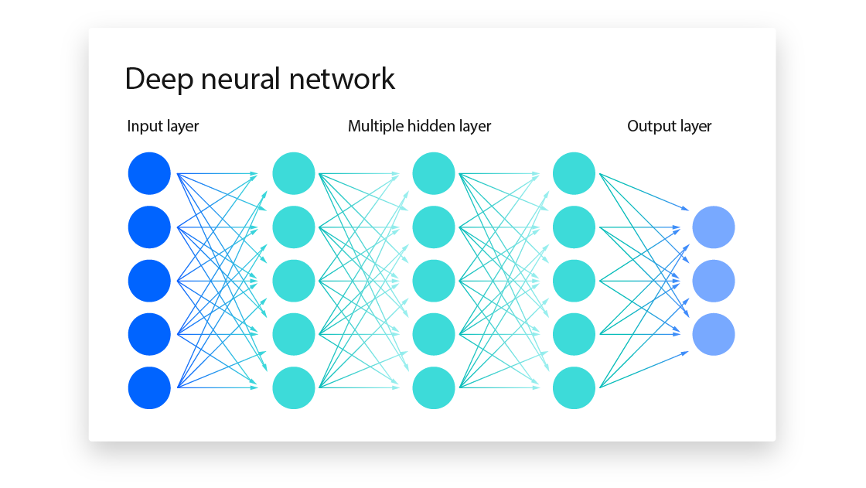
Neural nets
Compositions of linear and nonlinear transformations
Linear transformations of signals between layers
Nonlinear activations
Some extensions
Convolutional (CNNs)
Often applied to image data
Recurrent (RNNs)
Often applied to time series data
Transformers
Include LLMs
Autoencoders
For unsupervised learning

Slide 57
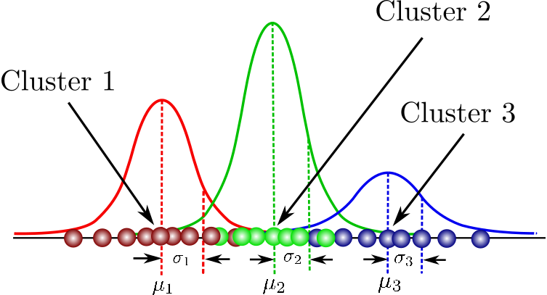
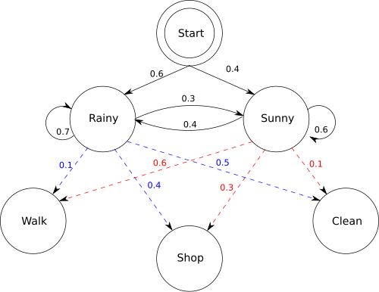
Probabilistic models
Core idea
“How likely are the data to have been generated by each class?”
Prediction: pick the class that makes the data most probable
Examples
Naïve Bayes
“ How strongly does each piece of evidence (e.g., dosage of allele A, expression of gene B, clinical feature C) point to “case vs. control”?
Naïve = no interactions
Gaussian mixture classifiers
Hidden Markov models
For sequential data (e.g., chromatin states along a segment of a chromosome)
You observe noisy signals but cannot directly observe state
Infer the state most likely to have emitted a signal

