Slide 1
PheWAS
HUGEN 2073
Jon Chernus
Notes:
This lecture is largely modeled after:
Bush, W. S., Oetjens, M. T., & Crawford, D. C. (2016). Unravelling the human genome-phenome relationship using phenome-wide association studies. Nature reviews. Genetics, 17(3), 129–145. https://doi.org/10.1038/nrg.2015.36

Slide 2
Motivation for pheWAS
What is the “paradigm” for a GWAS?
What is the direction of inference? Fill in the blanks. (Hint: think of the terms “forward” and “reverse” genetics.)
_______
_______
GWAS
Notes:
Forward: phenotype → genotype
Reverse: genotype → phenotype

Slide 3
Motivation for pheWAS
Can we reverse the GWAS “paradigm? What would the direction of inference be? What word goes in the second blank?
_______
_______
pheWAS

Slide 4
Motivation for pheWAS
phenome = set of “all” phenotypes (of an organism, at some level of abstraction)
pheWAS = testing variant(s) for association with phenome
pheWAS asks, “Given a variant (or set of variants), what are all the phenotypes associated with it?”

Slide 5
Motivation for pheWAS
Why do pheWAS? (Discuss)
Are there reasons to suspect this could be a good idea?
Are there any promising applications?

Slide 6
Motivation for pheWAS
Why do pheWAS? Some reasons:
“almost 5% of single nucleotide polymorphisms (SNPs) and almost 17% of genes or gene regions are associated with more than one distinct outcome or trait”
pheWAS lets us study variants like this more systematically
Feasibility of studying a variety of clinical traits (we’ll discuss why)
Possibility of using longitudinal data (what is longitudinal data?)
Potential, e.g., for discovering new drug targets/purposes (we’ll discuss this more)
PheWAS helps interpret GWAS results
Sivakumaran, S. et al. Abundant pleiotropy in human complex diseases and traits. Am. J. Hum. Genet. 89, 607–618 (2011).
Rastegar-Mojarad, M., Ye, Z., Kolesar, J. M., Hebbring, S. J. & Lin, S. M. Opportunities for drug repositioning from phenome-wide association studies. Nat. Biotechnol. 33, 342–345 (2015).

Slide 7
Motivation for pheWAS
In pheWAS we’re particularly interested in variants influencing more than one trait. (What is that called?!)
(Note that we are not necessarily talking about multivariate testing.)

Slide 8
Motivation for pheWAS
Pleiotropy = when a variant affects more than one phenotype
But a phenotype-genotype association can have different meanings.
pheWAS may help us begin to “dissect” pleiotropic associations.
Note that in pheWAS and in GWAS essentially the same kind of statistical test is performed
GWAS: “Is genotype associated with phenotype?” (x 1,000,000 variants)
PheWAS: “Is genotype associated with phenotype?” (x 1,000 phenotypes)

Slide 9
Pleiotropy
Once you’ve done a pheWAS, you can announce “rs12345 is associated with traits X and Y” and declare victory, right?
Not quite, but why?

Slide 10
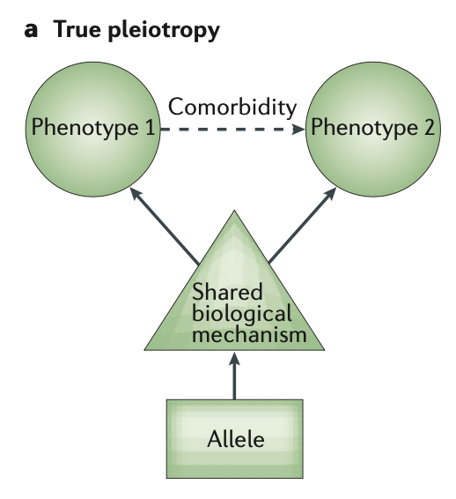
Pleiotropy
Suppose pheWAS tells you rs12345 is associated with phenotype 1 and phenotype 2.
True (or “horizontal”) pleiotropy is one possible explanation.
phenotypes 1 and 2 are both independently influenced by the genotypes at a locus influencing a shared biological mechanism.

Slide 11
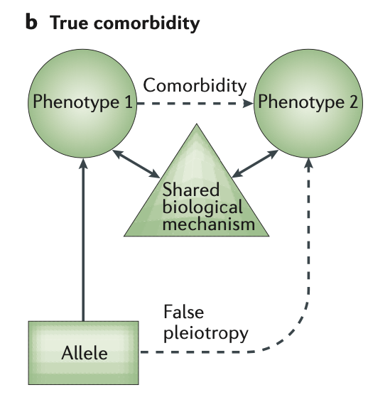
Pleiotropy
“Comorbidity” could be another explanation.
the phenotypes are causally linked in some way that mediates the effect of the genotype on phenotype 2. In this scenario, the genotypes of the locus influence phenotype 1, which induces phenotype 2, but they do not directly or independently influence phenotype 2

Slide 12
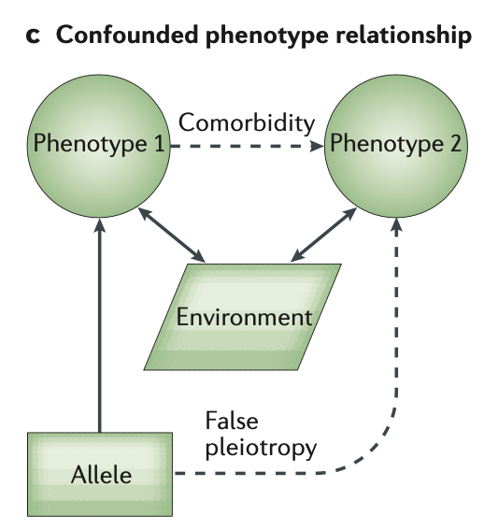
Pleiotropy
Confounding due to shared environmental (or “cryptic”) factors could also explain an association between rs12345 and phenotypes 1 and 2.
Non-genetic factors can also modulate the co-occurrence of phenotypes. In this scenario, both phenotypes 1 and 2 have an underlying environmental cause, thus they co-occur in the population. Genotypes at a locus only influence phenotype 1, but both phenotypes 1 and 2 are modulated in similar ways by the environment, and thus seem to be associated

Slide 13
False/vertical pleiotropy
The previous two slides represent false or “vertical” pleiotropy.
The association between genotype and phenotype 2 would disappear if you conditioned on the shared biological/environmental variable.

Slide 14
False/vertical pleiotropy example
Think back to variants in FTO being strongly associated with BMI.
They’re also associated with T2D.
But when adjusted for BMI, the T2D associations become weaker.
→ Unlikely that FTO variants have pleiotropic effects on T2D risk independent of BMI
https://journals.physiology.org/doi/full/10.1152/physiolgenomics.00040.2019?rfr_dat=cr_pub++0pubmed&url_ver=Z39.88-2003&rfr_id=ori%3Arid%3Acrossref.org

Slide 15
More false pleiotropy examples
Smoking tobacco is addictive and causes cancer and other diseases.
Changes to cerebral white matter (WM) could be related.
So could genetics.
But what causes what?
???
Smoking
White matter changes
???
???
???
Genetics
Ye Z, Mo C, Liu S, Hatch KS, Gao S, Ma Y, Hong LE, Thompson PM, Jahanshad N, Acheson A, Garavan H, Shen L, Nichols TE, Kochunov P, Chen S, Ma T. White Matter Integrity and Nicotine Dependence: Evaluating Vertical and Horizontal Pleiotropy. Front Neurosci. 2021 Oct 14;15:738037. doi: 10.3389/fnins.2021.738037. PMID: 34720862; PMCID: PMC8551454.

Slide 16
More false pleiotropy examples (con’t.)
Here are some possible relationships among the variables…
False/vertical pleiotropy:
Genes → WM integrity → Smoking
Genes → Smoking → WM integrity
True/horizontal pleiotropy:
Genes → Smoking & WM integrity (independently)

Slide 17
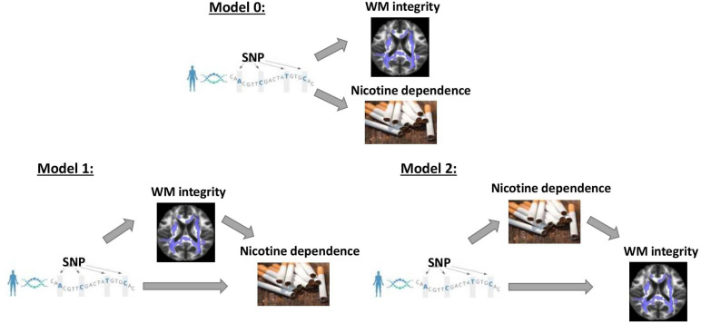
More false pleiotropy examples (con’t.)
Notes:
“Three competing vertical and horizontal pleiotropy pathways proposed to understand the causal relationship between genetics, white matter integrity, and nicotine dependence. Model 0 represents a horizontal pleiotropic relationship, while models 1 and 2 represent vertical pleiotropic relationships.”
“Vertical and horizontal pleiotropic pathways are chief causal mechanisms explaining the phenomenon of genetic variants affecting multiple traits (Tyler et al., 2009; Paaby and Rockman, 2013; Jordan et al., 2019). Vertical pleiotropy is observed when a trait influenced by genetic factors has, in turn, influenced another trait by acting as a mediator.
Horizontal pleiotropy refers to two traits being independently influenced by the same genetic factors. In the first vertical pleiotropic pathway (Figure 1: model 1), we assume that genetic factors underpinning susceptibility to nicotine dependence do so through alterations in WM integrity.
In the second vertical pleiotropic pathway (Figure 1: model 2), we alternatively hypothesize that genetic factors underpin nicotine addiction directly, and the reduction in WM integrity occurs due to a multitude of harmful effects of chronic or heavy smoking.
Lastly, we also test horizontal pleiotropy (Figure 1: model 0) where genetic factors affect both WM integrity and nicotine addiction independently. The proposed models are complementary to the widely used Mendelian randomization (MR) models that estimate the causal influence between the traits by relaxing the conditional independence assumption in instrumental variable (IV) analysis (Davey Smith and Hemani, 2014; Hemani et al., 2018a,b). We then develop rigorous analytical approaches to determine and validate the best causal model for pleiotropic genetic variants associated with both WM integrity and nicotine addiction.”

Slide 18
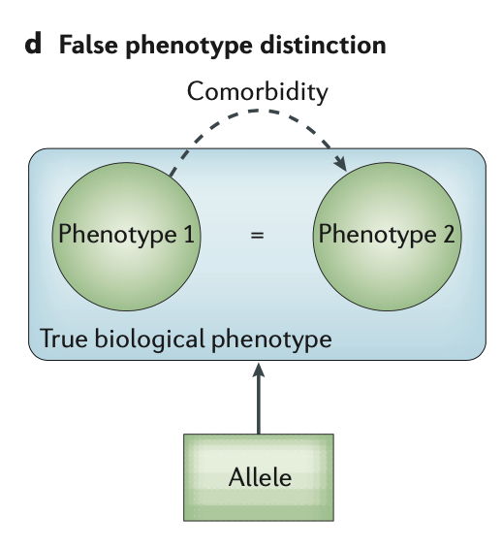
Pleiotropy
What if rs12345 is associated with X and Y simply because X and Y are actually the same phenotype? How would this happen?
two ‘phenotypes’ within the phenome represent only one underlying disease

Slide 19
Pleiotropy
PheWAS won’t necessarily disentangle these questions without statistical/functional follow-up!
Interpretation is challenging!

Slide 20
Pleiotropy and pheWAS
Example: rs12203592 (IRF4)
Prior GWAS associations for pigmentation phenotypes
Hair color
Increased freckling
Eye color
Increased sunburn
Decreased response to tanning
→ good pheWAS SNP
pheWAS: rs12203592 associated with actinic keratosis (AK), for which skin color is a risk factor
Is AK just a surrogate for skin color?
(If skin color data had been available in the pheWAS, the association could be conditioned on skin color)
An independent study confirmed pigmentation/AK signals for rs12203592 were independent, i.e., remains after adjusting for pigmentation (“true pleiotropy”)
Notes:
actinic keratosis = a pre-cancerous condition of scaly or crusty skin common in [lighter]-skinned individuals, particularly those who tan or are constantly exposed to ultraviolet light

Slide 21
phenome
We know what a reference genome is. So we can reason “trait → variants/genes in genome” (GWAS) But what is a “reference phenome”? Unlike the genome, this has to be defined.

Slide 22
How is a phenome defined?
There are two main ways for defining phenomes
Electronic health records (EHRs)
Define phenome in terms of billing codes, etc.
Epidemiological studies
Predefine a list of traits to measure/assess

Slide 23
EHR
Vital signs
Past/current health conditions
Diagnostic procedure results (images, etc.)
Lab results
Genetics
Linked to biorepository with genetic data

Slide 24
EHR-based phenomes
Generally use billing/diagnostic/procedural codes from patients’ records in repositories.
In the US, ICD-9-CM and ICD-10-CM, and ICD-11 codes have been used.
Hierarchical system for coding diseases, findings, injuries, procedures, etc.
Updated sometimes (major source of confusion and difficulty; codes have to be “mapped” between the ICD-9/10/11 for harmonization)
Tens of thousands of codes
Notes:
“ICD” = International Classification of Diseases
”CM” = clinical modification?

Slide 25
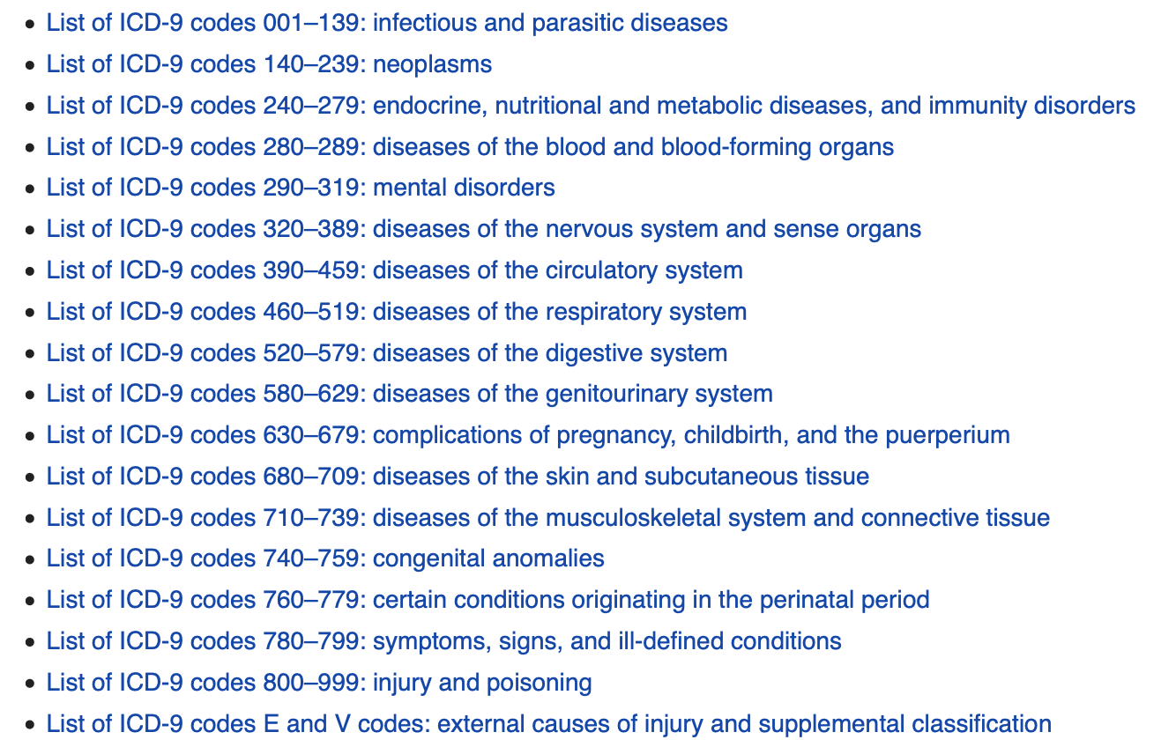
EHR-based phenomes: ICD codes
https://en.wikipedia.org/wiki/List_of_ICD-9_codes

Slide 26
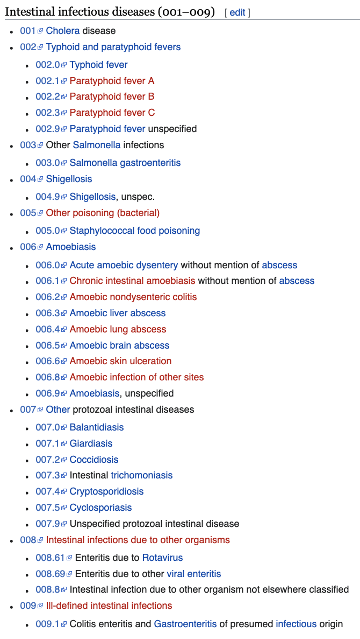
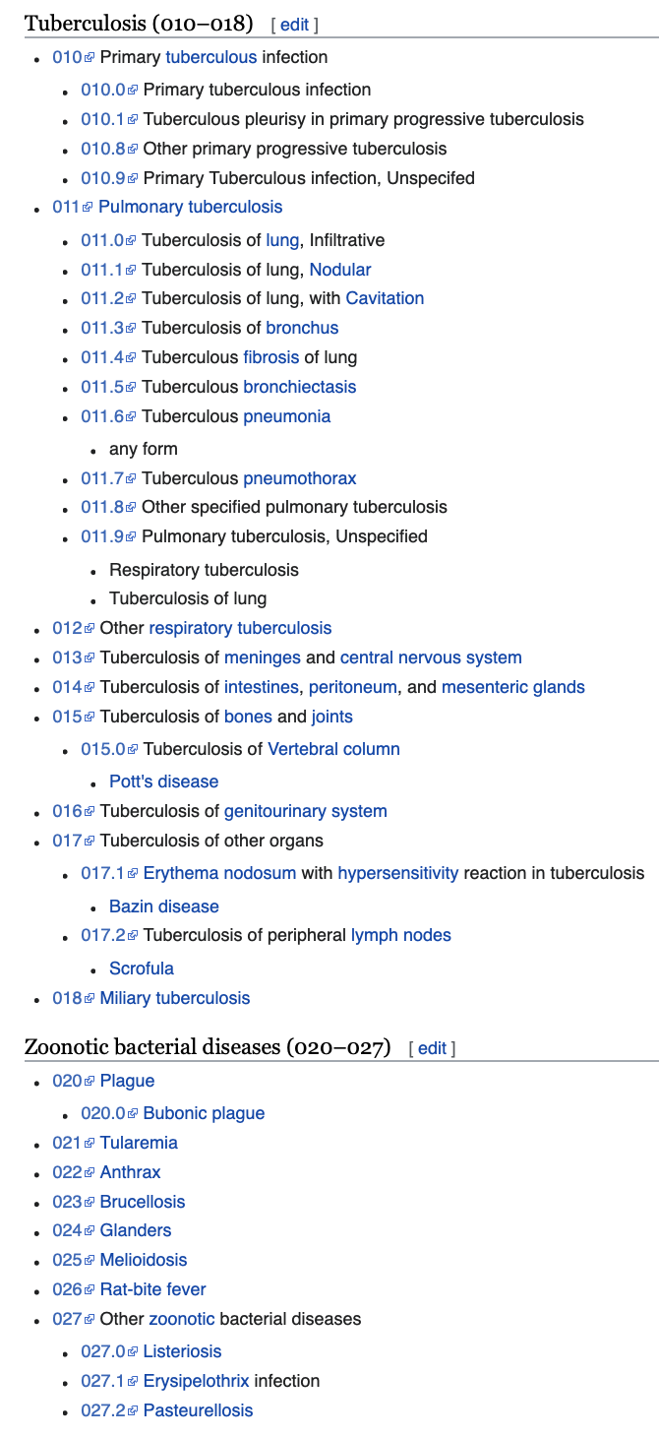
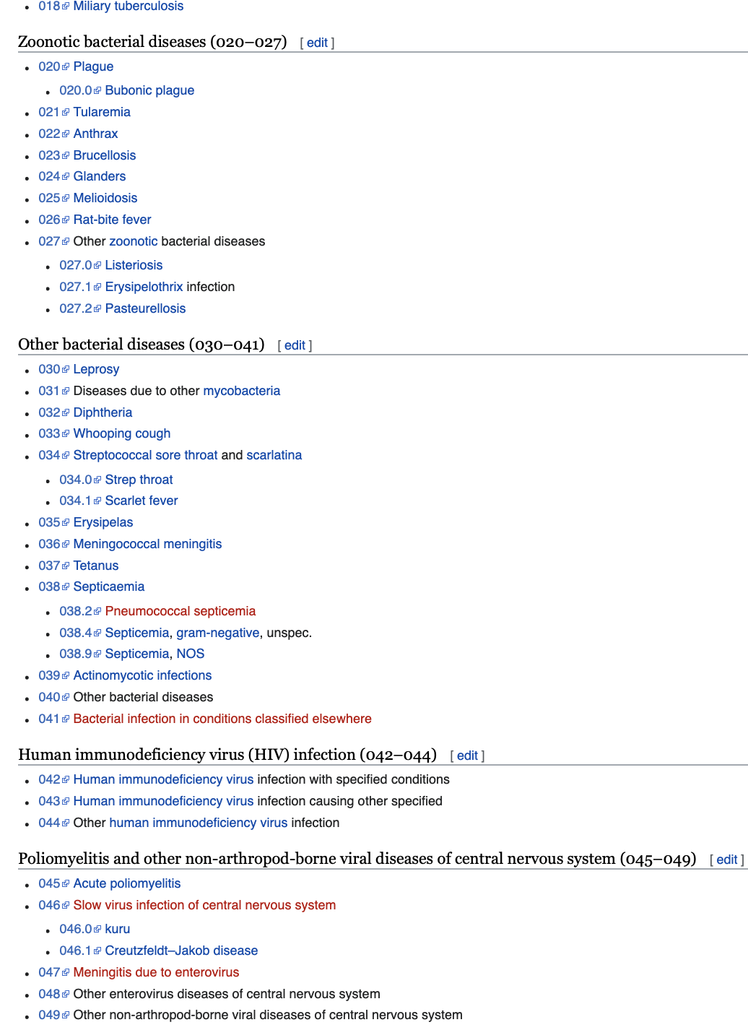
Notes:
https://en.wikipedia.org/wiki/List_of_ICD-9_codes_001–139:_infectious_and_parasitic_diseases

Slide 27
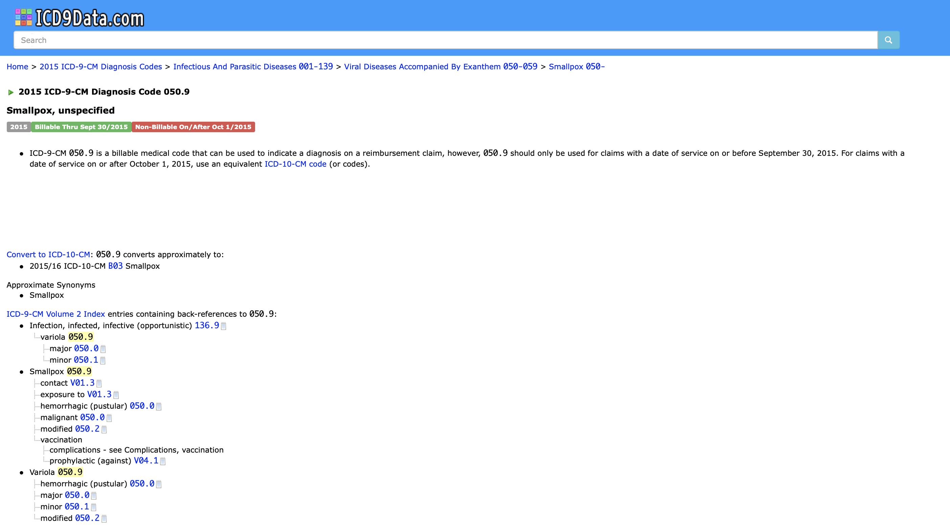
EHR-based phenomes: ICD codes
Smallpox in ICD-9

Slide 28
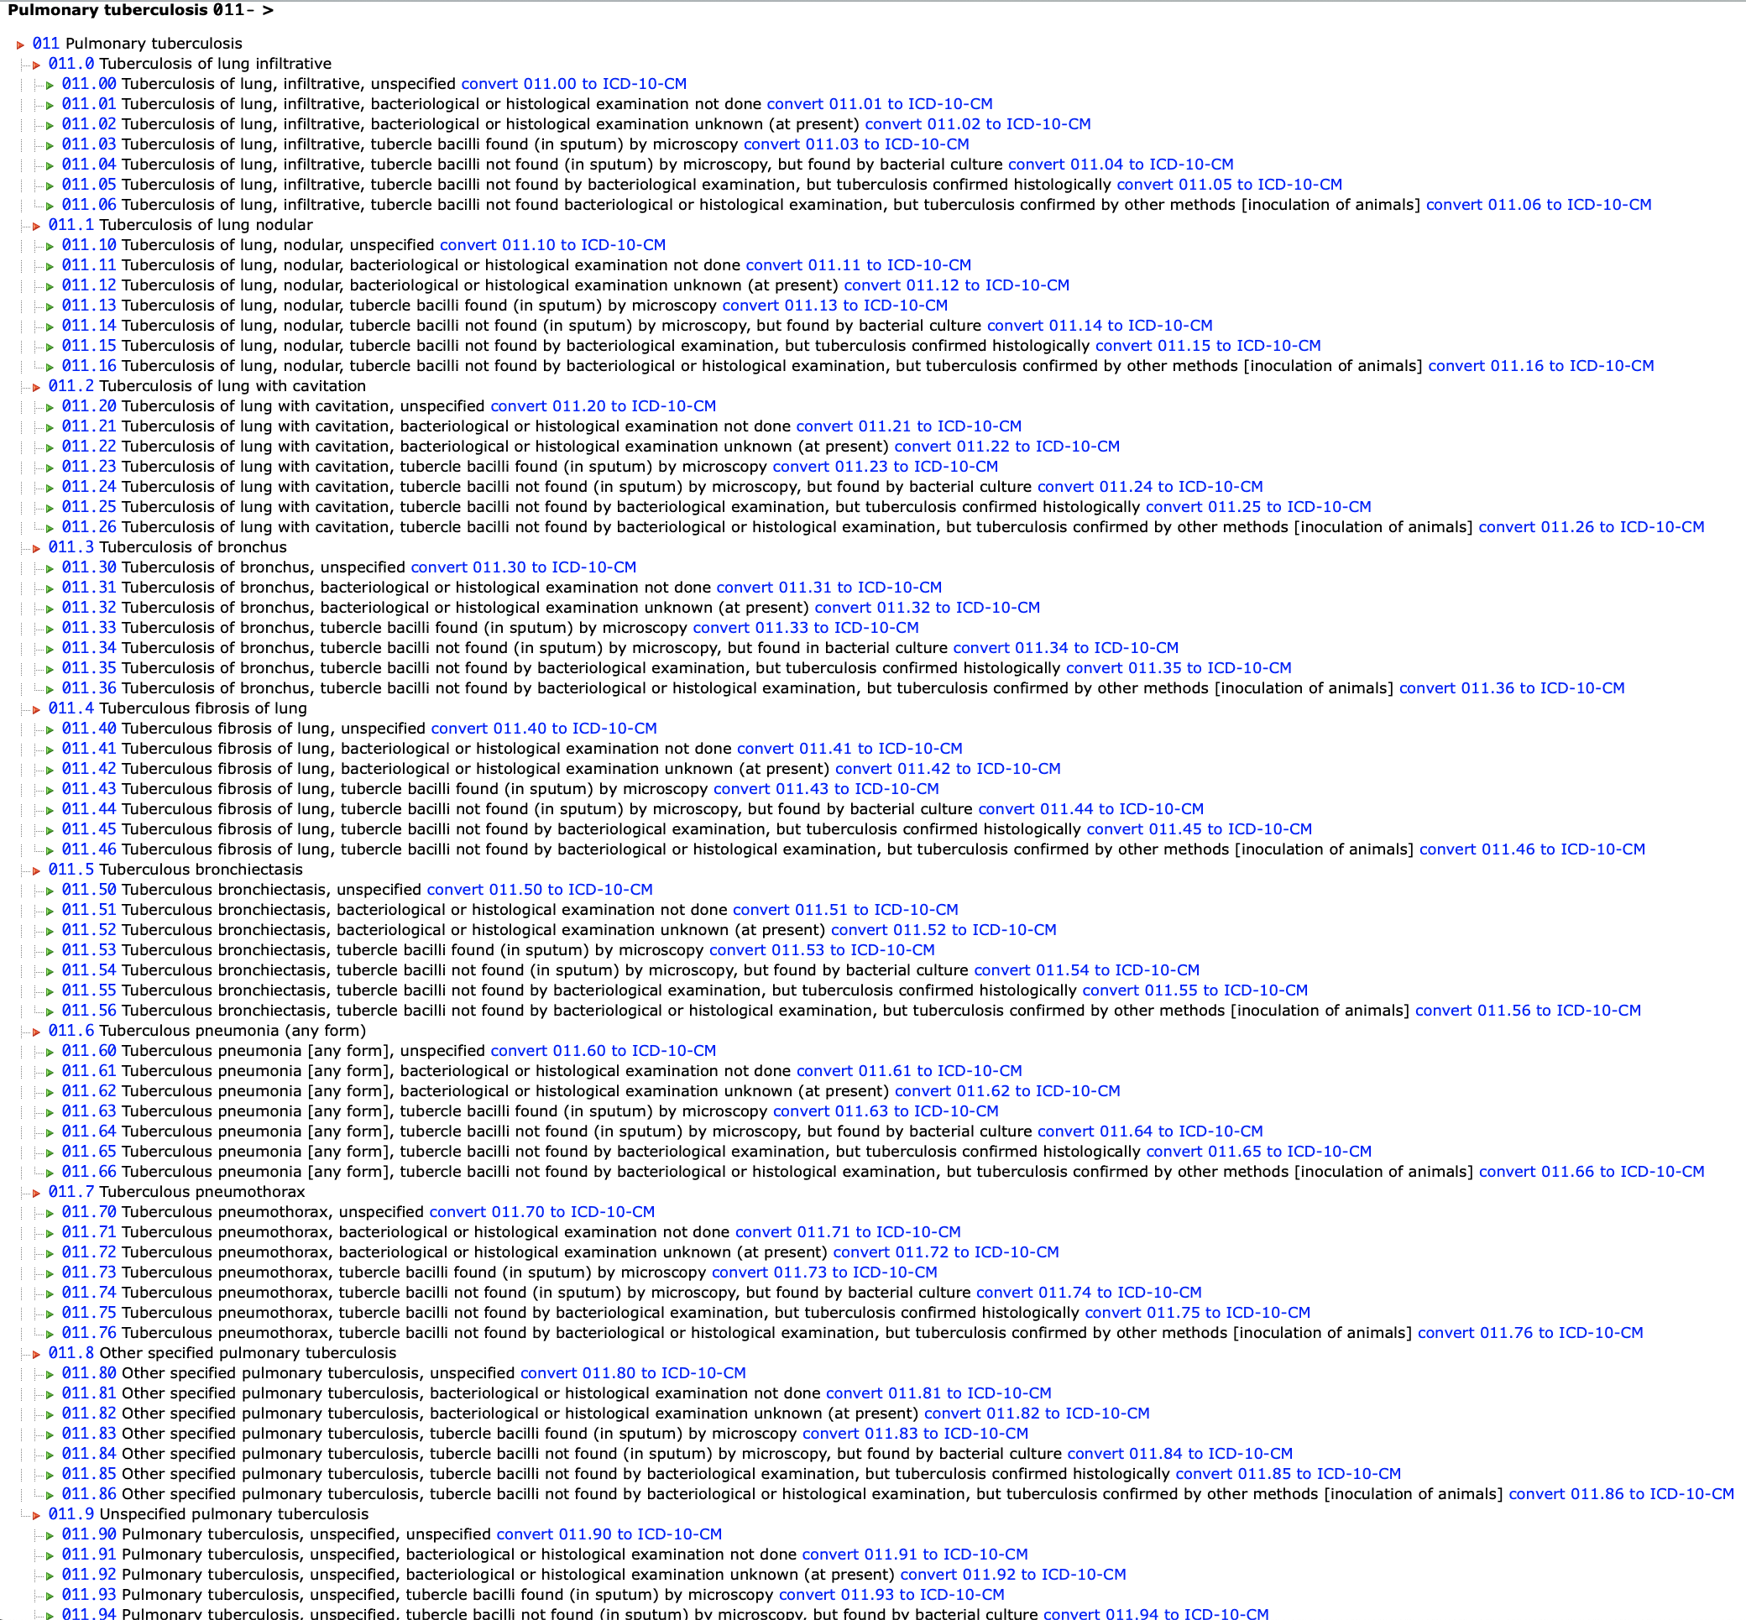
Pulmonary Tuberculosis ICD-9 codes (incomplete list)
Notes:
http://www.icd9data.com/2015/Volume1/001-139/010-018/011/default.htm

Slide 29
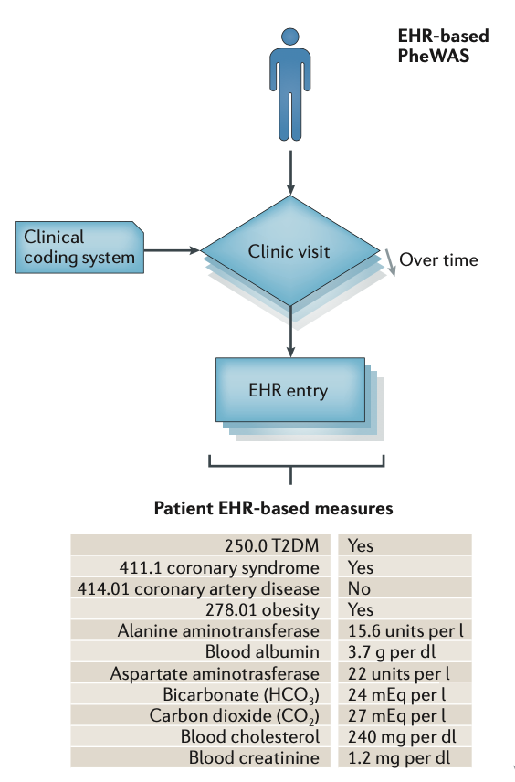
EHR-based phenomes

Slide 30
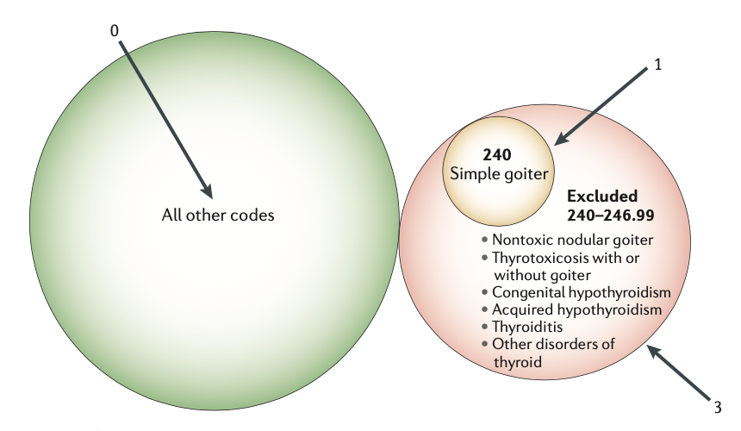
EHR-based phenomes: defining cases/controls using ICD codes
Cases
Decide which code(s)s represent the trait (Phecodes)
People with the code(s) are cases
Controls
Decide which codes are exclusion criteria
Exclude people with those codes
Everyone else who isn’t a case is a control
(Note that a control may not have been assessed for the trait at all!)

Slide 31
EHR-based phenomes: analysis
With cases/controls defined, you can now combine genotype + phenotype information, i.e., run the pheWAS.
Include “age at code” as a covariate. (For controls, use age at last assessment/record).

Slide 32
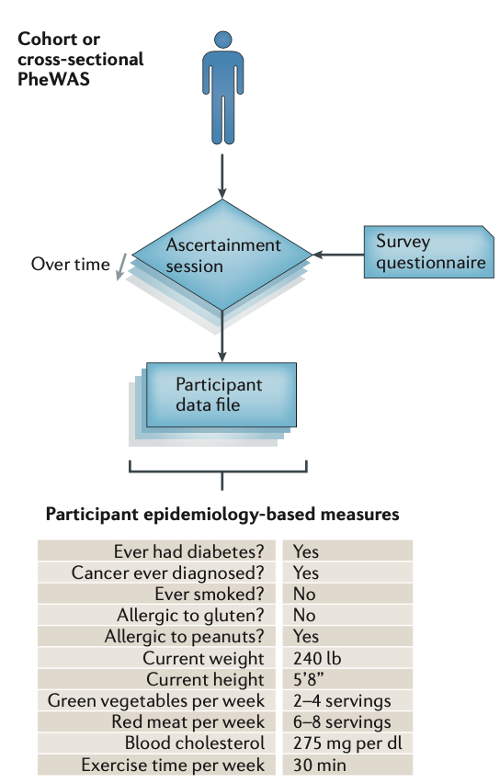
Epidemiology-based phenomes
Phenotypes collected by
Exams
Tests/labs
Questionnaires
Define cases/controls as desired.

Slide 33
Epidemiology-based phenomes: analysis
A multi-site study may require meta-analysis rather than pooling all the subjects into one analysis. Why? For example,
Subject consent issues
Data harmonization issues (protocols/variables may differ across sites)
“Pluses” of meta-analysis
Ability to explicitly study heterogeneity
Using discovery/replication cohort design
(Not so good if some sites have small sample sizes)

Slide 34
Some pheWAS challenges
Billing codes
Mapping between versions
“Too many” codes (~500 ICD-9-CM tuberculosis codes)
“Too few” codes (T1 and T2 diabetes had the same code)
Billing codes aren’t necessarily diagnoses (can reflect simply that a test was ordered, or a condition suspected)
One approach for simplification: collapse the decimal part of ICD codes to get to 3-digit codes

Slide 35
More pheWAS challenges
Algorithmic phenotyping in EHRs
Different record types require different algorithms
Text (including natural, “uncontrolled” language)
Images
And so on…
Epidemiological data
Different studies measure/define phenotypes differently
PhenX is a system for standardized/portable phenotype/environmental variable definition
Somehow these have to be harmonized if they’re to be combined
Can be complicated and highly dependent on “what’s available” in each study
As in EHRs, collapsing categories is possible
Multiple testing
A lot of tests are performed!
How many are independent? What is the correct adjustment?
Dimension reduction methods can simply phenotypes and result in fewer tests
Quality control (data errors, etc.)

Slide 36
Even more pheWAS challenges/concerns
“clinical order” bias
e.g., bone mineral density data may be available almost exclusively for older subjects, causing confounding
Epidemiological studies may avoid this
Environment
Environmental data may be “spotty”
Epidemiological studies may have more complete/varied data than EHRs
Real-time and longitudinal data
EHRs may have better “real-time” data
Both may have longitudinal data
Making the best use of repeated measures may not be straightforward

Slide 37
Yet more pheWAS challenges/concerns
Pharmacogenomics
Considered a potentially promising application for pheWAS
Records are complicated
Requires mining unsystematic, human-generated text
Timing/dosage/administration of medication may need to be mined and integrated with a subject’s other phenotypes (temporal relationships may be particularly important and difficult to mine)
Medication compliance is an extra layer of complexity
Privacy/consent
Data access
May need to apply to access raw data each time in EHR databases
Similarly, dbGaP has genotypes/phenotypes, but each study has to be accessed separately

Slide 38
Even further pheWAS challenges/concerns
Statistical analysis – sometimes multivariate approaches are better (more powerful)
MultiPhen
MQFAM (PLINK)
BIMBAM
PCHAT
Others
One advantage: multivariate testing may lower the multiple-testing burden. If a multivariate test is significant for a variant, you might then see which phenotypes drive the multivariate association.

Slide 39
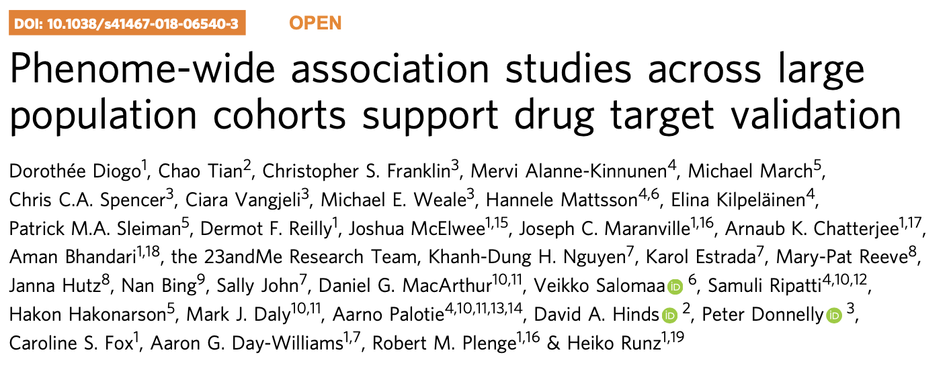
pheWAS example

Slide 40
Motivation
Why pheWAS for drug development?
“may validate target-disease links”
may “unravel pleiotropy”, “improve our understanding of the biological functions of a target”, or “hint at concealed pathophysiological connections between disease entities previously considered as distinct”
“may reveal opportunities for drug repurposing”
may help discover ADEs (adverse drug events) early
“may help prioritize multiple possible targets by identifying the target with the most promising therapeutic window”

Slide 41
Motivation
The study asks, “Can pheWAS inform target validation at early stages of drug discovery?”

Slide 42
Methods
pheWAS for 25 SNPs in/near 19 genes
Genes
9 involved in immune-mediated disease (ATG16L1, CARD9, CD226, CDHR3, GPR35, GPR65, IFIH1, IRF5, TYK2)
8 involved in cardiometabolic disease (F11, F12, GDF15, GUCY1A3, KNG1, LGALS3, PNPLA3, SLC30A8)
2 involved in neurodegenerative disease (LRRK2, TMEM175)
Genes were nominated by 25 GWAS SNPs with p < 5E-8 for “relevant” phenotypes
All either have been shown to influence target gene in functional studies OR to be near a gene “implicated” in a “relevant” mechanism
Some poorly understood as candidates, others already targets of drugs in clinical trials

Slide 43
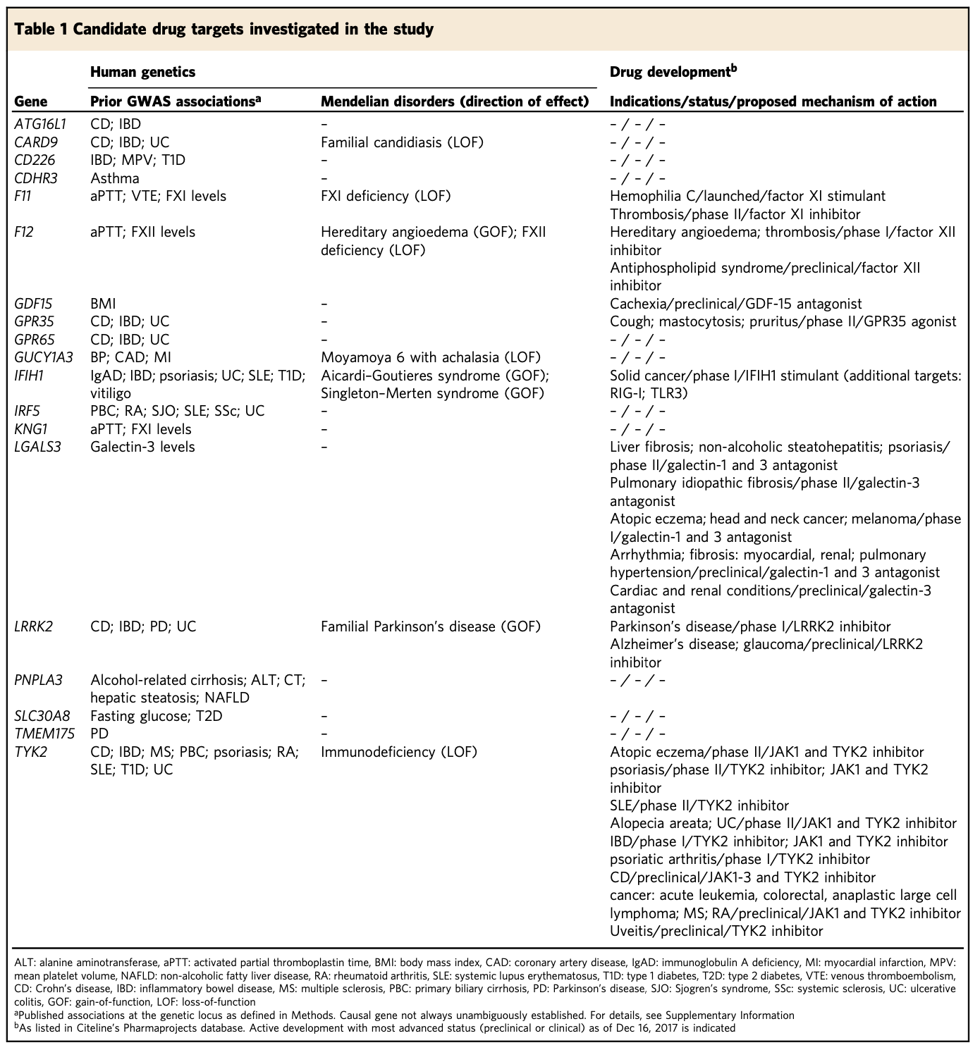
Methods – drug targets investigated

Slide 44
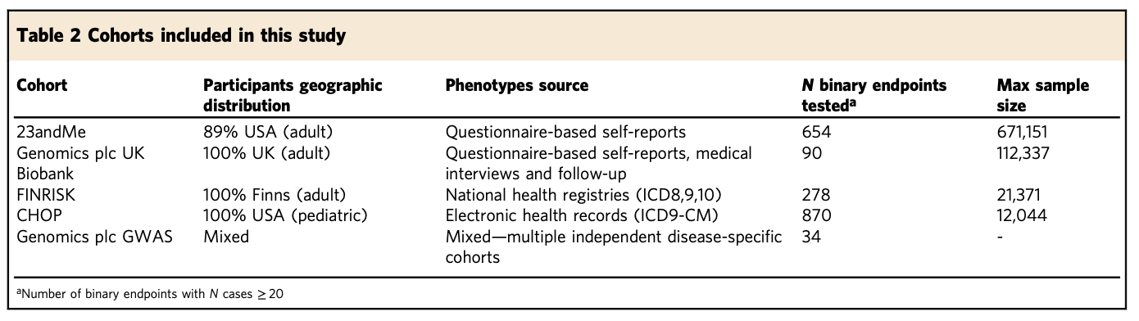
Methods - subjects
pheWAS subjects from 4 cohorts (European ancestry)
23andMe (self-reported phenotypes)
UK Biobank (questionnaire-based health info)
FINRISK (2 EHR-based subgroups)
CHOP (Children’s Hospital of Philadelphia, EHR-based)

Slide 45
Methods - phenomes
Data formats
medical interviews
self-reports
WHO ICD codes
ICD9-CM codes
“Manual phenotype mapping identified 145 distinct clinical endpoints that were tested in two or more cohorts in up to 697,815 individuals”
1,538 cohort-specific phenotypes (unmapped) were also analyzed.

Slide 46
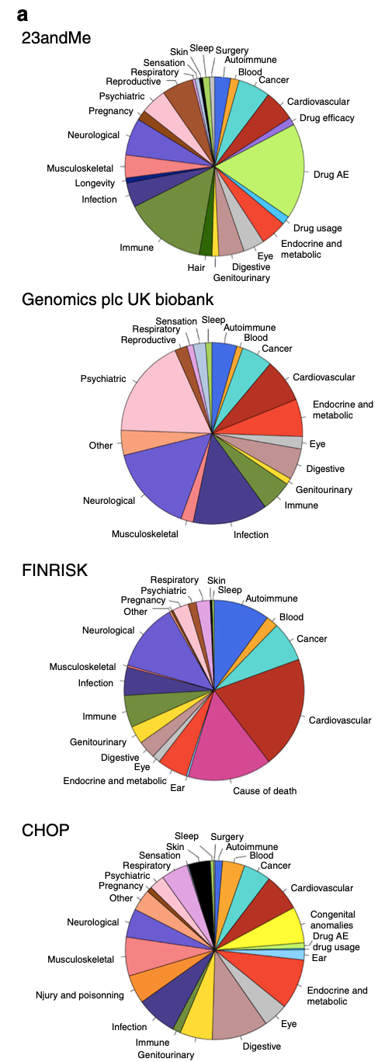
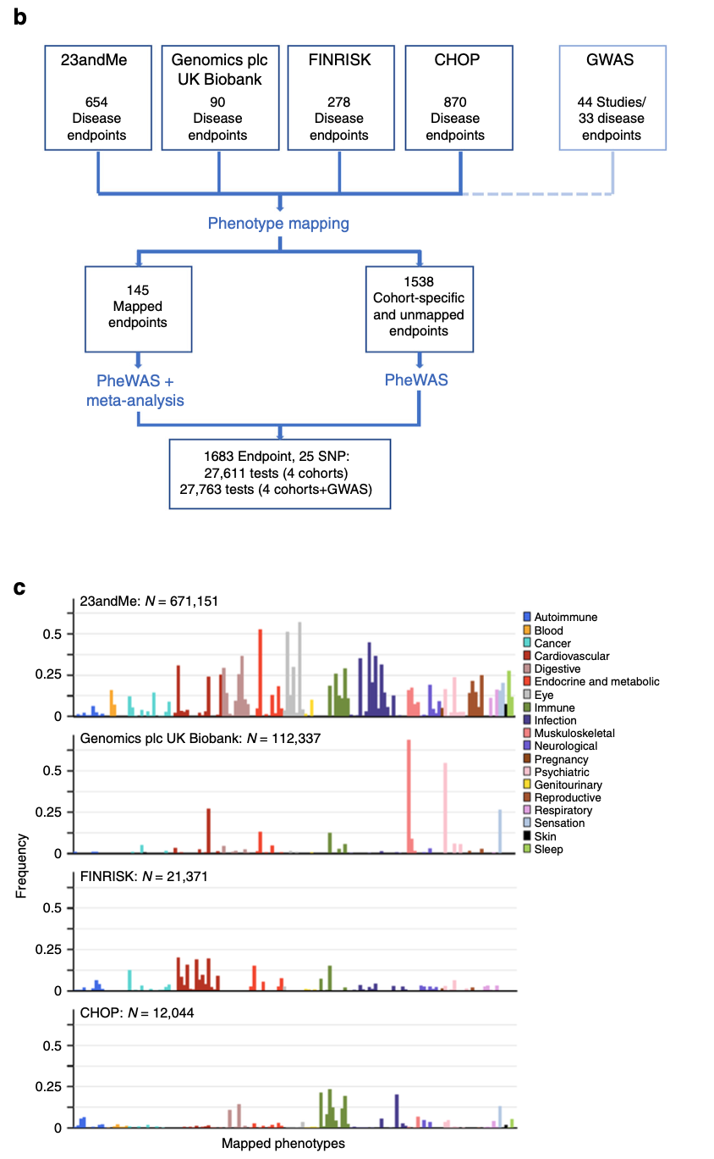
Phenomes
Notes:
I think (c) shows case-control ratios for each trait category in each cohort?

Slide 47
Methods – association testing
Logistic regression + meta-analysis
Statistically, like a GWAS…
…with 25 SNPs instead of 10,000,000
…and 1683 phenotypes instead of 1

Slide 48
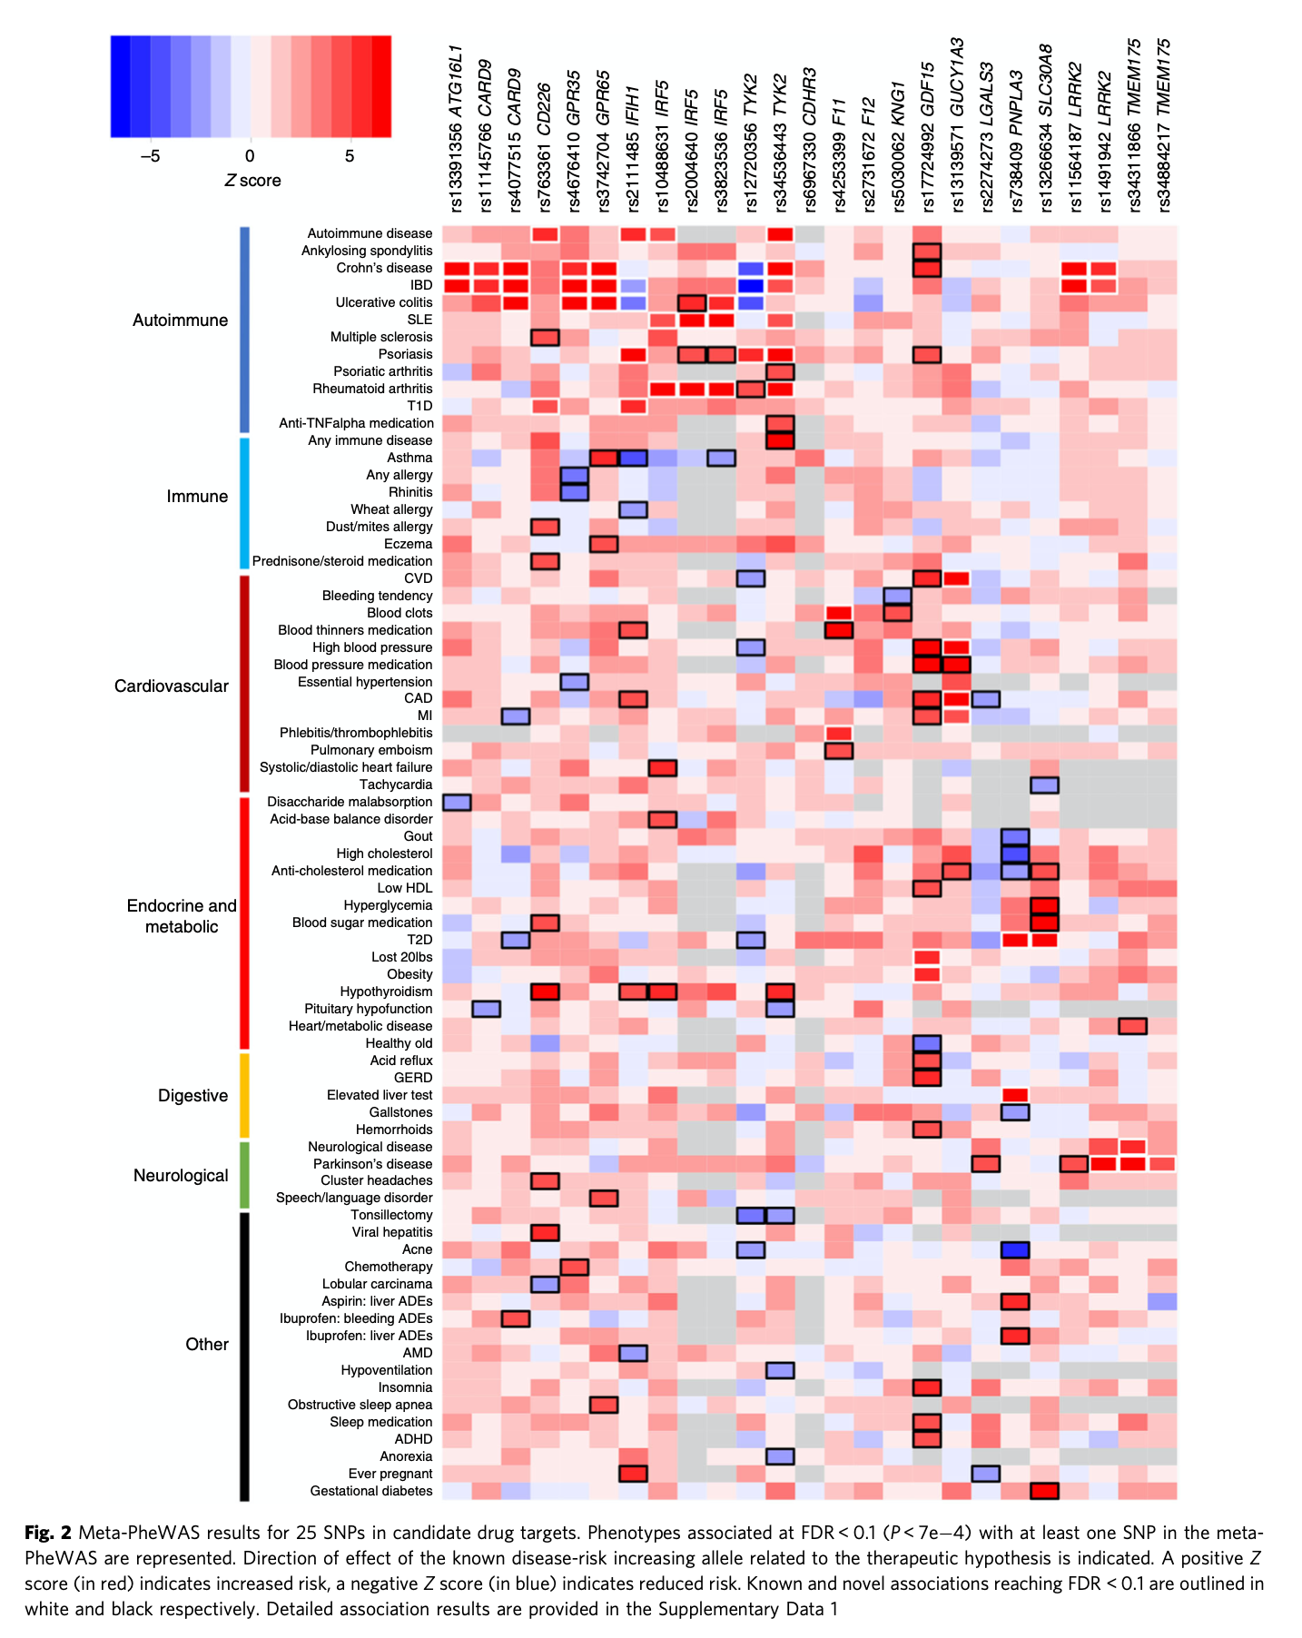
Results
9 associations study-wide significant (P < 1.8E−6)
(Where do you think that threshold came from?)
“we identified 71 distinct putative novel associations” (FDR < 0.1 (P < 7 × 10−4))
30 mapped
41 only in single cohorts
“Forty-three of these putative novel associations showed the same directions of effect as disease endpoints related to the proposed clinical indication for a drug and may hint at potential repositioning opportunities”
Why do you think there are gray cells?

Slide 49
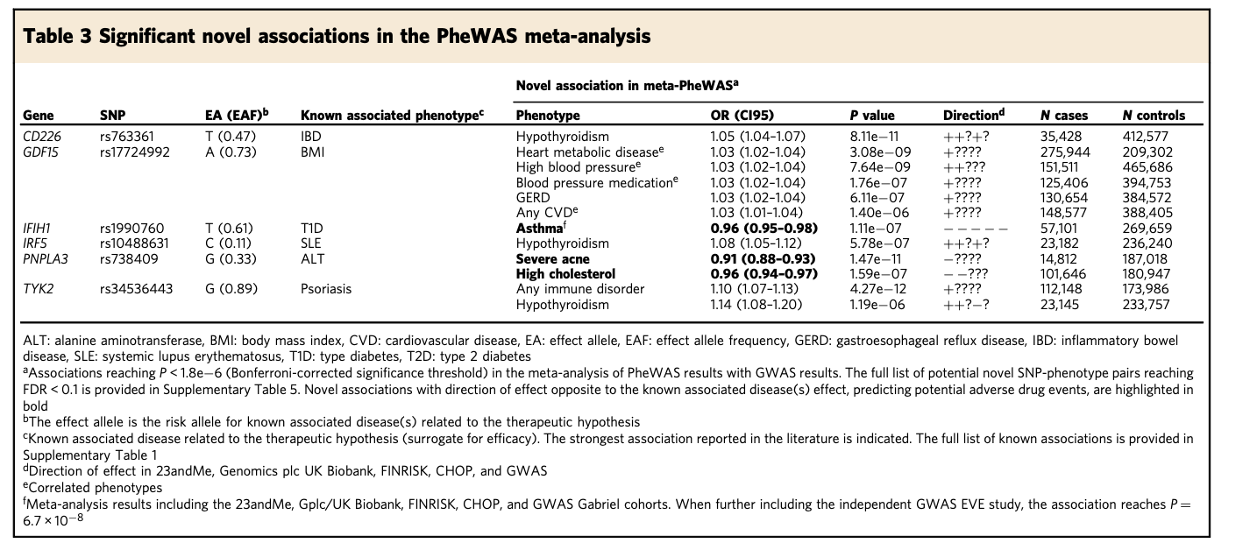
Results
9 associations study-wide significant (P < 1.8E−6)

Slide 50
Results – replication of novel associations
Meta-analysis of novel associations in another UK BioBank cohort (where possible)
41/71 novel associations re-tested
Includes 8/9 study-wide significant associations
“Overall, meta-analysis with UK Biobank v2 strengthened all eight novel associations with study-wide significance after Bonferroni correction and 23/41 (56%) of the potential novel associations with FDR < 0.1, including eight associations that were based on results from a single PheWAS cohort”

Slide 51
Results – replication of prior GWAS associations
25 SNPs had been significant in GWAS for 58 traits
47 of the 58 were replicated here (p < 0.05)
(Fewer had fully consistent effect directions)
Non-replication was “disease-dependent”, possibly the result of ascertainment error for conditions like inflammatory bowel disease, Crohn’s, ulcerative colitis

Slide 52
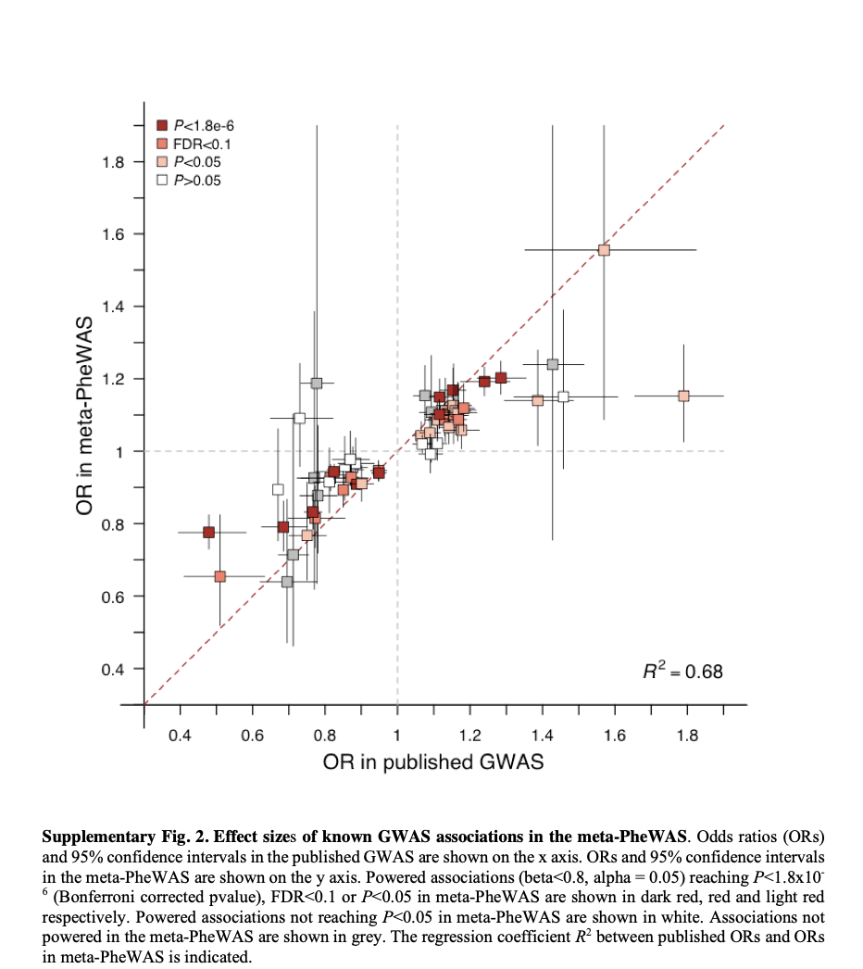
Results – replication of prior GWAS associations

Slide 53
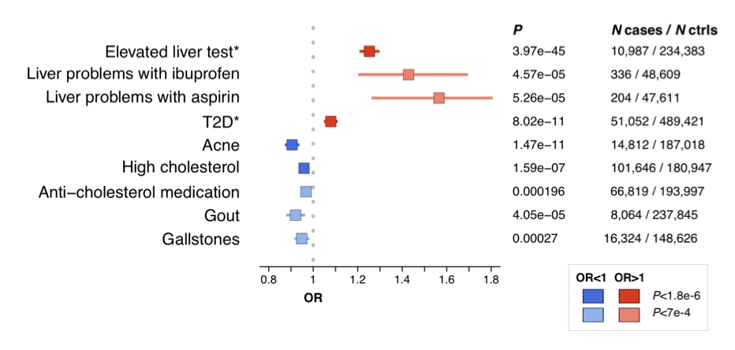
Results – novel associations
Novel association for PNPLA3 missense SNP rs738409-G (p.I148M)
Previous associations include
non-alcoholic fatty liver disease (NAFLD), alcohol-related
cirrhosis and hepatic steatosis
elevated alanine aminotransferase (ALT) levels
“Consistent findings”
“elevated liver tests” (OR_{23andMe} = 1.25, P_{23andMe} = 4E−45)
T2D (OR_{meta} = 1.08, P_{meta} = 8E−11 )
decreased risk for high cholesterol (OR_{meta} = 0.96, P_{meta} = 1.6E−7; _{Pmeta_v2} = 1.1E−8) and the intake of cholesterol-lowering medications (OR_{23andMe} = 0.97, P_{23andMe} = 2E−4; P_{meta_v2} = 2.8E−5)

Slide 54
Results – novel associations (con’t.)
New pheWAS-discovered associations for rs738409-G (missense variant in PNPLA3)
liver toxicities when treated with nonsteroidal anti-inflammatory drugs (NSAIDs)
Ibuprofen (OR_{23andMe} = 1.43, P_{23andMe} = 4.6E−5)
Aspirin (OR_{23andMe} = 1.57, P_{23andMe} = 5.3E-5 )
acne (OR_{23andMe} = 0.90, P_{23andMe} = 1.5E−11; P_{meta_v2} = 7.3E−12)
gout (OR_{meta} = 0.92, P_{meta} = 4.1E−5; P_{meta_v2} = 3.9E−9)
gallstones (OR_{meta} = 0.95, P_{meta} = 2.7E−4; P_{meta_v2} = 1.5E−5)
associations remained “prominent” after adjusting for elevated liver tests
Known previous associations: G-allele increases liver disease risk, likely through gain of function.
Hypothesis: therapeutic inhibition of PNPLA3 could treat liver diseases. “inverse associations with multiple other endpoints, including acne and high plasma cholesterol levels, indicate potential clinically relevant on-target ADEs that should be considered in decisions to progress PNPLA3 inhibitors toward clinical development”

Slide 55
Results – novel associations (con’t.)
rs1990760-C allele (IFIH1, which encodes MDA5)
Previous associations, mostly supported by pheWAS
Lower risk for
type 1 diabetes, T1D
vitiligo
systemic lupus erythematosus, SLE
Psoriasis
Higher risk for
ulcerative colitis

Slide 56
Results – novel associations (con’t.)
rs1990760-C allele (IFIH1)
Novel associations:
risk for asthma (OR_{meta} = 1.04, P_{meta} = 6.E 10−8, P_{meta_v2} = 2E−8)
Significant after adjustment for autoimmune disease (23andMe)
“Support[s] the hypothesis that inhibition of MDA5 may protect against several autoimmune diseases. However, our results also reveal the potential of MDA5 inhibitors to cause pulmonary ADEs and strengthen previous findings for an increased risk for colitis-related symptoms, endpoints that may limit the therapeutic window of MDA5 modulators and should be considered for monitoring in clinical trials.”

Slide 57
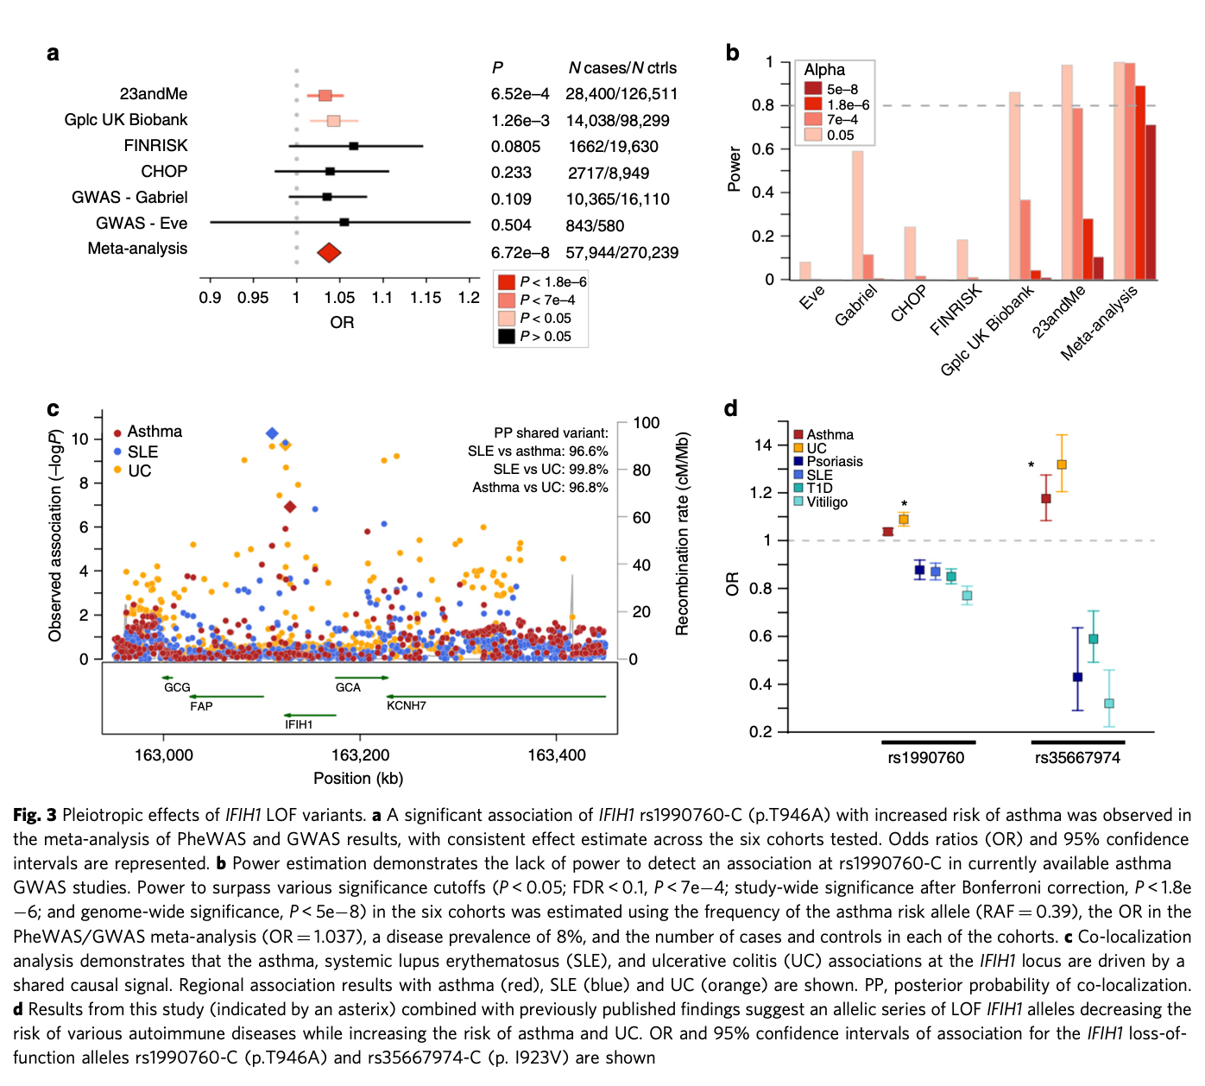

Slide 58
Results – target prioritization for thromboembolism
F11, F12, KNG1 are members of a coagulation pathway.
“Anti-coagulation therapies directed against these factors are hypothesized to have improved therapeutic windows over current standard-of-care, which is accompanied by significant bleeding liabilities ”

Slide 59
Results – target prioritization for thromboembolism
rs4253399-T
reduces circulating FXI levels
increases aPTT (blood clotting risk biomarker)
PheWAS
expected lower risk for blood clots (OR_{meta} = 0.84, P_{meta} = 3.5E−25)
no evidence for association with bleeding tendency (OR_{23andMe} = 1.04, P_{23andMe} = 0.35)
rs5030062-A
reduces plasma kininogen and circulating FXI
increases aPTT
PheWAS
Expected lower risk for blood clots (OR_{meta} = 0.93, P_{meta} = 1.6E−4)
Expected higher risk for bleeding tendency (OR_{23andMe} = 1.14, P_{23andMe} = 4.1E−4)
rs2731672- T
Reduces FXII levels
increases aPTT
PheWAS
Expected lower risk for blood clots (OR_{23andMe} = 0.96, P_{23andMe} = 0.034)
Expected higher risk for bleeding tendency (OR_{23andMe} = 1.09, P_{23andMe} = 0.039 )

Slide 60
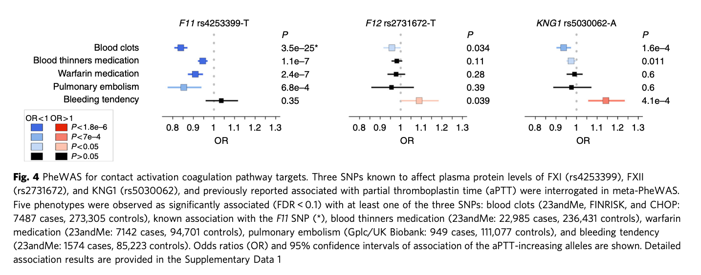
Results – target prioritization for thromboembolism
“targeting FXI may yield the best compromise between thromboembolism risk reduction and increased bleeding liability, which is consistent with the outcomes of a recent phase 2 clinical trial”

Slide 61
Results – non-examples of pleiotropy?
rs2274273 near LGALS3
associated with Parkinson’s disease (OR_{23andMe} = 0.94, P_{23andMe} = 1E−4)
rs2274273 is a pQTL for plasma levels of galectin-3
Co-localization analyses suggest rs2274273 isn’t a causal SNP for Parkinson’s
rs17724992 near GDF15
Associated with cardiovascular-related phenotypes here
Likely mediated by BMI (a known association for this SNP)
Large studies haven’t found associations between this SNP and coronary artery disease or blood pressure

Slide 62
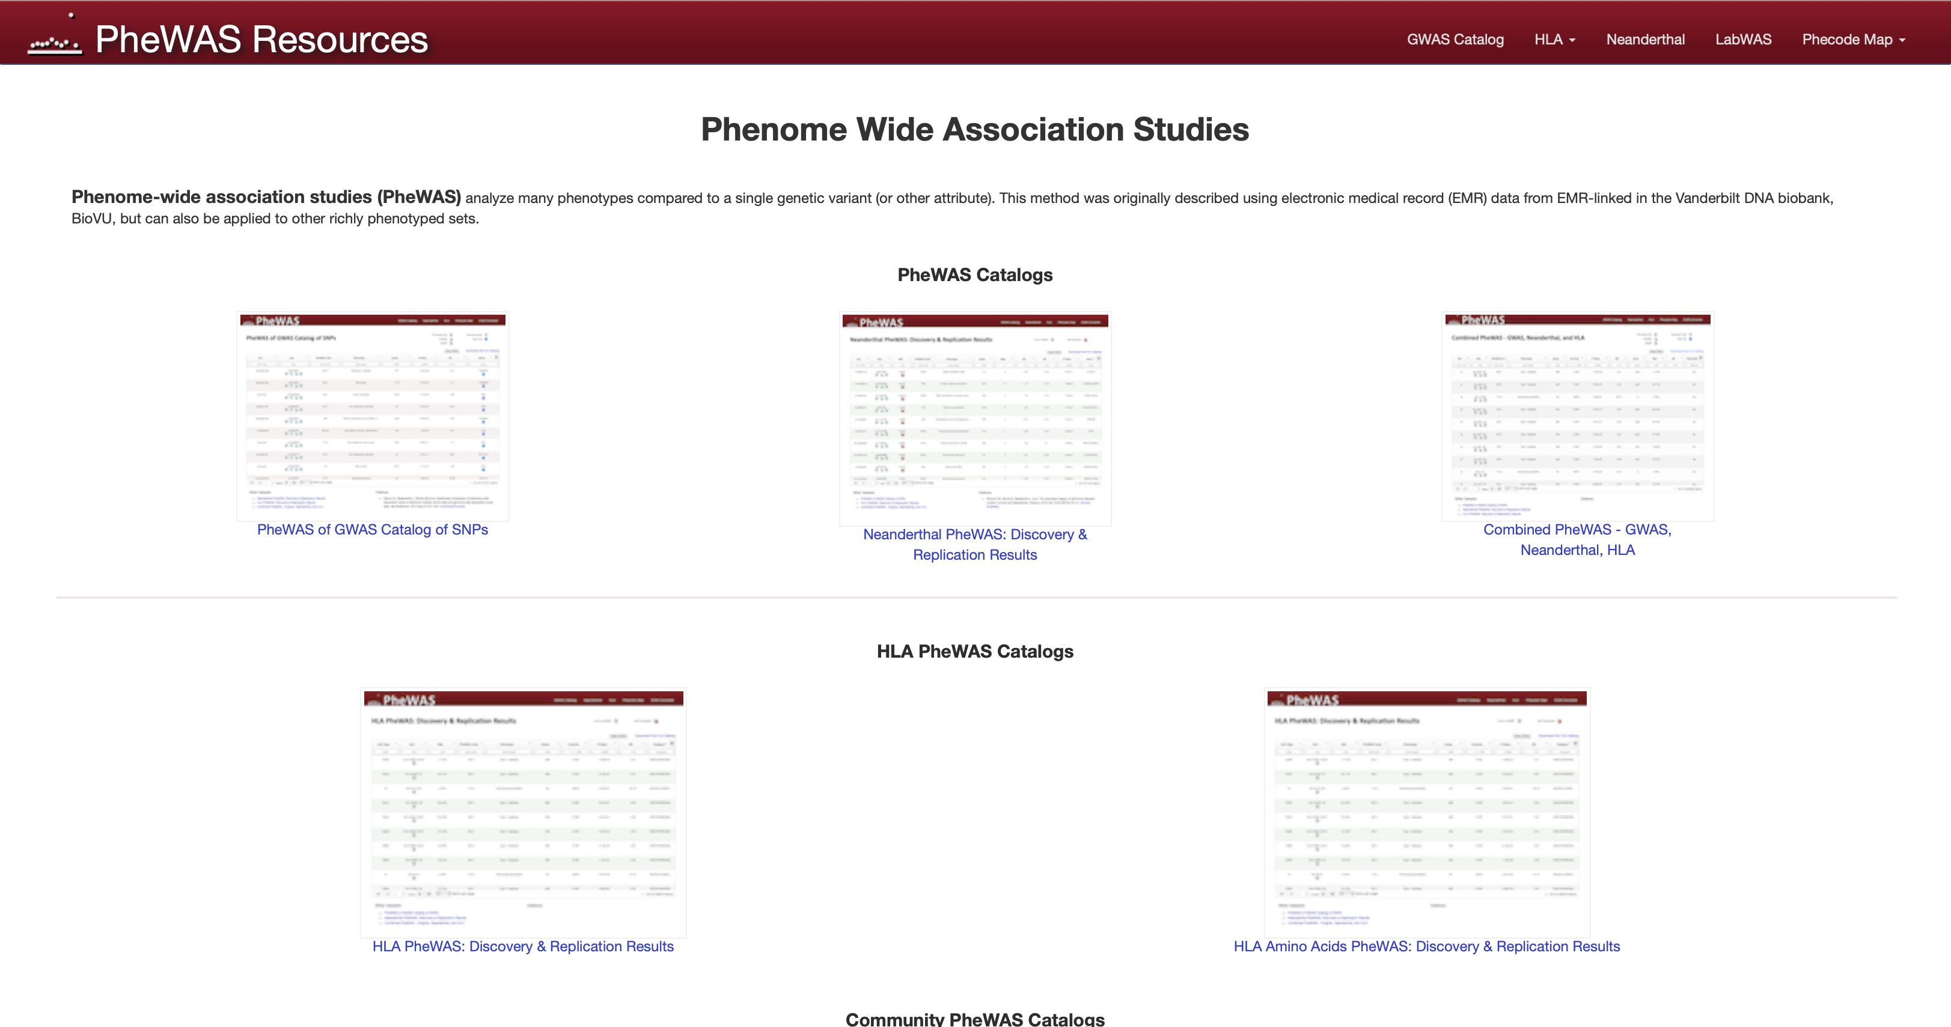
pheWAS catalog (small, unofficial” database)
https://phewascatalog.org
https://www.ncbi.nlm.nih.gov/pmc/articles/PMC3969265/
Denny, J. C., Bastarache, L., Ritchie, M. D., Carroll, R. J., Zink, R., Mosley, J. D., Field, J. R., Pulley, J. M., Ramirez, A. H., Bowton, E., Basford, M. A., Carrell, D. S., Peissig, P. L., Kho, A. N., Pacheco, J. A., Rasmussen, L. V., Crosslin, D. R., Crane, P. K., Pathak, J., Bielinski, S. J., … Roden, D. M. (2013). Systematic comparison of phenome-wide association study of electronic medical record data and genome-wide association study data. Nature biotechnology, 31(12), 1102–1110. https://doi.org/10.1038/nbt.2749

Slide 63
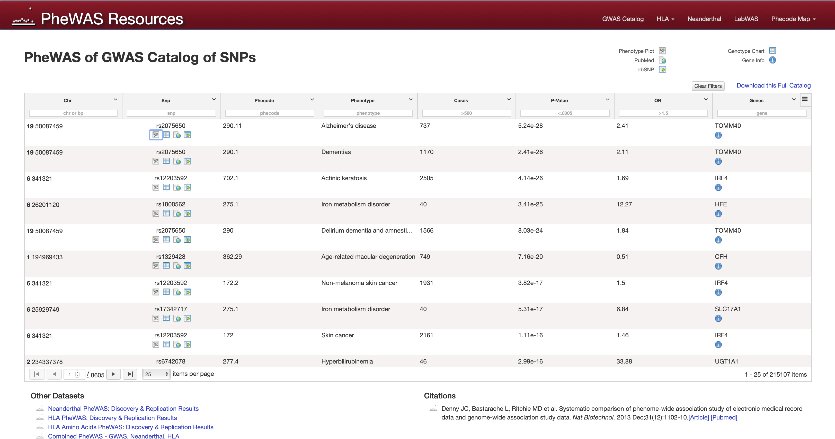
pheWAS catalog

Slide 64
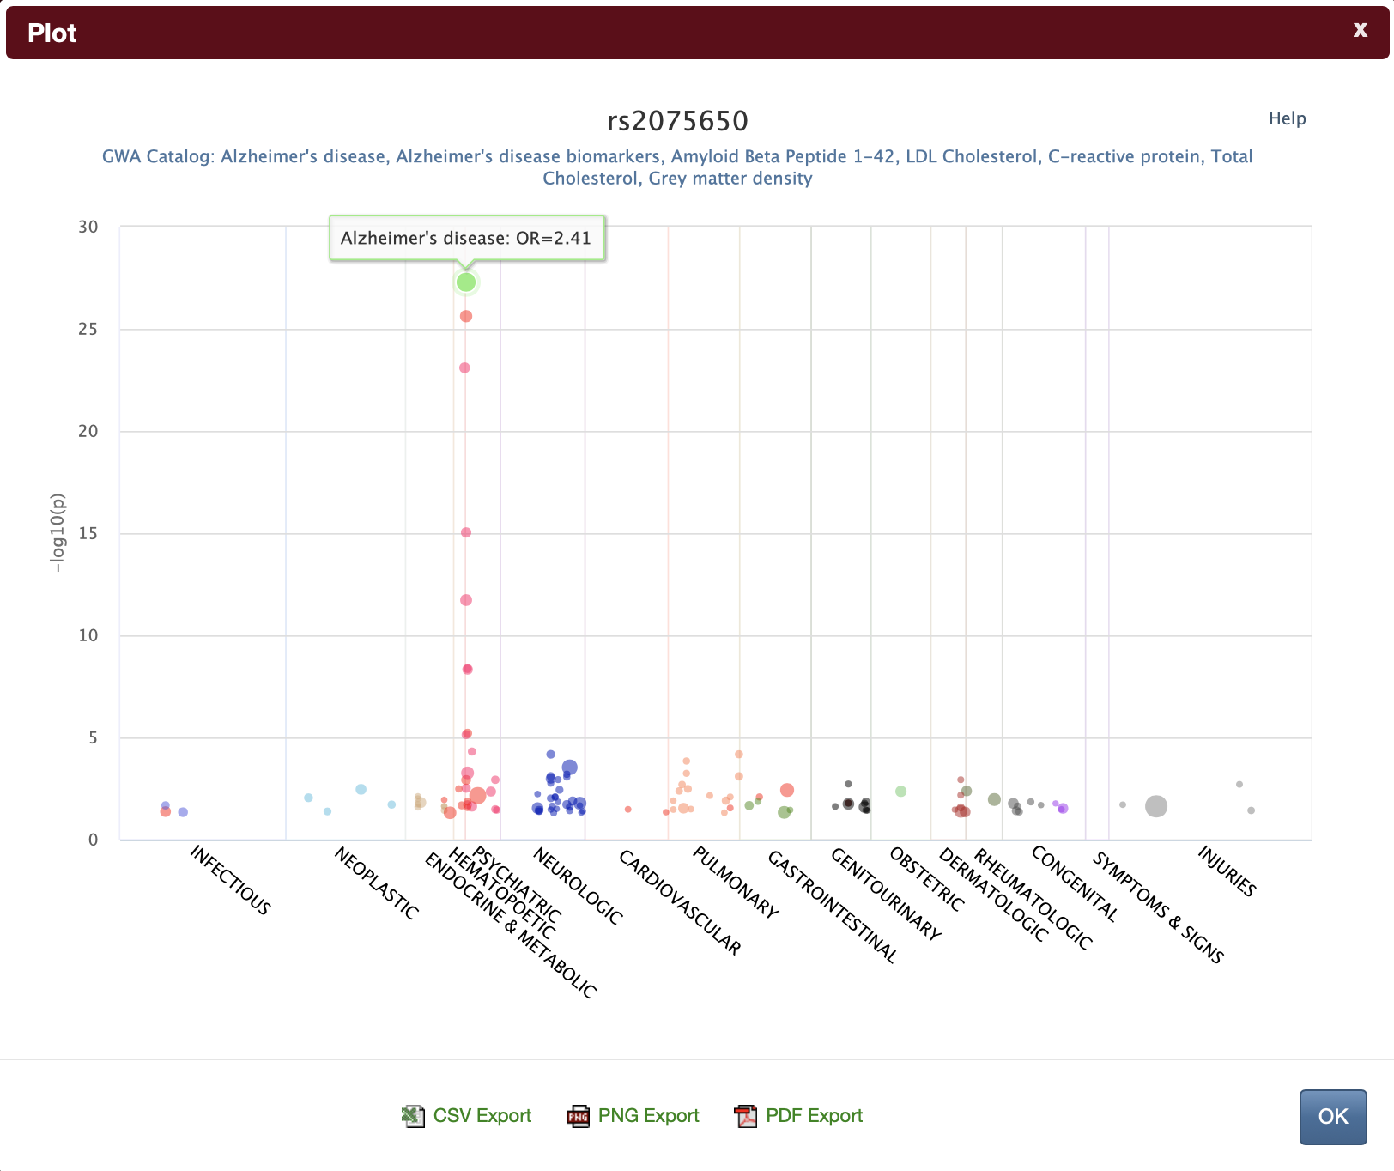
pheWAS catalog

Slide 65
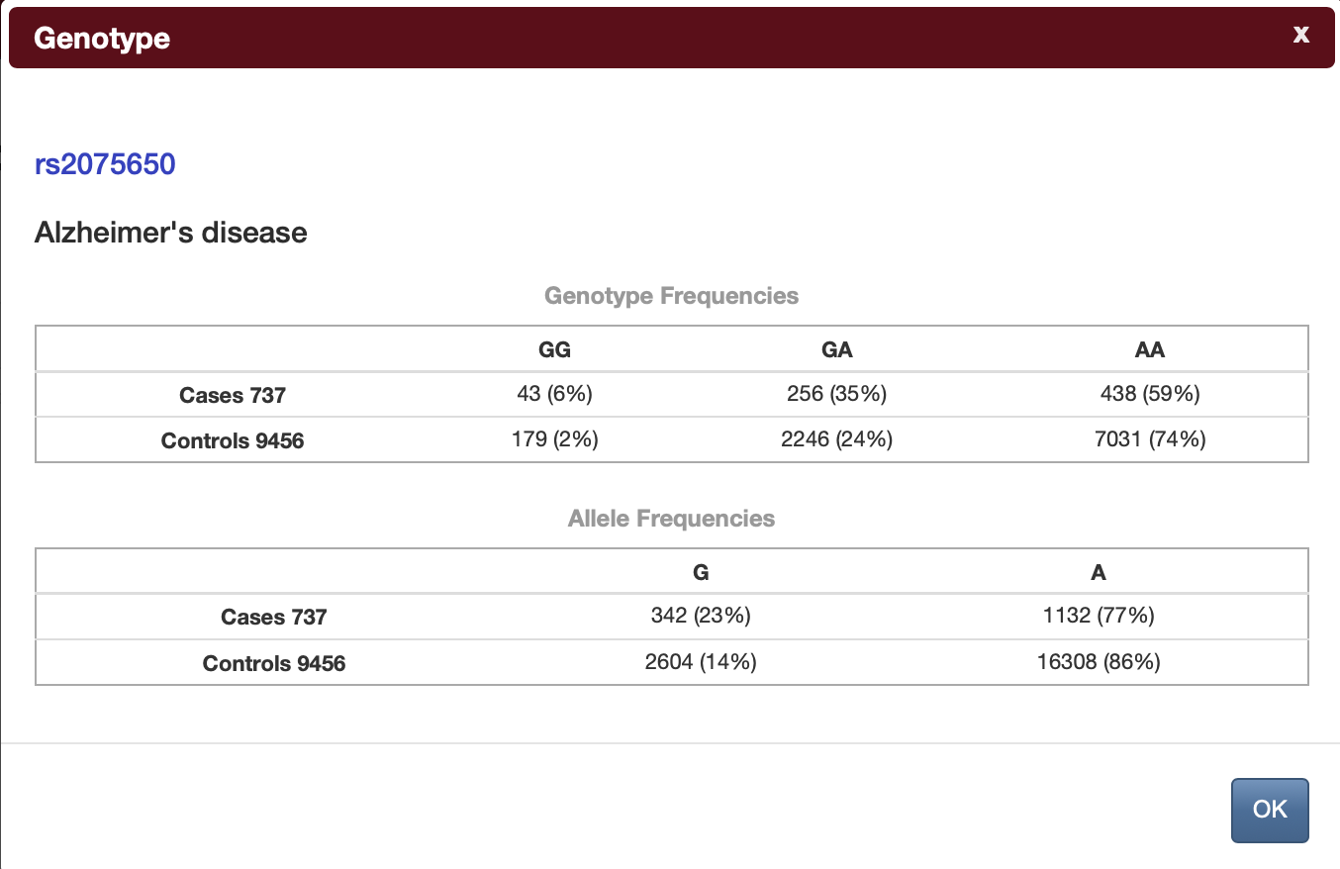
pheWAS catalog

Slide 66
pheWAS catalog
Sort by SNP/GWAS attribute
Search/filter (not all of these seem to work right)

Slide 67
PheWeb
A system for plotting pheWAS results.
https://pheweb.sph.umich.edu

Slide 68
Some pheWAS with ~publicly available stats
Access is spotty…
AllofUs (https://allbyall.researchallofus.org)
VA Million Veteran Program (https://www.mvp.va.gov/pwa/discover-mvp-data)
AstraZeneca PheWAS Portal (https://azphewas.com)
Other UKBB studies
FinnGEN (https://docs.finngen.fi/working-outside-the-sandbox/link-to-how-to-use-pheweb)

Slide 69
Other things to do with summary stats of multiple traits
LD score regression
Distinguish polygenicity from confounding
Input: GWAS summary stats
Output: intercept (confounding) + slope (heritability)
Estimate/partition heritability
Input: GWAS summary stats
Output: heritability, and fractions of heritability by annotation
Genetic correlations
Input: GWAS summary stats for two traits
Output: r_{g} (correlation of SNPs across traits; how similar the genetic architectures are)

Slide 70
Other things to do with summary stats of multiple traits
Mendelian randomization
Logic
If a SNP changes the outcome only because it changes the exposure, then…
…effect of SNP on outcome ÷ effect of SNP on exposure = causal effect of exposure on outcome
Use genetic variant to ask, “Does this exposure cause this trait?”
Assumptions
You already know some particular SNP is associated with the exposure (relevance)
The SNP is not associated with any confounders (independence)
The SNP affects the trait only through the exposure
These need to be checked - but checking can be difficult in practice!
Output
Evidence consistent with causality
Estimated causal effect (if assumptions hold)

Slide 71
MR (continued)
Example
Higher LDL cholesterol is associated with coronary artery disease risk
Is this causal?
Use MR
Instruments: SNPs (alleles) that lower LDL
Alleles that lower LDL risk also lower CAD risk
→ consistent with LDL causally increasing CAD risk

Slide 72
Summary MR
You can do MR without individual level data.
Use summary stats from two GWAS (same SNPs, aligned alleles)
GWAS 1: exposure
GWAS 2: outcome of interest
Summary MR
Use significant SNPs from the exposure GWAS
Combines SNP effects via β(outcome) / β(exposure)
Outputs estimate of causal effect of exposure on outcome
Same assumptions as before, with more caveats
Weak instrument bias: need SNPs that strongly affect exposure
Harder to check assumptions without individual-level data
Specifically, ruling out horizontal pleiotropy is harder

