Slide 1
Genomic Visualization Part 1
HUGEN 2073
Genomic Data Visualization & Integration
Slides adapted from Ryan Minster with permission

Slide 2
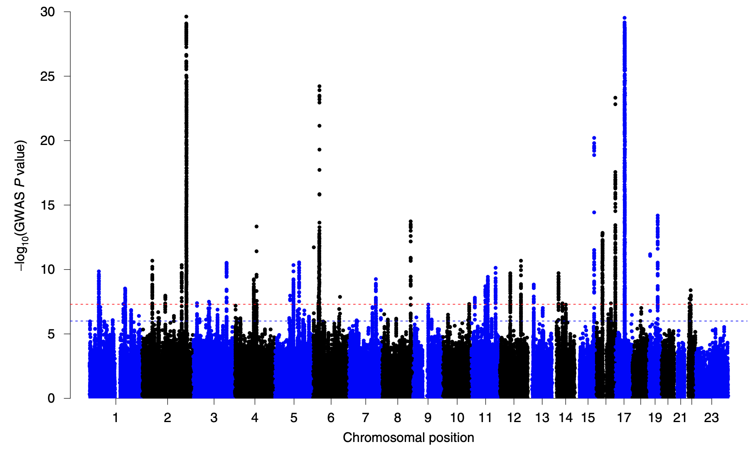
13,346,399 SNPs (MAF > 0.005)
Cuellar-Partida et al. Nat Hum Behav 2021

Slide 3
Learning Objectives
By the end of the session, students will be able to:
Describe taxonomies for genomic map visualization
Describe the difference between vector and raster graphics, use each in appropriate circumstances

Slide 4
Taxonomies for Genomic Map Visualizations

Slide 5
Visualization Taxonomy
Layout
Partition
Abstraction
Arrangement

Slide 6
Layout
Linear
Circular
Space-filling
Spatial

Slide 7
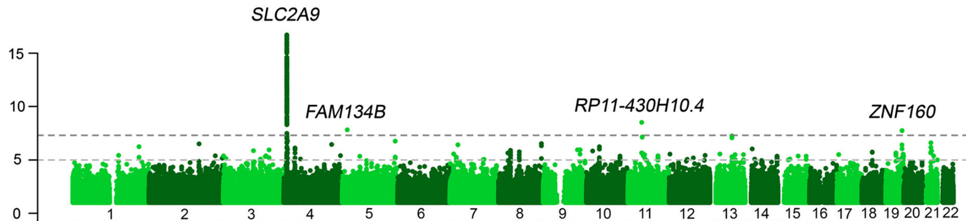
Linear Layouts
Manhattan plots
Most genome browsers (UCSC etc.)
Nagy et al. Genome Med 2017

Slide 8
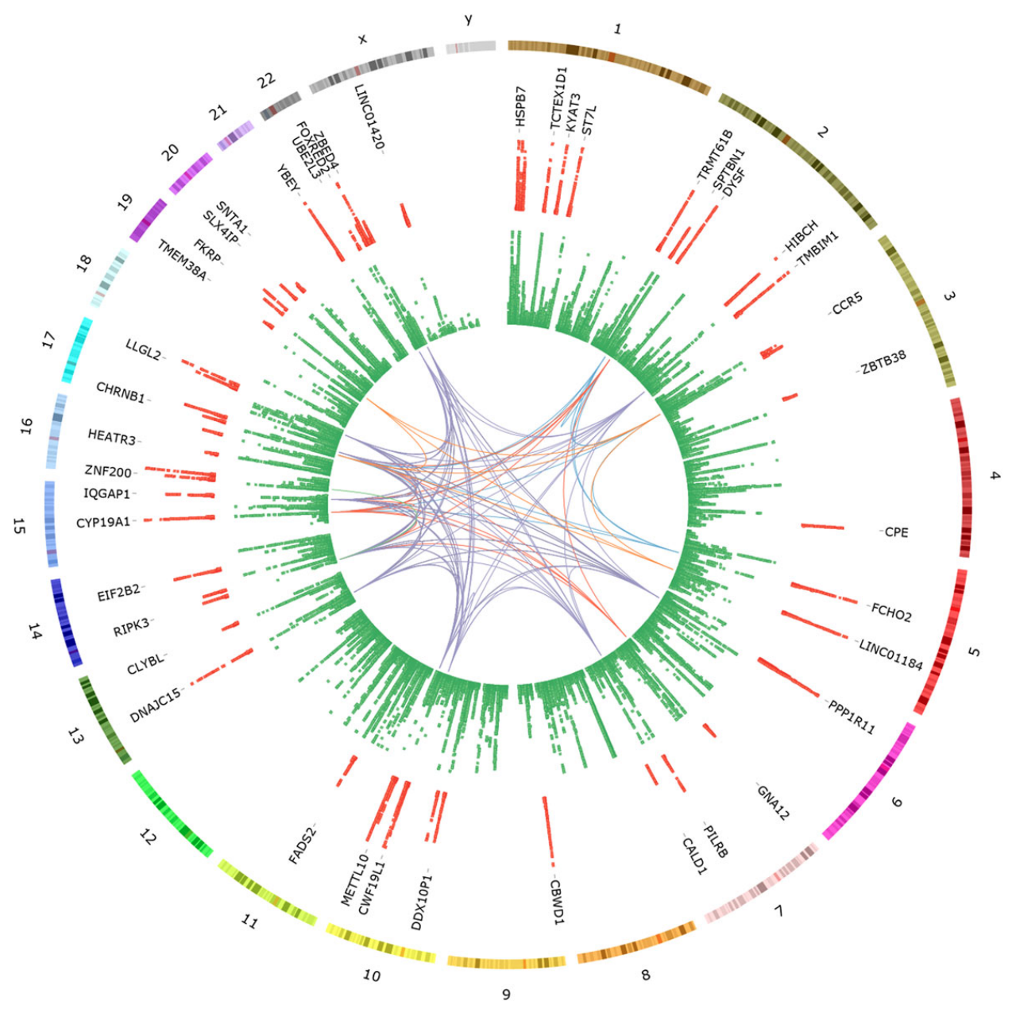
Circular Layout
“Circos” plots
Mullin et al. Genome Biol 2020

Slide 9
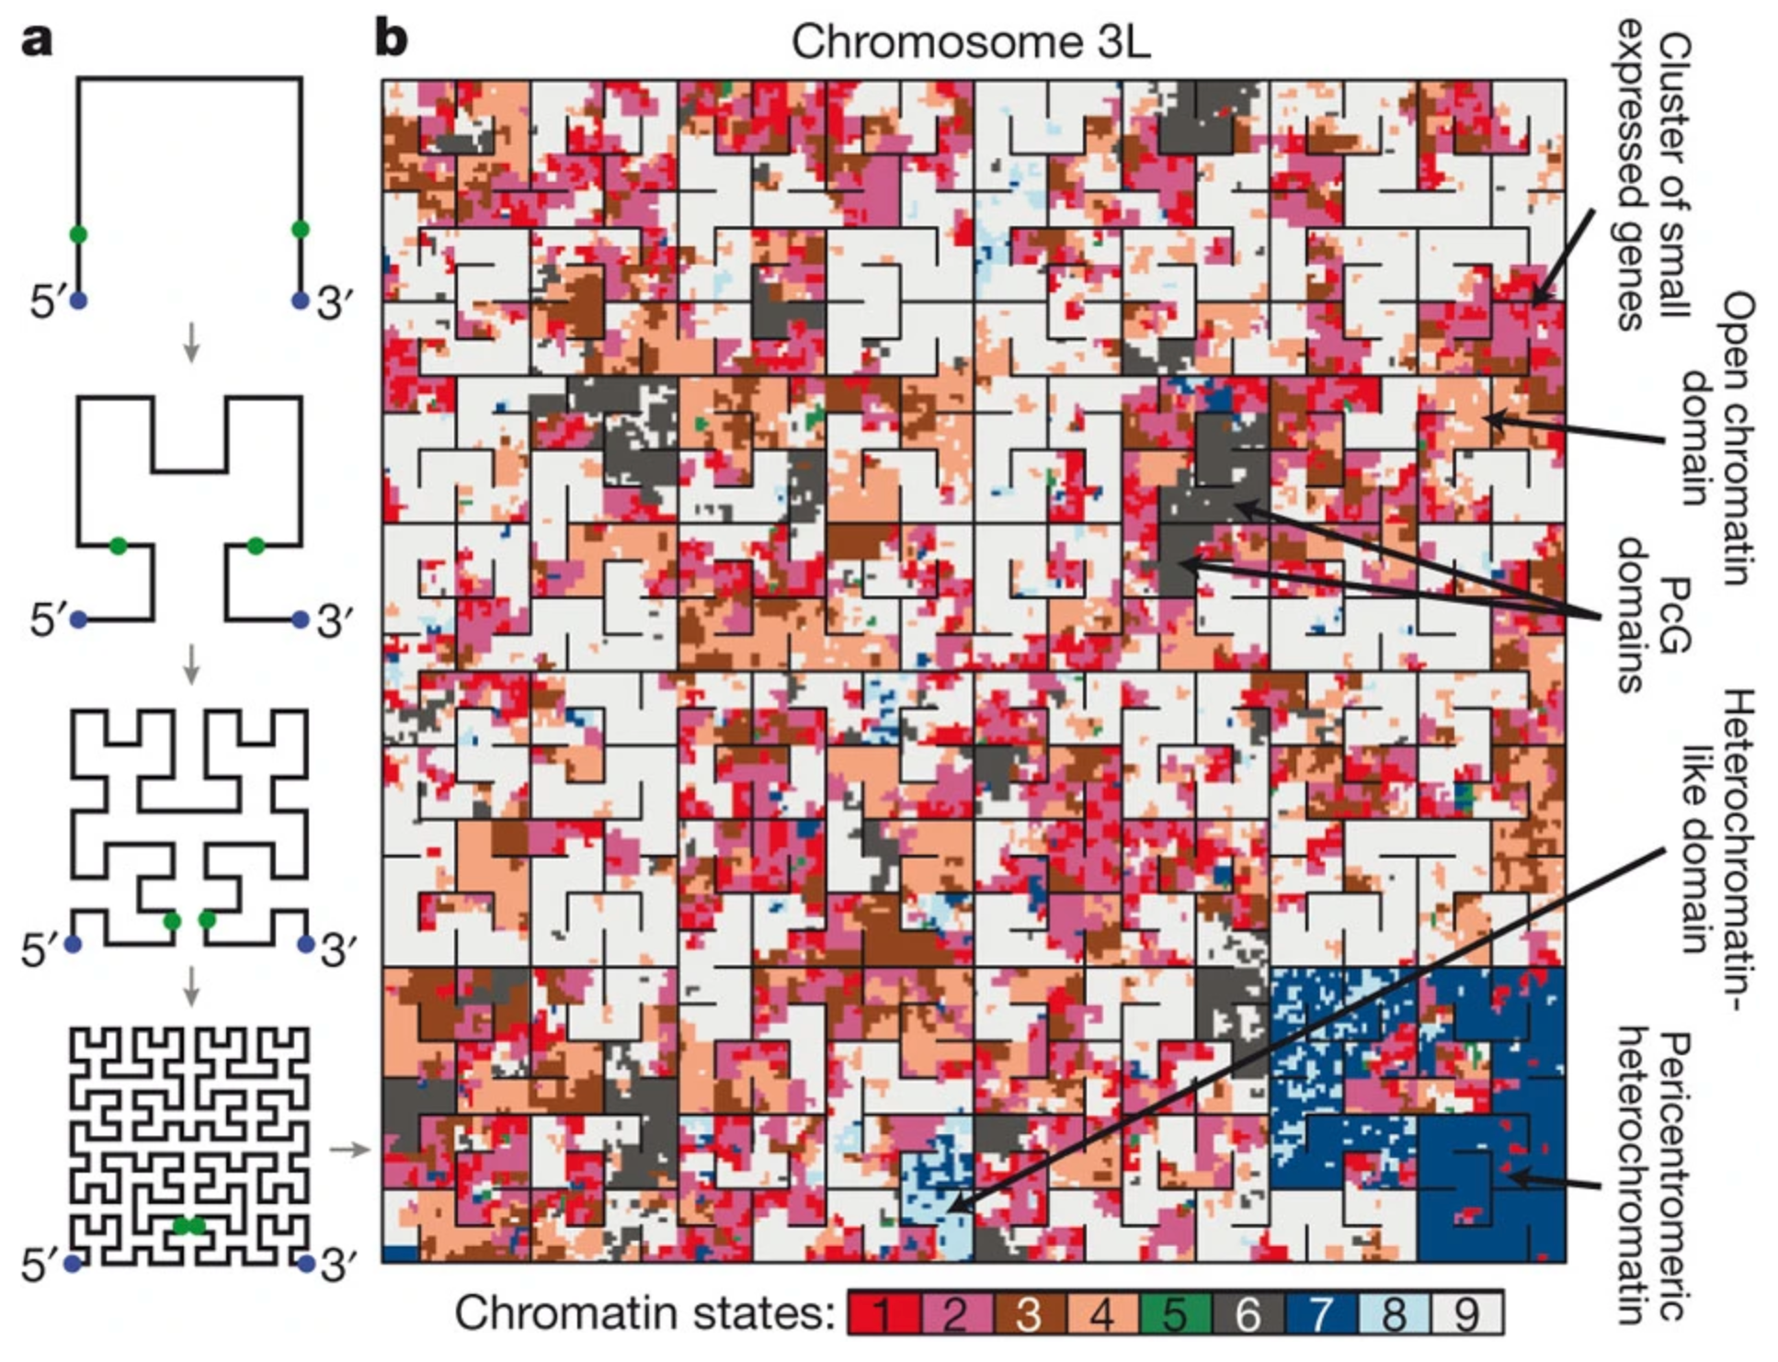
Space- Filling Layout
e.g., Hilbert curves
Kharchenko et al. Nature 2010

Slide 10
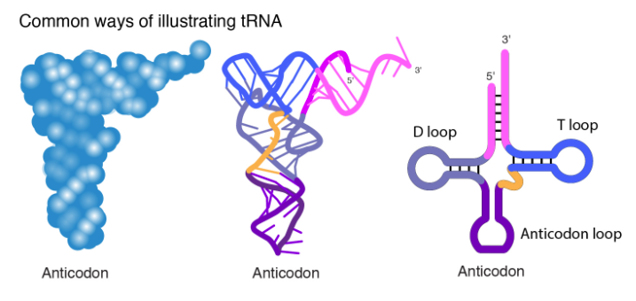
Spacial Layout
Actual (or hypothetical or abstract) 3D Structure
tRNA. NHGRI Talking Glossary of Genetic Terms
tRNA. Wikipedia

Slide 11
Partition
Contiguous
Segregated

Slide 12
Contiguous Partition
Manhattan plots
Genome browsers
Nagy et al. Genome Medicine 2017

Slide 13
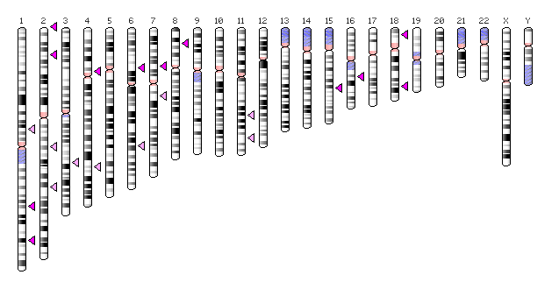
Segregated Partition
Ideograms
BMI loci. PheGenI

Slide 14
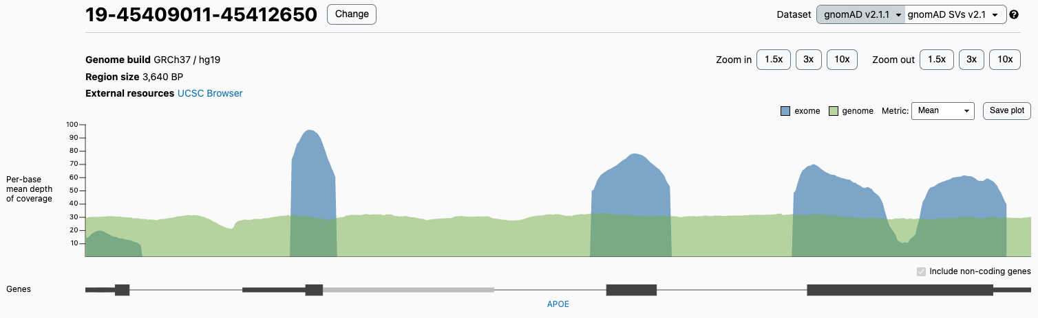
Abstraction
Replace segments of sequence with abstract symbols
19:45409011–45412650. gnomAD. 2022 Feb 17

Slide 15
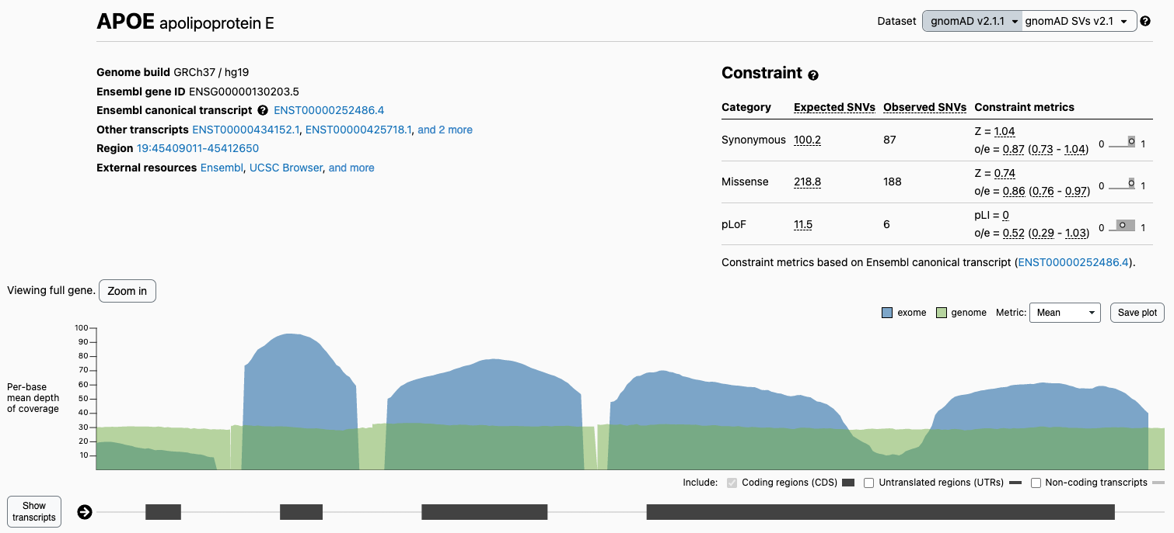
Abstraction
Replace segments of sequence with abstract symbols
In gnomAD, introns have been abstracted to short segments
APOE. gnomAD. 2022 Feb 17

Slide 16
Abstraction
Replace segments of sequence with abstract symbols
Russell et al. unpub.

Slide 17
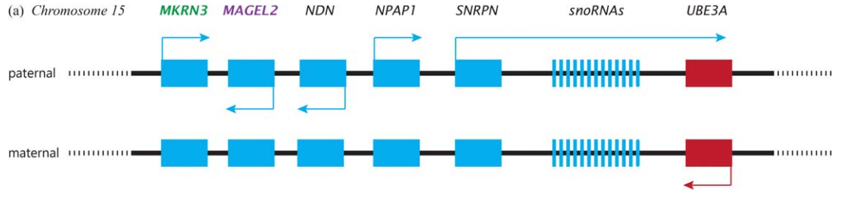
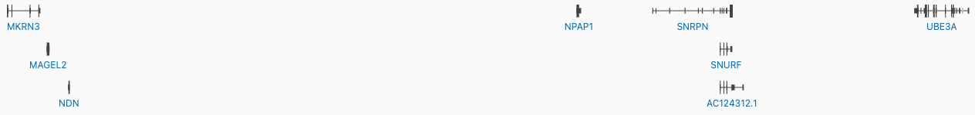
Abstraction
With increasing levels of abstraction, the order and position of features becomes more salient than the relative lengths of features.
Kotler & Haig. Evol Anthropol. 2018
15:23565674–25630075. gnomAD. 2022 Feb 17

Slide 18
Arrangement (Comparing or Linking)
Serial
Parallel
Orthogonal

Slide 19
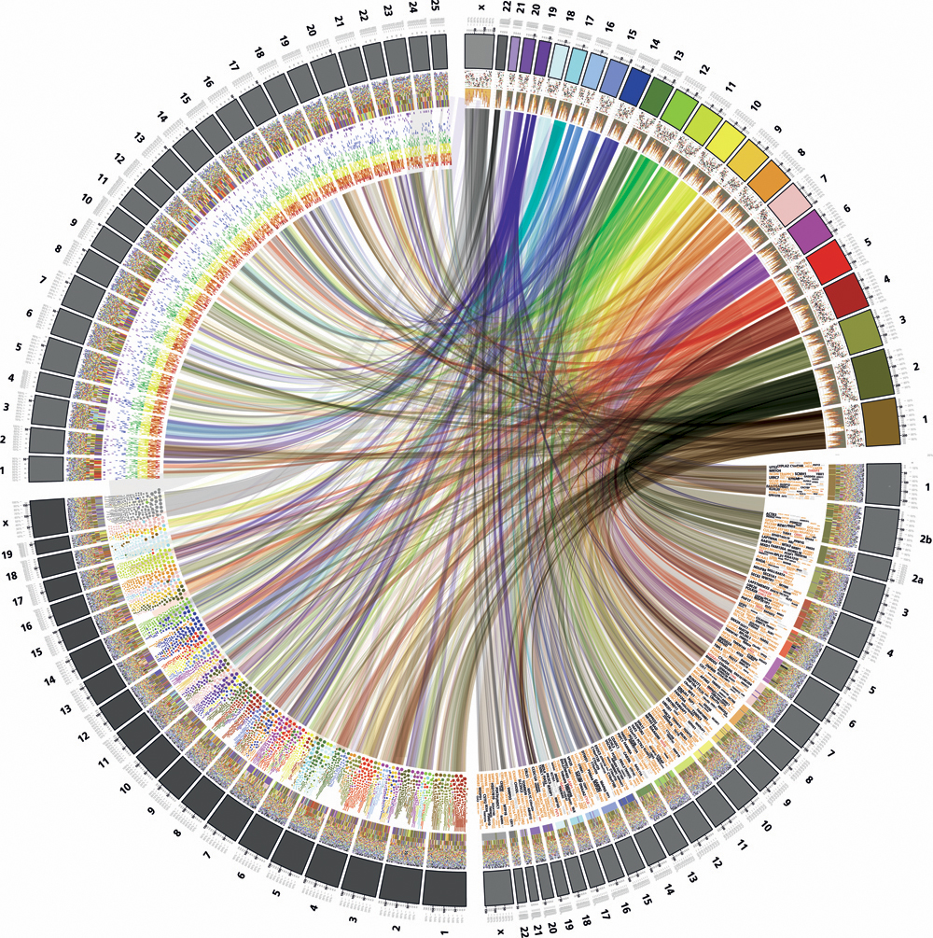
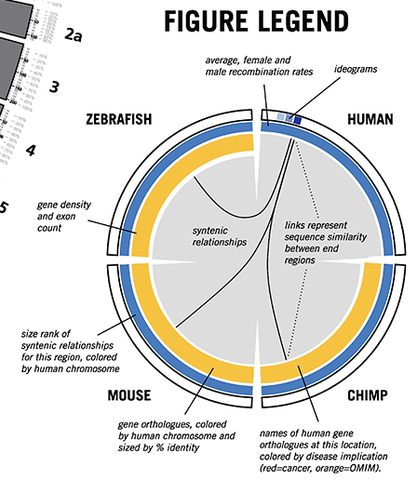
Arrangement (Comparing or Linking)
Serial Arrangement
End-to-end
Krzywinski. http://circos.ca/guide/visual/img/circos-visualguide-med.png

Slide 20
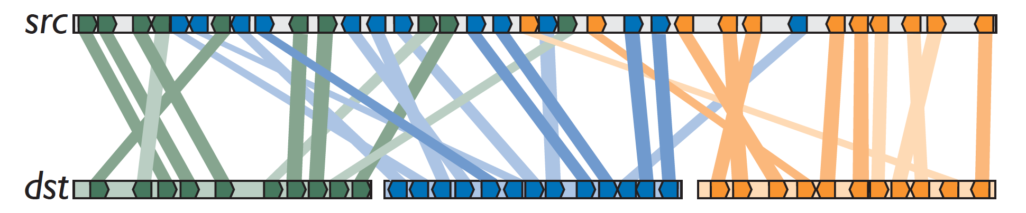
Arrangement (Comparing or Linking)
Parallel Arrangement
Linear or circular

Slide 21
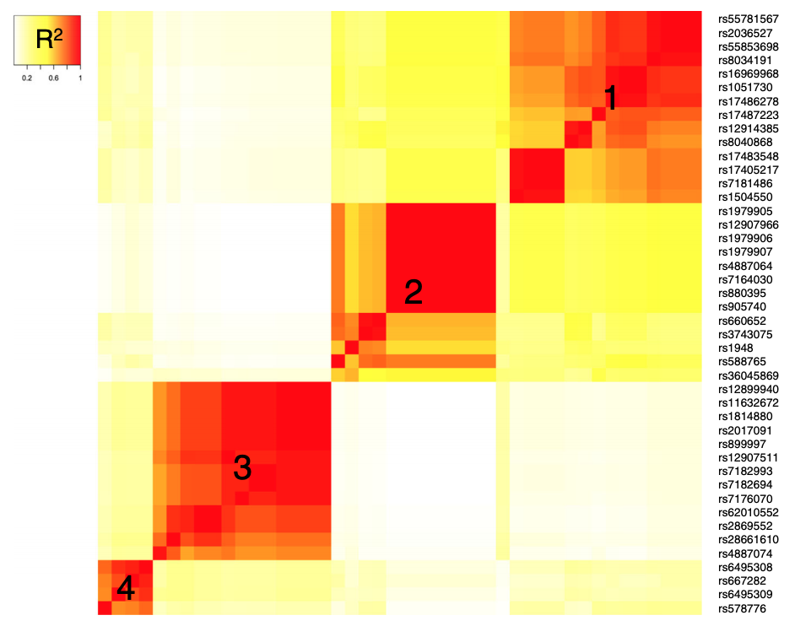
Arrangement (Comparing or Linking)
Orthogonal Arrangement
Lee et al. BMC Genomics. 2018

Slide 22
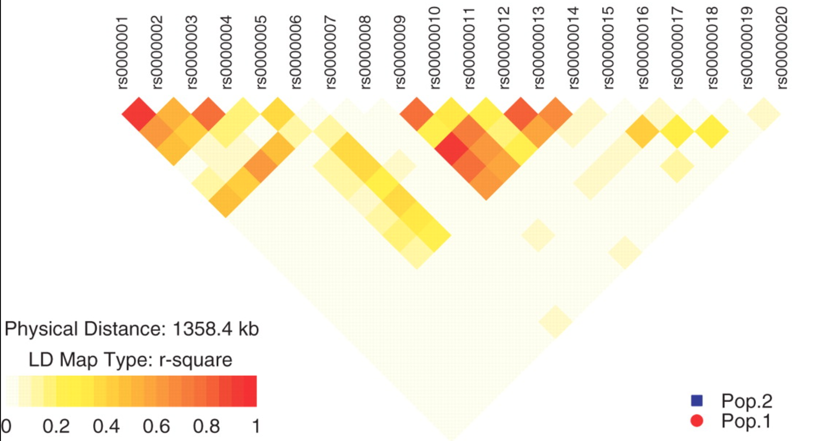
Arrangement (Comparing or Linking)
Orthogonal Arrangement (can often be rearranged to put the map along the diagonal)
Luna et al. Bioinformatics. 2007

Slide 23
Data or Feature Taxonomy
Segmentation Type
Length Type
Attributes / Annotation

Slide 24
Data or Feature Taxonomy
Segmentation Type
Sparse features
Genes, SNPs, etc.
Contiguous features
Copy number, coding/non-coding, etc.

Slide 25
Sparse Features
Have a start and an end
Genes
Transcripts
Introns and Exons
SNPs
Regulatory Elements
Repeats
19-45409011-45427650. gnomAD. 2022 Feb 17

Slide 26
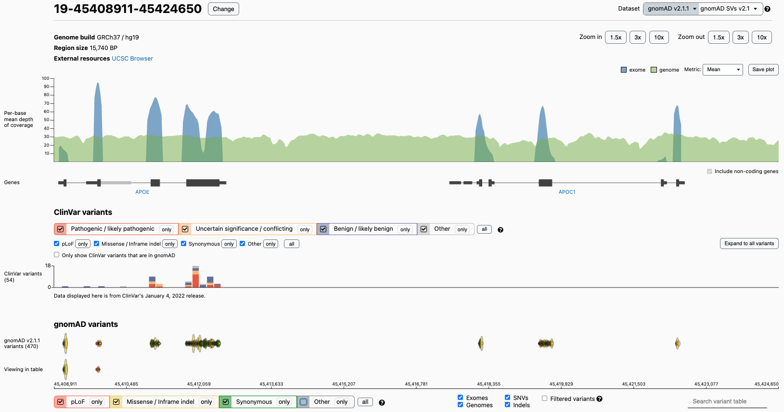
19-45408911–45424650. gnomAD. 2022 Feb 17

Slide 27
Contiguous Features
Every point/segment in the genome has a “value”
Chromosome
Chromosome band
Copy number
Coding vs non-coding
Methylation
Acetylation
GC%
Sequencing coverage
Conservation
19-45408911–45424650. gnomAD. 2022 Feb 17

Slide 28
19-45408911–45424650. gnomAD. 2022 Feb 17

Slide 29
Data or Feature Taxonomy
Length Type
Point features
1 nucleotide
Segment features
> 1 nucleotide
Both sparse and continuous features have lengths
Sequencing coverage is a point feature
​(Useful) GC% is a segment feature

Slide 30
Data or Feature Taxonomy
Attributes
Number of attributes = 0, 1, or > 1
Values
Quantitative
Expression, copy number, LD, p values
Ordinal
Copy number
Categorical
Samesense, missense, nonsense

Slide 31
Data or Feature Taxonomy
Interconnection
Links between features
eQTLs or other Regulatory Elements
Translocation
Co-location
Co-expression
Linkage disequilibrium
etc.

Slide 32
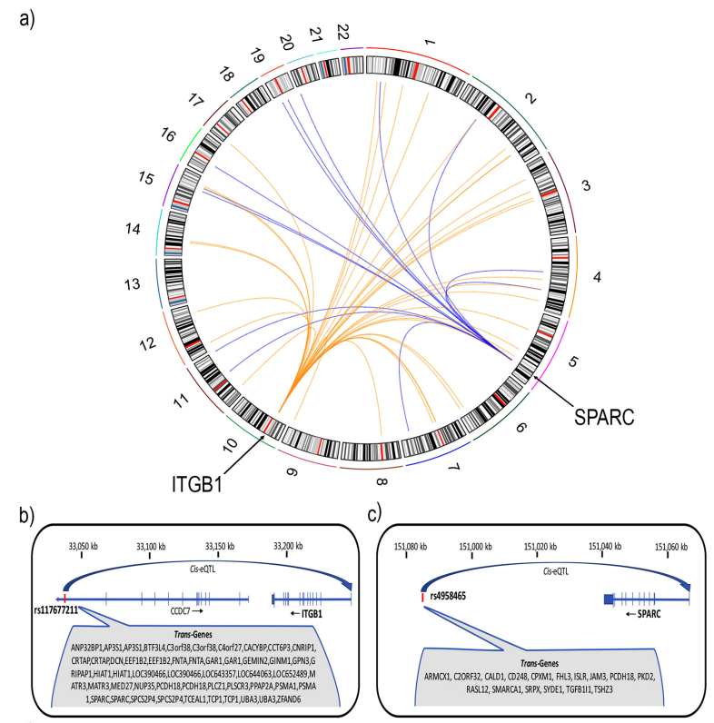
Visualizing Links
These figures illustrate connections between eQTLs and the genes they are associated with
The circos plot, (a), shows trans-regulatory links
The linear plots, (b) and (c), show cis-regulatory links
Fung et al. Sci Rep. 2018

Slide 33
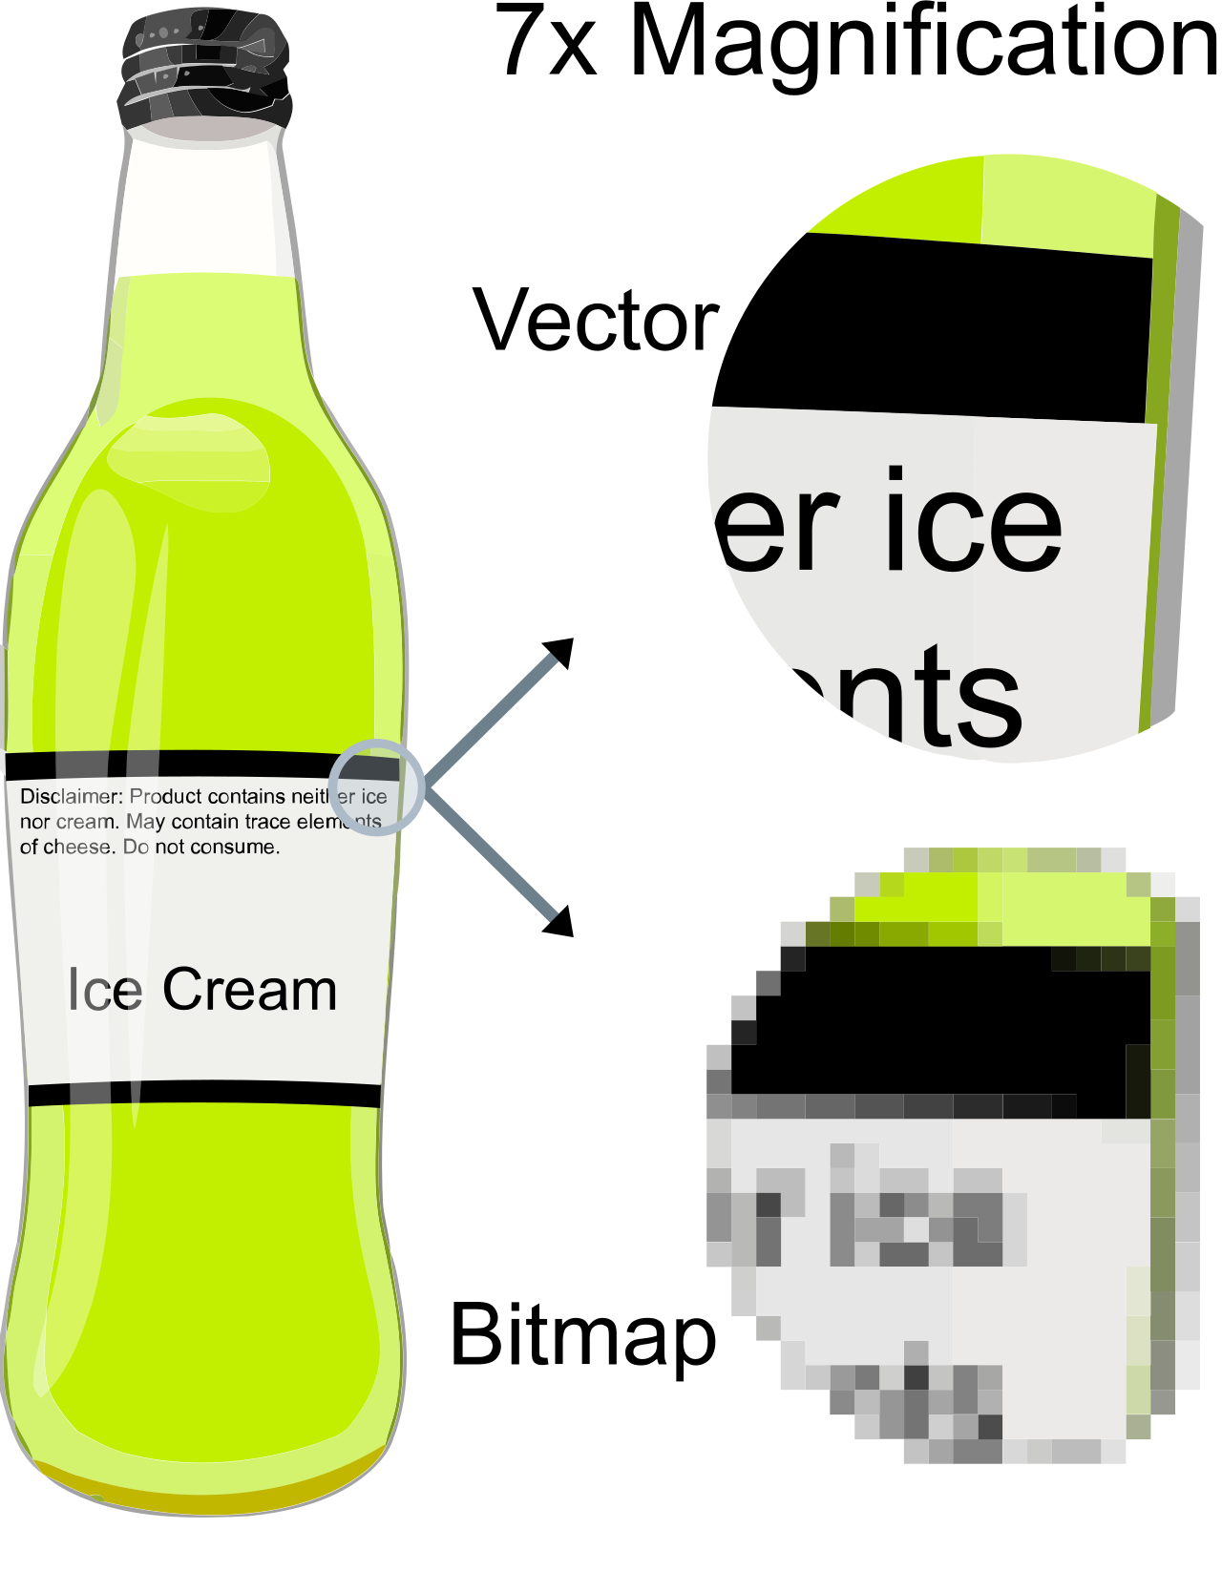
Vector vs Raster Graphics
Wikipedia

Slide 34

Vector vs Raster
https://upload.wikimedia.org/wikipedia/commons/3/30/Vector-based_example.svg
If you go to the link and zoom in and in and in and in and in, it always remains sharp.
However, if you take a screenshot and zoom in and in and in, you see

Slide 35
Vector vs Raster Graphics
Vector graphics are usually far preferable for visualizations
However, do not use vector graphics solutions for plots that have a ton of points
What are ”a ton of points”?
It depends on the processing capacity of the computer generating or (!!) displaying the image
Even if you have a high-powered machine that can create a vector graphics plot with 10,000,000 data points in it, no one on a low-power machine will ever be able to open it

Slide 36
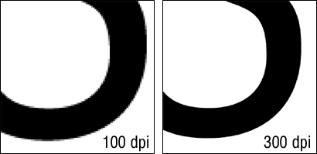
Vector vs Raster Graphics
If using raster graphics because of this limitation, turn up the resolution to at least 300 dpi
But remember if the image gets enlarged the resolution drops
So, an image at 300 dpi, if zoomed in 3× becomes 100 dpi

Slide 37
Vector vs Raster Graphics
Journals will usual have standards for minimum dpi for raster images

Slide 38
File Formats and Suffixes
Vector Graphics
Raster Graphics
​SVG (scalable vector graphics)
​EPS (encapsulated postscript)
​PDF (portable document format)
​PNG (portable network graphics)
​JPG (joint photographic experts group)
JPG format often uses additional compression that further reduces quality
​GIF (graphics interchange format)
​BMP (bitmap)

Slide 39
Saving R Images
To save images from R, you can use these commands:
ggsave()
Saves the last plot and guesses the format from the filename suffix
ggsave("myplot.pdf", width = 8, height = 8, units = "cm", dpi = 300)
pdf(), png(), svglite(), jpeg(), etc.
Opens a stream, saves plotted code to it.
It is necessary to close the “device” when done plotting.
png("myplot.png", w = 8, h = 8, u = "cm", r = 300) plot(…) dev.off()

Slide 40
Genomic Visualization Part 2
HUGEN 2073
Genomic Data Visualization & Integration
Slides adapted from Ryan Minster with permission

Slide 41
Learning Objectives
By the end of the session, students will be able to:
Create Manhattan and QQ plots for genome-wide statistics
Create regional Manhattan plots (LocusZoom plots)
Use basic ggbio commands to create chromosome ideograms and plots of genes

Slide 42
Manhattan Plots

Slide 43
Principles
x axis: genomic position (chr:bp)
y axis: −log₁₀ p
Point colors
Distinguish chromosomes
Distinguish important features
statistical significant “loci” (sometimes also point size)
known vs novel “loci”
Reference lines
Genome-wide statistical significance (5 × 10⁻⁸)
Suggestive significance (often 10⁻⁵ or 10⁻⁶)

Slide 44
Code
Examples: genome.sph.umich.edu/wiki/Code_Sample:_Generating_Manhattan_Plots_in_R
Examples: https://r-graph-gallery.com/101_Manhattan_plot.html
Data: chromosome and position, p values from GWAS, SNP ID
library(qqman) manhattan(results, chr = "CHR", bp = "BP", snp = "SNP", p = "P" )

Slide 45
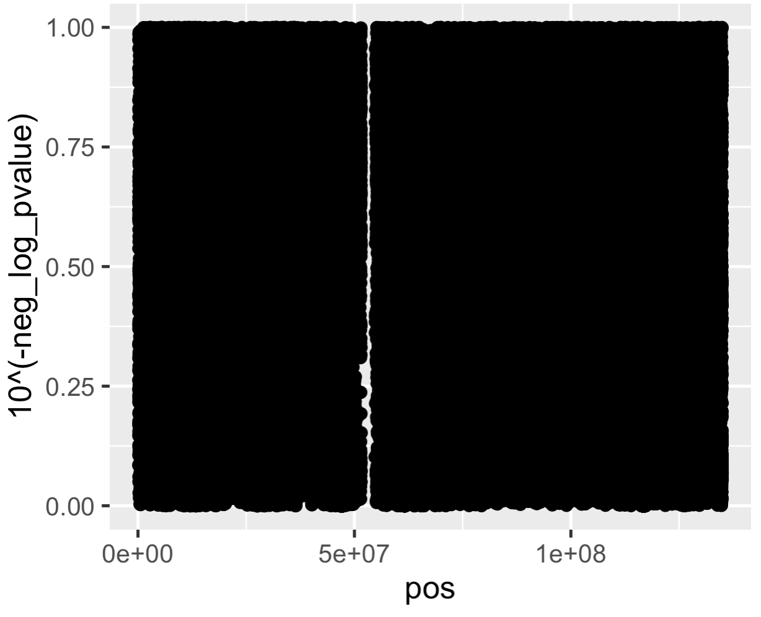
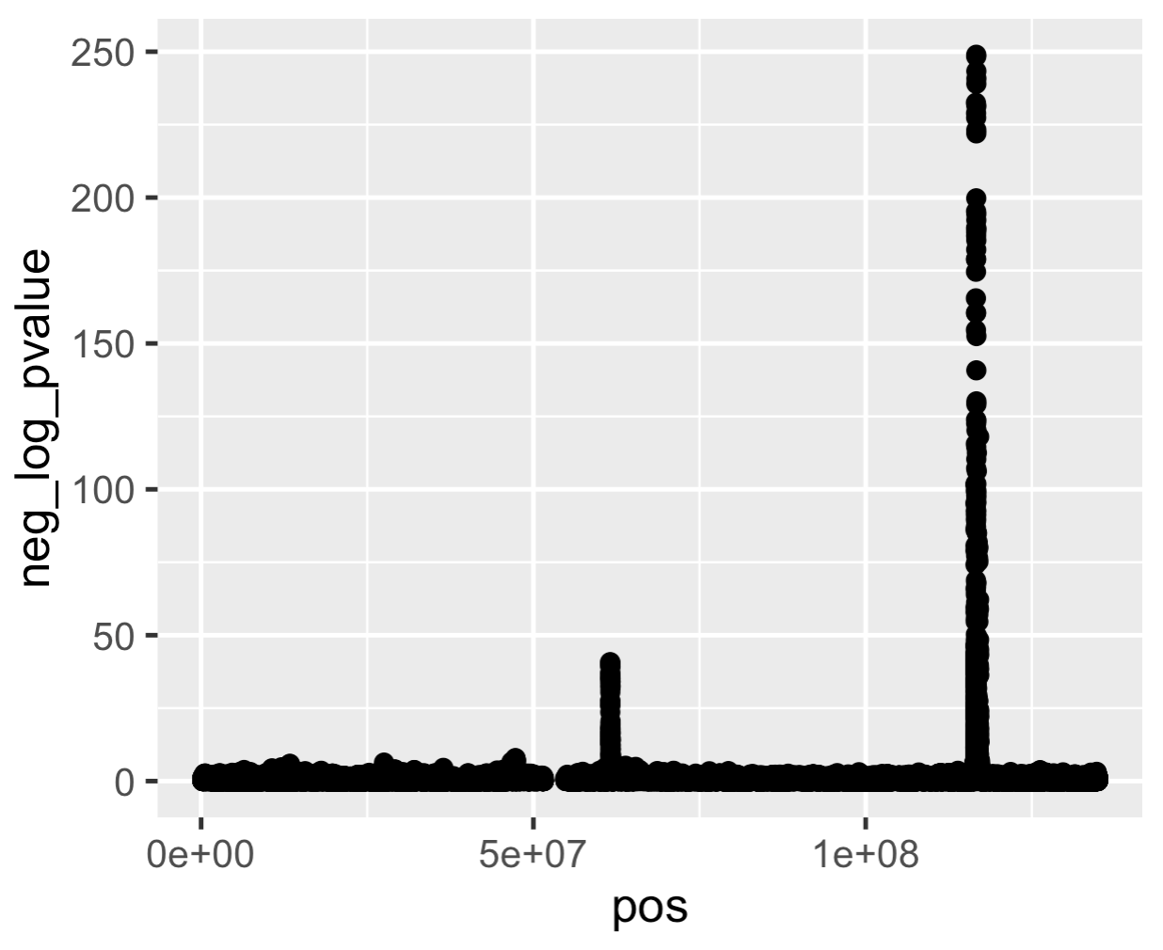
Why −log₁₀ p?
p values are usually transformed
Interesting p values (< 0.05) are compressed, and visually their differences are miniscule—whereas differences we don’t care about like between p = 0.5 and p = 0.7 are large and visible
−log₁₀ p rescales p so that the interesting differences are visible
The difference between 0.00000005 and 0.00001 is invisible but the difference between 7.3 and 5.0 is visible.
p
Chr 11 Position
−log₁₀ p
Chr 11 Position
Data for plots from Willer et al. Nat Genet 2013

Slide 46
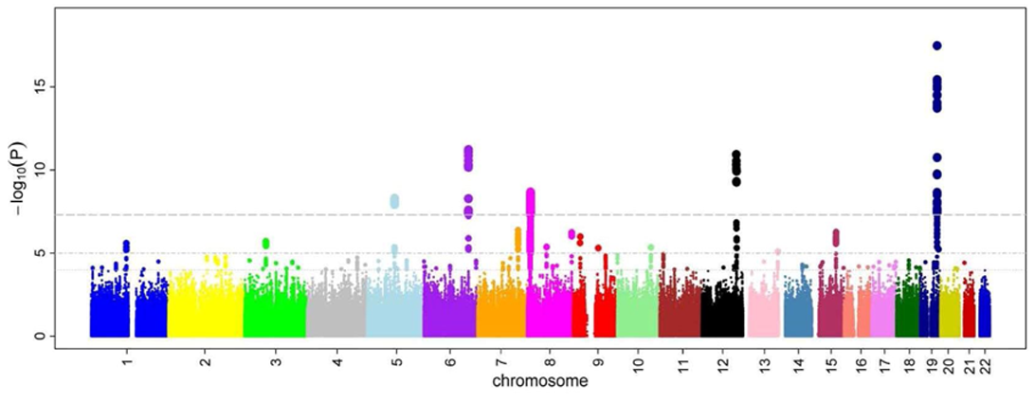
Variations
Ikram et al. PLoS Genet. 2010

Slide 47
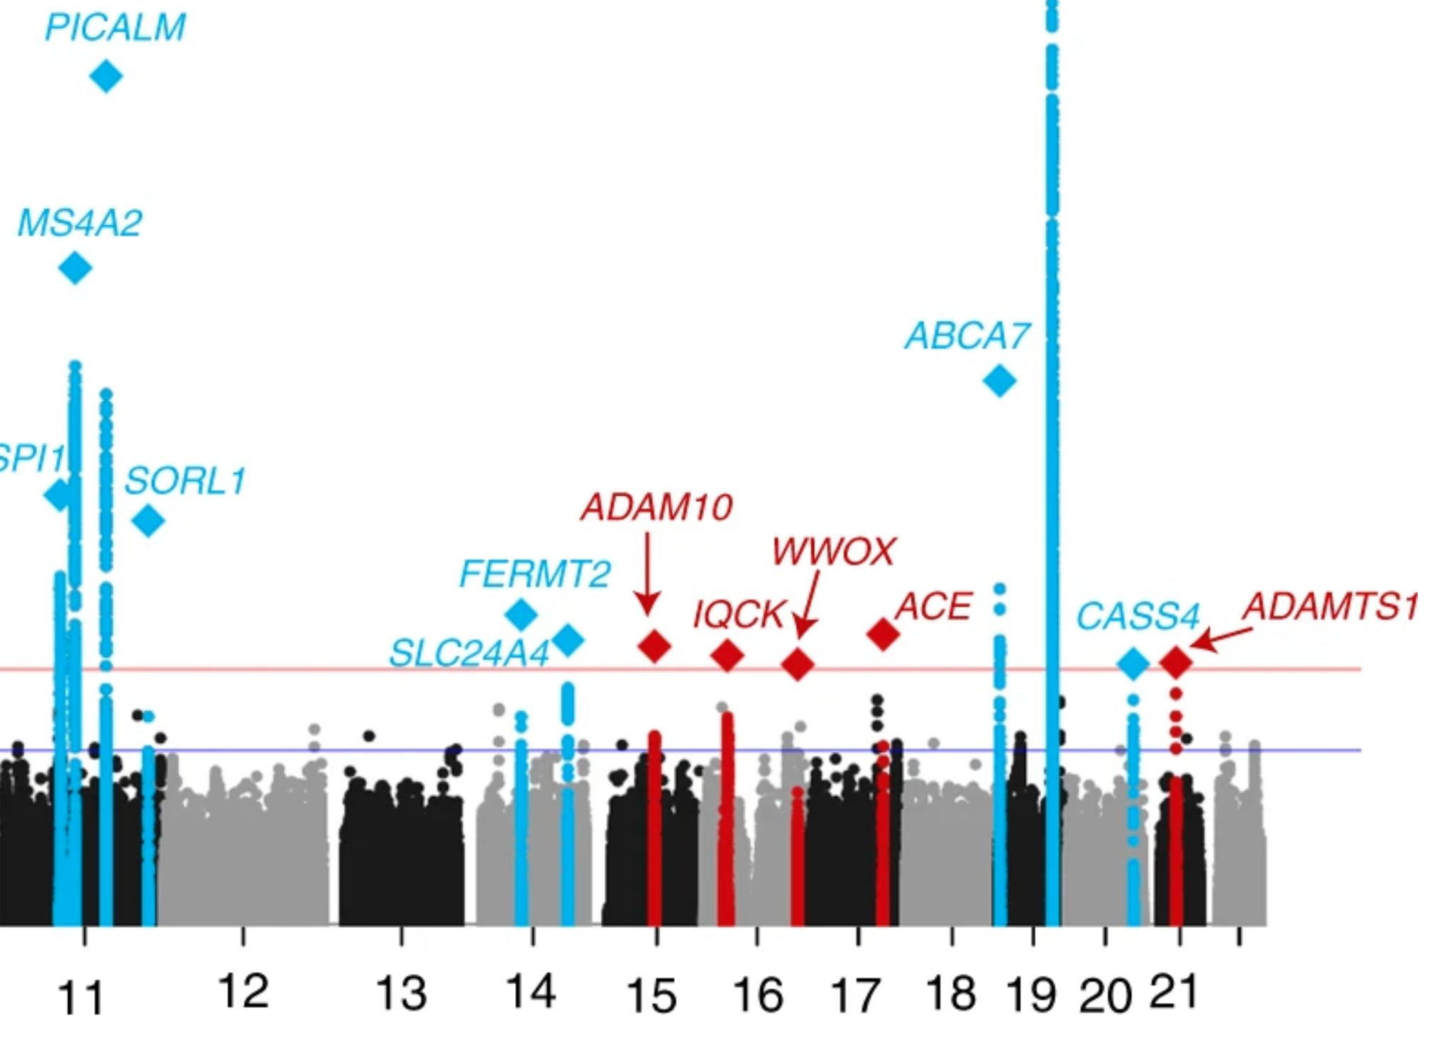
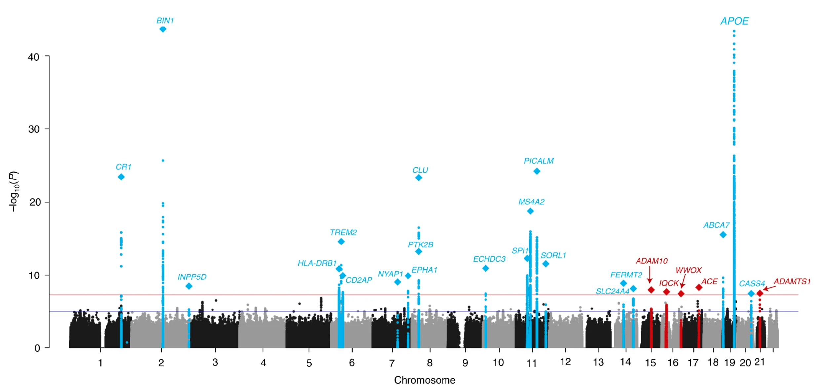
Variations
Kunkle et al. Nat. Genet. 2019

Slide 48
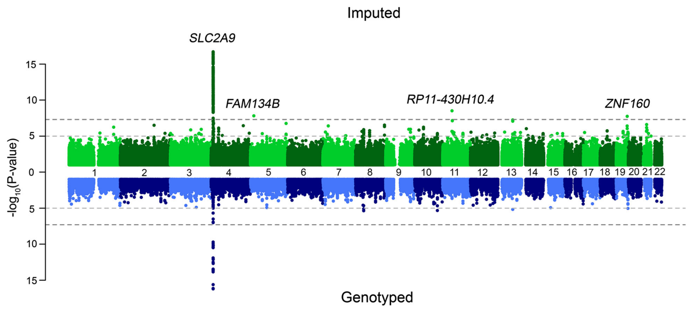
Miami Plots
Nagy et al. Genome Medicine 2017

Slide 49
Beyond Association Test p Values
Any point statistic can be used in a Manhattan-style plot
Most common is p value (−log₁₀ p)
You could plot t or F or χ² statistics — why not?
Population genetics statistics (F_{ST}, r ², D′, PBS, nS_{L})

Slide 50
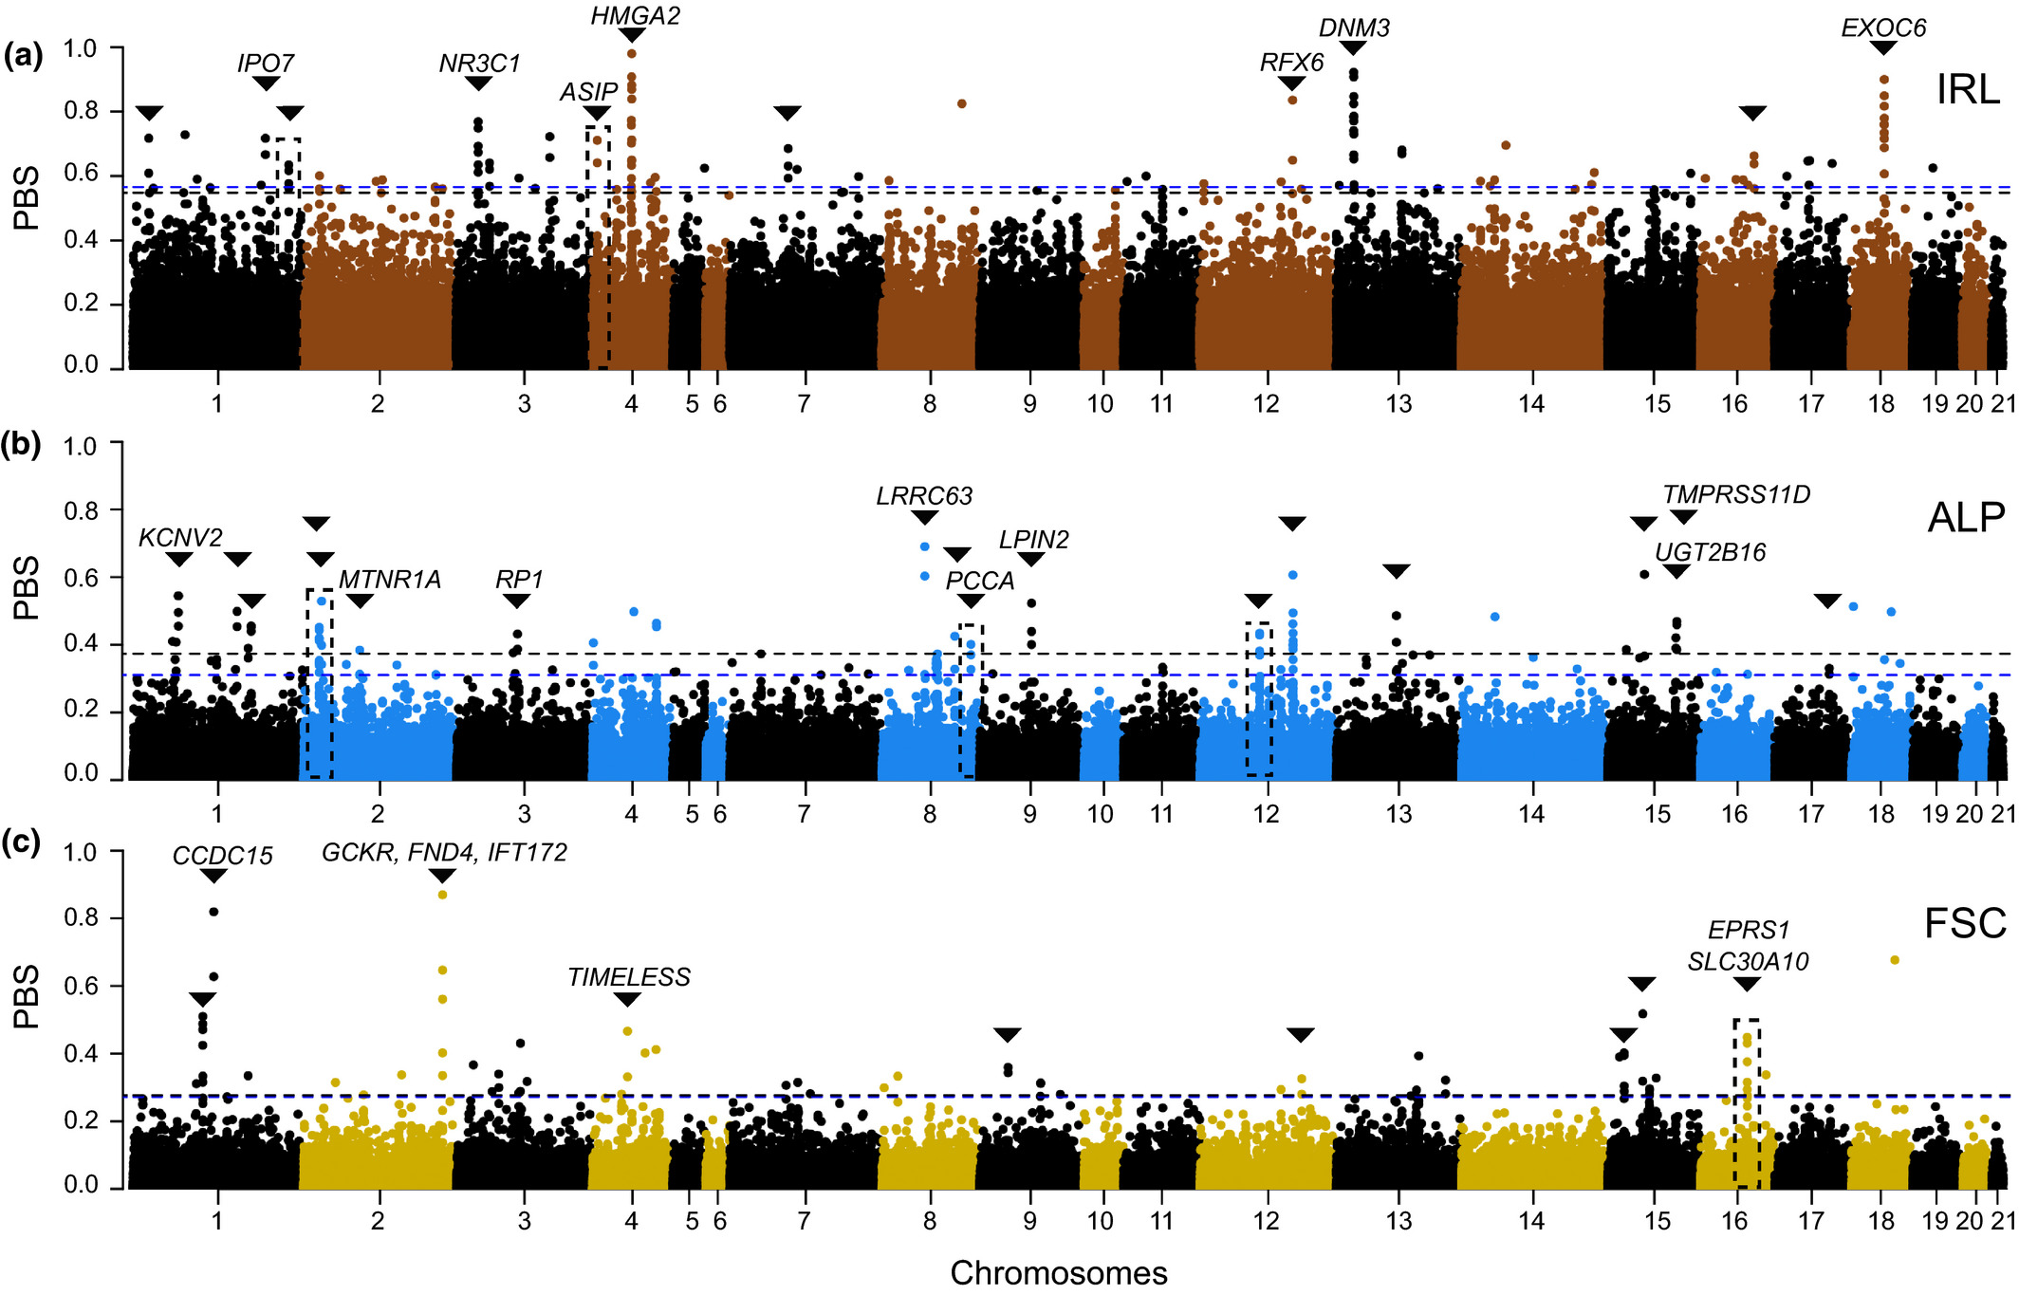
Natural Selection
Giska et al. Molec Ecol. 2022

Slide 51
Shortcuts
Reduce quantity of points to be plotted
Plot only points −log₁₀ p > 2
98.998% of points in a GWAS will be below this threshold
Takes 1.5 million points down to 15,028
Plot only random subset of points −log₁₀ p < 5
Plot subset of chromosomes

Slide 52
QQ Plots

Slide 53
Principles
x axis: expected −log₁₀ p
y axis: observed −log₁₀ p
Reference lines
y = x (identity line)
Confidence interval

Slide 54
Code
Examples: genome.sph.umich.edu/wiki/Code_Sample:_Generating_QQ_Plots_in_R
Examples: https://r-graph-gallery.com/101_Manhattan_plot.html
Data: p values from GWAS
library(qqman) qq(results$p)

Slide 55
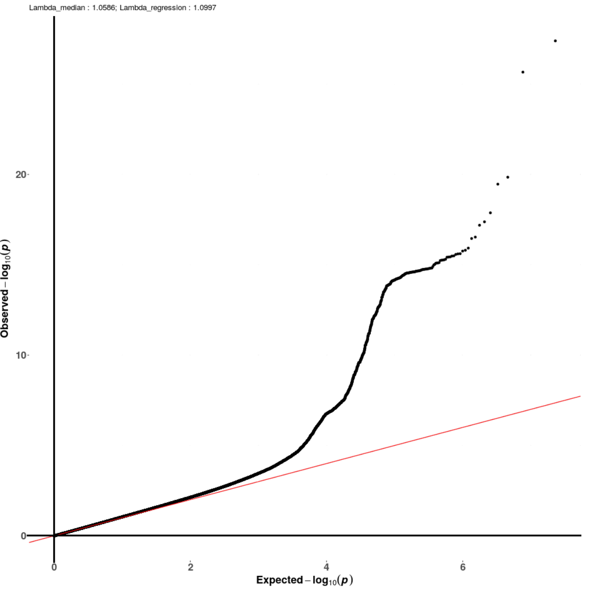
Variations
Kunkle et al. Nat. Genet. 2019

Slide 56
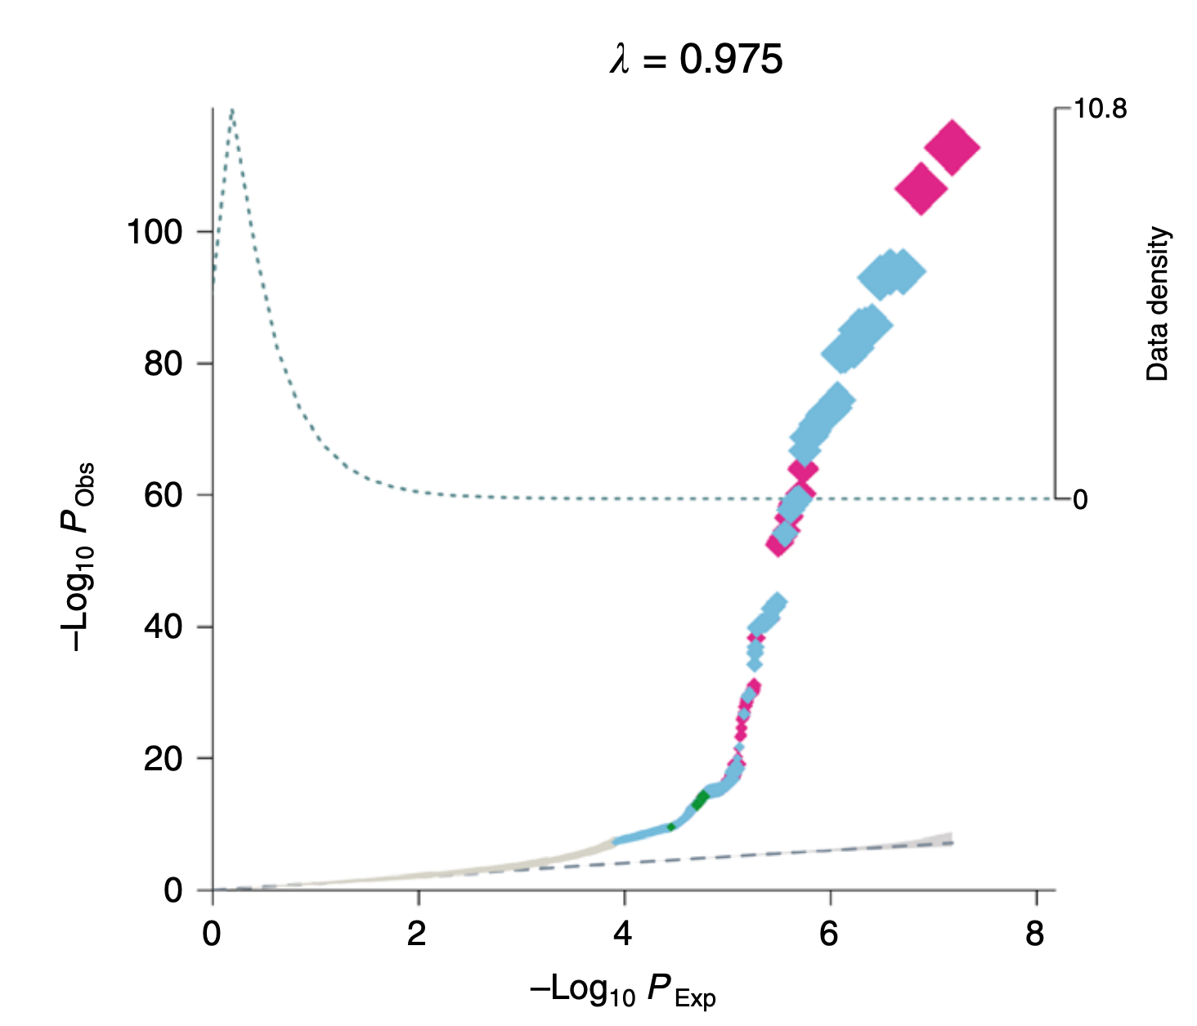
Variations
Highlighting with size and color
Bonàs-Guarch et al. Nat. Commun. 2018

Slide 57
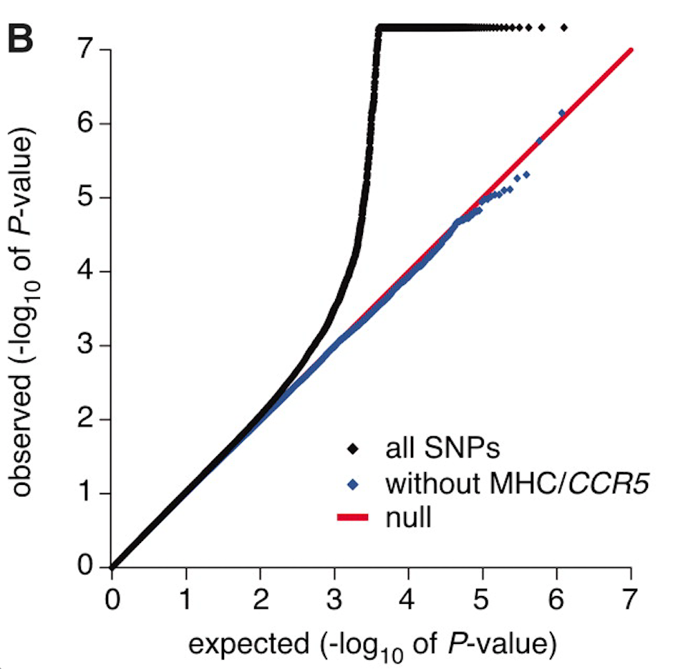
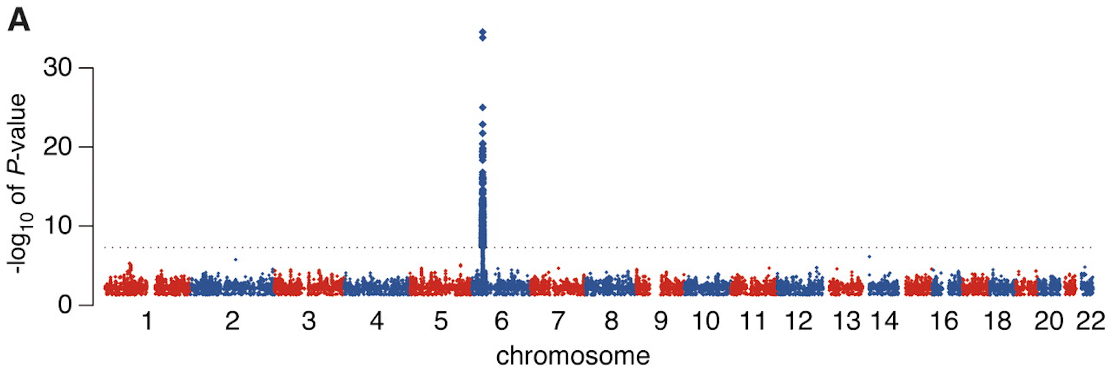
Variations
Subsetting
International HIV Controllers Study; Pereyra et al. Science 2010

Slide 58
Vector vs Raster Graphics
Vector graphics are usually preferable for visualizations
Generally, do not use vector graphics solutions for QQ plots.
(PDF, SVG, EPS)
Use raster graphics
(PNG, JPG, GIF)

Slide 59
Regional Manhattan Plots

Slide 60
Regional Manhattan Plots
Visualize small segment of genome

Slide 61
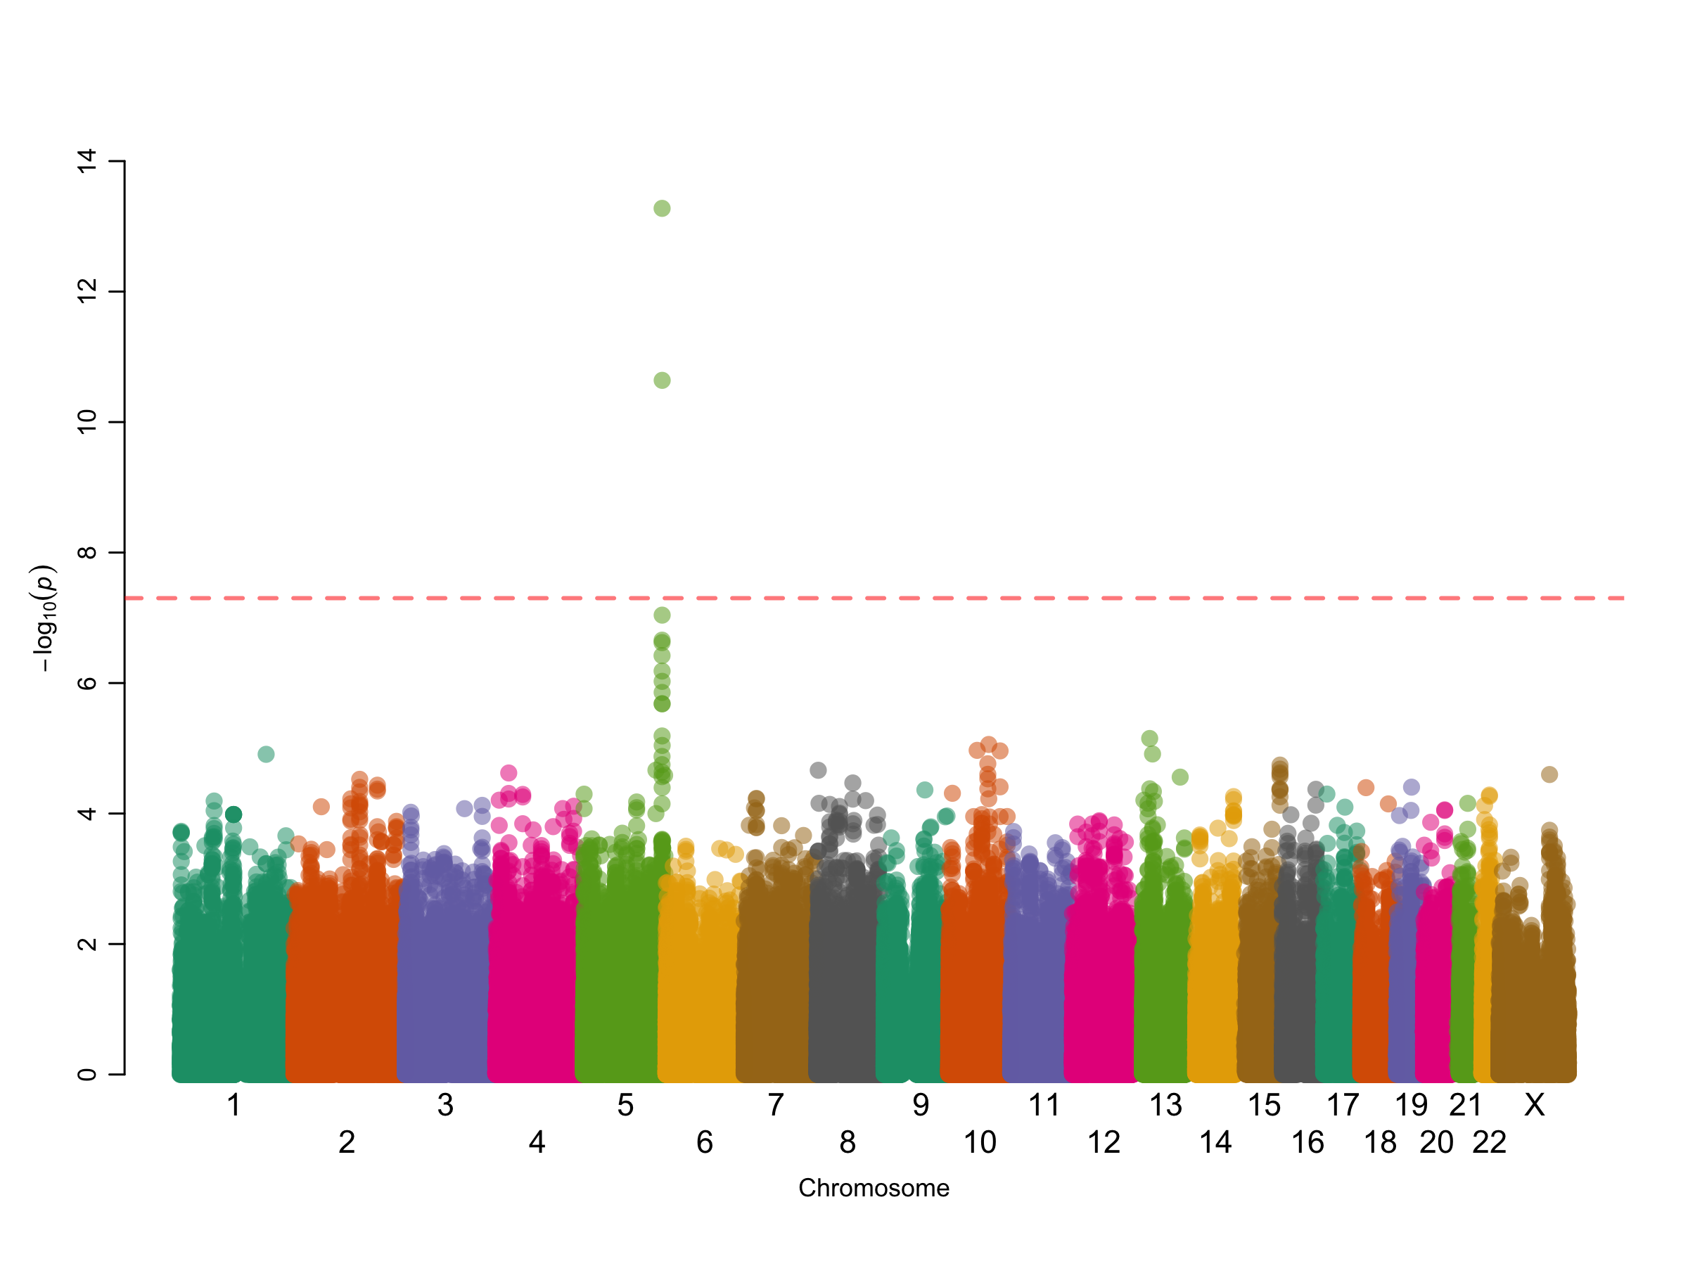

Slide 64
Principles
x axis: genomic position (chr:bp)
y axis: −log₁₀ p
Point colors
LD (usually r ²) between a “peak” SNP and the others
Reference lines
Genome-wide statistical significance (5 × 10⁻⁸)
Suggestive significance (often 10⁻⁵ or 10⁻⁶)
Often an overlay of recombination rate (to highlight recombination hotspots)
Often underlaid with genome map include gene diagrams

Slide 65
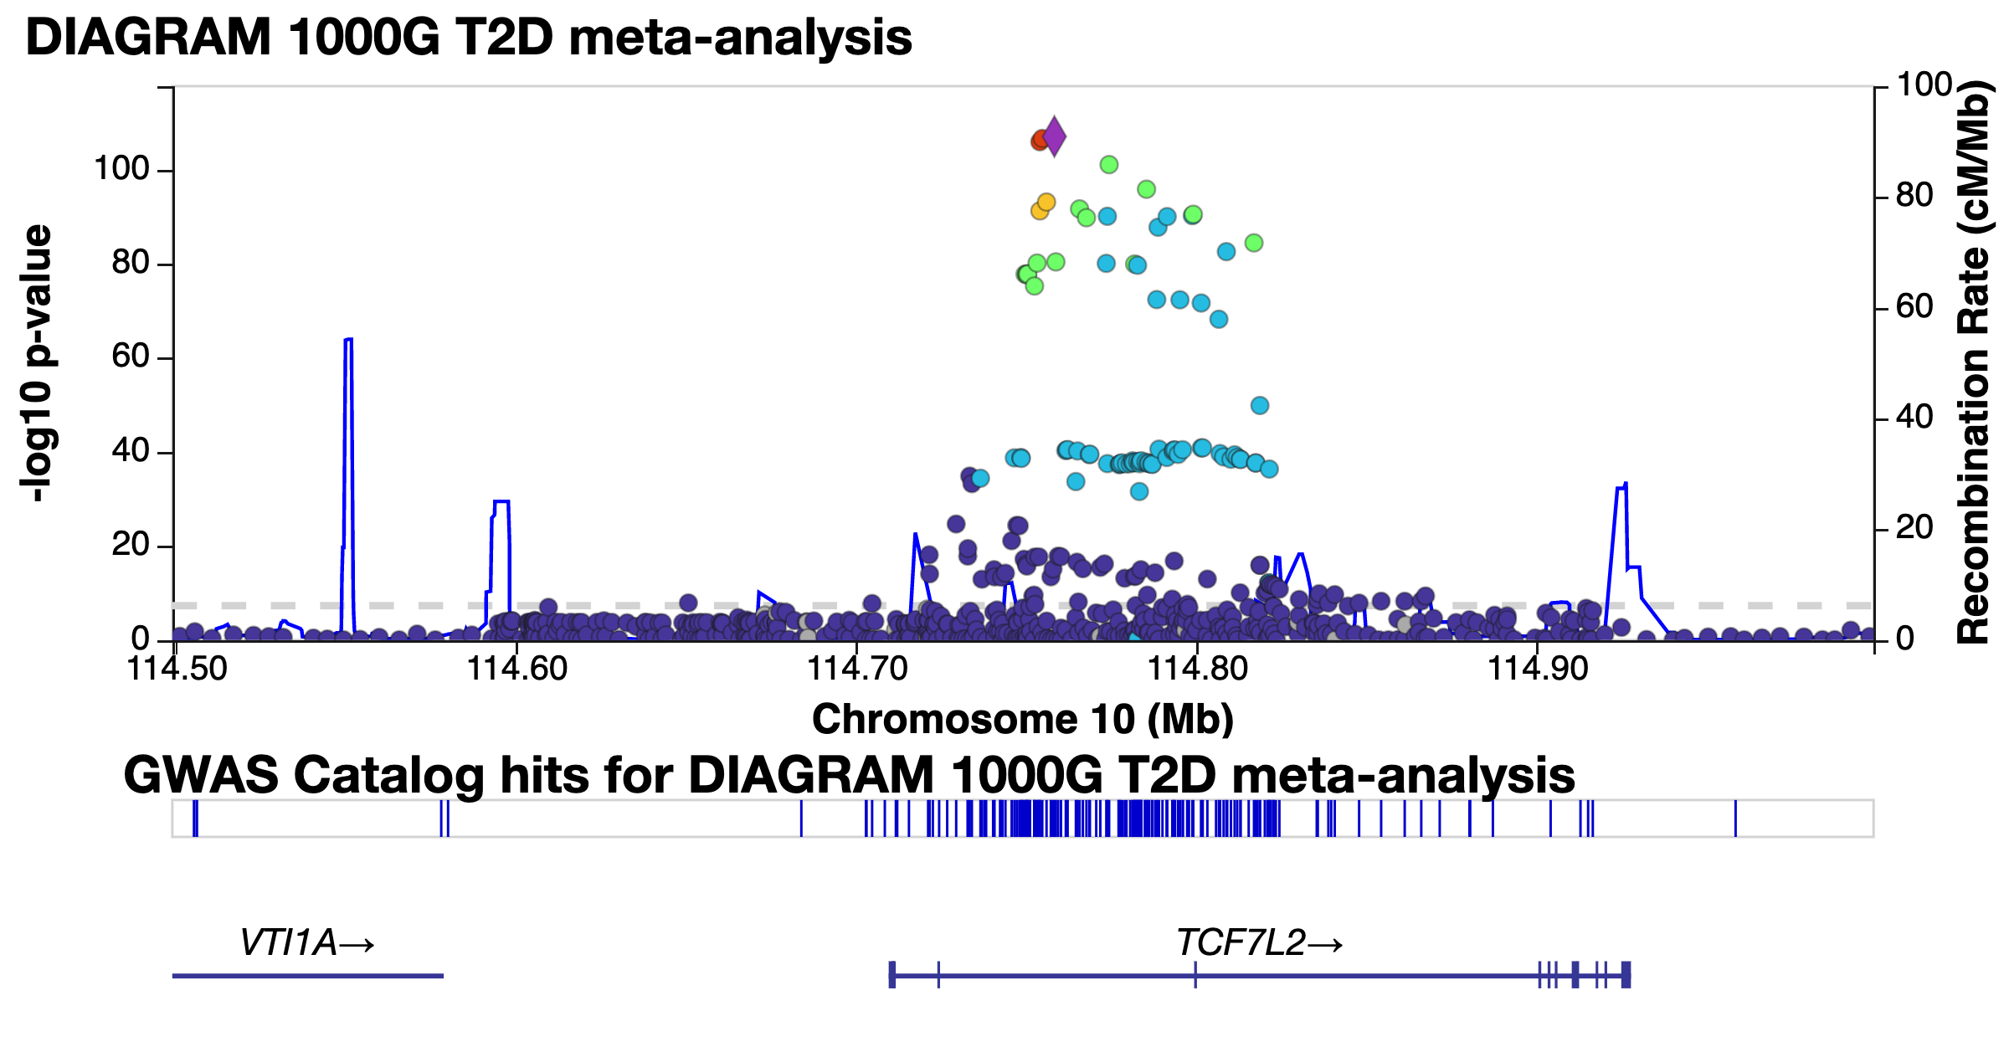

Slide 66
LocusZoom
(So you don’t have to code it yourself)
LocusZoom locuszoom.org Pruim et al. Bioinformatics 2010

Slide 67
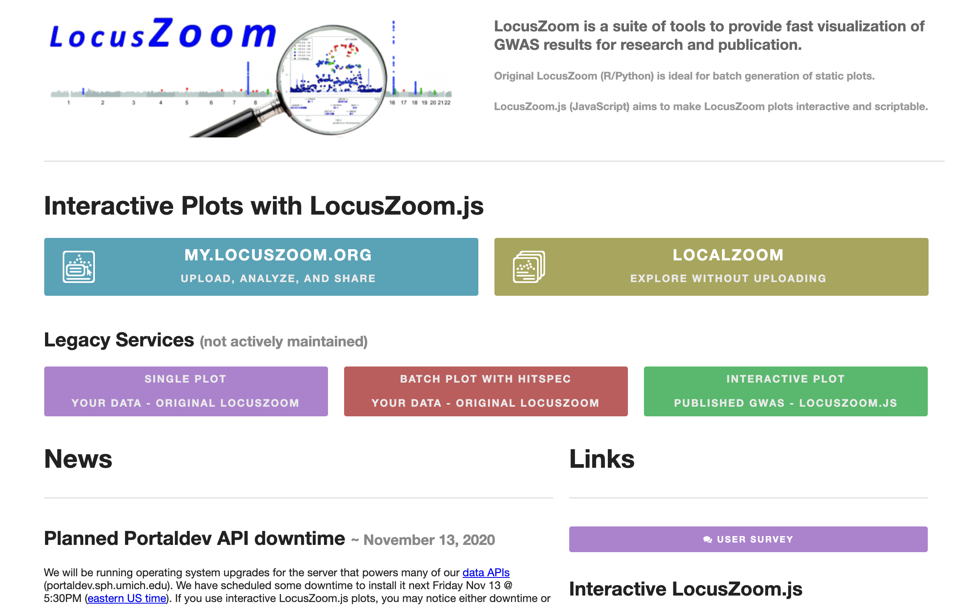

Slide 68
LocusZoom
Upload tab-delimited files with
Chromosome
Position
Reference allele
Alternate allele
p value or −log₁₀ p
Will highlight regions above a threshold for LocusZoom plots

Slide 69
Reference SNP against which all others are colored for LD (usually peak SNP)
Other SNPs colored by LD with the reference SNP
Recombination
Hotspots
Genes nearby

Slide 70
Standalone LocusZoom
There is a (no longer maintained) standalone version of LocusZoom
Command line interface via Unix, built with Python and R
https://genome.sph.umich.edu/wiki/LocusZoom_Standalone

Slide 71
ggbio

Slide 72
Plotting an Ideogram
library(ggbio) plotIdeogram(genome = "hg38", subchr = "chrX")

Slide 73
Plotting an Ideogram
library(ggbio) plotIdeogram(genome = "hg38", subchr = "chr19", which = GRanges(seqnames = "chr19", IRanges(44905791, 44909393))

Slide 74
Plotting an Ideogram
library(ggbio) plotIdeogram(genome = "hg38", subchr = "chr19", color = "blue", fill = "blue", which = GRanges(seqnames = "chr19", IRanges(43905791, 45909393))

Slide 75
Plotting Genes
library(EnsDb.Hsapiens.v86) autoplot(EnsDb.Hsapiens.v86, ~ symbol = "BRCA1", names.expr = "gene_name")

Slide 76
Plotting Regions
library(EnsDb.Hsapiens.v86) gr <- GRanges(seqnames = 19, IRanges(44895791, 44919393), strand = "*") autoplot(EnsDb.Hsapiens.v86, GRangesFilter(gr), names.expr = "gene_name")

Slide 77
Exercise
Download summary statistics for a GWAS of your choice from https://www.ebi.ac.uk/gwas/downloads/summary-statistics
Read the data into R
Create Manhattan and Q-Q plots
Try two packages
qqman (https://cran.r-project.org/web/packages/qqman/vignettes/qqman.html)
GWASTools
Installation instructions: https://www.bioconductor.org/packages/release/bioc/html/GWASTools.html
Plotting functions:
https://rdrr.io/github/smgogarten/GWASTools/man/qqPlot.html
https://rdrr.io/bioc/GWASTools/man/manhattanPlot.html
Save them as appropriate file types
Can you speed up the plotting?
Can you customize the plots at all?

