Slide 1
Interactive visualization in R with Shiny
HUGEN 2073
Genomic Data Visualization and Integration
Jon Chernus
Some material adapted from https://shiny.rstudio.com

Slide 2
Setup
Download the folder 16_shiny_data from this Canvas module.
It contains some Shiny apps, an R script, and a dataset.

Slide 3
Shiny
R package for building interactive web apps
“Automatic ‘reactive’ binding between inputs and outputs and extensive prebuilt widgets make it possible to build beautiful, responsive, and powerful applications with minimal effort.”
For genomics, perhaps most useful for data exploration?

Slide 4
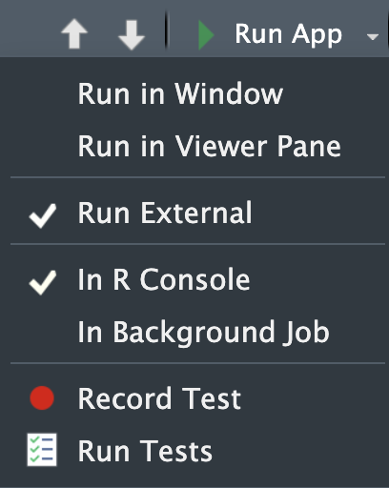
What is a Shiny app?
Just an R script, with a specific structure.
Can be run in RStudio
Other details
Usually name it something like “app.R”
Put it alone in its own folder, say, “app_dir”
Can run it with runApp(”/path/to/app_dir/")
Exit with the escape key
Can open in RStudio viewer window or in a browser

Slide 5
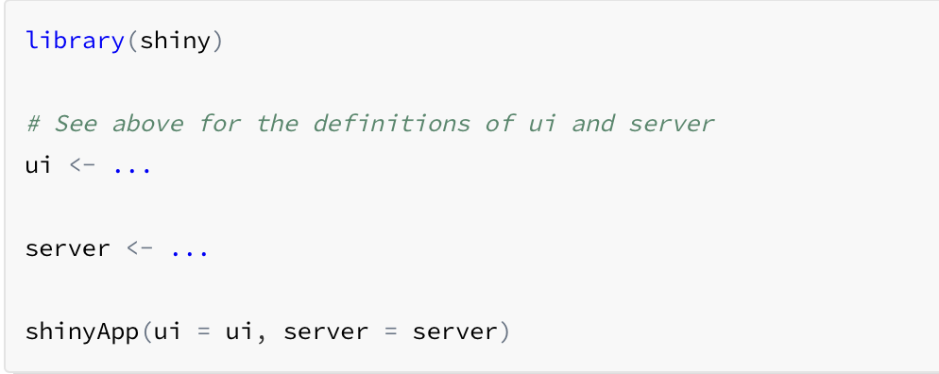
Structure of a Shiny app
Three parts
User interface object
Server function
A call to the shinyApp function
(You can also define global-level variables at the top, before the ui.)
The skeleton looks like this:

Slide 6
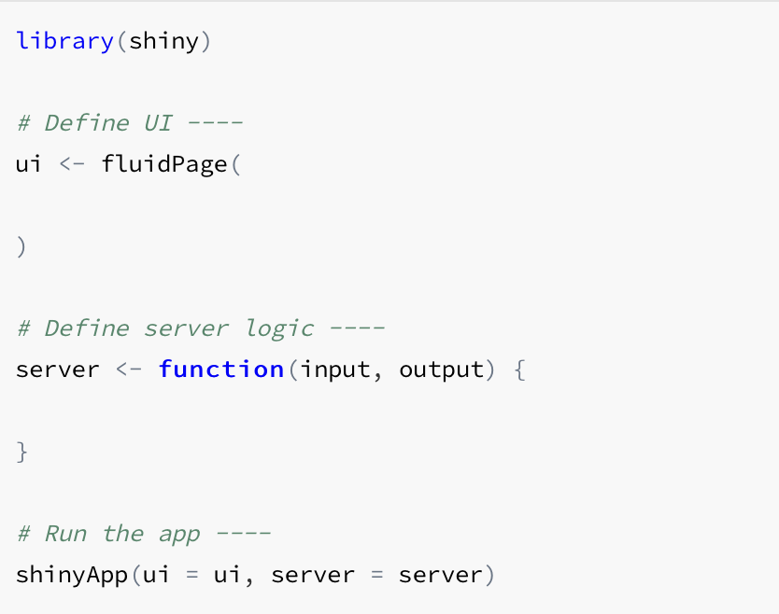
More detailed structure of a Shiny app
This is a Shiny app. A completely blank one.

Slide 7
ui
Nested structure wrapped in the function fluidPage.
ui specifies everything the user sees and interacts with
Titles (titlePanel)
Layout (sidebarLayout) always takes two arguments
Sidebar panel (the interactive control widgets; sidebarPanel)
The widgets you want are specified inside of sidebarPanel
Main panel (where output goes; mainPanel)
Fancier layouts are also possible.
You can also add customized text with HTML formatting.

Slide 8
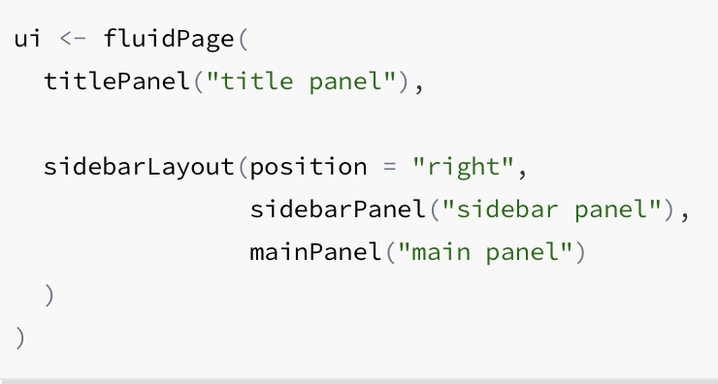
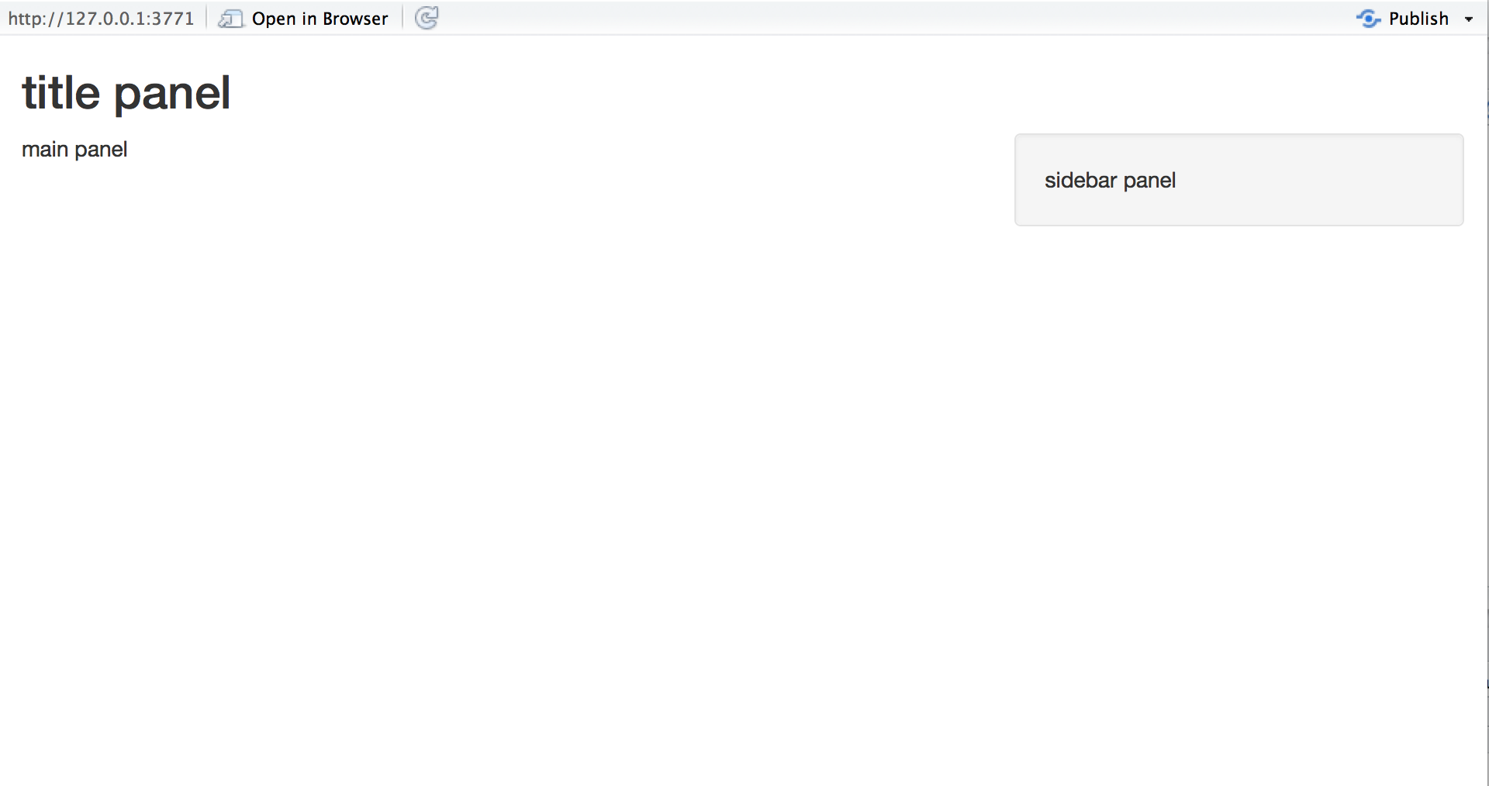
ui - basics
Combined with a server function, this is what the above ui gives you:

Slide 9
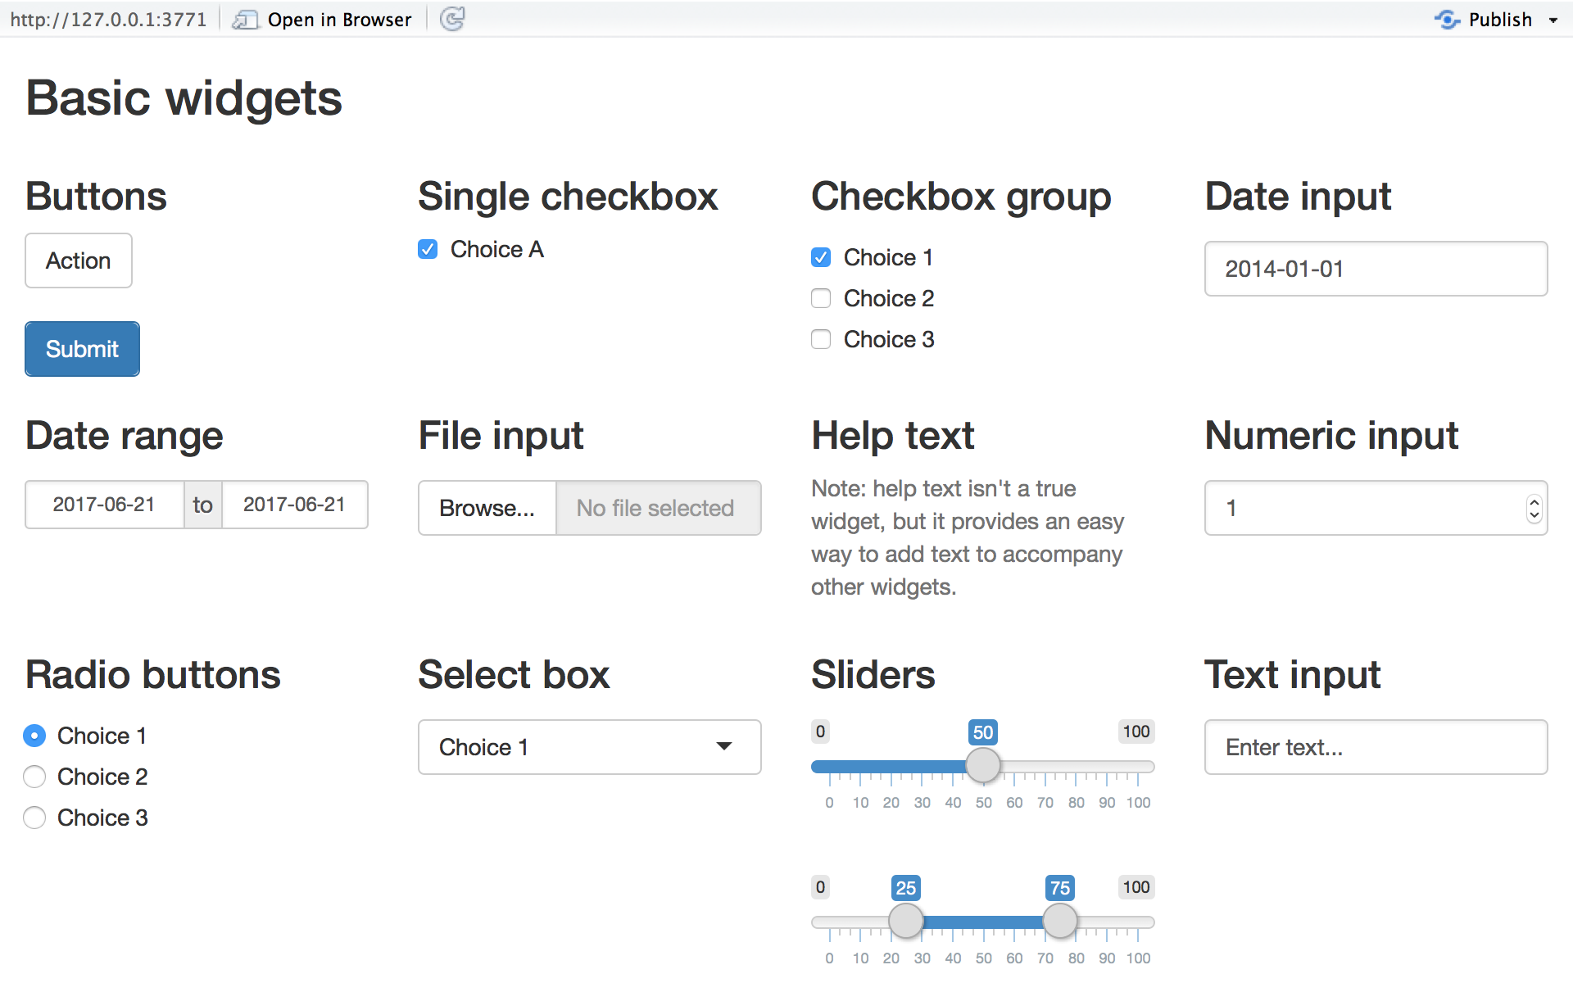
ui – basic widgets
Each widget is implemented with an R function. It will pass its input to the server function.
R function | widget
actionButton | Action Button
checkboxGroupInput | A group of check boxes
checkboxInput | A single check box
dateInput | A calendar to aid date selection
dateRangeInput | A pair of calendars for selecting a date range
fileInput | A file upload control wizard
helpText | Help text that can be added to an input form
numericInput | A field to enter numbers
radioButtons | A set of radio buttons
selectInput | A box with choices to select from
sliderInput | A slider bar
submitButton | A submit button
textInput | A field to enter text
For examples: https://shiny.rstudio.com/gallery/widget-gallery.html

Slide 10
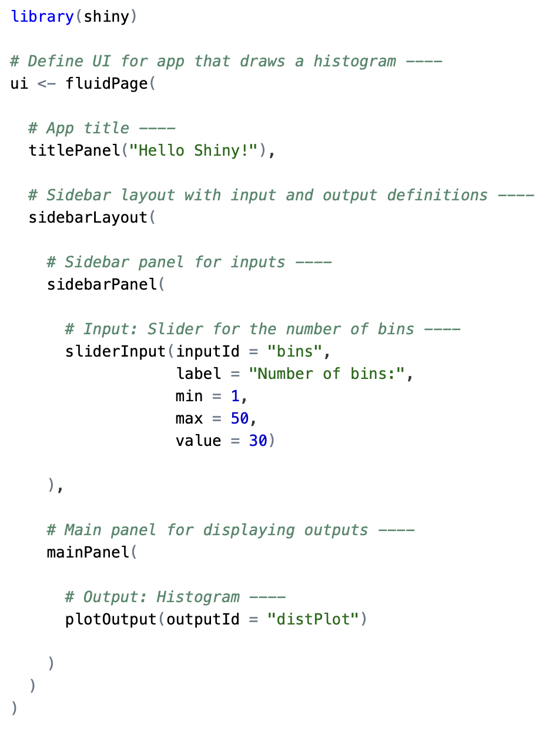
ui – adding widgets
Add a widget by calling its function within sidebarPanel.
The first two arguments are always
The widget’s name (a character string)
Will get used to access the stored user input
A label that the user sees (character string)
Other arguments vary.
Notice the nesting

Slide 11
Reactive output
Automatic response when the user adjusts a widget.
Two steps
Add an R object to the ui (let’s use mainPanel).
Tell R how to build it (do this in the server function). It will be reactive if the code uses a user-entered widget value.

Slide 12
Reactive output – 1. add R object to ui
Choose the function that returns the type of object you want to show.
Name the object in the ui; build it below in the server. The name is the only argument for the function.
Output function | Creates
dataTableOutput | DataTable
htmlOutput | raw HTML
imageOutput | image
plotOutput | plot
tableOutput | table
textOutput | text
uiOutput | raw HTML
verbatimTextOutput | text

Slide 13
Reactive output – 2. build object within server
Above, in sidebarLayout > sidebarPanel > mainPanel, we told Shiny where to put the output.
Now we give code to build it inside the server function, which:
Builds a list object named output containing all the code to update the object when the user enters new widget values
Gives each object its own entry in the output list
Do this by matching the entry in output with an object name given above as the argument to an output function

Slide 14
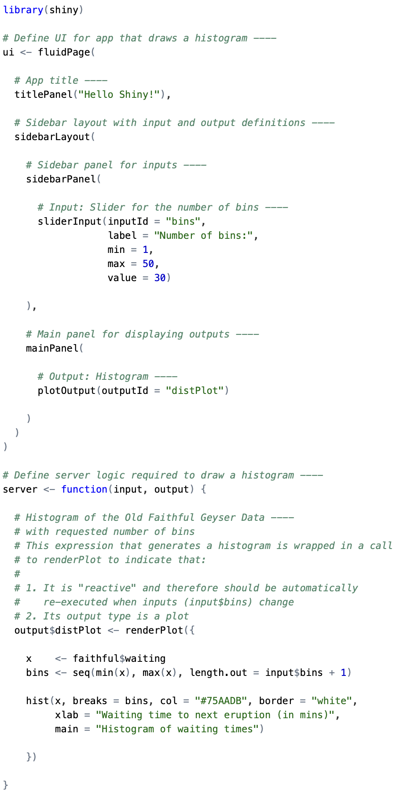
Reactive output – 2. build object within server
server automatically returns output
Each output component gets wrapped inside of a render* function that corresponds to the type of reactive object
The render* functions take one argument, an R expression in curly braces {}
The expression can be one line or many
Gets re-evaluated immediately when widget values change
Need to render* the right type of object to match the *Output function above
User widget input
Output name &
definition

Slide 15
Reactive output – 2. (continued) render* functions
render function | creates
renderDataTable | DataTable
renderImage | images (saved as a link to a source file)
renderPlot | plots
renderPrint | any printed output
renderTable | data frame, matrix, other table like structures
renderText | character strings
renderUI | a Shiny tag object or HTML

Slide 16
Reactive output – 2. (continued) Using the widget values
All user-supplied widget values are stored in the input list object.
Access them with the $ operator (see previous slide example).
server automatically makes any output component reactive if that component uses an input value, so objects stay “up-to-date.”
You just need to connect input to output objects, and Shiny does the rest.

Slide 17
Let’s walk through a couple of examples
In RStudio
Try an example I’ve provided, app.R, as well as two built-in examples:
runApp(“path/to/data/text_entry_app/app.R”, display.mode = "showcase")
runExample("01_hello")
runExample("02_text")

Slide 18
More built-in examples
runExample("01_hello") # a histogram runExample("02_text") # tables and data frames runExample("03_reactivity") # a reactive expression runExample("04_mpg") # global variables runExample("05_sliders") # slider bars runExample("06_tabsets") # tabbed panels runExample("07_widgets") # help text and submit buttons runExample("08_html") # Shiny app built from HTML runExample("09_upload") # file upload wizard runExample("10_download") # file download wizard runExample("11_timer") # an automated timer

Slide 19
Try a simple one on your own
Try making a new copy of my provided example text_entry_app/app.R and modify it to
Keep the original text entry and output
Now have a slider input that prompts the user to enter how hungry they are, on a scale of 1-10, with a default of 4
Output a message (text) re-stating how hungry the user said they were
A solution is provided in hungry/app.R

Slide 20
Making a Manhattan plot
chip_2_genesis_gwas_results.txt.gz contains a table of GWAS results.
static_manhattan_plot.R reads in the data (you need to adjust the path and possibly install some packages) and makes a Manhattan plot.
Let’s take a moment to see how the code works and see the plot.
> head(d)
variant.id chr pos n.obs freq MAC Score Score.SE Score.Stat Score.pval Est Est.SE PVE effect_allele other_allele strand
1: rs806731 1 30923 1226 0.13132137 322 1.8716091 2.798572 0.6687730 0.50364029 0.2389694 0.3573251 0.0003662529 A G +
2: rs183605470 1 84139 1226 0.01508972 37 2.6859570 1.140658 2.3547444 0.01853545 2.0643745 0.8766873 0.0045405783 A G +
3: rs148663102 1 254186 1226 0.01672104 41 -0.6500653 1.284419 -0.5061161 0.61277517 -0.3940427 0.7785619 0.0002097606 A G +
4: rs144425991 1 529782 1226 0.08809135 216 0.8124409 2.653831 0.3061390 0.75949884 0.1153574 0.3768138 0.0000767469 A G +
5: rs529192661 1 564158 1226 0.02039152 50 -2.2628646 1.409511 -1.6054250 0.10840030 -1.1389941 0.7094658 0.0021105890 A G +
6: rs6594031 1 565541 1226 0.10032626 246 -4.6564634 2.961961 -1.5720879 0.11593017 -0.5307591 0.3376141 0.0020238451 A G +
Code adapted from https://danielroelfs.com/blog/how-i-create-manhattan-plots-using-ggplot/

Slide 21
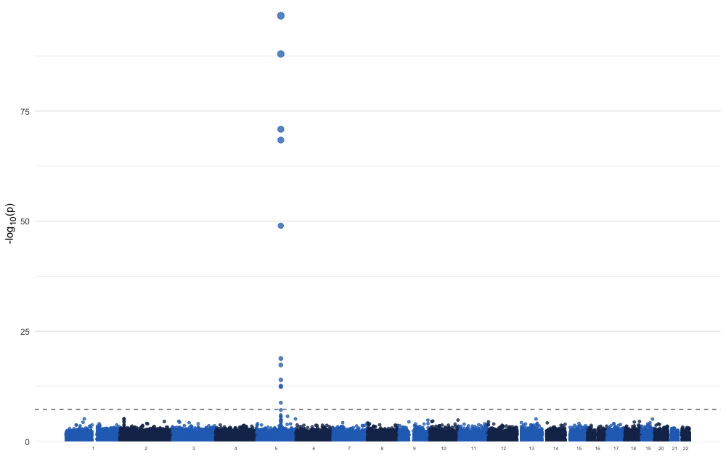
Our default Manhattan plot
Not ideal!

Slide 22
Interactive Manhattan plot with Shiny
interactive_manhattan_plot/app.R is a modified version with some widgets to help us improve the plot.
Adjust the y-axis maximum so that the plot isn’t all whitespace
Filtering non-significant p-values to speed up plotting
P-value threshold above which SNPs should be thinned
What percent of those non-significant SNPs to plot
Adjustable genome-wide significance line

Slide 23
Interactive Manhattan plot with Shiny
More ideas
Filter SNPs
Allele frequency
Allele count
Sample size
Effect size/direction
Filter regions
Chromosomes
By annotations (if we had them in this dataset)
Other aesthetics
Type in the name of a SNP to highlight it
Output summary tables, with messages about numbers of variants filter out
What else? See if you/we can implement one of your ideas.

