Slide 1
Genome Browser
Creating Custom Tracks
HUGEN 2073
Genomic Data Visualization & Integration
Slides adapted from Ryan L. Minster, PhD, MSIS

Slide 2
Learning Objectives
By the end of the session, students will be able to:
  Describe the various coordinate systems used in genomic data and will be able to convert between them
  Describe and use the RGB color system to assign colors to data
  Create a track for the UCSC Genome Browser in BED format
  Create a track for the UCSC Genome Browser in bedGraph format
  Create a track for the UCSC Genome Browser in Personal Genome SNP format

Slide 3
Chromosome Names
b37 Convention
(1000 Genomes Project)
  1
  2
  ⋮
  22
  X
  Y
  MT
hg19 Convention
(UCSC Genome Browser)
  chr1
  chr2
  ⋮
  chr22
  chrX
  chrY
  chrM
  Also, the current convention of the Genome Reference Consortium

Slide 4
Range Conventions
1-start, fully-closed
A C G T A
1 2 3 4 5
chr1:1-5
.gtf
.gff
.sam
.vcf
.wig
HGVS Nomenclature
0-start, half-open
A C G T A
0 1 2 3 4 5
chr1 0 5
Helps to think of it as
counting between the bases.
.bed (not PLINK .bed)
.bam
.bcf

Slide 5
Range Conventions
1-start, fully-closed
A C G T A
1 2 3 4 5
g.2del
chr1:2-2
g.1_2insA
chr1:1-2
g.3G>T
chr1:3-3
0-start, half-open
A C G T A
0 1 2 3 4 5
g.2del
chr1 1 2
g.1_2insA
chr1 1 1
g.3G>T
chr1 2 3

Slide 6
Range Conventions
Why 0-start? Because the math is easier.
seq1 A C G T A
seq2 T A G C T T
1-based 23 24 25 26 27 28 29 30 31
0-based 22 23 24 25 26 27 28 29 30 31
What is the length of the segment from A to A of seq1?
  1-based 27 - 23 + 1 = 5
  0-based 27 - 22 = 5
What is the overlap length of seq1 and seq1?
  1-based 27 - 26 + 1 = 2
  0-based 27 - 25 = 2

Slide 7
Converting from 1-start to 0-start
If the feature has a length > 0, subtract 1 from the start coordinate and leave the end coordinate the same
An exon starting with 10 and ending with 200:
chr1:10-200 -> chr1 9 200
A SNP at nucleotide 100 (i.e., starting with 100 and ending with 100):
chr1:100-100 -> chr1 99 100

Slide 8
Converting from 1-start to 0-start
If the feature has a length = 0 (an insertion), leave the start coordinate the same and subtract 1 from the end coordinate
An insertion between 10 and 11:
chr1:10-11 -> chr1 10 10

Slide 9
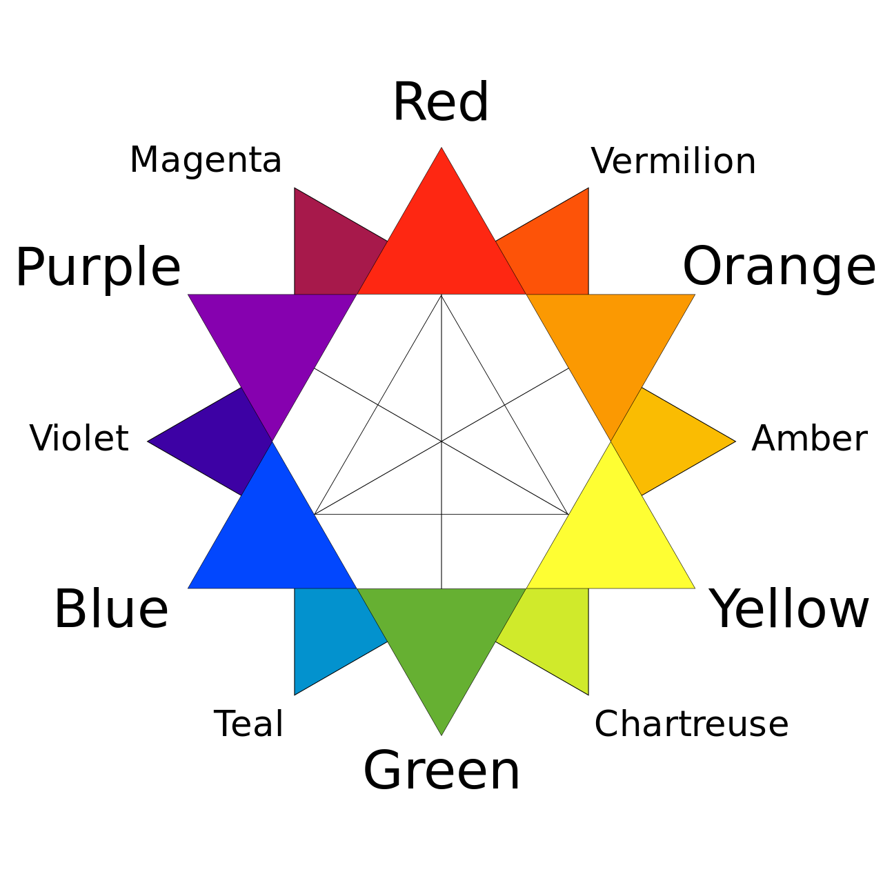
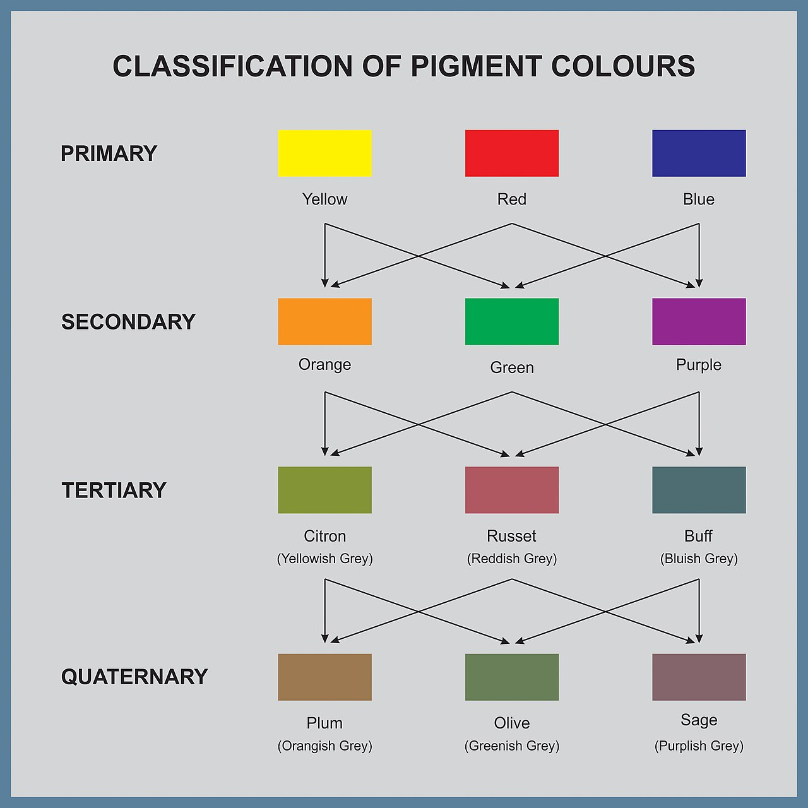
Color Theory

Slide 10


Additive vs Subtractive Color

Slide 11
RGB Color Model
Red
Green
Blue

Slide 12
RGB Color Model
Red
Green
Blue
Red, Green, Blue

Slide 13
RGB Color Model
Red
Green
Blue
Red, Green, Blue
0-255, 0-255, 0-255

Slide 14
RGB Color Model
Red
Green
Blue
Red, Green, Blue
0-255, 0-255, 0-255
00-FF, 00-FF, 00-FF

Slide 15
RGB Color Model
Red
Green
Blue
Red, Green, Blue, Transparency (Alpha Value)
0-255, 0-255, 0-255, 0-255
00-FF, 00-FF, 00-FF, 00-FF

Slide 16
Resources for Choosing Colors
https://htmlcolors.com/
  Doesn’t address accessibility
https://colorbrewer2.org/

Slide 17
BED Format
This is not PLINK’s binary pedigree format
Browser Extensible Data

Slide 18
BED Format
3–12 fields
  chrom Required
  chromStart Required
  chromEnd Required
  name These columns are optional, but “binding”:
  score If you include a column, all rows must include it, and
  strand if you include a column, you must include the
  thickStart columns before it. (Missing data = .)
  thickEnd
  itemRgb
  blockCount
  blockSizes
  blockStarts

Slide 19
Required Fields (BED3)
​chrom Name of the chromosome (chr1, chr2, chrX, etc.)
​chromStart Start of the feature (0-start)
​chromEnd End of the feature (0-start)
​Space- or tab-delimited
  Tab-delimited is preferable if you are uploading a file
  Space-delimited is useful if you are typing in data

Slide 20
Metadata Lines
Browser line(s)
Track line

Slide 21
Browser Line(s)
Configure(s) the Genome Browser display
  Positions shown
  Tracks shown
  “Density” settings for tracks

Slide 22
Browser Line(s)
browser position chr22:1-10000 # 1-start
browser hide all
browser pack knownGene
Separate lines
Visibility modes: hide, dense, pack, squish, full

Slide 23
Track Line
Configure the track display
  Name
  Type
  Visibility mode
  Color
  etc.

Slide 24
Track Line
track name=Example1 description="HUGEN 2073" color=255,0,0 visibility=3
All one line
Visibility modes: hide=0, dense=1, full=2, pack=3, squish=4

Slide 25
BED3 Example
browser position chr22:1-10000
browser hide all
track name=Example1 description="HUGEN 2073"
color=255,0,0 visibility=3 Make sure track is all one line
chr22 1000 5000
chr22 2000 6000
Go to My Data › Custom Tracks in the UCSC Genome Browser and try adding this track

Slide 26
BED Format
3–12 fields
  chrom Required
  chromStart Required
  chromEnd Required
  name These columns are optional, but “binding”
  score If you include a column, all rows must include it, and
  strand if you include a column, you must include the columns
  thickStart before it. (Missing data = .)
  thickEnd
  itemRgb
  blockCount
  blockSizes
  blockStarts

Slide 27
Optional Fields (BED4 to BED12)
​name A label for the feature
​score Quantitative value from 0–1000 that will display the feature in shades of gray if useScore=1
​strand . or + or -
​thickStart The starting point for going from a thin line to a thick bar (think TSS), set to chromStart for non-genes
​thickEnd The starting point for going from a thin line to a thick bar (think TES), set to chromEnd for non-genes

Slide 28
Optional Fields (BED4 to BED12)
​itemRgb · RGB value 255,0,0 that will display the feature in color if
itemRgb=1
​blockCount · Number of thick bars blocks (think exons)
​blockSizes · List of block sizes (lengths) exon lengths
​blockStarts · List of starting points for blocks, relative to chromStart

Slide 29
BED12 Example
track name="twoGenes" description="Example Genes"
itemRgb=1 visibility=3 Make sure track is all one line
chr22 1000 5000 geneA 0 + 1000 5000 255,0,0 2 567,488 0,3512
chr22 2000 6000 geneB 0 - 2000 6000 0,0,255 2 433,399 0,3601

Slide 30
bedGraph Format
Adds a track of continuous values (with colors and shades etc.)

Slide 31
bedGraph Format
4 fields
  chrom Required
  chromStart Required
  chromEnd Required
  dataValue Optional

Slide 32
Track Line
track type=bedGraph name=Example2 description="HUGEN 2073 2" color=255,0,0 altColor=0,0,255 visibility=3 graphType=points
All one line
Required
Visibility modes: hide=0, dense=1, full=2, pack=3, squish=4
Graph types: bar, points

Slide 33
bedGraph Example
track type=bedGraph name=Example2
description="HUGEN 2073 2" color=255,0,0
altColor=0,0,255 visibility=3
graphType=points Make sure track is all one line
chr22 1010 1011 10.1
chr22 1011 1025 3
chr22 1025 1030 -2
chr22 1030 1033 -6
chr22 1033 1040 -3

Slide 34
Personal Genome SNP Format
7 fields
  chrom
  chromStart
  chromEnd
  alleleNames
  alleleCount
  alleleFreq
  alleleScores

Slide 35
Personal Genome SNP Format Example
track type=pgSnp visibility=3 db=hg38 name="pgSnp" description="Personal Genome SNP example”
browser position chr22:1924-2937
chr22 2007 2008 T/G 2 21,70 0,0
chr22 2035 2035 -/CGG 2 20,80 0,0
chr22 2088 2093 CTCGG/- 2 30,70 0,0
chr22 2277 2278 T 1 15 0
chr22 2771 2772 A 1 36 0
chr22 2827 2828 A/T 2 15,5 0,0
chr22 2879 2880 C 1 0 0
chr22 2915 2916 - 1 0 0

