Slide 1
Visualizing Uncertainty
HUGEN 2073
Genomic Data Visualization and Integration
Slides borrowed/adapted from H. J. Park with permission

Slide 2
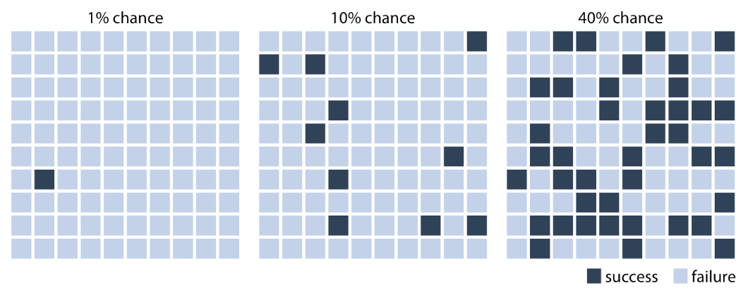
Visualizing uncertainties is visualizing probability
Visualizing uncertainty to a binary outcome, survival or mortality
e. g., how certain is a breast cancer patient to survive?
OK since 2 factors to define a probability
Sample size
Individuals with event (case or control)
Not OK since it doesn’t show stochasticity?
Adapted from Fundamentals of Data Visualization, Wilke, O’Reilly, 1st Ed.
Notes:
If we are only interested in two discrete outcomes, success or failure, then a visualization such as Figure 16.1 works fine.

Slide 3
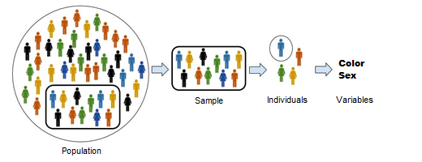
Population, samples, individuals and variables
https://www.datalaria.com/en/post/fundamentos/2018-10-07-estadistica-descriptiva/
Population: The set of all the elements under study (e. g., all breast cancer patients)
Sample: A subset of elements of the population (assumed to be representative of the population) (e. g., a breast cancer cohort)
Individuals: Individual element in the population (e. g., a breast cancer patient)
Variables: Characteristics of the individuals (clinical, molecular, socioeconomic features)
Notes:
To make a prediction before the election, we cannot poll each individual citizen in each district about how they are going to vote. Instead, we have to poll a subset of citizens in a subset of districts and use that data to arrive at a best guess. In statistical language, the total set of possible votes of all citizens in all districts is called the population, and the subset of citizens and/or districts we poll is the sample. The population represents the underlying, true state of the world and the sample is our window into that world.

Slide 4
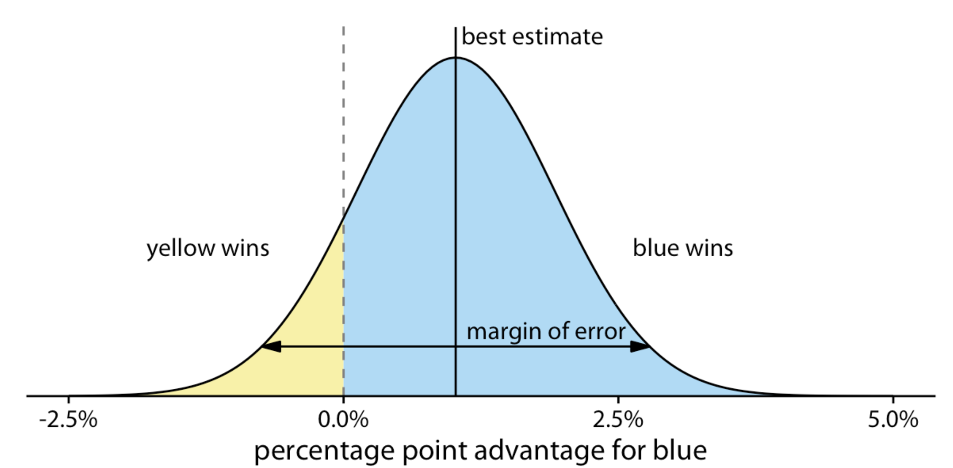
Outcome prediction as probability
E. g., an upcoming election with two parties, the yellow party and the blue party
On radio, the blue party is predicted to have a 1% advantage with a margin of error of 1.76 % points
The range of possible outcomes with their associated likelihoods in curve
Hypothetical prediction of an election outcome
Fundamentals of Data Visualization, Wilke, O’Reilly, 1st Ed.
Notes:
However, often we are dealing with more complex scenarios where the outcome of a random trial is a numeric variable. One common scenario is that of election predictions, where we are interested not only in who will win but also by how much. Let’s consider a hypothetical example of an upcoming election with two parties, the yellow party and the blue party. Assume you hear on the radio that the blue party is predicted to have a one percentage point advantage over the yellow party, with a margin of error of 1.76 percentage points. What does this information tell you about the likely outcome of the election? It is human nature to hear “the blue party will win,” but reality is more complicated. First, and most importantly, there is a range of different possible outcomes. The blue party could end up winning with a lead of two percentage points or the yellow party could end up winning with a lead of half a percentage point. The range of possible outcomes with their associated likelihoods is called a probability distribution, and we can draw it as a smooth curve that rises and then falls over the range of possible outcomes (Figure 16.2). The higher the curve for a specific outcome, the more likely that outcome is.

Slide 5
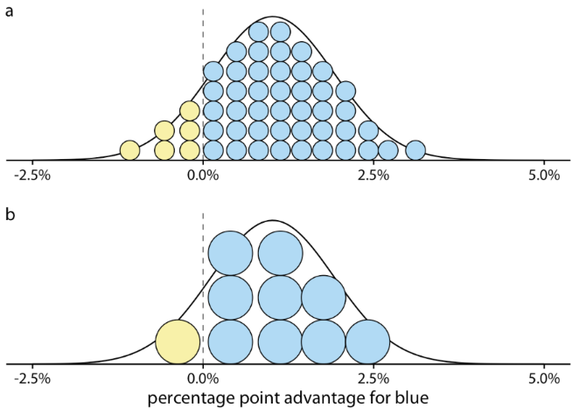
Quantile dot plots to represent probability
Hypothetical prediction of an election outcome
Visualizing that the chance of the yellow party winning is 12.9%
Too many dots: have it perceived as a continuum
Too few dots: make the estimation inaccurate
How many dots would work?
  Manual inspection
  Who’s your audience?
Similar for bin width, bandwidth, window size in the sliding window
Fundamentals of Data Visualization, Wilke, O’Reilly, 1st Ed.
Notes:
By doing some math, we can calculate that for our made-up example, the chance of the yellow party winning is 12.9%. So the chance of yellow winning is a tad better than the 10% chance scenario shown in Figure 16.1. If you favor the blue party, you may not be overly worried, but the yellow party has enough of a chance of winning that they might just be successful. If you compare Figure 16.2 to Figure 16.1, you may find that Figure 16.1 creates a much better sense of the uncertainty in outcome, even though the shaded areas in Figure 16.2 accurately represent the probabilities of blue or yellow winning. This is the power of a discrete outcome visualization. Research in human perception shows that we are much better at perceiving, counting, and judging the relative frequencies of discrete objects—as long as their total number is not too large—than we are at judging the relative sizes of different areas.
We can combine the discrete outcome nature of Figure 16.1 with a continuous distribution as in Figure 16.2 by drawing a quantile dotplot (Kay et al. 2016). In the quantile dotplot, we subdivide the total area under the curve into evenly sized units and draw each unit as a circle. We then stack the circles such that their arrangement approximately represents the original distribution curve (Figure 16.3).
As a general principle, quantile dotplots should use a small to moderate number of dots. If there are too many dots, then we tend to perceive them as a continuum rather than as individual, discrete units. This negates the advantages of the discrete plots. Figure 16.3 shows variants with 50 dots (Figure 16.3a) and with ten dots (Figure 16.3b). While the version with 50 dots more accurately captures the true probability distribution, the number of dots is too large to easily discriminate individual ones. The version with ten dots more immediately conveys the relative chances of blue or yellow winning. One objection to the ten-dot version might be that it is not very precise. We are underrepresenting the chance of yellow winning by 2.9 percentage points. However, it is often worthwhile to trade some mathematical precision for more accurate human perception of the resulting visualization, in particular when communicating to a lay audience. A visualization that is mathematically correct but not properly perceived is not that useful in practice.

Slide 6
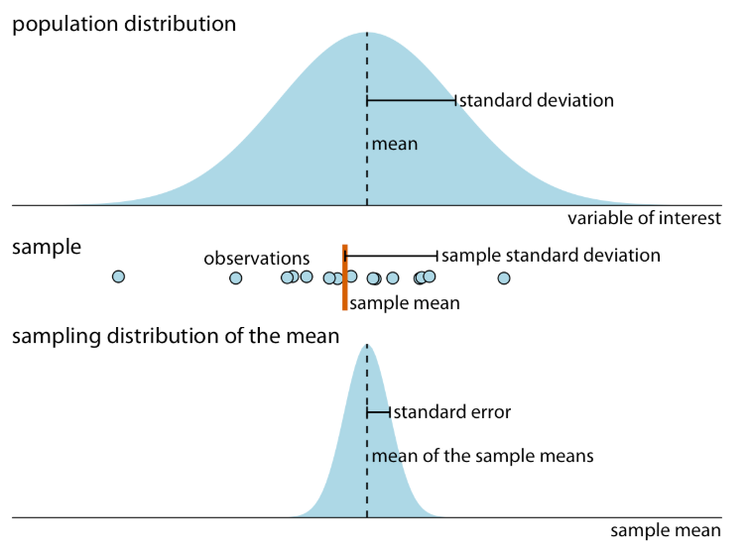
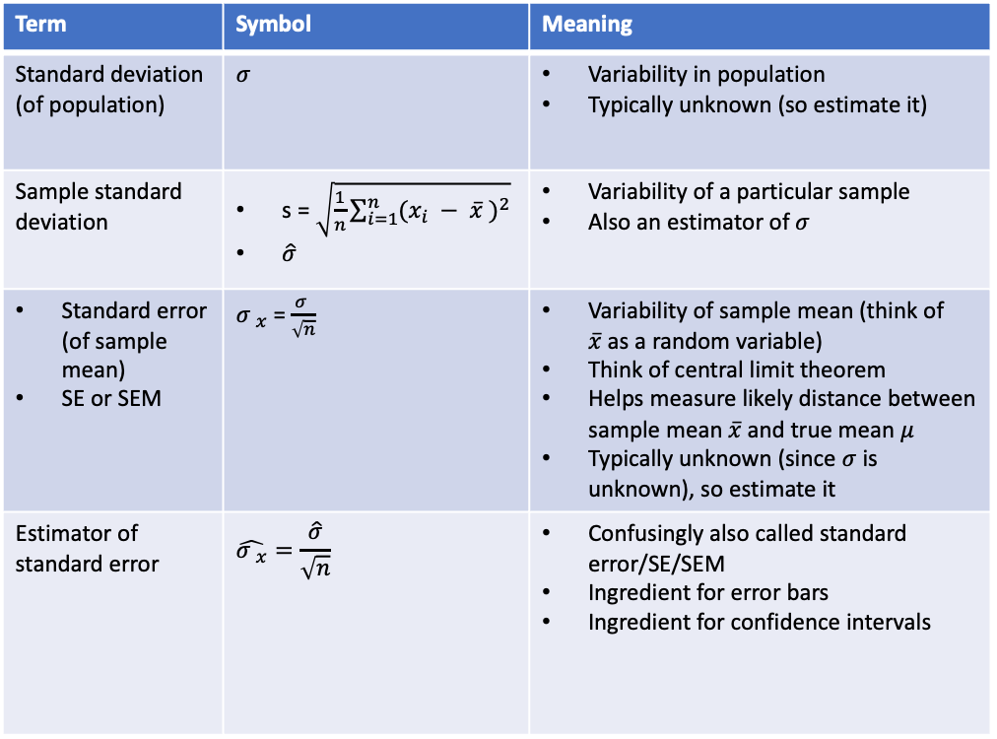
Standard deviation and standard error of the mean to measure uncertainty
Term | Symbol | Meaning
Standard deviation (of population) | $$σ$$ | Variability in population Typically unknown (so estimate it)
Sample standard deviation | s = $\sqrt{\frac{1}{n}\sum_{i=1}^{n}{{(x_{i} − \overline{x} )}^{2}}}$ $\hat{σ}$ | Variability of a particular sample Also an estimator of $σ$
Standard error (of sample mean) SE or SEM | ${σ }_{\overline{x}}$ = $\frac{σ }{\sqrt{n}}$ | Variability of sample mean (think of $\overline{x}$as a random variable) Think of central limit theorem Helps measure likely distance between sample mean $\overline{x}$and true mean $μ$ Typically unknown (since $σ$ is unknown), so estimate it
Estimator of standard error | $$\hat{{σ }_{\overline{x}}}=\frac{\hat{σ}}{\sqrt{n}}$$ | Confusingly also called standard error/SE/SEM Ingredient for error bars Ingredient for confidence intervals
Fundamentals of Data Visualization, Wilke, O’Reilly, 1st Ed.
Notes:
Error bars give a general idea of how precise a measurement is, or conversely, how far from the reported value the true (error free) value might be. If the value displayed on your barplot is the result of an aggregation (like the mean value of several data points), you may want to display error bars.
In the graphic above 5 groups are reported. The bar heights represent their mean value. The black error bar gives information on how the individual observations are dispersed around the average. For instance, it appears that measurements in group B are more precise than in group E.

Slide 7
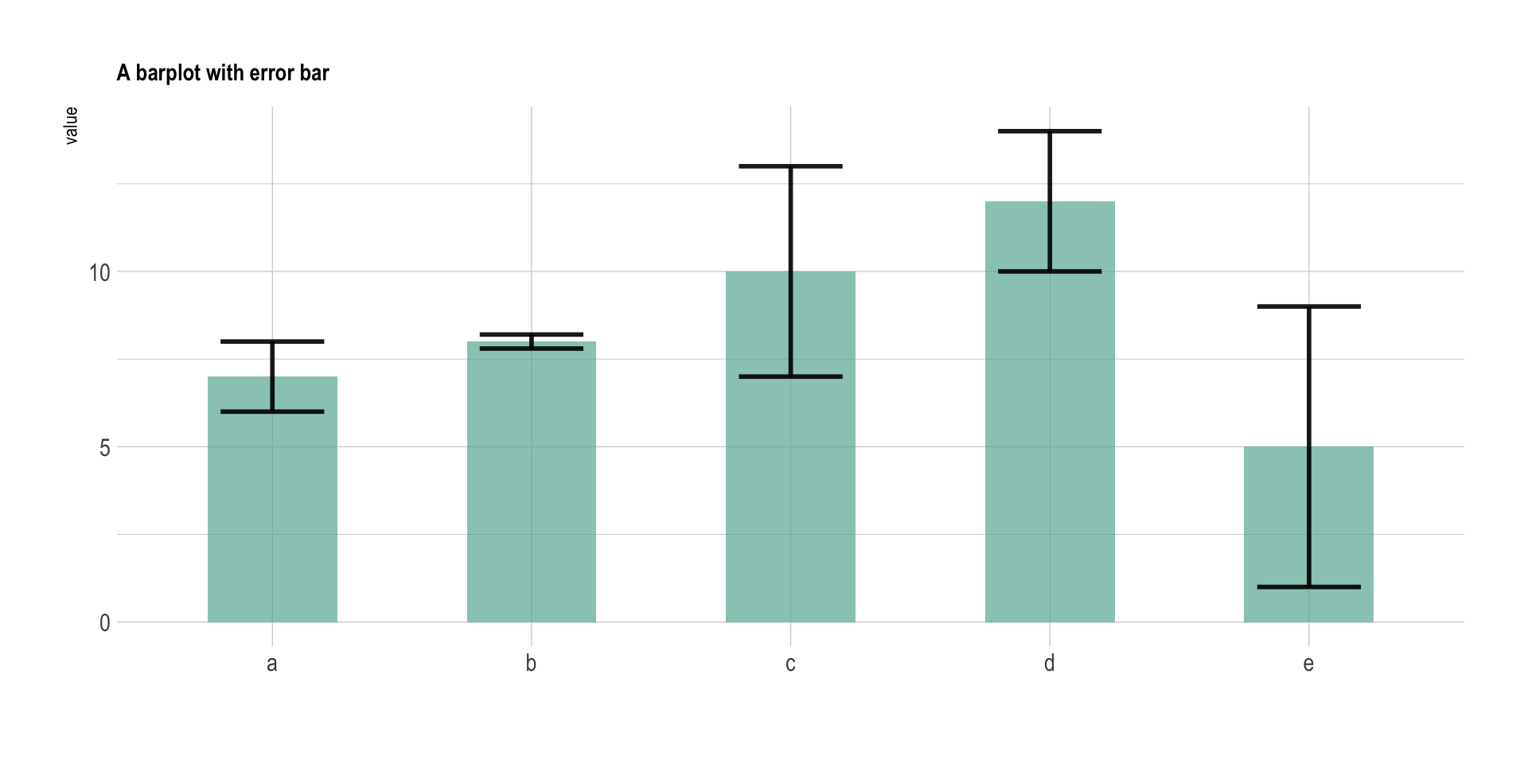
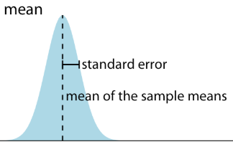
Error bars visualize uncertainty
Five samplings from five populations
Showing the sample distributions with confidence
Error bars usually are +/- SE (not always – could be a confidence interval)
Always define error bar!
https://www.data-to-viz.com/caveat/error_bar.html
Notes:
Error bars give a general idea of how precise a measurement is, or conversely, how far from the reported value the true (error free) value might be. If the value displayed on your barplot is the result of an aggregation (like the mean value of several data points), you may want to display error bars.
In the graphic above 5 groups are reported. The bar heights represent their mean value. The black error bar gives information on how the individual observations are dispersed around the average. For instance, it appears that measurements in group B are more precise than in group E.

Slide 8
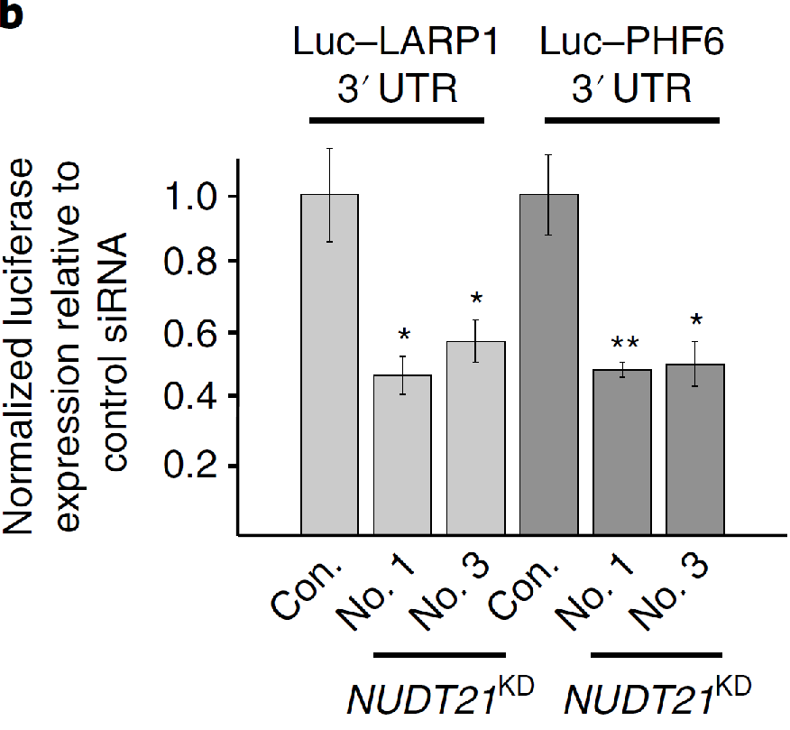
Show significance whenever possible
Different numbers of stars to represent significance of difference (usually from control)
Park et al. Nature Genetics, 2018
Notes:
There’s an error bar.
There’re stars.

Slide 9
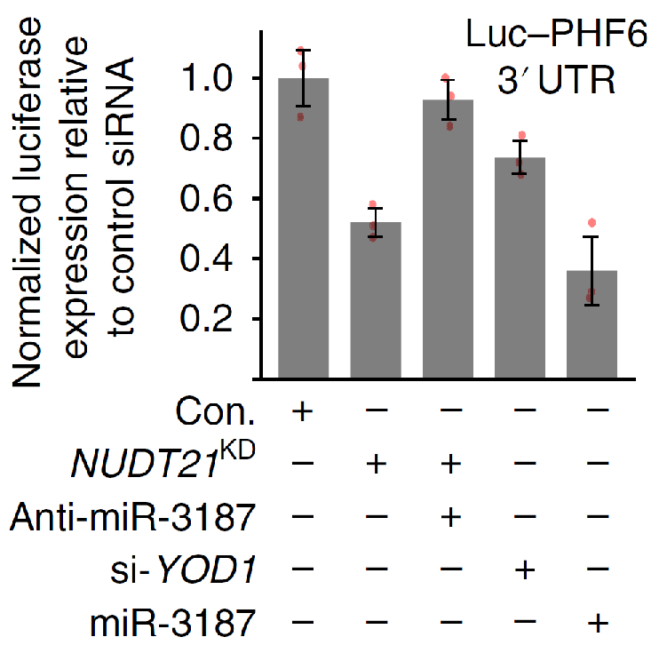
Show real data points whenever possible
Error bars to represent uncertainty
Stars to represent significance of difference (usually from control)
Dots to represent real values
X-axis label can be a table
Park et al. Nature Genetics, 2018
Notes:
With dots

Slide 10
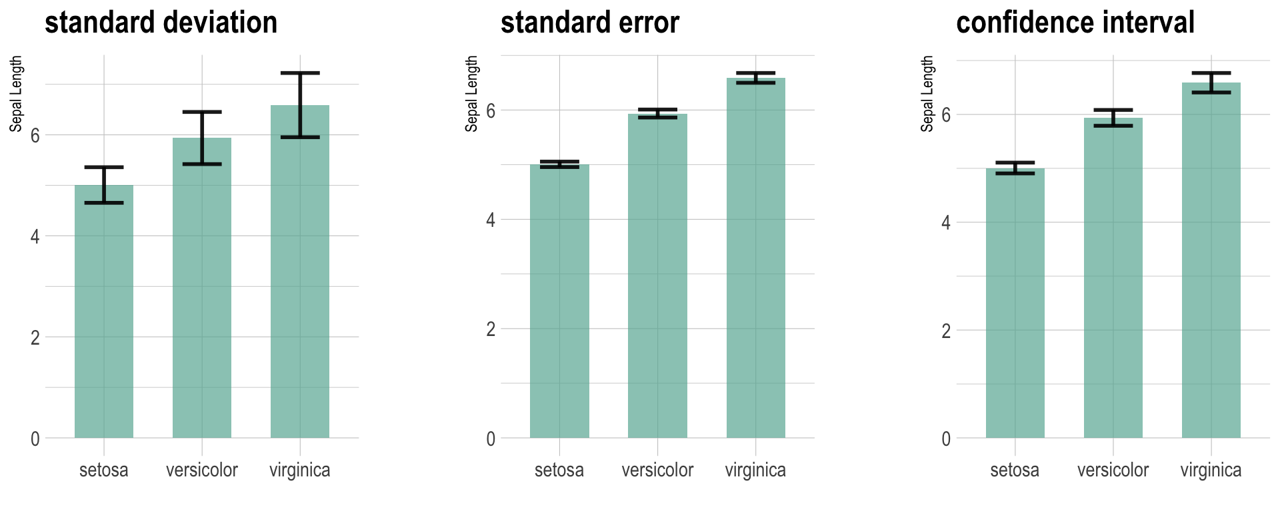
Error bars can indicate different types of variations
State clearly if yours is
Standard Deviation (SD): variability within a sample,
Standard Error (SE): variability across samples of a population, or
A confidence interval (CI): a range that a value is usually expected to lie in
Credible interval (Bayesian-flavored confidence interval)
https://www.data-to-viz.com/caveat/error_bar.html
Notes:
Frequentists most commonly visualize uncertainty with error bars. While error bars can be useful as a visualization of uncertainty, they are not without problems, as I already alluded to in Chapter 9 (see Figure 9.1). It is easy for readers to be confused about what an error bar represents.

Slide 11
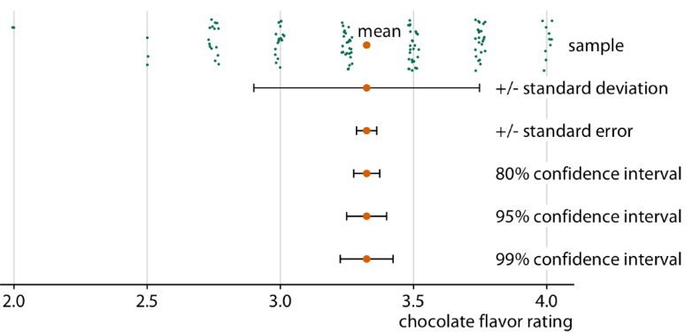
Visualizing uncertainty with error bars
Expert ratings of chocolate bars
Specify what quantity and/or confidence level the error bars represent
Fundamentals of Data Visualization, Wilke, O’Reilly, 1st Ed.
Notes:
To highlight this problem, in Figure 16.5 I show five different uses of error bars for the same dataset. The dataset contains expert ratings of chocolate bars, rated on a scale from 1 to 5, for chocolate bars manufactured in a number of different countries. For Figure 16.5 I have extracted all ratings for chocolate bars manufactured in Canada. Underneath the sample, which is shown as a strip chart of jittered dots, we see the sample mean plus/minus the standard deviation of the sample, the sample mean plus/minus the standard error, and 80%, 95%, and 99% confidence intervals. All five error bars are derived from the variation in the sample, and they are all mathematically related, but they have different meanings. And they are also visually quite distinct.

Slide 12
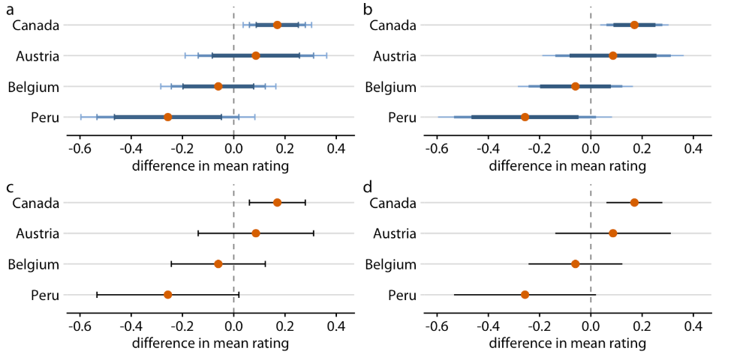
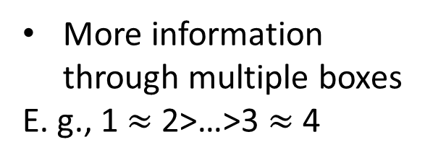
Various visualization styles for error bars
Mean chocolate flavor rating by country (vs. US chocolate rating)
More information through multiple boxes
E. g., 1 $≈$2>…>3 $≈$4
1
1
2
3
4
Fundamentals of Data Visualization, Wilke, O’Reilly, 1st Ed.
Notes:
In the preceding figures, I have used two different types of error bars, graded and simple. More variations are possible. For example, we can draw error bars with or without a cap at the end (Figure 16.9a, c versus Figure 16.9b, d). There are advantages and disadvantages to all these choices. Graded error bars highlight the existence of different ranges corresponding to different confidence levels. However, the flip side of this additional information is added visual noise. Depending on how complex and information-dense a figure is otherwise, simple error bars may be preferable to graded ones. Whether to draw error bars with or without cap is primarily a question of personal taste. A cap highlights where exactly an error bar ends (Figure 16.9a, c), whereas an error bar without cap puts equal emphasis on the entire range of the interval (Figure 16.9b, d). Also, again, caps add visual noise, so in a figure with many error bars omitting caps may be preferable.

Slide 13
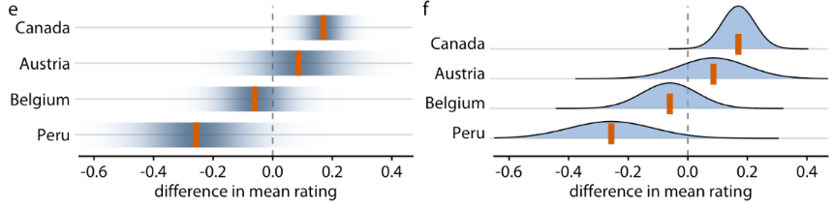
Various visualization styles for error bars
Mean chocolate flavor rating by country (vs. US chocolate rating)
1
2
Often, styles obstruct scientific communication
  Confidence strip, e.g. Is the mean rating of Peruvian chocolate significantly lower than that of the US?
  Ridgeline style
3
4
Fundamentals of Data Visualization, Wilke, O’Reilly, 1st Ed.
Notes:
As an alternative to error bars we could draw confidence strips that gradually fade into nothing (Figure 16.9e). Confidence strips better convey how probable different values are, but they are difficult to read. We would have to visually integrate the different shadings of color to determine where a specific confidence level ends. From Figure 16.9e we might conclude that the mean rating for Peruvian chocolate bars is significantly lower than that of U.S. chocolate bars, and yet this is not the case. Similar problems arise when we show explicit confidence distributions (Figure 16.9f). It is difficult to visually integrate the area under the curve and to determine where exactly a given confidence level is reached. This issue can be somewhat alleviated, however, by drawing quantile dotplots as in Figure 16.3.

Slide 14
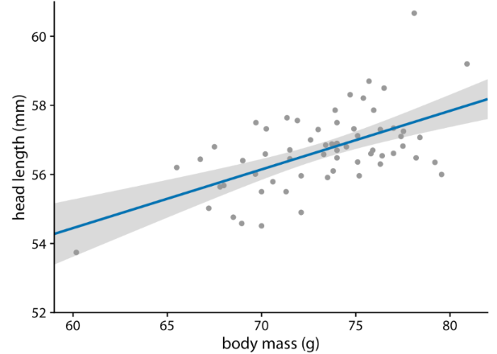
Confidence band to show uncertainty of a linear model
Head length versus body mass for male blue jays
Trend in a real line and the uncertainty in a trend line with a confidence band
Need to be very clear about what quantity the uncertainty is in
Fundamentals of Data Visualization, Wilke, O’Reilly, 1st Ed.
Notes:
we discussed how to show a trend in a dataset by fitting a straight line or curve to the data. These trend estimates also have uncertainty, and it is customary to show the uncertainty in a trend line with a confidence band (Figure 16.15). The confidence band provides us with a range of different fit lines that would be compatible with the data.

Slide 15
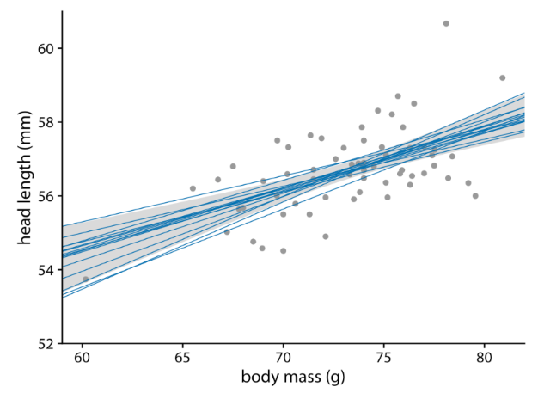
Confidence band to show uncertainty of a linear model
Head length versus body mass for male blue jays
Different intercepts and slopes of line fits create the curvature
15 randomly chosen alternative fits from the confidence band
Fundamentals of Data Visualization, Wilke, O’Reilly, 1st Ed.
Notes:
The reason for the curvature is that the straight line fit can move in two distinct directions: it can move up and down (i.e., have different interepts), and it can rotate (i.e., have different slopes). We can visually show how the confidence band arises by drawing a set of alternative fit lines randomly generated from the posterior distribution of the fit parameters. This is done in Figure 16.16, which shows 15 randomly chosen alternative fits. We see that even though each line is perfectly straight, the combination of different slopes and intercepts of each line generates an overall shape that looks just like the confidence band.

Slide 16
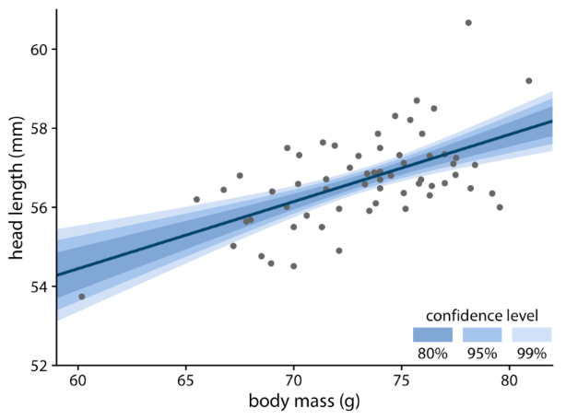
Confidence band to show uncertainty of a linear model
Head length versus body mass for male blue jays
A graded confidence band
Highlights different levels of confidence
Not only to show the distribution across the confidence levels
Enhances the sense of uncertainty in the reader, and
Forces the reader to confront the possibility that the data might support different alternative trend lines
Fundamentals of Data Visualization, Wilke, O’Reilly, 1st Ed.
Notes:
To draw a confidence band, we need to specify a confidence level, and just as we saw for error bars and posterior probabilities, it can be useful to highlight different levels of confidence. This leads us to the graded confidence band, which shows several confidence levels at once (Figure 16.17). A graded confidence band enhances the sense of uncertainty in the reader, and it forces the reader to confront the possibility that the data might support different alternative trend lines.

Slide 17
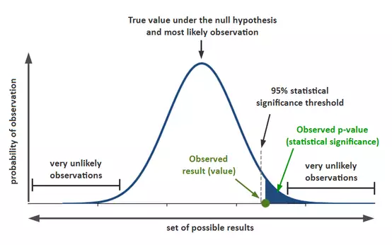
P-value to represent (un)certainty of a hypothesis
P-value
The probability of obtaining the observation (or something more extreme) under the null hypothesis or null distribution
The lower, the more certain to reject null hypothesis and to accept alternative hypothesis
https://www.simplypsychology.org/p-value.html

Slide 18
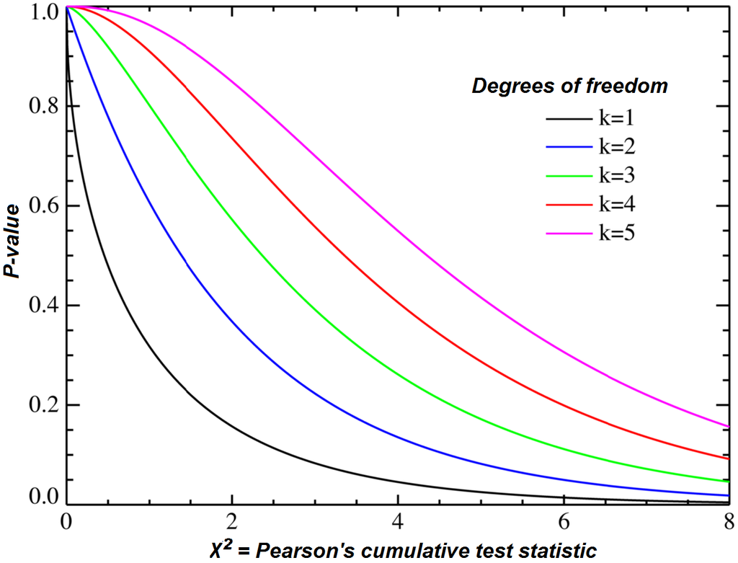
P-value to represent (un)certainty of a hypothesis
Now consider testing many similar hypotheses
Null hypothesis: the number of tumor suppressors and oncogenes in each group, adding up to 40, is balanced
Can use chi-square with df=1
Imagine we test this across many gene groups (several thousand)
 | # tumor suppressors | # oncogenes | P-value
Expected number | 20 | 20 | NA
Gene group 1 | 9 | 31 | ..
Gene group 2 | 21 | 19 | ..
… | … | … | …
https://en.wikipedia.org/wiki/Chi-squared_distribution

Slide 19
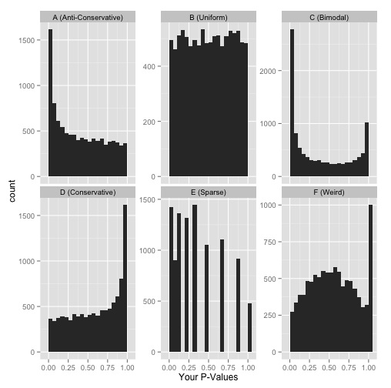
How to interpret P-value distribution?
If we have many gene groups to test, we will have many p values, one for each gene group
The distribution of the p values provides insights to your experimental design
http://varianceexplained.org/statistics/interpreting-pvalue-histogram/
Notes:
Here are six approximate versions of what your histogram might look like.
The first one has a many number of hypotheses estimated to be significant.
We’ll explore what each one means in turn.

Slide 20
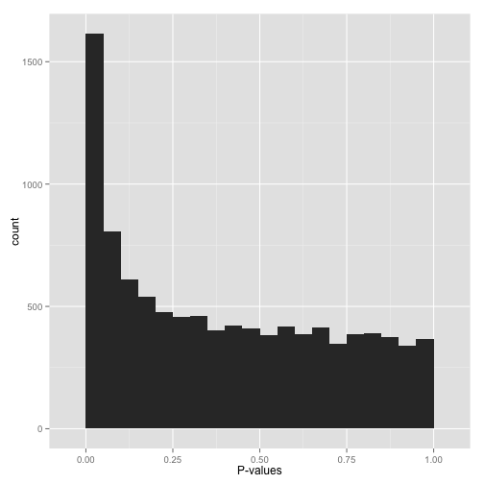
Anti-conservative p-values (“Hooray!”)
Example:
  ~1,700 hypotheses (tests or gene groups) with p-value < 0.05
  ~780 hypotheses with p-value b/w 0.05 and 0.1
One may think that all ~1,700 hypotheses under p-value < 0.05 are truly unbalanced gene groups (true positives), but not all of them are.
http://varianceexplained.org/statistics/interpreting-pvalue-histogram/
Notes:
If your p-values look something like this:then it’s your lucky day! You have (on the surface) a set of well-behaved p-values.
That flat distribution along the bottom is all your null p-values, which are uniformly distributed between 0 and 1. Why are null p-values uniformly distributed? Because that’s part of a definition of a p-value: under the null, it has a 5% chance of being less than .05, a 10% chance of being less than .1, etc. This describes a uniform distribution.
That peak close to 0 is where your alternative hypotheses live- along with some potential false positives. If we split this up into nulls and alternatives, it might look like this:

Slide 21
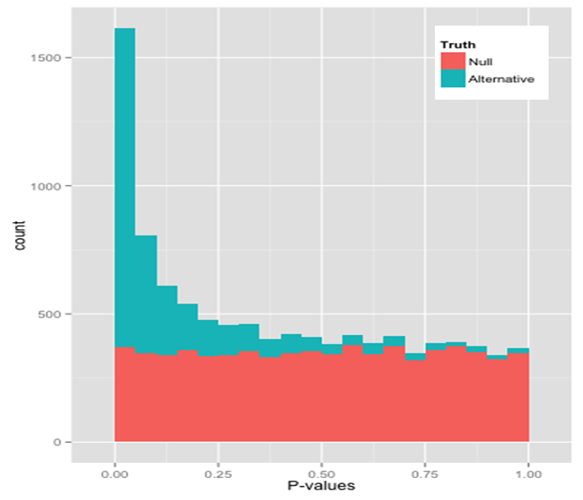
Anti-conservative p-values (“Hooray!”)
1,700 gene groups with p-value < 0.05 consist of
unbalanced gene groups (true positives)
balanced gene groups (false positives)
Because p-values are distributed uniformly under H₀ (and the null is usually true)
http://varianceexplained.org/statistics/interpreting-pvalue-histogram/
Notes:
Notice that there are plenty of null hypotheses that appear at low p-values, so you can’t just say “call all p-values less than .05 significant” without thinking, or you’ll get lots of false discoveries. Notice also that some alternative hypotheses end up with high p-values: those are the hypotheses you won’t be able to detect with your test (false negatives). The job of any multiple hypothesis test correction is to figure out where best to place the cutoff for significance.

Slide 22
Anti-conservative p-values (“Hooray!”)
Some positives are not identifiable to your test (all the blue rectangles to the right of p=0.05).
http://varianceexplained.org/statistics/interpreting-pvalue-histogram/
Notes:
Notice that there are plenty of null hypotheses that appear at low p-values, so you can’t just say “call all p-values less than .05 significant” without thinking, or you’ll get lots of false discoveries. Notice also that some alternative hypotheses end up with high p-values: those are the hypotheses you won’t be able to detect with your test (false negatives). The job of any multiple hypothesis test correction is to figure out where best to place the cutoff for significance.

Slide 23
Anti-conservative p-values (“Hooray!”)
Consider the significance thresholds:
< 0.1 (gray dotted line) and
< 0.05 (black dotted line)
What would you pick if you want to
to increase the number of true positives
vs.
to increase the ratio of true positives
Let’s not consider multiple testing issue
http://varianceexplained.org/statistics/interpreting-pvalue-histogram/
Notes:
Notice that there are plenty of null hypotheses that appear at low p-values, so you can’t just say “call all p-values less than .05 significant” without thinking, or you’ll get lots of false discoveries. Notice also that some alternative hypotheses end up with high p-values: those are the hypotheses you won’t be able to detect with your test (false negatives). The job of any multiple hypothesis test correction is to figure out where best to place the cutoff for significance.

Slide 24
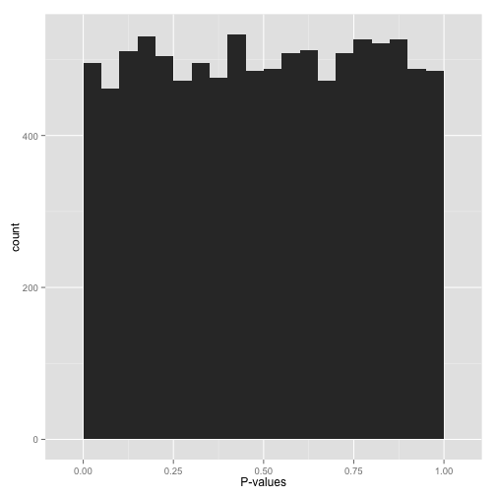
Uniform p-values (“Awww…”)
P ~ U(0,1) under null
The picture is consistent with an appropriate model, where H₀ is generally false
There could be some very significant p-values in the first bin (there just are not a whole lot of significant gene groups)
http://varianceexplained.org/statistics/interpreting-pvalue-histogram/
Notes:
Alternatively, you might see a flat distribution (what statisticians call a “uniform” distribution):
This is what your p-values would look like if all your hypotheses were null. Now, seeing this does not mean they actually are all null! It does mean that
At most a small percentage of hypotheses are non-null. An FDR correction method such as Benjamini-Hochberg will let you identify those.
Applying an uncorrected rule like “Accept everything with p-value less than .05” is certain to give you many false discoveries. Don’t do it!

Slide 25
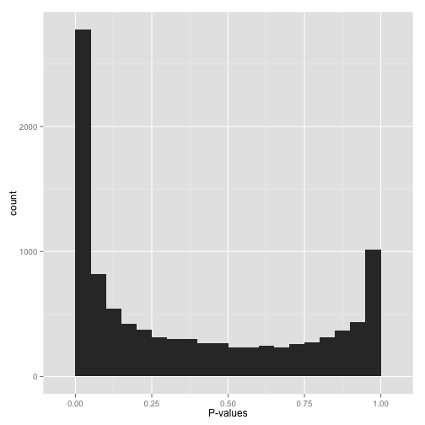
Bimodal p-values (“Hmmm…”)
Don’t proceed just yet (why?)
Possible reasons:
  A wrong handling of exceptions in the hypothesis testing (e. g., your method may throw p-value 1 for undefined cases)?
  Did you use a two-tailed test when it should’ve been one-tailed?
http://varianceexplained.org/statistics/interpreting-pvalue-histogram/
Notes:
So you have a peak at 0, just like you saw in (A)… but you also have a peak close to 1. What do you do?
Don’t apply false discovery rate control to these p-values yet. (Why not? Because some kinds of FDR control are based on the assumption that your p-values near 1 are uniform. If you break this assumption, you’ll get way fewer significant hypotheses. Everyone loses).
Instead, figure out why your p-values show this behavior, and solve it appropriately:
Are you applying a one-tailed test (for example, testing whether each gene increased its expression in response to a drug)? If so, those p-values close to 1 are cases that are significant in the opposite direction (cases where genes decreased their expression). If you want your test to find these cases, switch to a two-sided test. If you don’t want to include them at all, you can try filtering out all cases where your estimate is in that direction.
Do all the p-values close to 1 belong to some pathological case? An example from my own field: RNA-Seq data, which consists of read counts per gene in each a variety of conditions, will sometimes include genes for which there are no reads in any condition. Some differential expression software will report a p-value of 1 for these genes. If you can find problematic cases like these, just filter them out beforehand (it’s not like you’re losing any information!)

Slide 26
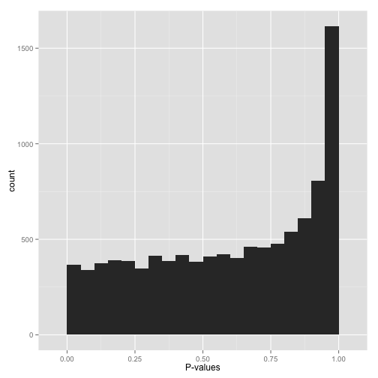
Conservative p-values (“Whoops…”)
Don’t just assume nothing is significant!
May signify that your test
  Assumes a wrong distribution/model mis-specfication
    Designed for normally-distributed data but your data is not?
    Designed for continuous data but your data are discrete?
  Already multiple testing corrected?
http://varianceexplained.org/statistics/interpreting-pvalue-histogram/
Notes:
Do not look at this distribution and say, “Oh, I guess I don’t have any significant hypotheses.” If you had no significant hypotheses, your p-values would look something like (B) above. P-values are specifically designed so that they are uniform under the null hypothesis.
A graph like this indicates something is wrong with your test. Perhaps your test assumes that the data fits some distribution that it doesn’t fit. Perhaps it’s designed for continuous data while your data is discrete, or perhaps it is designed for normally-distributed data and your data is severely non-normal. In any case, this is a great time to find a friendly statistician to help you.
(Update 12/17/14: Rogier in the comments helpfully notes another possible explanation: your p-values may have already been corrected for multiple testing, for example using the Bonferroni correction. If so, you might want to get your hands on the original, uncorrected p-values so you can view the histogram yourself and confirm it’s well behaved!)

Slide 27
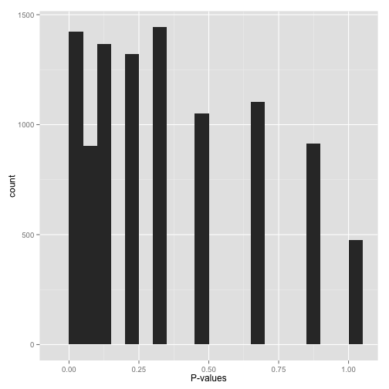
Sparse p-values (“Hold on…”)
Don’t proceed just yet
Only a small number of distinct p-values
Did you run
  A bootstrap or permutation with too few iterations?
  Non-parametric test (e. g., the Wilcoxon rank-sum test or Spearman correlation) on a small sample size data?
http://varianceexplained.org/statistics/interpreting-pvalue-histogram/
Notes:
Sparse p-values are easy to recognize by those big gaps in the histogram. What this means is that while you may have (say) 10,000 hypotheses, they generated only a small number of distinct p-values. You can find out just how many distinct p-values your test generated with this line of R code:
length(unique(mypvalues))
Why did you get p-values like this? Did you:
Run a bootstrap or permutation test with too few iterations? Try increasing the number of iterations.
Run a nonparametric test (e.g. the Wilcoxon rank-sum test or Spearman correlation) on data with a small sample size? If you can, either get more data or switch to a parametric test.
Don’t run false discovery rate control, which typically makes the assumption that the p-value distribution is (roughly) continuous. If you absolutely need to use these p-values (and can’t switch to a test that doesn’t give you such sparse p-values), find a statistician!

Slide 28
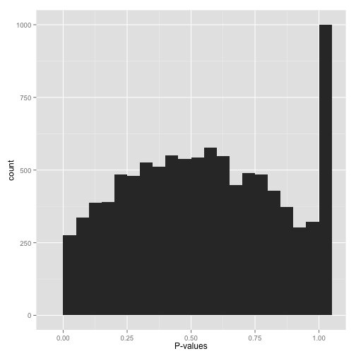
Something even weirder (“What the…?!?”)
Stop whatever you’re doing and find a statistician
http://varianceexplained.org/statistics/interpreting-pvalue-histogram/
Notes:
Big bump in the middle? Bunch of random peaks? Something that looks like nothing from this post?
Stop whatever you’re doing, and find a statistician. There may be a simple explanation and/or fix, but you want to make sure you’ve found it before you work with these p-values any more.
In closing: this post isn’t a replacement for having a qualified statistician look over your data. But just by glancing at this simple visualization, you can tell a lot about how your test performed across your hypotheses- and you’ll be a lot closer to knowing what to do with them.

Slide 29
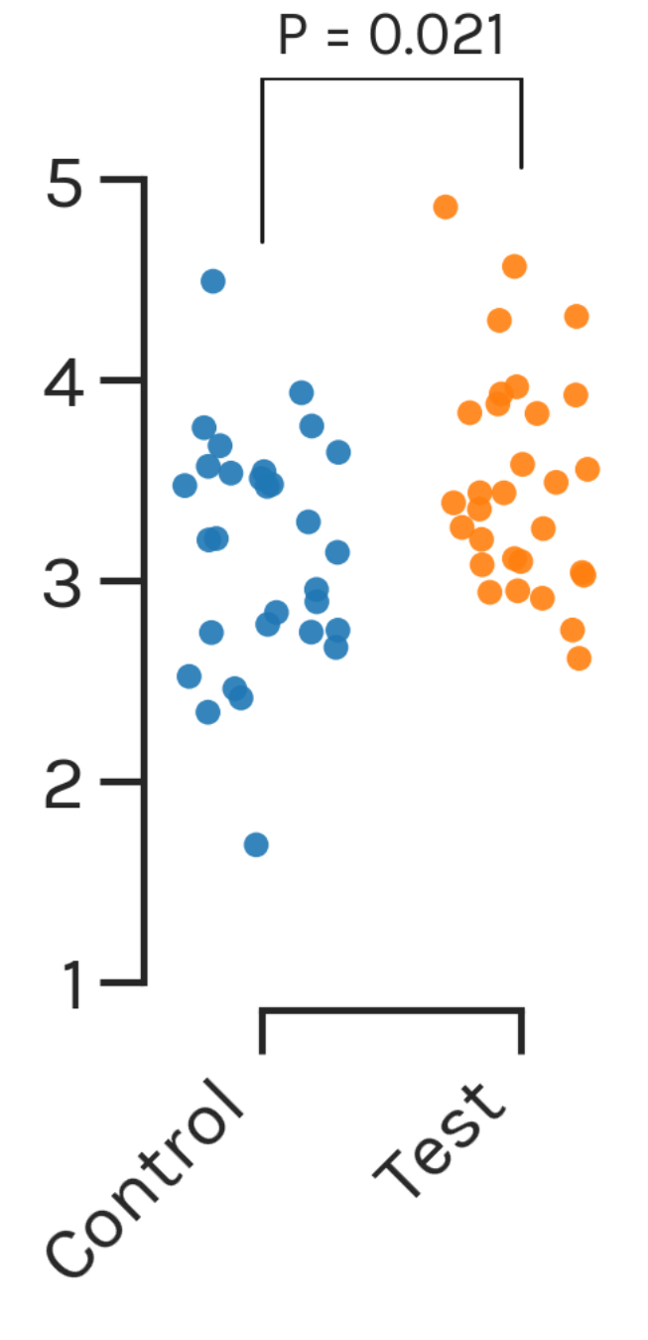
Recent criticism on significance testing (p-value)
Let's say an experiment with 30 control subjects, and 30 test subjects
Observed values shown
Underlying distribution not shown
Effect size (the mean difference in the observed samples) not shown
Confidence and likelihood of effect size not shown
Ho et al. Nature Methods, 2019
Notes:
Signfiicance testing is one way of estimating their mean difference. This way is represented with jittered dots.

Slide 30
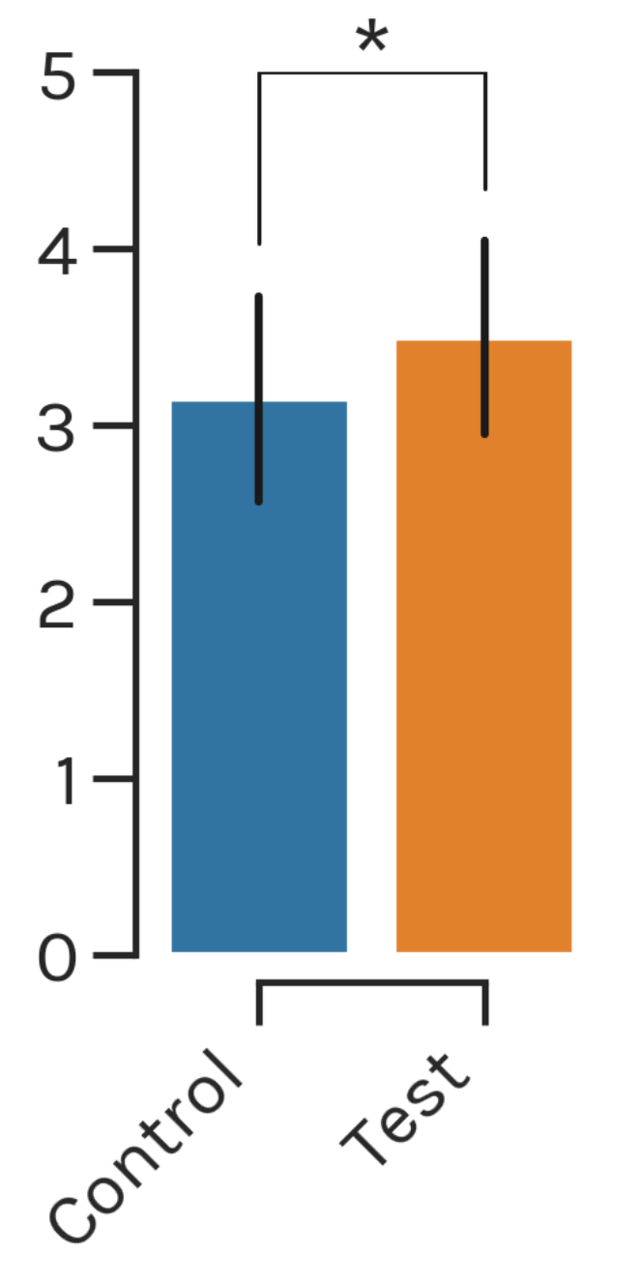
Recent criticism on significance testing (p-value)
Let's say an experiment has 30 control subjects, and 30 test subjects
Observed values not shown
Underlying distribution not shown
Effect size not shown
Confidence and likelihood of effect size not shown
Ho et al. Nature Methods, 2019
Notes:
With dots

Slide 31
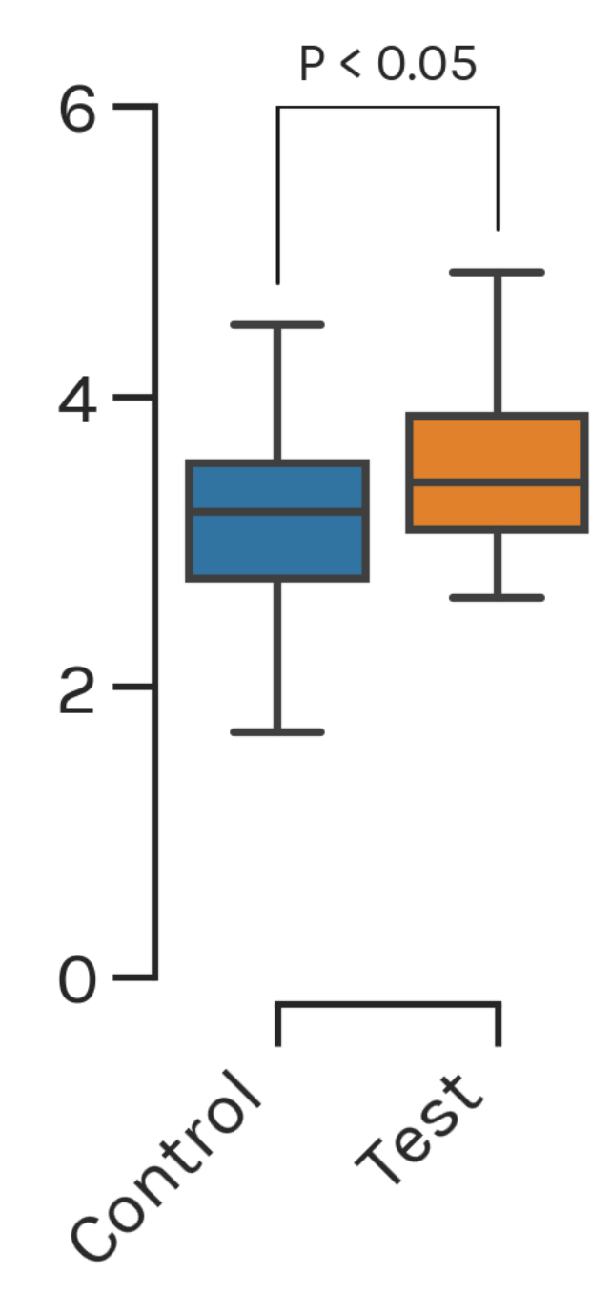
Recent criticism on significance testing (p-value)
Let's say an experiment has 30 control subjects, and 30 test subjects
Medians, quartiles, minima, and maxima shown
Observed values not shown
Effect size not shown
Confidence and likelihood of effect size not shown
Ho et al. Nature Methods, 2019
Notes:
With dots

Slide 32
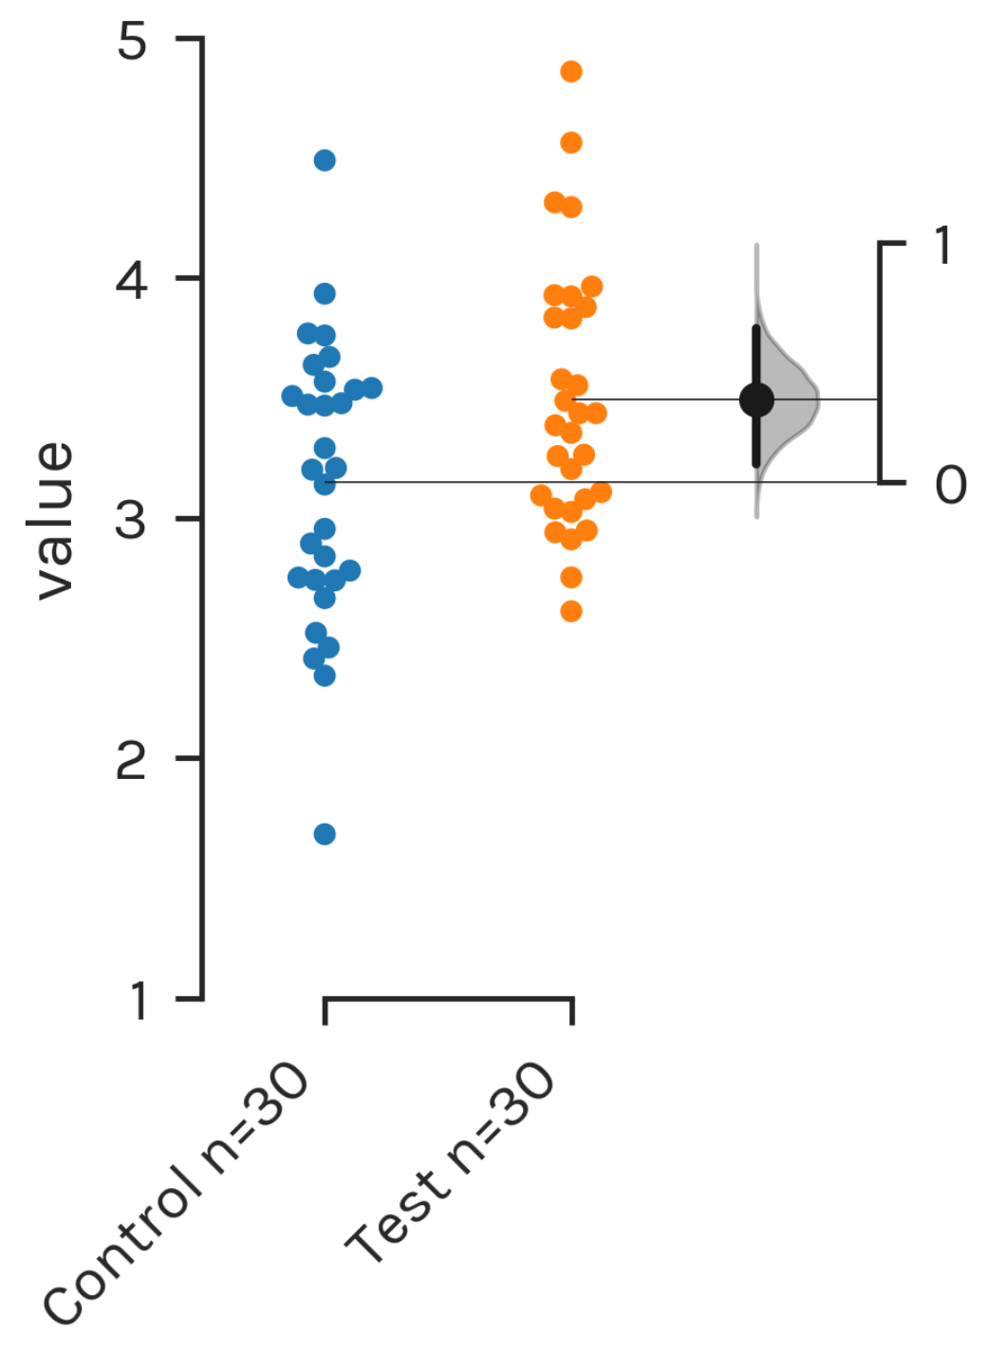
Introducing estimation statistics
Let's say an experiment has 30 control subjects, and 30 test subjects
Data points in swarm plot
Effect size on a separate but aligned axes as a bootstrap 95% confidence interval (CI)
Ho et al. Nature Methods, 2019
Notes:
With dots
Precision of effect size, I think, has something to do with the shape of the bootstrap distribution.

Slide 33
Introducing estimation statistics
Let's say an experiment has 30 control subjects, and 30 test subjects
Observed values shown
Effect size shown in the curve
Precision of effect size shown
Confidence and likelihood of effect size shown
Ho et al. Nature Methods, 2019
Notes:
With dots
Precision of effect size, I think, has something to do with the shape of the bootstrap distribution.

Slide 34
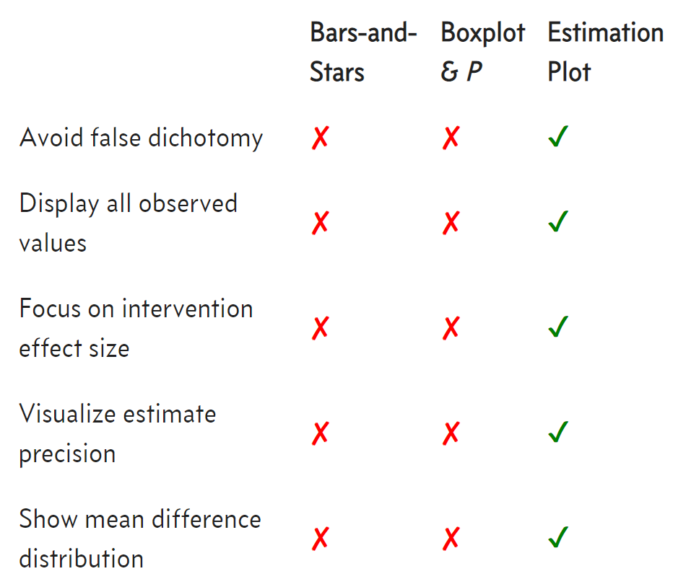
Estimation plot vs. barchart or boxplot (P-value based)
Ho et al. Nature Methods, 2019
Notes:
Can you read this?

