Slide 1
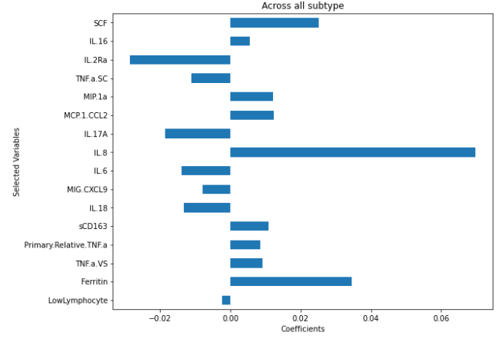
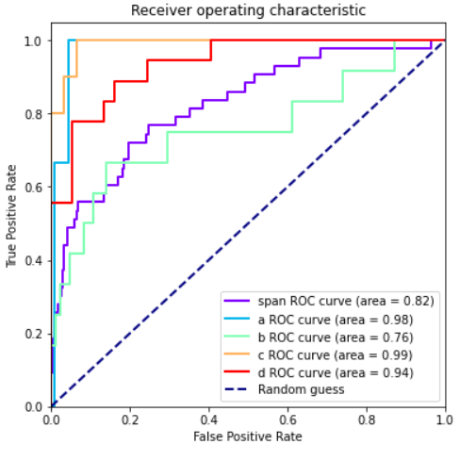
Visualizing regression (if there are lots of variables, or if there is a binary outcome)
Regression analysis is predictive, so visualization can focus on prediction performance
Effect size
Prediction performance

Slide 2
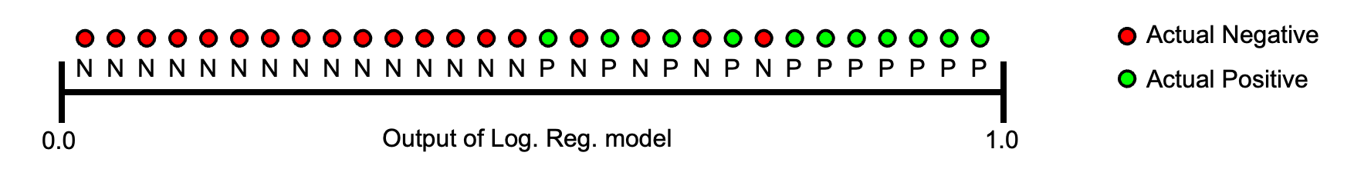
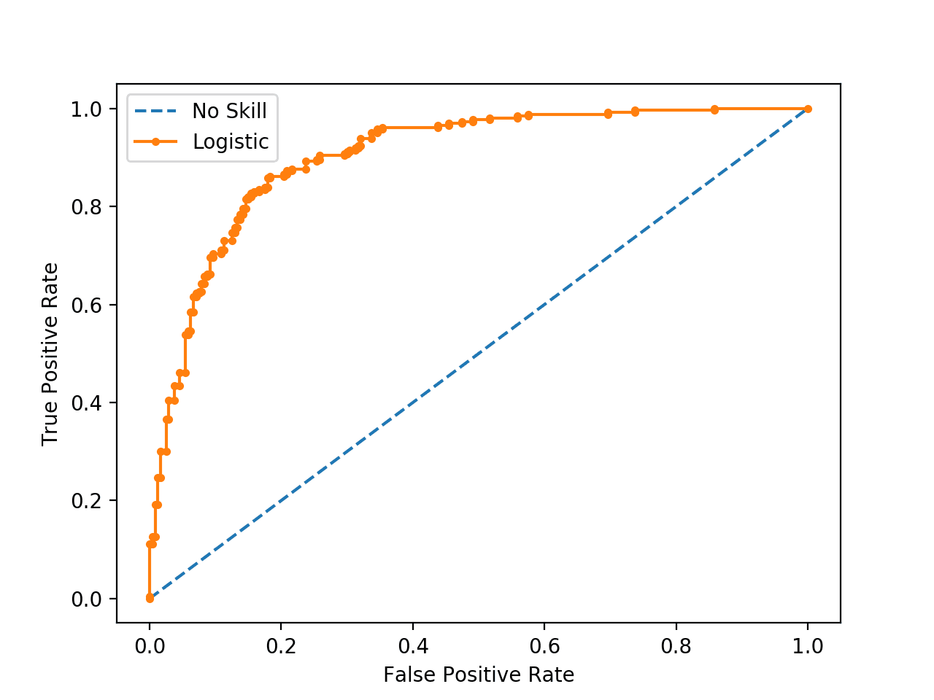
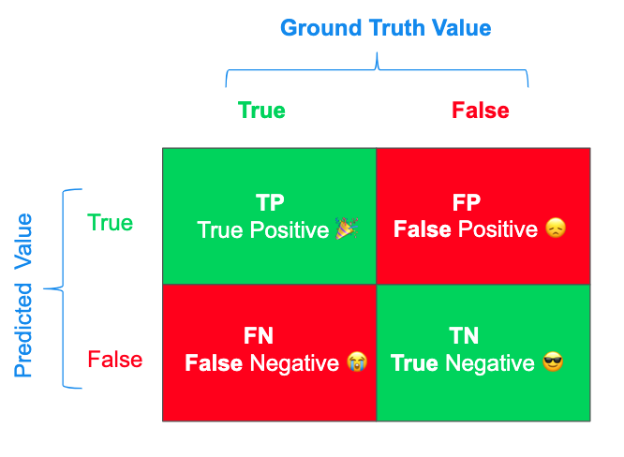
Digression on visualizing classifier results
Receiver operating characteristic (ROC)
The relationship between false positive rate and true positive rate as in a model
One possible threshold
= sensitivity
https://blog.floydhub.com/a-pirates-guide-to-accuracy-precision-recall-and-other-scores/
= 1 - specificity

Slide 3
Digression on visualizing classifier results
Diagonal line = random guessing (with different probabilities)
The perfect model would have 0 FTP and 1 TPR no matter what.
https://blog.floydhub.com/a-pirates-guide-to-accuracy-precision-recall-and-other-scores/

