Slide 1
Corporate Finance
Uncertainty, Default, & Risk
Fall 2026
Prof. Jeffrey Colón

Slide 2
Uncertainty, Default, & Risk
Same
  No differences in opinion
  No taxes
  No transaction costs.
  No big sellers/buyers
Different
  Project cash flows are not certain
    Cash flows to be discounted are the expected cash flows
    Distinction between promised (quoted or stated) returns and expected returns

Slide 3
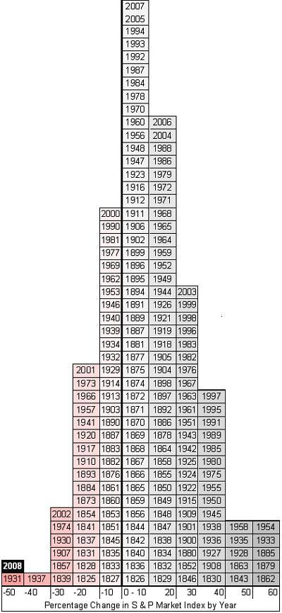
Risk: Percentage Change in SP500 by Year
16
15
11
26
25
20
14
12
10
18
24
23
21
17
09
22
19
13

Slide 4
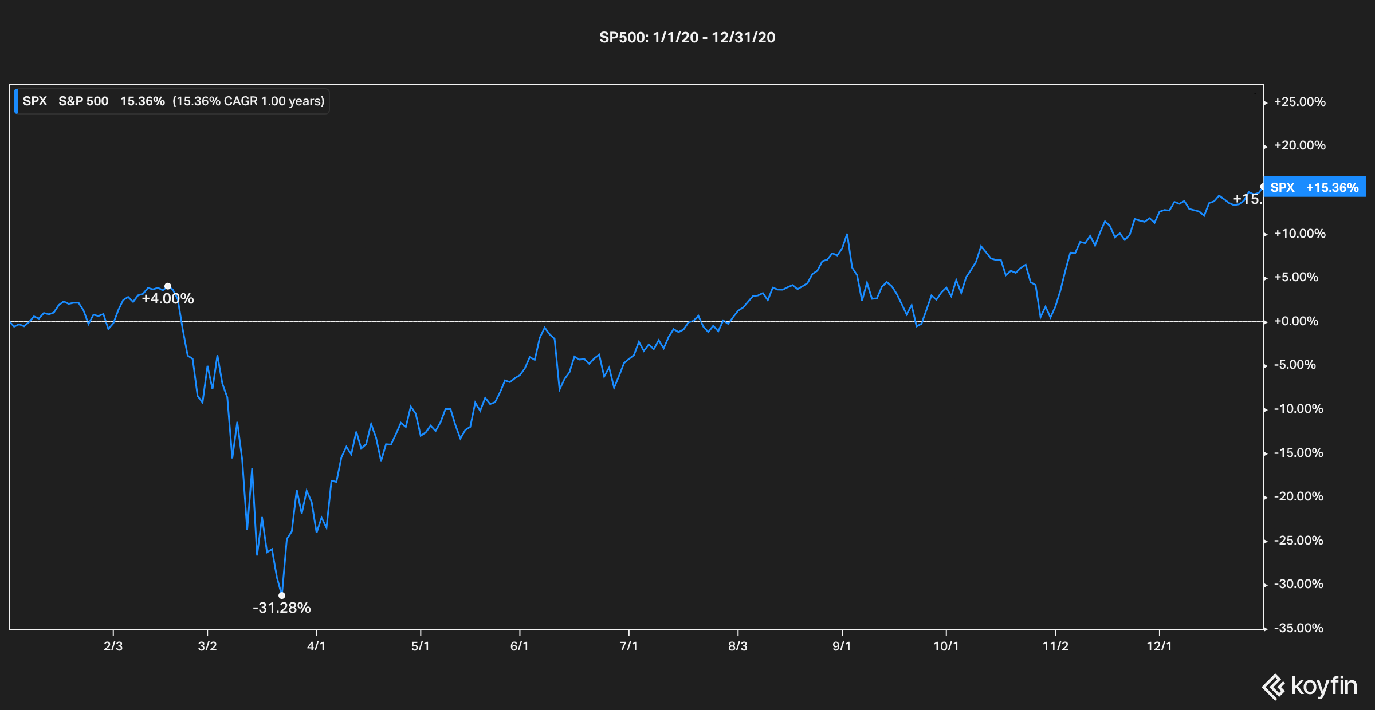
Annual returns can obscure useful information

Slide 5
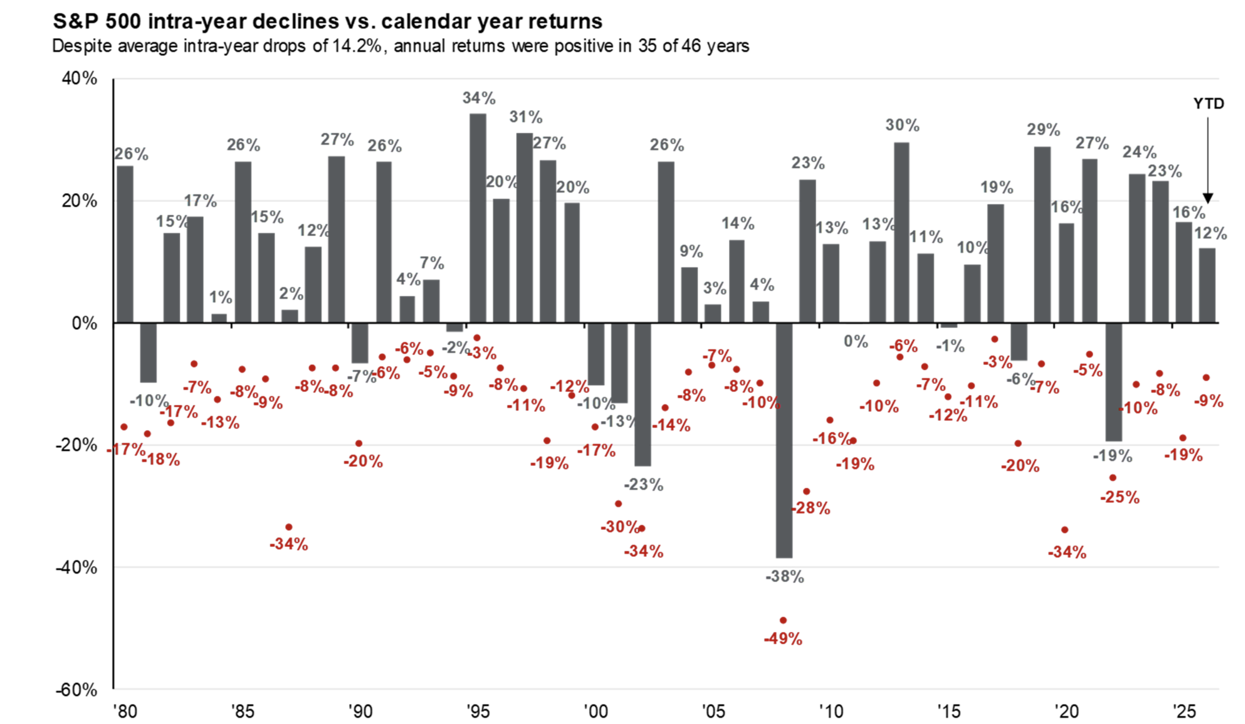
Annual returns can obscure useful information
Source: JPM; as of June 2026

Slide 6


Random Variables
Random variable:
Examples: Cash flows and Returns

Slide 7
Expectation of a Random Variable
Expectation of a RV:
Examples:
  You throw a die. What’s the expected value?
  You throw a pair of dice and add the two faces. What’s the expected value?

Slide 8
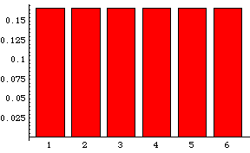
Probability Distribution: Single Die
Probability
Outcomes
EV= 3.5 = 1/6*1 + 1/6*2…+1/6*6

Slide 9
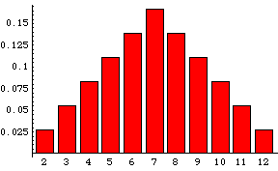
Probability Distribution: Sum of 2 Dice
Probability
Outcomes
EV=7

Slide 10
Risk
Probability weighted dispersion of returns around the expected return
Variance:
  Find ,
  Subtract each return from and square the result.
  Multiply each value by its probability, and
  Add
Standard Deviation:

Slide 11
Risk: Example
What are the Var and SD of the throw of dice?
  Var:
  SD:
Units of SD same as the units of the underlying variable:
  SD of annual returns--> %
  Var of annual returns--> %²
probability
mean
outcome

Slide 12
SDs and the Normal Distribution
A large enough sample drawn from a normal distribution looks like a bell-shaped curve.
The probability that a yearly return will fall within 20.1 percent of the mean of 13.3 percent will be approximately 2/3.
Probability
– 3s
– 49.3%
– 2s
– 28.8%
– 1s
– 8.3%
0
12.2%
+ 1s
32.7%
+ 2s
53.2%
+ 3s
73.7%
Return on
large company common
stocks
68.26%
95.44%
99.74%

Slide 13
Risk Adverse, Risk Neutral, and Risk Lover
Fair bet: Cost = E(value)
Risk Averse:
  rejects fair bets;
  pays premium (more than expected value) for insurance
  is indifferent about fair bets (will write or take)
  Evaluates outcomes solely on the basis of expected value and not risk
  does not pay a premium for insurance
Risk Lover:
  accepts all fair (and some unfair) bets;
  never purchases insurance
Market vs. Personal Risk Aversion
Risk Neutral

Slide 14

Debt Risk Factors
Interest Rate
Reinvestment Risk
Inflation Risk
Credit (Default) Risk
Liquidity
Contract Risk, e.g., Redemption (Call) Risk
Exchange (FX) Risk

Slide 15
Credit Risk: Example
A bank is considering a loan of $1M to a customer. The r_{f} is 5% and the default risk is 50%, in which case the bank will recover $750,000.
If the bank charges r_{f}, calculate its E(ROR) on the loan?
Assume that the bank is risk neutral. How much does it have to charge on the loan to expect to earn the r_{f}?

Slide 16
Credit Risk: Example
Default/Credit Premium = 30%
Promised/Quoted/Stated Interest = 35%
Time Premium = 5%

Slide 17
Default Premiums in a Risk Neutral World
Promised/Quoted Rate of Return =
  Time Premium + Default/Credit Premium
Expected Rate of Return [E(r)] =
  E(Time Premium) + E(Default Premium)
  E(Time Premium) + 0
  From prior example: (.5)*(35%-5%) + (.5)(-25%-5%) = 0
    The E(DefaultPremium) is the expected difference between expected outcomes ( + or - ) and the time premium
In risk neutral world, all investments are expected to earn the risk-free rate
Actual Earned (Realized) Rate = Time Premium + Default Realization

Slide 18
Corporate Bond Ratings
What is rated:
  The likelihood that the firm will default.
  The protection afforded by the loan contract in the event of default.
Who pays for ratings:
  Issuers pay to have their bonds rated.
  The ratings are constructed from the financial statements supplied by the firm.
  Subscriptions
Ratings can change. See, e.g., ratings of CDOs, subprime MBS
Raters can disagree.
Personal: annualcreditreport.com

Slide 19
Corporate Bond Ratings
Credit Rating Agencies (NRSROs)
  Federal securities law (mutual funds), financial legislation, state legislation with respect to insurance companies, some foreign legislation, and private contracts
Credit Rating Agency Reform Act of 2006 (§15E of the Exchange Act)
  Analysts level conflicts
  Rating level conflicts
  Expanded record keeping requirements
  Disclosure of performance statistics
    Transition and default rates
    10% Rating Sample
    Disclosure of all ratings for all sectors
Dodd-Frank Act, Title IX, Subsection C
SEC Office of Credit Ratings

Slide 20
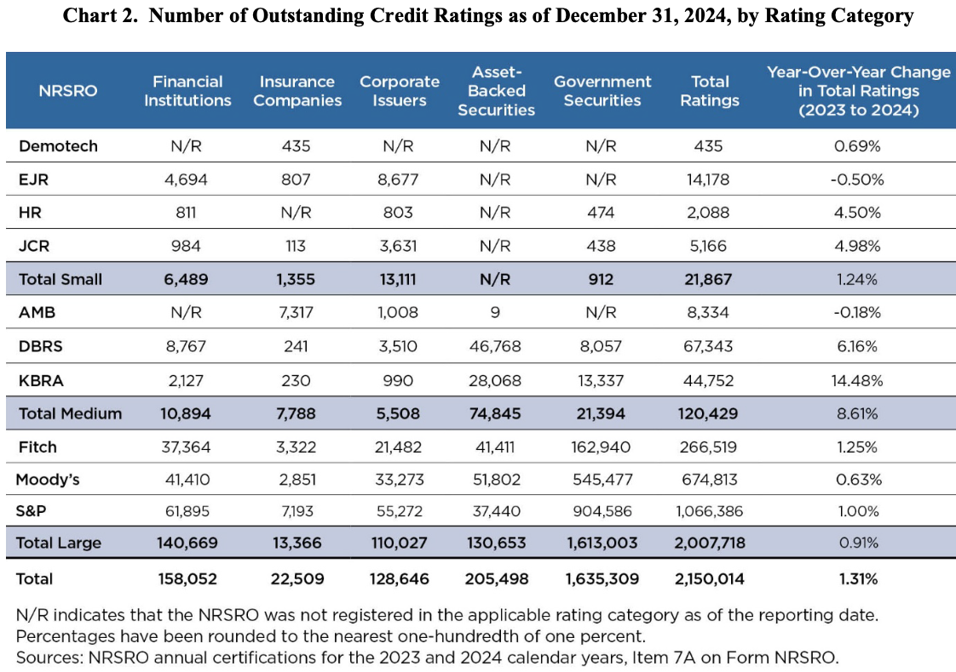
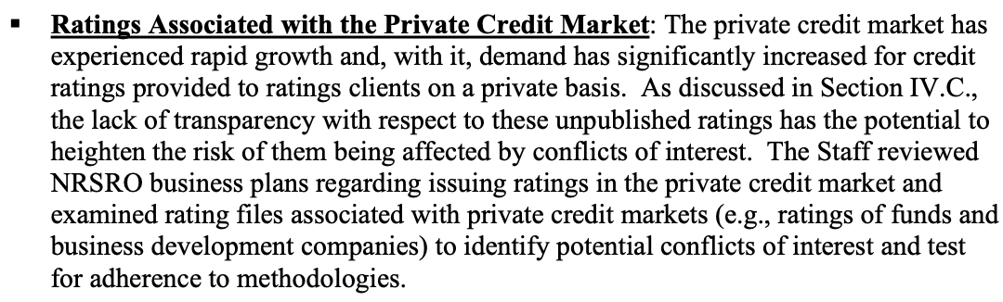
Outstanding Credit Ratings
SEC, Annual Report on NRSRO (Apr ‘25)

Slide 21
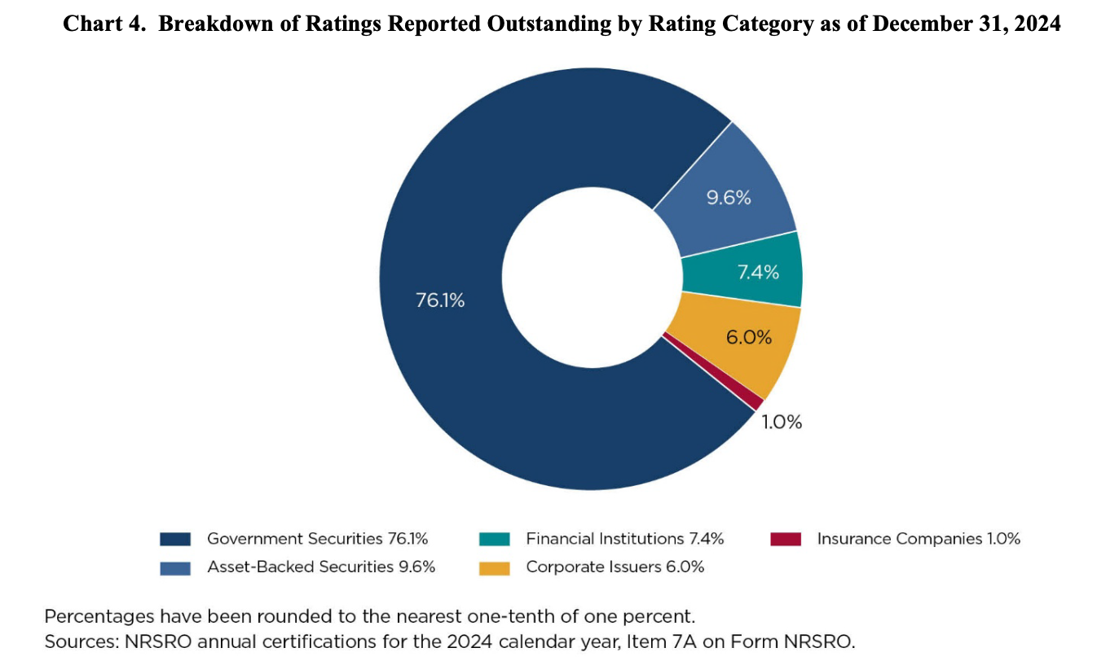
Breakdown of Ratings
SEC, Annual Report on NRSRO (Apr ‘25)

Slide 22
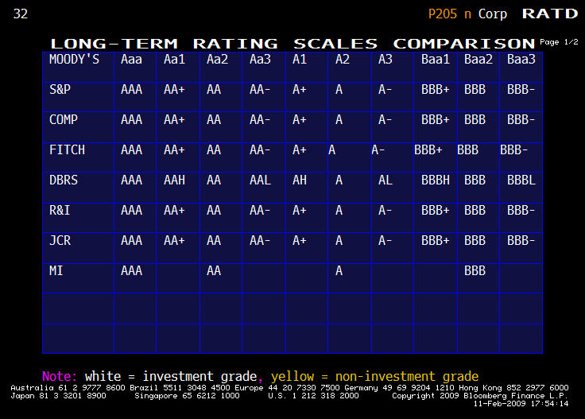
Bond Ratings: Investment Grade

Slide 23
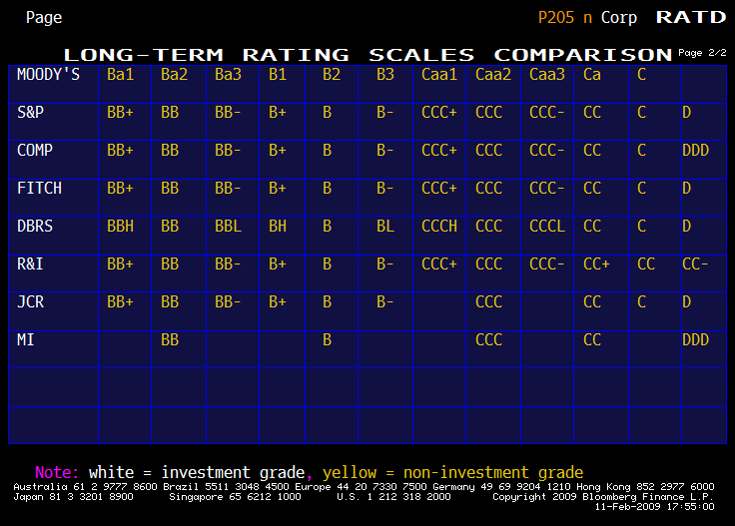
Bond Ratings: Non-Investment Grade (Junk)

Slide 24
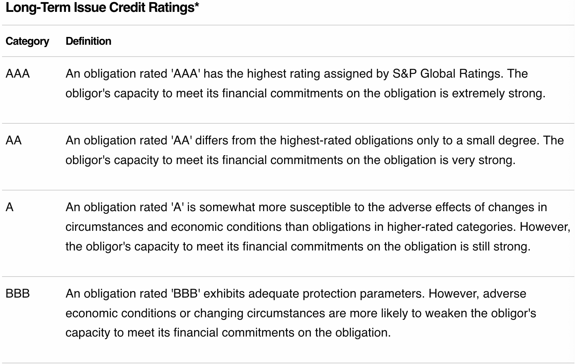
S&P Ratings: Investment
Source: S&P Global Ratings Definitions

Slide 25
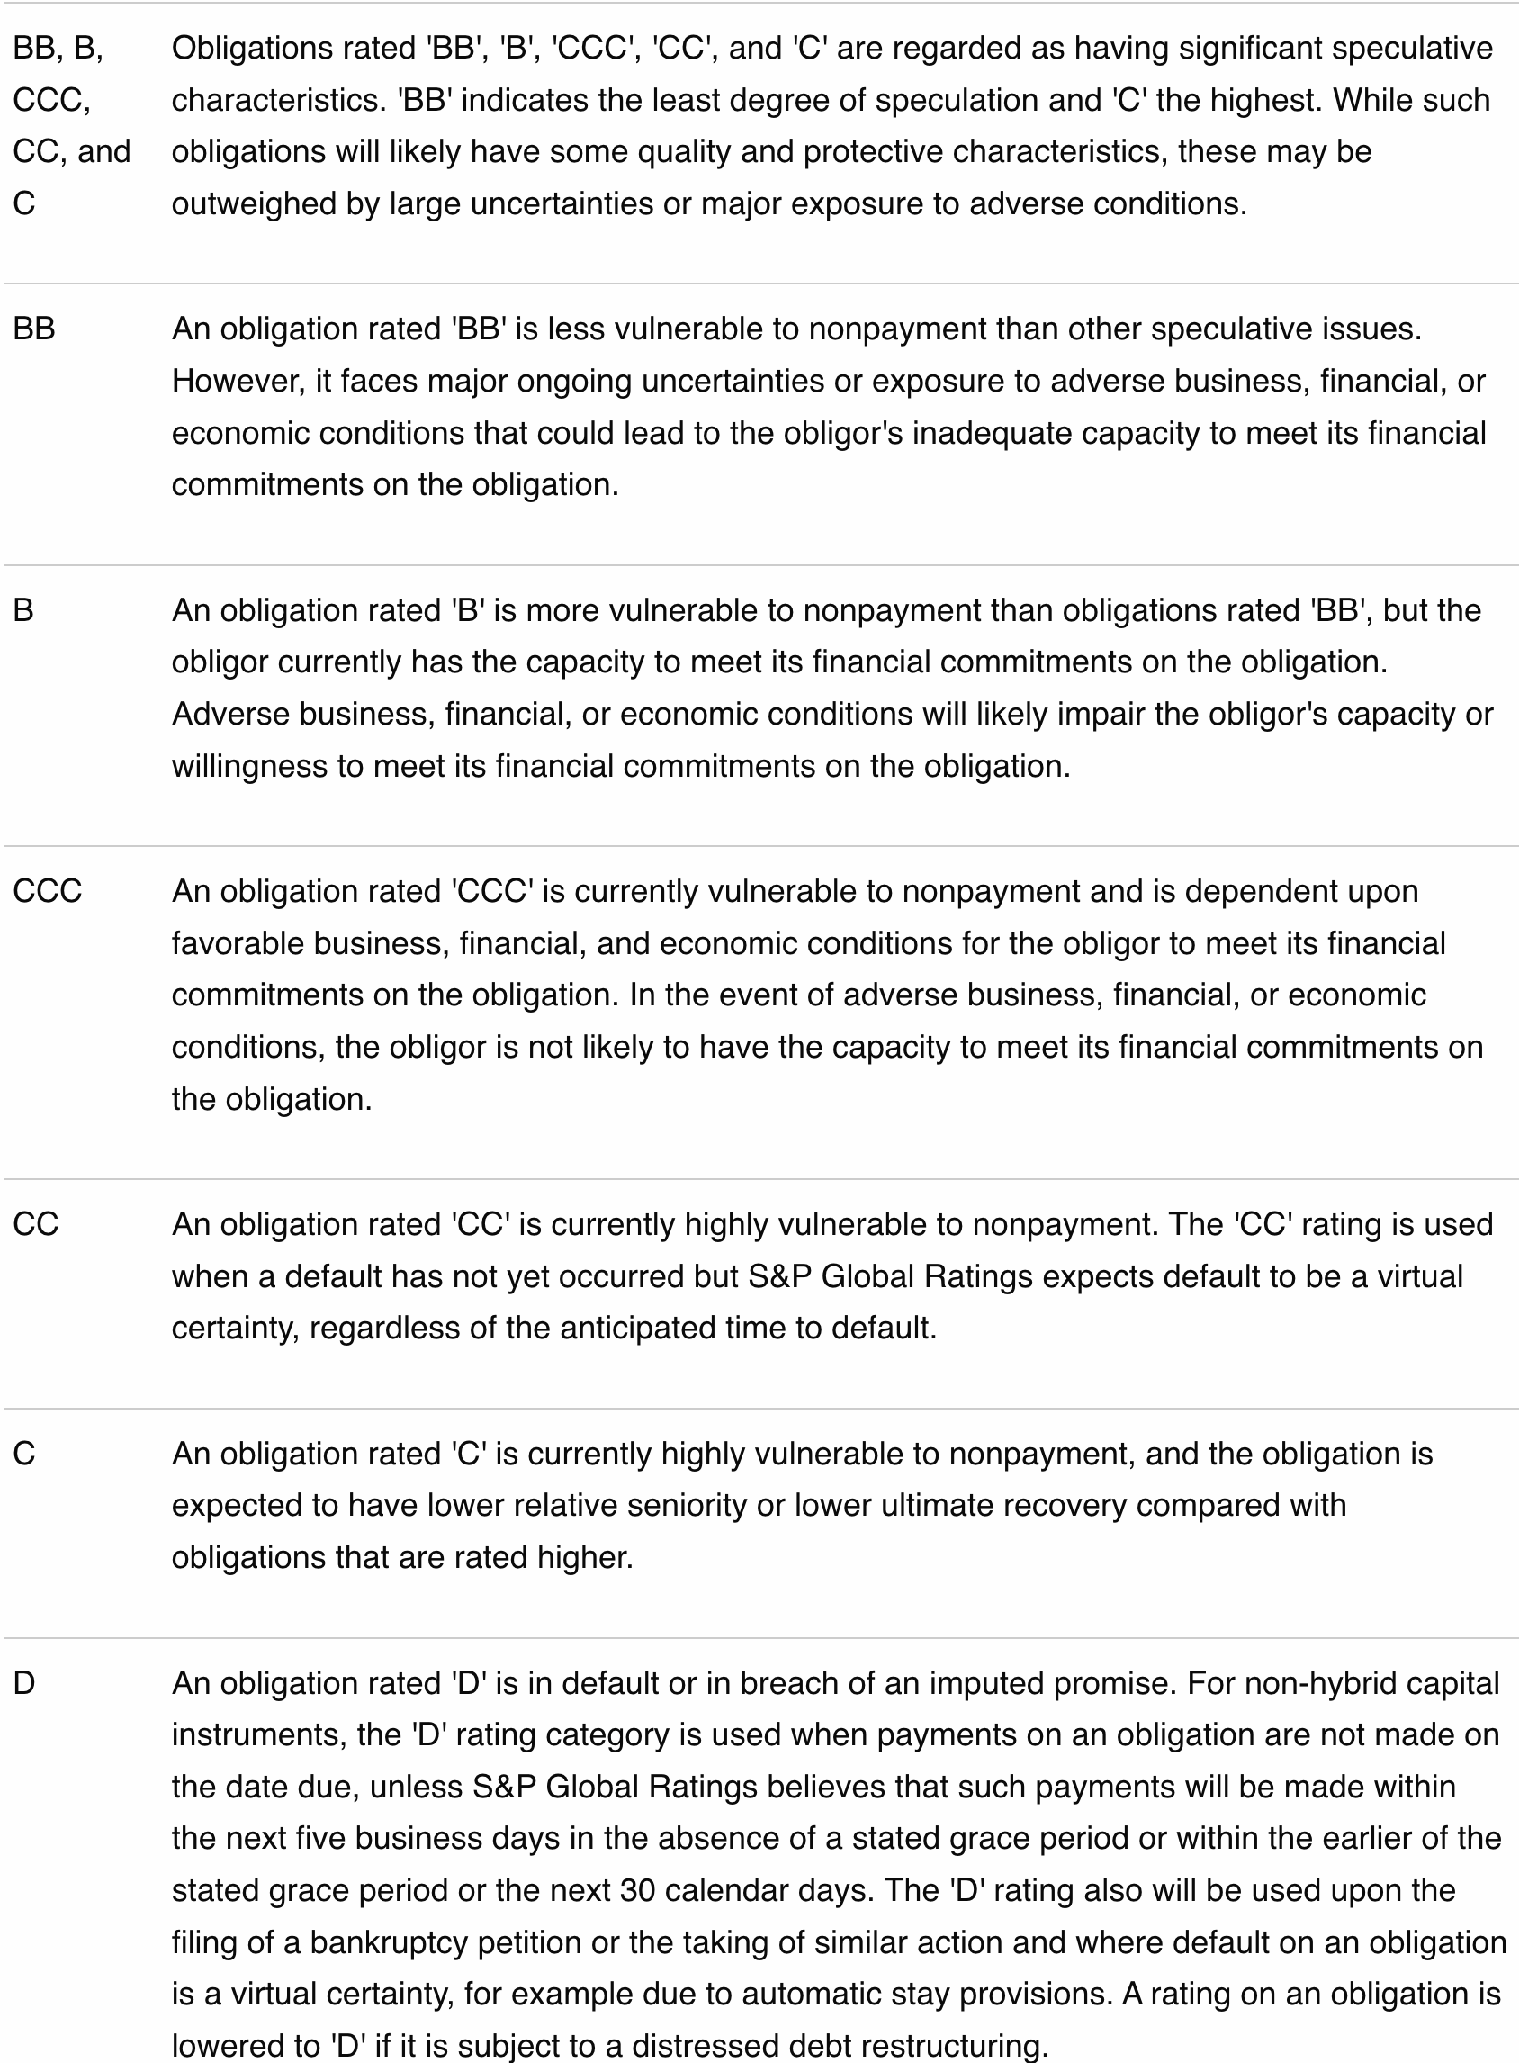
S&P Ratings: Speculative
Source: S&P Global Ratings Definitions

Slide 26
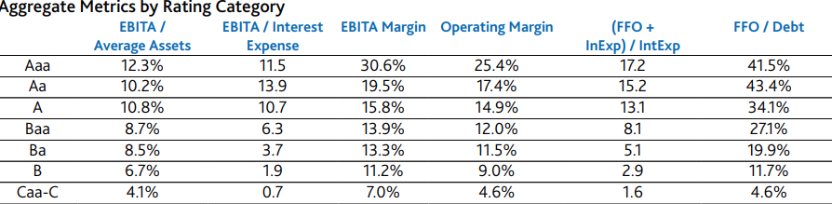
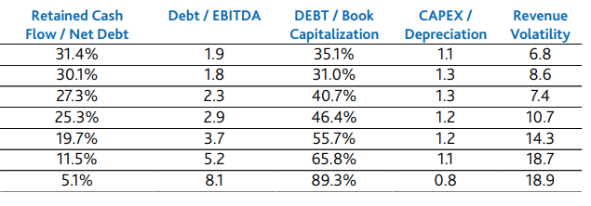
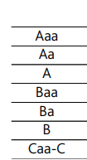
Bond Ratings: Moody’s Financial Metrics Key Ratios (Median 2016)
Source: Moody’s Financial Metrics Key Ratios for Global Non-Financial Corporations: 2016

Slide 27
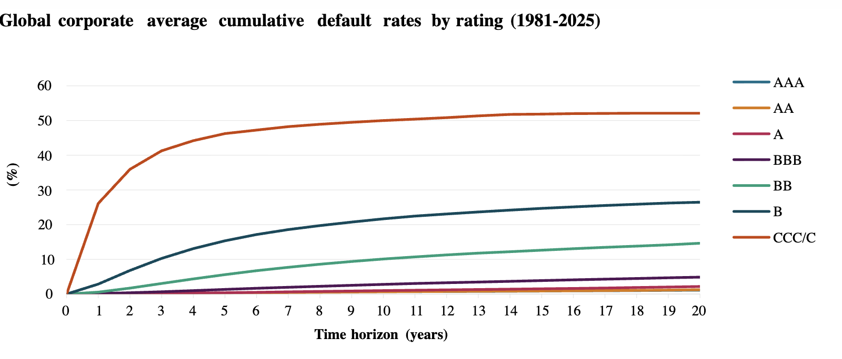
Global Average Cumulative Default Rates by Rating: 1981-2025
Source: S&P 2025 Annual Global Corporate Default Study And Rating Transitions

Slide 28
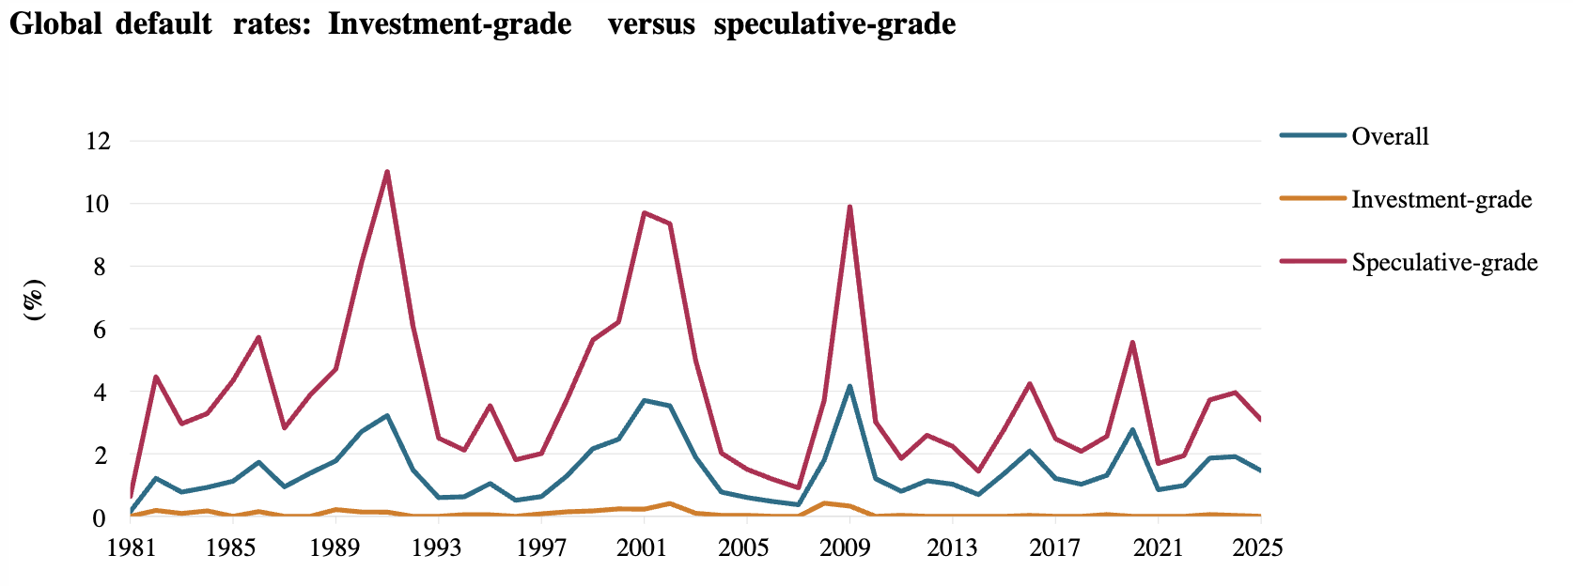
Default rates of corporate bonds 1981-2025 by S&P rating at time of issue
Source: S&P 2025 Annual Global Corporate Default Study And Rating Transitions

Slide 29
Moody’s Assigns A2 to Fordham Revenue Bonds (Oct., 2021)
Fordham University's A2 issuer rating reflects its relatively large scope of operations and good market position as a prominent Jesuit institution located in New York City offering a diversity of undergraduate and graduate programs. Enrollment continues to rise with the exception of a coronavirus related dip in fall 2020 and supports prospects for rising net tuition revenue. That revenue growth along with strong fundraising is boosting operating performance and building reserves, with total cash and investments reaching $1 billion at June 30, 2021. Offsetting factors include a relatively high leverage compared to peers, limited flexible reserves relative to expenses, relatively low levels of liquidity, and a high dependence on student charge revenue in a competitive market.
RATING OUTLOOK
  The stable outlook is based on expectations that EBIDA margins will recover post pandemic to provide debt service coverage of at least 2.5x, net tuition growth and strong donor support will continue, and that debt will not materially increase beyond the proposed series 2021 bonds.
FACTORS THAT COULD LEAD TO AN UPGRADE OF THE RATINGS
  Substantial growth in financial reserves and liquidity providing a stronger cushion relative to debt and operations
  Consistently stronger EBIDA, resulting in increased debt service coverage and additional financial flexibility
  Strengthening market position with increasing yield
FACTORS THAT COULD LEAD TO A DOWNGRADE OF THE RATINGS
  Deterioration in operating performance or decrease in debt service coverage below 2.5x
  Weakened enrollment or net tuition revenue growth
  Increase in financial leverage beyond planned borrowing
The series 2021, bonds are a general obligation of the university on parity with series 2016A, 2017 and 2020. Prior bonds - including the Series 2008A and 2012 bonds - are further enhanced by pledged revenues consisting of student tuition and fees, equal to maximum annual debt service, and series 2014 bonds are secured by a general pledge of tuition revenues. The university covenants that if any future revenue bonds are granted a security pledge, the same security interest will also be provided to the series 2016A, series 2017, series 2020 and forthcoming series 2021 bondholders.

Slide 30
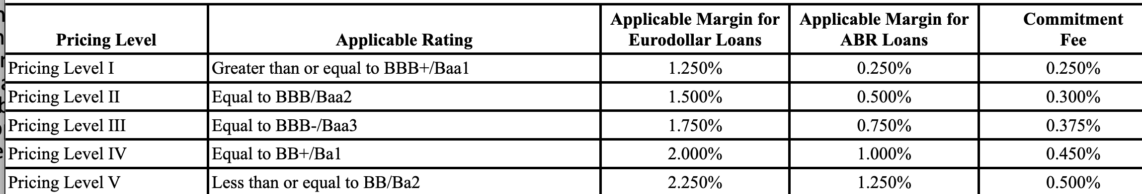
Credit Ratings Requirements Example
(c) As used in this Agreement and in the other Loan Documents, “Applicable Margin” means, as to Loans consisting of a single Borrowing, a rate per annum determined pursuant to the table set forth below by reference to the Borrower’s S&P Rating, Moody’s Rating or Fitch Rating (individually, a “Rating” and collectively, the “Ratings”) and the Type of Loans comprising such Borrowing, whereby (i) if either Moody’s or S&P shall not have in effect a Rating (other than by reason of the circumstances referred to in the last sentence of this Section 2.07(c)) and the Borrower is using all commercially reasonable efforts to maintain both Ratings, then the remaining Rating shall determine the Pricing Level; (ii) if the Moody’s Rating and the S&P Rating shall differ by one level, the higher Rating shall determine the Pricing Level; (iii) if the Moody’s Rating and the S&P Rating shall differ by more than one level and the Fitch Rating is equal to the higher of the Moody’s Rating and the S&P Rating, the higher Rating shall determine the Pricing Level; (iv) if the Moody’s Rating, the S&P Rating and the Fitch Rating each shall differ by one or more levels, and the Moody’s Rating and the S&P Rating shall differ by more than one level, the Rating which is the middle Rating shall determine the Pricing Level; (v) if the Moody’s Rating and the S&P Rating shall differ by more than one level and the Fitch Rating is equal to the lower of the Moody’s Rating and the S&P Rating, the lower Rating shall determine the Pricing Level; (vi) if the Moody’s Rating and the S&P Rating shall differ by more than one level and Fitch shall not have in effect a Rating, the Rating which is one level below the higher of the Moody’s Rating and the S&P Rating shall determine the Pricing Level; and (vii) if the Moody’s Rating and the S&P Rating are the same, that Rating shall determine the Pricing Level. Each change in the Applicable Margin shall apply during the period commencing on the effective date of such change and ending on the date immediately preceding the effective date of the next such change. If the rating system of Moody’s, S&P or Fitch shall change, or if any such rating agency shall cease to be in the business of rating corporate debt obligations, the Borrower and the Banks shall negotiate in good faith to amend this definition to reflect such changed rating system or the unavailability of ratings from such rating agency and, pending the effectiveness of any such amendment, the Applicable Margin shall be determined by reference to the rating most recently in effect prior to such change or cessation.

Slide 31
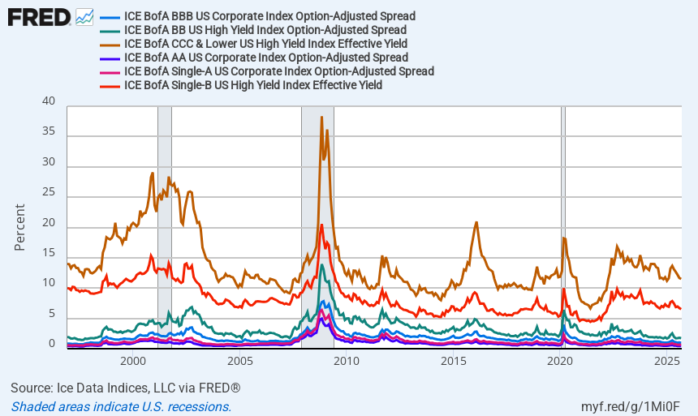
Corporate Spreads: 1996-2025

Slide 32
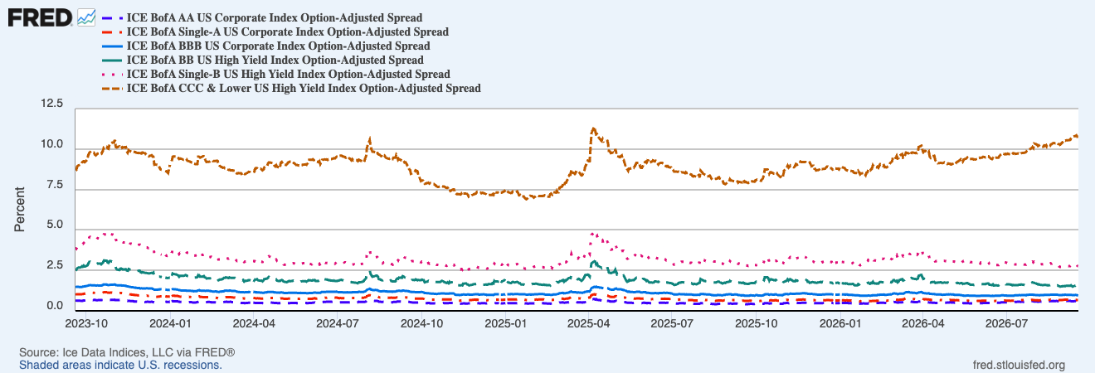
Corporate Spreads: 2023-2026

Slide 33
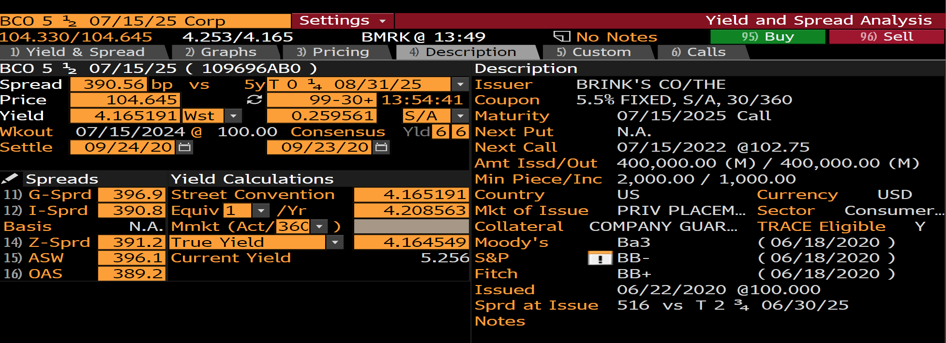
Corporate Spreads (9/22/20): Brink’s 5 ½ maturing on 7/15/25

Slide 34
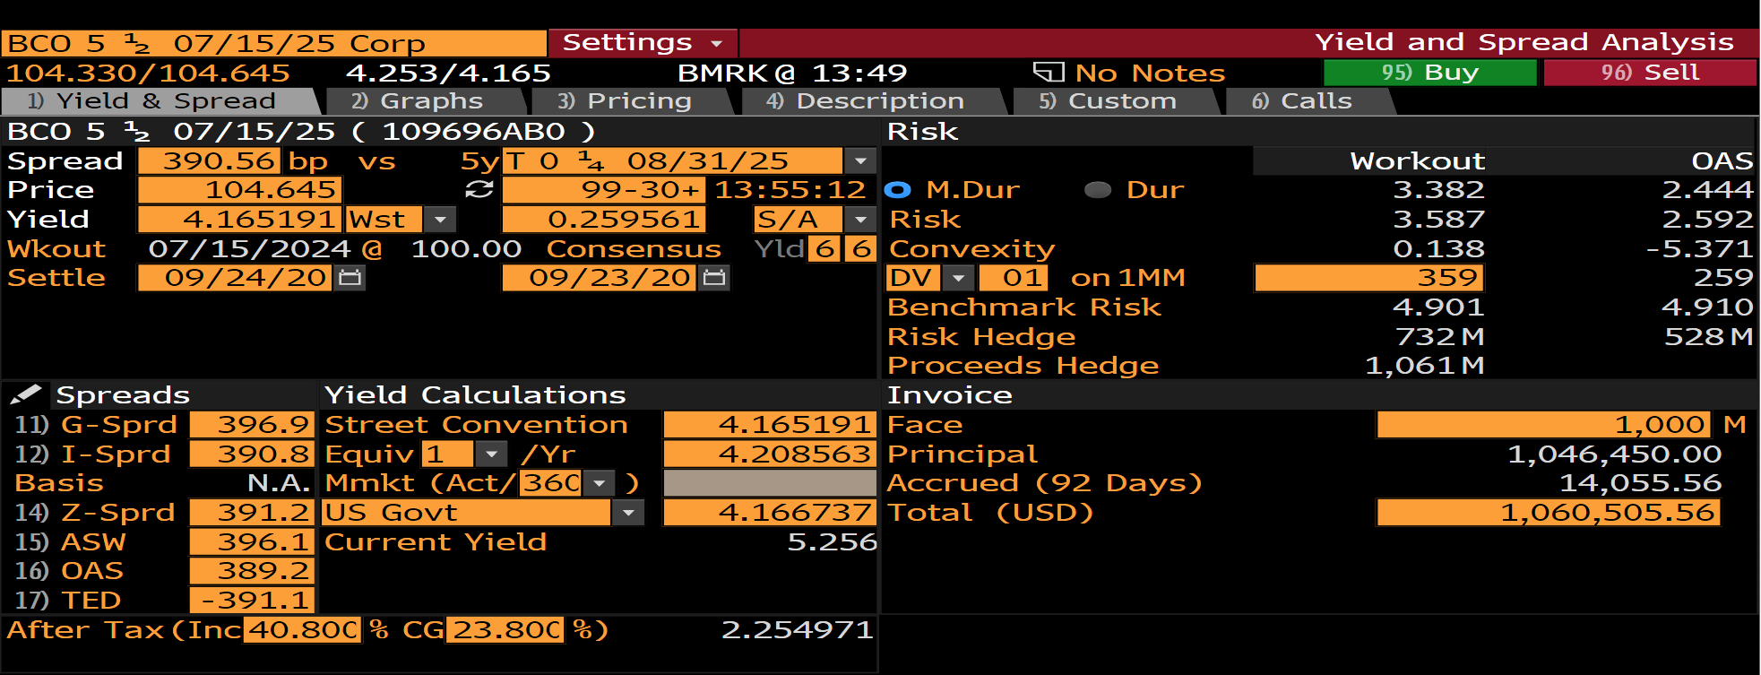
Corporate Spreads (9/22/20): Brink’s 5 ½ maturing on 7/15/25

Slide 35
Debt Risk Premiums
Contract/Risk/Liquidity Premiums
Credit/Default Premium
Promised/Quoted/
Stated Interest
Time Premium

Slide 36
Risk and NPV Formula
When future CFs are uncertain, the CFs in the NPV formula are the expected values of the future CFs, E(CFs).
Once the E(CFs) are calculated, discount them at the appropriate, expected risk-adjusted rate of return, E(r) to get the NPV of the investment.
Example
You are offered a 1-yr project that will pay off 100,000 (30% probability), 300,000 (60% probability), or 800,000 (10% probability).
If the appropriate E(r) is 5%, what’s a fair price for the project?
What’s your ROR under each scenario if you pay a fair price?

Slide 37
Risk and NPV Formula: Example

Slide 38
Debt and Equity
The expected value analysis can be applied to value any portion or combination of the future outcomes [“state-contingent claims”] of an investment
General description of Debt and Equity
  DHs: paid off first
  EHs (SHs): residual claimants after debt paid off.
    If project payoffs are insufficient to pay off DHs, SHs generally don’t have to make up the difference (non-recourse).

Slide 39
Valuing Debt and Equity: Sample Problem
You want to buy a building today that you believe will be worth $501,429 (70%) or $300,000 (30%) in one year. The E(r) is 5%. Unfortunately, you only have $100,000 and will have to borrow the difference from a bank. Assume that any borrowing is non-recourse to the borrower.
  What’s the PV of the building?
  How much will you have to borrow to acquire it?
  What rate will you have to offer the bank if it’s risk neutral?
  What’s the ROR on your equity under each scenario?
  Create a payoff table like Table 6.7 in Welch.

Slide 40

Leverage

Slide 41
Leverage

Slide 42
Leverage

Slide 43
X% ASSET and (100-X)% CASH: P/L Diagram
100% Asset
S = 100
t = 1
1+r = 1.15
D = 0
Profit
25
50
75
125
150
Future Asset Price
50% Asset, 50% Cash
(Lending)
150% Asset, -50% Cash
(Borrowing)
-25
Loss
Notes:
2. Forwards and Futures → 2.1 Asset and Cash

Slide 44
Prejudgment Interest
What is prejudgment interest?
What is post-judgment interest?
State rules on PJ Interest
Federal Rules
  “Prejudgment interest is an element of complete compensation.”
How to view PJI
  PV of judgment = PV of harm
  Coerced Loan Theory
    Risk: risk of DEFENDANT’S default
    ROR: Defendant’s interest rate on similar loan
    Floating, short-term rate

Slide 45
Amoco Cadiz
District court: T-bill rate at time of judgment
7th Cir.:
  “complete compensation”
  involuntary creditor
  “market rate for money”—defendant’s borrowing rate
    Use Prime rate if court doesn’t want to engage in “refined rate setting”
    11.9%: average prime rate
Delaware rule for prejudgment interest: Merion Capital
  Simple or Compound?: Brown v. Ct. Square (Del. Ch. Ct. 2024)

