Slide 1
Corporate Finance
Capital Asset Pricing Model
Fall 2025
Prof. Jeffrey Colón

Slide 2
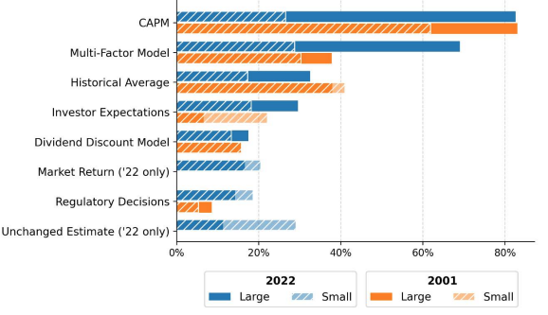
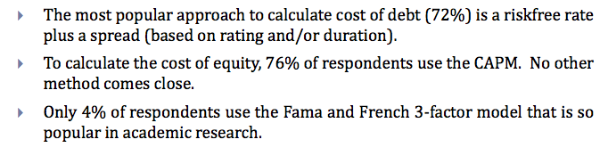
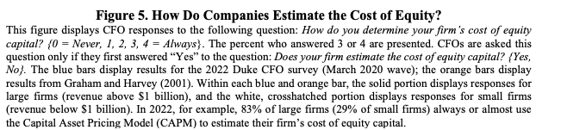
Use of CAPM
Source: Nyborg & Mukhlynina, 2016
Source: Graham, Corp. Fin. And Reality , NBER (Mar. 2022)

Slide 3
CAPM Assumptions
Investors care only about means and variances (SDs)
Markets are frictionless
No Taxes
No Transaction costs
Same investment choices for everyone
Markets are efficient
Same risk-free rates for borrowing and lending
All model parameters are perfectly known
E(r) of every stock, bond, etc.
All expected covariances (betas) are known
Implication: Under the CAPM assumptions, if a risk-free asset exists, every investor should hold a combination of the market portfolio and risk-free asset

Slide 4
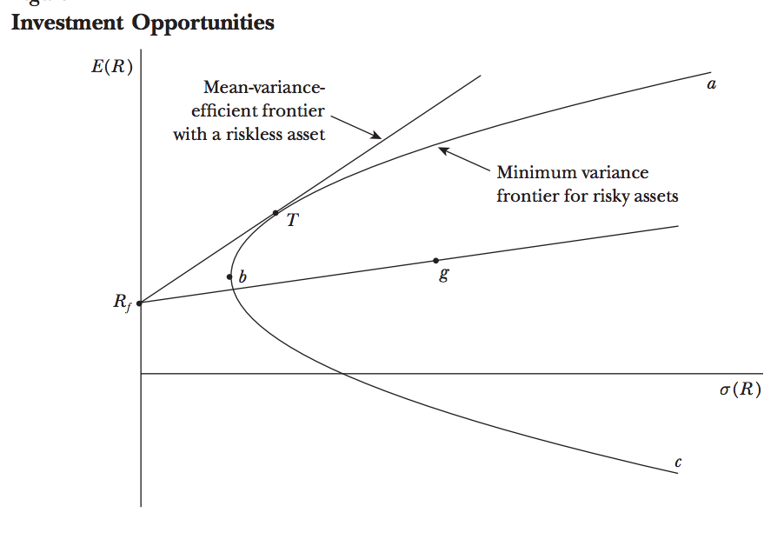
CAPM

Slide 5
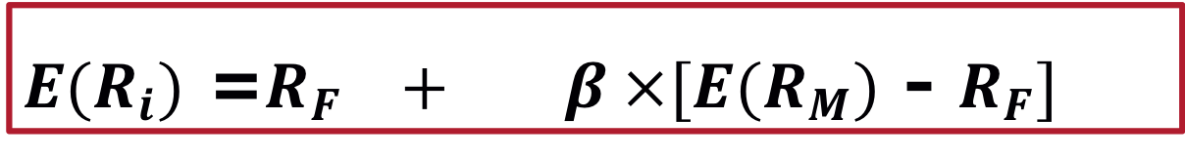

Expected Return on an Individual Security
The Capital Asset Pricing Model (CAPM)
Assume β_{i} = 0, then the E(r) is R_{F}
Assume β_{i} = 1, then $E(R_{i})$ = $E(R_{M})$
Assume β_{i} = -1, R_{i} is negative if market premium is greater than R_{f}
Note: SDev_{i} is irrelevant
$E(R_{i})$ =$R_{F} + β ×[E(R_{M})$ - $R_{F}]$
Expected return on a security
Beta of the security
Market risk premium
=
Risk-free rate
+
x

Slide 6
CAPM
CAPM gives us the expected return, , which is used (in the denominator) in calculating NPV.
CAPM inputs:
Risk-free rate
Market premium
Project beta (with market)
E(r) is a linear function of beta
Higher beta, higher expected return
Lower beta, lower expected return
What does that imply about price?

Slide 7
Relationship Between Risk & Expected Return: Security Market Line
R_{F} = 3%; Equity Premium = 5%

Slide 8
Security Market Line

Slide 9

Relationship Between Risk & Expected Return
$E(R_{i}$) =$R_{F} + β × [E(R_{M}$) - $R_{F}]$
Asset B
●
Expected return
Security Market Line
●
Asset A
1.0
Is this a riskless arbitrage opportunity?

Slide 10
Rate of Returns: Risk Premiums
Promised/Quoted/Stated Return
Expected Rate of Return:
In CAPM, different assets have different E(r)
Contract/Risk/
Liquidity Premiums
Credit/Default Premium
Risk,
Contract, and
Liquidity Premiums
Time Premium
Time Premium

Slide 11
Using CAPM in the NPV Formula
CAPM gives expected return, E(r), not promised return.
CAPM E(r) doesn’t incorporate default risk.
Default risk is incorporated in the numerator, E(CF), of the NPV formula.
Default risk affects the price today but not through the expected return, E(r).

Slide 12
Financial Leverage and Beta: Be Careful in Comparing Reported Equity Betas
The relationship between the betas of a firm’s debt, equity, and assets is:
Financial leverage always increases the equity beta relative to the asset beta (assume β_{Debt}=0) :
β_{Asset} x (1+D/E) = β_{Equity}
Debt
Equity
β_{Asset} =
x β_{Debt} +
x β_{Equity}
Debt + Equity
Debt + Equity

Slide 13
Financial Leverage and Beta: Example
Consider a firm that is currently all-equity and has an equity and asset beta of 0.90. The firm has decided to lever up to a capital structure of 2 parts debt to 1 part equity.
Since the firm will remain in the same industry, its asset beta should remain 0.90.
Assuming a zero beta for its debt, its equity beta would become 3 times as large:
β_{Asset} x (1+D/E) = β_{Equity}
1
β_{Asset} = 0.90 =
x β_{Equity}
2 + 1
β_{Equity} =
3 x 0.90 = 2.70

Slide 14
Combining Betas in Portfolios
Corp A, which is worth $900mm and has a beta of 2 and a SD of 20%, is considering combining with Corp B, which is worth $100mm and has a beta of 1 and a SD of 20%. Assume that risk-free rate is 3% and the equity premium is 5%.
Very generally, will the risk of the combined company be greater or less than 20%?
What is the expected return of each company if the CAPM applies?
What will be the expected return (cost of capital) of the combined company?
If the beta of a portfolio is the weighted average of the portfolio betas, what is the beta of the combined company?
What will be the expected return of the combined company under CAPM?

Slide 15
Estimating CAPM Inputs: Beta
Project (not necessarily firm) specific
Estimation issue
Historical rates of return for specific firm vs. historical rates of return for industry
Beta shrinkage towards 1
Daily, monthly, number of years?
Equity Beta, which is reported on finance sites, depends on a firm’s leverage
Equity beta helps find E(r_{Equity}), but you should use β_{Asset} to finding the appropriate hurdle/discount rate for a project

Slide 16
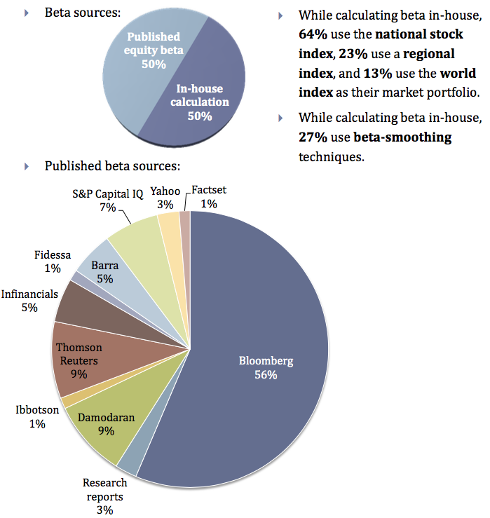
CAPM Beta
Source: Nyborg & Mukhlynina, 2016

Slide 17
CAPM Inputs: Equity Risk Premium (r_{m} – r_{f})
Historical averages for r_{m}:
Time period?
LT or ST bonds for r_{f}?
Geometric v. arithmetic?
Peso problem
Adjustment for bubbles and busts?

Slide 18
The Firm versus the Project
If a project has the same risk as the company as a whole and the company has debt, the equity beta is used to calculate the E(r) on equity and the WACC is used to discount the E(CFs) of the project.
Any project’s cost of capital depends on the use to which the capital is being put—not the source.
Therefore, it depends on the risk of the project and not the risk of the company.
Notes:
16

Slide 19
The Cost of Capital with Debt
The Weighted Average Cost of Capital (WACC) is given by:
Because interest expense is tax deductible, we multiply the last term by (1 – T_{C})
Remember: Equity beta helps find E(r_{Equity}); for E(r_{Debt}) best to use market rates
r_{WACC} =
Equity
* E(r_{Equity}) +
Debt
* E(r_{Debt})* (1 – T_{C})
Equity + Debt
Equity + Debt
E
D
r_{WACC} =
* r_{E} +
* r_{D} * (1 – T_{C})
E + D
E + D

Slide 20
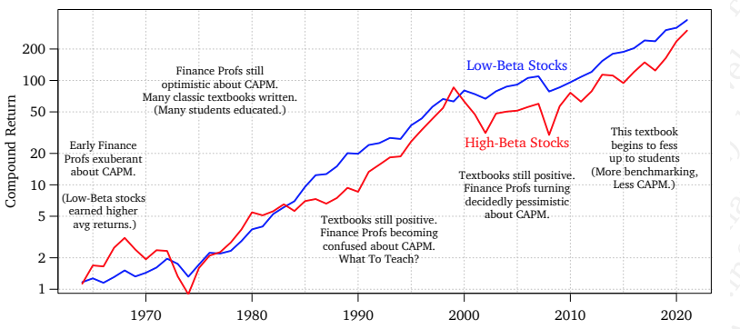
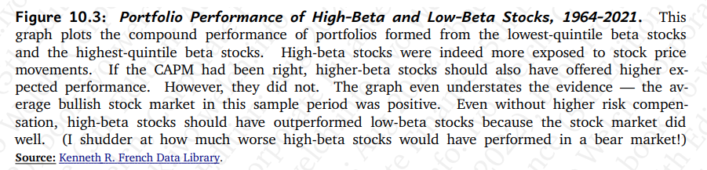
Low Beta vs. High Beta Stock Returns

Slide 21
Fama & French: Theory and Evidence (2004)
The version of the CAPM developed by Sharpe (1964) and Lintner (1965) has never been an empirical success…The problems are serious enough to invalidate most applications of the CAPM.
…CAPM estimates of the cost of equity for high beta stocks are too high (relative to historical average returns) and estimates for low beta stocks are too low. Similarly, if the high average returns on value stocks (with high book-to-market ratios) imply high expected returns, CAPM cost of equity estimates for such stocks are too low.
The CAPM, like Markowitz’s (1952, 1959) portfolio model on which it is built, is nevertheless a theoretical tour de force. We continue to teach the CAPM as an introduction to the fundamental concepts of portfolio theory and asset pricing, to be built on by more complicated models… But we also warn students that despite its seductive simplicity, the CAPM’s empirical problems probably invalidate its use in applications.

Slide 22
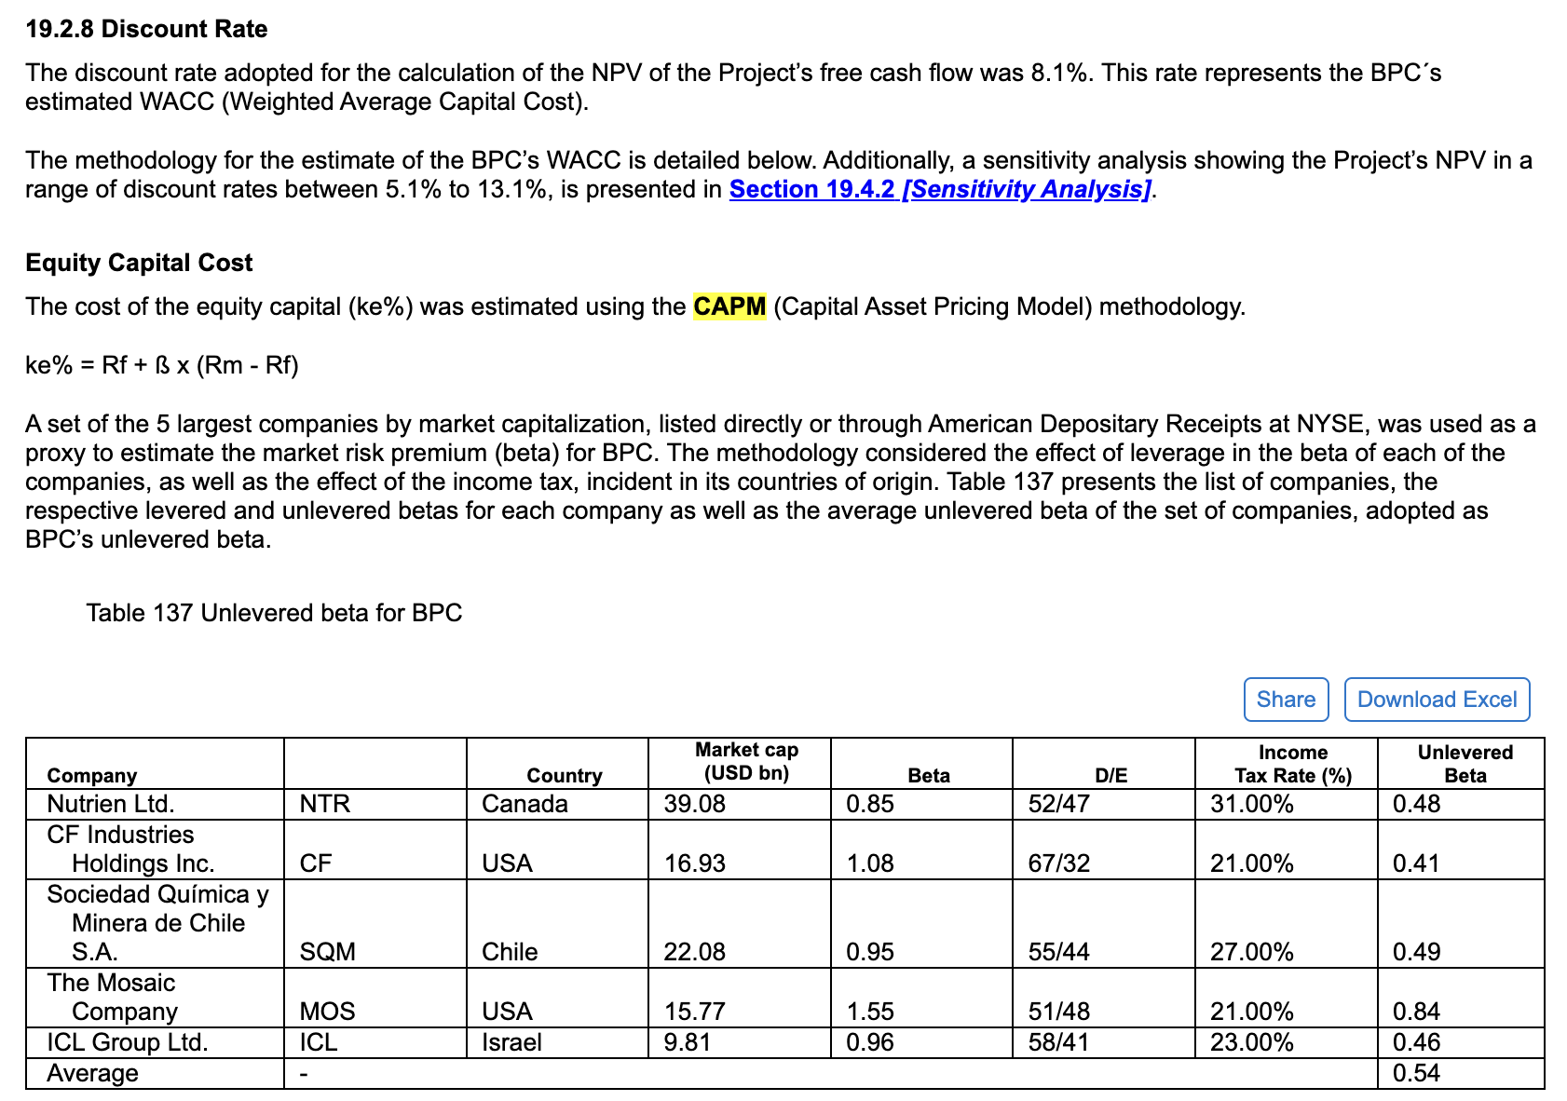
CAPM: Practice
F-1 Br. Potash Corp (8/24)

Slide 23
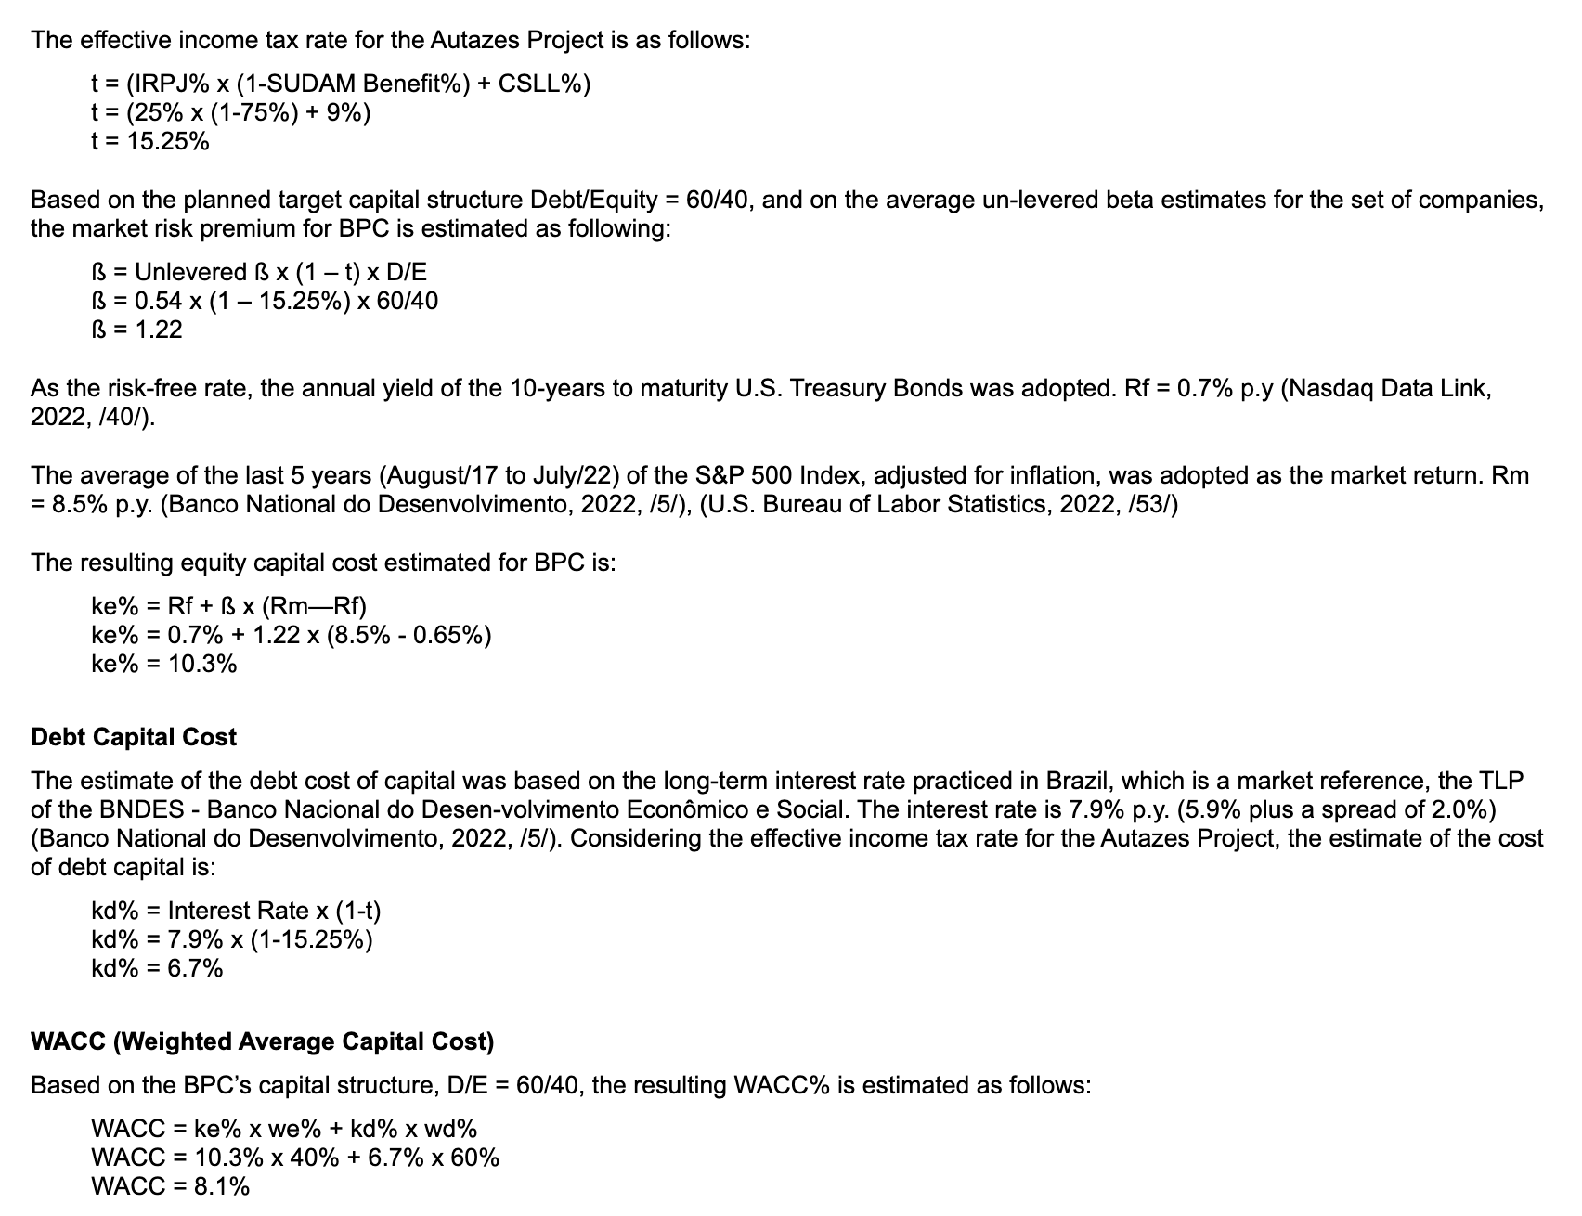
CAPM: Practice
F-1 Br. Potash Corp (8/24)

