Slide 1
Corporate Finance
Benchmarked Cost of Capital
Fall 2024
Prof. Jeffrey Colón

Slide 2

The Issue: The Right Discount Rate
$$NPV=C_{0}+{\frac{ℇ(C_{1})}{1+ℇ(r_{1})}+\frac{ℇ(C_{2})}{1+ℇ(r_{2})}}_{ }$$

Slide 3
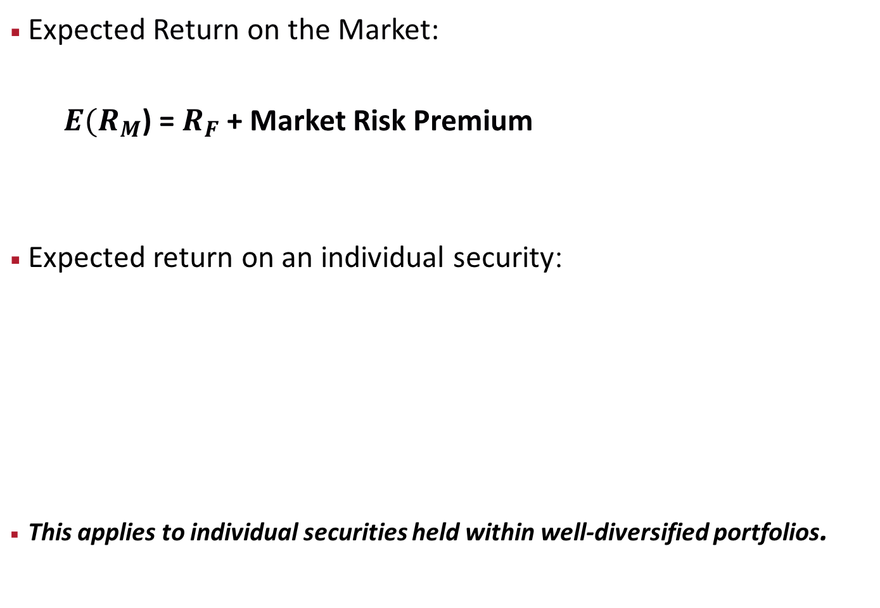
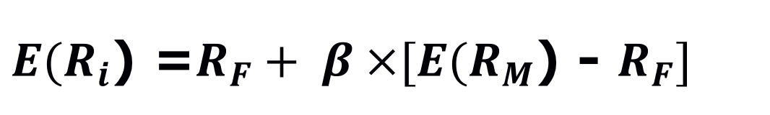
Relationship between Risk and Expected Return: CAPM
Expected Return on the Market:
$E(R_{M}$) = $R_{F}$ + Market Risk Premium
Expected return on an individual security:
This applies to individual securities held within well-diversified portfolios.
$E(R_{i}$) =$R_{F}+ β ×[E(R_{M}$) - $R_{F}]$
Market Risk Premium

Slide 4
Benchmarked Costs of Capital
Short-term
Long-term
Project
Risk-free Bonds
Equity

Slide 5
ERP Estimates: Academic Corporate Finance Textbooks
Source: Pablo Fernandez (2013)

Slide 6
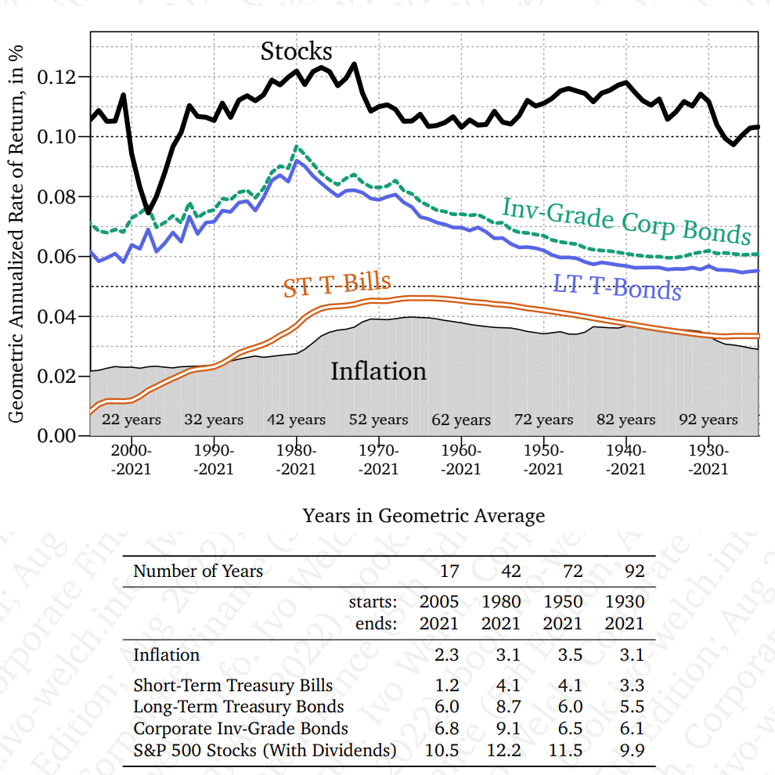
Asset Class Geometric Rates of Return

Slide 7
Equity Risk Premium
Historical averages for r_{m}:
Time period?
25?, 50?, 100 years?
LT bonds or ST bills for r_{f}?
How does Welch break down the equity premium?
See p. 235
From Fig. 9.2, what has been approximately the term premium and risk premium over the last 50 years?

Slide 8
Risk-free Rate
Short-term rates
Long-term rates
Duration matching of cash CFs
Average rates or midpoint of CFs
Consistency with r_{f} in equity premium

Slide 9
Equity (Market) Risk Premium
ERP = E(r_{m}) - r_{f}
Extra return a risky (stock-like) project has to offer above the risk-free rate
Extra return a stock-like investment promises above the risk-free rate

Slide 10
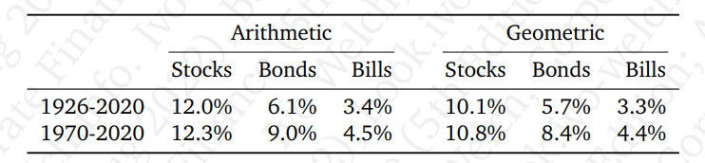
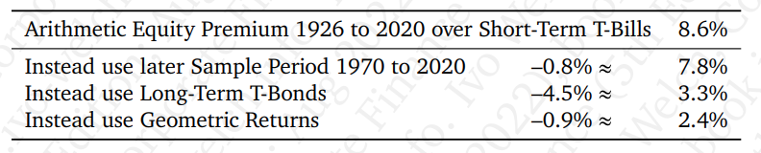
Equity Risk Premium: Where does the 8% Number Come From
What’s the FV of annual investments of 10k earning 8% for 40 years?

Slide 11
CAPM Inputs: Equity Risk Premium
Historical averages for r_{m}:
Geometric v. arithmetic?
Note: The practice is to use arithmetic in the NPV formula. What is that implicitly assuming the future relative performance of stock vs. bonds in the future? Peso problem: What’s this?
Adjustment for bubbles and busts?
Dividend or earnings yields [Skip]

Slide 12
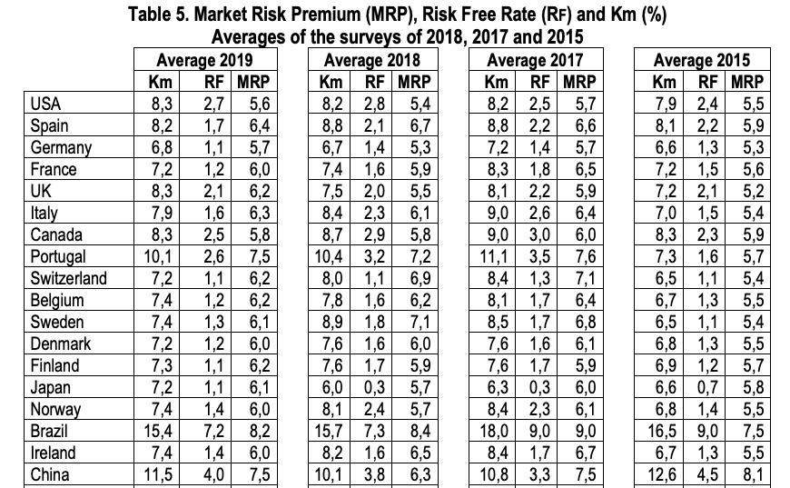
Equity Risk Premium: Surveys
Source: Market Risk Premium, Fernandez (2019)

Slide 13
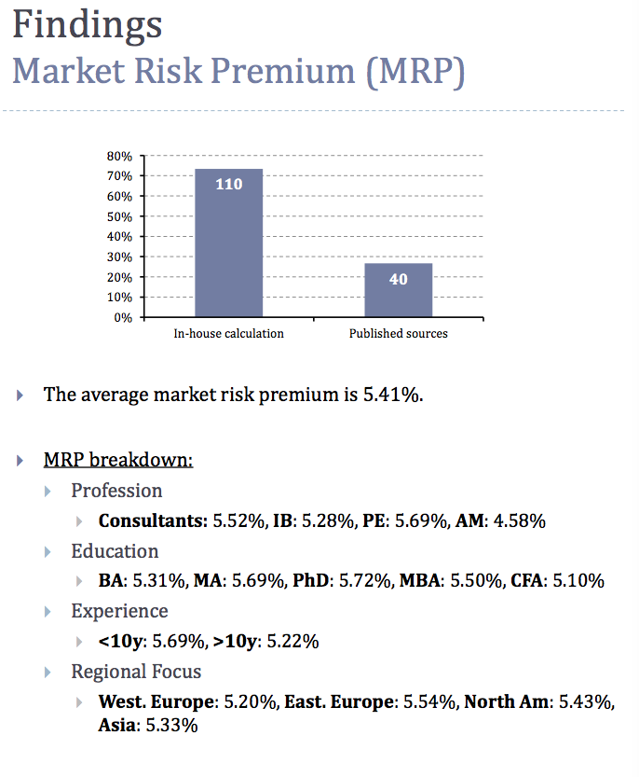
Market Risk Premium
Source: Nyborg & Mukhlynina, 2016

Slide 14
ERP: Internal Cost of Capital

Slide 15
Benchmarked Costs of Capital
Short-term
Long-term
Project
Risk-free Bonds
Equity

Slide 16
Asset Cost of Capital and Equity Cost of Capital
The relationship between the expected return of the firm’s debt, equity, and assets is:
Debt
Equity
E(r)_{Asset} =
x E(r)_{Debt} +
x E(r)_{Equity}
Debt + Equity
Debt + Equity

Slide 17
Rate of Returns: Risk Premiums
Promised/Quoted/Stated Return
Expected Rate of Return:
In CAPM or benchmark RoR, different assets have different E(r)
Contract/Risk/
Liquidity Premiums
Credit/Default Premium
Risk,
Contract, and
Liquidity Premiums
Time Premium
Time Premium

Slide 18
Expected Return Example: Supplying Default Risk
A corporate bond promises 1,000 one year from today. You estimate that it will pay 1,000 with a p=95% and will default entirely with a p=5%. If the bond is 75% like risk-free debt and 25% like equity, the risk-free rate is 2% and the E(r_{m}) is 6%, find the price of the bond.
E(r_{bond}) = 75%*2% + 6%*25% = 3%
E(cf) = 950 [probability * outcome]
PV = 950/(1+.03) = 922.33 [PV formula: E(cf) / 1+ E(r_{bond})]
Promised ROR = 8.4% [(1000-922.33)/922.33]
Risk Premium = 1% [3% – r_{f} of 2%]
Default Premium =5.4% (on average, will be zero)
Time Premium = 2%
Default Risk -> numerator; risk aversion -> denominator

