Slide 1
Corporate Finance
The Rise and Challenges of Passive Investing
Fall 2025
Prof. Jeffery Colon

Slide 2
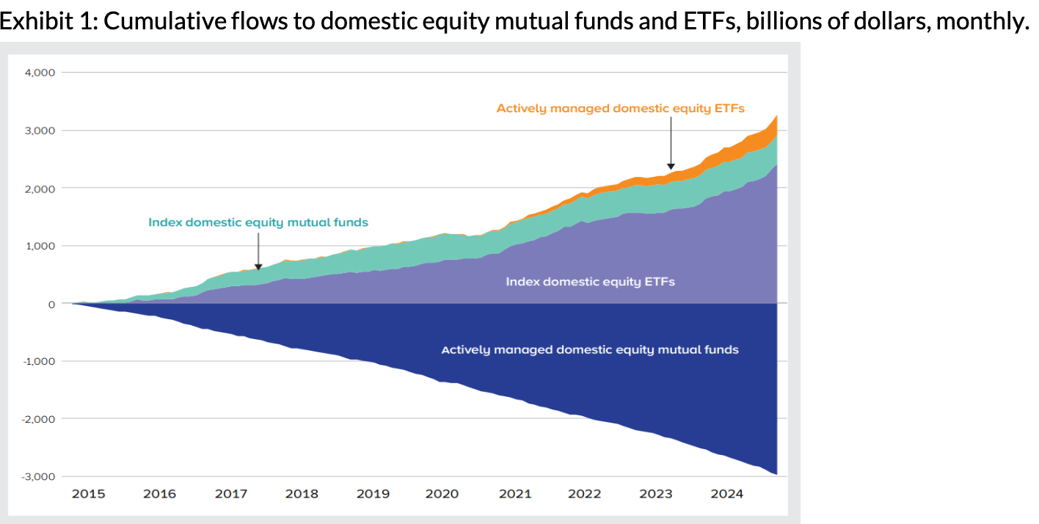
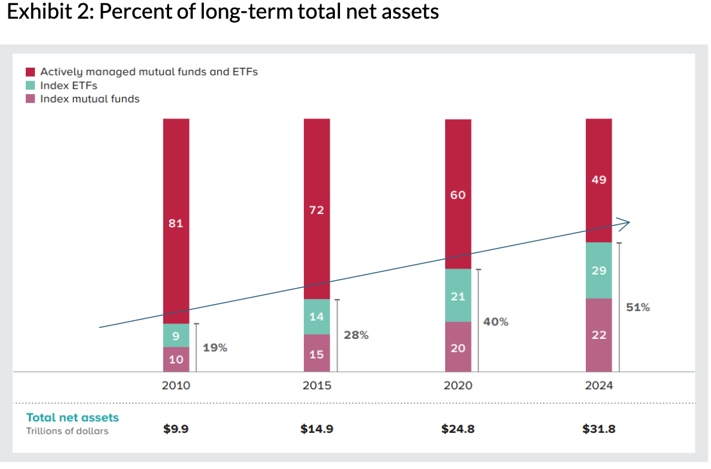
The Rise of Passive Equity ETFs and Mutual Funds
Cumm. flows to US Equity MFs and ETFs (billions, monthly)
Percent of LT Net Assets

Slide 3
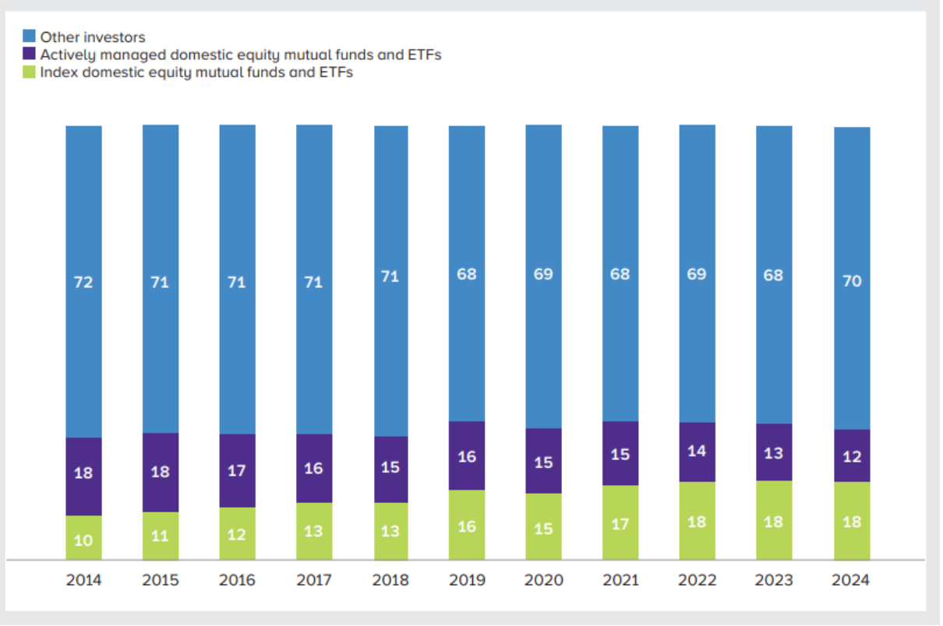
The Rise of Passive Investing

Slide 4
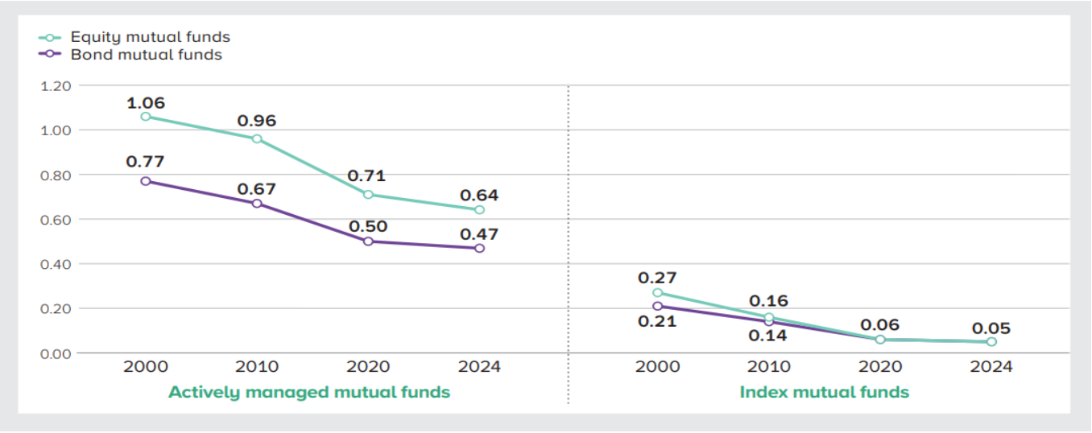
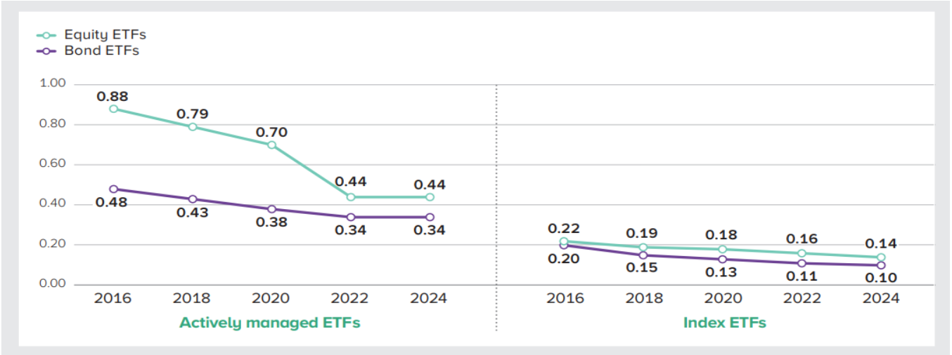
Expense Ratios: Actively managed and Index MFs and ETFs

Slide 5
Potential Issues
Horizontal holdings
Corporate governance
Market efficiency
Market liquidity

Slide 6
Horizontal Shareholdings
Vanguard, State Street, BlackRock, and Fidelity are the largest shareholders of many important U.S. companies.
  Vanguard owns around 9% of MSFT and Nvidia; 7% of Alphabet and AMZN
  V, BR, FMR, and SS own around 23% of Alphabet
Common shareholdings of competitor corporations may reduce incentives to compete.
  If I own X% of the shares of two competitors, Corp A and Corp B, and Corp A competes away some of Corp B profits, market share, etc., my portfolio’s value may be reduced, and markets may move towards more monopolies.
  ”Ticket prices are approximately 3% to 7% higher in the average US airline route than would be the case under separate ownership.” Azar et al, JoF (2018)
Common shareholding may explain why corp. SHs support executive compensation based on industry success rather than the firm alone. Elhauge, Har. LR (2016)

Slide 7
Corporate Governance
Do index fund managers have the proper incentives to monitor their shareholdings?
Fund managers generally have small staff directed to stewardship. V, for example, has around 60 professionals that that are involved in governance to monitor 12K to 14K companies.
If an ideal world, manager would spend $X on monitoring if the benefits (increased portfolio value, V+) were greater than $X: V+ > $X
Managers are generally paid NOT on V+ but on a percentage of AUM (%AUM+), so if:
  V+ > $X > %AUM+, then manager won’t spend on stewardship
  Example: $1Bi fund can increase value of company by $1MM but would earn only 50bps (5K) of additional fees from the $1MM increase.
Freeriding problem of other index managers.

Slide 8
Market Efficiency
Does the increase in index investing affect market efficiency, i.e., does it reduce price discovery?
True percentage of active/passive investors. Maybe 33% (Sammon, JoFE (2024))
As a company’s price increase, it gets a bigger share of every new dollar invested, which may increase the price more, etc.
If there are fewer active investors, does the activity of the remaining active investors have an outsized weight on market volatility?
Can fewer active investors correct any distortions caused by index funds?

