Slide 1
Corporate Finance
Financial Statements to Economic Cash Flows
Fall 2026
Prof. Jeffrey Colón

Slide 2
Financial Statements
Importance of Understanding Financial Statements
  May be required to be reported (10-K, 10-Q)
  Often reported in the media
  Understand strengths and limitations in order to value a firm or investment project from financials
  Financial contracts (debt and derivative instruments) may refer to financials
  Regulatory rules may refer to financials
  Managers may care a lot about financials
    Manager compensation
    “Show me the incentives and I will show you the outcome.” Charlie Munger

Slide 3
GAAP
Generally Accepted Accounting Principles (US GAAP)
Standard Setting
  FASB, Emerging Issues Task Force, AICPA, and the SEC
  Before 7/1/09, hodgepodge of various statements and standards: FAS, FIN, FTB, EITF, APB
Accounting Standards Codification (7/1/09)
  Topic--Subtopic—Section
    820—15—1
    Fair Value Measurement—Scope—Overall Guidance
  Accounting Standards Update (ASU)
    ASU 2010-06, Fair Value Measurements and Disclosures (Topic 82)
SEC Requirements
  Regulations S-X (17 CFR §§ 210 et seq.); S-K (17 CFR §§ 229.300 et seq.)
  Staff Accounting Bulletins, Interpretive Releases, etc.
  Compliance and disclosure interpretations
  Example: Item 7: Management Discussion and Analysis of Financial Condition and Results of Operations

Slide 4
Components of Financial Statements
Balance Sheet
Income Statement
Statement of Cash Flows
Consolidated Statement of Common SHs’ Equity
Notes

Slide 5
Balance Sheet
Snapshot of a firm’s financial condition at a moment in time prepared in accordance with GAAP/IFRS.
Components of a Balance Sheet
  Assets: resources/investments
  Liabilities:
  Shareholders’ Equity:
Assets = Liabilities + Shareholders’ Equity
claims on resources/financing

Slide 6
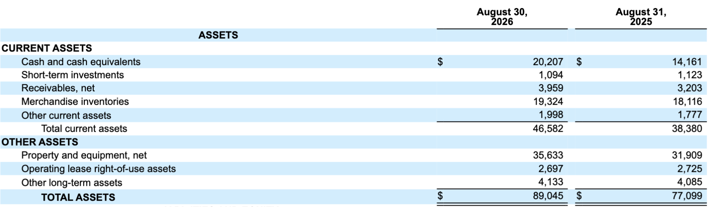
Costco’s FY 2026 Balance Sheet (Assets)
In ‘000,000s, except par value & share data

Slide 7


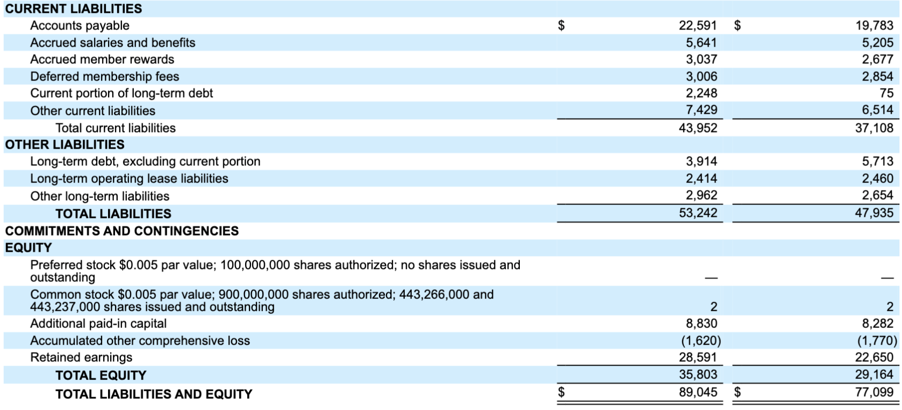
Costco’s FY 2026 Balance Sheet (L & SH Equity)
In ‘000,000s, except par value & share data

Slide 8
Balance Sheet Concerns
Cash v. accrual
Assets that don’t appear on the BS
  Self-created intangibles
    Brands, Goodwill, Software, Employee Training
Liabilities that don’t appear on the BS
Liquidity
Retained earnings ≠ cash
Estimates/contingencies
Book Value
  Fair market value v. historical cost

Slide 9
Income Statement
Shows firm’s net profit/loss over given period and how it was earned:
  Revenues
  Costs/Expenses
  Interest/Dividends
  Income Taxes
Measures flows not stock
Also referred to as a P&L Statement

Slide 10
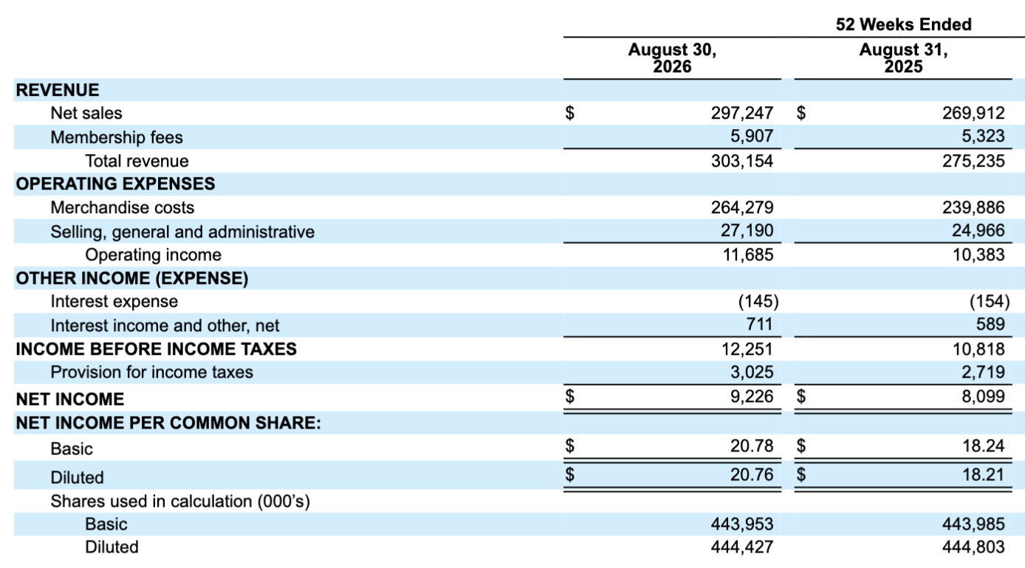
Costco’s FY 2026 Income Statement
In ‘000,000s

Slide 11
Statement of Cash Flows
Shows changes in Cash (BS) over period
  Flow, not stock
Difference between Net Income and Cash Flow?
CFs separated by activity:
  Operating Activities
  Investing Activities
  Financing Activities

Slide 12
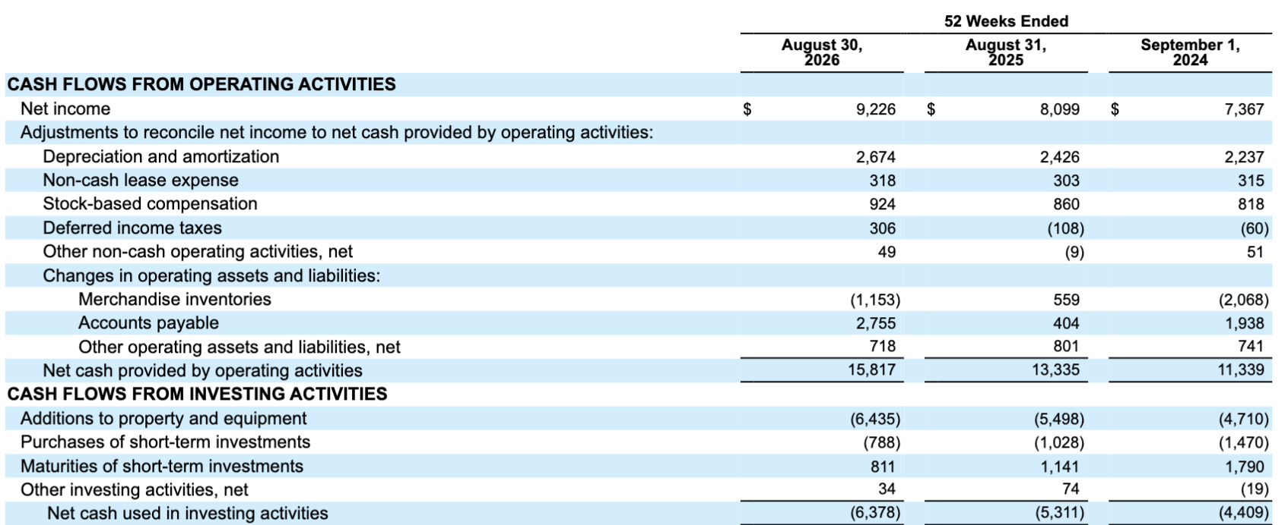
Costco’s FY 2026 Statement of Cash Flows: Operating & Investing Activities
In ‘000,000s

Slide 13
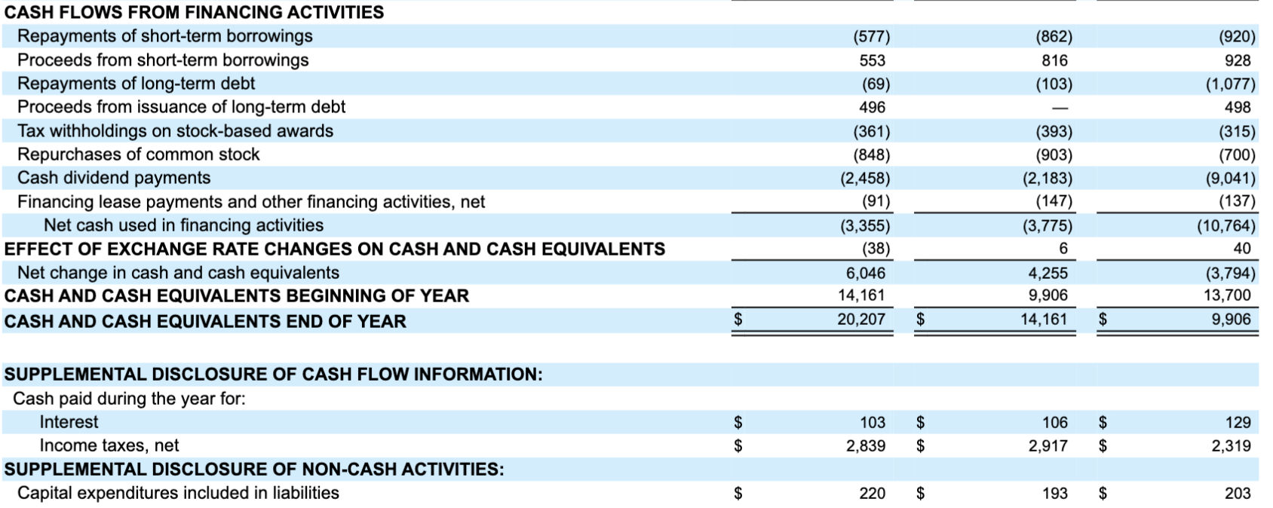
Costco’s FY 2026 Statement of Cash Flows: Financing Activities
In ‘000,000s
2026 2025 2024

Slide 14
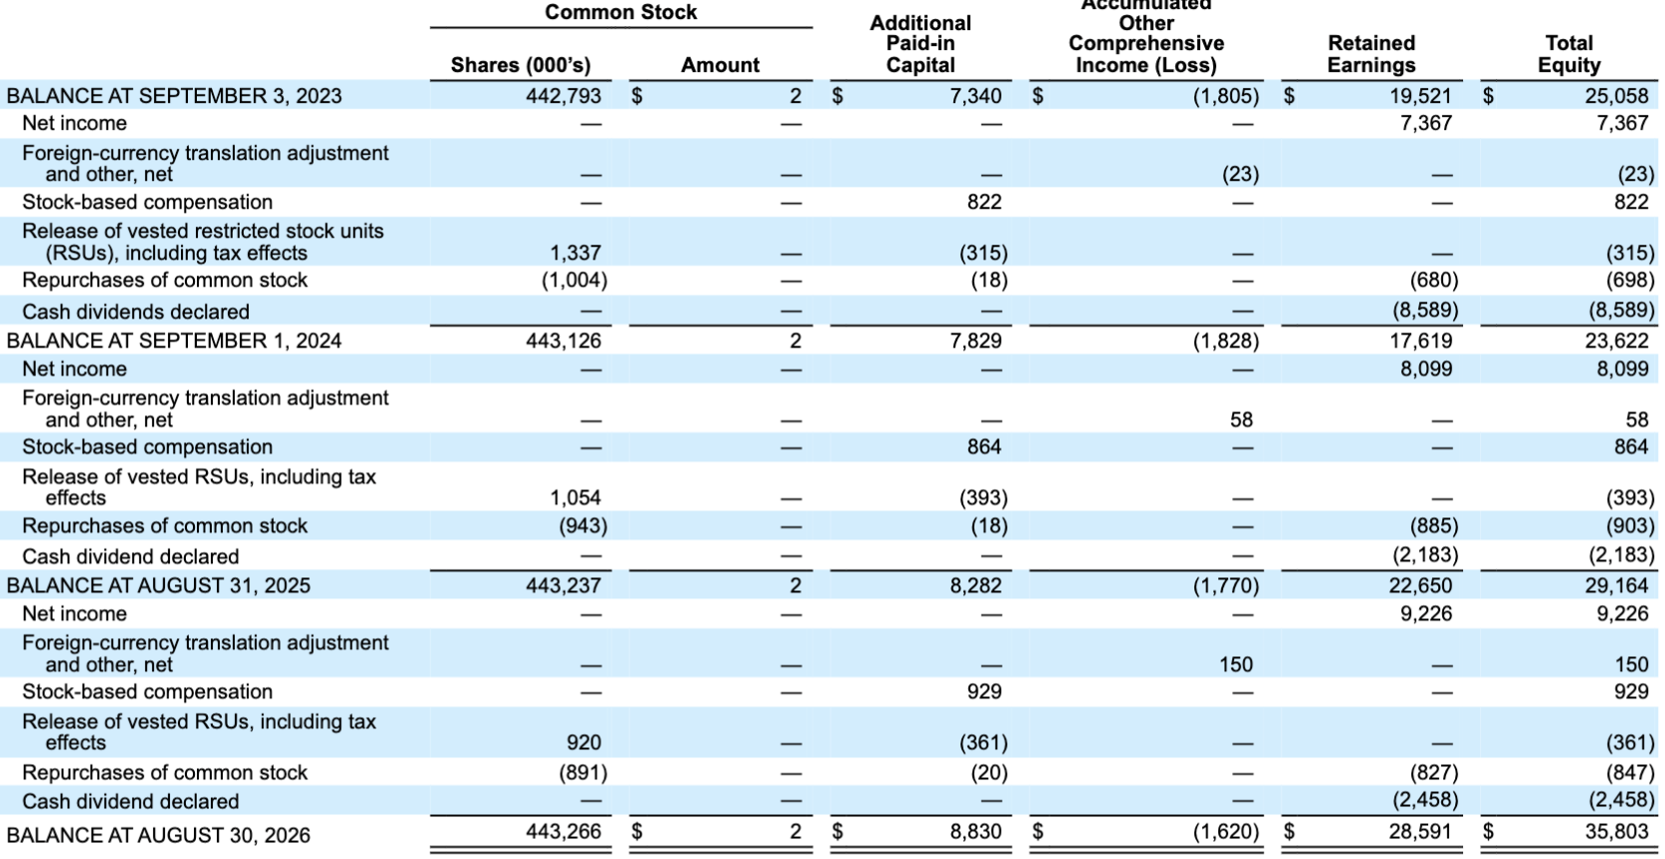
Costco’s FY 2026’s Consolidated Statement of Common Shareholders’Equity
In ‘000,000s

Slide 15
Finance and Accounting
Finance focuses on Cash Flows
Accountants focus on current valuation through the lenses of the BS, IS, and SoCF
Important Differences: Accruals
  long-term (depreciation), and
  short-term (changes in working capital, e.g., accounts receivable, and corporate income taxes)

Slide 16
Cash Flows (Finance) vs. Accruals (Accounting)
Accrual vs. cash method of accounting
  Sales
  Payables, such as interest
  Capital expenditures vs. expenses
Depreciation
  Accounting
  Economic
  Tax (SL v. accelerated)
  Useful life, salvage value, and conventions
  Depreciation is NOT a CF, but it affects taxes, a CF

Slide 17
Fair Value
Classification of Securities with readily determinable fair value
  Marketable Securities: liquid assets that the company can and intends to convert into cash, when necessary, but usually within 1 year (current asset)
  Investment In Securities: noncurrent asset
Valuation at Acquisition
  Initially booked at cost

Slide 18
FV: Valuation after Acquisition FASB 115 (Topics 320 and 820)
Trading Securities (TS)
  Held for short-term profit
  Shown on the BS at FV with changes in FV reported in the IS
Securities Available for Sale (AFS)
  Neither TS nor HTM; acquired for operating rather than ST potential
  Shown on the BS at FV with changes in FV reported SHs Equity in Comprehensive Income
Debt Held to Maturity (HTM)
  Debt securities that a firm intends to hold to maturity
  Shown on the BS at amortized cost (premium or discount amortized over the life of the bond as an adjustment to interest)
  Changes in FV not reported in IS or BS unless security value is permanently impaired
Direct Investment Loans
  HFI: shown at amortized cost, with impairment recognized for probable credit losses (delay in timing and amount of E(CF) due to events incurred as of measurement date)
  HFS: lower-of-cost-or-FV, with losses recognized in income

Slide 19
Fair Value Hierarchy
Fair Value:
  “price that would be received to sell an asset or paid to transfer a liability in an orderly transaction between market participants at the measurement date.” SFAS 157, par. 5. (Topic 820-10-35-2)
Level 1: inputs based on prices on active markets of identical asset or liability
Level 2: quoted prices of similar instruments in active markets or identical instruments in inactive markets, or market information on valuation parameters (e.g., yield curves, interest rates)
Level 3: inputs that are not currently observable, such as the firm’s own assumptions regarding valuation parameters that participants would use, e.g., expected CFs, discount rates.

Slide 20
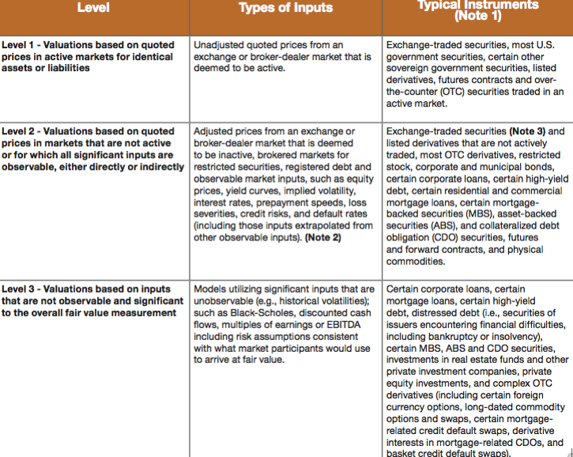
Level Designations and Typical Instruments

Slide 21
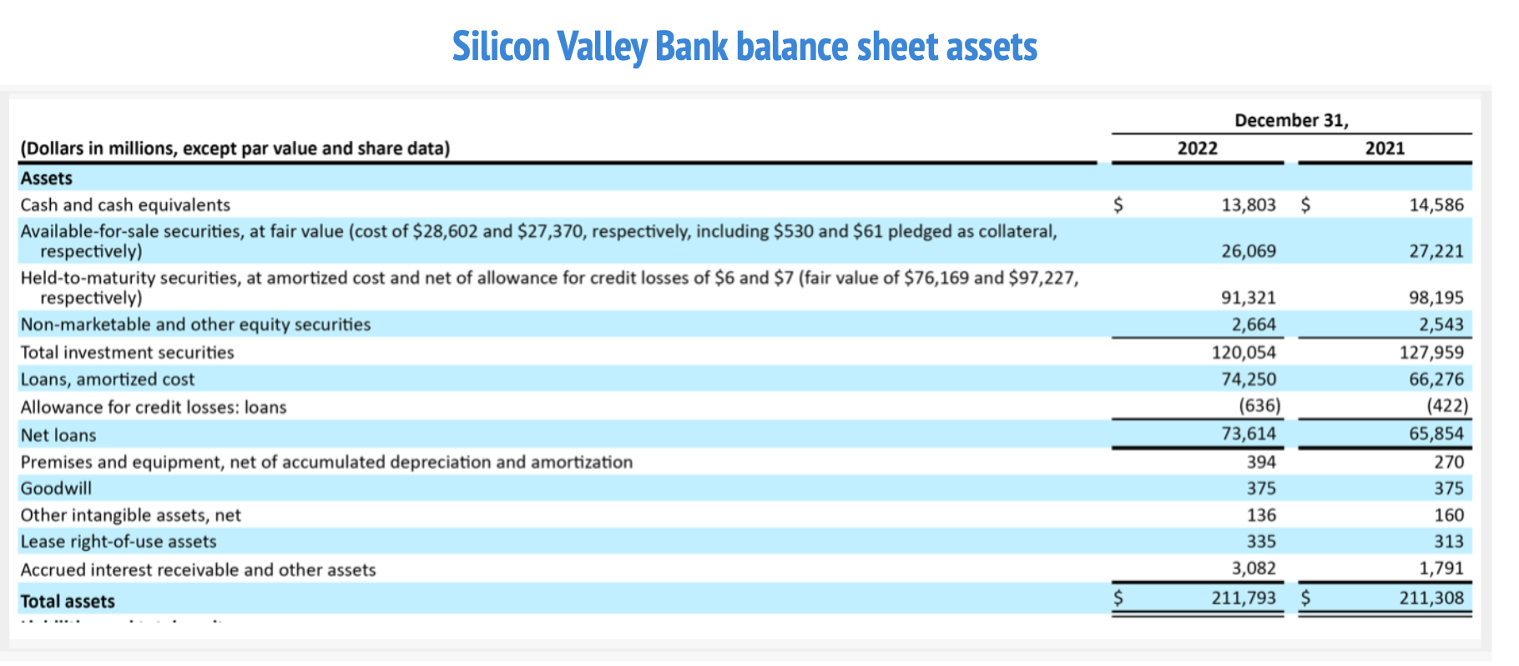
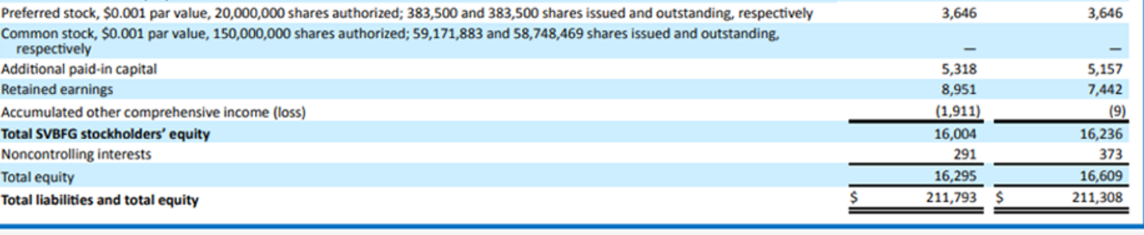
SVB Balance Sheet (2022)
SVB showed cash, AFS, and HTM with a value of around 120Bi.
Its SH equity was 16Bi

Slide 22
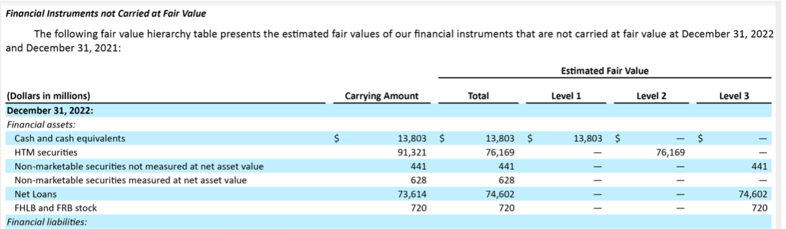
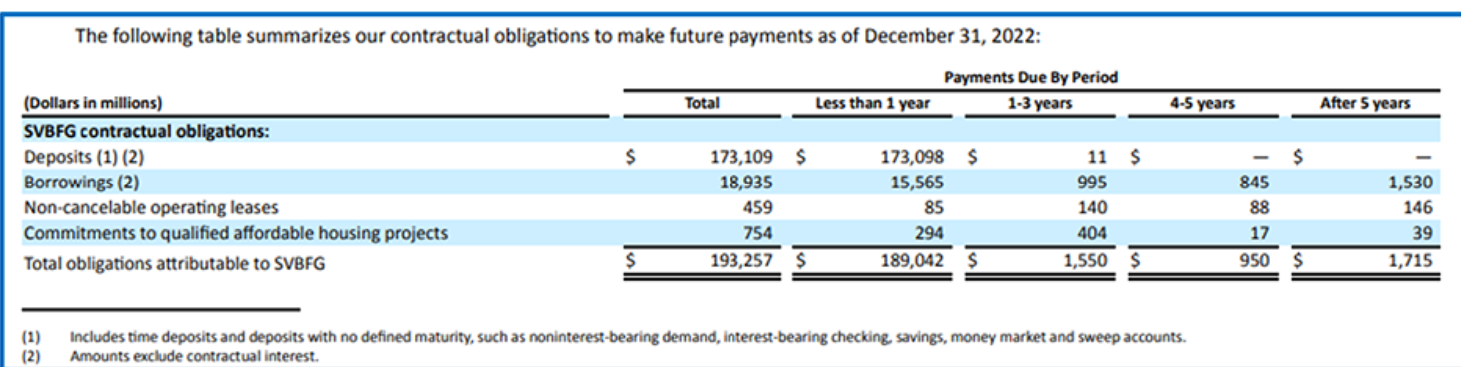
SVB 2022
SVB’s FV of the HTM securities was 76Bi versus 91Bi on the balance sheet.
Had the HTM been instead AFS, the 15Bi of loss would have been recognized in Other Comprehensive Income and would have wiped out virtually all the equity book value.
The FV of cash, AFS and HTM (115Bi) was around 66% of the deposits due under 1 year (173Bi) making it susceptible to a run.

Slide 23
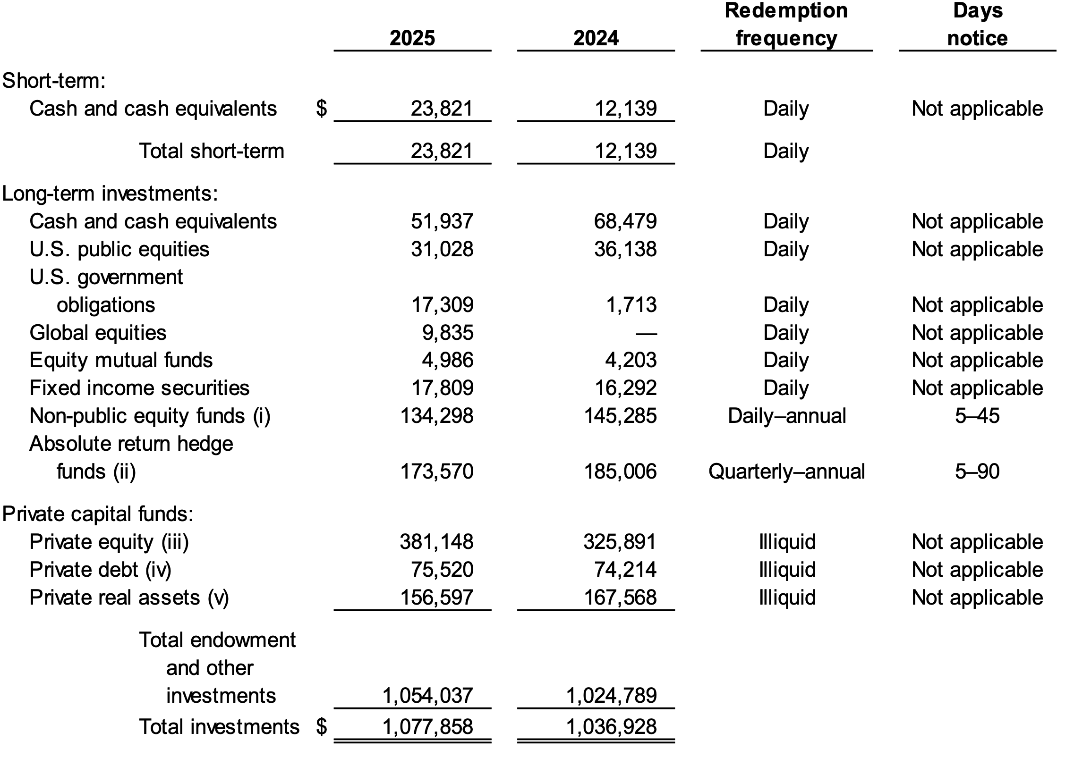
Fordham’s Financials

Slide 24
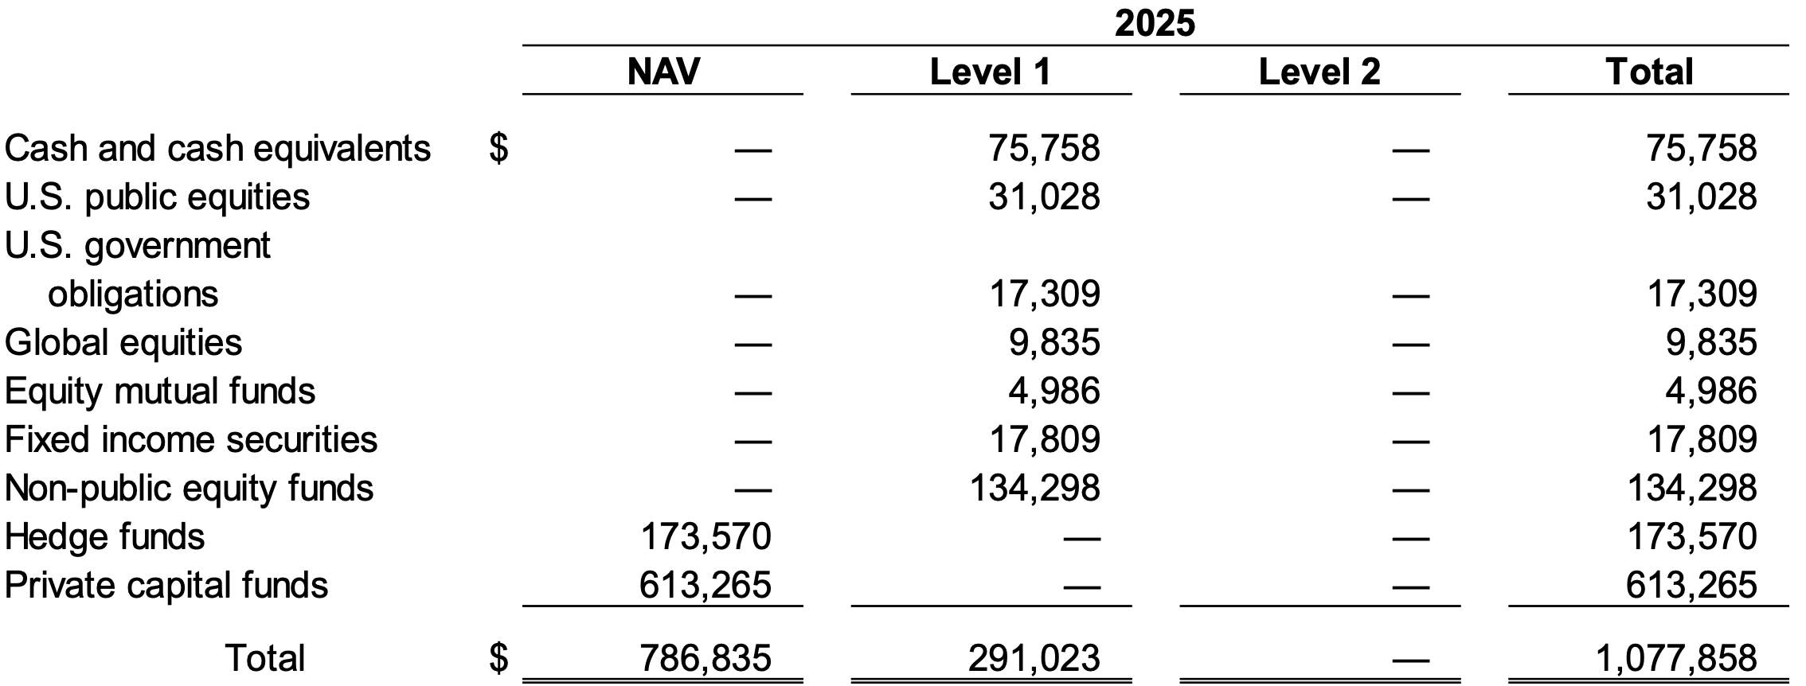
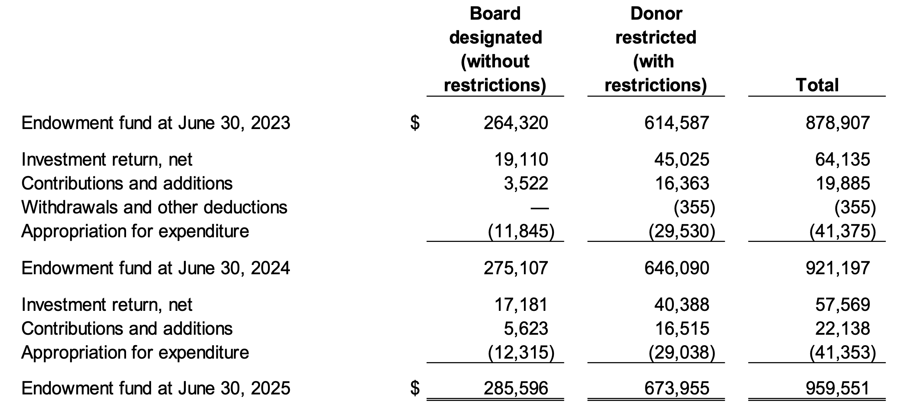
Fordham’s Financials

Slide 25
Cash Flows (Finance) vs. Accruals (Accounting)
Why can’t we just use earnings for our NPV analysis?
Going from Financials to Finance

Slide 26
Unlevered Free Cash Flow: Accounting to Finance
EBIT (Earnings before Interest and Taxes)
+ Depreciation/Amort
- Capital Expenditures
- Taxes (EBIT – Tax Rate)
-Increases (+Decreases) in Working Capital (Inv, Pay)
____________________________________________________________________________________________________________
= Unlevered Free Cash Flow

Slide 27
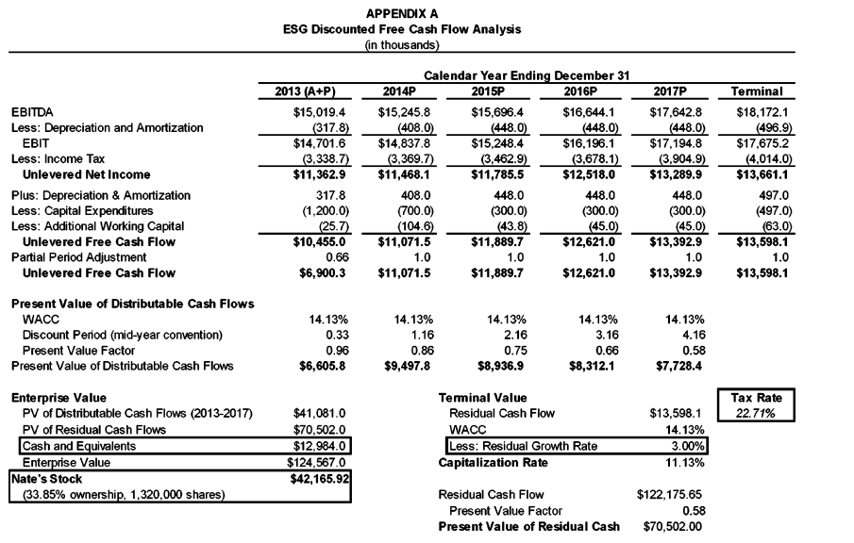
FCF Analysis: Owen v. ESG, Del. Ch. Ct. 2015

Slide 28
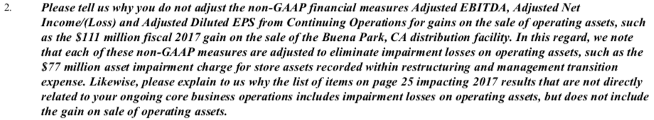
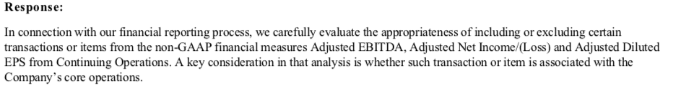
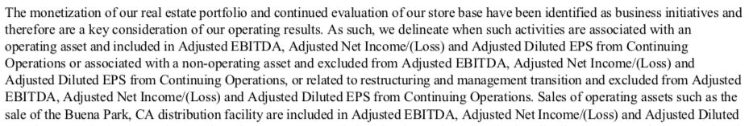
JC Penny (2/3/18)

