Slide 1

The Issue: The Right Discount Rate
$$NPV=C_{0}+{\frac{ℇ(C_{1})}{1+ℇ(r_{1})}+\frac{ℇ(C_{2})}{1+ℇ(r_{2})}}_{ }$$

Slide 2
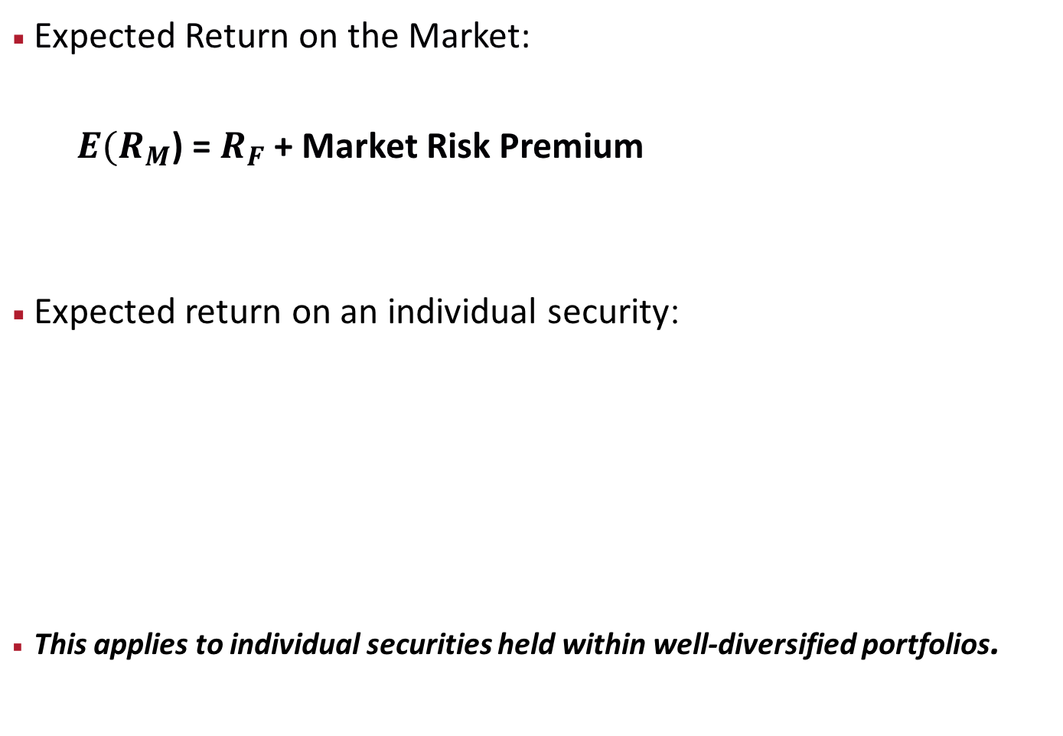
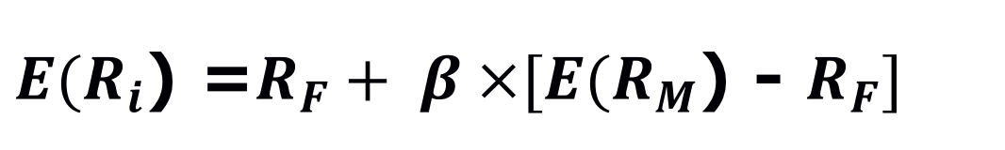
Relationship between Risk and Expected Return: CAPM
Expected Return on the Market:
$E(R_{M}$) = $R_{F}$ + Market Risk Premium
Expected return on an individual security:
This applies to individual securities held within well-diversified portfolios.
$E(R_{i}$) =$R_{F}+ β ×[E(R_{M}$) - $R_{F}]$
Market Risk Premium

Slide 3
Benchmarked Costs of Capital
Short-term
Long-term
Project
Risk-free Bonds
Equity

Slide 4
ERP Estimates: Academic Corporate Finance Textbooks
Source: Pablo Fernandez (2013)

Slide 5
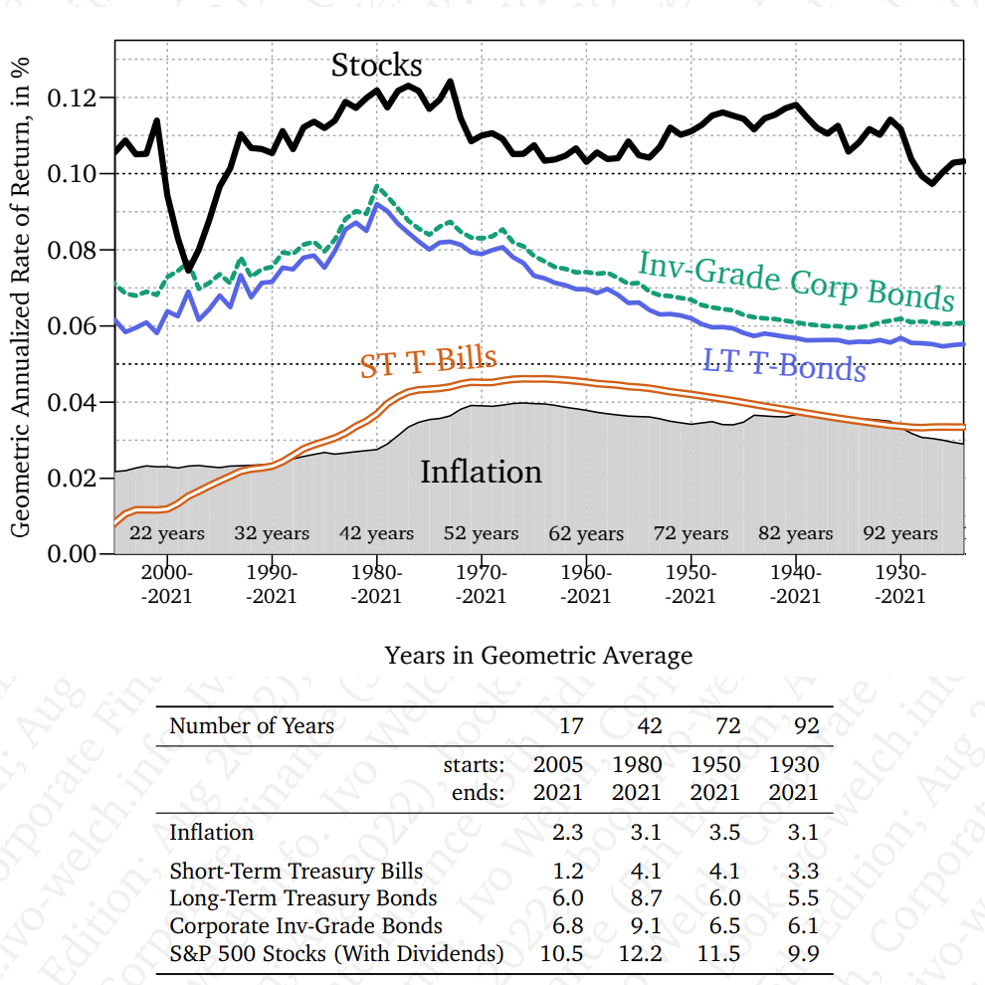
Asset Class Geometric Rates of Return

Slide 6
Equity Risk Premium
Historical averages for r_{m}:
Time period?
25?, 50?, 100 years?
LT bonds or ST bills for r_{f}?
How does Welch break down the equity premium?
See p. 198
From Ex. 9.2, what has been approximately the term premium and risk premium over the last 50 years?

Slide 7
Risk-free Rate
Short-term rates
Long-term rates
Duration matching of cash CFs
Average rates or midpoint of CFs
Consistency with r_{f} in equity premium

Slide 8
Equity (Market) Risk Premium
ERP = E(r_{m}) - r_{f}
Extra return a risky (stock-like) project has to offer above the risk-free rate
Extra return a stock-like investment promises above the risk-free rate

Slide 9
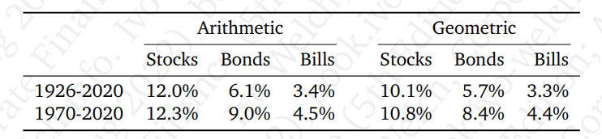
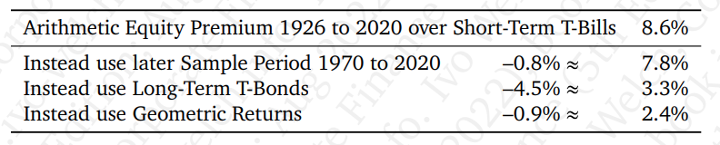
Equity Risk Premium: Where does the 8% Number Come From
What’s the FV of annual investments of 10k earning 8% for 40 years?

Slide 10
CAPM Inputs: Equity Risk Premium
Historical averages for r_{m}:
Geometric v. arithmetic?
Note: The practice is to use arithmetic in the NPV formula. What is that implicitly assuming the future relative performance of stock vs. bonds in the future? CF, p. 199.
Peso problem: What’s this?
Adjustment for bubbles and busts?
Dividend or earnings yields [Skip]

Slide 11
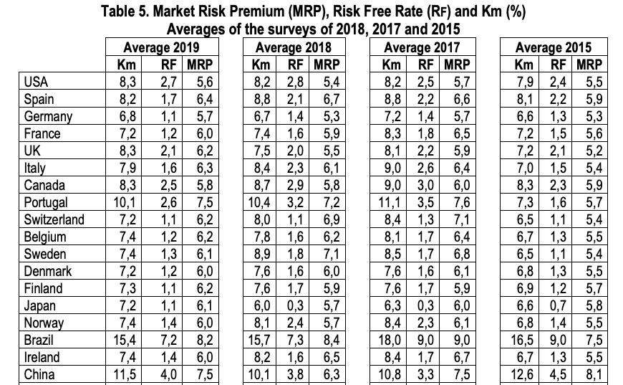
Equity Risk Premium: Surveys
Source: Market Risk Premium, Fernandez (2019)

Slide 12
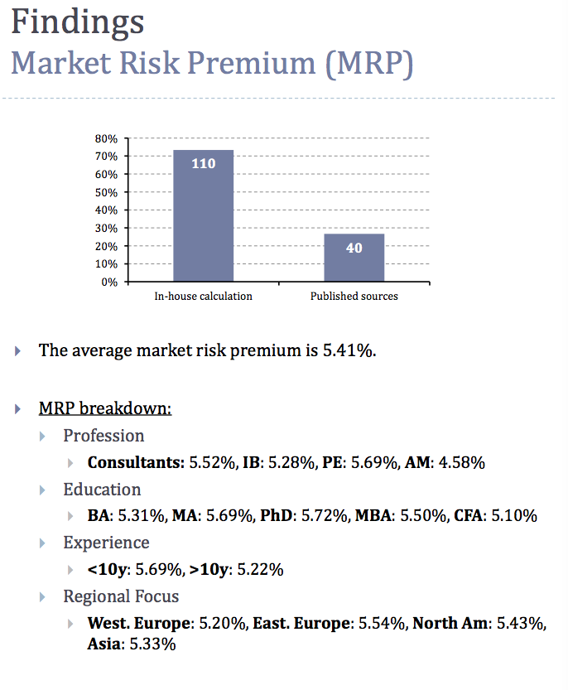
Market Risk Premium
Source: Nyborg & Mukhlynina, 2016

Slide 13
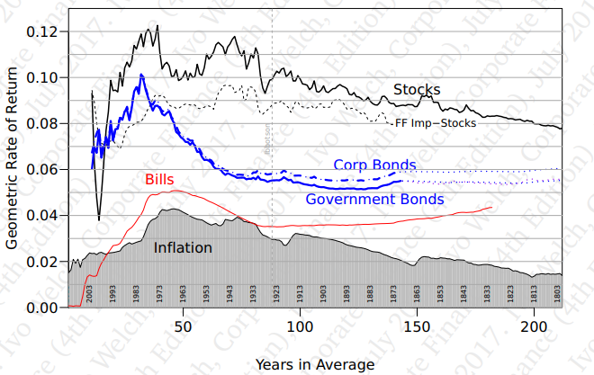
ERP: Internal Cost of Capital

Slide 14
Benchmarked Costs of Capital
Short-term
Long-term
Project
Risk-free Bonds
Equity

Slide 15
Asset Cost of Capital and Equity Cost of Capital
The relationship between the expected return of the firm’s debt, equity, and assets is:
Debt
Equity
E(r)_{Asset} =
x E(r)_{Debt} +
x E(r)_{Equity}
Debt + Equity
Debt + Equity

Slide 16
Rate of Returns: Risk Premiums
Promised/Quoted/Stated Return
Expected Rate of Return:
In CAPM or benchmark RoR, different assets have different E(r)
Contract/Risk/
Liquidity Premiums
Credit/Default Premium
Risk,
Contract, and
Liquidity Premiums
Time Premium
Time Premium

Slide 17
Expected Return Example: Supplying Default Risk
A corporate bond promises 1,000 one year from today. You estimate that it will pay 1,000 with a p=95% and will default entirely with a p=5%. If the bond is 75% like risk-free debt and 25% like equity, the risk-free rate is 2% and the E(r_{m}) is 6%, find the price of the bond.
E(r_{bond}) = 75%*2% + 6%*25% = 3%
E(cf) = 950 [probability * outcome]
PV = 950/(1+.03) = 922.33 [PV formula: E(cf) / 1+ E(r_{bond})]
Promised ROR = 8.4% [(1000-922.33)/922.33]
Risk Premium = 1% [3% – r_{f} of 2%]
Default Premium =5.4% (on average, will be zero)
Time Premium = 2%
Default Risk -> numerator; risk aversion -> denominator

