Slide 1
Corporate Finance
Comparables
Fall 2024
Prof. Jeffrey Colón

Slide 2
Two Approaches to Equity Valuations
NPV (Estimated)
Your project vs. CoC of similar projects
Estimates of inputs, CFs and DR
Less restrictive than comparables
Comparables
Project vs. some attribute/metric, e.g., P/E ratio, sales, EBITDA, book value, of similar companies
Comparable transactions
(a) Finding comparables (firm, transaction) and (b) choosing correct attribute
Verifiable inputs—aka
Law of One Price: relative valuations
Companies with similar attributes should have the similar values
NPV vs. Comparables: The tradeoffs
E(CFs) and E(r) vs. attribute and comparable firms

Slide 3
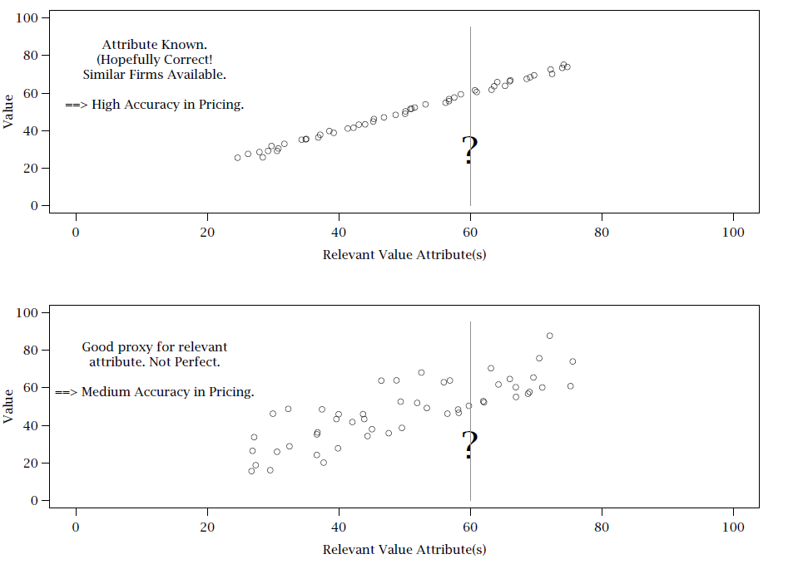
Valuation with Comparables

Slide 4
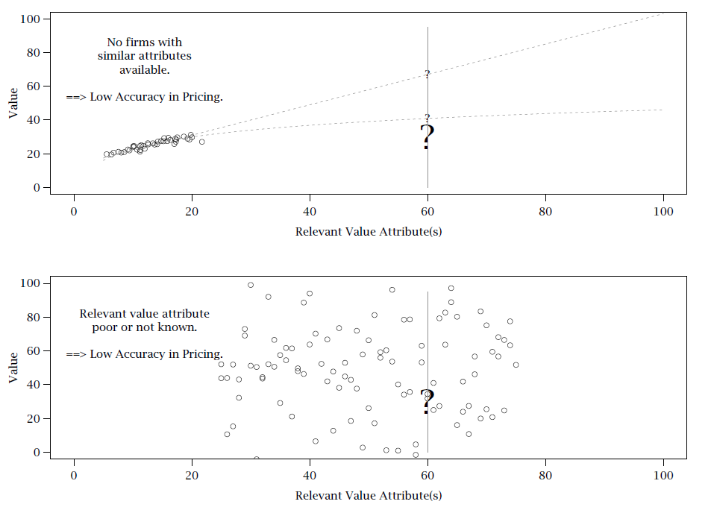
Valuation with Comparables

Slide 5
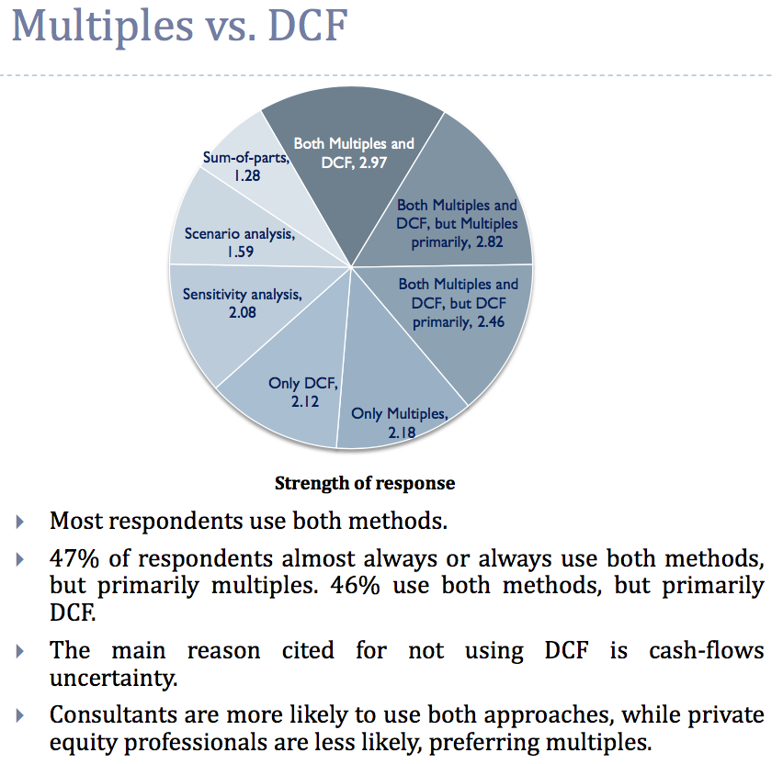
Valuation in Practice
Source: Nyborg, Valuation Survey (2016)

Slide 6
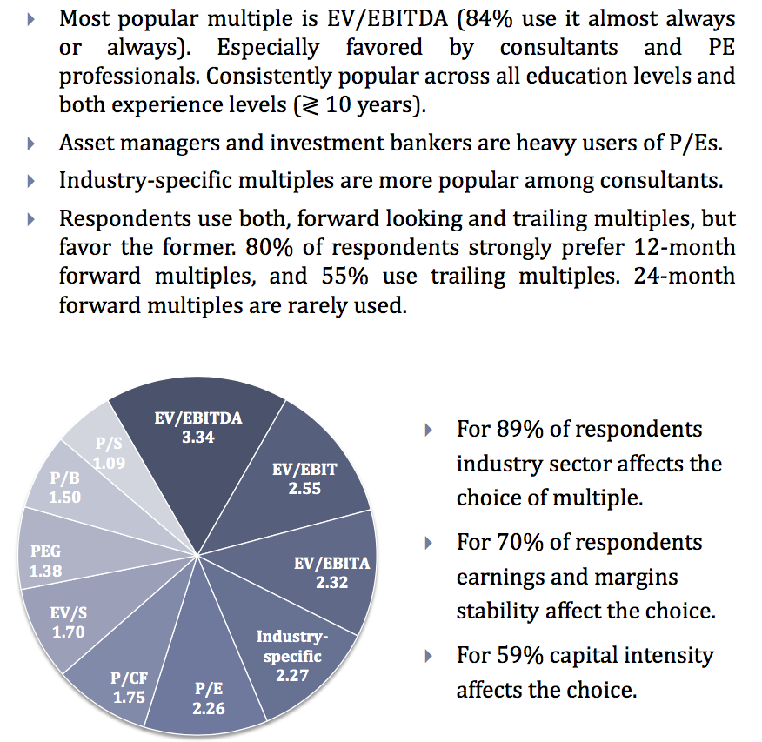
Valuation in Practice
Source: Nyborg, Valuation Survey (2016)

Slide 7
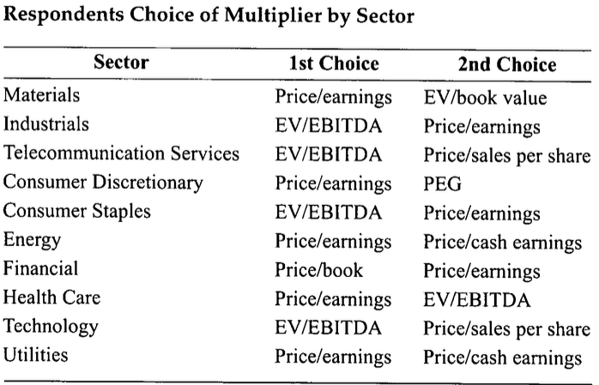
Primary Multiplier Used by the Survey Participants
Block, Methods of Valuation, J. of Investing (2010)

Slide 8
P/E Ratio
P/E Ratio:
Can be calculated on a firm-wide or per-share basis
Earnings: may be better proxy for future CFs than current CFs
Earnings Yield:
Growing Perpetuity Formula:

Slide 9
P/E Ratio: The Role of Growth
Higher P/E ratios may indicate higher future growth
P = 50 / (10% - 2%)
P = 625
P/E = 625 / 50 = 12.5
P = 50 / (10% - 5%)
P = 1000
P/E = 1000 / 50 = 20

Slide 10
P/E Ratio: PVGO
The price of a share can be calculated as the sum of
(1) its price as a cash cow (no growth), plus
(2) the value of its growth opportunities (which can be negative).
Assume E₁ is 5, E(r) is 10%, and E(g) is 5%.
P = 5 / (.10 - .05)
P = 100
P = 5/.10 + PVGO
100 = 50 + PVGO
PVGO = 50

Slide 11
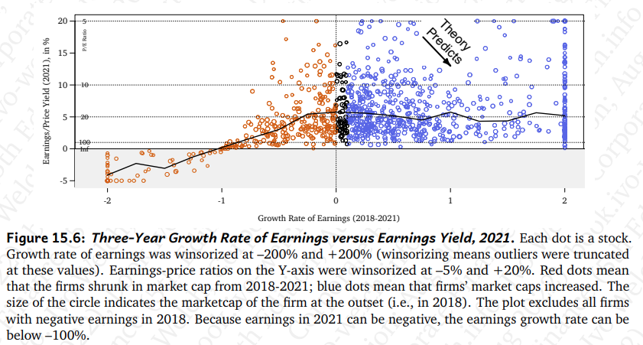
3-yr Growth Rate of Earnings vs. Forward Earnings Yield (E/P) 2021

Slide 12
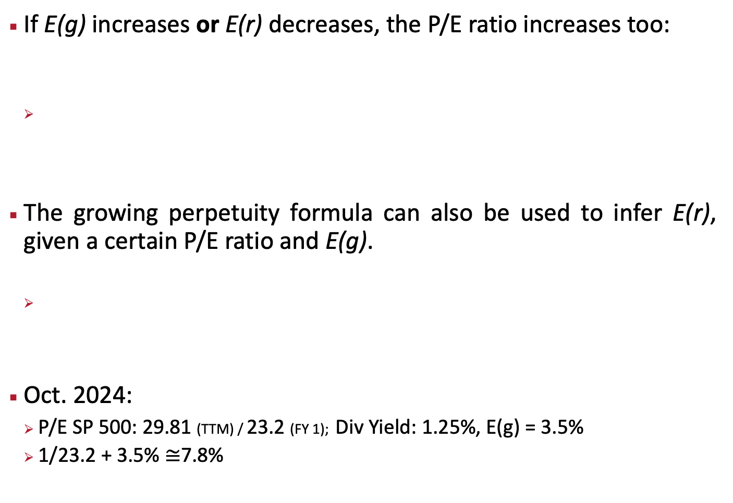
P/E Ratios, E(r), and E(g)
If E(g) increases or E(r) decreases, the P/E ratio increases too:
The growing perpetuity formula can also be used to infer E(r), given a certain P/E ratio and E(g).
Oct. 2024:
P/E SP 500: 29.81 (TTM) / 23.2 (FY 1); Div Yield: 1.25%, E(g) = 3.5%
1/23.2 + 3.5% $≅$7.8%

Slide 13
SP500 Index (real) and SP Earnings (real)

Slide 14
CAPE Ratio
Source: Shiller web page

Slide 15
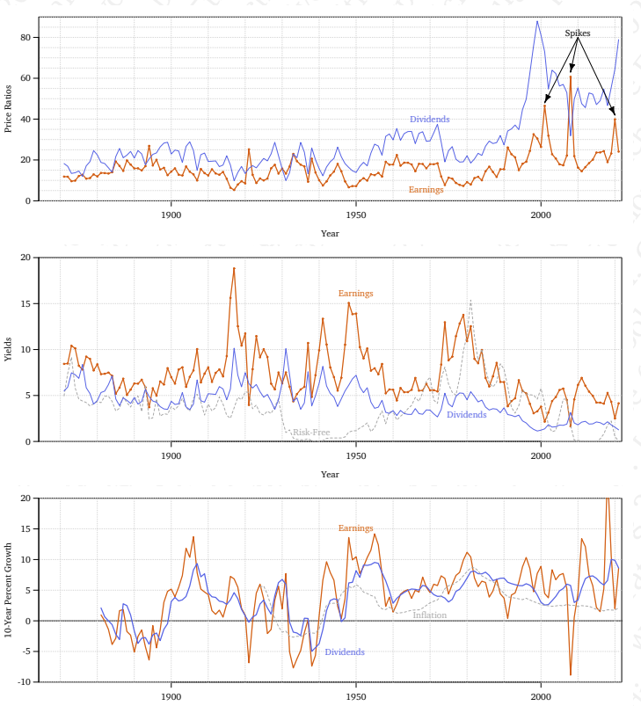
P/E Ratio, Yields, and Growth Rates SP500

Slide 16
Limitations of P/E Ratios
Comparable firms
P/E ratios can’t be value weighted or averaged
Conglomerates (with many divisions) are especially troublesome
Negative (or tiny) earnings problem
Exclude firms w/ negative earnings
Use average aggregate values and earnings
Median
Use average E/P yields and then invert
TTM Figures/quarterly numbers/52-53 week years

Slide 17
P/E Ratio Limitations: Debt Adjustments
Debt affects P/E ratios—depends on whether firm has high or low E(g)
High E(g)----->more debt, higher P/E
Low E(g)----->more debt, lower P/E
Adjustment: Determine P/E of levered firm as if it were unlevered
Add interest expense to earnings to get firm earnings
Add debt back to value of equity to get firm (enterprise) value

Slide 18



P/E and Lots of Other Financial Ratios of Selected Tech Companies:
Name | Market Cap | P/E Ratio | EV / EBITA | EBITDA | EBITDA Margin | P / B | PE 10 | P/ S | EV / FCF | FCF
Alphabet | 2.032T | 23.68 | 16.83 | 115.43B | 35.16% | 6.756 | 57.13 | 6.433 | 31.96 | 60.79B
Meta Platforms | 1.458T | 29.43 | 19.25 | 73.69B | 49.20% | 9.303 | 77.06 | 10.12 | 28.64 | 49.54B
Microsoft | 3.108T | 35.41 | 23.19 | 133.01B | 54.26% | 11.58 | 75.68 | 12.74 | 41.64 | 74.07B
Apple | 3.573T | 35.77 | 26.73 | 135.15B | 35.05% | 53.56 | 62.84 | 9.456 | 34.62 | 104.34B
Amazon | 1.984T | 45.21 | 18.3 | 106.53B | 17.63% | 8.389 | 167.7 | 3.326 | 40.33 | 48.34B
NVIDIA | 3.385T | 64.76 | 53.34 | 62.97B | 65.39% | 58.21 | 495.34 | 35.69 | 71.79 | 46.79B
SP500 |  | 29.94 |  |  |  | 5.15 |  | 3.06

Slide 19
Other Financial Ratios
EBITDA: Earnings Before Interest, Tax, Depreciation, & Amortization
EV/EBITDA, where EV is enterprise value (equity + MV debt - cash)
May be close to cash flow; but taxes and WC needs use cash
Useful in LBOs as EBITDA measures the cash flow that can be used to support debt payments
Can be computed for loss firms since EBITDA is usually positive
Can be used to compare firms with different capital structure (e.g., more debt and higher interest deductions)
May eliminate distortions in depreciation elections; but still subject to aggressive revenue estimates
But doesn’t consider CapEx—where do future earnings come from?
Can’t be used to compare companies/industries with different CapEx requirements

Slide 20
EBITDA
Non-U.S. GAAP Information
In this press release, we have referenced the non-U.S. GAAP financial measure, Adjusted EBITDA. We present results adjusted to exclude the effects of certain specified items (“special items”) that would otherwise be included under U.S. GAAP. Non-U.S. GAAP measures are used by management to review and analyze our operating performance and, along with other data, as internal measures for setting annual budgets and forecasts, assessing financial performance, providing guidance and comparing our financial performance with our peers and may also be used for purposes of determining incentive compensation. Adjusted EBITDA has limitations as an analytical tool and should not be considered in isolation from or as a substitute for U.S. GAAP information. It does not purport to represent any similarly titled U.S. GAAP information and is not an indicator of our performance under U.S. GAAP. Adjusted EBITDA as determined by us may not be comparable with similarly titled measures used by others. Investors are cautioned against placing undue reliance on these non-U.S. GAAP measures. For a reconciliation of Adjusted EBITDA to Operating Profit, see the attached supplementary schedule entitled “Summary Financial Data.
Source: SealedAir 8-k, 10/16/16

Slide 21
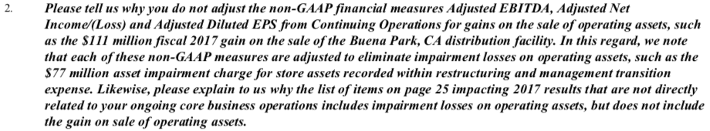
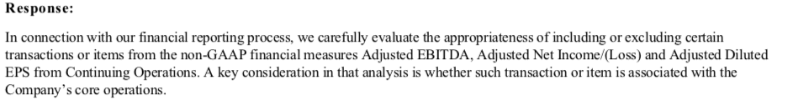
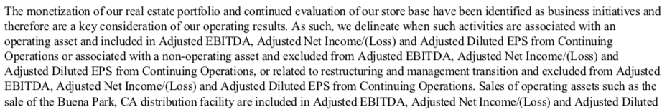
JC Penny (2/3/18)

Slide 22
EBITDA: SEC C&DI (5/17/16)
Question 103.01
Question: Exchange Act Release No. 47226 describes EBIT as "earnings before interest and taxes" and EBITDA as "earnings before interest, taxes, depreciation and amortization." What GAAP measure is intended by the term "earnings"? May measures other than those described in the release be characterized as "EBIT" or "EBITDA"? Does the exception for EBIT and EBITDA from the prohibition in Item 10(e)(1)(ii)(A) of Regulation S-K apply to these other measures?
Answer: "Earnings" means net income as presented in the statement of operations under GAAP. Measures that are calculated differently than those described as EBIT and EBITDA in Exchange Act Release No. 47226 should not be characterized as "EBIT" or "EBITDA" and their titles should be distinguished from "EBIT" or "EBITDA," such as "Adjusted EBITDA." These measures are not exempt from the prohibition in Item 10(e)(1)(ii)(A) of Regulation S-K, with the exception of measures addressed in Question 102.09. [Jan. 11, 2010]
Question 103.02
Question: If EBIT or EBITDA is presented as a performance measure, to which GAAP financial measure should it be reconciled?
Answer: If a company presents EBIT or EBITDA as a performance measure, such measures should be reconciled to net income as presented in the statement of operations under GAAP. Operating income would not be considered the most directly comparable GAAP financial measure because EBIT and EBITDA make adjustments for items that are not included in operating income. In addition, these measures must not be presented on a per share basis. See Question 102.05. [May 17, 2016]

Slide 23
Some More Financial, Liquidity, and Operational Ratios
D/E and Total Liabilities/Equity
Market is preferable to book
LT Debt / MV Equity
Financial Debt / MV Equity
All Liabilities / MV Equity
LT Debt / (MV Equity + BV Debt)
All Liabilities / (MV Equity + BV Debt)
Times Interest Earned: Oper. Inc /Int. Pay.
Current Ratio: Current Assets/Current Liab
Turnover Ratios: Net Sales / Inventories
Days of Inventory Outstanding: 365*Inven/Net Sales
Profit Margin (Return on Sales): NI / Sales
Return on Assets or Equity: NI / Ass or NI / E
Dividend Yield: Div / MV Equity
Payout Ratio: (Div + Equity repurchased) / NI

