Slide 1
Preferred Stock: Overview
General characteristics of preference
Priority in dividends over common (either % or $); negative right
Cumulative dividends
But manager discretion in dividend payments; compare interest & principal debt payments
Priority in liquidation over common based on amount paid
But when you really need this protection, will the company’s assets be sufficient?
Voting rights?
Class votes
Directors, COI amendments, mergers
Redemption rights?
Call rights?
Conversion rights?
Venture capital

Slide 2
Preferred Stock
Pricing
Interest rate risk
Credit risk
Taxes
Not deductible by payor corporation
Qualified dividends for individuals
23.8% (20% + 3.8%) highest rate: compare interest: 40.8% (37% + 3.8%)
Dividend received deduction for Corporations (50%, 65%,or 100%)
Corp has 100 of income and 10 of dividend.
Taxable Inc: 100 + 10 (div) – (50% *10) = 105
ETR: 21% * (1-.50) = 10.5%
Accounting
Mandatorily redeemable stock treated as LT debt

Slide 3
DGCL: § 151(a)
(a) Every corporation may issue 1 or more classes of stock or 1 or more series of stock within any class thereof, …and which classes or series may have such voting powers, full or limited, or no voting powers, and such designations, preferences and relative, participating, optional or other special rights, and qualifications, limitations or restrictions thereof, as shall be stated and expressed in the certificate of incorporation or of any amendment thereto, or in the resolution or resolutions providing for the issue of such stock adopted by the board of directors pursuant to authority expressly vested in it by the provisions of its certificate of incorporation. Any of the voting powers, designations, preferences, rights and qualifications, limitations or restrictions of any such class or series of stock may be made dependent upon facts ascertainable outside the certificate of incorporation or of any amendment thereto, or outside the resolution or resolutions providing for the issue of such stock adopted by the board of directors pursuant to authority expressly vested in it by its certificate of incorporation, provided that the manner in which such facts shall operate upon the voting powers, designations, preferences, rights and qualifications, limitations or restrictions of such class or series of stock is clearly and expressly set forth in the certificate of incorporation or in the resolution or resolutions providing for the issue of such stock adopted by the board of directors.

Slide 4
DGCL: § 151(g)
(g) When any corporation desires to issue any shares of stock of any class or of any series of any class of which the powers, designations, preferences and relative, participating, optional or other rights, if any, or the qualifications, limitations or restrictions thereof, if any, shall not have been set forth in the certificate of incorporation or in any amendment thereto but shall be provided for in a resolution or resolutions adopted by the board of directors pursuant to authority expressly vested in it by the certificate of incorporation or any amendment thereto, a certificate of designations setting forth a copy of such resolution or resolutions and the number of shares of stock of such class or series as to which the resolution or resolutions apply shall be executed, acknowledged, filed and shall become effective, in accordance with § 103 of this title.

Slide 5
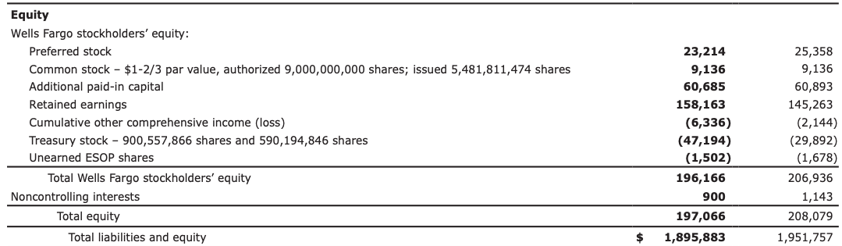
Preferred Stock on the Balance Sheet: Wells Fargo (10-K, 2018)

Slide 6
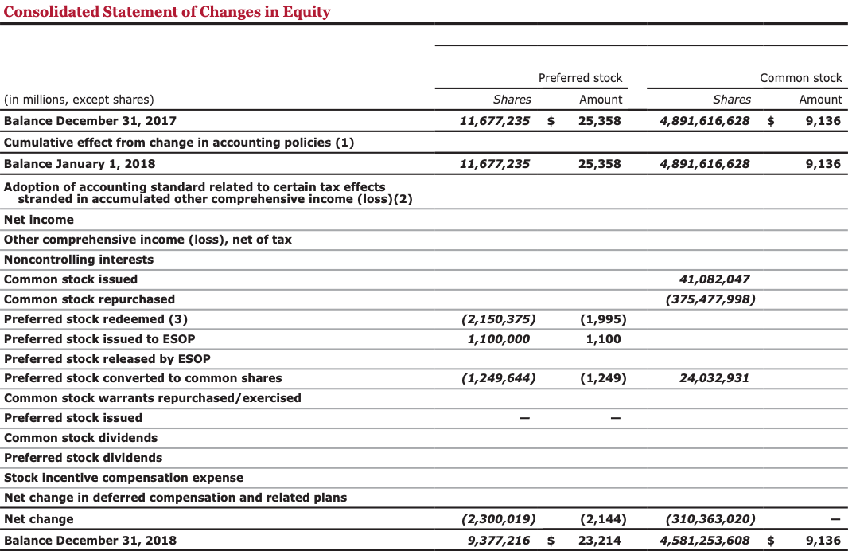
Preferred Stock on the Balance Sheet: Wells Fargo (10-K, 2018)

Slide 7
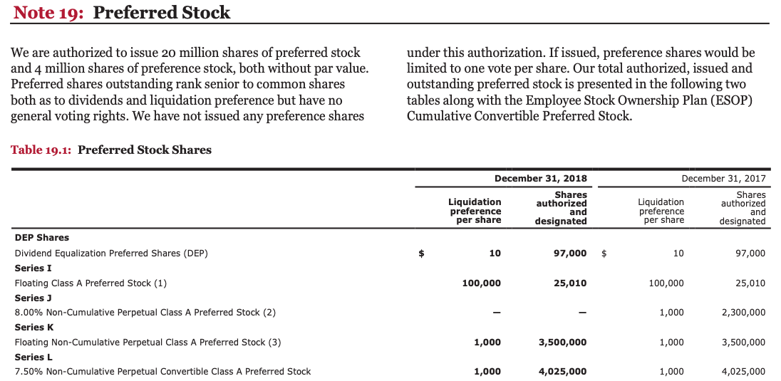
Preferred Stock on the Balance Sheet: Wells Fargo (10-K, 2018)

Slide 8
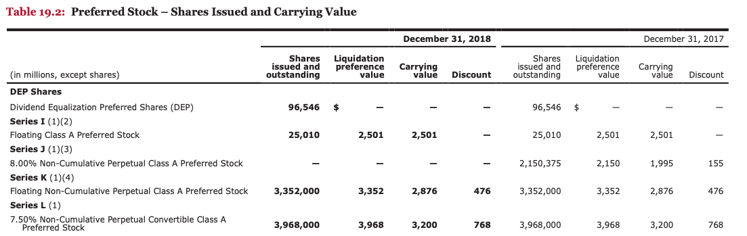
Preferred Stock on the Balance Sheet: Wells Fargo (10-K, 2018)

Slide 9
GenTech COI
Read Article 4(b) of GenTech’s Certificate of Incorporation
In the absence of this provision, what would GenTech have to do to issue preferred shares?
Where else have you seen before this type of provision?
Read the ”RESOLVED” paragraph of the GenTech BOD resolution

Slide 10
GenTech Preferred: Elements of Preference
Voting Rights
Does the GenTech Series A Preferred Stock (Series A) have voting rights? (4(d)(3)).
In regular corporate matters, is that right significant?
For which matters does the Series A have a class vote? (4(d)(3)(a)).
When can the Series A elect its own directors?
4(d)(3)(b)(i)
4(d)(3)(c)(i)
When do these rights end? (4(d)(3)(b)(v)) and (4(d)(3)(c)(v)).
Can the Series A elect 4 directors in the case of both dividend and redemption arrearages? (4(d)(3)(c)(i))
What is the need for DGCL § 242(b)(2)? How does it help to protect preferred shareholders?

Slide 11
DGCL § 242(b)(2)
(2) The holders of the outstanding shares of a class shall be entitled to vote as a class upon a proposed amendment, whether or not entitled to vote thereon by the certificate of incorporation, if the amendment would increase or decrease the aggregate number of authorized shares of such class, increase or decrease the par value of the shares of such class, or alter or change the powers, preferences, or special rights of the shares of such class so as to affect them adversely… The number of authorized shares of any such class or classes of stock may be increased or decreased (but not below the number of shares thereof then outstanding) by the affirmative vote of the holders of a majority of the stock of the corporation entitled to vote irrespective of this subsection, if so provided in the original certificate of incorporation, in any amendment thereto which created such class or classes of stock or which was adopted prior to the issuance of any shares of such class or classes of stock, or in any amendment thereto which was authorized by a resolution or resolutions adopted by the affirmative vote of the holders of a majority of such class or classes of stock.

Slide 12
GenTech Preferred: Elements of Preference
Dividend Rights
What dividends are the holders of the Series A entitled to? (4(d)(2)).
Are the dividends obligatory? (4(d)(2)).
What happens if the dividends are skipped? (4(d)(3)(b)(i)).
Non-cumulative preferred: Will a court imply a right to a dividend if there are otherwise sufficient profits?
‘‘Here we are interpreting a contract into which uncoerced men entered. Nothing in the wording of that contract would suggest to an ordinary wayfaring person the existence of a contingent or inchoate right to arrears of dividends. The notion that such a right was promised is, rather, the invention of lawyers or other experts, a notion stemming from considerations of fairness, from a policy of protecting investors in those securities. But the preferred stockholders are not—like sailors or idiots or infants— wards of the judiciary. As courts on occasions have quoted or paraphrased ancient poets, it may not be inappropriate to paraphrase a modern poet, and to say that ‘a contract is a contract is a contract.’ Guttmann v. Ill. Cen. RR, 189 F.2d 927 (2d. Cir. 1951)

Slide 13
GenTech Preferred: Elements of Preference
Liquidation Preference
What is the Series A liquidation preference? 4(d)(6)).
Does this give a Series A much protection? What will generally be the financial and economic state of the corporation when a liquidation occurs?
Is a merger or sale of substantially all of the assets of the corporation a deemed liquidation? 4(d)(6)).

Slide 14
GenTech Preferred: Elements of Preference
Redemption Rights
Under what circumstances would it be beneficial for a corporation to have a right of redemption?
Is GenTech obligated to redeem the Series A shares? If so, at what price? (4(d)(7)).
Can GenTech redeem more shares than it’s obligated to redeem?
If so, at what price? (4(d)(7) and 4(d)(8)).
Are there any limits to the optional redemption in 4(d)(8)? (4(d)(8)(a) and (b), skim only).
Can GenTech purchase Series A shares in the open market? (4(d)(13)).
What does funds legally available mean in 4(d)(7)? See DGCL 160 and SVIP v. ThoughtsWorks (Del. Ch. 2010) on the class web page. See also (d)(12).
What are other situations in which GenTech can redeem the Series A shares? (4)(d)(9).

Slide 15
Conversion Rights
Sample conversion
Please find a sample and bring it to class.
Conversion price of sample
Conversion ratio of sample

Slide 16
SV Investment Partners, LLC v. ThoughtWorks, Inc. (Del. Ch. Ct. 2010)
What were the basic characteristics of the TW preferred stock?
What was the preferred’s basic redemption right? What was the redemption price?
What was the source of the redemption proceeds?
How much was SVIP owed?
How much did TW offer?
What is the limitation in DGCL 160?
What is surplus under DGCL 154? What’s capital?
What was SVIP’s argument? Why did SVIP argue that TW had sufficient assets to distribute to SVIP?
How does the court respond to SVIP’s argument equating funds legally available with surplus? (p. 641)
What does the Court think of SVIP’s valuation?
Drafting responses:
Omit funds legally available. See Shiftan v. Morgan Joseph Holdings (Del. Ch. 2012) and TCV v. TradingScreen (Del. Ch. 2015)
What is a drag-along right? What protection does that potentially offer preferred shareholders?
Right to elect majority of the board?
Sinking fund?

Slide 17
Bove v. The Community Hotel Corp. of Newport, RI
Before
Merger (Recap)
After (Recap)
SH Equity (all common)
2.1k shares +
21.6k shares (5 common for 1 prd)
SH Equity
Prd: 4.3k shares; 645k in arrears
Com. Hotel Corp
Common: 2.1k shares
1: Form sub
2: Merger
Com. Hotel Corp
Newport Hot. Corp.
Newport Hot. Corp.
Issue: A straight recap would require 100% approval of the preferred; the merger requires a 2/3 vote.
Question: Are the GenTech Series A protected against such a move? (4(d)(3)(a)(vi))

Slide 18
Jedwab v. MGMI (Del. Ch. 1986)
Thus, with respect to matters relating to preferences or limitations that distinguish preferred stock from common, the duty of the corporation and its directors is essentially contractual and the scope of the duty is appropriately defined by reference to the specific words evidencing that contract; where however the right asserted is not to a preference as against the common stock but rather a right shared equally with the common, the existence of such right and the scope of the correlative duty may be measured by equitable as well as legal standards.
With this distinction in mind the Delaware cases which frequently analyze rights of and duties towards preferred stock in legal (i.e., contractual) may be made consistent with those cases that apply fiduciary standards to claims of preferred shareholders.

Slide 19
LC Capital Master Fund, Ltd. v. James
What was the underlying transaction?
What were the terms of the mandatory conversion right? Did it apply in the case of a merger?
What was the preferreds’ liquidation right? Did it apply in the case of a merger?
Why did the acquirer insist on eliminating the preferred in the merger?
Did the preferreds have any vote on mergers?
Did the BoD owe the preferred fiduciary duties?
What were the preferreds’ entitled to in a merger?
How did the BoD allocate the merger proceeds btwn the common and preferred SHs?

Slide 20
GenTech Preferred: Merger Consideration
Does a merger trigger the liquidation preference? 4(d)(6)).
What is the Series A entitled to in a merger? 4(d)(9)).

Slide 21
Equity-Linked Investors, L.P. v. Adams
What was the FMV of Genta at the time of the case? What was the liquidation preference of the Series A?
Was Genta ever profitable? p746
What were the terms of the Series A? p. 746 What happened in the case of a fundamental change? p746, n. 6.
What were the terms (roughly) of the Aries investment? p750
How did that affect the Series A? What did the Series A want?
Why did the court conclude that the BoD didn’t violate their duties by not offering the preferred an opportunity to meet or exceed the Aries proposal? p754
Why didn’t the Court require an auction for control of Genta? Why did it believe that an auction would have favored the preferred over the common? p755

Slide 22
In re Trados Incorporated Shareholder Litigation (2009)
What was Trados’ capital structure like? p760 Who controlled the BoD? p759
What was Trados’ common stock worth in ’04? p760
What was the total consideration in the merger? How much went to management and how much went to the preferred? Common? p762
What was the peferred’s liquidation preference? p762 Why was it triggered?
What facts did P allege regarding the BoD to rebut the BJR? p764
What are the two prongs of the entire fairness SOR?
In light of this reality, the directors breached no duty to the common stock by agreeing to a Merger in which the common stock received nothing. The common stock had no economic value before the Merger, and the common stockholders received in the Merger the substantial equivalent in value of what they had before. In re Trados (2013)

