Slide 1
Standard Options: Call Definition
A standard call is an option giving the "buyer" the right to buy from the "seller" an "underlying asset" for a fixed price ("strike price") at any time on or before a fixed date ("expiration date").
S ≡ current underlying asset price
S* ≡ underlying asset price on expiration date
K ≡ strike price of option (“exercise price”)
t ≡ current time-to-expiration of option (in years)
r ≡ riskless return (annualized)
d ≡ payout return (annualized)
σ ≡ underlying asset volatility
C* ≡ call value/payoff on expiration date
C ≡ current call value/price (“premium”)
C* = max[ 0, S* - K ]
Notes:
3. Introduction to Options → 3.1 Basic Positions

Slide 2
Standard Options: Put Definition
A standard put is an option giving the "buyer" the right to sell to the "seller" an "underlying asset" for a fixed price ("strike price") at any time on or before a fixed date ("expiration date").
P ≡ current put value/price (“premium”)
P* ≡ put value/payoff on expiration date
P* = max [ 0, K - S* ]
Exercise styles:
European: option only exercisable on expiration date
American: option exercisable at any time
Bermudan: option exercisable only at some predefined times
Atlantic: option exercisable depending on underlying asset price
Notes:
3. Introduction to Options → 3.1 Basic Positions

Slide 3
Standard Options: Example
Nov. 17, 2013
buy 1 GOOGLE/Dec/1,035 call
@ $1,490
Nov. 17, 2013 through Dec. 20, 2013
SELL the call at its market price
or
EXERCISE the call by payment of $103,500
in return for 100 shares
or
RETAIN the call and do nothing
Dec 20, 2013: 5:00 p.m. Central Time
secondary market trading ceases
Dec 21, 2013: 5:00 p.m. Central Time
call expires
Notes:
3. Introduction to Options → 3.1 Basic Positions

Slide 4
BUY CALL: P/L Diagram
S = 100
K = 100
t = 1
1 + r = 1.15
1 + d = 1.00
σ = . 3
Profit
25
50
75
125
150
Future Asset Price
Call Value = $18.84
Strategy: Buy asset but
with limited downside.
-25
Loss
Notes:
3. Introduction to Options → 3.1 Basic Positions

Slide 5
SELL CALL: P/L Diagram
S = 100
K = 100
t = 1
1 + r = 1.15
1 + d = 1.00
σ = . 3
Profit
25
Call Value = $18.84
50
75
125
150
Strategy: Be paid to provide the
upside profits of underlying asset.
Future Asset Price
-25
Loss
Notes:
3. Introduction to Options → 3.1 Basic Positions

Slide 6
BUY PUT: P/L Diagram
S = 100
K = 100
t = 1
1 + r = 1.15
1 + d = 1.00
σ = . 3
Profit
25
50
75
125
150
Future Asset Price
Strategy: Short asset but
with limited downside.
Put Value = $5.80
-25
Loss
Notes:
3. Introduction to Options → 3.1 Basic Positions

Slide 7
SELL PUT: P/L Diagram
S = 100
K = 100
t = 1
1 + r = 1.15
1 + d = 1.00
σ = . 3
Profit
25
Put Value = $5.80
50
75
125
150
Future Asset Price
Strategy: Be paid to make up the
downside loss of underlying asset.
-25
Loss
Notes:
3. Introduction to Options → 3.1 Basic Positions

Slide 8
Put-Call Parity
Consider two portfolios:
Portfolio A: a one-month riskless bond with a face value of 100 and a one-month call option on a share of Google (FMV 100) with a strike price of 100
Portfolio B: one share of Google (FMV 100) and a one-month put option with a strike price of 100
In one month, the price of Google will be greater or less than 100:
If the price is 150, for example, and you own Portfolio A, you will exercise the call for 100 with the bond proceeds and purchase the stock for a total payoff of 150. Portfolio B will also be worth 150.
If the price is 50, for example and you own Portfolio B, you will exercise the put and sell your share for 100. Portfolio A will also be worth 100
At expiration the portfolios have the same value so they must have the same value today:
Call + PV(K) = Stock + Put

Slide 9
PUT-CALL Parity Relation: Numerical Example
Underlying Asset Price = S = 100 (dollars) Put Price = P = 5.80 (dollars)
Riskless Return = 1+r = 1.15 Time-to-Expiration = 1 (year)
Current Expiration Date
Date S* < 100 100 < S*
Buy Call - C 0 S* - 100
Buy Put - 5.80 100 - S* 0
Buy 1 unit of Asset - 100 S* S*
Borrow PV₀ of Strike Price 100/1.15 - 100 - 100
Total - 5.80 - 100 + 100/1.15 0 S* - 100
Note: Assume there are no payouts over the year.
C = 5.80 + 100 - 100/1.15 = 18.84
Notes:
3. Introduction to Options → 3.1 Basic Positions

Slide 10
Synthetic Call: PUT + ASSET + BORROWING
S = 100
K = 100
t = 1
1 + r = 1.15
1 + d = 1.00
σ = . 3
Profit
Buy Asset
Synthetic Call
25
Buy Put
50
75
125
150
Future Asset Price
Borrowing
-25
C = $5.80 + $100 - ($100/1.15) = $18.84
Loss
Notes:
3. Introduction to Options → 3.1 Basic Positions

Slide 11
PUT-CALL Parity Relation: Arbitrage Table
Current Expiration Date
Date S* < K K < S*
Buy Call - C 0 S* - K
Buy Put - P K - S* 0
Buy 1/(1+d)^{t} units of Asset - S/(1+d)^{t} S* S*
Borrow PV₀ of Strike Price K/(1+r)^{t} - K - K
Total – P – S/(1+d)^{t} + K/(1+r)^{t} 0 S* - K
Note: Applies only to standard European options with known payouts.
C = P + S/(1+d)^{t} – K/(1+r)^{t}
Notes:
3. Introduction to Options → 3.1 Basic Positions

Slide 12
PUT-CALL Parity Relation: Implications
Creating puts out of calls:
P = C – S(1+d)^{-t} + K(1+r)^{-t}
Replicating borrowing with options:
-K(1+r)^{-t} = – P + C – S(1+d)^{-t} (implicitly borrowing at r)
Replicating short positions with options:
– S(1+d)^{-t} = P – C – K(1+r)^{-t} (implicitly earn interest at r)
Implied riskless return:
1+r = [(P – C + S(1+d)^{-t} )/K]^{-1/t}
Protective Put = Fiduciary Call ( Asset + Put = Call + Cash )
S(1+d)^{-t} + P = C + K(1+r)^{-t}
Difference between C and P determined only by S, K, t, r, d:
C – P = S(1+d)^{-t} – K(1+r)^{-t}
Create Stock—How?

Slide 13
Covered Call: ASSET - CALL
S = 100
K = 100
t = 1
1 + r = 1.15
1 + d = 1.00
σ = . 3
Profit
Buy Asset
25
Sell Call
Covered Call
50
75
125
150
Future Asset Price
-25
Strategy: Like selling insurance;
benefits from reversals.
Loss
Notes:
3. Introduction to Options → 3.1 Basic Positions

Slide 14
Bear Spread: ITM PUT - OTM PUT
S = 100
K₁ = 90
K₂ = 110
t = 1
1+r = 1.15
1+d = 1.00
σ = . 3
Profit
(SELL OTM PUT @ $3.07)
(BUY ITM PUT @ $9.62)
25
50
75
125
150
Future Asset Price
Strategy: Believe asset price
will fall but not very far, and
limit loss if asset prices rises.
-25
Spread Value = $9.62 - $3. 07 = $6.55
Loss
Notes:
3. Introduction to Options → 3.2 Combined Positions

Slide 15
Collar: Asset + OTM Put - OMC
S = 100
K₁ = 90
K₂ = 110
t = 1
1+r = 1.15
1+d = 1.00
σ = . 3
(BUY ASSET @ 100)
(BUY OTM PUT @ $3.07)
(SELL OTM CALL @ $13.97)
Profit
25
50
75
125
150
Future Asset Price
-25
Loss
COLLAR VALUE = $100 - $13.97 + $3.07 = $89.10
Notes:
3. Introduction to Options → 3.2 Combined Positions

Slide 16
Synthetic Forward: OTM CALL - ITM PUT
S = 100
K = 115
t = 1
1 + r = 1.15
1 + d = 1.00
σ = . 3
Profit
Synthetic Forward
25
Sell Put
50
75
125
150
Future Asset Price
Buy Call
-25
C - P = $11.92 - $11.92 = $0
Loss
Notes:
3. Introduction to Options → 3.1 Basic Positions

Slide 17
FORWARDS vs OPTIONS: Arbitrage Table
Expiration/Delivery
Current Date
Date S* ≤ F F < S*
Buy Forward 0 S* - F S* - F
Buy Call (K = F) - C 0 S* - F
Sell Put (K = F) P S* - F 0
Total - C + P S* - F S* - F
On its initiation date, a forward contract is equivalent to a portfolio consisting of one purchased European call and one sold European put on the underlying asset, both with a common expiration date equal to the delivery date, and with a common strike price equal to the forward price.
Notes:
3. Introduction to Options → 3.1 Basic Positions

Slide 18
Straddle: ITM CALL + ATM PUT
S = 100
K = 100
t = 1
1+r = 1.15
1+d = 1.00
σ = . 3
Profit
(BUY ATM CALL @ $18.84)
(BUY ATM PUT @ $5.80)
25
50
75
125
150
Strategy: Believe volatility of
asset price will be high, but have no clue about direction.
-25
Future Asset Price
Loss
Straddle Value = $18.84+$5.80 = $24.64
Notes:
3. Introduction to Options → 3.2 Combined Positions

Slide 19
Out-of-, At-, In-the-Money
CALLS
S > K: "in-the-money" (ITM)
S = K: "at-the-money" (ATM)
S < K: "out-of-the-money" (OTM)
PUTS
S > K: "out-of-the-money" (OTM)
S = K: "at-the-money" (ATM)
S < K: "in-the-money" (ITM)
Notes:
3. Introduction to Options → 3.1 Basic Positions

Slide 20
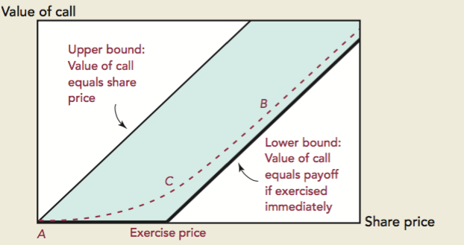
Value of Call
Option Price = (Exercisable Value) + (Premium over Exercisable Value)
(Intrinsic Value) + (Time Value)

Slide 21
Determinants of Option Value: Volatility, Riskless and Payout Returns
Asset Volatility: Buyer of call receives full benefit of favorable asset price outcomes but avoids the unfavorable ones
Riskless Return: The higher the riskless return, the lower the present value of the strike price.
Payout Return: On ex-payout dates, asset prices tend to fall by the amount of the payout.
Effect #1: the higher the payouts, the lower the value of a call relative to the asset (opposite for puts).
Effect #2: optimal timing of exercise.
Notes:
3. Introduction to Options → 3.3 Valuation

Slide 22
Fundamental Determinants of Value: Time-to-Expiration
Time-to-Expiration:
Effect #1: the greater the time-to-expiration, the more time for changes to occur in the asset price.
Effect #2: the greater the time-to-expiration, the lower present value of the strike price.
(these two effects insure, ignoring payouts, that before expiration C > S - K)
Effect #3: the greater the time-to-expiration, the more time for the asset price to be reduced by payouts.
Effect of increase in time-to-expiration via variable on left on:
Call Value Put Value
Volatility ↑ ↑
Riskless Return ↑ ↓
Payout Return ↓ ↑
Notes:
3. Introduction to Options → 3.3 Valuation

Slide 23
Fundamental Determinants of Value
Effect of increase on:
Determining Factors Call Value Put Value
1. Current asset price
2. Strike price
3. Asset volatility
4. Riskless return
5. Payout return
6. Time-to-expiration
↑ ↓
↓ ↑
↑ ↑
↑ ↓
↓ ↑
↑* ↑*
* for European options, could be increasing or decreasing
Notes:
3. Introduction to Options → 3.3 Valuation

Slide 24
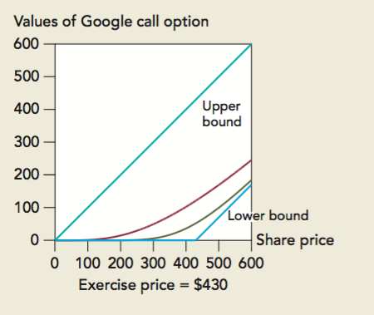
Option Value

Slide 25
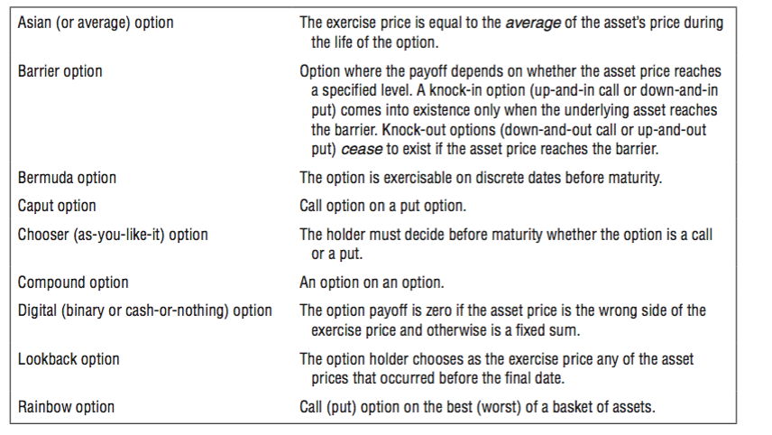
Different Types of Options

Slide 26
Option Valuation
GOAL
Derive the value of a call option by creating a portfolio consisting of the underlying stock and riskless bond so the future payoffs of the [Stock (S) +Bond (B)] portfolio are identical to the Call (C).
NOTATION
1+r ≡ riskless return (over known but arbitrary time interval)
1+u ≡ asset return if increase (up)
1+d ≡ asset return if decrease (down)
q ≡ subjective probability of increase
1+δ ≡ asset payout return [assume δ = 0]
no riskless arbitrage opportunities ➔ 1+ u > (1+r) >1+ d
Notes:
4. Binomial Option Pricing Model → 4.2 Single-Period Model

Slide 27
Option Valuation
Assumptions
S = 100
1+ u = 1.2 [20% return]
1+ d = .9 [-10% return]
1+ r = 1.08 [8% riskless rate]
K = 100
Given these assumptions, in one period C and B will have the following values:
C_{u} = 20 [value of call at expiration if up return occurs]
C_{d} = 0 [value of call at expiration if down return occurs]
B * 1.08 [value of B invested at riskless rate]
Notes:
4. Binomial Option Pricing Model → 4.2 Single-Period Model

Slide 28

Asset, Cash, and Call
q (1+u)S [120] q (1+r)B [1.08B]
100 Asset B Cash
1-q (1+d)S [90] 1-q (1+r)B [1.08B]
q C_{u} [20]
C Call
1-q C_{d} [0]
+
Notes:
4. Binomial Option Pricing Model → 4.2 Single-Period Model

Slide 29
Replicating Portfolio
q (1+u)SΔ + (1+r)B = C_{u}
SΔ + B Asset + Cash
1-q (1+d)SΔ + (1+r)B = C_{d}
choose Δ (# of units of asset) and B ($ in cash):
(1+u)SΔ + (1+r)B = C_{u} (1+d)SΔ+(1+r)B = C_{d}
120Δ + Β1.08 = 20 90Δ + Β1.08 = 0
Notes:
4. Binomial Option Pricing Model → 4.2 Single-Period Model

Slide 30
Solving for Δ and B
Two Equations and Two Variables, Δ and B.
120 Δ + B 1.08 = 20
90 Δ + B 1.08 = 0
30 Δ + 0 = 20
Δ = 0.666
B = -55.55
We know that [Δ S + B] portfolio always has the same payoffs as C in one period, so it must be equal to C today
C = Δ S + B
C = 100*.666 + -55.55
C = 11.11
Notes:
4. Binomial Option Pricing Model → 4.2 Single-Period Model

Slide 31
General Formulas for Δ and B

Slide 32
Option Valuation
C = S Δ + B
= (C_{u} – C_{d}) / (S(1+u) – S(1+d))
B = ((1+u)C_{d} – (1-d)C_{u})/(u-d)(1+r)
Substitute and simplify:
C = S[(C_{u} - C_{d} )/(u-d)S] + [(1+u)C_{d} - (1-d)C_{u} )/(u-d)(1+r)]
r - d u - r
C =
C_{u}
+
(u - d)(1+r)
C_{d}
(u - d)(1+r)
r - d
u - d
C = [pC_{u} + (1 - p)C_{d}] / (1+r) where p =
Notes:
4. Binomial Option Pricing Model → 4.2 Single-Period Model

Slide 33
Binomial Formula: Interpretation
(r - d)
u - d
C = [pC_{u} + (1 - p)C_{d}] / (1+r) where p ≡
exact formula for the value of an option prior to expiration
option value depends only upon S, K, u, d, r, and δ
option value depends only on one random variable: underlying asset price
investor motivation: eliminate arbitrage opportunities; neither rationality nor risk aversion required
Notes:
4. Binomial Option Pricing Model → 4.2 Single-Period Model

Slide 34
Binomial Formula: Interpretation
(r - d)
u - d
C = [pC_{u} + (1 - p)C_{d}]/(1+r) where p ≡
p is a probability since 0 < p < 1; subjective probability q is NOT in the formula; since p satisfies p(1+u) + (1-p)(1+d) = (1+r), p qualifies as a "risk-neutral probability"
the current value of the option, C, is the risk-neutral expected value of the call at the end of the next period, discounted by the riskless return; this is an application of the "risk neutral valuation principle"
Notes:
4. Binomial Option Pricing Model → 4.2 Single-Period Model

Slide 35
Option Valuation: Risk Neutral Valuation
[1] 100 *(1+ r) = p*120 + (1-p) * 90,
where 1+ r = 1.08 [p = .6 and 1-p = .4]
[2] C = [.6 * 20 + .4*0]/1.08
C = 12/1.08
C = 11.11
C = [pC_{u} + (1 - p)C_{d}] / (1+r) where p =
r - d
u - d
Notes:
4. Binomial Option Pricing Model → 4.2 Single-Period Model

Slide 36
Option Valuation: Multi-Period Model
144 [Suu; Cu = 44]
120
108 [Sud/Sdu; Cud/Cdu = 8]
100
90
81 [Sdd; Cdd = 0]
Notes:
4. Binomial Option Pricing Model → 4.2 Single-Period Model

Slide 37
Black-Scholes Formula
C = S*N(x) - PV(K)*N(x - σ√t)
with x ≡ [log(S/PV(K)) ÷ σ√t] + 1/2σ√t
C = S*N(d₁) - PV(K)*N(d₂)
S ≡ current underlying asset price (in dollars)
K ≡ strike price (in dollars)
t ≡ current time-to-expiration (in years)
r ≡ riskless return (annualized)
σ ≡ underlying asset volatility (annualized)
Notes:
5. Black-Scholes Formula → 5.1 Derivation

Slide 38
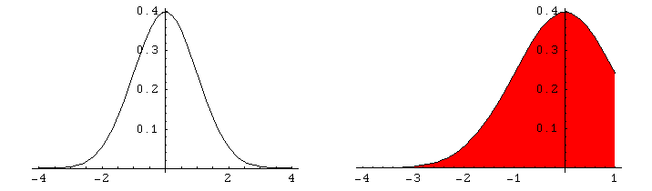
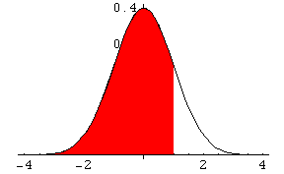
Interpretation of N(x)
N(x): Probability that a random, normally distributed variable with a mean of 0 and SD of 1 is less than x. [Excel: NORMSDIST(x)]
Notes:
5. Black-Scholes Formula → 5.1 Derivation

Slide 39
Black-Scholes Example
Assume S=100, K=100, σ=30%, r=15%, and t=1
N(d₁) = [ln(100/86.96) / .3*1^{.5}] + .5*.3* 1^{.5}
N(d₁) = .46574+.15
N(d₁) = N(.61574) =0.7309667
N(d₂) = N(.61574-.3) = N(.31573981) = 0.6239
100*.7309667 - 86.96* .6239
18.84
NOTE: If you use an online pricing calculator, you need to enter the continuously compounded interest rate equivalent to 15%, which is 13.97%. This is derived from solving for “r”: e^{rt} = 1.15.

Slide 40
Call vs Replicating Portfolio: 1 Year to Expiration
S₀ = 100
K = 100
t = 1
r = 1.15
d = 1.00
σ = . 3
Profit
Call Value = 18.84
25
50
75
125
150
Future or Current Asset Price
Slope of this line is
number of shares in
replicating portfolio:
D = .731
-25
Loss
Borrowing = Call Value - (Current Asset Price × Delta)

Slide 41
Call vs Replicating Portfolio: ½ Year to Expiration
S₀ = 100
K = 100
t = .5
r = 1.15
d = 1.00
σ = . 3
Profit
Call Value = $11.97
25
50
75
125
150
Future or Current Asset Price
lost value = $18.84 - $11.97 = $6.87
Slope of this line is
number of shares in
replicating portfolio:
Δ = .668
-25
Loss
Borrowing = Call Value - (Current Asset Price × Delta)

Slide 42
Implied Volatility and Greeks
If we know all of the B-S inputs, except for volatility, and the current market of the option, implied volatility is the volatility that will make the B-S formula return the current market price
Delta: How much the value of the option changes for small changes in the stock price
Gamma: How much the delta changes for small changes in the stock price
Vega: How much the value of the option changes for small changes in the volatility

Slide 43
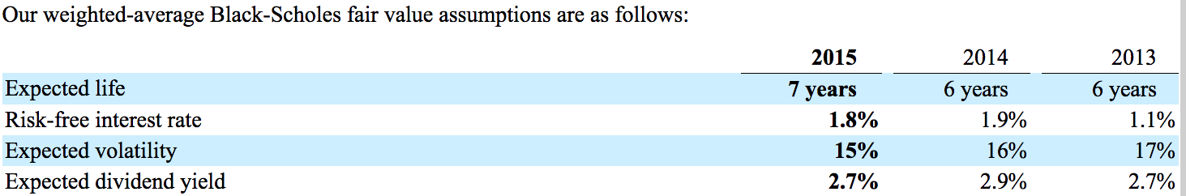
Pepsico Option Disclosure
Method of Accounting and Our Assumptions
We account for our employee stock options under the fair value method of accounting using a Black-Scholes valuation model to measure stock option expense at the date of grant.
All stock option grants have an exercise price equal to the fair market value of our common stock on the date of grant and generally have a 10-year term. We do not backdate, reprice or grant stock-based compensation awards retroactively. Repricing of awards would require shareholder approval under the LTIP.
The fair value of stock-based award grants is amortized to expense over the vesting period, primarily three years, using the following B-S assumptions:
The expected life is the period over which our employee groups are expected to hold their options. It is based on our historical experience with similar grants. The risk-free interest rate is based on the expected U.S. Treasury rate over the expected life. Volatility reflects movements in our stock price over the most recent historical period equivalent to the expected life. Dividend yield is estimated over the expected life based on our stated dividend policy and forecasts of net income, share repurchases and stock price.

Slide 44
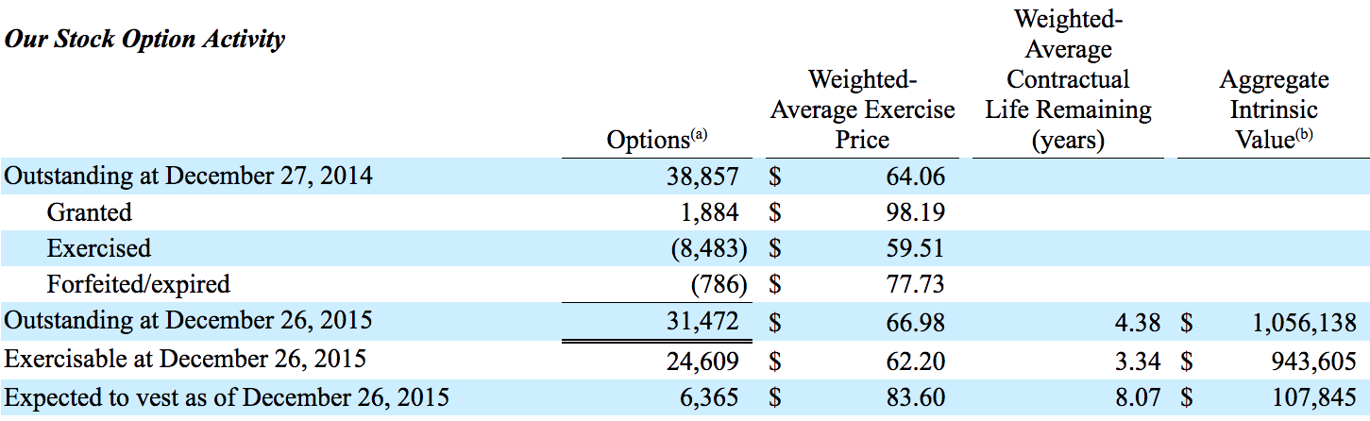
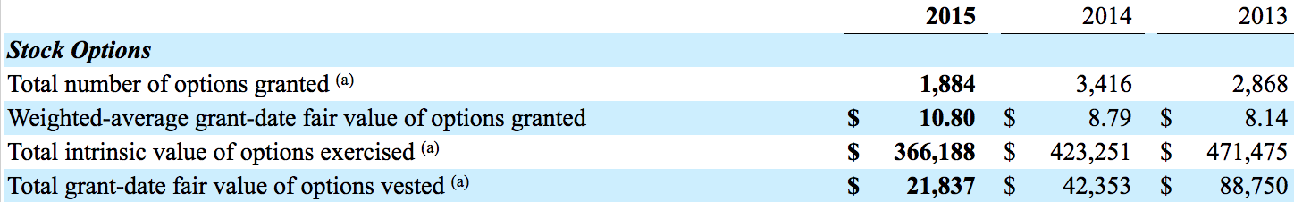
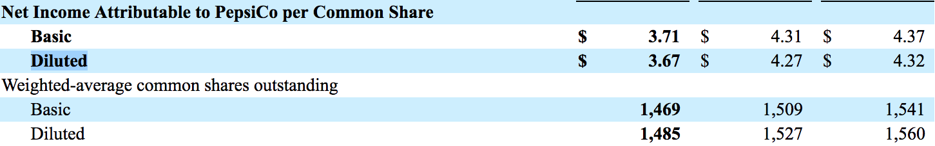
Pepsico Option Disclosure
Notes:
Diluted EPS
Ave#Shares 49,462
Opt P/Share $61.58
Proceeds $3,045,870
Ave Mrkt $96.00
Treasury Shares 31,728
Excess (Ave-Treas) 17,734

Slide 45
The Firm as a Portfolio of Call Options
For a company with debt:
Shareholders can be viewed as having purchased a Call from the bondholders (strike = face value of debt)
If the value of the firm is greater than the debt, the SHs exercise the call and purchase the firm from the bondholders (pay back the debt).
BHs can be seen as owning the firm and having sold a call option to SHs

Slide 46
The Firm as a Portfolio of Put Options
For a company with debt:
SHs can be viewed as:
owning the firm,
owing debt to bondholders, and
having purchased a PUT option from the BHs (strike = debt)
BHs:
Owed the debt
Sold a put to SHs (strike = debt)
If firm > debt, SHs will not exercise the put and will pay back BHs
If firm < debt, SHs will exercise the put and sell the firm to the BHs for the amount of the debt, which is used to pay off the debt. The BHs end up with the firm.
Value of Risky bond = Value of Riskfree bond - Put option

Slide 47
The Firm as a Portfolio of Options
P-C Parity: S + P = C + PV(K)
S is firm/asset value and PV(K) is value of risk-free bond
C = S + P - PV(K)
S - C = PV(K) - P
SHs’ position
as Calls
SHs’ position
as Puts
BHs’ position
as Calls
BHs’ position
as Puts

