Slide 1
Corporate Finance
Market Efficiency
Fall 2026
Prof. Jeffrey Colón

Slide 2
Perfect Markets and Efficient Markets
Perfect Markets
  Market Imperfections (taxes, transaction costs, etc.)
Efficient Markets
  Market sets prices using all available information (future CFs, covariances, liquidity)
    Does it matter if different investors have different information, e.g., insiders?
  Asset Pricing Model for E(r): CAPM? A factor model, such as Fama-French?
    If true E(r) is different from CAPM, is CAPM wrong or market inefficient?
    Every test of market efficiency is also a test of the pricing model behind it.
  Long-term vs. short-term efficiency
Imperfect, efficient markets

Slide 3
Arbitrage
True Arbitrage: Positive CFs in some future scenarios and no negative net CFs, such as buying Apple in London @ 50.90 and selling in NY @ 51.
Risky Arbitrage:
  Suppose that your superior, rational analysis shows that company ABC is overpriced.
  Arbitrage would suggest that you should short the shares.
  After the rest of the investors come to their senses, you make money because you were smart enough to “sell high and buy low.”
  But what if the rest of the investment community doesn’t come to their senses in time for you to cover your short position?
  This makes arbitrage risky.

Slide 4
Perfect Markets and Efficient Markets
A Perfect Market is efficient
An Imperfect Market (taxes, transaction costs) can be efficient.
  Competition by investors to earn “abnormal returns” or “arbitrage profits” will keep prices near to their true values even with some transaction costs.
  If transaction costs to trade are very high, however, prices can stray further from their true values or stay at inefficient levels for some time before different parties act to correct them.

Slide 5
Market Efficiency
U.S. Treasury and U.S. large-cap markets close to efficient
Market for small cap stocks and corporate bonds may not be so efficient
  High bid-ask spreads, especially for bonds
  Shorting difficult
  Higher commissions
Can markets be 100% efficient?
  Probably not. See Grossman & Stiglitz (1980): Informed traders earn just enough, trading against noise traders, to cover the cost of their research.
Efficient markets mean:
  Prices are fair for both investors and issuers
  No need for too much investor due diligence--information already reflected in price.
  But diversification is still important

Slide 6
Reaction of Stock Price to New Information in Efficient and Inefficient Markets
Stock Price
Overreaction to “good news” with reversion
Delayed response to “good news”
Efficient market response to “good news”
-30 -20 -10 0 +10 +20 +30
Days before (-) and after (+) announcement

Slide 7
Reaction of Stock Price to New Information in Efficient and Inefficient Markets
Efficient market response to “bad news”
Stock Price
Delayed response to “bad news”
-30 -20 -10 0 +10 +20 +30
Overreaction to “bad news” with reversion
Days before (-) and after (+) announcement

Slide 8
Market Efficiency
Classical finance proponents believe markets are efficient.
  Efficient Market Hypothesis (EMH) holds for all securities.
Behavioral finance proponents believe markets do not use all available information.
  Behavioral finance views markets as having dumb and smart investors.
  Smart investors find a market rich in opportunities and compete for profits.
Both views on efficiency require arbitrage, and a reasonable amount of perfection in a market is necessary to price assets correctly.
If an investment strategy yields abnormal profits, is that evidence of:
  market inefficiency, or
  a bad pricing model?

Slide 9
Different Types of Market Efficiency
Weak Form
  Security prices reflect all information found in past prices and volume.
Semi-Strong Form
  Security prices reflect all publicly available information.
Strong Form
  Security prices reflect all information—public and even private.
An alternate taxonomy:
  True believer: Price is always PV of the firm’s future cash flows.
  Firm believer: Price deviates from PV, but this is not exploitable.
  Mild believer: Price deviates from PV and exploiting it is possible.
  Non-believer: Price deviates strongly from PV, so investors can easily get rich.

Slide 10
Weak Form of Market Efficiency
Security prices reflect all information found in past prices and volume.
If the weak form of market efficiency holds, then technical analysis is of no value.
Maybe possible to make excess returns by analyzing other company characteristics, such as fundamentals
Notes:
Stock prices following a random walk is not the same thing as stock prices having random returns.

Slide 11
Why Technical Analysis Fails
Investor behavior tends to eliminate any profit opportunity associated with stock price patterns.
Stock Price
If it were possible to make big money simply by finding “the pattern” in the stock price movements, everyone would do it and the profits would be competed away.
Sell
Sell
Buy
Buy
Time

Slide 12
Semi-Strong Form of Market Efficiency
Security Prices reflect all publicly available information.
  Difficult to make money trading on this information (fundamental investing)
Publicly available information includes:
  Historical price and volume information
  Published accounting statements
  Information found in annual reports

Slide 13
Strong Form of Market Efficiency
Security Prices reflect all information—public and private.
Strong form efficiency incorporates weak and semi-strong form efficiency.
Strong form efficiency says that anything pertinent to the stock and known to at least one investor is already incorporated into the security’s price.

Slide 14
Relationship among Three Different Information Sets
All information
relevant to a stock
Information set
of publicly available
information
Information
set of
past prices

Slide 15
What the EMH Does and Does NOT Say
Investors can throw darts to select stocks.
  This is almost, but not quite, true.
  An investor must still decide how risky a portfolio he wants based on risk aversion and the level of expected return.
  Diversification still important
Prices are random or uncaused.
  Prices reflect information.
  The price CHANGE is driven by new information, which by definition arrives randomly.
  Therefore, financial managers cannot “time” stock and bond sales.

Slide 16
The Evidence
The record on the EMH is extensive and generally supports the hypothesis of the efficiency of markets.
  But there are some analomies
Studies fall into three broad categories:
  Are changes in stock prices random? Are there profitable “trading rules”?
  The record of professionally managed investment firms.
  Event studies: does the market quickly and accurately respond to new information?

Slide 17
Are Changes in Stock Prices Random?
Can we really tell?
  Many psychologists and statisticians believe that most people want to see patterns even when faced with pure randomness.
  People claiming to see patterns in stock price movements are probably seeing optical illusions.
A matter of degree
  Even if we can spot patterns, we need to have returns that beat our transactions costs and are adjusted for risk.
Random stock price changes support weak-form efficiency.

Slide 18
Issues: Signal-to-Noise Ratio
Stock returns have a low signal-to-noise ratio--returns are small compared to the noise of the day-to-day volatility
  Daily E(r) = 3bp < E(r) < 7bp. [8% < E(r) (yearly) < 15%]
  Daily SD: individual stocks: 200-300bp; for portfolio, 50-100bp
  E(P₁) = P₀ + m*P₀+ e, where m is 3-7bps [Random Walk Model]
  A signal of 1bp/day translates into ≈ 2.6% per year. [How?]
Complication: Transaction costs: 10bp/day -->23%/year [(1- 0.1%)²⁵² ≈ 78%]
It can take decades of data to determine whether a signal strategy is skill or luck.
  A signal of 1bp extra in a portfolio of 150bp of noise requires 90,000 days of data (p. 337)

Slide 19
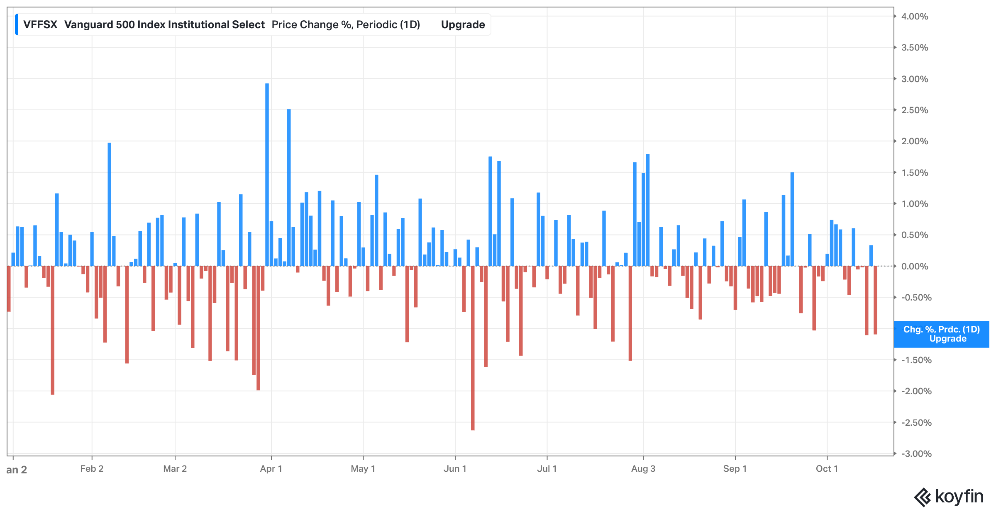
S&P 500 Daily Historical Changes (%): 2026

Slide 20
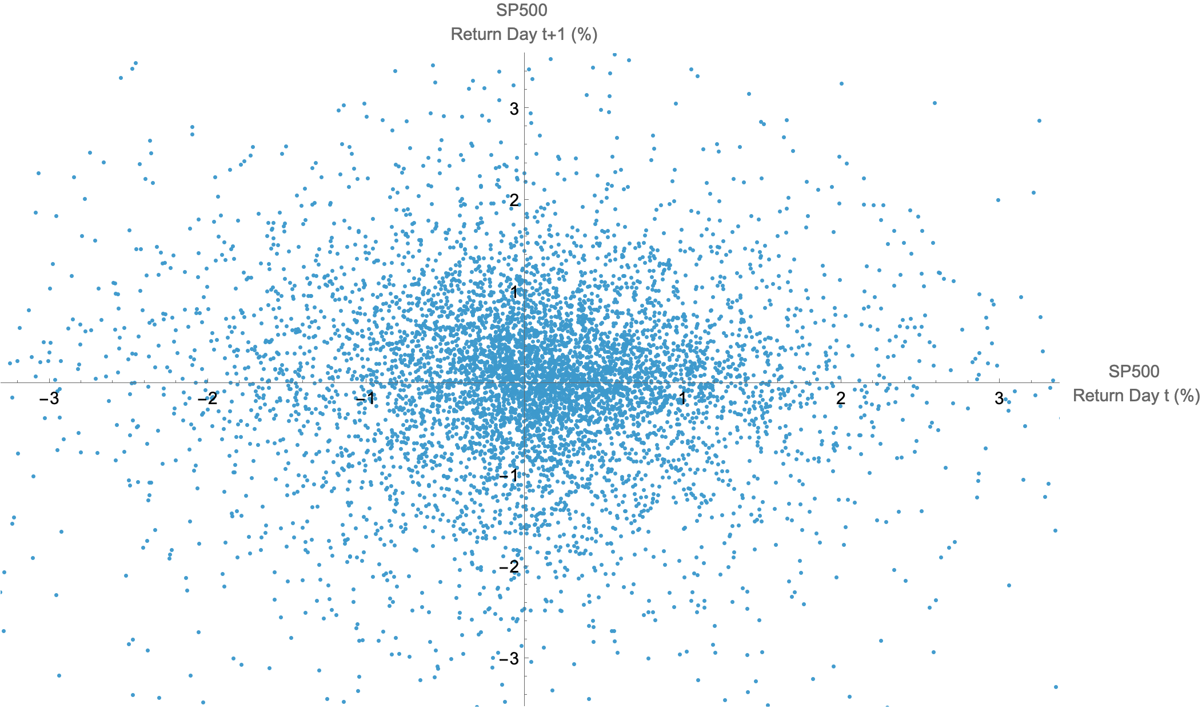
SP500 Daily Returns (t, t+1): 2000-2026 (Oct)
Correlation = -0.0993788

Slide 21
Could you make money if you knew tomorrow’s news today? Maybe not.
Two years ago, we put that conjecture to the test. We called it "The Crystal Ball Challenge." We staked 120 finance-trained adults with $50 each and handed them the front page of the Wall Street Journal - one day before publication, with any mention of market moves blacked out. In effect, we gave them what every trader dreams of: a working crystal ball. They could go long or short the S&P 500 and 30-year Treasury bonds, with leverage if desired. For example, shown Wednesday's front page - reporting on Tuesday's events - they placed their trades at Monday's close and were closed out at Tuesday's close, once the news had played out in the market. Each player got 15 trading opportunities, one front page per year from 2008 to 2022.
The result: our paid players didn't do too well! On average, they broke even and about 1/6 went bust. They weren't great at inferring market direction from the crystal ball, but they were particularly bad at position-sizing. We also invited five very successful macro-traders to play the game and they did pretty well - more on that shortly.
Our Crystal Ball experiment suggests that AIs - particularly Claude and ChatGPT - are roughly as good as expert humans on the what decision, at least when it comes to connecting macro-economic news to near-term market direction. That's a genuinely impressive result.
Source: https://elmwealth.com/ai-trading/

Slide 22
Market Inefficiencies: Fama and French
 | All Firms (%) | Low Betas (%) | High Betas (%)
All Firms | 15 | 16.1 | 13.7
Small Cap | 18.2 | 20.5 | 17
Large Cap | 10.7 | 12.1 | 6.7
 | All Firms | High ME/BE | Low ME/BE
All Firms | 14.8 | 7.7 | 19.6
Small Cap | 17.6 | 8.4 | 23
Large Cap | 10.7 | 11.2 | 14.2
Fama and French (1992). Data from ’63-’90

Slide 23
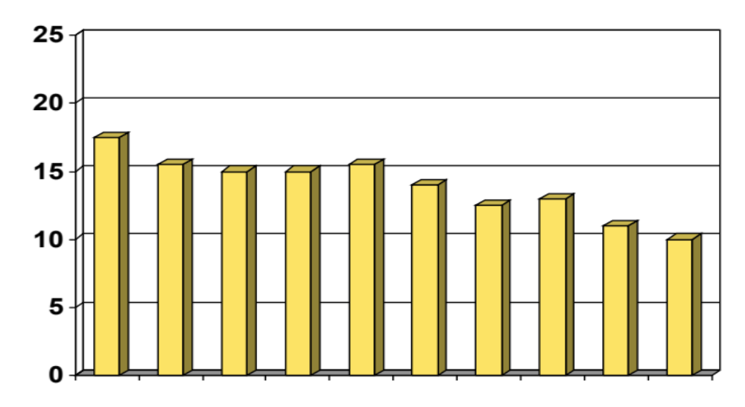
Market Inefficiencies: Fama and French
Company Size versus Average Return
Return
Smallest
Company Size
Largest

Slide 24
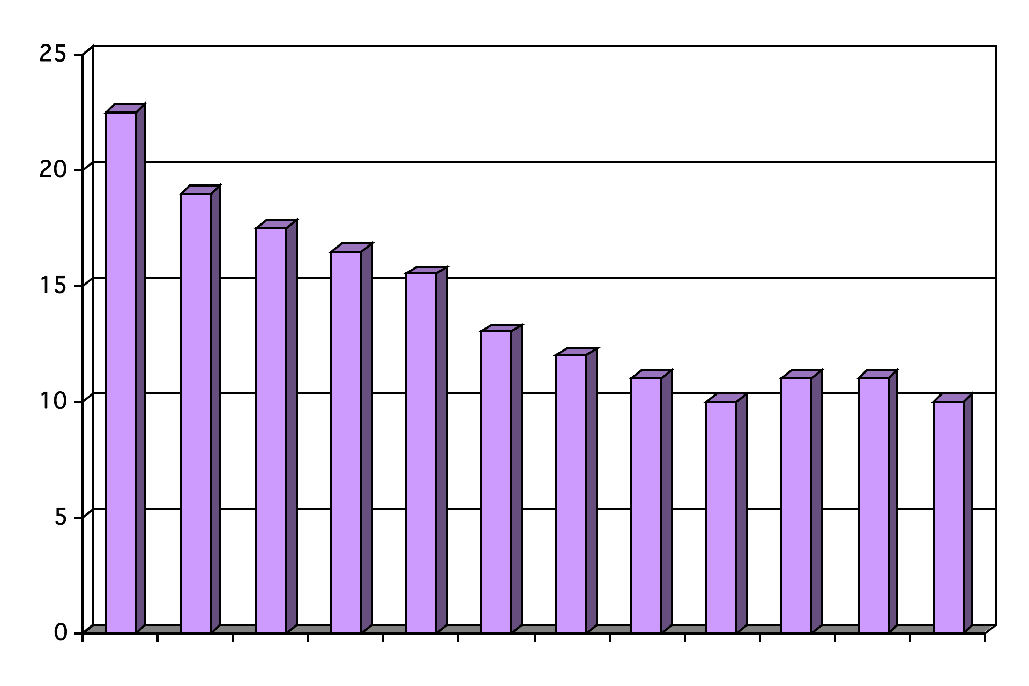
Market Inefficiencies: Fama and French
Book-Market versus Average Return
Return
Highest
Book-Market Ratio
Lowest

Slide 25
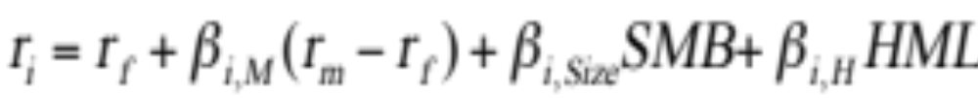
Market Inefficiencies: Fama and French
FF (1992) found:
  The market capitalization or size of a firm is a predictor of its average historical return (SIZE Factor)
  Stocks with low market-to-book ratios tend to have higher returns than stock with high market-to-book ratios (VALUE Factor)
  Differences in beta do NOT explain these differences (MARKET Factor)
FF proposed a three-factor (now 5!) model for expected returns based on:
  the difference between the returns of small stocks and big stocks (R_{SMALL} – R_{BIG})
  the market premium (R_{M} – R_{f}) and
  the difference between the returns of high and low B/M stocks (R_{HIGHBM} - R_{LOWBM})
FF (‘92):
FF (‘15): 2 additional factors:
  Operating Profitability (RMW) & Investment (CMA)

Slide 26
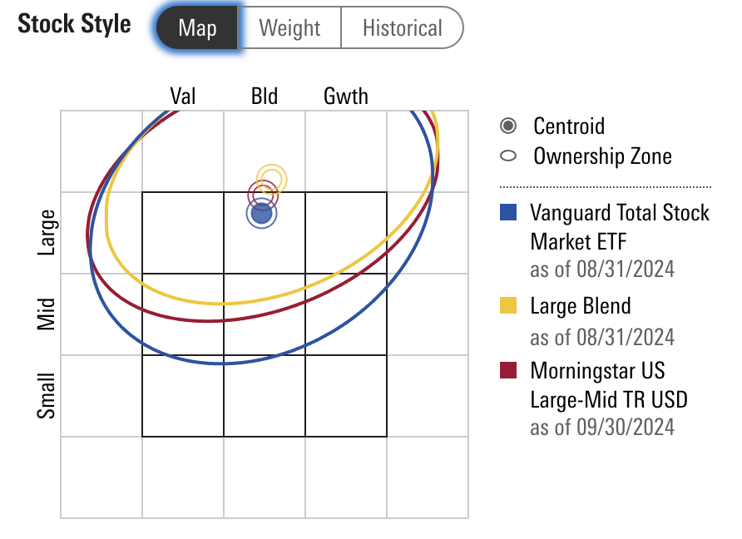
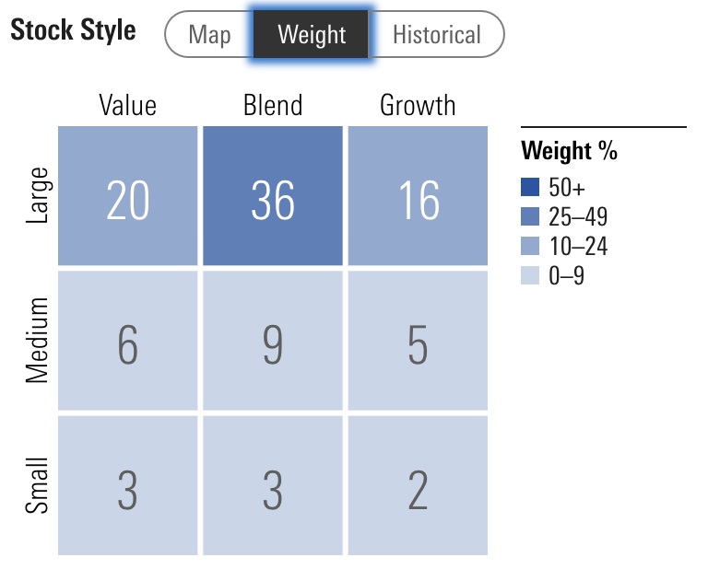
Morningstar Style Tables for Vanguard Total Stock

Slide 27
Size Effect: Illusion?
In the earliest days of empirical work in academic finance, the size effect was the first market anomaly to challenge the standard asset pricing model and prompt debates about market efficiency. The notion that small stocks have higher average returns than large stocks, even after risk-adjustment, was a pathbreaking discovery, and for decades it has been taken as an unwavering fact of financial markets. In practice, the discovery of the size effect fueled a crowd of small cap indices and active funds to a point where the investment landscape is now segmented into large and small stock universes. However, despite its long and illustrious history in academia and its commonplace acceptance in practice, there is still confusion and debate about the size effect. We examine many claims about the size effect and aim to clarify some of the misunderstanding surrounding it by performing simple tests using publicly available data. For one, using 90+ years of U.S. data, there is no evidence of a pure size effect, and moreover, it may not have existed in the first place, if not for data errors and insufficient adjustments for risk and liquidity.
  Fact, Fiction, and the Size Effect, Alquist, Israel, Moskowitz (June 2018)

Slide 28
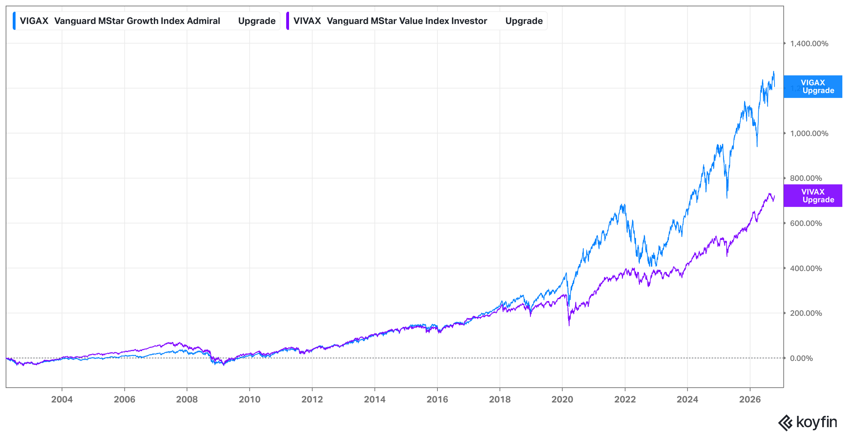
Value Factor: Vanguard Growth MF & Vanguard Value MF (Oct ‘02 – Oct ‘26)

Slide 29
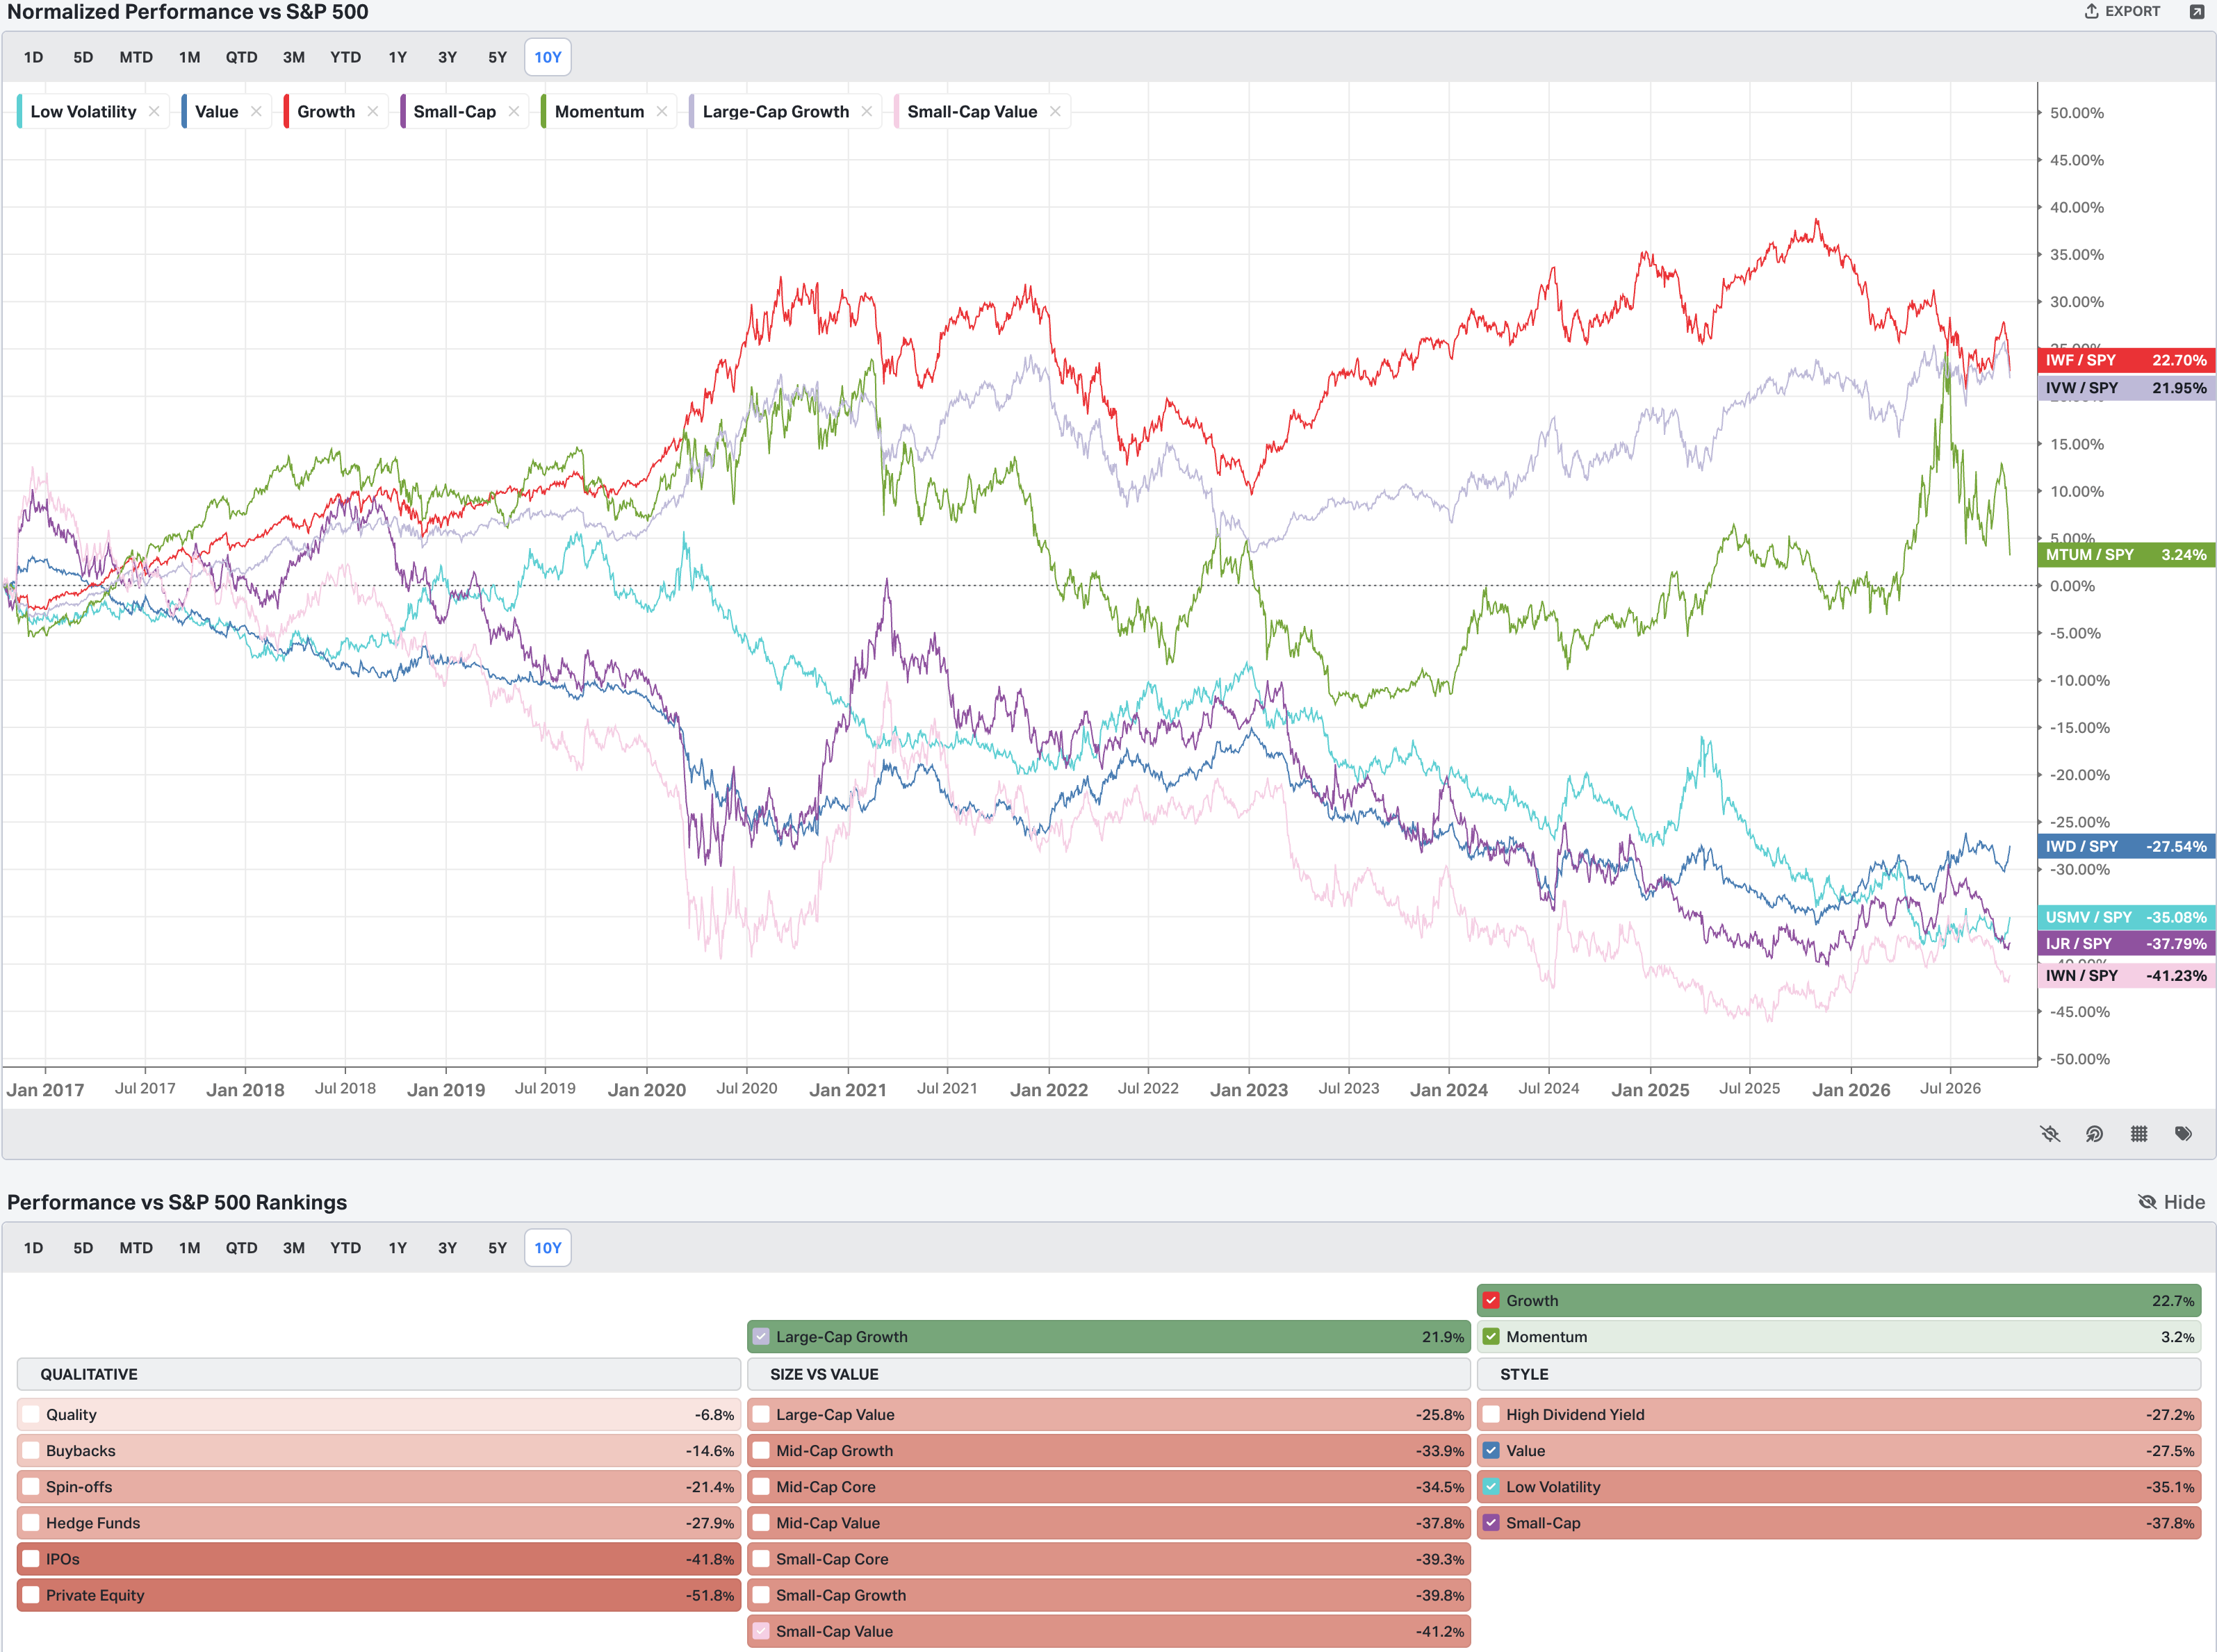
S&P vs. Various Factors (Oct 2026)

Slide 30
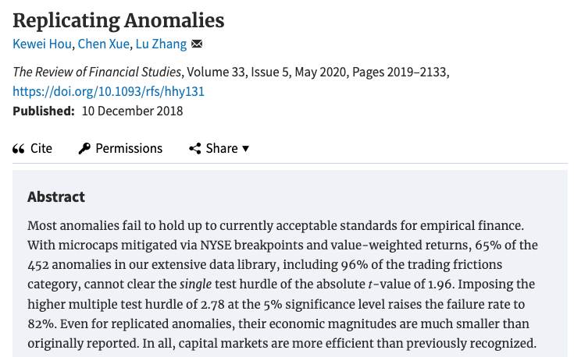
Empirical Challenges to Market Efficiency: Anomalies

Slide 31
The Record of Mutual Funds and Managers
If the market is semi-strong-form efficient, then no matter what publicly available information mutual-fund managers rely on to pick stocks, their average returns should be the same as those of the average investor in the market as a whole.
We can test efficiency by comparing the performance of professionally managed mutual funds with the performance of a comparable market index.

Slide 32
Mutual Funds: Starting in the Red
Average Annual Costs
Management Fee .9%
Other Expenses .6%
Implicit Trading Costs .8%
Loads .7%
Total 3%
TAXES? Maybe another 2%
Total 5%
Average Annual Costs
Management Fee .6%
Other Expenses .3%
Implicit Trading Costs .8%
Loads 0%
Total 1.7%
TAXES? Maybe another 1.5%
Total 3.2%
Source: J. Bogle, “The Arithmetic of Mutual Fund Investing is More Important Than Ever,” (speech given to AAII on 5/24/05) LH; Revised Oct 25 (RH)

Slide 33
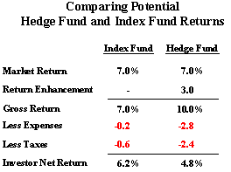
Hedge Funds? Buyer Beware
Source: J. Bogle, “The Arithmetic of Mutual Fund Investing is More Important Than Ever,” (speech given to AAII on 5/24/05)

Slide 34
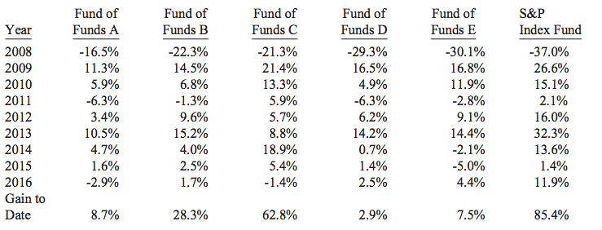
Hedge Funds? Buyer Beware
Source: BH ’16 Letter to SHs

Slide 35
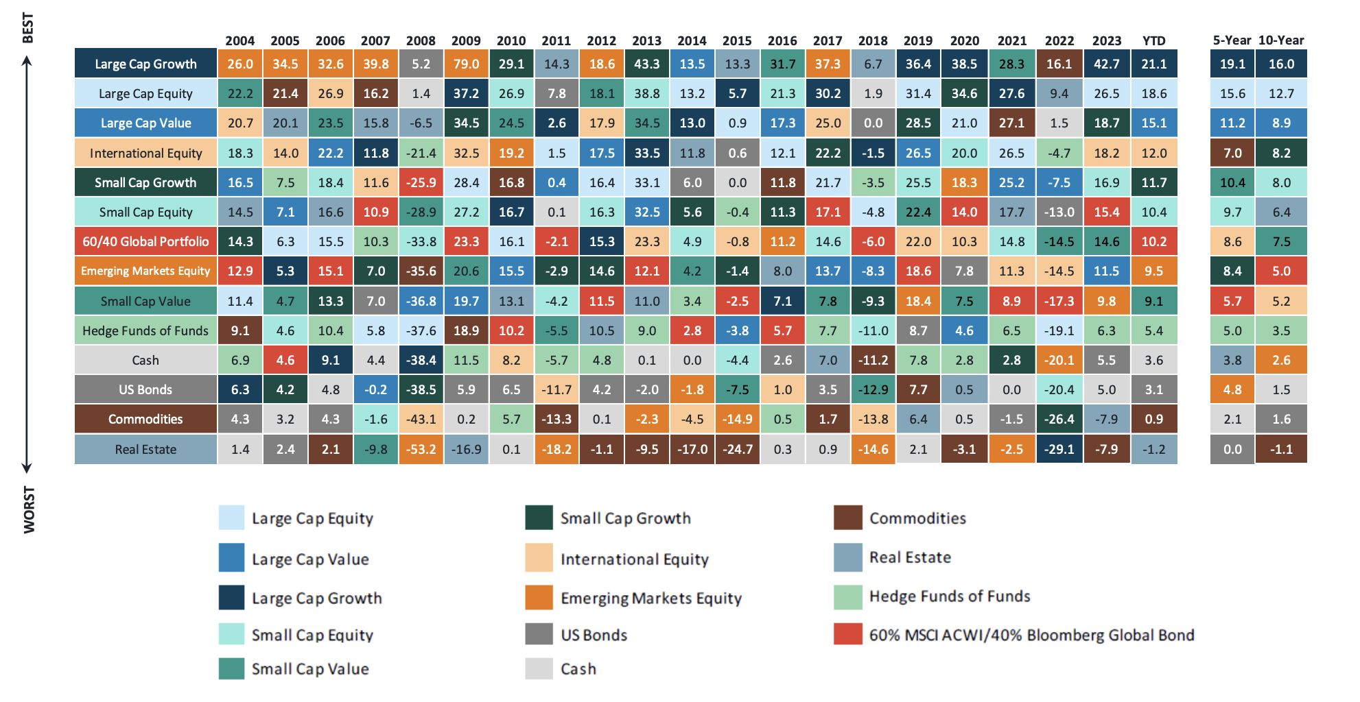
Hedge Funds? Buyer Beware

Slide 36
PE Investments in 401(k) Accounts Blessed by the DOL and New EO: WCGW?
…You represent that some private equity investments may offer the potential for enhanced returns over time by giving investors a stake in privately held companies during their early growth stages. You also state that private equity investments may also contribute to diversification and provide a hedge against market downturns by offering investment opportunities that do not move in tight lockstep with the broader public market.
[A]s with any designated investment alternative, the plan fiduciary must consider whether it has the skills, knowledge, and experience to make the required determinations or whether the plan fiduciary needs to seek assistance from a qualified investment adviser or other investment professional.
In conclusion, a plan fiduciary would not, in the view of the Department, violate the fiduciary’s duties under section 403 and 404 of ERISA solely because the fiduciary offers a professionally managed asset allocation fund with a private equity component as a designated investment alternative for an ERISA covered individual account plan in the manner described in this letter.
Source: DOL to Groom Law Group (June 3, 2020)
Sec. 2. Policy. It is the policy of the United States that every American preparing for retirement should have access to funds that include investments in alternative assets (private market assets, RE, commodities, infrastructure, digital assets) when the relevant plan fiduciary determines that such access provides an appropriate opportunity for plan participants and beneficiaries to enhance the net risk-adjusted returns on their retirement assets. EO 14330 (8/7/25), Democratizing Access to Alternative Assets for 401(k) Investors
Proposed DOL regulations (Mar. 30, 2026) provide safe harbor for ERISA fiduciaries in selecting designated investment alternatives for participant-directed individual accounts plan. The proposed rules interpret ERISA’s duty of prudence when selecting investment alternatives for a retirement plan. Goal: to allow fiduciaries discretion to chose investment alternatives without the fear of litigation. The rules focus on process, and require an examination of performance, fees, liquidity, valuation, performance benchmark, and complexity.

Slide 37
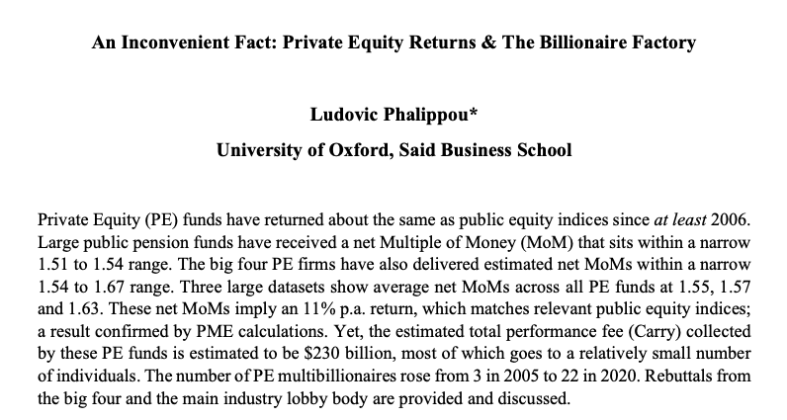
PE Returns: Great for managers; maybe mediocre for investors

Slide 38
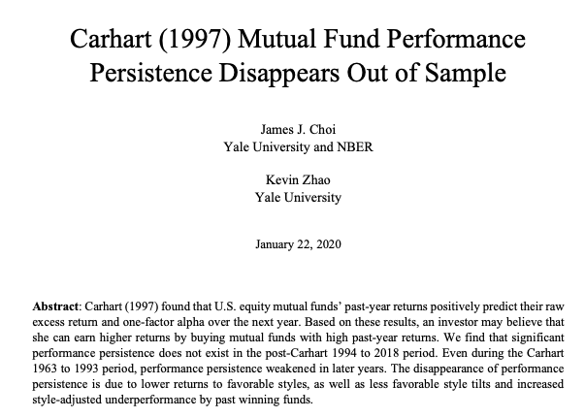
It’s easy, just buy the winners

Slide 39
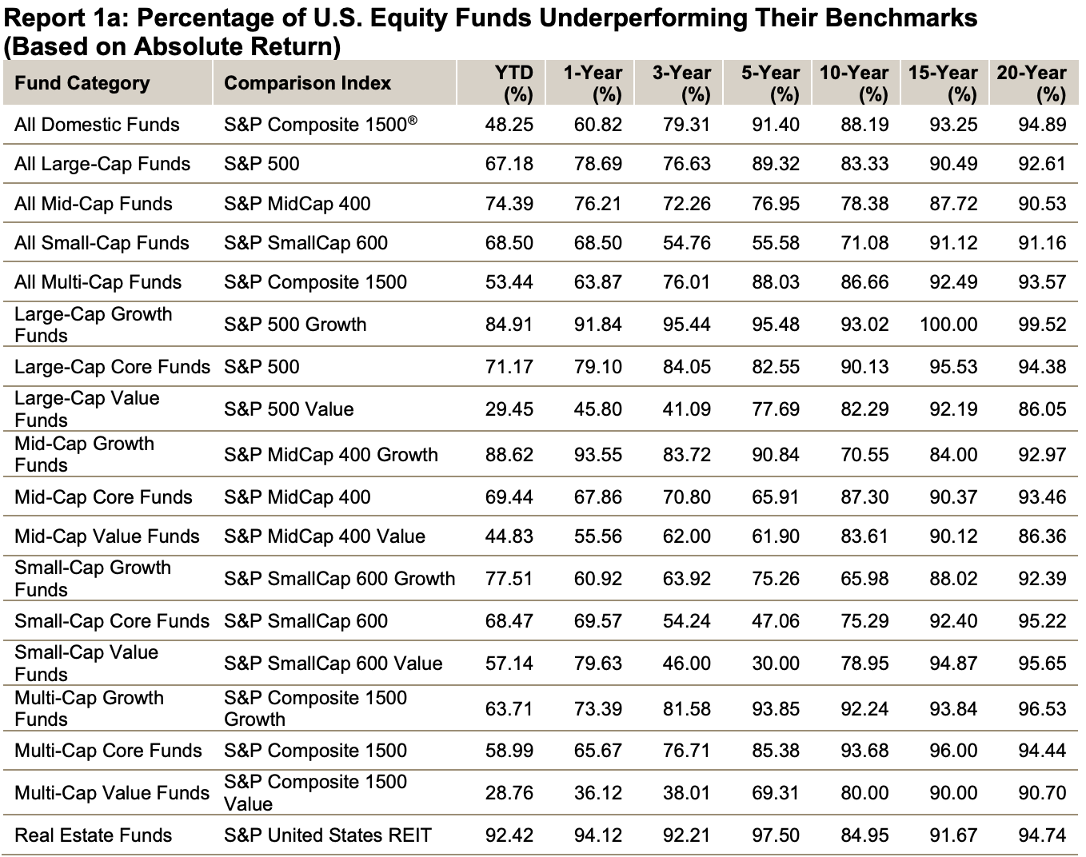
US Mutual Funds vs. Indices
Source: SPIVA US Scorecard ’26 (mid-year)

Slide 40
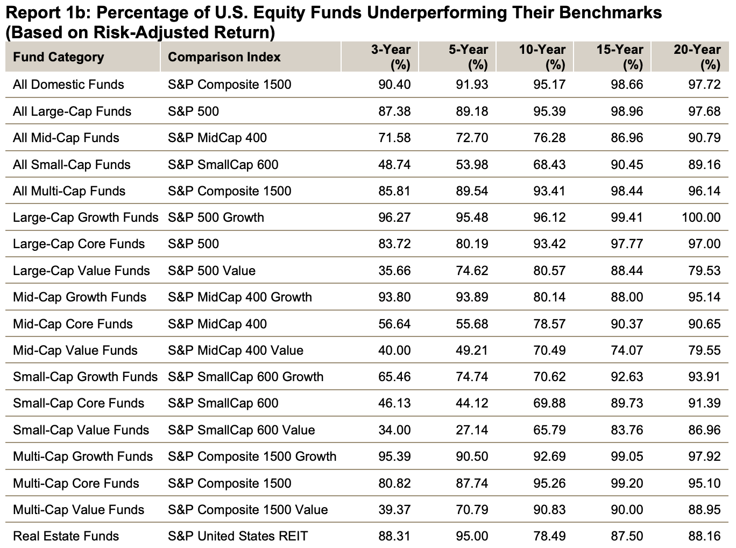
US Mutual Funds vs. Indices (Risk Adjusted)
Source: SPIVA US Scorecard ’24 (year-end)

Slide 41
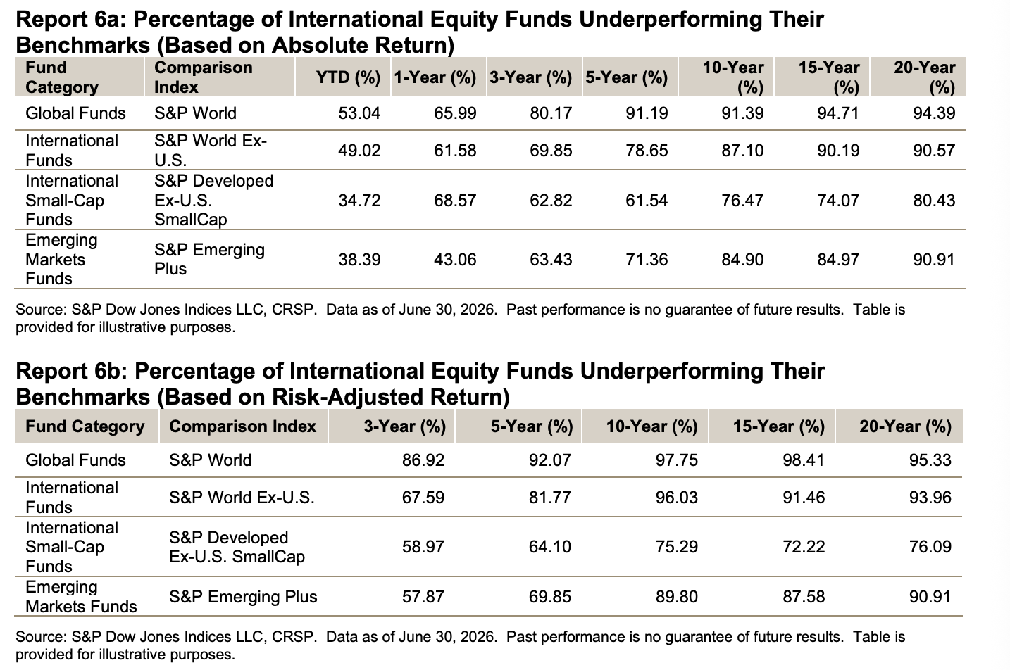
Foreign Mutual Funds vs. Indices (Absolute & Risk-Adjusted)
Source: SPIVA US Scorecard ’26 (mid-year)

Slide 42
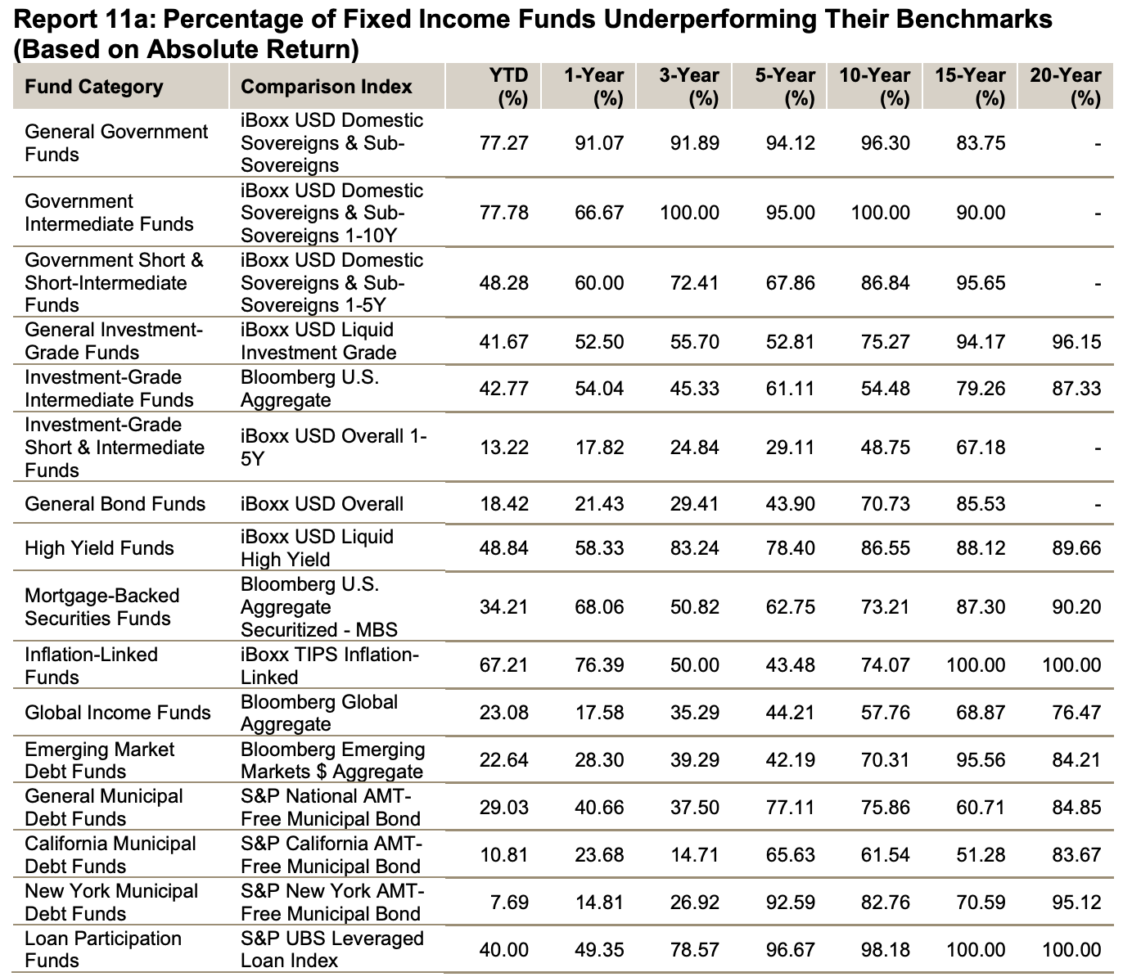
Fixed Income Mutual vs. Benchmarks (Absolute Return)
Source: SPIVA US Scorecard ’26 (mid-year)

Slide 43
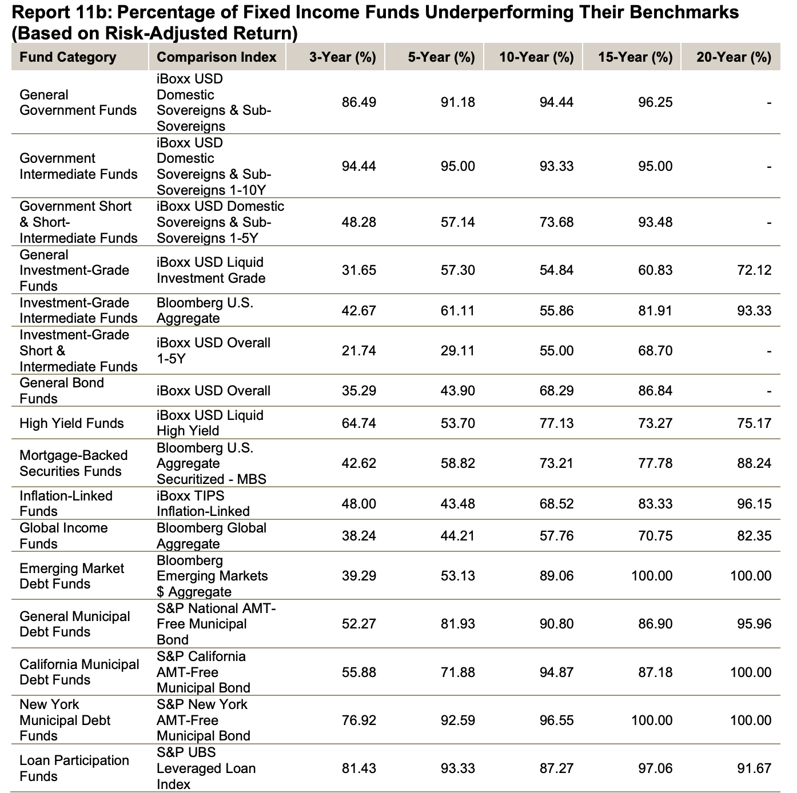
Fixed Income Mutual vs. Benchmarks (Risk Adjusted Return)
Source: SPIVA US Scorecard ’26 (mid-year)

Slide 44
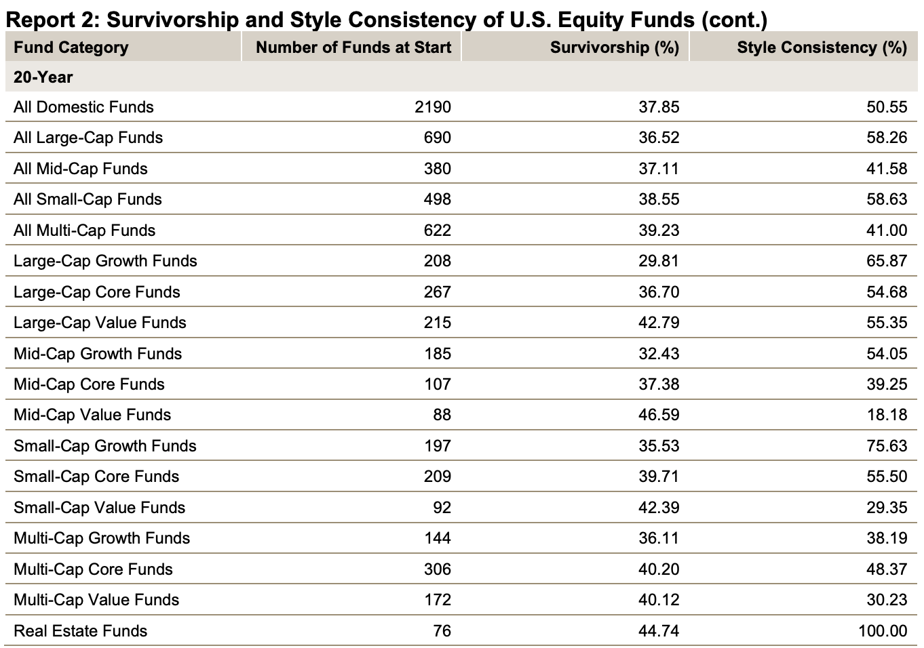
Mutual Funds: Survivorship
Source: SPIVA US Scorecard ’26 (mid-year)

Slide 45
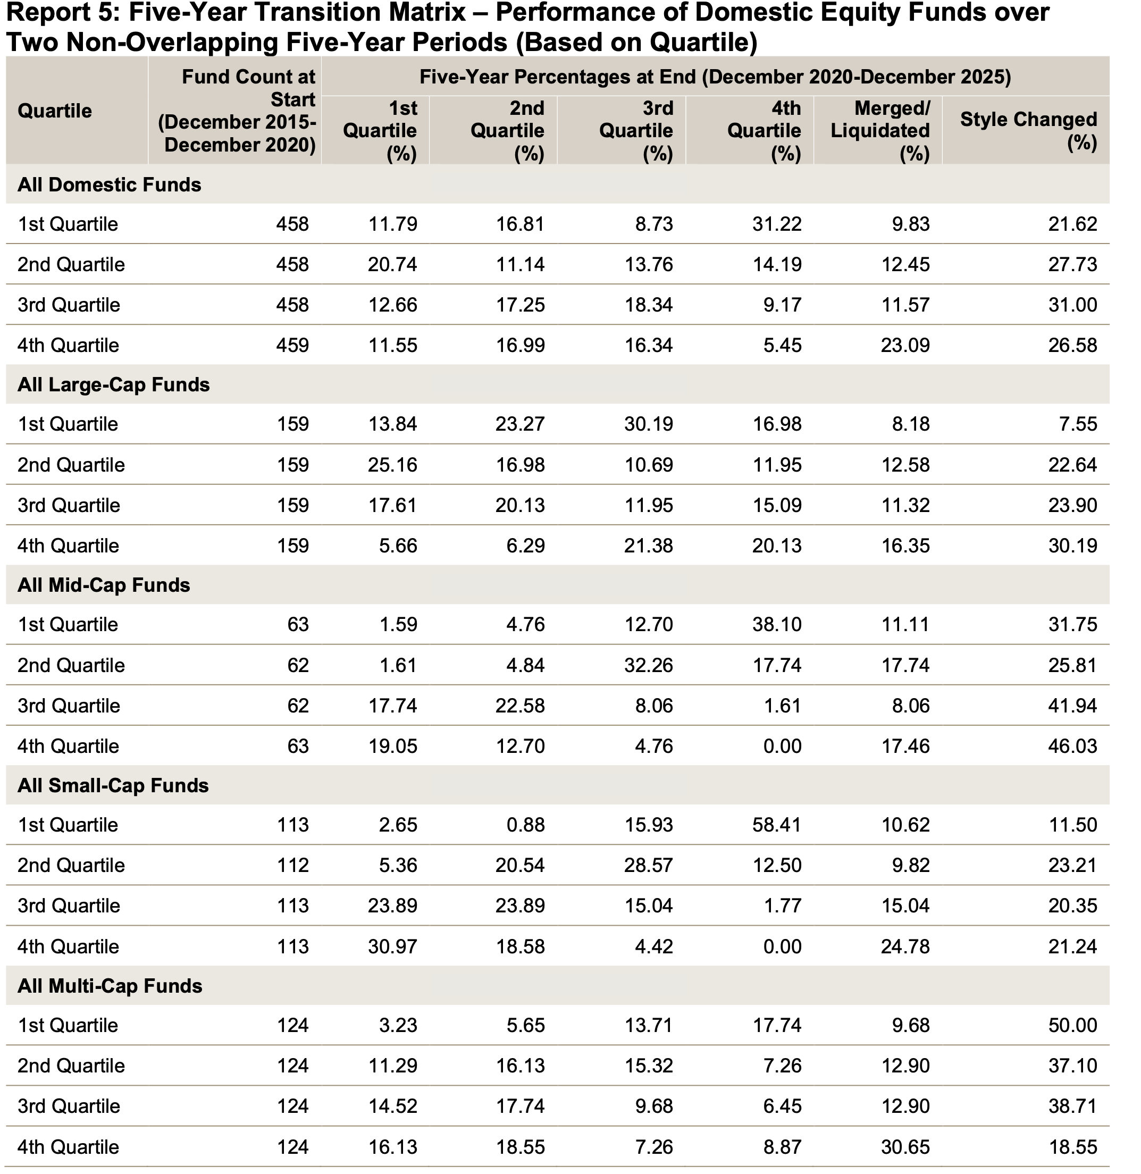
Persistence: Hey, I’ll just pick the past winners
S&P Persistence Score Card 2025

Slide 46
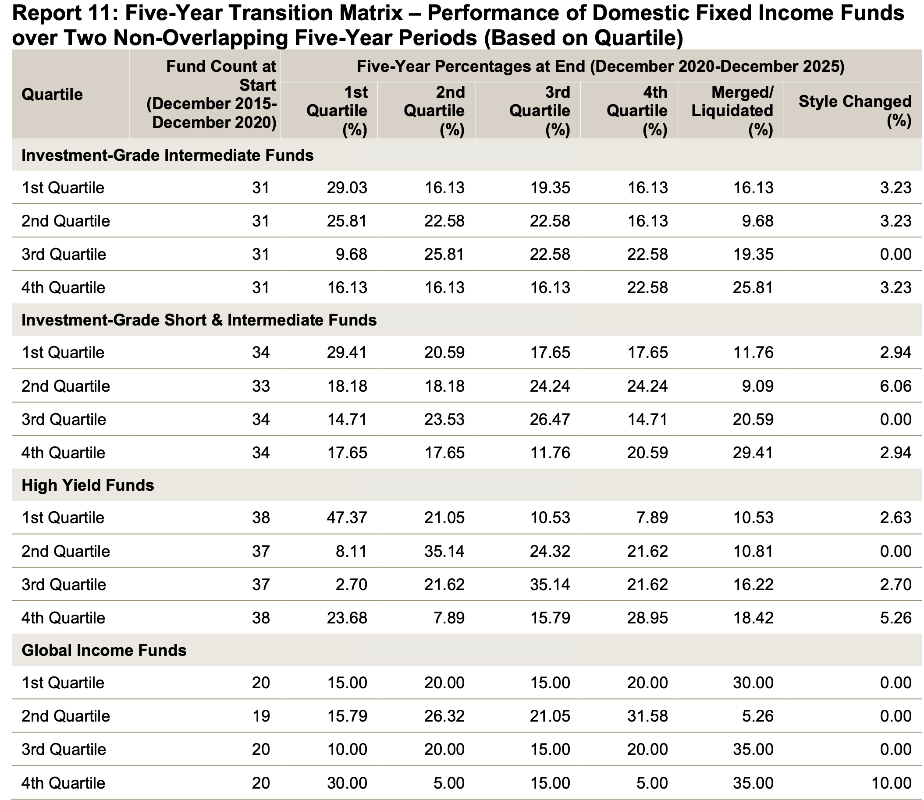
Persistence: Hey, I’ll just pick the past winners
S&P Persistence Score Card 2025

Slide 47
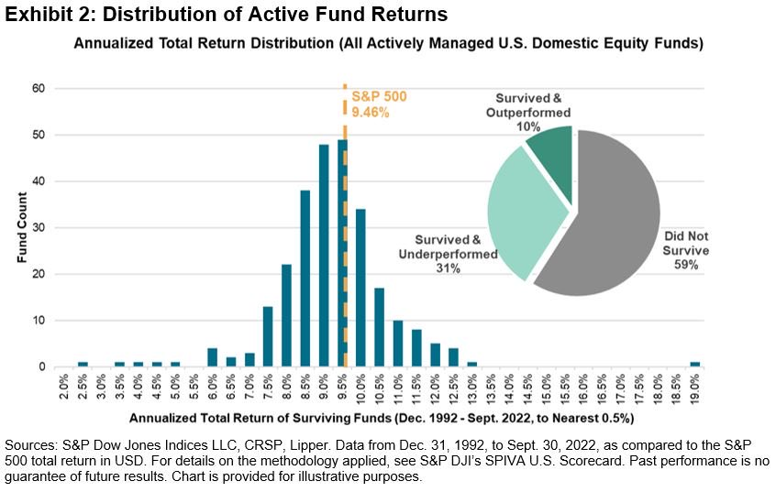
Mutual Funds
S&P: Rise of Passive Management (4/23)

Slide 48
The Cost of Active Investing
I compare the fees, expenses, and trading costs society pays to invest in the U.S. stock market with an estimate of what would be paid if everyone invested passively. Averaging over 1980 to 2006, I find investors spend 0.67% of the aggregate value of the market each year searching for superior returns. Society’s capitalized cost of price discovery is at least 10% of the current market cap. Under reasonable assumptions, the typical investor would increase his average annual return by 67 basis points over the 1980 to 2006 period if he switched to a passive market portfolio.
Source: Ken French, The Cost of Active Investing, ssrn: abstract=1105775
(1 + 0.0067) ²⁶ – 1 = 19%

Slide 49

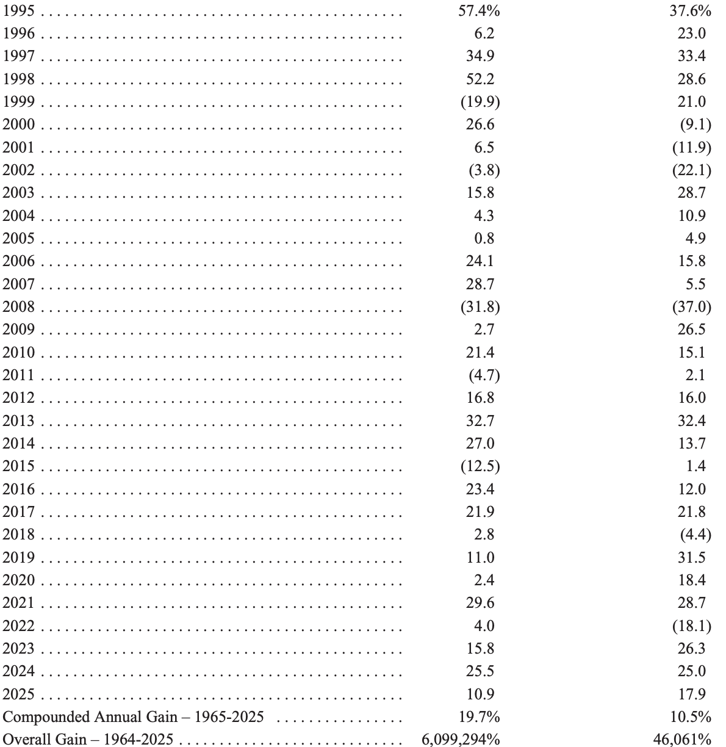
Berkshire Hathaway v. SP 500 (1964-2025)

Slide 50
Berkshire Hathaway: Letter to Shareholders ‘13
The goal of the non-professional should not be to pick winners – neither he nor his “helpers” can do that – but should rather be to own a cross-section of businesses that in aggregate are bound to do well. A low-cost S&P 500 index fund will achieve this goal.
Following those rules, the “know-nothing” investor who both diversifies and keeps his costs minimal is virtually certain to get satisfactory results. Indeed, the unsophisticated investor who is realistic about his shortcomings is likely to obtain better long-term results than the knowledgeable professional who is blind to even a single weakness.
If “investors” frenetically bought and sold farmland to each other, neither the yields nor prices of their crops would be increased. The only consequence of such behavior would be decreases in the overall earnings realized by the farm-owning population because of the substantial costs it would incur as it sought advice and switched properties.
Nevertheless, both individuals and institutions will constantly be urged to be active by those who profit from giving advice or effecting transactions. The resulting frictional costs can be huge and, for investors in aggregate, devoid of benefit. So ignore the chatter, keep your costs minimal, and invest in stocks as you would in a farm.
What I advise here is essentially identical to certain instructions I’ve laid out in my will. One bequest provides that cash will be delivered to a trustee for my wife’s benefit. (I have to use cash for individual bequests, because all of my Berkshire shares will be fully distributed to certain philanthropic organizations over the ten years following the closing of my estate.) My advice to the trustee could not be more simple: Put 10% of the cash in short-term government bonds and 90% in a very low-cost S&P 500 index fund. (I suggest Vanguard’s.) I believe the trust’s long-term results from this policy will be superior to those attained by most investors – whether pension funds, institutions or individuals – who employ high-fee managers.

Slide 51
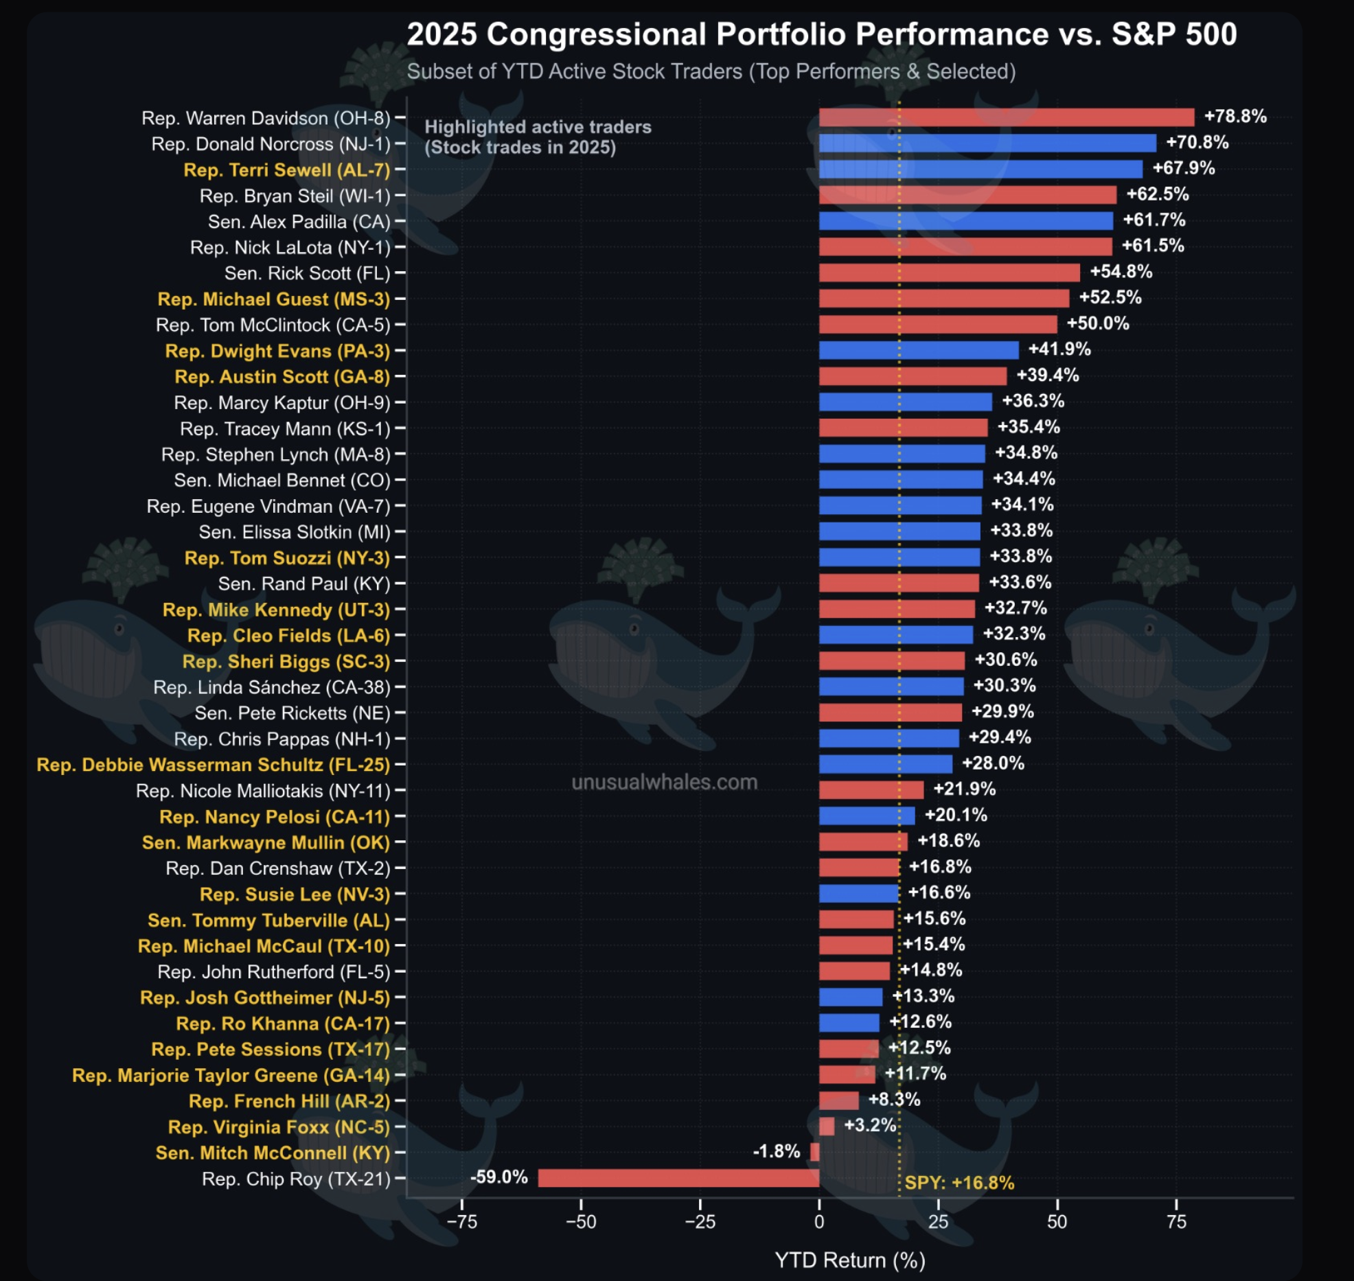
Strong Form of the EMH
Insider trading seems to give abnormal profits, but don’t forget about about potential attorney’s fees, fees, and prison time, unless you are in Congress

Slide 52
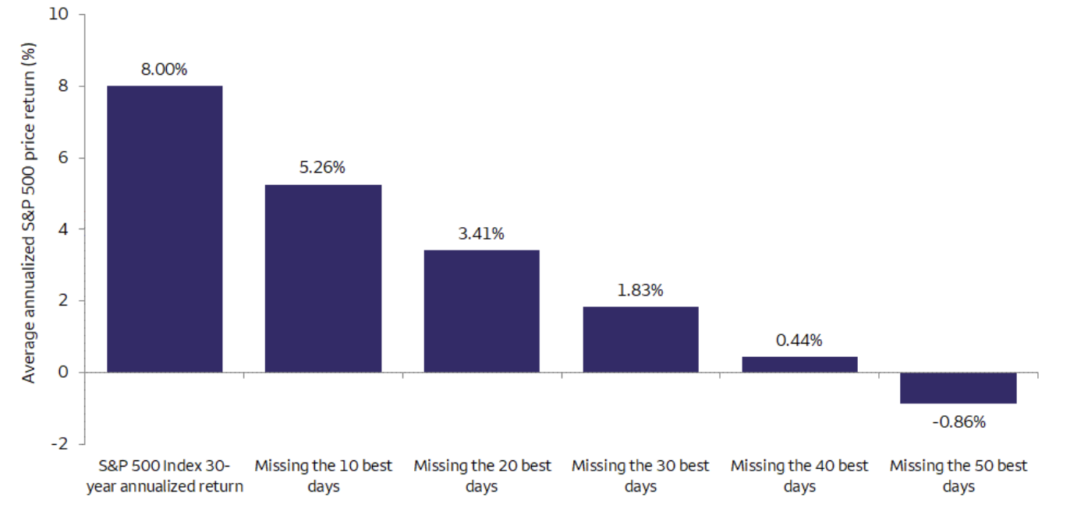
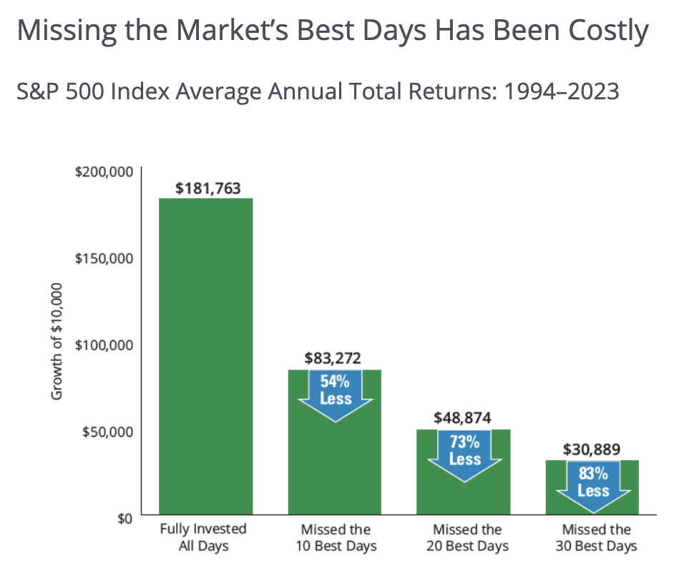
No pain, no gain

Slide 53
Event Studies: How Tests Are Structured
Event Studies are one type of test of the semi-strong form of market efficiency.
  This form of the EMH implies that prices should reflect all publicly available information.
Event studies examine prices and returns over time—particularly around the arrival of new information.
Test for evidence of under reaction, overreaction, early reaction, delayed reaction around the event.

Slide 54
How Tests Are Structured (cont.)
Returns are adjusted to determine if they are abnormal by taking into account what the rest of the market did that day.
The Abnormal Return on a given stock for a particular day can be calculated by subtracting the market’s return on the same day (R_{M}) from the actual return (R) on the stock for that day:
AR = R – R_{M}
The abnormal return can also be calculated using the Market Model approach, which subtracts the actual return from the expected return (E(r):
AR = R – (α + βR_{M})
CAPM

Slide 55
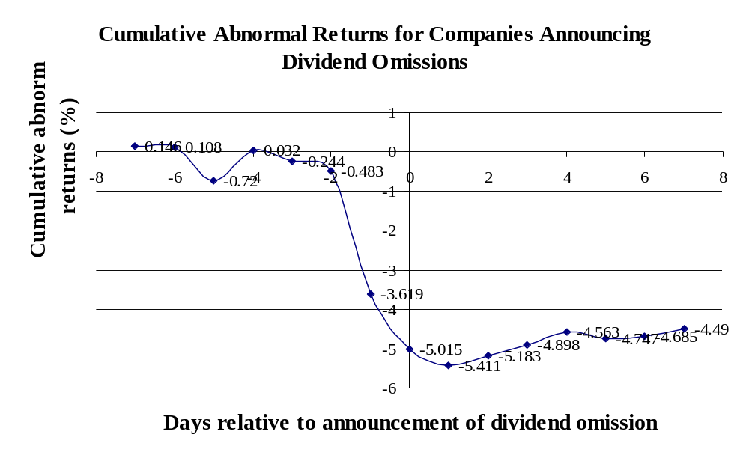
Event Studies: Dividend Omissions
Efficient market response to “bad news”
S.H. Szewczyk, G.P. Tsetsekos, and Z. Santout “Do Dividend Omissions Signal Future Earnings or Past Earnings?” Journal of Investing (Spring 1997)

Slide 56
Event Study Results
Over the years, event study methodology has been applied to a large number of events including:
  Dividend increases and decreases
  Earnings announcements
  Mergers
  Capital Spending
  New Issues of Stock
  Purchase of corporate jet
The studies generally support the view that the market is semi-strong efficient.
In fact, the studies suggest that markets may even have some foresight into the future—in other words, news tends to leak out in advance of public announcements.

Slide 57
Some Anomalies
Closed-end fund discounts (less relevant w/ ETFs)
Size, Value, Momentum, and Low-volatility
Bitcoin
GameStop (short squeeze) and bubbles
IPOs

Slide 58
The Behavioral Challenge to Market Efficiency
Rationality
  People are not always rational:
  Many investors fail to diversify, trade too much, and seem to try to maximize taxes by selling winners and holding losers.
    Example: Holding too much stock of the company you work for
  Top 20% of accounts (ranked by trading activity) had returns 7 percentage points lower than the accounts with the lowest 20% turnover rates.
    “Trading is hazardous to your wealth.” Barber and Odean, “Boys will be Boys: Gender, Overconfidence, and Common Stock investment,” 16 Q. J. of Econ. 262 (2001).

Slide 59
Implications for Corporate Finance
Because information is reflected in security prices quickly, investors should only expect to obtain a normal rate of return.
  Awareness of information when it is released does an investor little good. The price adjusts before the investor has time to act on it.
Firms should expect to receive the fair value for securities that they sell.
  Fair means that the price they receive for the securities they issue is the present value.
  Thus, valuable financing opportunities that arise from fooling investors are unavailable in efficient markets.

Slide 60
Implications for Corporate Finance
The EMH has three implications for corporate finance:
  The price of a company’s stock cannot be affected by a change in accounting. For example, what should we expect to occur when a company begins to adjust earnings for stock options issued to employees as happened in 2004?
  Financial managers cannot “time” issues of stocks and bonds using publicly available information.
  A firm can sell as many shares of stocks or bonds as it desires without depressing prices.
There is conflicting empirical evidence on all three points.

