Slide 1
Risk and Return: Overview
Historical US and global returns and volatility
How to estimate and measure risk and return
Single assets
Portfolio of assets
Role of Risk aversion
Examine sample asset returns and variances
Portfolios and diversification
How to measure the benefits of diversification
How to measure the trade-off between risk and return
Construction of diverse portfolios
Limits
Importance: Determine the Cost of Capital →

Slide 2
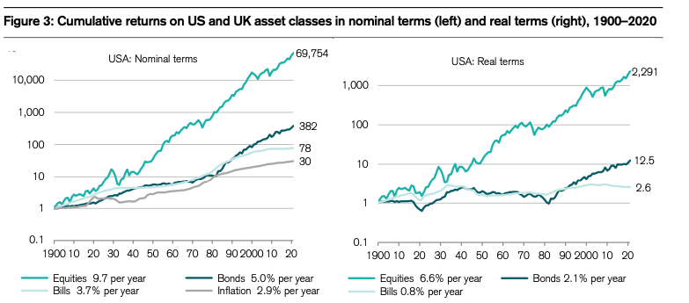
Cumulative Returns on US Assets Classes (Nominal (LH) and Real (RH), 1900-2020
Source: Credit Swiss Global Invest. Returns YB 2021

Slide 3
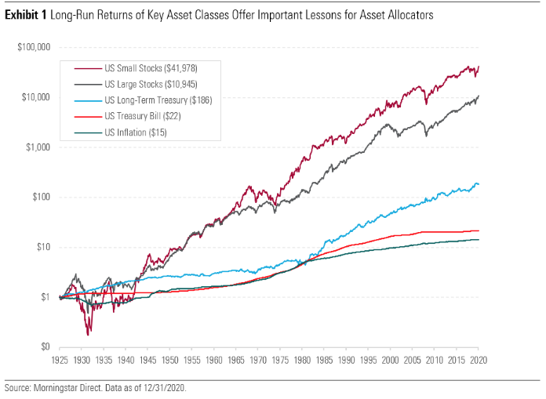
Nominal Value of an Investment of $1 in 1926 Through 2020 (U.S.)

Slide 4
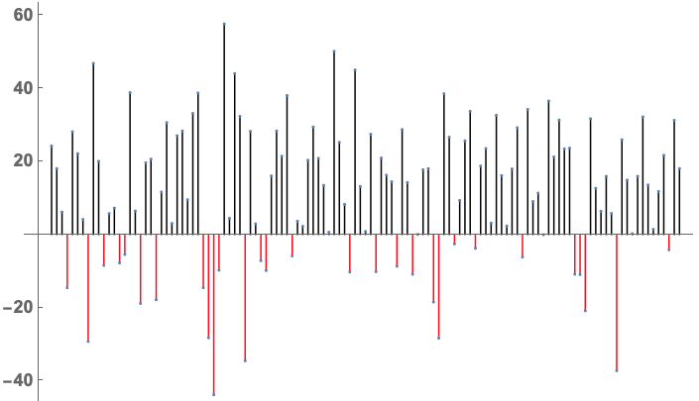
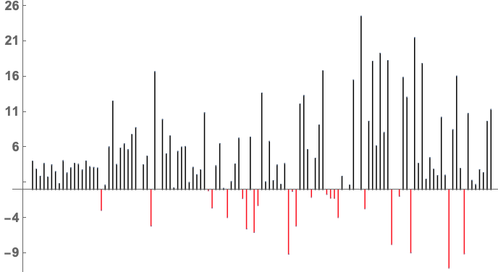
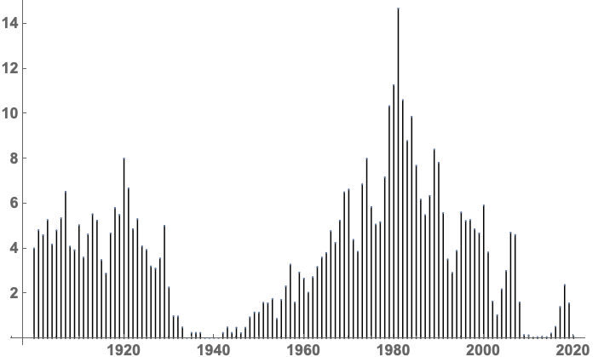
Time Series: US Stocks, Bonds, and T-Bills (1900-2020)

Slide 5
Histogram: US Stocks and Bonds (1900-2020)

Slide 6
Histogram: Bills (1900-2020)

Slide 7
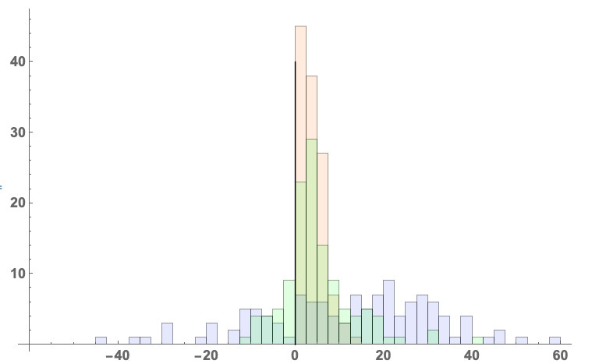
Histogram: US Stocks, Bonds, and T-Bills (1900-2020)
T-Bills
Bonds
Stocks

Slide 8
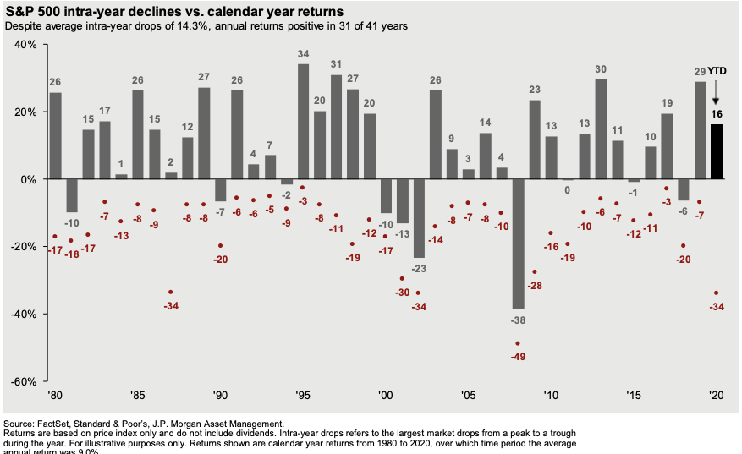
The ride can be rough (1980-2020)

Slide 9
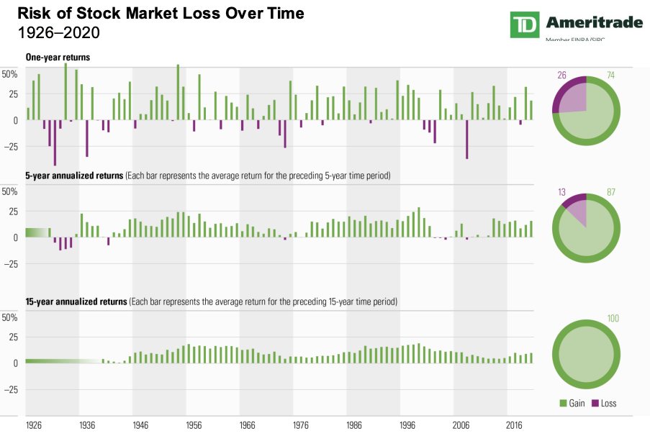
Annual and Rolling 1, 5, and 15 year Rolling Returns
Source: Dimson, Marsh, and Staunton: Triumph of the Optimists:101 Years of Global Investment Returns (2002); Morningstar

Slide 10
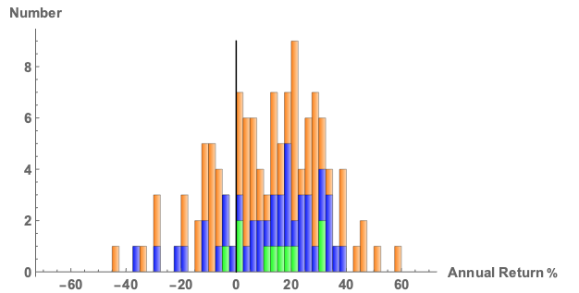
U.S. Equity Nominal Returns
1900-2020 (Mean = 11.56%)
1971-2020 (Mean = 12.36%)
2011-2020 (Mean = 14.15%)

Slide 11
Annual Returns: SP500, T-Bills, T-Bonds
 |  | SP500 | T-Bills | T-Bonds | Baa Corp Bond
 |  |  | Arithmetic
1928-2020 |  | 11.64% | 3.36% | 5.21% | 7.25%
1971-2020 |  | 12.18% | 4.51% | 7.29% | 9.55%
2011-2020 |  | 14.34% | 0.51% | 4.64% | 7.44%
 |  |  | Geometric
1928-2020 |  | 9.79% | 3.32% | 4.95% | 6.99%
1971-2020 |  | 10.80% | 4.46% | 6.89% | 9.28%
2011-2020 |  | 13.75% | 0.51% | 4.40% | 7.26%
2001-2010 |  | 1.38% | 2.16% | 5.49%
Source: Damodaran

Slide 12
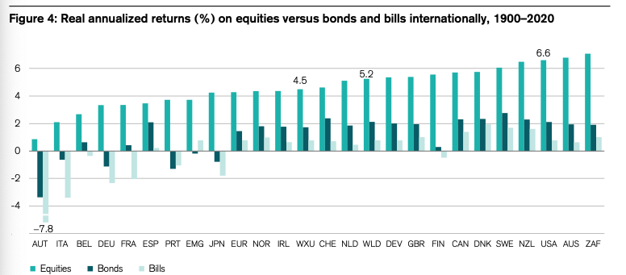
Global Real Returns on Equities vs. Bonds and Bills
Source: Credit Swiss Global Invest. Returns YB 2021

Slide 13
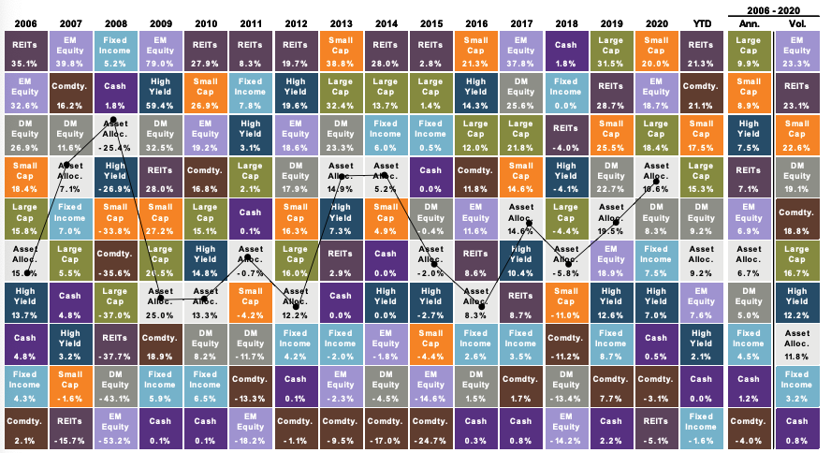
Asset-Class Winners & Losers: 2006 - 2021(3rdQ)
Source: JP Morgan

Slide 14
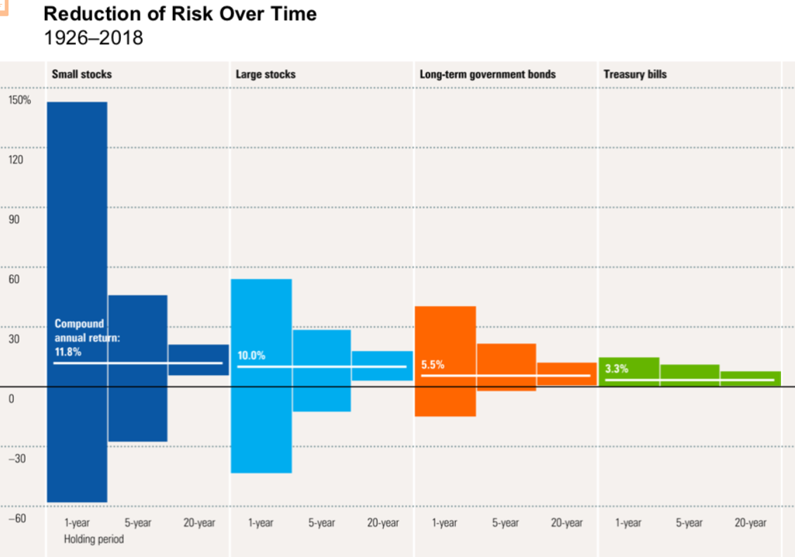
Reduction of Risk Over Time: 1926-2018
Source: Morningstar

Slide 15
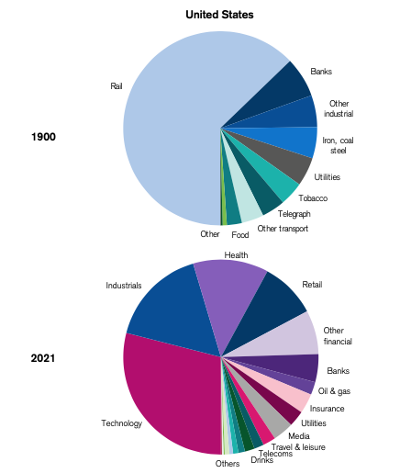
Industry Weighting in the US: 1900 and 2021
Source: Credit Swiss Global Invest. Returns YB 2021

Slide 16
A Step Back
Stocks had higher returns than bonds, which beat cash
Cash was the safest investment, followed by bonds and stocks.
Portfolios generally have less than risk than individual stocks
Average return is always greater than geometric return
Correlation between stock market and cash/bond is low (10%), but around 50% -70% for individual stocks and the market.
Historical risk measures (correlation, Sdev, Beta) are more stable than historical returns

Slide 17
Returns: Single Asset
Return of asset “j” at time t=
Sample Average Return
(Arithmetic Mean):
Sample Average Return
(Geometric Mean):

Slide 18
Measuring Risk (Volatility): Single Asset
Variance:
Standard Deviation:
Example
A stock has the following returns (in %): 8, -10, 24, 5, and -2. Find the mean and SD of the returns.
Mean: (8-10+24+5-2) / 5 = 5%
Var: 1/5*[(8-5)²+(-10-5)²+(24-5)²+(5-5)²+(-2-5)²] = 128.8%²
SD: √Var = 11.35%

Slide 19
Risk and Risk Aversion
As investors, for wealth we don’t consume today, we aim generally to maximize expected future consumption or maximize expected future utility of wealth
We generally prefer more to less, and
Our utility increases as wealth increases, but at a decreasing rate
Different representations of utility curves:
Logarithm
Square Root

Slide 20
Risk Lover, Risk Averse, and Risk Neutral
Risk Averse:
rejects fair bets;
pays premium (more than expected value) for insurance
Risk Neutral:
is indifferent about fair bets;
does not pay a premium for insurance
Risk Lover:
accepts all fair (and some unfair) bets;
never purchases insurance

Slide 21
Diversification
What happens to expected returns when assets are combined to form portfolios?
E(wAMZN + wBABA + wTBill) ?=? wE(AMZN) +wE(BABA) + wE(TBill)
What happens to standard deviation when assets are combined to form portfolios?
SD(wAMZN + wBABA + wTBill) ?=? wSD(AMZN) + wSD(BABA) + wSD(TBill)
Efficient Portfolio: portfolio whose return is maximized for a given level of risk or whose risk is minimized for a given level of return

Slide 22
Diversification
Diversification can lower an investor’s overall risk to the extent that the returns of the assets in a portfolio don’t move together.
Measures of comovement: correlation, covariance, and beta (β)
The market beta (β) of a stock measures a stock’s comovement with the market portfolio
A stock with a negative beta functions like insurance

Slide 23
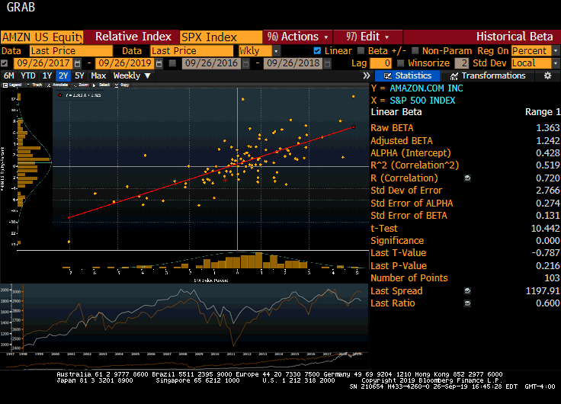
Beta (β) of AMZN-SP500 (Sept 2019)

Slide 24
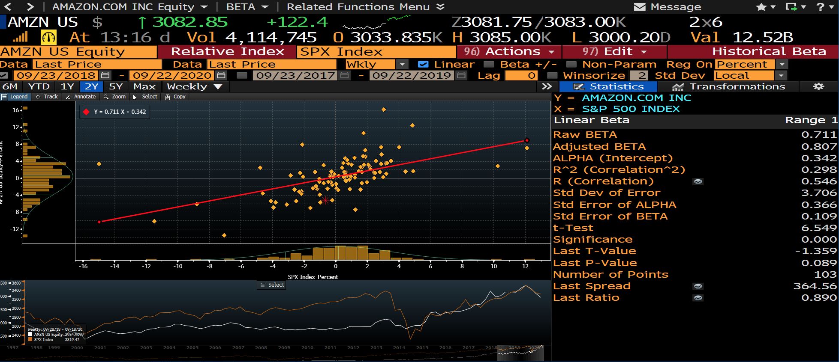
Beta (β) of AMZN-SP500 (Sept 2020)

Slide 25
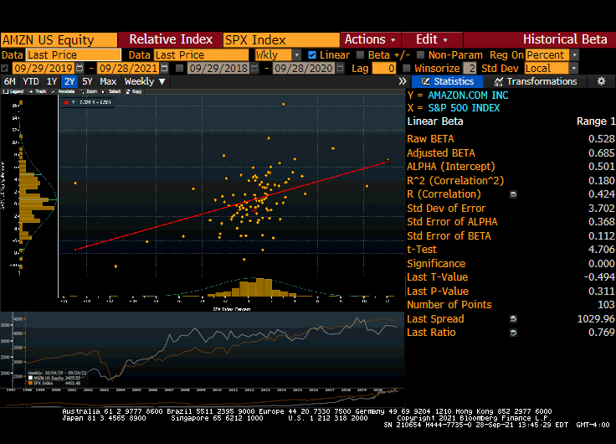
Beta (β) of AMZN-SP500 (Sept 2021)

Slide 26
Mutual Funds
Mutual Funds
Open-end Funds
Exchange Traded Funds (ETFs)
Closed-end Funds
Regulation
Investment Company Act of 1940
Investment Advisers Act of 1940

Slide 27

Open-End Mutual Fund
Buy
Sell
$$ @ NAV
$$ @ NAV
Mutual Fund Regulated Invest. Co.
Assets: Stocks, Bonds, RE
NAV: Net Assets (Ass-Liab) / # Shares

Slide 28
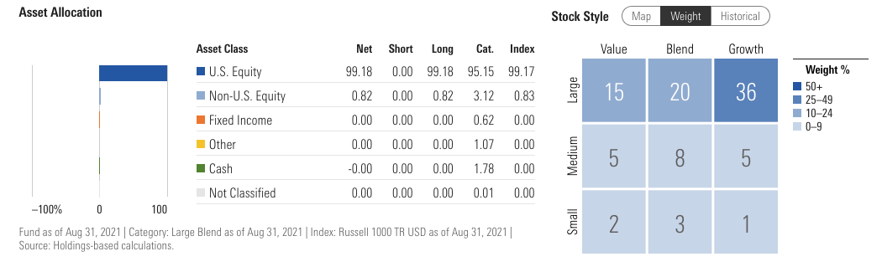
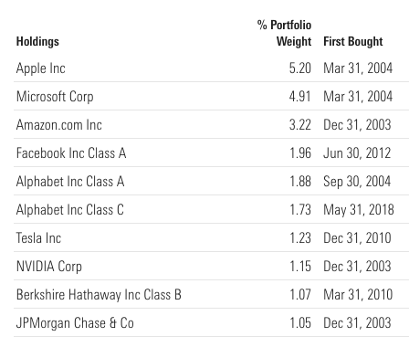
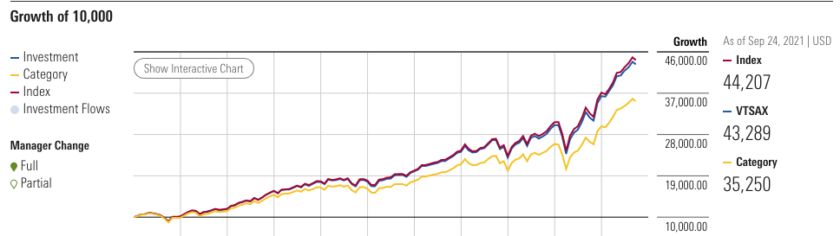
Open-End Mutual Fund: VTSAX

Slide 29
Exchanged Traded Funds (ETFs)
Sale/purchase of
ETF shares @ market price
Authorized Participant
Buy Shares
Redeem Shares
Contribute
portfolio
Portfolio (not $)
ETF Regulated Invest. Co.
Creation/Redemption
If NAV (10) > mrkt price (9)
Buy shares at 9, redeem, and sell portfolio for 10
If NAV (9) < mrkt price (10)
Buy portfolio at 9, create shares, and sell to public for 10
Assets: Stocks, Bonds, RE

Slide 30



Shorting
I believe that Apple stock is overvalued. How can I make money if my beliefs are correct?
Borrow shares
Sell shares
Receive $$$
IOU: Return shares + Dividends
Return shares
Buy shares
Cancel IOU
$$$

