Slide 1
Financial Statements
Importance of Understanding Financial Statements
May be required to be reported (10-K, 10-Q)
Often reported in the media
Understand strengths and limitations in order to value a firm or investment project from financials
Financial contracts (debt and derivative instruments) may refer to financials
Regulatory rules may refer to financials
Managers may care a lot about financials
Manager compensation

Slide 2
GAAP
Generally Accepted Accounting Principles (US GAAP)
Standard Setting
FASB, Emerging Issues Task Force, AICPA, APB, and the SEC
Before 7/1/09, hodgepodge of various statements and standards: FAS, FIN, FTB, EITF, APB
Accounting Standards Codification (7/1/09)
Topic--Subtopic—Section
820—15—1
Fair Value Measurement—Scope—Overall Guidance
Accounting Standards Update (ASU)
ASU 2010-06, Fair Value Measurements and Disclosures (Topic 82)

Slide 3
Components of Financial Statements
Balance Sheet
Income Statement
Statement of Cash Flows
Consolidated Statement of Common SHs’ Equity
Notes
Management Discussion and Analysis of Financial Condition and Results of Operations

Slide 4
Balance Sheet
Snapshot of a firm’s financial condition at a moment in time prepared in accordance with GAAP/IFRS.
Components of a Balance Sheet
Assets: resources/investments
Liabilities:
Shareholders’ Equity:
Assets = Liabilities + Shareholders’ Equity
claims on resources/financing

Slide 5
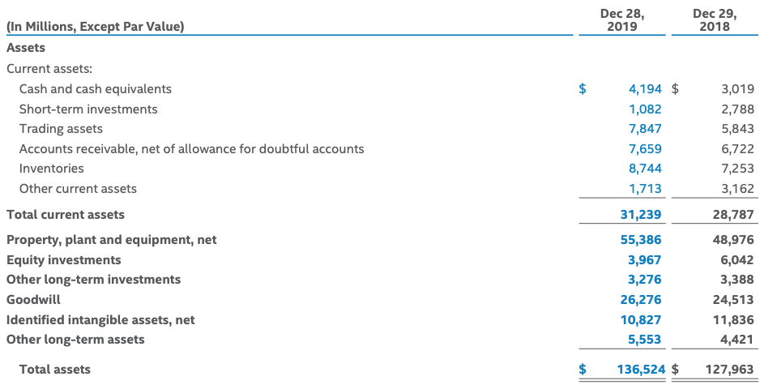
Intel’s 2019 Balance Sheet (Assets)

Slide 6
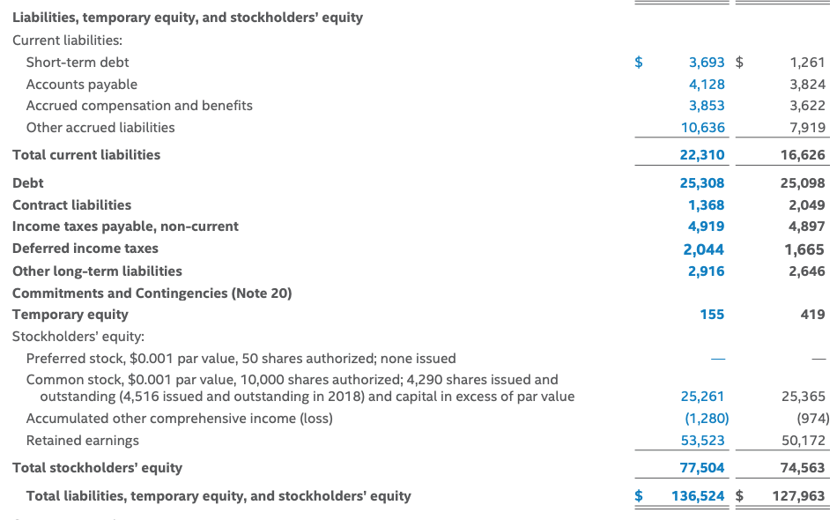
Intel’s 2019 Balance Sheet (L & SH Equity)
2018 2017

Slide 7
Balance Sheet Concerns
Cash v. accrual
Assets that don’t appear on the BS
Self-created intangibles
Liabilities that don’t appear on the BS
SIVs
Liquidity
Retained earnings ≠ cash
Book Value
Fair market value v. historical cost

Slide 8
Income Statement
Shows firm’s net profit/loss over given period and how it was earned:
Revenues
Costs/Expenses
Interest/Dividends
Income Taxes
Measures flows not stock
P&L Statement

Slide 9
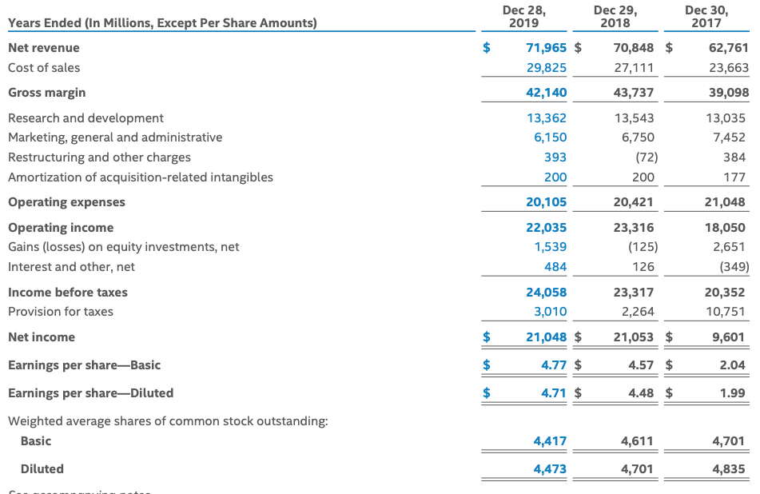
Intel’s 2019 Income Statement

Slide 10
Statement of Cash Flows
Shows changes in Cash (BS) over period
Flow, not stock
Difference between Net Income and Cash Flow?
CFs separated by activity:
Operating Activities
Investing Activities
Financing Activities

Slide 11
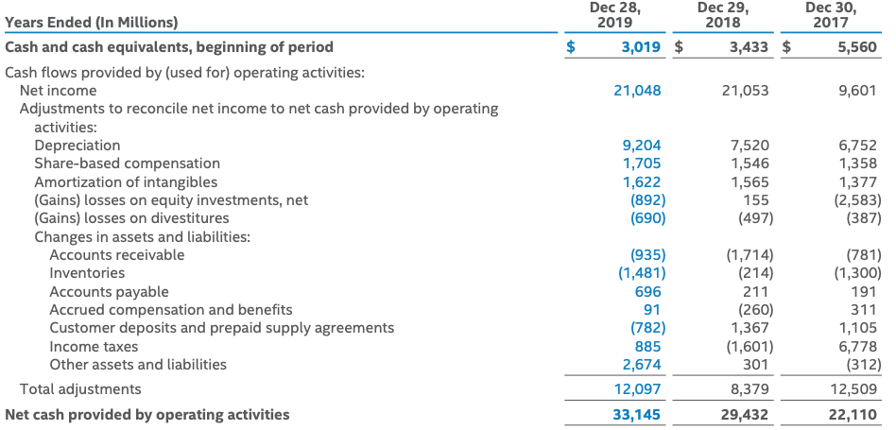
Intel’s 2019 Statement of Cash Flows: Operating Activities

Slide 12

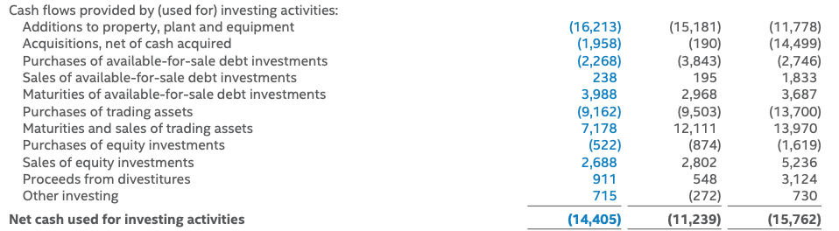
Intel’s 2019 Statement of Cash Flows: Investing Activities

Slide 13
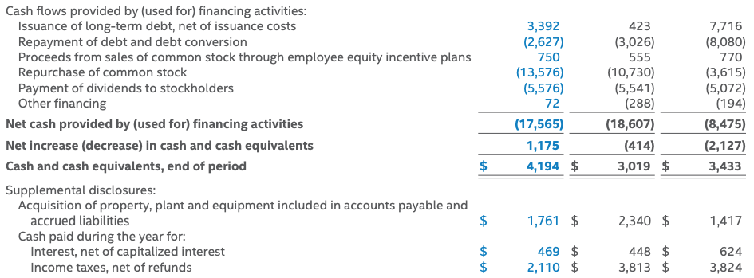
Intel’s 2019 Statement of Cash Flows: Financing Activities

Slide 14
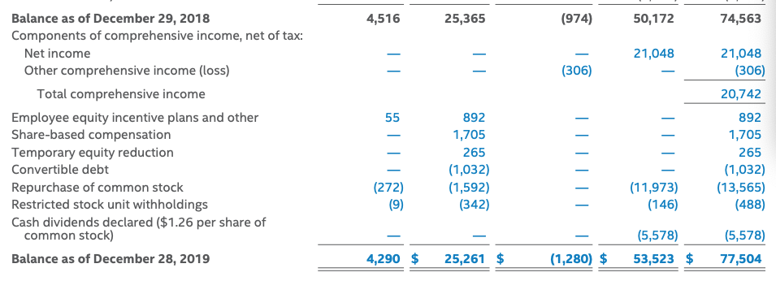
Intel’s 2019 Consolidated Statement of Common Shareholders’Equity

Slide 15
Finance and Accounting
Finance focuses on Cash Flows
Accountants focus on current valuation through the lenses of the BS, IS,and SoCF
Important Differences: Accruals
long-term (depreciation), and
short-term (changes in working capital, e.g., accounts receivable, and corporate income taxes)

Slide 16
Cash Flows (Finance) vs. Accruals (Accounting)
Accrual vs. cash method of accounting
Sales
Payables
Capital expenditures vs. expenses
Depreciation
Accounting
Economic
Tax (SL v. accelerated)
Useful life, salvage value, and conventions
Depreciation is NOT a CF, but it affects taxes, a CF

Slide 17
Fair Value
Classification of Securities with readily determinable fair value
Marketable Securities: liquid assets that the company can and intends to convert into cash when necessary, but usually within 1 year (current asset)
Investment In Securities: noncurrent asset
Valuation at Acquisition
Initially booked at cost

Slide 18
FV: Valuation after Acquisition FASB 115 (Topics 320 and 820)
Trading Securities (TS)
Held for short-term profit
Shown on the BS at FV with changes in FV reported in the IS
Securities Available for Sale (AFS)
Neither TS nor HTM; acquired for operating rather than ST potential
Shown on the BS at FV with changes in FV reported SHs’ Equity in Comprehensive Income
Debt Held to Maturity (HTM)
Debt securities that a firm intends to hold to maturity
Shown on the BS at amortized cost (premium or discount amortized over the life of the bond as an adjustment to interest)
Changes in FV not reported in IS or BS unless security value is permanently impaired
Direct Investment Loans
HFI: shown at amortized cost, with impairment recognized for probable credit losses (delay in timing and amount of E(CF) due to events incurred as of measurement date)
HFS: lower-of-cost-or-FV, with losses recognized in income

Slide 19
Fair Value Hierarchy
Fair Value:
“price that would be received to sell an asset or paid to transfer a liability in an orderly transaction between market participants at the measurement date.” SFAS 157, par. 5. (Topic 820-10-35-2)
Level 1: inputs based on prices on active markets of identical asset or liability
Level 2: quoted prices of similar instruments in active markets or identical instruments in inactive markets, or market information on valuation parameters (e.g., yield curves, interest rates)
Level 3: inputs that are not currently observable, such as the firm’s own assumptions regarding valuation parameters that participants would use, e.g., expected CFs, discount rates.

Slide 20
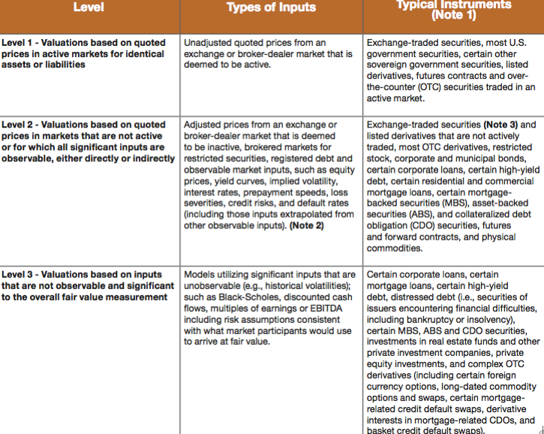
Level Designations and Typical Instruments

Slide 21
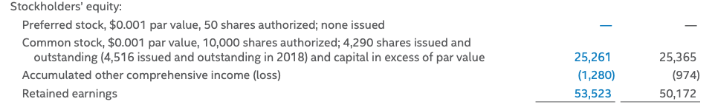
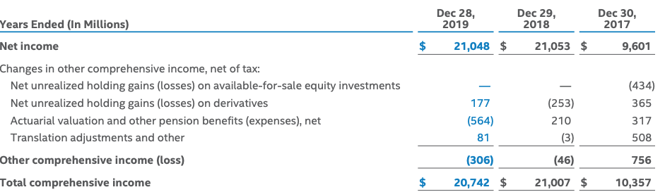
Intel: OCI
2019 2018

Slide 22
Cash Flows (Finance) vs. Accruals (Accounting)
Why can’t we just use earnings for our NPV analysis?
Going from Financials to Finance

Slide 23
Finance and Accounting Example: (Q 14.5)
 | Project |  | Financing
True Lifespan | 5 YRS
Cost | ($120) Yr1 |  | Debt Capacity | $100
 |  |  | Debt Interest Rate | 8%
Raw Output | $80/yr
-Input cost | ($6/yr)
-Selling Expense | ($8/yr) |  | Accounting Depreciation | 4 years
= Net output | $66/yr
 |  |  | Interest paid starting in YR 2
Overall COC | 8%
Corporate Tax Rate | 50%

Slide 24
Finance and Accounting Example
Income Statement
Year | 1
Sales (Revenues) | $80
- COGS | <$6>
- SG&A | <$8>
= EBITDA | $66
- Depreciation | <$30>
= EBIT (Operating Inc) | $36
- Interest Expense | $0
EAIBT (EBT) | $36
-Corporate Tax @ 50% | <$18>
Net Income | $18
Cash Flow Statement (Excerpts)
Year | 1
Capital Expenditure | <$120>
Net Debt Issue | $100

Slide 25
Finance and Accounting Example
Income Statement
Year | 1 | 2 | 3 | 4 | 5
Sales (Revenues) | $80 | $80 | $80 | $80 | $80
- COGS | <$6> | <$6> | <$6> | <$6> | <$6>
- SG&A | <$8> | <$8> | <$8> | <$8> | <$8>
= EBITDA | $66 | $66 | $66 | $66 | $66
- Depreciation | <$30> | <$30> | <$30> | <$30> | <$0>
= EBIT (Oper. Inc) | $36 | $36 | $36 | $36 | $66
- Interest Exp. | $0 | <$8> | <$8> | <$8> | <$8>
EAIBT (EBT) | $36 | $28 | $28 | $28 | $58
-Corp. Tax (50%) | <$18> | <$14> | <$14> | <$14> | <$29>
= Net Income | $18 | $14 | $14 | $14 | $29

Slide 26
Finance and Accounting Example
Cash Flow Statement (Excerpts)
Year | 1 | 2 | 3 | 4 | 5
Capital Expenditure | <$120> | -- | -- | -- | --
Depreciation | $30 | $30 | $30 | $30
Net Debt Issue | $100 | -- | -- | -- | <$100>

Slide 27
NPV Analysis
NPV_{Full Project} (D + E) = NPV Project - NPV Taxes
NPV_{Lev. Owner.} = NPV Project - NPV Taxes + NPV Loan

Slide 28
NPV Analysis (Year 1)
NPV Analysis
Year | 1
CF Project (Pre-tax) | - $54 [-120+66]
CF Taxes | - $18
CF Project | - $72
CF Loan | $100
Residual CF: Levered Ownership | $28
Compare: Net Income | $18

Slide 29
NPV Analysis (Years 1-5)
All CFs made at year end
NPV Analysis
Year | 1 | 2 | 3 | 4 | 5 | NPV
CF Project (Pre-tax) | - $54 | $66 | $66 | $66 | $66 | $152.41
CF Taxes | - $18 | - $14 | - $14 | - $14 | - $29 | -$69.81
CF Project | - $72 | $52 | $52 | $52 | $37 | $82.60
CF Loan | $100 | -$8 | -$8 | -$8 | -$108 | $0
Residual CF: Levered Ownership | $28 | $44 | $44 | $44 | -$71 | $82.60
Compare: Net Inc. | $18 | $14 | $14 | $14 | $29 | $69.81

Slide 30
Project CFs and Net Income

Slide 31
Accounting to Finance (Depreciation Accruals)
Start with EBIT
Add back Depreciation
Subtract CapEx (Capital Expenditure)
EBIT + Depreciation - CapExp = CF Project (Pre-Tax)
Subtract Taxes
EBIT + Dep - CapExp - Taxes = CF Project (After-tax)
If there is debt, creditors will provide CFs to and be entitled to CFs from the project
EBIT + Dep - CapExp - Taxes + Debt - Int = CF Lev. Own.

Slide 32
Accounting to Finance
 | Year 1 | Year 2
EBIT | $36 | $36
+ Depreciation | $30 | $30
- Capital Expenditures | -$120 | $0
CF Project (Pre-tax) | -$54 | $66
- Tax | -$18 | -$14
CF Project (After-tax) | -$72 | $52
+ Net Debt Issue | $100 | --
- Interest | -- | -$8
CF Levered Ownership | $28 | $44

Slide 33
Free Cash Flow
EBIT
+ Depreciation
- Capital Expenditures
- Taxes
-Increases (+Decreases) in Working Capital
______________________________________________________________________
= Free Cash Flow

Slide 34
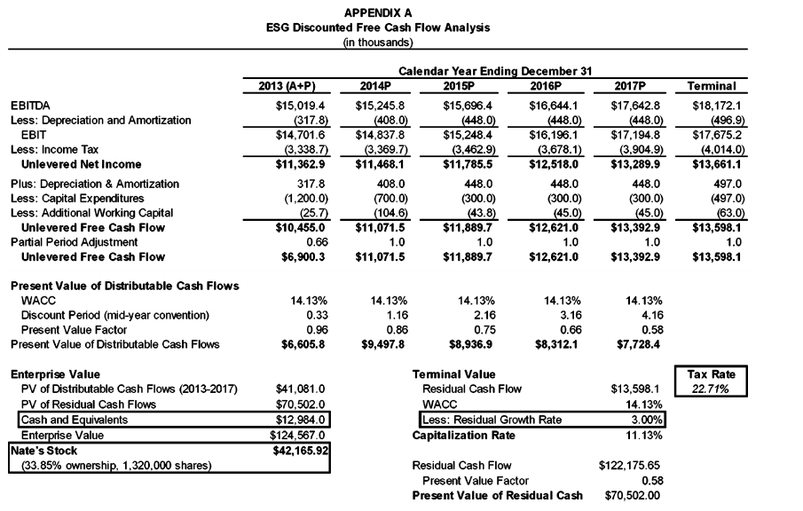
FCF Analysis: Owen v. ESG, Del. Ch. Ct. 2015

Slide 35
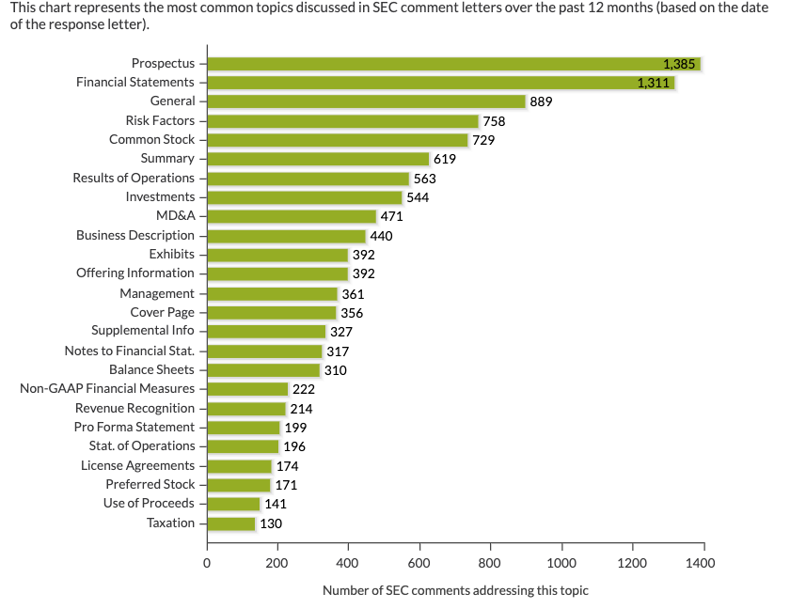
SEC Comment Letter Topics (10/29/19)

Slide 36
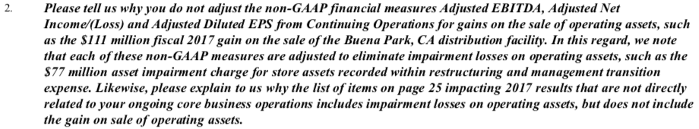
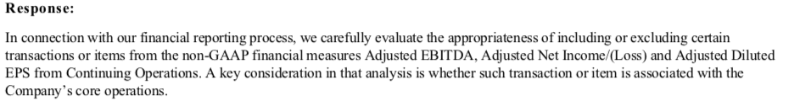
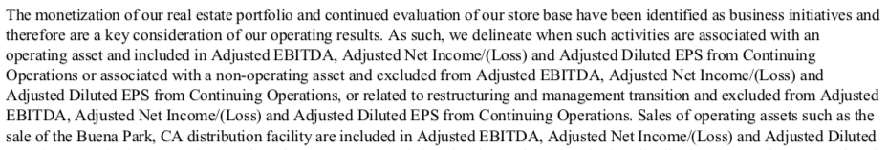
JC Penny (2/3/18)

