Slide 1
Corporate Finance
Capital Budgeting Rules: NPV and IRR
Fall 2025
Prof. Jeffrey Colón

Slide 2
Capital Markets and the Separation of Investment and Consumption Decisions
Dollars T₁
120
105
Invest $100 now and consume $120 next year.
Invest $100 now, borrow $114.29 and consume now.
100 114.29
Dollars T₀

Slide 3
Capital Budgeting Tools
SOURCE: Graham and Harvey, “The Theory and Practice of Finance: Evidence from the Field,” Journal of Financial Economics 61 (2001), pp. 187-243.

Slide 4
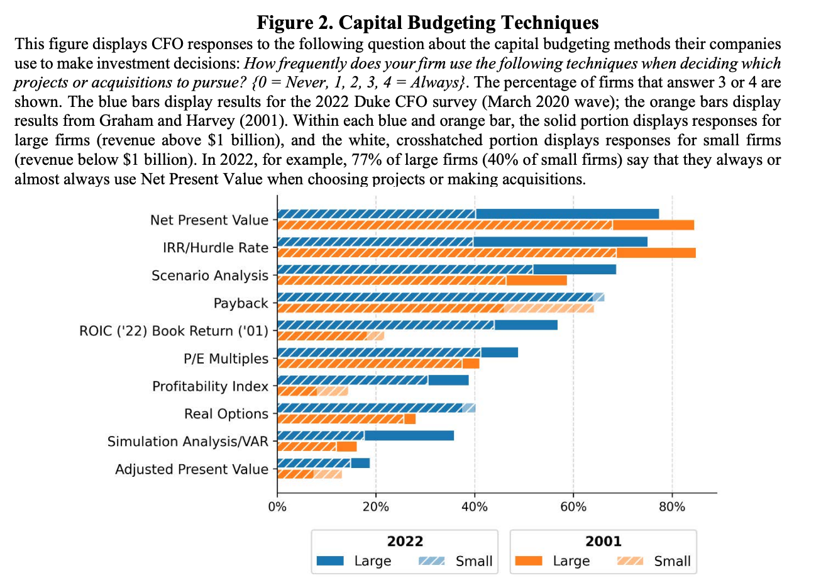
Capital Budgeting Tools
Source: Graham 2022

Slide 5
Estimation Mistakes

Slide 6
Internal Rate of Return (IRR)
IRR: Discount rate that sets the NPV to zero
Minimum Acceptance Criteria:
Accept if the IRR exceeds the required return.
Ranking Criteria:
Select alternative with the highest IRR (if investment project)
Reinvestment assumption:
All future, interim cash flows assumed reinvested at the IRR.
When referring to bonds, the IRR is called the Yield to Maturity (YTM)

Slide 7
IRR
Used as the standard performance measure for private equity, venture capital, real estate, and LBO investments
Used to determine compensation of investment managers
Used to measure and determine cash flows and returns to investors from investments

Slide 8
IRR: Private Equity
Performance Measurement for Private Equity Vehicles. Traditional approaches to the presentation of performance, such as average annual total return, have limitations when applied to private equity. The Adviser believes that reviewing the performance of a pool of private equity investments over a period of time that more closely equates to the long term cycle of private equity investments is a more effective measure of historic investment returns. Unlike mutual funds or private investment funds that invest primarily in the public securities markets ( e.g. , hedge funds), performance of private equity funds generally is not measured on the basis of annual total return calculations. Rather, most private equity funds use the “internal rate of return” or “IRR” as a measure of fund performance. This is because most private equity funds invest capital over several years by calling capital from investors, and make distributions to investors periodically, generally in connection with realization of one or more underlying investments. Therefore, the timing and amount of cash flows are more significant in measuring the performance of a private equity fund because, unlike most mutual funds or hedge funds, the timing and amount of cash flows to and from a private equity fund generally are determined by the fund’s investment manager or affiliated general partner, rather than the investor. IRR is a measurement of the average annual return earned on an investment since the investment’s inception. More specifically, IRR measures the internal rate of return on the present value of all capital called from investors, by calculating a rate of return on such capital contributions based on (i) all distributions made to investors and (ii) the value of residual unrealized investments in the applicable fund’s portfolio. The “net” IRR takes into account the management fees, expenses and carried interest paid by the applicable private equity fund-of-funds vehicle.
Source: NB Crossroads Private Market Fund, Registration Statement (8/22/16)

Slide 9
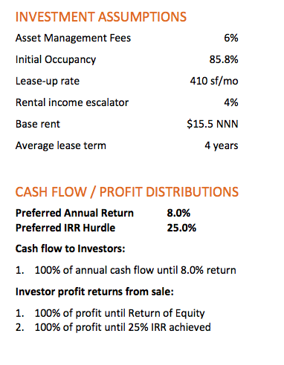
IRR: Offering Memorandum Example
OM, Wild Basin, Austin, TX

Slide 10
Internal Rate of Return (IRR)
Disadvantages:
IRR may not exist or there may be multiple IRRs
Different acceptance criteria for investing and financing projects
Problems with mutually exclusive investments
⚡️If interim CFs cannot be invested at the IRR, the nominal IRR will be too high
Advantages:
Easy to understand and communicate
Mitigate disputes over discount rates

Slide 11
IRR: Example
Consider the following project:
$50
$100
$150
0
1
2
3
-$200
The internal rate of return for this project is 19.44%

Slide 12
IRR on a Spreadsheet
 | A | B | C | D | E | F
1 | -200 | 50 | 100 | 150 | =IRR(A1:D1) | <---E1 will be 19.44%
If there is no CF for a particular period, enter “0”. If not, Excel assumes that the CFs are sequential.
If the cash flows are not evenly spaced, use XIRR instead of IRR
For a simple demonstration of the limitations of XIRR, look at the following video: XIRR Limitation

Slide 13
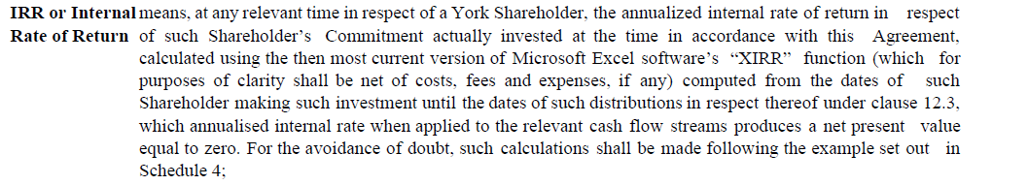
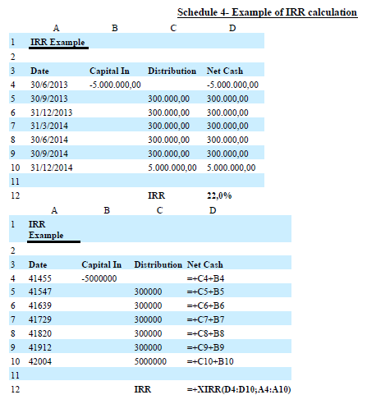
IRR
Form 6-K, Ex. 10.1 Costomare Inc. (5/29/13)

Slide 14
The IRR is a Return (Sometimes)

Slide 15
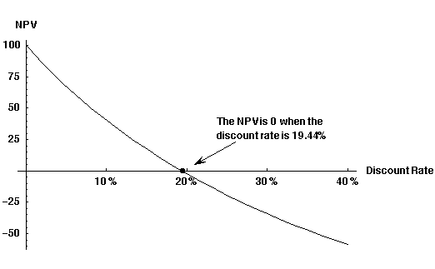
The NPV Payoff Profile for This Example
If you graph NPV as a function of the discount rate, the IRR is where the graph crosses the x-axis intercept--where the NPV = 0
CFs: -200 + 50/(1+r) + 100/(1+r)² + 150/(1+r)³

Slide 16
Problems with IRR
Multiple (or no) IRRs
The Scale Problem
🔥Interim CF Problem
Early Exit Problem
Investing/Financing Problem

Slide 17
Multiple IRRs
There are two IRRs for this project:
$200 $800
Which one should we use?
0 1 2 3
-$200
- 800
100% = IRR₂
0% = IRR₁

Slide 18
The Scale Problem
Would you rather make 100% or 50% on your investments?
What if the 100% return is on a $100 investment while the 50% return is on a $1,000 investment?

Slide 19
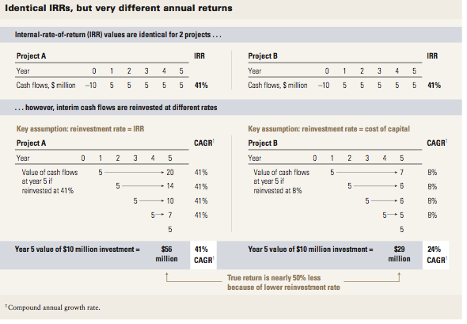
IRR: The Interim Cash Flow Problem
*Kelleher & MacCormack, IRR: A Cautionary Tale (2004)

Slide 20
Modified IRR and the Reinvestment Problem
MIRR: Cash inflows are grown at specified reinvestment rate and cash outflows are discounted at a firm’s cost of capital.
MIRR = -PV (Cash Out from Investment)*(1+MIRR)^{T} ⁼ FV(Cash In to Investment)

Slide 21
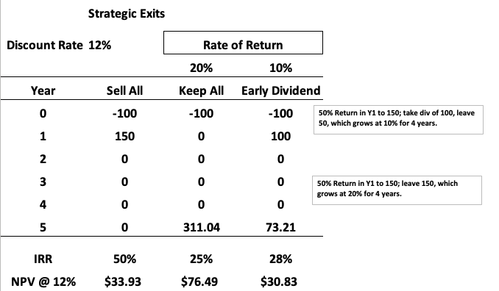
IRR: Early Exit Problem
Initial investment of $100 increases to $150 at the end of Y₁. The discount rate = 12%
Scenario 1: investment is sold.
Scenario 2: investment maintained but increases in value by 20%
Scenario 3, initial capital of $100 is taken out and $50 is left, which accrues at 10%.
If you are paid on the basis of IRR, which scenario would you choose?
Phalippou, The Hazards of Using IRR to Measure Performance: The Case of Private Equity, Tbl. 3

Slide 22
IRR: The Reinvestment Assumption, Bonds, and YTM

Slide 23
Investing v. Financing
In a financing project, +CF₀ +(-CF₁) +(-CF₂), the project should be accepted only if the IRR is less than the discount or interest rate
In an investing project, -CF₀ +(CF₁) +(CF₂), the project should be accepted only if the IRR is greater than the discount or interest rate

Slide 24
Payback Rule
How long does it take the project to “pay back” its initial investment?
Payback Period = number of years to recover initial costs
Minimum Acceptance Criteria:
set by management
Ranking Criteria:
set by management
Disadvantages??

Slide 25
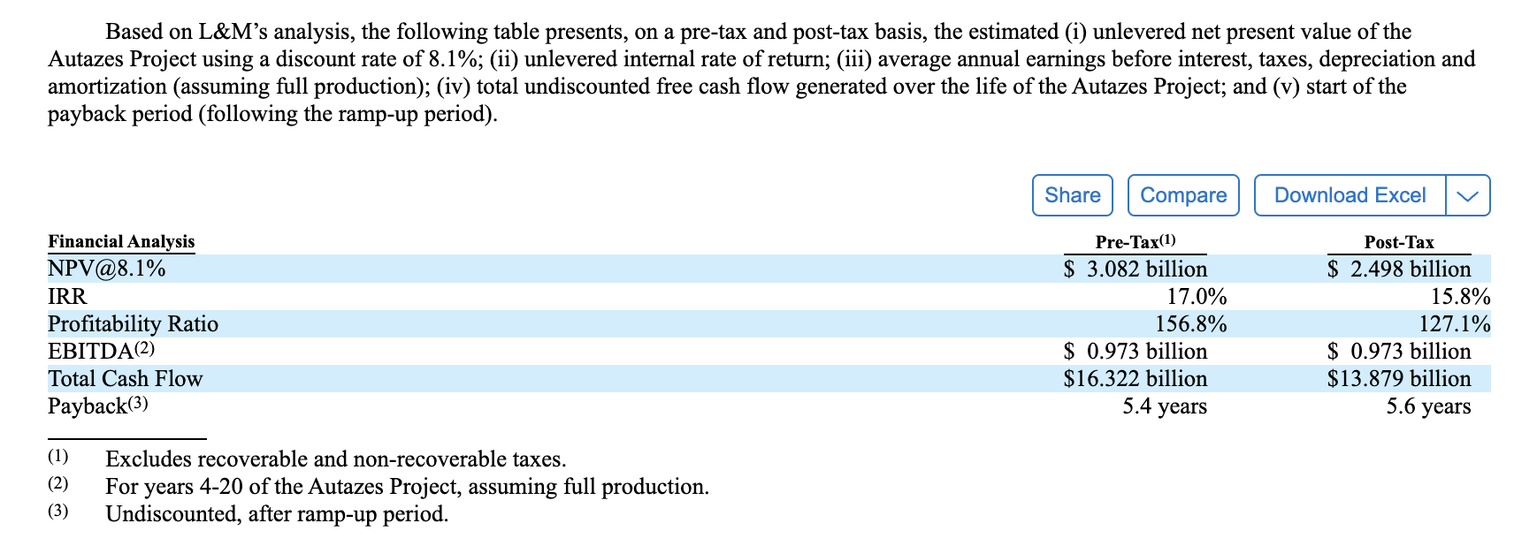
Disclosure Example
F-1 Brazil Potash Corp (Aug. 20, 2024)

