Slide 1
Valuing Debt and Equity

Slide 2
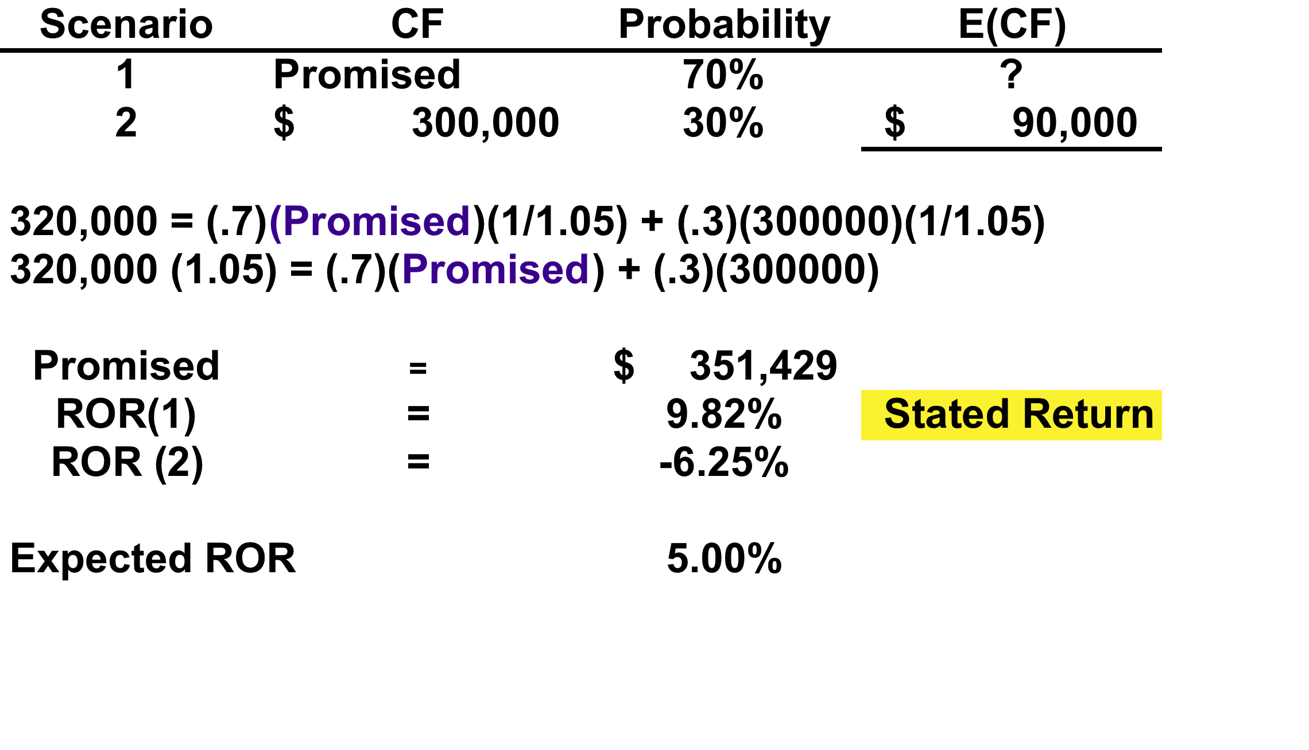
Valuing Debt and Equity

Slide 3
Valuing Debt and Equity

