Slide 1
Corporate Finance
Market Imperfections
Fall 2026
Prof. Jeffrey Colón

Slide 2
Market Imperfections
Perfect Market Assumptions
No Disagreements (not no uncertainty)
Deep, competitive markets
No Transaction Costs
No Taxes
Violation of the perfect market assumptions can lead to:
  differences between borrowing and lending rates, and
  separation of investing and financing decisions.
A project may not have a unique value: its value may depend on the owner of the project and capital on hand

Slide 3
Disagreements
In a perfect market, expected borrowing and lending rates are identical
In an imperfect market, disagreements about default risk can cause expected borrowing and lending rates to diverge
Your cost of capital and project valuation will depend on whether you are borrowing or lending
  Large firms and entrepreneurs
Covenants, Collateral, and Credit Agencies

Slide 4
Transaction Costs
Direct
  Brokerage commissions (houses: 5%-6% in US; compare other countries)
  Market maker fees (bid-ask spread)
  Market impact costs (especially for mutual funds; maybe 1.5x brokerage commissions)
  Registration
  Inspection--due diligence
Indirect
  Search costs and opportunity costs
Capital Budgeting Rule:
  The E(CFs) and E(r) should reflect transaction costs:
    They should be subtracted for cash inflows and added for cash outflows

Slide 5
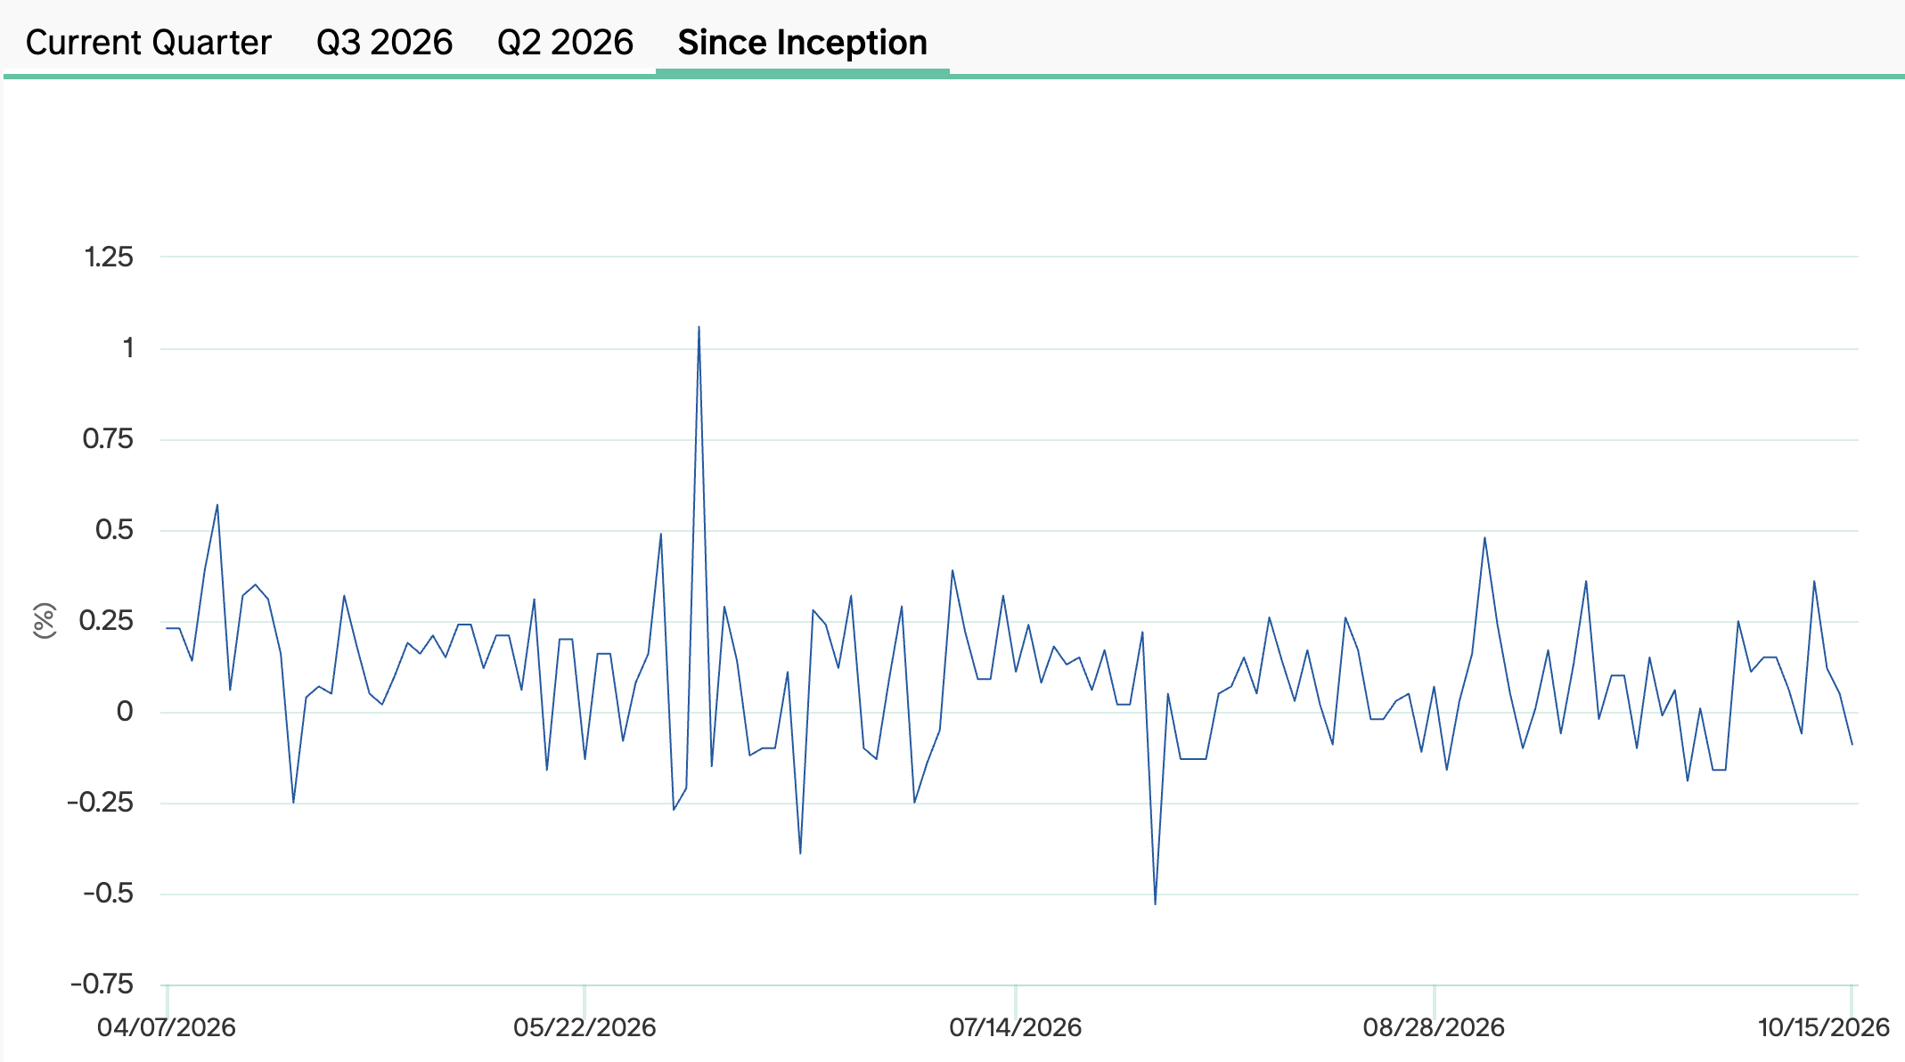
Morgan Stanley Bitcoin Investment Trust (MSBT): Discounts and Premiums

Slide 6
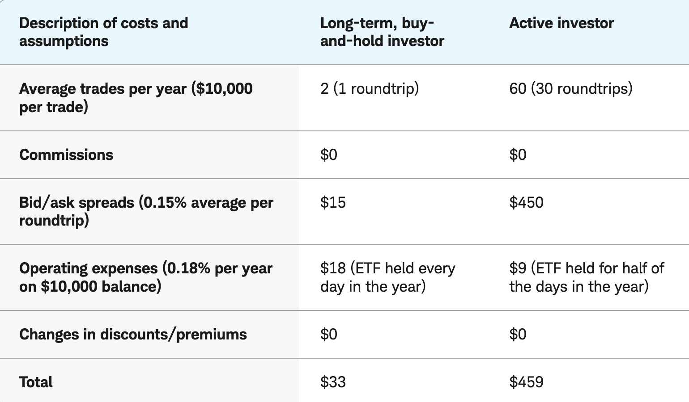
Some Costs with Trading ETFs

Slide 7
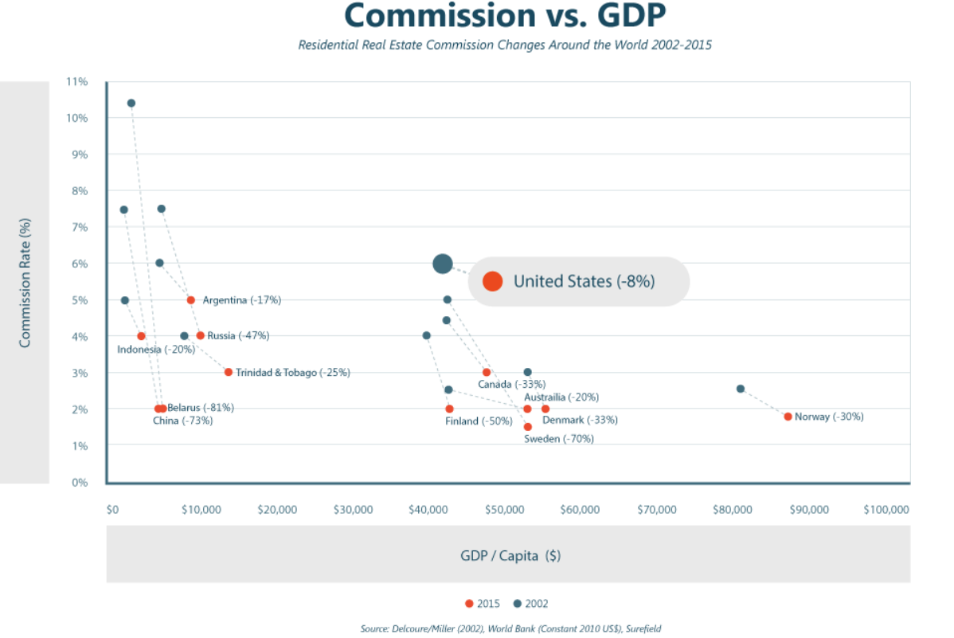
Residential Brokerage Commissions

Slide 8
NAR Lawsuit & Settlement
In Burnett v. NAR (2023), plaintiffs secured a $1.8Bi jury verdict against the Nat. Assoc. of Realtors
  Issue: To list home on MLS, a seller’s agent had to include buyer commissions.
    Steering by buyers’ agent away from sellers offering commissions less than 2.5%
    Buyers had no incentive to negotiate lower commissions b/c they are paid by seller
NAR Settlement (Mar. 15, 2024; effective)
  $418MM compensation paid over 4 years
  New MLS rule prohibiting offers of broker compensation on MLS (but can be communicated off MLS)
  MLS participants working with buyers must enter into written agreements w/ their buyers
Changes
  Non-traditional pricing (flat fees, hourly charges)
  Charges for particular services
  Negotiate who pays buyer’s agent (can still be seller)
  Impact on lower-income buyers
Effect of Settlement
  Average seller commissions haven’t dropped much (and may have slightly increased)
    old habits die hard
    buyer limited $
    Seller competition

Slide 9
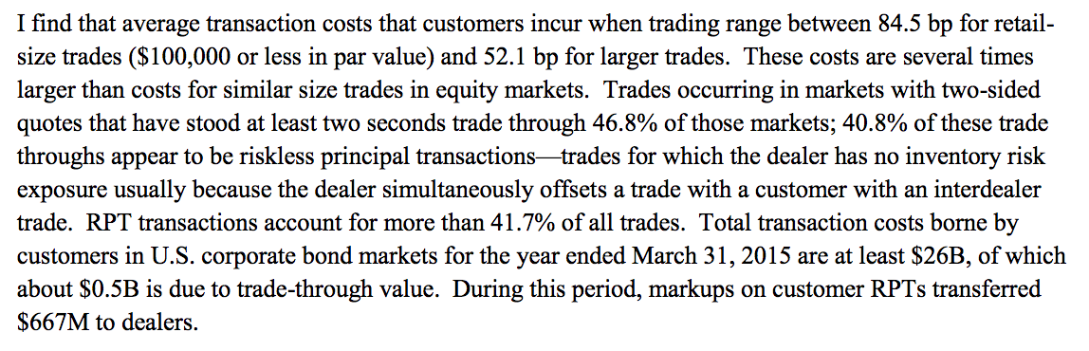
Transaction Costs: Trading Bonds
L. Harris, Transaction Costs, Trade Throughs, and Riskless Principal Trading in Corporate Bond Markets (2015)

Slide 10
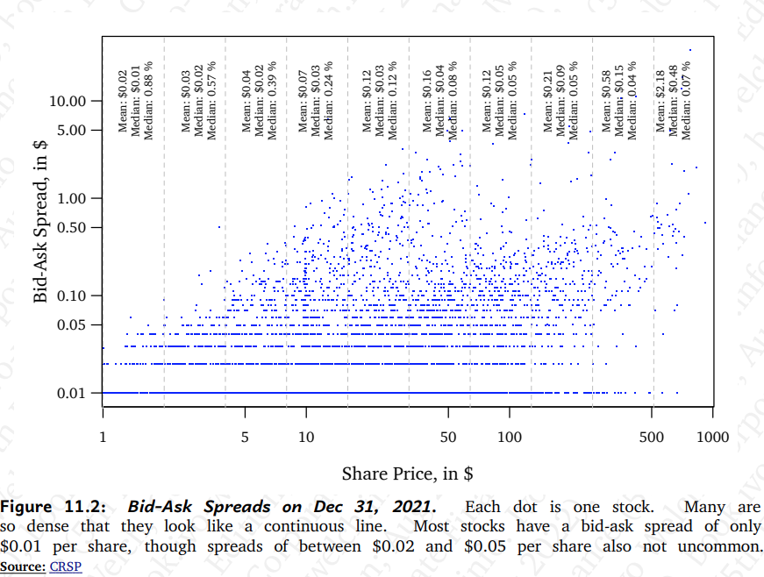
Bid-Asked Spreads Stocks in $

Slide 11
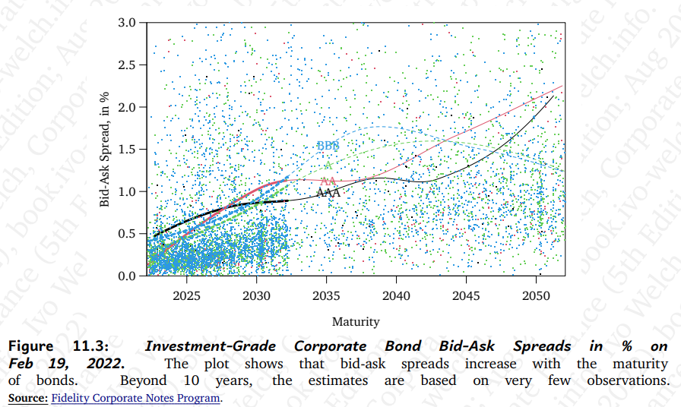
Bid-Ask Spreads (%) Investment Grade Bonds

Slide 12
Transaction Costs: Liquidity
Liquidity premium
  On-the-run v. off-the-run treasuries
  Bid-asked spreads
  LP PE investments
  Flight to quality in 2008
    Auction rate securities
    Increased credits spreads
Liquidity premium
  What were the discounts in Pierre?

Slide 13
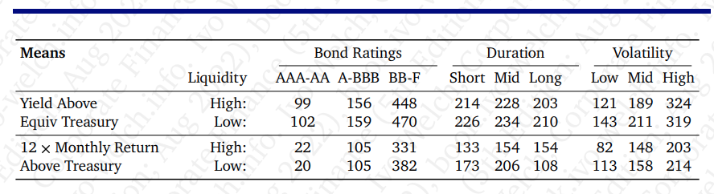

Determinants of Corporate Bond Yields and Returns (‘99-’20)

Slide 14
Taxes (aka our silent partner’s share)
Income
  Federal
    AMT
    3.8% tax on investment income > 200,000(single), 250,000 (MFJ)
  State & Local
    NY: 6.0%: 80.6K-215.4K (single); 161.5K-323.2K (MFJ); top rate: 10.90% (>25MM)
    NYC: 3.876%: >50K (single); >90K (MFJ)
    NJ: 6.37%: 75K < TI < 500k (single); 150K < TI < 500K (MJF); top rate 10.75% (>1MM)
Social Security (Employee)
  7.65% [6.2% (OASDI)+1.45% (Medicare)] to $184,500 [$192,300 for 2027]
  1.45% on earned income > $184,500 [$192,300 for 2027]
  0.9% additional Medicare tax on earned income > $200,000 (single); 250,000 (joint)
Sales (sale and use)
Property
Transfer

Slide 15
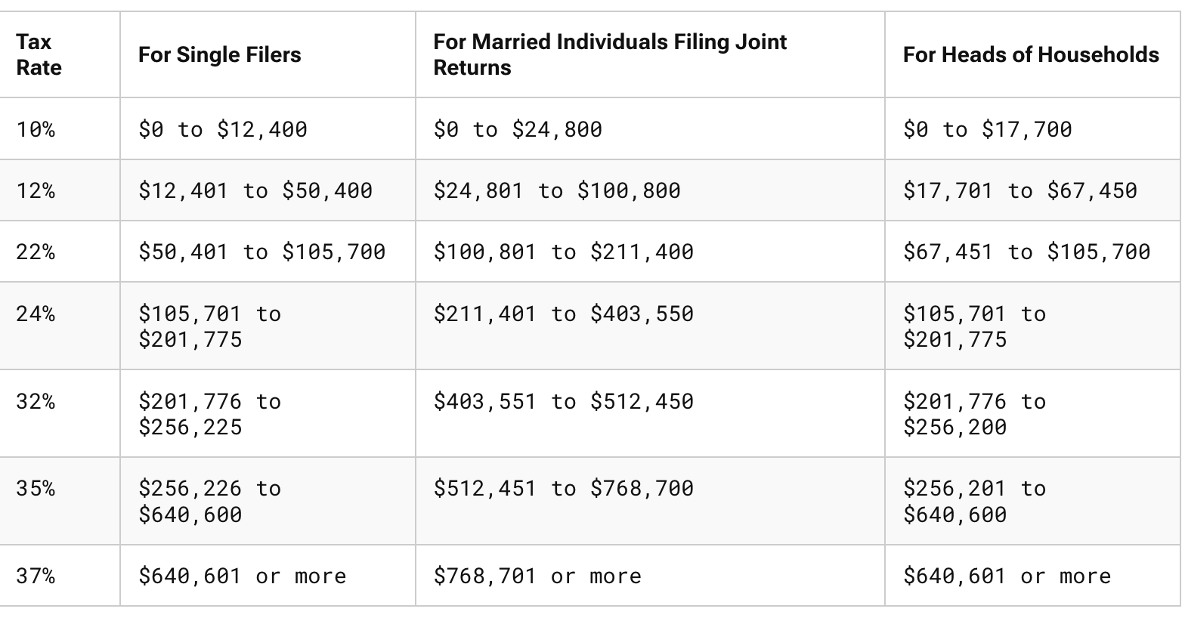
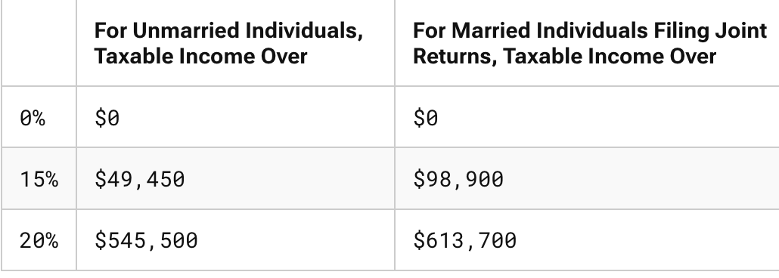
Marginal Federal Income Tax Rates (2026)
Capital Gains Rates
For 2027, there is a 3.2%
increase in the bracket cut offs (chained CPI).

Slide 16
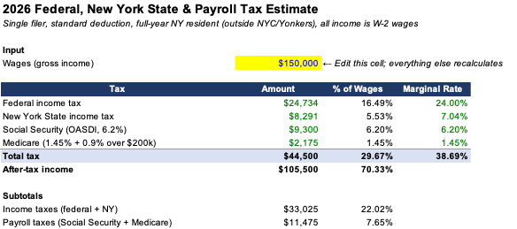
Taxes: Marginal and Average Rates
Tax Rates:
  Marginal Tax Rate: the tax rate on an additional $1 of taxable income
  Average or Effective Tax Rate: Total Taxes / Total Income (gross or taxable)
What are your federal MTR and ATR if your gross income is $150,000? (TI= 133,900 (150k – 16.1k stan. deduct.) [TY 2026]

Slide 17
Taxes: Different Income and Taxpayers
Different Income
  Long-term Capital Gains and Dividends: 15%; 20%; 23.8%
  Wages, Interest, and Short-term Capital Gains: 37% (+3.8%)
  Municipal bonds and tax-exempt interest
    MTR of the marginal investor
Different taxpayers
  Foreign v. U.S.
  Tax Exempts: pension plans, IRAs, 401(k)s, charitable organizations
  Taxable: individuals and corporations

Slide 18
Yields, Prices, and Taxes
Interest on bonds issued by corporations is taxed at regular tax rates, but interest on bonds issued by states and municipalities is exempt from federal tax.
Assume two tax rates, 40% and 20%.
If a corporation issues a bond yielding 10%, a state with the same credit rating would only have to offer 6% in order to entice the 40% taxpayers to purchase. That is, a 6% yield makes the 40% investors indifferent between the taxable and tax-exempt bonds. Notice that the 20% taxpayers should buy the taxable bonds because they will end up with 8% after-tax but only 6% if they buy the tax-exempt bonds.
Since there’s a limited number of 40% taxpayers, but a lot of states & municipalities that want to borrow money, eventually the states and municipalities will have offer bonds that will be attractive to the 20% taxpayers.
The states can now issue the bonds (and squander the money), but now notice the benefit for the 40% taxpayers: the 8% after-tax yield is now equivalent to them of a pre-tax return of 13.33% (13.33 – 5.33(40% tax on 13.33) = 8).
 | Verizon | New Jersey
Pre-Tax | 10 | 6
Tax | <4> | 0
After-Tax | 6 | 6
 | Verizon | New Jersey
Pre-Tax | 10 | 8
Tax | <2> | 0
After-Tax | 8 | 8

Slide 19
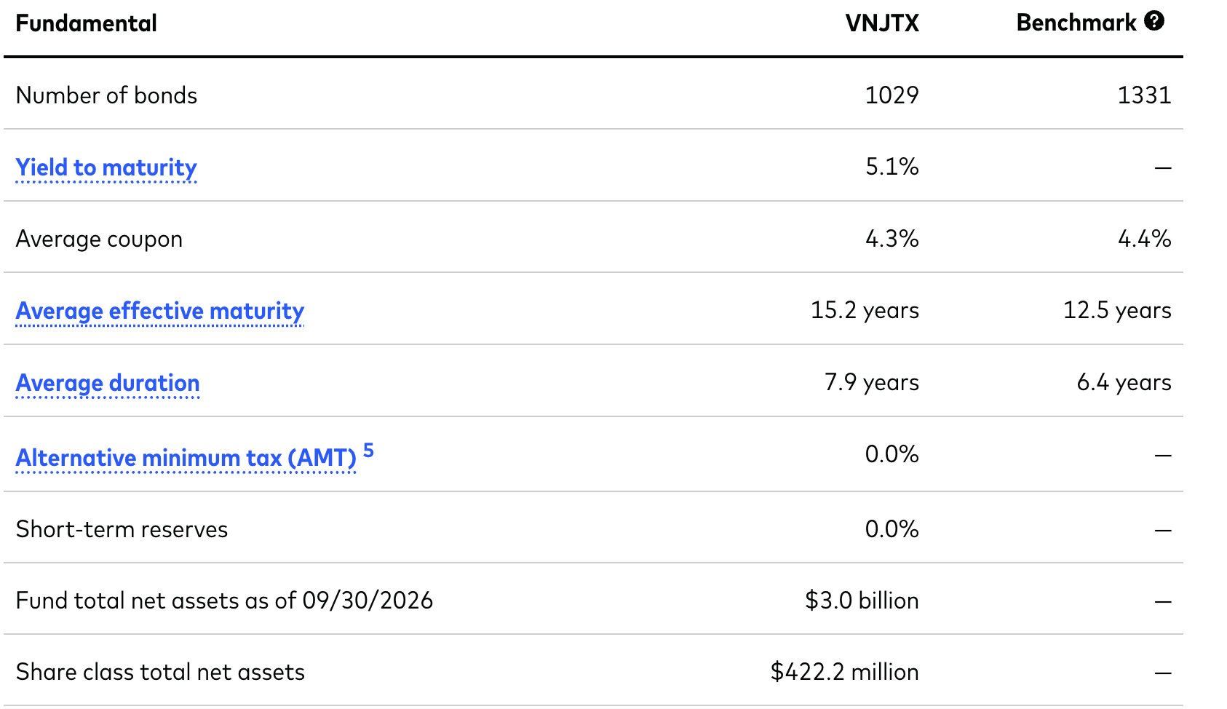
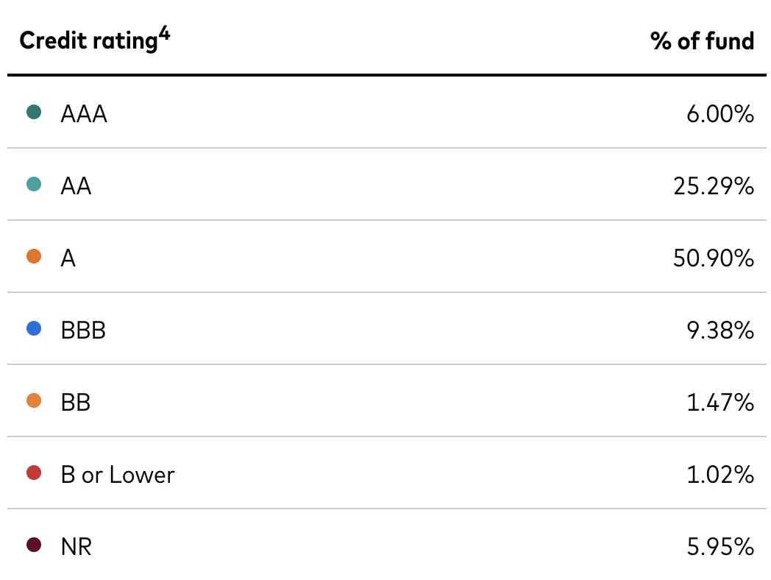
Vanguard NJ LT Tax-Exempt Inv Oct 2026 (VNJTX)
Assume that the yield of an equivalent taxable corporate fund (VFICX) is 6.2%. What would be an estimate of the MTR of the marginal NJ investor in NJ tax exempts?
If your MTR is 24%, which should you buy?

Slide 20
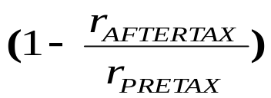
Pre-Tax and After-Tax Returns and Expenses
Pre-Tax Return* (1-MTR) = After-tax Return
  r_{PRETAX} *(1-MTR) = r_{AFTERTAX}
  MTR =
An investment offers a pre-tax return of 10%. If your MTR is 32%, what’s your after-tax return?
  10% * (1-.32) = 6.8%

Slide 21
Taxes: Capital Budgeting Rules
Capital Budgeting Rule: For NPV calculations, use:
  (1) expected after-tax dollars, AND
  (2) expected after-tax discount rates
A project that gives a higher pre-tax NPV will also give a higher after-tax NPV, provided that MTRs are the same for all outcomes (including symmetrical treatment of gains and losses)

Slide 22
Taxes, Timing, and NPV: Settlements
Your client has been harmed, and you sue. A settlement is reached, and D offers 1,000 today or $1,900 ten years from today. Either payment is tax-free, but the annual earnings on the up-front payment would be subject to tax as ordinary income at a 35% MTR.
If the appropriate pre-tax discount rate is 10%, which do you prefer?

Slide 23
Rate of Returns: Risk Premiums
Promised/Quoted/Stated Return
Expected Rate of Return
Contract/Risk/
Liquidity
Premiums
Tax Premium
Credit/Default Premium
Liquidity Premium
Expected Contract/
Risk/
Liquidity Premiums
Risk Premium
Time Premium
Time Premium

Slide 24
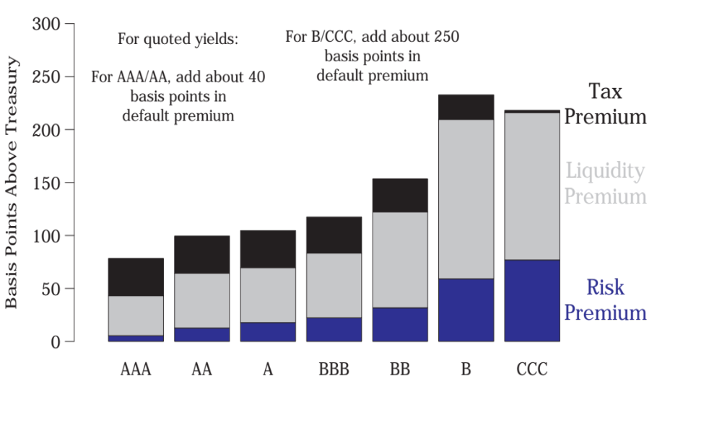
Premiums
Long-Term Corporate Bonds, 1985-2003
Source: De Jong & Driessen (2005)

Slide 25
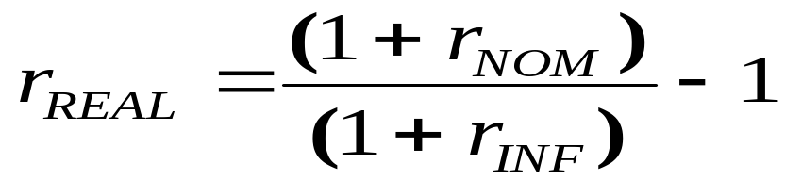
Taxes and Inflation
Tax rates are applied to nominal returns.
  Tax brackets and some values, e.g., personal exemption, are adjusted for inflation.
Taxes and inflation can turn positive after-tax nominal returns into negative after-tax real returns.

Slide 26
Taxes and Inflation
Example
The YTM on the Vanguard ST Corporate Bond ETF (VCSH) portfolio is about 5.6% and the one-year E(inflation) is 3.9%. If your MTR is 37%, your after-tax nominal and real returns are:
r_{NOM-AT} = r_{NOM- PT} * (1-.37)
= 5.6% * (.63)
= 3.53%
r_{REAL-AT} = [(1+ r_{NOM-AT} )/(1+ r_{INF})] - 1
= [(1+.0353) / (1+.039)] - 1 = -0.0036 or -0.36%

